Slide 1
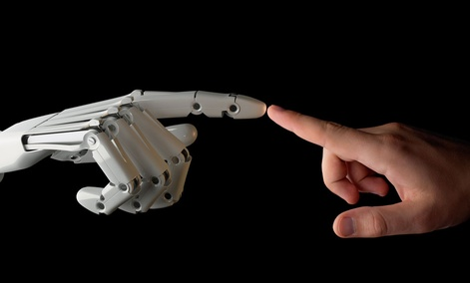
AI:
Is it for us or
against us?
Joe Vandeville
7 January 2016
Notes:
In the past few years several noted scientists and technologists have made public statements about the potential dangers of AI – artificial intelligence. Stephen Hawking's has said “. . . full artificial intelligence could spell the end of the human race”, Bill Gates has said ““I don’t understand why some people are not concerned” and Elon Musk has indicated that AI is a “demon” that is “potentially more dangerous than nuclear weapons”. With the predicted demise of the planet due to global warming, the coming mini-ice age, assaults by violent extremists, do we also need to prepare for a robot apocalypse fueled by AI gone rogue?
Is there something fundamentally dangerous about AI or is this similar to the dangers often cited against technological advances in general, such as the Luddite fears.
This presentation will take a look at some of the ideas expressed by various people who are on the leading edge of this new technology.

Slide 2
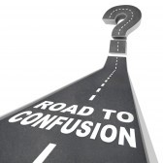
Purpose
The purpose of this presentation is to add to your confusion about artificial intelligence (AI)
Is it a good thing or a bad thing?

Slide 3
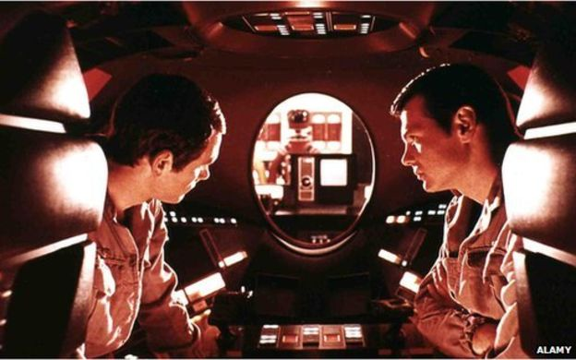
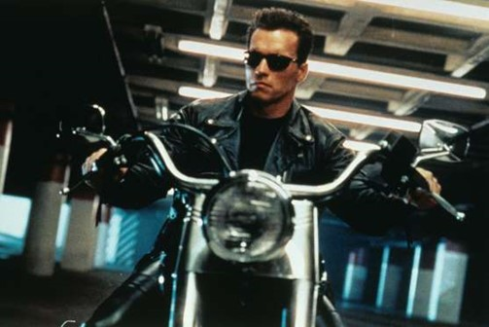
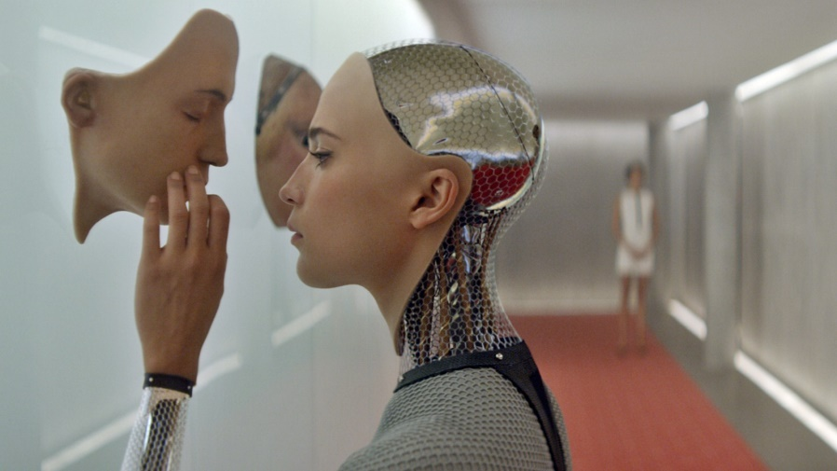
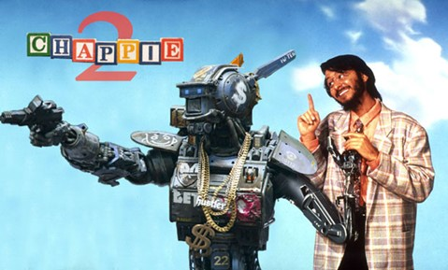
It’s Only the Stuff of Movies – Right?

Slide 4
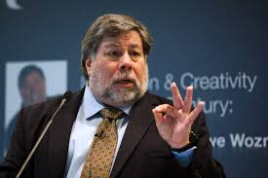
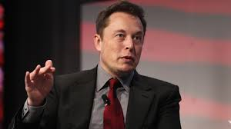
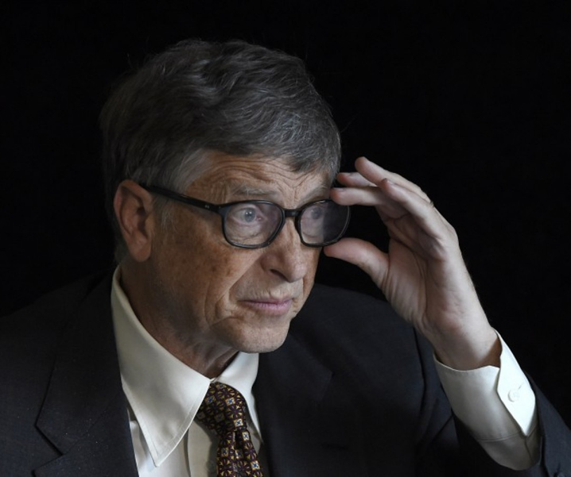
What Some Smart People are Saying About AI
“The future is scary and very bad for people.” [1]
AI is a “demon” that is “potentially more dangerous than nuclear weapons” [2]
Elon Musk
Tesla chief executive
Steve Wozniak
Apple co-founder
“I don’t understand why some people are not concerned” [3]
“ … full artificial intelligence could spell the end of the human race” [4]
Bill Gates
Microsoft co-founder
Stephen Hawking
British theoretical physicist
Notes:
1. http://www.cnet.com/news/woz-says-the-future-is-very-bad-for-humans
2. http://www.cnet.com/news/elon-musk-artificial-intelligence-could-be-more-dangerous-than-nukes/
3. http://www.washingtonpost.com/blogs/the-switch/wp/2015/01/28/bill-gates-on-dangers-of-artificial-intelligence-dont-understand-why-some-people-are-not-concerned/
4. http://www.bbc.com/news/technology-30290540

Slide 5
Some Other Quotes
'Eventually, I think human extinction will probably occur, and technology will likely play a part in this,' DeepMind's Shane Legg [1] (DeepMind is part of Google)
How can an AI system behave carefully and conservatively in a world populated by unknown unknowns - Tom Dietterich, president of the AAAI [2]
"It [AI] would take off on its own, and re-design itself at an ever increasing rate," – Stephen Hawking [3] (on the consequences of creating something that can match or surpass humans)
“Humans, who are limited by slow biological evolution, couldn't compete, and would be superseded.“– Stephen Hawking [3]
Notes:
1. http://www.dailymail.co.uk/sciencetech/article-2907069/Don-t-let-AI-jobs-kill-Stephen-Hawking-Elon-Musk-sign-open-letter-warning-robot-uprising.html
2. http://futureoflife.org/2015/10/12/11m-ai-safety-research-program-launched
3. http://www.bbc.com/news/technology-30290540

Slide 6
Topics
Artificial Intelligence (aka Machine Intelligence) has been around for some time with no one claiming potentially dangerous consequences (outside science fiction) – so what’s changed?
What is AI?
Are there dangers - What are they?
What can be done about them?

Slide 7
Artificial Enhancements
Not a new thing . . .
Strength – tractor replaced horse-drawn plow that replaced human labor
Speed – Automobile replaced the horse that replaced walking
Sight – telescopes & microscopes enhance human visual capabilities
Hearing – non-electronic amplification (e.g., gramophone) electronic amplification (electric speakers)
These are generally regarded as good things
What about enhanced intelligence?
Notes:
Elon Musk’s hyperloop – LA to San Francisco in 30 minutes (760 mph); Los Angeles to Las Vegas in 20 minutes

Slide 8
What is Artificial Intelligence?
So . . . What is AI?
In 1956, the computer scientist John McCarthy coined the term "Artificial Intelligence" (AI) to describe the study of intelligence by implementing its essential features on a computer.
Artificial intelligence (AI) is the intelligence exhibited by machines or software.
https://en.wikipedia.org/wiki/Artificial_intelligence

Slide 9
What is Artificial Intelligence?
Can a machine be intelligent? Can it "think"?
Turing's polite convention - We need not decide if a machine can "think"; we need only decide if a machine can act as intelligently as a human being. This approach to the philosophical problems associated with artificial intelligence forms the basis of the Turing test.
https://en.wikipedia.org/wiki/Artificial_intelligence

Slide 10
The Turing Test
The Turing Test was introduced by Alan Turing in his 1950 paper Computing Machinery and Intelligence.
“I propose to consider the question, ‘Can machines think?’”
Since “thinking” is difficult to define, Turing chooses to “replace the question by another, which is closely related to it.”
“Are there imaginable digital computers which would do well in the imitation game?”
http://en.wikipedia.org/wiki/Turing_test

Slide 11
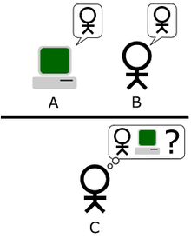
The Imitation Game
A human judge engages in a natural language conversation with one human and one machine, each emulating human responses.
All participants are separated from one another.
If the judge cannot reliably tell the machine from the human, the machine is said to have passed the test.
http://www.turinghub.com/ - take a Turing test on-line

Slide 12
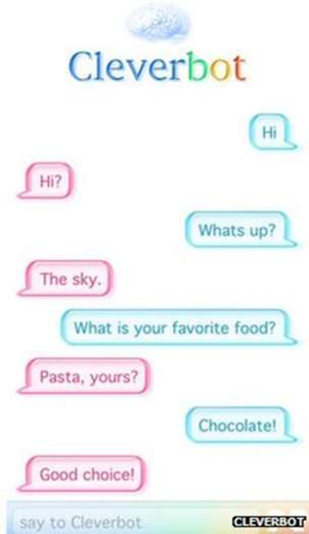
Are We There Yet?
Cleverbot's software learns from its past conversations, and has gained high scores in the Turing test, fooling a high proportion of people into believing they are talking to a human. [1]
http://www.cleverbot.com/
Notes:
1. http://www.bbc.com/news/technology-30290540

Slide 13
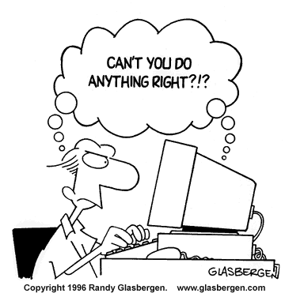
Can Experts Be Fooled?
Robert Epstein is a psychologist. A former editor & chief of Psychology Today. He lives in San Diego area and is also a leading researcher in computer human interaction
Notes:
1 http://drrobertepstein.com/downloads/FROM_RUSSIA_WITH_LOVE-Epstein-Sci_Am_Mind-Oct-Nov2007.pdf?lbisphpreq=1

Slide 14
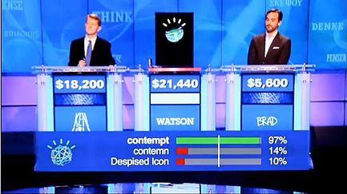
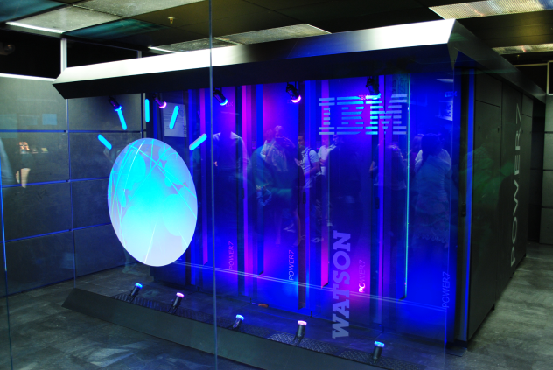
Are We There Yet?
2011: IBM Watson takes on Jeopardy champs [1]
"IBM Watson" by Clockready - Own work. Licensed under CC BY-SA 3.0 via Commons - https://commons.wikimedia.org/wiki/File:IBM_Watson.PNG#/media/File:IBM_Watson.PNG
"Watson Jeopardy" by Source. Licensed under Fair use via Wikipedia - https://en.wikipedia.org/wiki/File:Watson_Jeopardy.jpg#/media/File:Watson_Jeopardy.jpg
The first round was broadcast February 14, 2011: Jennings with $4,800, Rutter with $10,400, and Watson with $35,734
The second round was broadcast February 15, 2011:
Watson with a score of $77,147, besting Jennings who scored $24,000 and Rutter who scored $2
Notes:
1. https://en.wikipedia.org/wiki/Watson_(computer)1,600

Slide 15
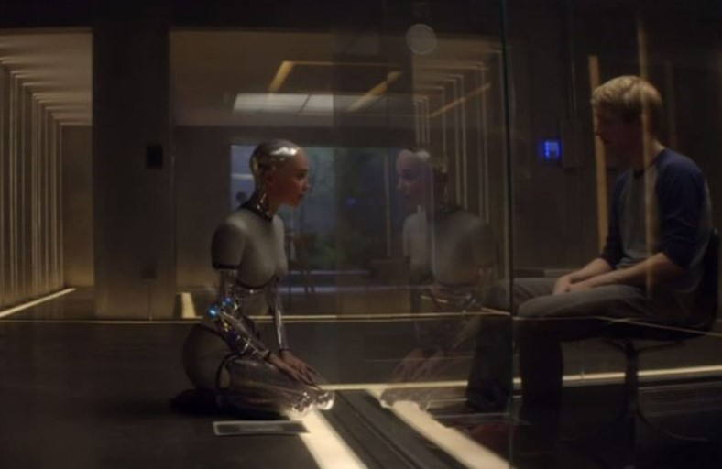
Is the Turing Test Enough?
“. . . it's not enough to have a human be deceived for a machine to be real, The machine needs to convince the human to do things for it -- to fall in love with it, to serve its own purposes.” [1]
- Tim Tuttle, a former MIT AI researcher and the CEO of the predictive-intelligence company Expect Labs
IBM's Deep Blue is better at chess than any human and Watson proved it could outsmart Jeopardy world champions, but they don't have any consciousness of their own.
It's worth noting that neither of those supercomputers has gone through the Turing test, though inventor and futurist Ray Kurzweil believes Watson could be retooled to pass it easily. [1]
Notes:
1. http://www.engadget.com/2015/04/10/ex-machina-review/

Slide 16
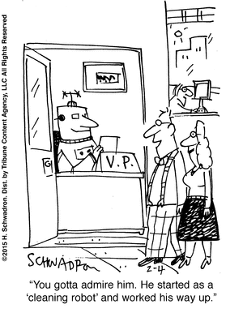
The Singularity
Will artificial intelligence surpass human intelligence?
If so . . . When?
The “singularity” - the point in time in which artificial intelligence exceeds human intellectual capability.
Kurzweil predicts the singularity to occur around 2045, others predict some time before 2030.
https://en.wikipedia.org/wiki/Technological_singularity
Notes:
The technological singularity is a hypothetical event related to the advent of artificial general intelligence (also known as "strong AI"). Such a computer, computer network, or robot would theoretically be capable of recursive self-improvement (redesigning itself), or of designing and building computers or robots better than itself. Repetitions of this cycle would likely result in a runaway effect — an intelligence explosion[1][2] — where smart machines design successive generations of increasingly powerful machines, creating intelligence far exceeding human intellectual capacity and control. Because the capabilities of such a superintelligence may be impossible for a human to comprehend, the technological singularity is an occurrence beyond which events may become unpredictable or even unfathomable.[3]
The first use of the term "singularity" in this context was made in 1958 by the Hungarian born mathematician and physicist John von Neumann. In 1958, regarding a summary of a conversation with von Neumann
Kurzweil predicts the singularity to occur around 2045[6] whereas Vinge predicts some time before 2030.[7]

Slide 17
What’s the Problem?
Who cares if machines are smarter than people

Slide 18
What are the Dangers?
Automation putting us all out of work
We will be working for robots
Loss of human control of our lives - Robots that surpass humans in strength, speed, agility, endurance, decision making, intelligence
Killer robots – militarization of robots (e.g. drones) with AI
Robot emotions – will they have empathy
Will goal seeking intelligent machines, seek the same goals as we do? Will their goals “evolve” in a negative direction?
Everybody knows everything – the drones are watching you!

Slide 19
What are the Benefits?
'The potential benefits are huge, since everything that civilization has to offer is a product of human intelligence; we cannot predict what we might achieve when this intelligence is magnified by the tools AI may provide, but the eradication of disease and poverty are not unfathomable‘ – Elon Musk, Stephen Hawking [1,2]
Notes:
1. http://www.dailymail.co.uk/sciencetech/article-2907069/Don-t-let-AI-jobs-kill-Stephen-Hawking-Elon-Musk-sign-open-letter-warning-robot-uprising.html
2. http://futureoflife.org/ai-open-letter/

Slide 20
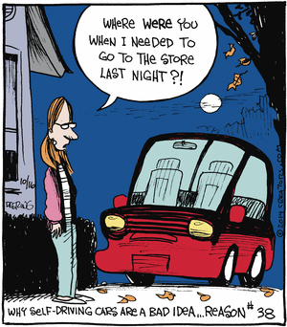
AI is Becoming Ubiquitous

Slide 21
Are They Taking Our Jobs?
Industries that robots will transform by 2025 [1]
Automotive - 10% of cars will be fully autonomous and many will drive themselves. Japan is testing "robot taxis" for transportation during the 2020 Olympics in Tokyo.
Agriculture - Farm will increasingly use AI technology and big data analytics to optimize crop output. More driverless tractors, drones and milk bots.
Service - Personal robots will take on easy, dangerous or repetitive jobs. Mowing your lawn, cleaning your windows, washing dishes.
from BusinessInsider.com
Notes:
[1] 8 industries robots will completely transform by 2025
Mike Nudelman and Paul Szoldra Dec. 14, 2015, 10:42 AM http://www.businessinsider.com/8-industries-robots-will-completely-transform-by-2025-2015-12?utm_source=feedburner&utm_medium=feed&utm_campaign=Feed%3A+typepad%2Falleyinsider%2Fsilicon_alley_insider+%28Silicon+Alley+Insider%29

Slide 22
Are They Taking Our Jobs?
Financial - Up to $2.2 trillion in investments will be made through AI-enabled computers that can learn markets
Healthcare - Robot assistance in critical surgery, elderly care, disabled patient assistance. In 2000 there were 1,000 robot-assisted surgeries performed, with 570,000 in 2014
Manufacturing - 10% of worldwide manufacturing tasks are automated. In 10 years that will increase to 45% as robots get cheaper.
Aerospace and Defense - 90 countries now operate drones, 1/3 are armed. The number of commercial and military drones will triple over the next 5 years. Autonomous military vehicles and land robots are under development.

Slide 23
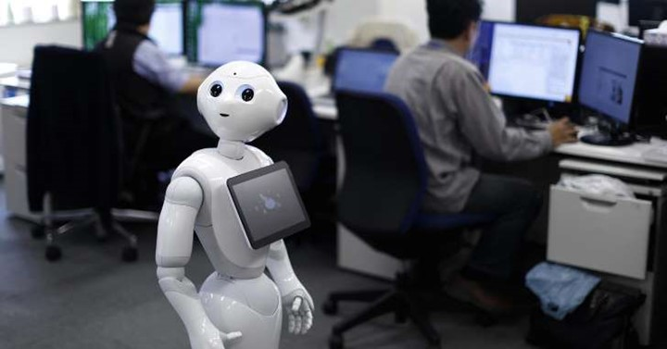
Is Your Job at Risk?
Robots could steal 80 million U.S. jobs: BoE [1]
80 million jobs in the United States are at risk of being taken over by robots in the next few decades, a Bank of England (BoE) official warned
In a speech at the Trades Union Congress in London, the bank's chief economist, Andy Haldane, said that up to 15 million jobs in the U.K. were at risk of being lost to an age of machines, which is around half of the employed population.
Notes:
[1] http://www.msn.com/en-us/money/careersandeducation/robots-could-steal-80-million-us-jobs-boe/ar-BBmY9ej?ocid=spartandhp

Slide 24
Is Your Job at Risk?
Jobs with the highest level of being taken over by a machine in the U.K. included administrative, production, and clerical tasks. Haldane (Bank of England (BoE) official) gave two contrasting examples of risk, with accountants having a 95 percent probability of losing their job to machines, while hairdressers had lower risk, at 33 percent. [1]
With robots being more cost-effective than hiring individuals in the workplace over the long term, jobs with the lowest wages were also at the highest risk of going to the machines.
Notes:
[1] http://www.msn.com/en-us/money/careersandeducation/robots-could-steal-80-million-us-jobs-boe/ar-BBmY9ej?ocid=spartandhp

Slide 25
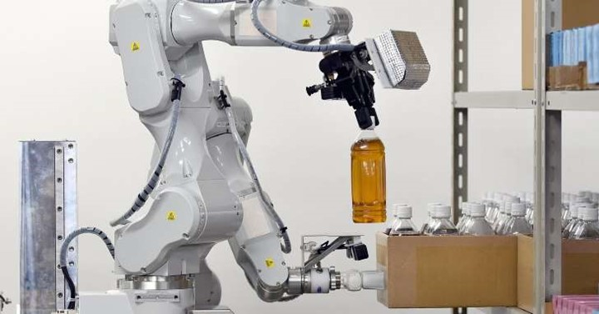
Is Your Job at Risk?
Haldane noted, adding that in the past, workers have moved up the income escalator by "skilling up," therefore staying one-step-ahead of the machine.
Haldane suggested society may have an edge against machines in jobs which require high-level reasoning, creativity and cognition, while AI (artificial intelligence) problems are more digital and data driven.
"The smarter machines become, the greater the likelihood that the space remaining for uniquely-human skills could shrink further. Machines are already undertaking tasks which were unthinkable – if not unimaginable – a decade ago. Algorithms are rapidly learning not just to process and problem-solve, but to perceive and even emote."
Notes:
[1] http://www.msn.com/en-us/money/careersandeducation/robots-could-steal-80-million-us-jobs-boe/ar-BBmY9ej?ocid=spartandhp

Slide 26
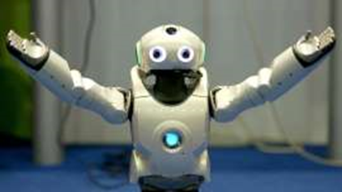
Will We be Working for Robots?
Apply now for the job of the future: “Robot helper” [1]
AI machines can learn from experience and from the humans around them. Which means that, as AIs take on a growing role in the workplace, a new role is opening up for humans: The robot’s assistant
AI trainers who work as “robot’s helpers” already exist at several tech companies: Facebook, virtual assistant start-up Clara Labs, and Interactions, a company that builds AI to handle customer service calls.
Notes:
[1] http://www.msn.com/en-us/news/technology/apply-now-for-the-job-of-the-future-%e2%80%9crobot-helper%e2%80%9d/ar-CC6lQ5?ocid=spartandhp
AI trainers who work as “robot’s helpers” already exist at several tech companies: Facebook, virtual assistant start-up Clara Labs, and Interactions, a company that builds AI to handle customer service calls.
At Facebook, AI trainers are helping a new digital assistant called M, which works as a concierge service to make reservations, order delivery, and send reminders through Facebook messenger. The product is being trialled in San Francisco, and a host of humans work to make sure that M’s recommendations are solid and that tables have been booked at the right restaurant.
Though an AI personal assistant might be able to handle most requests, it’s handy to have a human around to decipher confusing wording, check for accuracy, and—in the case of Interactions, which takes instructions by voice—make sense of mumbled comments. In short, humans can help when the robot isn’t sure.

Slide 27
Will We be Working for Robots?
A real robot boss?
Milgram obedience studies (Yale University psychologist Stanley Milgram 1963) [1]
Young and Cormier Study [2] found that around half of the participants obeyed the robot until the end, and many reacted to it as though it were human, offering compromises and logical arguments to persuade the robot
MIT research [3] has found that human employees are more productive when a robot allocates tasks
Notes:
[1] Milgram, S. Behavioral Study of Obedience. J Abnormal Psychology 67, 4 (1963), 371–378. Humans will obey even harsh commands from seemingly authoritative bosses. Under authoritative command, they administered severely painful electric shocks (they thought) to volunteer test subjects (who acted as if they were in pain).
[2] http://hci.cs.umanitoba.ca/assets/publication_files/2013-would-you-do-as-a-robot-commands.pdf Humans will take orders from a known robot boss.
[3] https://interactive.mit.edu/sites/default/files/documents/HRI_Pioneers_Gombolay.pdf Humans tend to be more productive when working for a robot.

Slide 28
“Man in the Loop” – Maybe Not
Can AI Machines make better decisions than us?
Protect pedestrians
Protect my passengers
Protect
“my self”
Your autonomous car
How well will an autonomous vehicle resolve conflicting priorities?
Should your car be making these decisions?
Notes:
No matter how much automation we have – there is still someone (human) in control – right? Maybe not so much.

Slide 29
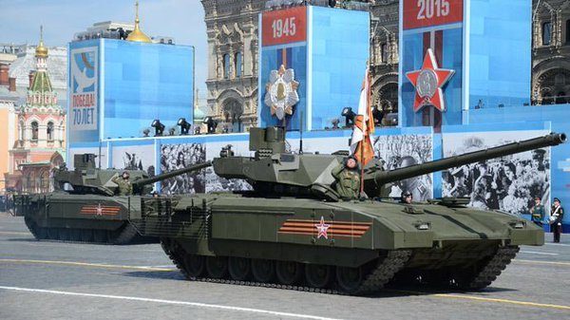
Smarter War Toys
In March 2014, the Russian Strategic Missile Forces announced it would deploy armed sentry robots that could select and destroy targets with no human in or on the loop at five missile installations.
China’s Harbin Institute of Technology, unveiled at the Beijing 2015 World Robot Conference. The robots can wield anti-tank weapons, grenade launchers, or assault rifles. [1]
The Armata (T14 tank) now requires three crew members.
“Then it will be two and then without them at all,” Vyacheslav Khalitov, the company’s deputy director said. [2]
Notes:
1. http://www.defenseone.com/threats/2015/12/pentagon-nervous-about-russian-and-chinese-killer-robots/124465/?oref=DefenseOneFB&&&
2. https://www.rt.com/news/319229-russia-armata-tanks-robots/#.VlnSvzN24wY.twitter

Slide 30
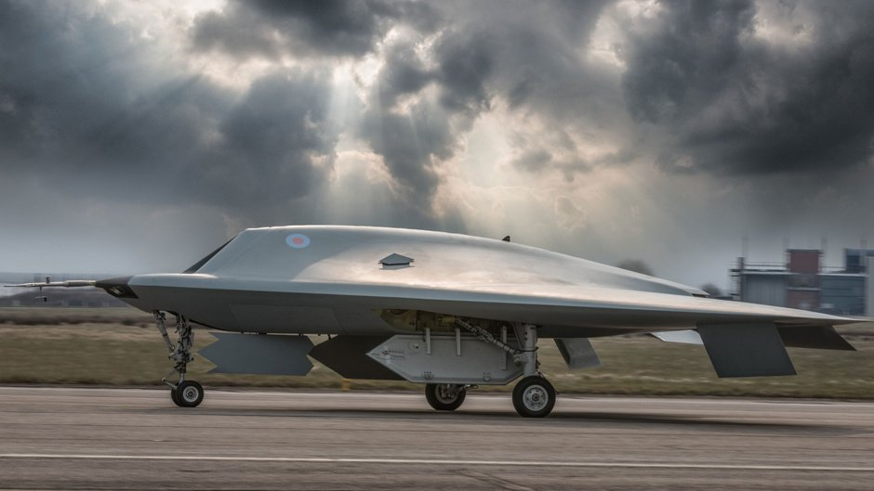
Autonomous Weapons
The Taranis (BAE Systems) drone [1]
Uses a programmed flight path to reach a preselected area.
Automatically identifies and targets the threat within that search area.
Sends data back to its home base, where the information is verified by the human operator.
Human OK‘s attack and a remote pilot essentially pulls the trigger, and the Taranis fires before flying back to the base on its own
Because the Taranis is a prototype, it doesn't currently carry missiles, but future generations will likely carry weapons
Taranis is a technology demonstrator, much like the U.S. Navy's X-47B. [2]
Notes:
[1] http://www.techinsider.io/british-taranis-drone-first-autonomous-weapon-2015-9. Taranis is the Celtic god of thunder
[2] http://www.popsci.com/article/technology/meet-taranis-uks-shiny-new-stealth-drone

Slide 31
What Can We Do?
Duck & Hide
Skill up
Fight the machines
Build in safeguards (against what?)
Get leaders (researchers, technologists, government) aware and involved
Implement more research into AI priorities
Review, implement ethics related to AI
Notes:
Just some of my thoughts

Slide 32
What Can We Do?
A neo-Luddite movement?
A Neo-Luddite is someone who believes that the use of technology has serious ethical, moral, and social ramifications. Operating under this belief, Neo-Luddites are critical of technology and cautious to promote its early adoption. [1]
The Luddites were English textile workers who protested newly developed labor-economizing technologies from 1811 to 1816. The stocking frames, spinning frames and power looms introduced during the Industrial Revolution threatened to replace the artisans with less-skilled, low-wage laborers, leaving them without work. Although the origin of the name Luddite is uncertain, a popular theory is that the movement was named after Ned Ludd, a youth who allegedly smashed two stocking frames in 1779. [2]
Didn’t work then, probably won’t work now
Notes:
1. http://www.wisegeek.com/what-is-a-neo-luddite.htm
2. [http://en.wikipedia.org/wiki/Luddite]
The Luddites were 19th-century English textile workers who protested newly developed labour-economizing technologies from 1811 to 1816. The stocking frames, spinning frames and power looms introduced during the Industrial Revolution threatened to replace the artisans with less-skilled, low-wage labourers, leaving them without work.
Although the origin of the name Luddite (/ˈlʌd.aɪt/) is uncertain, a popular theory is that the movement was named after Ned Ludd, a youth who allegedly smashed two stocking frames in 1779, and whose name had become emblematic of machine destroyers.
The term has since developed a secondary meaning: a "Luddite" is one opposed to industrialisation, automation, computerisation or new technologies in general.
More recently, the term Neo-Luddism has emerged to describe opposition to many forms of technology.[26] According to a manifesto drawn up by the Second Luddite Congress (April 1996; Barnesville, Ohio), Neo-Luddism is "a leaderless movement of passive resistance to consumerism and the increasingly bizarre and frightening technologies of the Computer Age."

Slide 33
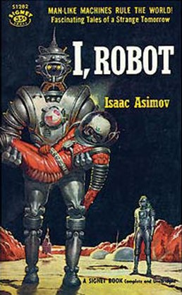
What Can We Do?
Build in “defects” or “safeguards”
Or . . . Implement “The Three Laws of Robotics”
A set of rules devised by the science fiction author Isaac Asimov, introduced in his 1942 short story "Runaround”
"I Robot - Runaround". Via Wikipedia - https://en.wikipedia.org/wiki/File:I_Robot_-_Runaround.jpg#/media/File:I_Robot_-_Runaround.jpg
Notes:
[1] https://en.wikipedia.org/wiki/Three_Laws_of_Robotics

Slide 34
What Can We Do?
Build in “defects” or “safeguards”
A robot may not injure a human being or, through inaction, allow a human being to come to harm.
A robot must obey the orders given to it by human beings except where such orders would conflict with the First Law.
A robot must protect its own existence as long as such protection does not conflict with the First or Second Laws.[1]
Notes:
[1] https://en.wikipedia.org/wiki/Three_Laws_of_Robotics

Slide 35
What Can We Do?
Autonomous weapons are a problem
More than 16,000 AI researchers have signed an open letter to the UN, urging government leaders to take action against the creation of semiautonomous and autonomous weapons. [1, 2]
It's often unclear where the human comes into the decision process of targeting and firing an intelligent weapon [2]
Starting a military AI arms race is a bad idea, and should be prevented by a ban on offensive autonomous weapons beyond meaningful human control [2]
http://www.businessinsider.com/british-taranis-drone-first-autonomous-weapon-2015-9
Notes:
[1] http://www.techinsider.io/british-taranis-drone-first-autonomous-weapon-2015-9
[2] http://futureoflife.org/open-letter-autonomous-weapons/ Autonomous Weapons: an Open Letter from AI & Robotics Researchers

Slide 36
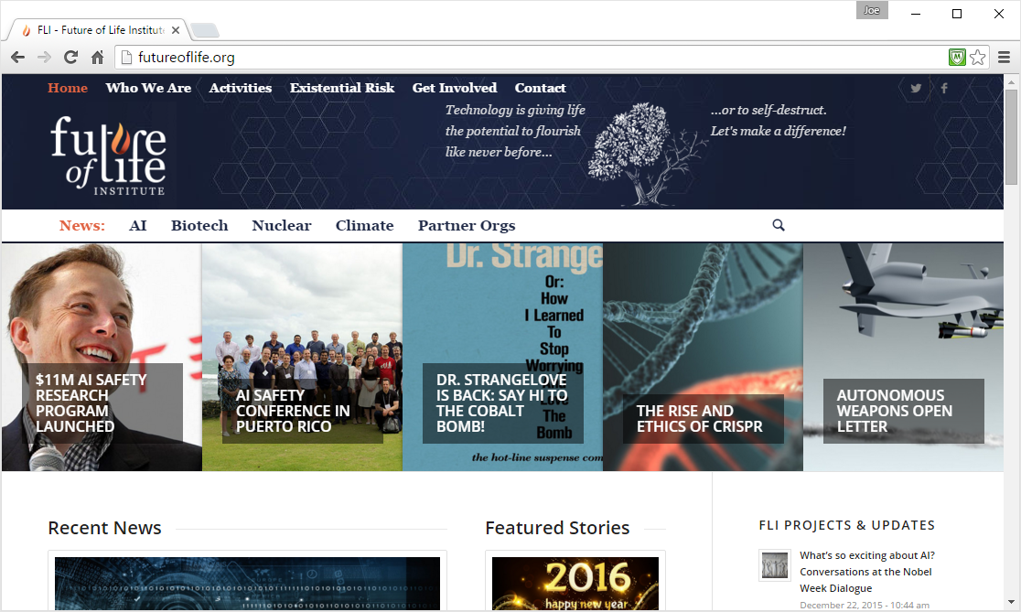
Future of Life Institute
Notes:
1. http://futureoflife.org/ai-open-letter/
2. http://futureoflife.org/2015/10/12/11m-ai-safety-research-program-launched/
3. http://www.dailymail.co.uk/sciencetech/article-2907069/Don-t-let-AI-jobs-kill-Stephen-Hawking-Elon-Musk-sign-open-letter-warning-robot-uprising.html

Slide 37
Future of Life Institute
http://futureoflife.org
Notes:
http://futureoflife.org
Founders:
- Jaan Tallinn - an Estonian programmer who participated in the development of Skype
- Max Tegmark - a Swedish-American cosmologist. Tegmark is a professor at the Massachusetts Institute of Technology and the scientific director of the Foundational Questions Institute.
- Meia Chita-Tegmark -Ph.D. candidate in Developmental Sciences at Boston University and an alumna of the Harvard Graduate School of Education
- Viktoriya Krakovna - PhD candidate, Harvard University, a doctoral researcher in statistics at Harvard University
- Anthony Aquirre - a theoretical cosmologist, professor at the University of California

Slide 38
Future of Life Institute
Future of Life Institute [1, 2]
An Open Letter - Research Priorities for Robust and Beneficial Artificial Intelligence
“We recommend expanded research aimed at ensuring that increasingly capable AI systems are robust and beneficial: our AI systems must do what we want them to do.”
(12 pages)
Notes:
1. http://futureoflife.org/ai-open-letter/
2. http://futureoflife.org/2015/10/12/11m-ai-safety-research-program-launched/
3. http://www.dailymail.co.uk/sciencetech/article-2907069/Don-t-let-AI-jobs-kill-Stephen-Hawking-Elon-Musk-sign-open-letter-warning-robot-uprising.html

Slide 39
Future of Life Institute
Future of Life Institute [1, 2]
$11M AI safety research program launched (37 projects funded)
The 37 projects being funded include:
developing techniques for AI systems to learn what humans prefer from observing our behavior
how to keep the interests of superintelligent systems aligned with human values
making AI systems explain their decisions to humans
how to keep the economic impacts of AI beneficial
how to keep AI-driven weapons under “meaningful human control”
Notes:
1. http://futureoflife.org/ai-open-letter/
2. http://futureoflife.org/2015/10/12/11m-ai-safety-research-program-launched/
3. http://www.dailymail.co.uk/sciencetech/article-2907069/Don-t-let-AI-jobs-kill-Stephen-Hawking-Elon-Musk-sign-open-letter-warning-robot-uprising.html

Slide 40
Google AI Ethics Board
Google is a computer software and a web search engine company
In October 2015, Google became a subsidiary of Alphabet Inc.
Why does Google need an AI Ethics Board?
Notes:
1. Rusli, Evelyn M. (October 27, 2011). "For Google, a New High in Deal-Making". The New York Times. Retrieved December 7, 2011.
2. Google's New A.I. Ethics Board Might Save Humanity From Extinction http://www.huffingtonpost.com/2014/01/29/google-ai_n_4683343.html
2.

Slide 41
Google AI Ethics Board
Wikipedia list 187 acquired companies from Feb. 2001 thru Nov. 2015
Dark Blue Labs - deep learning for understanding natural language
Vision Factory - visual recognition systems and deep learning
DeepMind Technologies, one of the biggest concentrations of researchers anywhere working on deep learning, a relatively new field of artificial intelligence research that aims to achieve tasks like recognizing faces in video or words in human speech
Quest Visual, Inc. - augmented reality translation software
Boston Dynamics a robotics design company designed for the U.S. military with funding from Defense Advanced Research Projects Agency (DARPA
Notes:
1. Rusli, Evelyn M. (October 27, 2011). "For Google, a New High in Deal-Making". The New York Times. Retrieved December 7, 2011.
2. Google's New A.I. Ethics Board Might Save Humanity From Extinction http://www.huffingtonpost.com/2014/01/29/google-ai_n_4683343.html

Slide 42
Google AI Ethics Board
Google bought seven robotics companies in December 2013 alone
Google AI Ethics Board [2] - Set up to oversee its work in artificial intelligence
“AI is very powerful technology that is largely invisible to the average person. Right now, AI controls airplanes, stock markets, information searches, surveillance programs, and more. These are important applications that can’t help but to have a tremendous impact on society and ethics, increasingly so as every futurist predicts AI to become more pervasive in our lives.” [3]
Inside Google's Mysterious Ethics Board, www.forbes.com Feb 3, 2014
Notes:
1. Rusli, Evelyn M. (October 27, 2011). "For Google, a New High in Deal-Making". The New York Times. Retrieved December 7, 2011.
2. Google's New A.I. Ethics Board Might Save Humanity From Extinction http://www.huffingtonpost.com/2014/01/29/google-ai_n_4683343.html
3. HTTP://WWW.FORBES.COM/SITES/PRIVACYNOTICE/2014/02/03/INSIDE-GOOGLES-MYSTERIOUS-ETHICS-BO

Slide 44
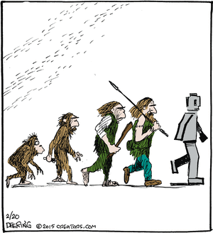
The End
Hopefully, just figuratively

