Slide 1
The Information Side of System Engineering
Helping System Engineers Create 21st Century Architectures

Slide 2
Role of System Engineering
According to INCOSE:
“enable the realization of successful systems”
Customer needs, Requirements
Concepts of operations, Architecture
Performance, Cost, Schedule
Test, Deployment, Disposal

Slide 3
Typical System Engineering Process
Define Requirements
Define Preliminary Architecture
Perform Detailed Design
Implement System
Integrate System
Verify System
Deploy System
Process steps; do things

Slide 4
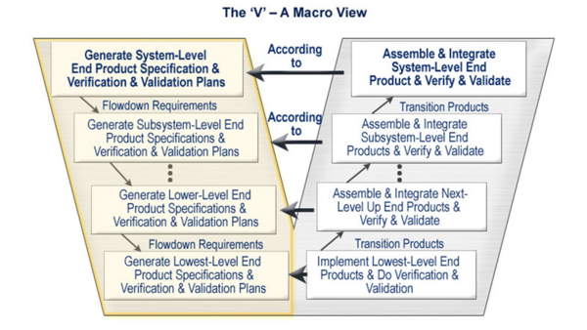
The System Engineering Vee
Still “do things”, with a more result focus

Slide 5
System Engineering Products
Requirements database
Concept of Operations document
Trade Studies
Specifications
Architecture Descriptions
MBSE database

Slide 6
NOT System Engineering Products
Printed circuit boards
Integrated circuits
Blade servers and racks
Production Java or C++ code
Database designs
(none of the fun stuff)

Slide 7
Product of System Engineering
“information”
System engineers answer the critical questions the other disciplines need to know up front to do their jobs right.

Slide 8
Role of System Engineering 2
SEs “gather and synthesize critical system information and present it in a way that is useful to and understood by the development disciplines”
SE is a discipline of information management and coordination

Slide 9
Model Based System Engineering (MBSE)
Information management for SE via a set of formalized models
MBSE falls short of that goal
☒ Customer needs, ☑ Requirements
☑ Concepts of operations, ☑ Architecture
☒ Performance, ☒ Cost, ☒ Schedule
☒ Test, ☒ Deployment, ☒ Disposal

Slide 10
Mapping the SE Territory
What critical system information does the SE discipline cover?
Where’s the map of the data?
Hypothesis: Lack of emphasis on information is a weakness of system engineering

Slide 11
A Real SE Map
RDD-100 Schema “C” for System Engineering circa 1995

Slide 12
A Simplified SE Map
Document
has parent
verifies
Test Case
1
Requirement
*
reports on
*
1
modifies
Change Record
*
describes
1
Capability
implemented during
allocated to
satisfies
1
*
Increment
1
Component
implements
How many companies define even to this level? None in my experience.

Slide 13
Digging Deeper into the Map
Requirement Attributes
Attribute | Meaning | Necessity | Type
ReqID | Short unique identifier for the requirement | Mandatory | (KEY)
Text | The full text statement of the requirement | Mandatory | Text
Guidance | Formal explanatory material that further guides or constrains the requirement; this material is controlled and tested to the same degree as the requirement text. | Recommended | Text
Rationale | Explanation of why this a valid requirement (i.e. why this requirement exists) | Recommended | Text
CM State | Current state of configuration management for this requirement | Recommended | Enumerated
Notes | Informal comments on the requirement; not controlled or tested. | Optional | Text
Category | Company process unique category | Optional | Enumerated
Abbreviated Text | An abbreviated description for convenience | Optional | Text
Security | Flag to indicate this requirement is a security issue | Optional | Boolean
Safety | Flag to indicate this requirement is a safety issue | Optional | Boolean
Legal | Flag to indicate this requirement is a legal or regulatory issue | Optional | Boolean
Rule Check | Flag to indicate this requirement passes company internal process checks | Optional | Boolean
Author | Name of original author | Recommended | Text
Origination Date | Date of first creation | Recommended | Date
Change Date | Date of most recent update via change request | Recommended | Date

Slide 14
Importance of Understanding the Territory
An adaptation of a drawing by Hugh MacLeod at gapingvoid.com

Slide 15
Importance of Understanding the Territory
An adaptation of a drawing by Hugh MacLeod at gapingvoid.com

Slide 16
Importance of Understanding the Territory
An adaptation of a drawing by Hugh MacLeod at gapingvoid.com

Slide 17
Importance of Understanding the Territory
An adaptation of a drawing by Hugh MacLeod at gapingvoid.com

Slide 18
Importance of Understanding the Territory
An adaptation of a drawing by Hugh MacLeod at gapingvoid.com

Slide 19
Information
“It's whatever a user interprets from the arrangement or sequence of things they encounter.”
“While we can arrange things with the intent to communicate certain information, we can't actually make information. Our users do that for us.”
Covert, Abby (2014-11-12). How to Make Sense of Any Mess: Information Architecture for Everybody

Slide 20
Reality
Intent does not equal reality
What you intend to show does not always get communicated
People have differing interpretations of reality
Is your SE map of reality compatible with your customer’s map?

Slide 21
Stakeholders
People (stakeholders) are complex beings
Who are they?
What decisions will they make? (insight, wisdom)
What do they need to know? (knowledge)
Where does the knowledge come from? (information)
How do we provide that? (data)
“What” before “how”!

Slide 22
User, Viewpoints, Decisions
Stakeholders operate from different viewpoints for different reasons
Do we address those properly?
Borrowing from Goal-Question-Metric methodology
GQM paradigm https://en.wikipedia.org/wiki/GQM
Also see Practical System/Software Measurement (PSM) http://www.psmsc.com
Substitute “Data” for “Metric”

Slide 23
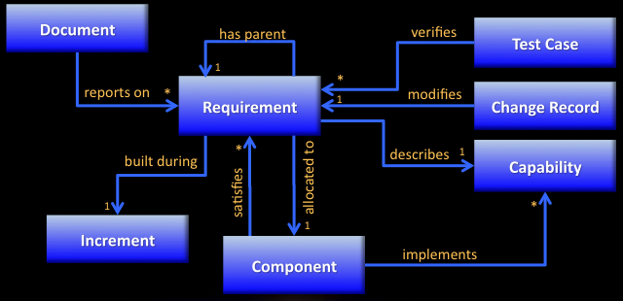
SE as a Requirements Author
Goal: Create and edit requirements
Question: What does the requirement say?
Data: All the requirements attributes

Slide 24
DOORS Administrator as a Status Reporter
Goal: Report requirements database status
Question: How many requirements are there?
How many requirements in each CM state?
Data: Requirements CM status
Requirements count by status (calc)

Slide 25
CSE as a Systems Engineer
Goal: Validate all requirements
Question: Are all the requirements compliant to guidelines?
Does each requirement have a validation attribute?
Have all requirements been peer reviewed?
Data: Requirements text,
Rationale attribute,
Rule check attribute,
CM status

Slide 26
CSE as a Planner
Goal: Get the specification document out on time
Question: Which requirements are in the document?
How many of those are baselined?
How many requirements yet to complete?
Data: Requirements CM status
Average time to complete a requirement (PM metric, calc)
Estimated time to completion (calc)

Slide 27
CSE as a Manager
Goal: Determine impacts of a requirements change
Question: Which system elements are impacted by a change to a customer requirement?
Which increments are impacted?
Data: Ancestor requirements of the changed requirement(s) (requirement and relationships to other requirements)
Elements that satisfy each of the ancestor requirements (requirement and relationships to other elements)
CM Status attribute of each element

Slide 28
Takeaway
Can your system engineering process address the needs of all the SE stakeholders?
Have you mapped your SE information “territory” adequately?

Slide 29
Takeaway
A SE process that does not have a well-defined information map is inadequate to the task
After the map is well-defined, the process needs verified methods for generating the data needed by stakeholders

Slide 30
Recursive Takeaways
The system engineering process is a system designed to realize other successful systems.
Can your system engineering process address the information territory of the system being built?
Have you adequately mapped the information “territory” of the system being built?
Does the system being built include adequate processes for generating information for its stakeholders?

Slide 31
Conclusions
System engineering is highly information oriented, yet defined in terms of process, not data
Successful companies need to do a better job of defining the information needs of the system engineering process stakeholders
Successful system engineering processes need to do a better job of defining the information needs of the target system stakeholders
Information management plans need to have more importance at both the enterprise level and product level (a future topic)

