Slide 1

CAB Representatives Orientation
International Council on Systems Engineering
A better world through a systems approach
incose.org

Slide 2


incose.org | 2

Slide 3
Agenda
Welcome everyone to the CAB representative orientation
Introductions to the staff – Tomi Okey, Janeen Schuh and Honor Lind
Basic introduction to Leverage Yourself with INCOSE
Why Join INCOSE? Member benefits
What is the Corporate Advisory Board?
  Lifecycle of the CAB impact
  Annual CAB Membership Payment Information
What is a Corporate Advisory Board Representative?
Benefits of CAB Membership for the CAB Rep
General CAB Reps’ Best Practices
How to find CAB resources
Online CAB Representatives Resources
CAB Rep iNet Resources
CAB Recognition Badge Usage Guideline
CAB Representative Badge
Contact Information
Suggestions? Feedback? Questions?

Slide 4
Introductions
Tomi Okey
  CAB Administrator
  Operations Administrator
  Helpdesk/InfoDesk
  Advertising and Sponsorship Support
Janeen Schuh
  Web Support
  Marcom Support
  Advertising and Sponsorship Support
Honor Lind
  Head of Marcom and Business Development
  Branding, Marketing and Communications
  Sponsorship and Advertising

Slide 5
Tomi Okey – CAB Administrator
Receives CAB Application
Process CAB Member application and add to the website
Initiate contact with CAB Representative, along with option for a 1 on 1 onboarding
Send out Welcome Letter from INCOSE
Maintain
  The information and logo on the website
  How to Guides on Viva Engage Community
  CAB Rep complimentary membership
  How to Manage CAB Associated/Reports
  CAB Associates
  Answer any questions at tomi.okey@incose.net

Slide 6





Leverage yourself with INCOSE
INCOSE is the premier choice of systems engineers for professional development.
With over 30 years of experience, we are shaping the future of systems engineering.
We interact with systems engineers across the globe on a daily basis to set standards.
25,000+
140+
52
65
76
Members and
CAB Associates
Corporate Members
Working Groups
Chapters Worldwide
Countries with Active Members

Slide 7

Why Join INCOSE?
INCOSE is the global Systems Engineering professional society – providing the opportunity for life-long learning in systems approaches.
A community of peers, resources for your career, and a place
to be a leader.
Our members stand out and are often sought after as experts.
They also share practices and learn from each other.
Members create products, produce events and represent
the organization in international forums.
Increase your professional stature with the INCOSE Systems Engineering Professional Certification.
Affiliates expand the body of knowledge and advance
the practice of systems engineering.
Network with over 23,000 members in 76 countries.

Slide 8







Membership Benefits
A global network of colleagues who understand systems engineering
Collaborate with experts and practitioners worldwide
Certification Opportunities
Exclusive access to INCOSE iNet and Viva Engage, the collaborative space for INCOSE Members Only
Access to quarterly e-Publications, INSIGHT and Journal of Systems Engineering
Member discounted registration to the International Workshop and International Symposium.
Electronic version of the Systems Engineering Handbook
Access to a range of systems engineering technical products, resources and training.

Slide 9
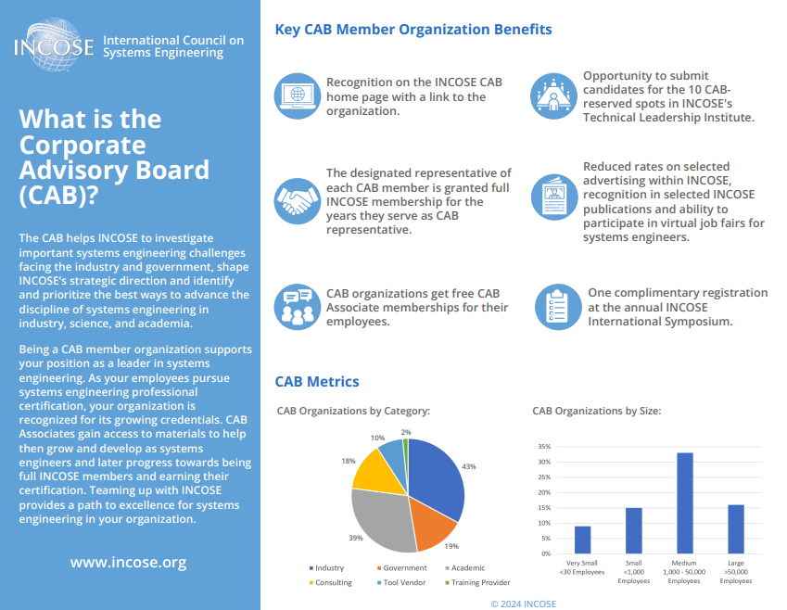
What is the Corporate Advisory Board (CAB)?

Slide 10

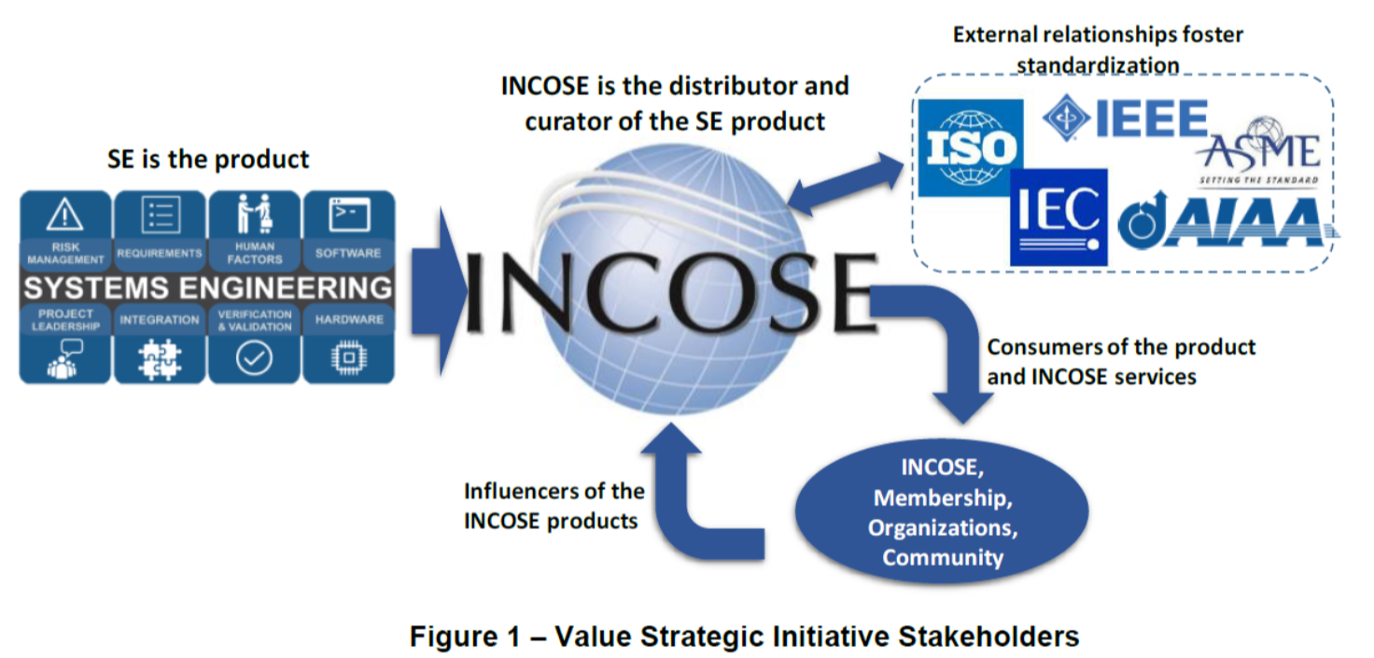



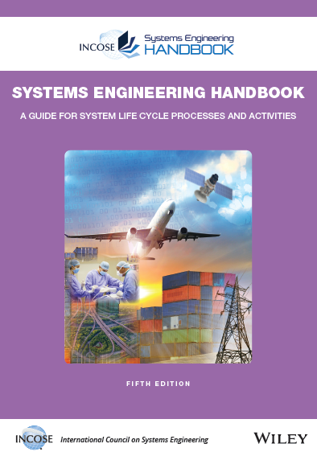




Lifecycle of the CAB Impact
CAB organizations influence INCOSE work and benefit from INCOSE products
INCOSE Vision and Strategic Plan
External Organizations
CAB Member Organizations
CAB needs are briefed annually to the INCOSE Board of Directors and the Technical Director; Needs are flowed to the appropriate workgroups for action
INCOSE Products and Services
Working Groups and Technical Services deliver product solutions that further the systems engineering discipline consistent with the INCOSE Vision, Strategic Plan while addressing CAB Needs
Products
CAB member organizations, CAB Reps, and CAB Associates identify and document CAB needs annually based on challenges facing industry and academia
Value Streams / Working Groups
Events
CAB Members help to Lead, Support, and Mentor Working Groups
Certification

Slide 11
CAB Membership Costs
Item | Regular/Senior/Life Members | Student Members | Corporate Advisory Board (including Academic Council), CAB Associates | Non-Members
 | GROUP 1: Membership
Member Voting Rights | Included | Not Available | Not Available | Not Available
Working Group Membership | Included | Included | Not Available | Not Available
Chapter Membership | Included | Included | Not Available | Not Available
Member Services | Included | Included | Included | Not Available
 | GROUP 2: Access/Videos & Softcopies of...
eNewsletter | Included | Included | Included | Included
eNote | Included | Included | Included | Included
SE Tools Database (SETDB) | Included | Included | Included | Not Available
Internally Developed Technical Products | Included | Included | Included | List Price via INCOSE Store
Past Symposia Papers & Proceedings | Included | Included | Included | List Price via INCOSE Store
SE Handbook | Included | Included | Included | List Price via INCOSE Store
Systems Engineering Journal | Included | Included | Included | List Price via INCOSE Store
Technical Products (released at no charge to members) | Included | Included | Included | List Price via INCOSE Store
INSIGHT | Included | Included | Included | List Price via INCOSE Store
Different sources for video recordings (Post-event, with permissions from presenter)
*IS Keynote Presentations | Included | Included | Included | Included
*Webinars | Included | Included | Included | List Price via INCOSE Store
*INCOSE Tutorials (WG) | Included | Included | Included | List Price via INCOSE Store
*INCOSE Tutorials (IS) | Included | Included | List Price via INCOSE Store | List Price via INCOSE Store
*Other Presentations Videos (IW, WG, Mini-Event, Chapter, Others) | Included | Included | Discount Price | List Price via INCOSE Store
*Symposia Event Presentation (IS & Joint) | Discount Price | Discount Price | Discount Price | List Price via INCOSE Store
 | GROUP 3: Other
Certification | Available | Available | Not Available | Not Available
INCOSE Events | Discount Price | Discount Price | List Price | List Price
Hardcopy of internally Developed INCOSE Products (ie: SE Handbook, Vision, Journal) | Discount Price | Discount Price | List Price via INCOSE Store, Wiley, or other publisher/distributor | List Price via INCOSE Store, Wiley, or other publisher/distributor
Externally Produced Technical Products) | Discount Price | Discount Price | List Price via INCOSE Store, Wiley, or other publisher/distributor | List Price via INCOSE Store, Wiley, or other publisher/distributor

Slide 12
Annual CAB Membership Payment Information
CAB Invoices sent in Q4 for the upcoming year’s fees
These payments are due by March 1st!
  5% Discount if organization pays for 3 years
  10% Discount if organizations pays for 5 years
  Please contact John Hedrick (accounting@incose.net) for further details

Slide 13
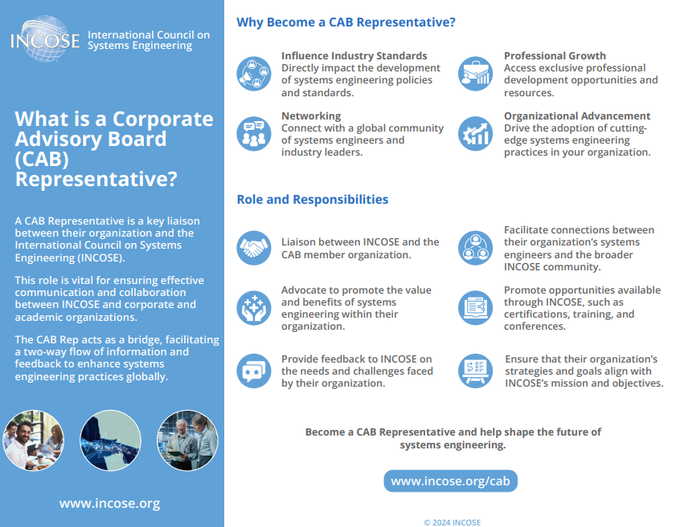
What is a Corporate Advisory Board (CAB) Representative?

Slide 14
Benefits of CAB Membership for the CAB Rep
Complimentary Individual INCOSE Membership, while you remain as the CAB Rep
  CAB Alternates are not eligible for this benefit
  If you no longer are the CAB Rep, this benefit will be removed from your profile and granted to the new Rep. If you previously paid for your membership, you will be given access to that membership again but subject to pay the renewal fee to remain a member at the expiration date
Complimentary IS Registration for CAB Representative or Designee
Complimentary IS CAB Dinner for CAB Representative & Guest
Complimentary Entrance for INCOSE Foundation Wine Soiree at IW

Slide 15

General CAB representatives’ Best Practice
Attend our CAB Zoom Meeting
Interact & connect with your fellow CAB Reps.
Hear about what is happening in INCOSE. Guest Speakers are invited each month to keep you up to date
Can express your (or your organization’s) concerns, needs, thoughts, questions, opportunities, etc.
EVERY 2ND MONDAY OF THE MONTH
Miss a meeting? Catch up on the Meeting Minutes in SharePoint.
Promote what is happening in INCOSE within your organization (events, product releases, webinars, etc.)
Advise colleagues how to become a CAB Associate. They take advantage of the “CAB Transition
Rate” for a discounted Membership rate for 2-years!
Manage your organization’s CAB Associate Account List. Nominate colleagues for the Technical
Leadership Institute (TLI) when application period is open

Slide 16
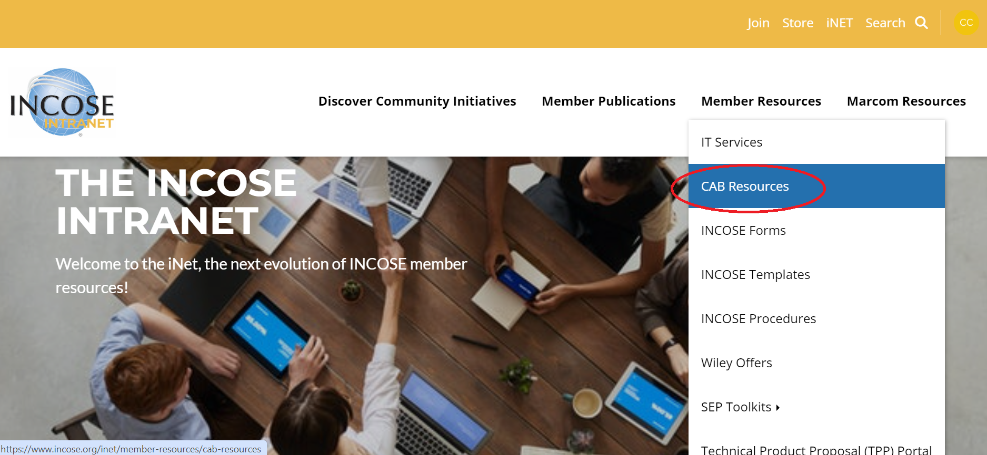
How to find CAB resources
Log in to your INCOSE account and go to iNet for your CAB resources.
Under Member Resources select from the dropdown menu CAB Resources
Only CAB Representatives have access to this resource

Slide 17
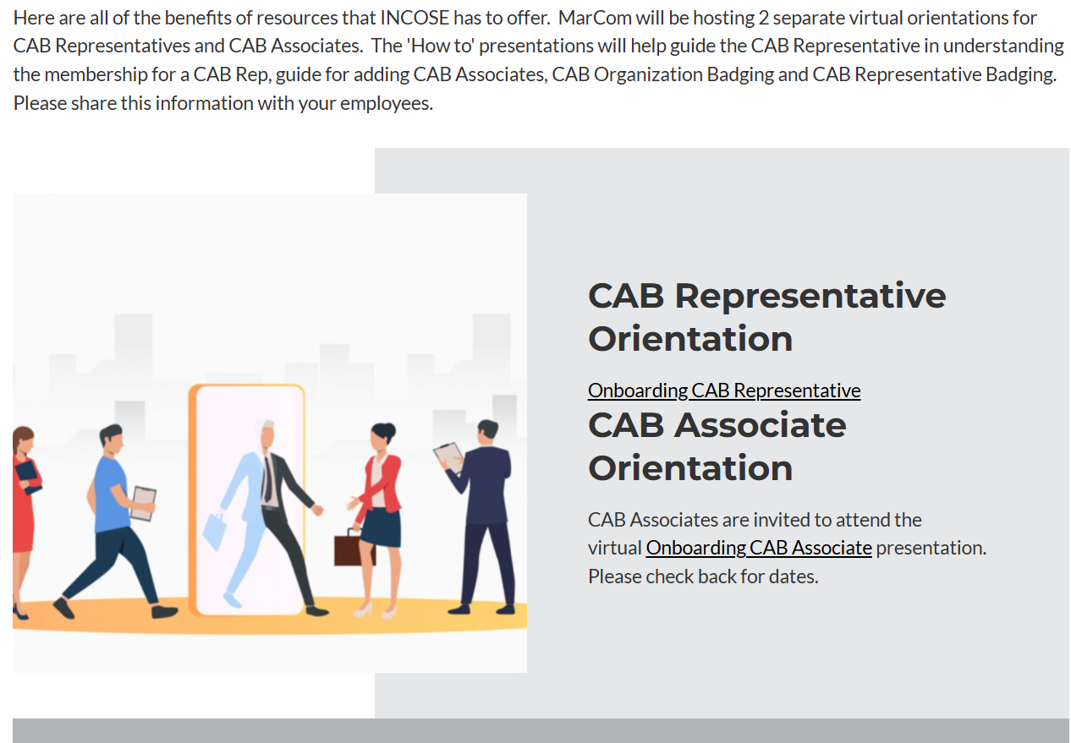
CAB Representatives Orientation
INCOSE will host 4 Onboarding CAB Representatives. Three will be virtual and a in-person session at INCOSE International Symposium.

Slide 18
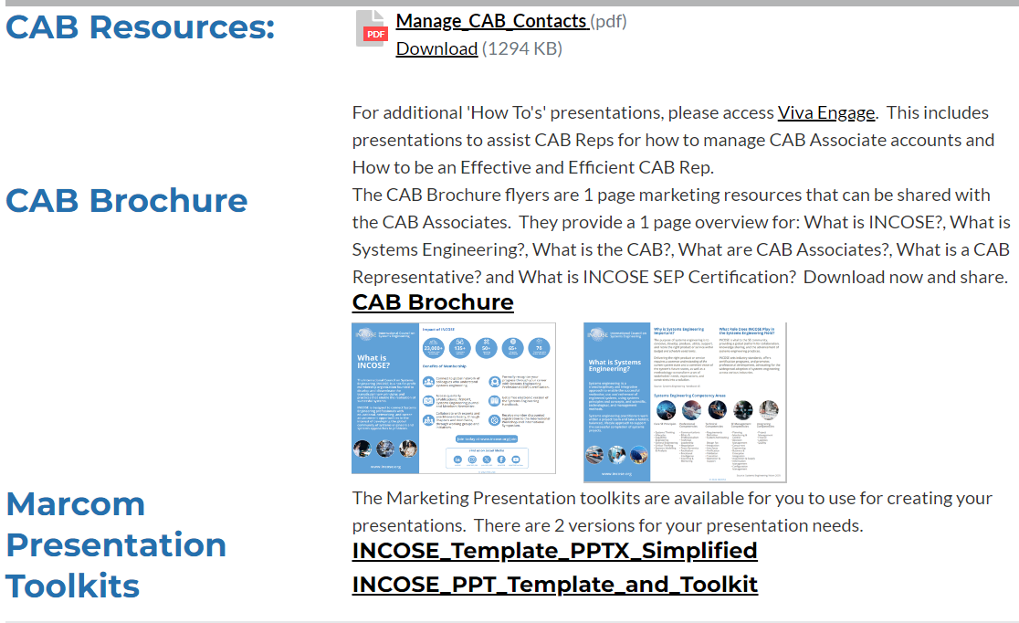
CAB resources on iNet
The “Manage CAB Contacts”, CAB Brochure and presentations toolkits.

Slide 19
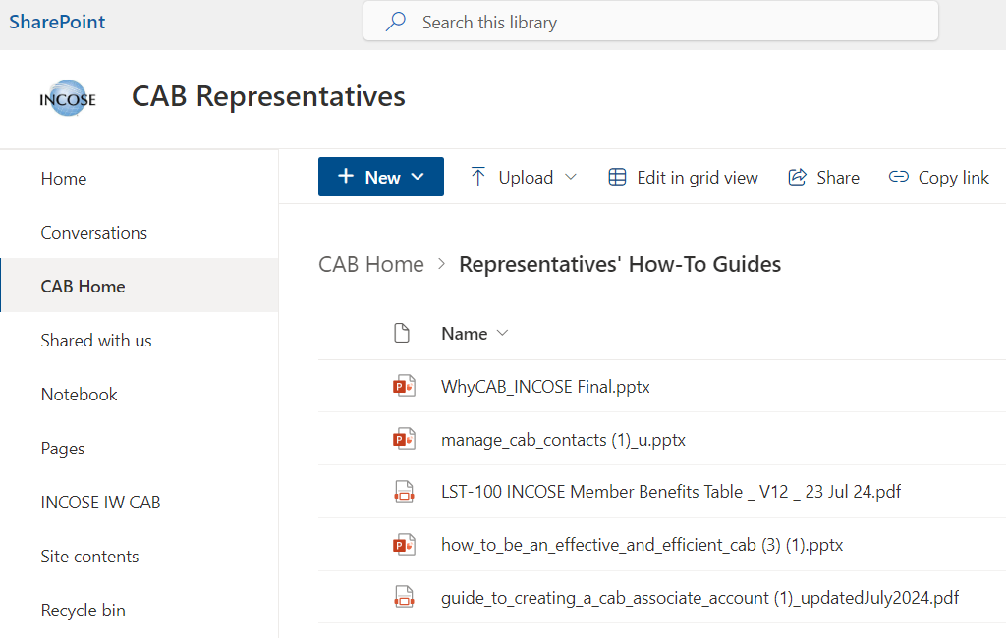
CAB resources on Viva Engage
The "How to guides” presentations can be found on Viva Engage via Sharepoint

Slide 20
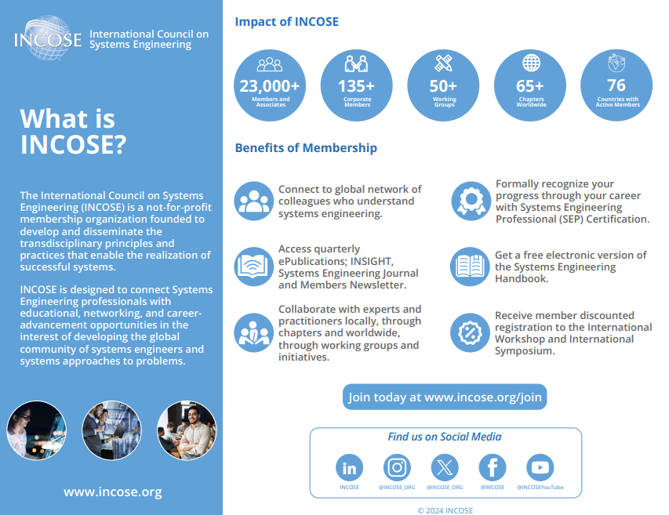
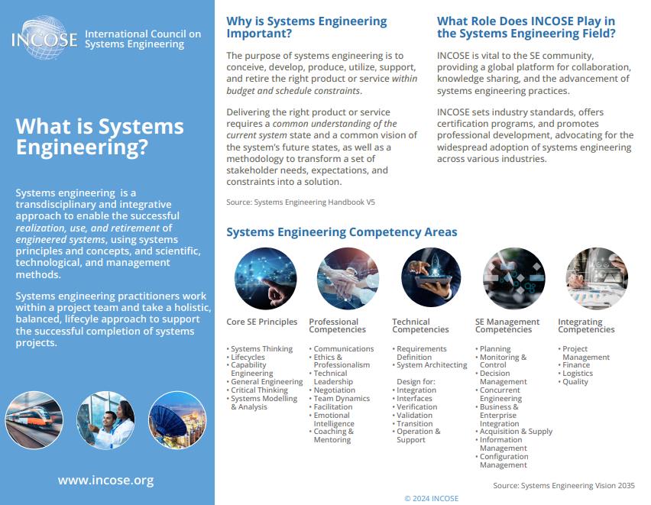
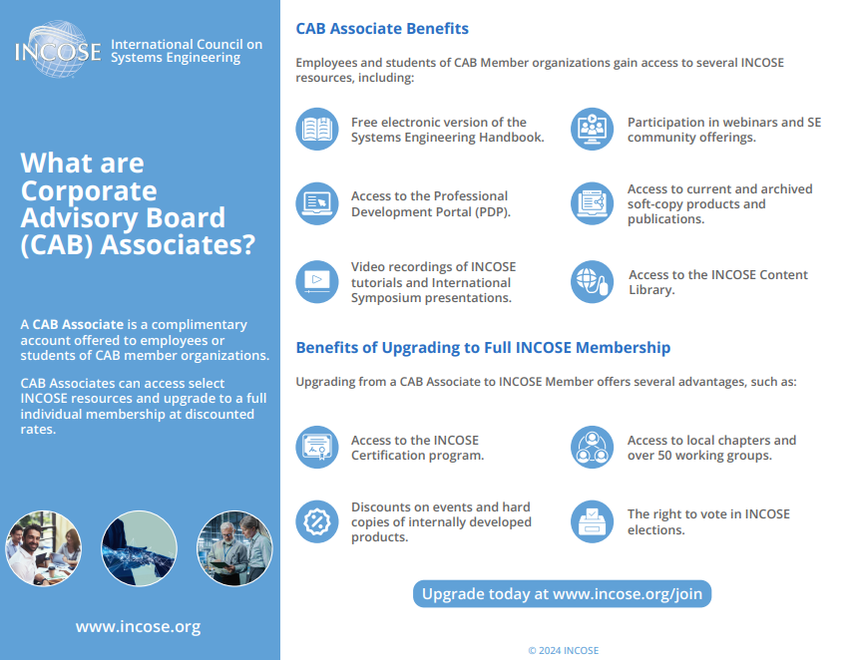
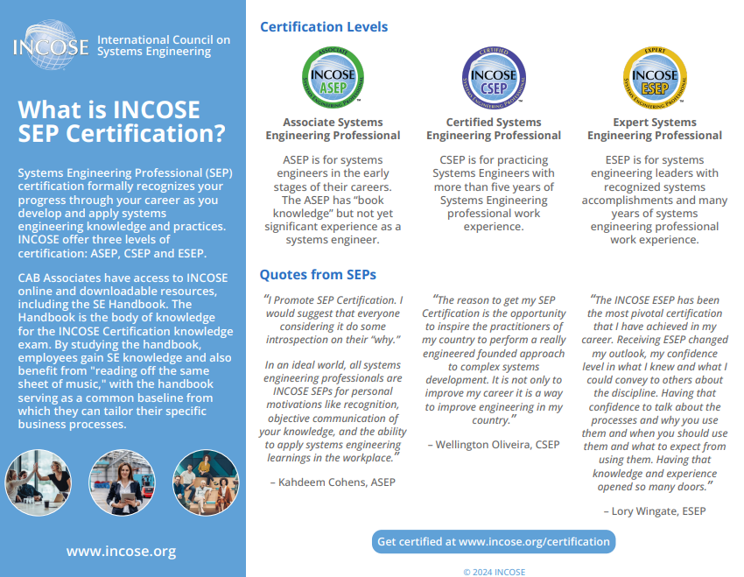
CAB Rep iNet Resources
CAB Brochure Flyers – These flyers can be shared with your CAB Associates.

Slide 21
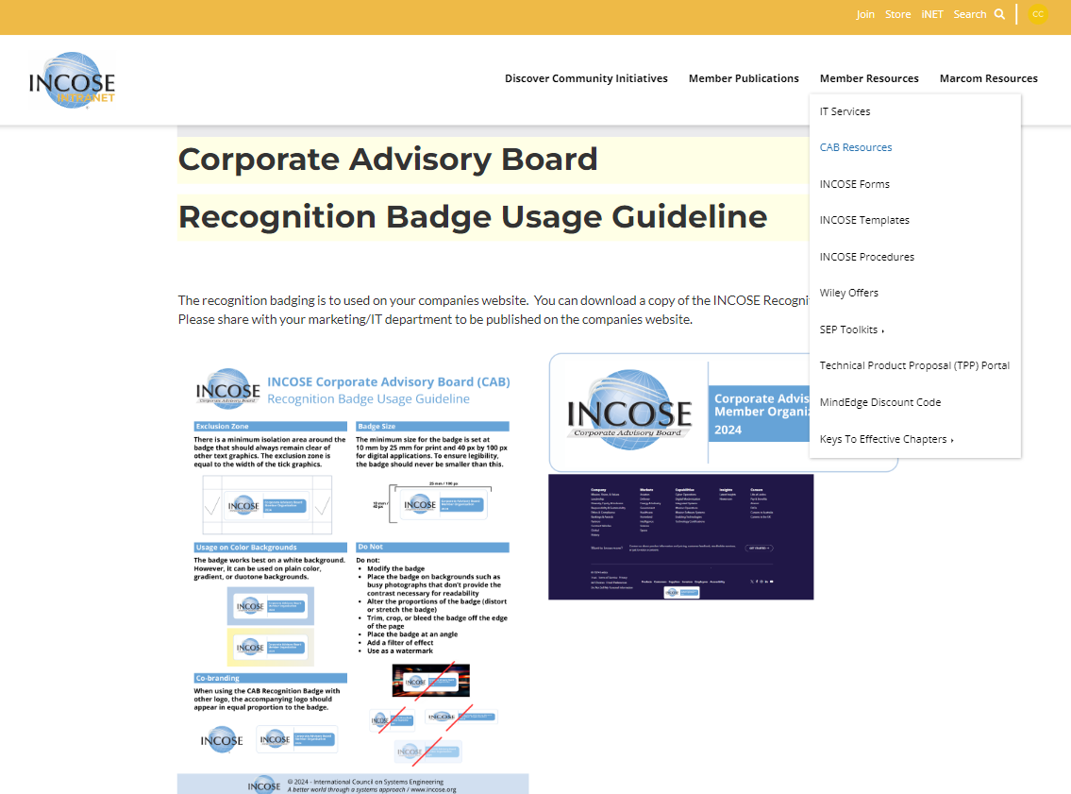
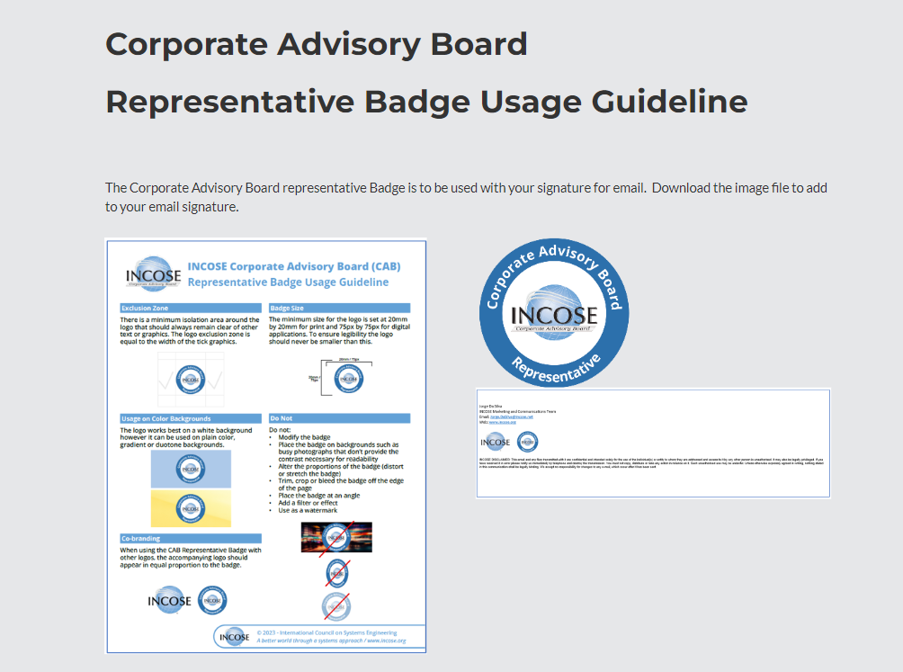
CAB Rep Marcom iNet Resources
Here is the CAB Recognition Badge and CAB Representative Badge and guidelines for use on your companies website and your email signature, as the CAB Rep. Forward the CAB Recognition Badge file and instructions to your Marketing/IT contact to add to the companies website.

Slide 22
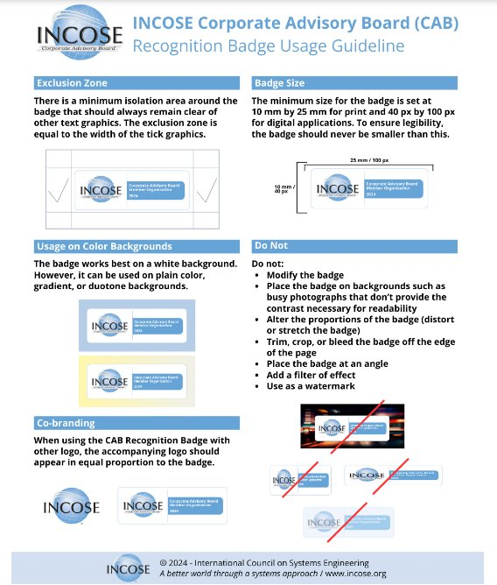


CAB Recognition Badge Usage Guideline
The recognition badging is to used on your company's website. You can download a copy of the INCOSE Recognition Badge. Please share with your marketing/IT department to be published on the company's website.

Slide 23
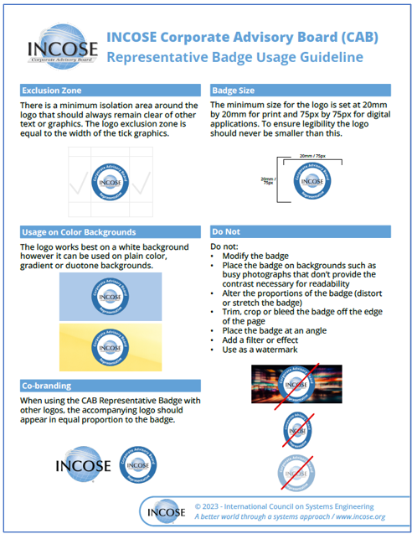

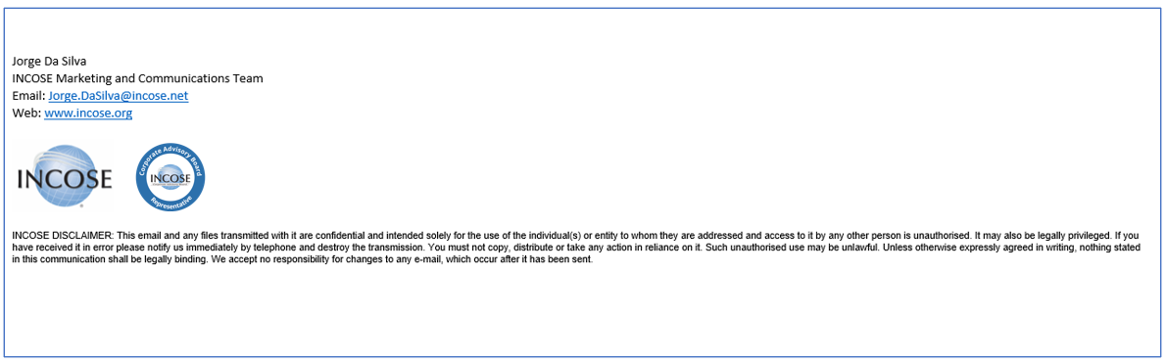
CAB Representative Badge
The Corporate Advisory Board representative badge is to be used with your signature for email. Download the image file to add to your email signature.

Slide 24
Online CAB Rep Resources – Viva Engage
Join Viva Engage: CAB Representatives Community
  https://engage.cloud.microsoft/main/org/incose.net/groups/eyJfdHlwZSI6Ikdyb3VwIiwiaWQiOiI5ODEzNDUyMzkwNCJ9/all
This community is private to only CAB Reps and INCOSE Admin – CAB Associates DO NOT have access to Viva Engage
  You must log in using your first.last@incose.net email, your organization email will not allow access.
– Don’t know this login information? Send an email to info@incose.net for assistance.
When a new CAB Organization joins or a CAB Rep changes, this community is updated to reflect that change
All resources are available here:
  Monthly Meeting Minutes
  Representatives’ How-To Guides
  Associates’ How-To Guides
Viva Engage is an app that is hosted on SharePoint (see next slide)

Slide 25
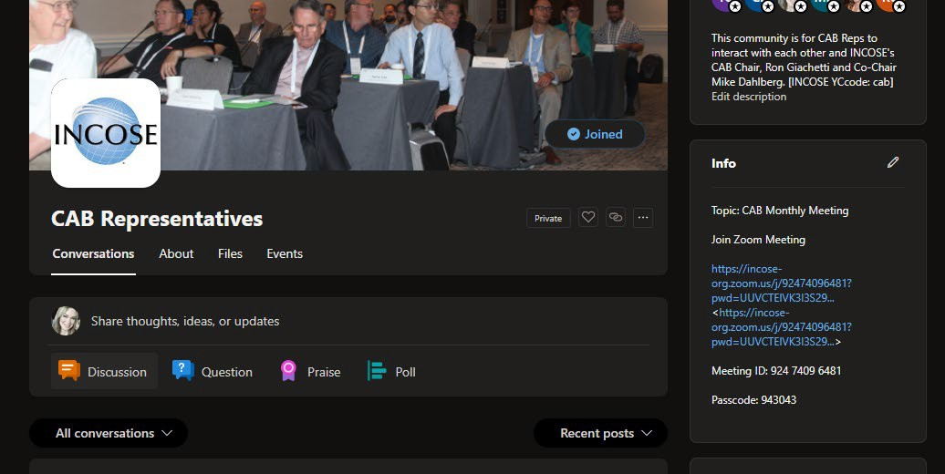
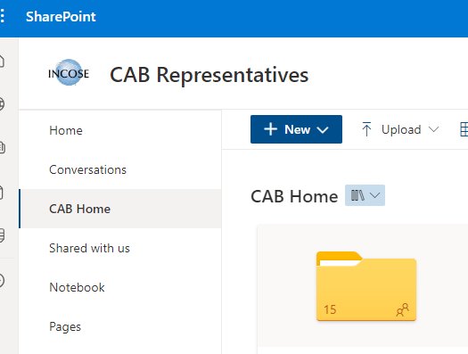

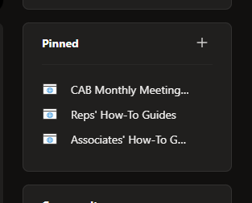
Online CAB Rep Resources – Viva Engage
Monthly Zoom Meeting Info
Directly below the Zoom Info, you will see the “Pinned” items box…
You can post on this page to interact with the CAB Rep Community.
Clicking on any of these “Pinned” items will open another browser
Clicking on any of these “Pinned” items will open another browser
window in SharePoint and you will be able to access all available files.
window in SharePoint and you will be able to access all available files.

Slide 26
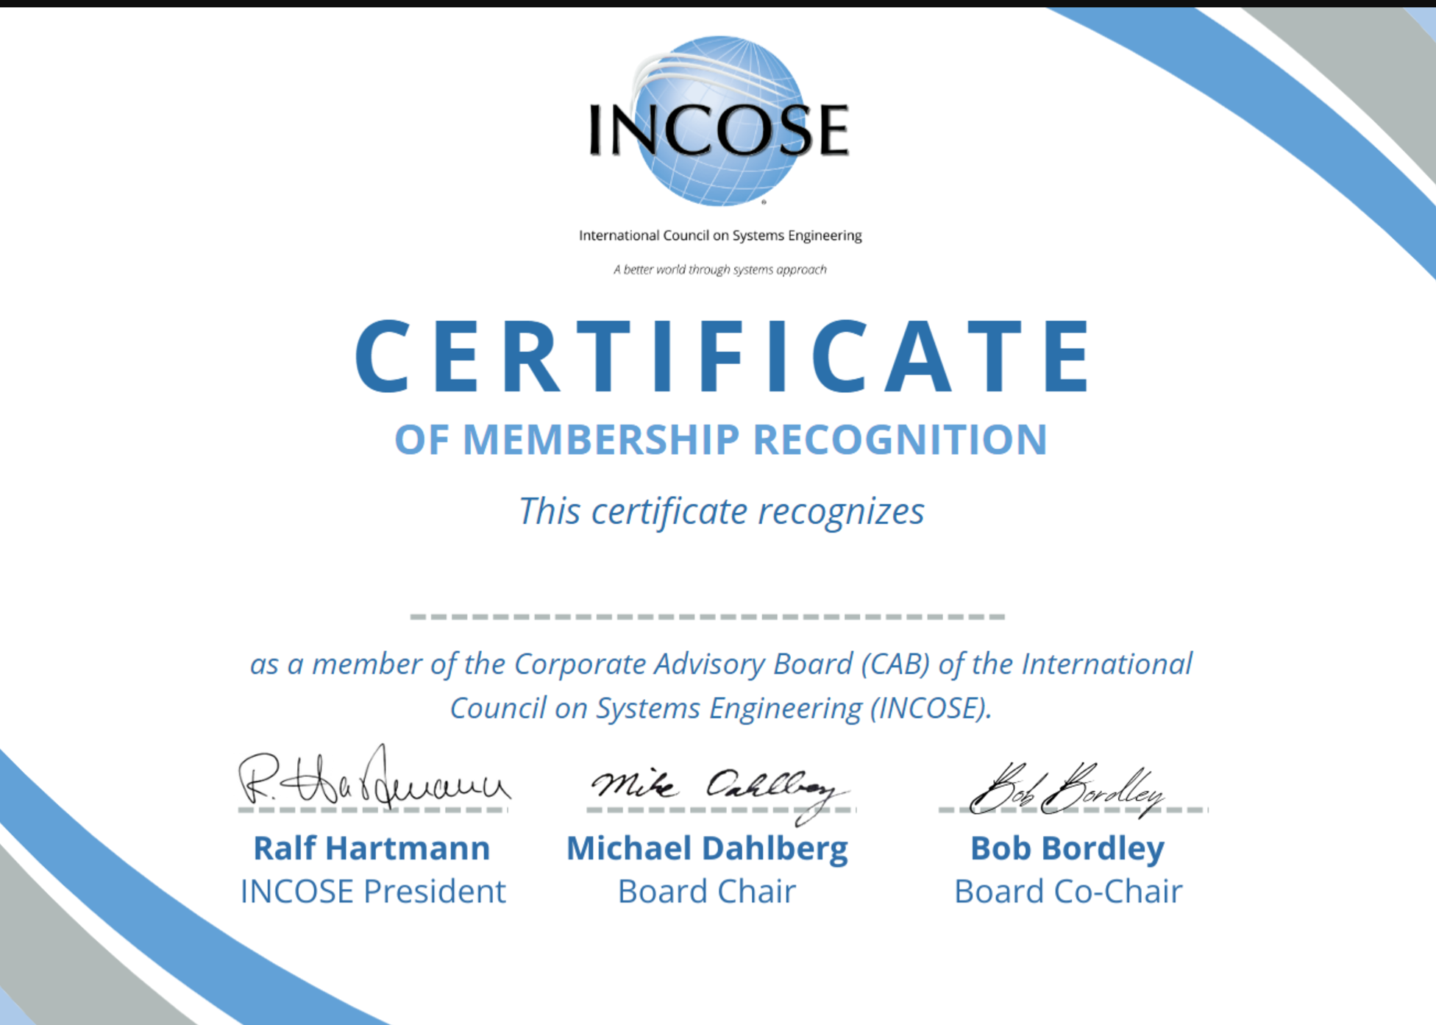
Certificate of Membership Recognition
The CAB representative will receive the Certificate of Membership Recognition. The Marcom Department wants to ‘spotlight’ the CAB Member and Representative with a social media post.
When you receive the certificate, please take a picture with it. Then, send the picture to tomi.okey@incose.net.

Slide 27
Need Assistance? Contact Us!
CAB Administration Questions? You can reach out via :
  helpdesk@incose.net

Slide 28
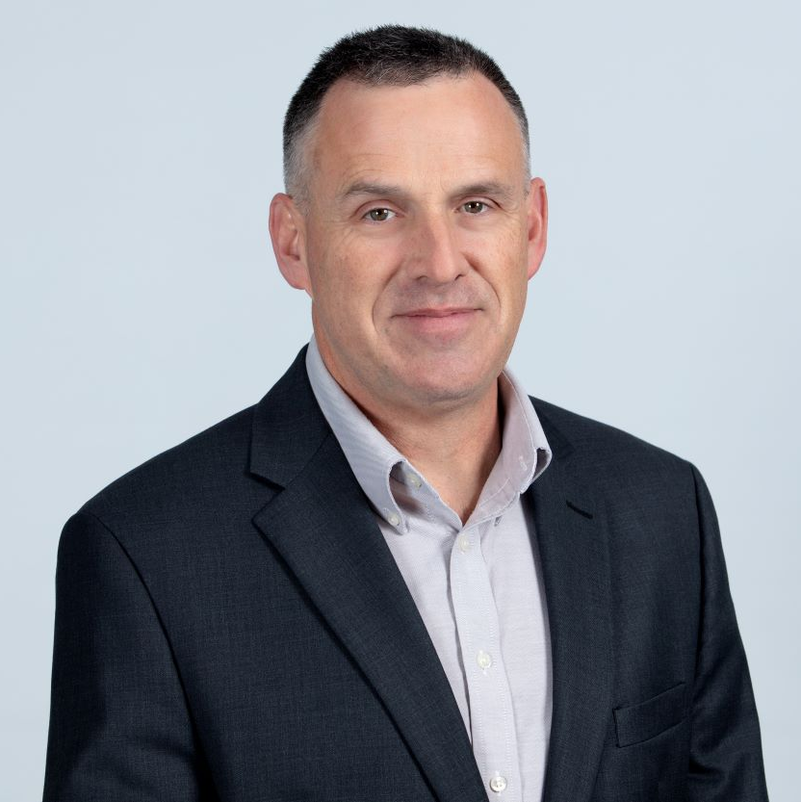
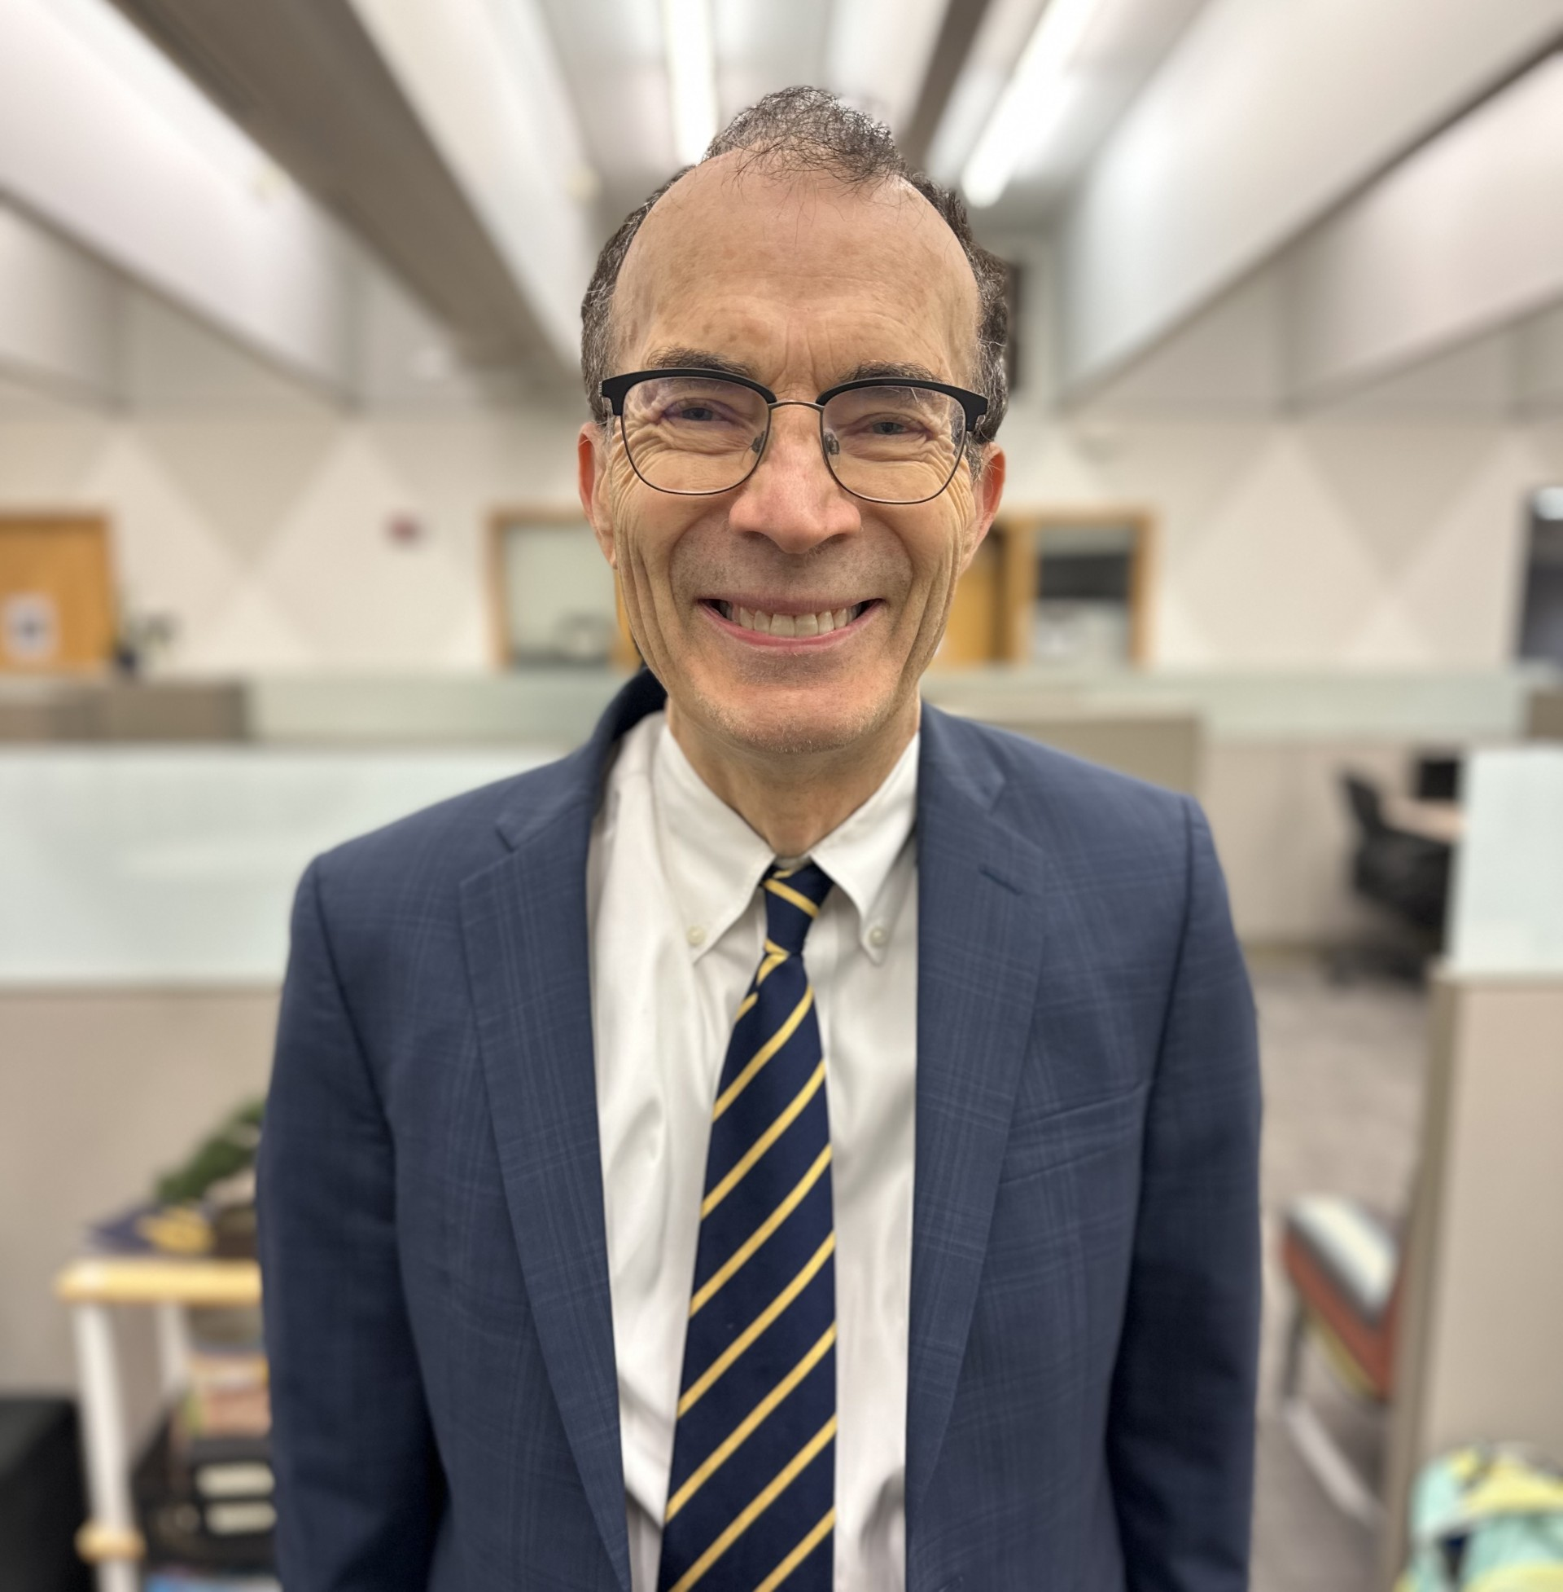
Corporate Advisory Board Leadership
Chair Co-Chair
Michael Dahlberg
Michael.Dahlberg@incose.net
  Robert Bordley
  Robert.Bordley@incose.net

Slide 29

Thank you

Slide 30

© 2024 INCOSE. All rights reserved.
INCOSE.org

Slide 31
CAB Associate Overview
Depending on the size / type of organization, you receive…
Organization Type Number of CAB Associate Accounts Included
Academic Organization 300
Very Small Organization 20
Small Organization 150
Medium Organization 200
Large Organization 300
***Additional Accounts $35 USD per account

Slide 32
CAB Associate Overview
Employees / Students can gain access to some of INCOSE’s state-of-the art products & publications through these accounts.
Becoming a CAB Associate is easy!
  You can find the Associates’ How-To Guides in the Viva Engage Community & SharePoint Site and provide to the individuals. (Note: These links will NOT work for anyone but the CAB Rep, you will have to download to provide.)
  Or they can send an email to helpdesk@incose.net for further assistance
Managing your organization’s CAB Associate Account List
  Download the Manage CAB Associate Account Guide
  You can find the Representatives’ How-To Guides in the Yammer Community & SharePoint Site and provide to the individuals.
  Request assistance from helpdesk@incose.net

Slide 33
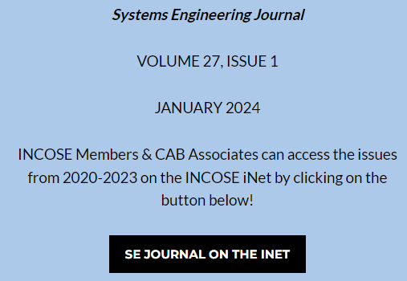
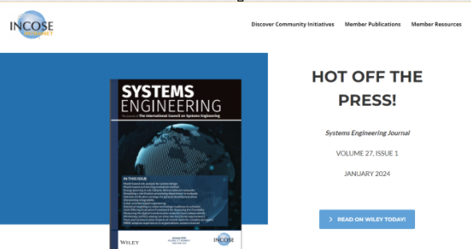
CAB Associate Benefits Overview
Employees / Students can gain access to some of INCOSE’s state-of-the art products & publications through these accounts.
On the public page for the SE Journal, there is a link to the iNet page.
Clicking on this link will open the SE Journal iNet Page which will allow them to utilize SSO to access the publication on Wiley.

Slide 34
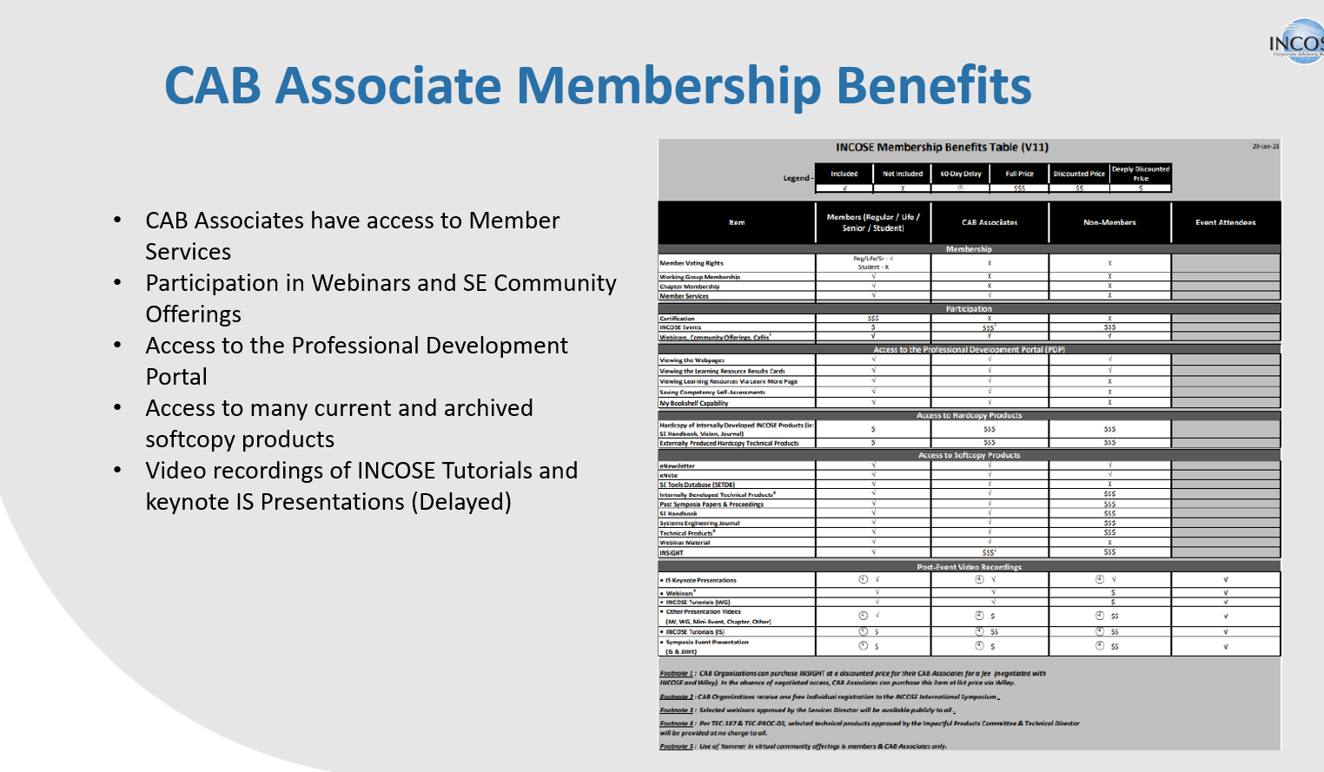

Slide 36
Online CAB Rep Resources - iNet
The INCOSE iNet is available to access CAB resources
– Unlike Viva Engage, CAB Associates can access the iNet by logging into www.incose.org (the same way they would access the Store).
https://www.incose.org/inet/member-resources/cab-resources
There are additional resources that are available to all Members and Associates.
Most of these resources are linked from the public pages on www.incose.org (see next slide)

Slide 37
CAB Membership Fees
INITIATION FEE (first year only) / ANNUAL MEMBERSHIP FEE
Organization type | Annual fee * | First Year Initiation Fee (1x Only) | Number of CAB Associate Accounts Included
Academic Organization | $5,225.00 | $- | 300
Very small Organization | $2,750.00 | $- | 20
Small Organization | $5,225.00 | $5,500.00 | 150
Medium Organization | $6,600.00 | $6,500.00 | 200
Large Organization | $8,000.00 | $7,500.00 | 300
Additional CAB Associate Accounts |  |  | $35/person/year

