Slide 1

Onboarding CAB Associates
International Council on Systems Engineering
A better world through a systems approach
incose.org

Slide 2


incose.org | 2

Slide 3
Agenda
Leverage yourself with INCOSE
What is the Corporate Advisory Board?
  Lifecycle of the CAB impact
What is a CAB Associate?
How to access CAB Associate resources
  INCOSE Content Library
  PDP
  SE Journal
  Members Newsletter
  Handbook V5
What is SEP Certification?
Why become an INCOSE Member and CAB Associate Transition Discount
Contact Information. Suggestions? Feedback? Questions?

Slide 4





Leverage yourself with INCOSE
INCOSE is the premier choice of systems engineers for professional development.
With over 30 years of experience, we are shaping the future of systems engineering.
We interact with systems engineers across the globe on a daily basis to set standards.
23,000+
138
53
65
76
Members and
CAB Associates
Corporate Members
Working Groups
Chapters Worldwide
Countries with Active Members

Slide 5

Why Join INCOSE?
INCOSE is the global Systems Engineering professional society – providing the opportunity for life-long learning in systems approaches.
A community of peers, resources for your career, and a place
to be a leader.
Our members stand out and are often sought after as experts.
They also share practices and learn from each other.
Members create products, produce events and represent
the organization in international forums.
Increase your professional stature with the INCOSE Systems Engineering Professional Certification.
Affiliates expand the body of knowledge and advance
the practice of systems engineering.
Network with over 23,000 members in 76 countries.

Slide 6







Membership Benefits
A global network of colleagues who understand systems engineering
Collaborate with experts and practitioners worldwide
Certification Opportunities
Exclusive access to INCOSE iNet and Viva Engage, the collaborative space for INCOSE Members Only
Access to quarterly e-Publications, INSIGHT and Journal of Systems Engineering
Member discounted registration to the International Workshop and International Symposium.
Electronic version of the Systems Engineering Handbook
Access to a range of systems engineering technical products, resources and training.

Slide 7
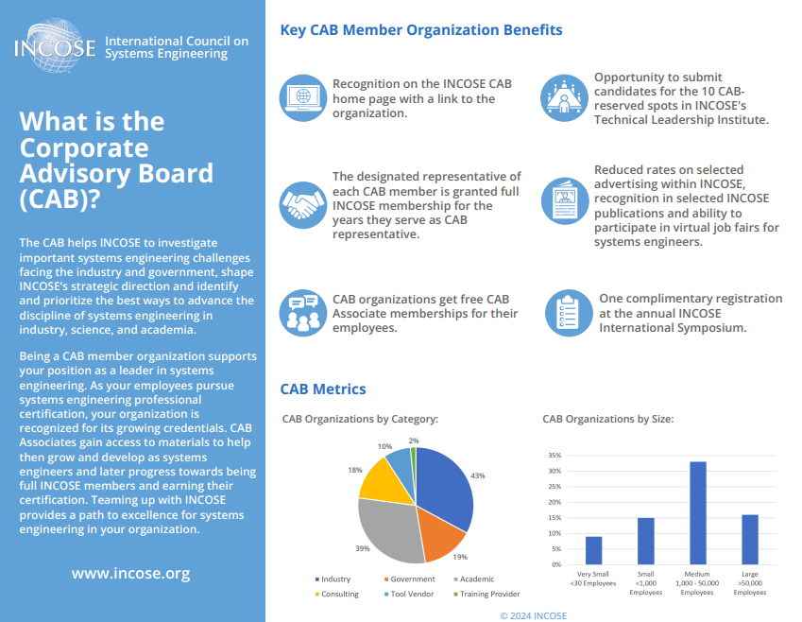
What is the Corporate Advisory Board (CAB)?

Slide 8

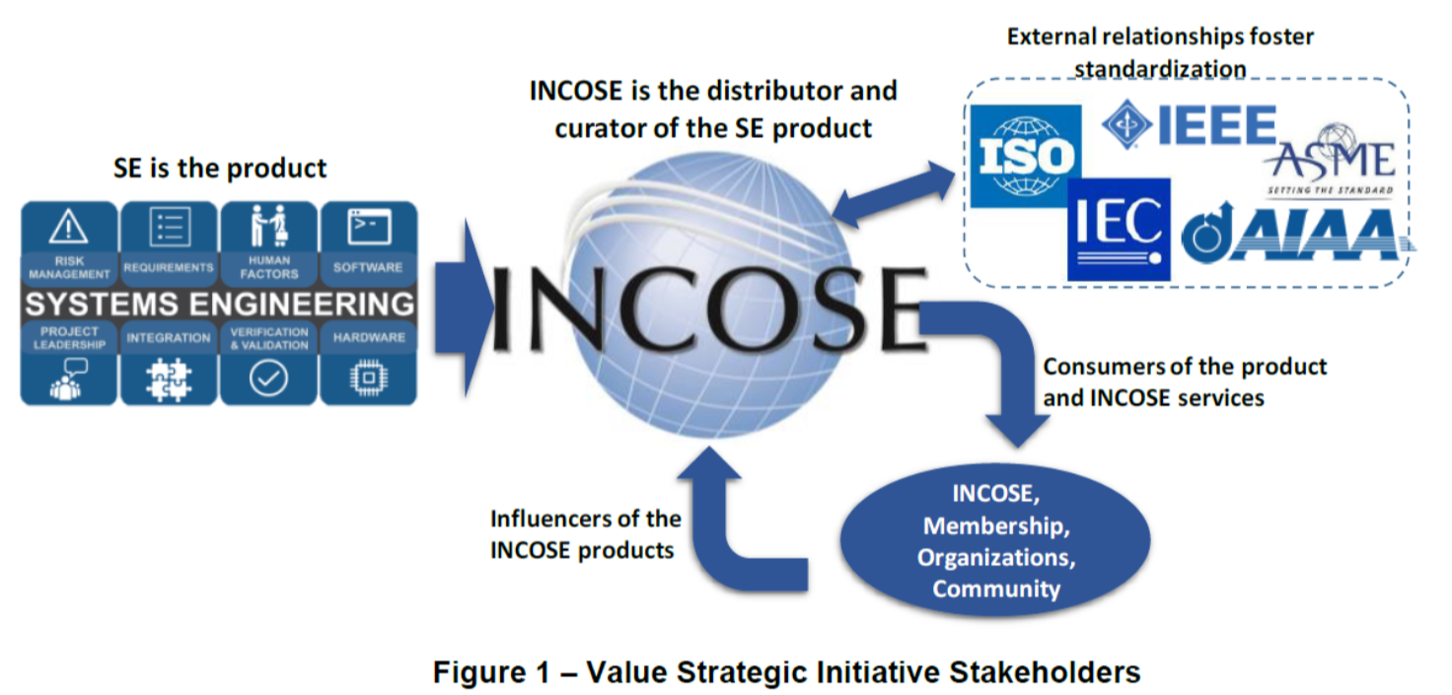



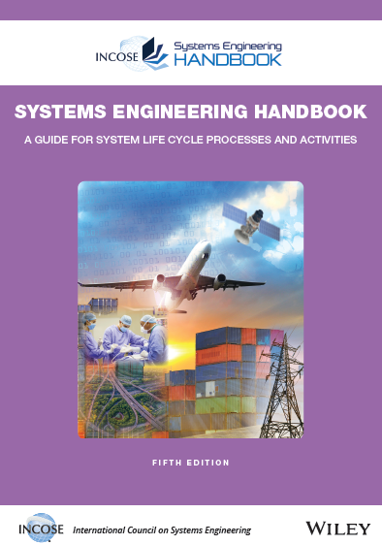




Lifecycle of the CAB Impact
CAB organizations influence INCOSE work and benefit from INCOSE products
INCOSE Vision and Strategic Plan
External Organizations
CAB Member Organizations
CAB needs are briefed annually to the INCOSE Board of Directors and the Technical Director; Needs are flowed to the appropriate workgroups for action
INCOSE Products and Services
Working Groups and Technical Services deliver product solutions that further the systems engineering discipline consistent with the INCOSE Vision, Strategic Plan while addressing CAB Needs
Products
CAB member organizations, CAB Reps, and CAB Associates identify and document CAB needs annually based on challenges facing industry and academia
Value Streams / Working Groups
Events
CAB Members help to Lead, Support, and Mentor Working Groups
Certification

Slide 9
CAB Membership Costs
Item | Regular/Senior/Life Members | Student Members | Corporate Advisory Board (including Academic Council), CAB Associates | Non-Members
 | GROUP 1: Membership
Member Voting Rights | Included | Not Available | Not Available | Not Available
Working Group Membership | Included | Included | Not Available | Not Available
Chapter Membership | Included | Included | Not Available | Not Available
Member Services | Included | Included | Included | Not Available
 | GROUP 2: Access/Videos & Softcopies of...
eNewsletter | Included | Included | Included | Included
eNote | Included | Included | Included | Included
SE Tools Database (SETDB) | Included | Included | Included | Not Available
Internally Developed Technical Products | Included | Included | Included | List Price via INCOSE Store
Past Symposia Papers & Proceedings | Included | Included | Included | List Price via INCOSE Store
SE Handbook | Included | Included | Included | List Price via INCOSE Store
Systems Engineering Journal | Included | Included | Included | List Price via INCOSE Store
Technical Products (released at no charge to members) | Included | Included | Included | List Price via INCOSE Store
INSIGHT | Included | Included | Included | List Price via INCOSE Store
Different sources for video recordings (Post-event, with permissions from presenter)
*IS Keynote Presentations | Included | Included | Included | Included
*Webinars | Included | Included | Included | List Price via INCOSE Store
*INCOSE Tutorials (WG) | Included | Included | Included | List Price via INCOSE Store
*INCOSE Tutorials (IS) | Included | Included | List Price via INCOSE Store | List Price via INCOSE Store
*Other Presentations Videos (IW, WG, Mini-Event, Chapter, Others) | Included | Included | Discount Price | List Price via INCOSE Store
*Symposia Event Presentation (IS & Joint) | Discount Price | Discount Price | Discount Price | List Price via INCOSE Store
 | GROUP 3: OTher
Certification | Available | Available | Not Available | Not Available
INCOSE Events | Discount Price | Discount Price | List Price | List Price
Hardcopy of internally Developed INCOSE Products (ie: SE Handbook, Vision, Journal) | Discount Price | Discount Price | List Price via INCOSE Store, Wiley, or other publisher/distributor | List Price via INCOSE Store, Wiley, or other publisher/distributor
Externally Produced Technical Products) | Discount Price | Discount Price | List Price via INCOSE Store, Wiley, or other publisher/distributor | List Price via INCOSE Store, Wiley, or other publisher/distributor

Slide 10
CAB Associate Overview
Depending on the size / type of organization, you receive…
Organization Type Number of CAB Associate Accounts Included
Academic Organization 300
Very Small Organization 20
Small Organization 150
Medium Organization 200
Large Organization 300
***Additional Accounts $35 USD per account

Slide 11
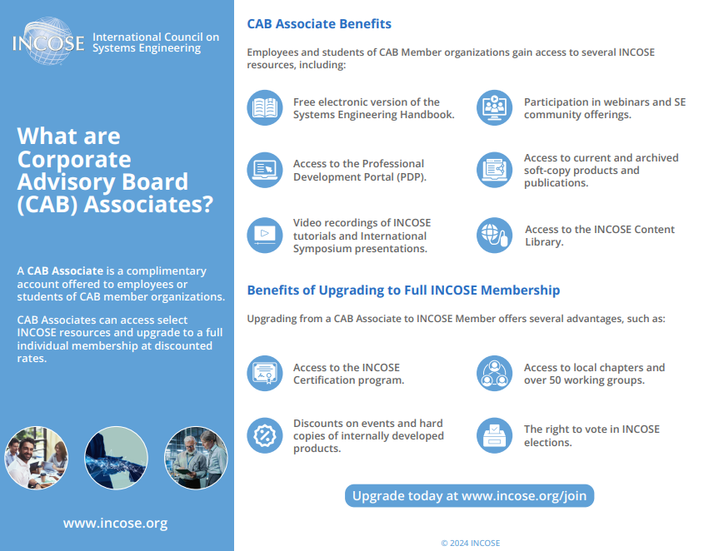
What are the Corporate Advisory Board (CAB) Associates?

Slide 12
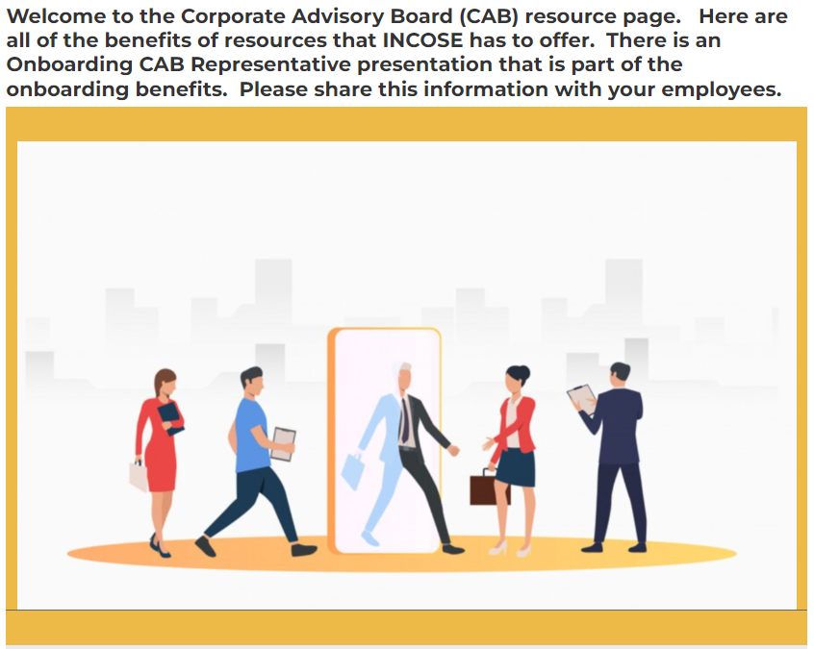
Onboarding CAB Associates
INCOSE will host twice a year a virtual onboarding for CAB Associates.
CAB Associates are encouraged to learn about the INCOSE benefits.

Slide 13
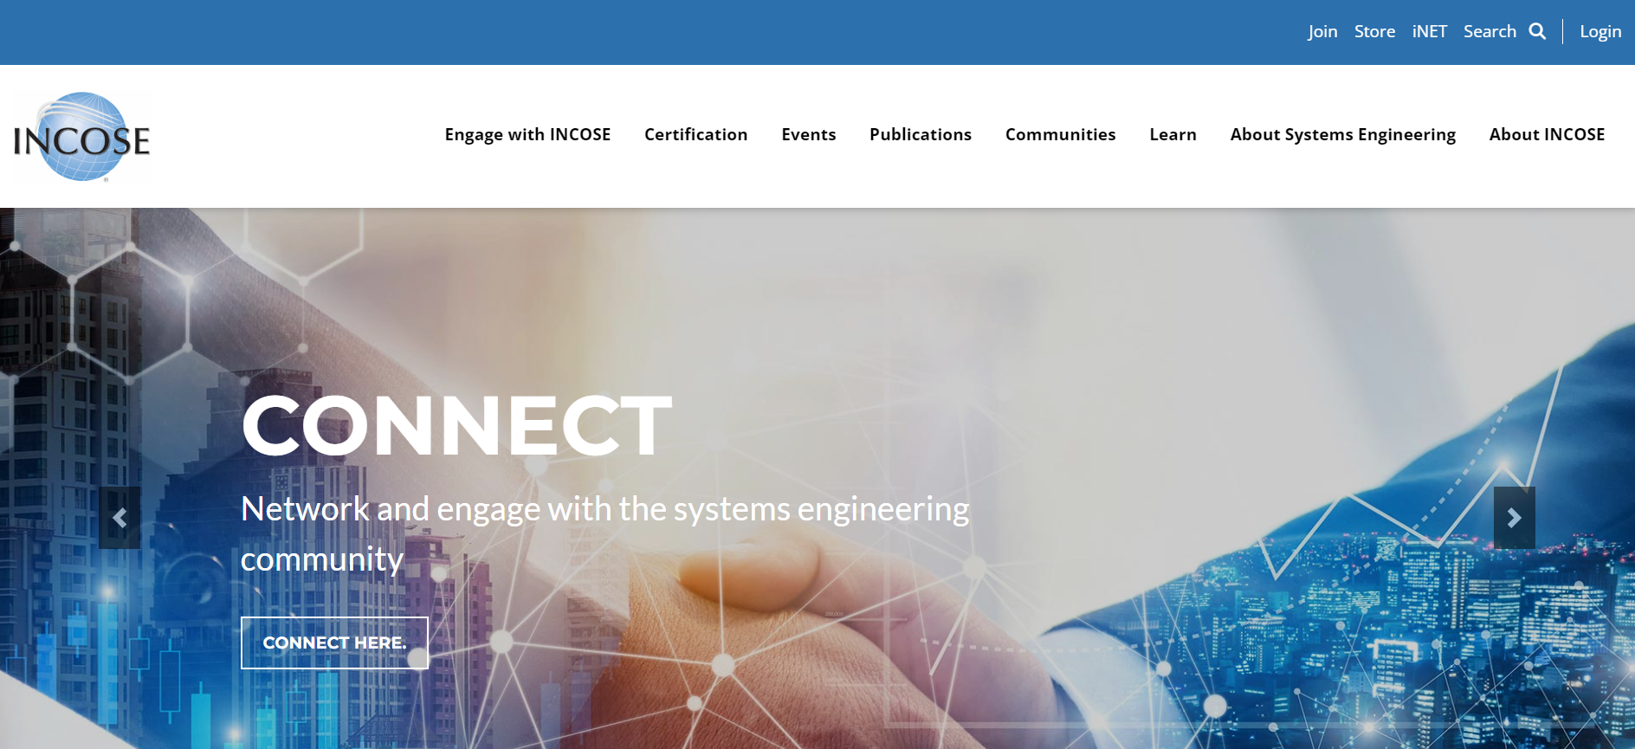
Here is how to find access to the INCOSE resources.

Slide 14
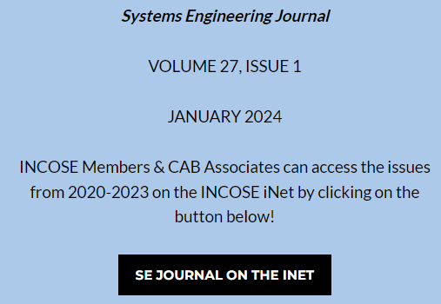
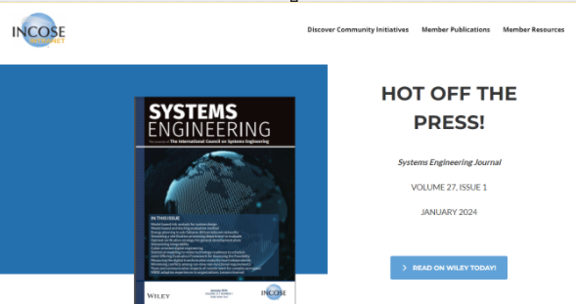
CAB Associate Benefits Overview
Employees / Students can gain access to some of INCOSE’s state-of-the art products & publications through these accounts.
On the public page for the SE Journal, there is a link to the iNet page.
Clicking on this link will open the SE Journal iNet Page which will allow them to utilize SSO to access the publication on Wiley.

Slide 15
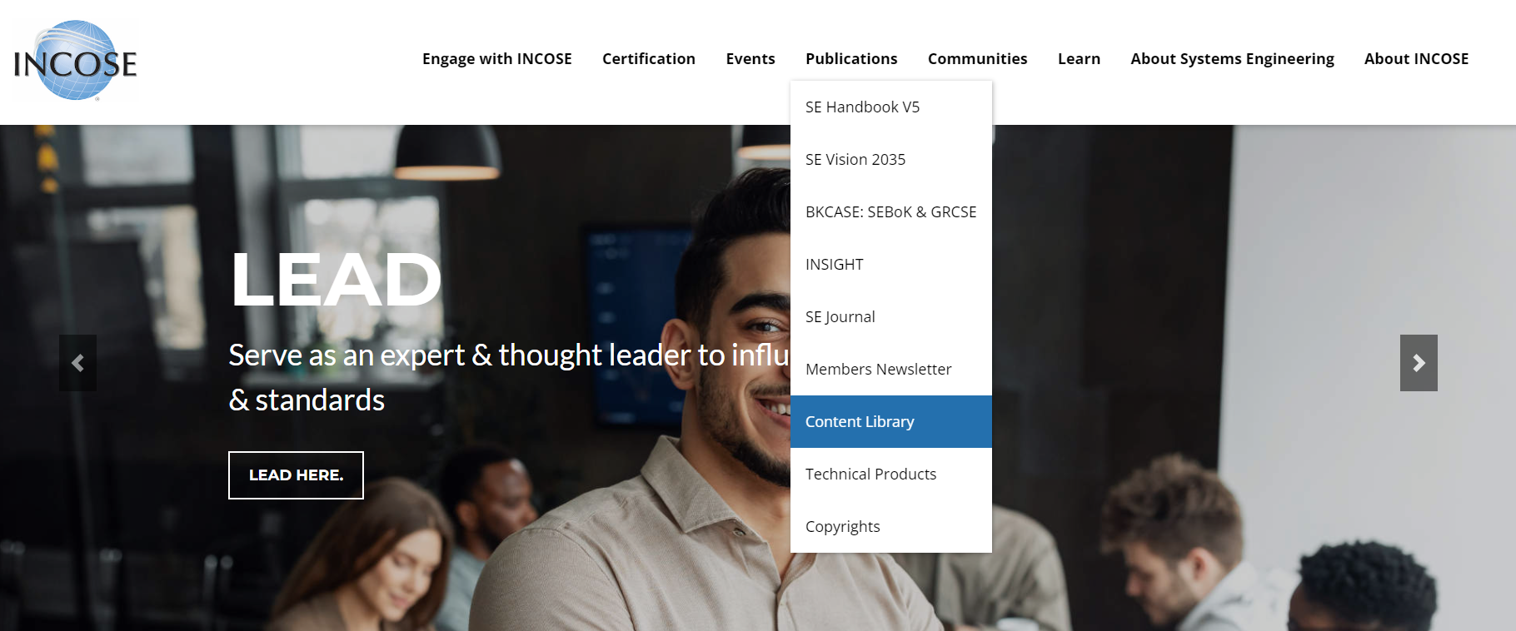
How to access the INCOSE Content Library

Slide 16
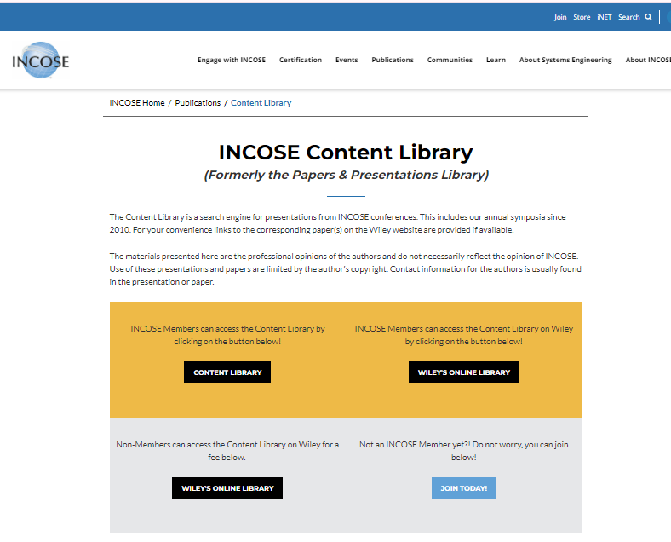
How to access the INCOSE Content Library
From the Home Page navigation bar, Click on Publications and from the drop down menu, select Content Library
https://www.incose.org/publications/papers-presentations-library

Slide 17
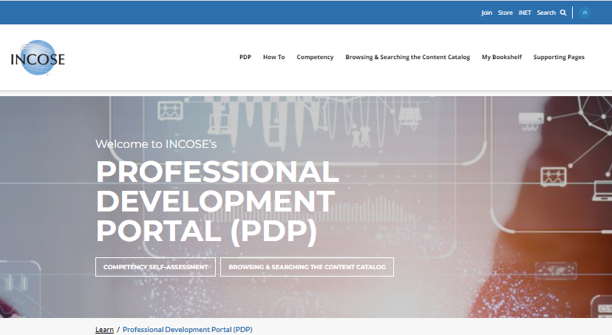
How to access PDP
From the Home Page navigation bar, Click on Learn and from the drop down menu, select Professional Development Portal (PDP).
https://www.incose.org/learn/incose-pdp

Slide 18

Access to the INCOSE Newsletter
https://www.incose.org/publications/members-newsletter
The INCOSE Members Newsletter is published every quarter and seeks articles and news items of interest. The Newsletter is focused on happenings of interest from across the systems community. Packed with events from around the world, news from working groups, insights on the upcoming standards, and items of interest from beyond INCOSE’s borders, this quarterly newsletter adds new depth as we share the latest news in the world of systems.

Slide 19
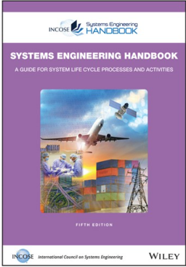
How to find Handbook V5
As a CAB Associate, you can access and download a copy of the Systems Engineering Handbook V5.
https://www.incose.org/publications/se-handbook-v5

Slide 20
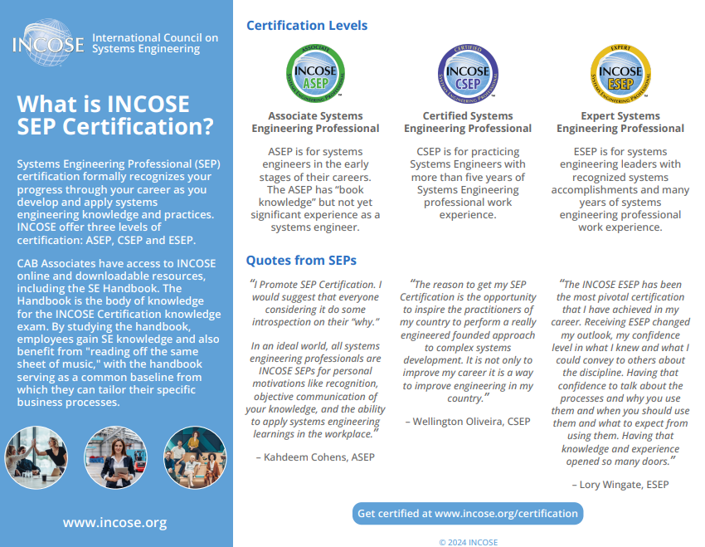
What is SEP Certification?

Slide 21
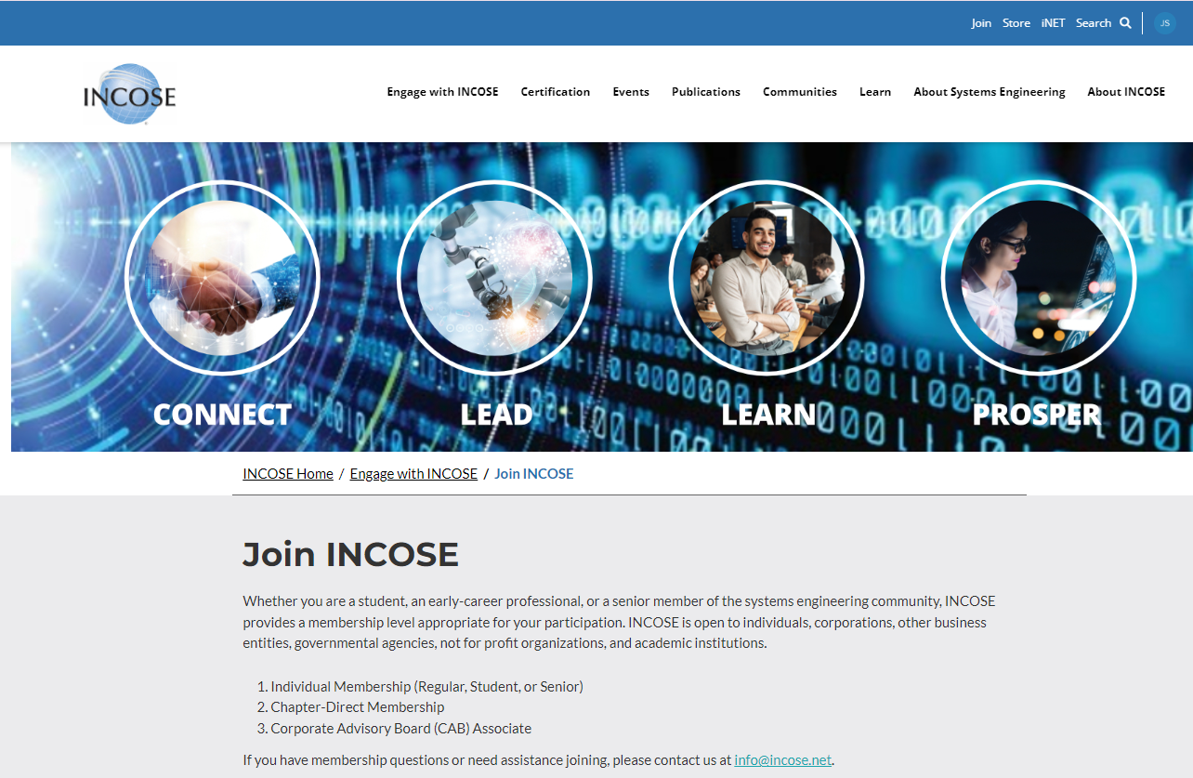
How to transition from a CAB Associate to an
INCOSE Member
A CAB Associate account does not allow you to join a chapter, join a Working Group or apply for a certification. However, you may upgrade to a regular individual member at a discounted transition fee if you decide you are ready to become an INCOSE member. Only CAB Associates joining INCOSE for the first time (does not include previous regular individual members) are eligible for the discounted Transition rate.
Transitioning to Regular Member: CAB Associates with an active account AND who have never been an INCOSE Individual Member at a discounted Transition Fee ($115); to take advantage of this offer, please follow the directions in this How to Guide.

Slide 22
Need Assistance? Contact Us!
CAB Administration Questions? You can reach out via :
  Teams
  iNet
  SharePoint
  helpdesk@incose.net

Slide 23

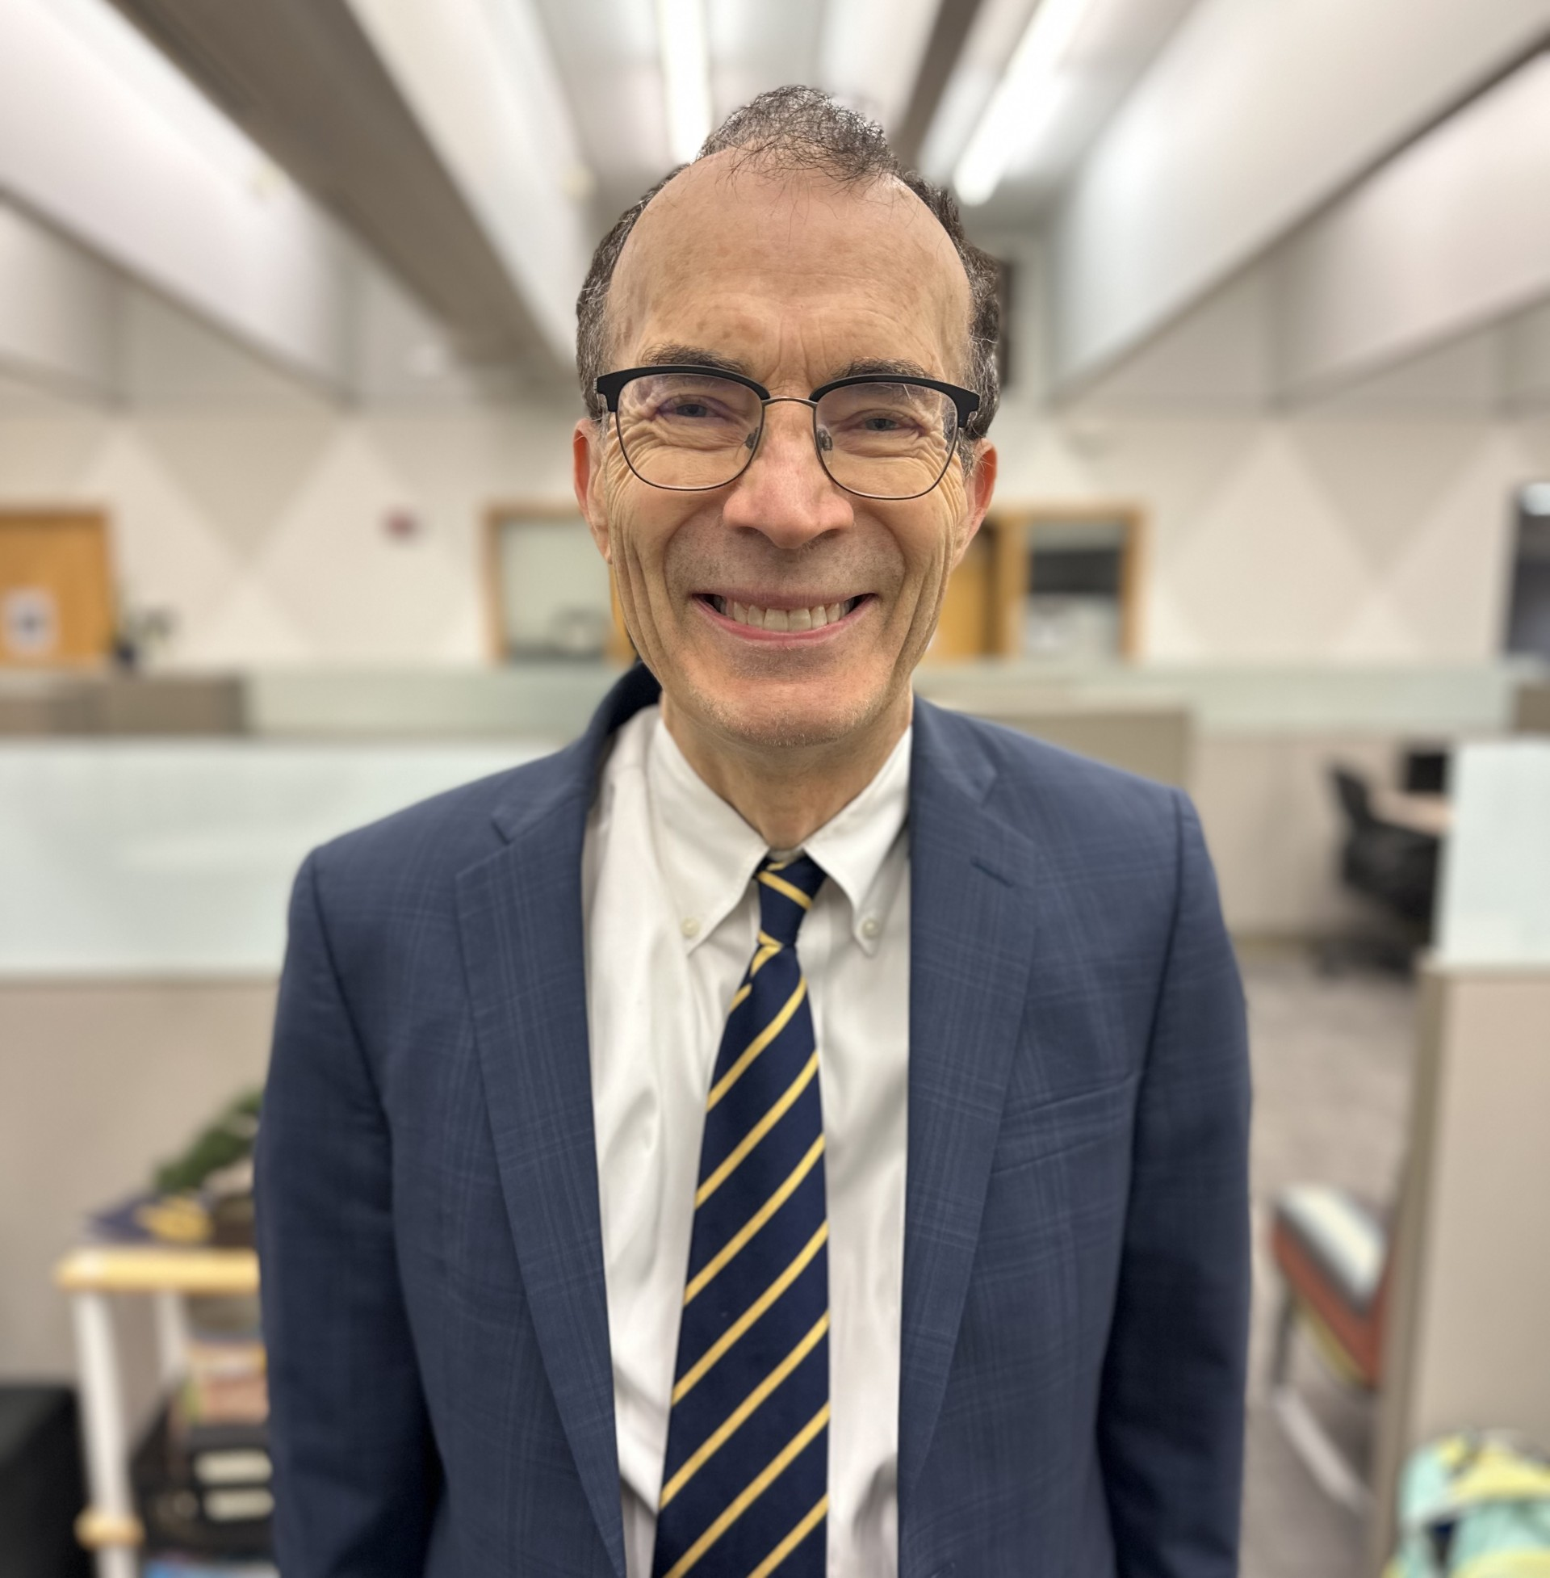
Corporate Advisory Board Leadership
Chair Co-Chair
Michael Dahlberg
Michael.Dahlberg@incose.net
  Robert Bordley
  Robert.Bordley@incose.net

Slide 24

Thank you

Slide 25

© 2024 INCOSE. All rights reserved.
INCOSE.org

Slide 26
Annual CAB Membership Payment Information
CAB Invoices sent in Q4 for the upcoming year’s fees
These payments are due by March 1st!
  5% Discount if organization pays for 3 years
  10% Discount if organizations pays for 5 years
  Please contact John Hedrick (accounting@incose.net) for further details

Slide 27
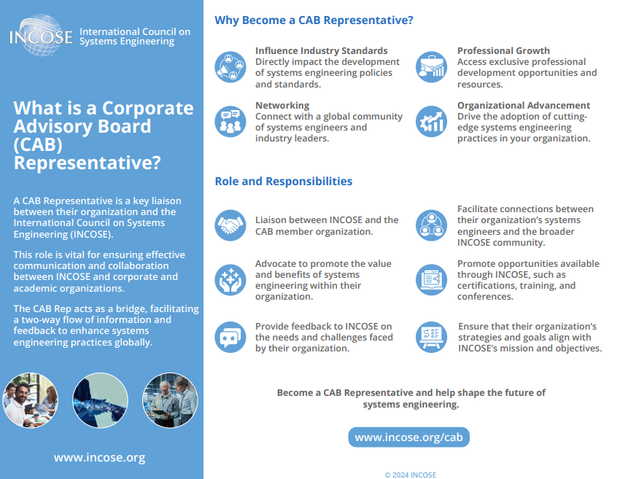

Slide 28
Benefits of CAB Membership for the CAB Rep
Complimentary Individual INCOSE Membership, while you remain as the CAB Rep
  CAB Alternates are not eligible for this benefit
  If you no longer are the CAB Rep, this benefit will be removed from your profile and granted to the new Rep. If you previously paid for your membership, you will be given access to that membership again but subject to pay the renewal fee to remain a member at the expiration date
Complimentary IS Registration for CAB Representative or Designee
Complimentary IS CAB Dinner for CAB Representative & Guest
Complimentary Entrance for INCOSE Foundation Wine Soiree at IW

Slide 29

General CAB representatives’ Best Practice
Attend our CAB Zoom Meeting
Interact & connect with your fellow CAB Reps.
Hear about what is happening in INCOSE. Guest Speakers are invited each month to keep you up to date
Can express your (or your organization’s) concerns, needs, thoughts, questions, opportunities, etc.
Every 2nd Monday of the month
Miss a meeting? Catch up on the Meeting Minutes in SharePoint.
Promote what is happening in INCOSE within your organization (events, product releases, webinars, etc.)
Advise colleagues how to become a CAB Associate. They take advantage of the “CAB Transition
Rate” for a discounted Membership rate for 2-years!
Manage your organization’s CAB Associate Account List. Nominate colleagues for the Technical
Leadership Institute (TLI) when application period is open

Slide 30
Online CAB Rep Resources – Viva Engage
CAB Representatives Community
This community is private to only CAB Reps and INCOSE Admin – CAB Associates DO NOT have access to Viva Engage
  You must log in using your first.last@incose.net email, your organization email will not allow access.
– Don’t know this login information? Send an email to info@incose.net for assistance.
When a new CAB Organization joins or a CAB Rep changes, this community is updated to reflect that change
All resources are available here:
  Monthly Meeting Minutes
  Representatives’ How-To Guides
  Associates’ How-To Guides
Viva Engage is an app that is hosted on SharePoint (see next slide)

Slide 31
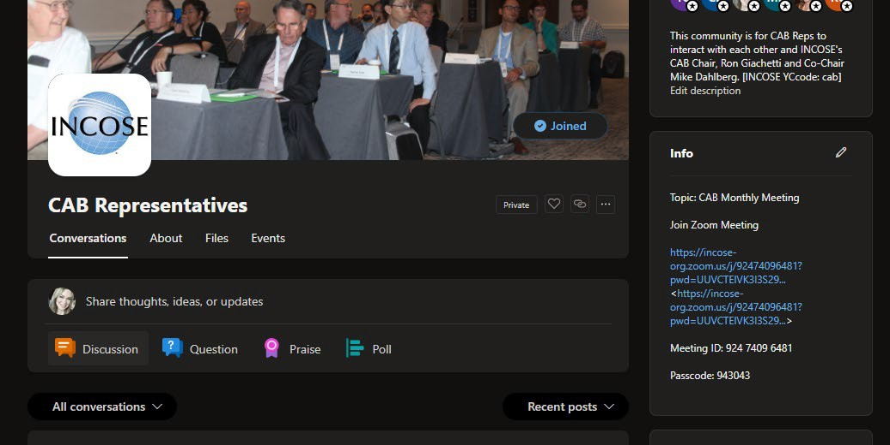
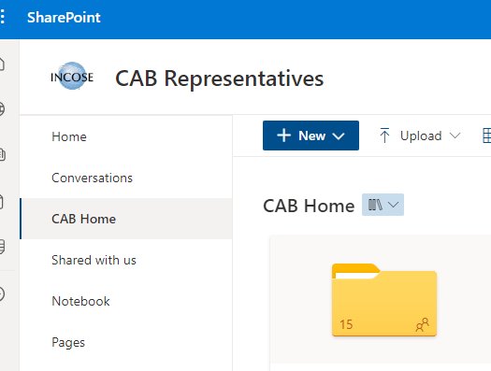

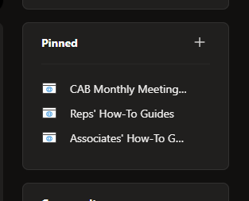
Online CAB Rep Resources – Viva Engage
Monthly Zoom Meeting Info
Directly below the Zoom Info, you will see the “Pinned” items box…
You can post on this page to interact with the CAB Rep Community.
Clicking on any of these “Pinned” items will open another browser
Clicking on any of these “Pinned” items will open another browser
window in SharePoint and you will be able to access all available files.
window in SharePoint and you will be able to access all available files.

Slide 32
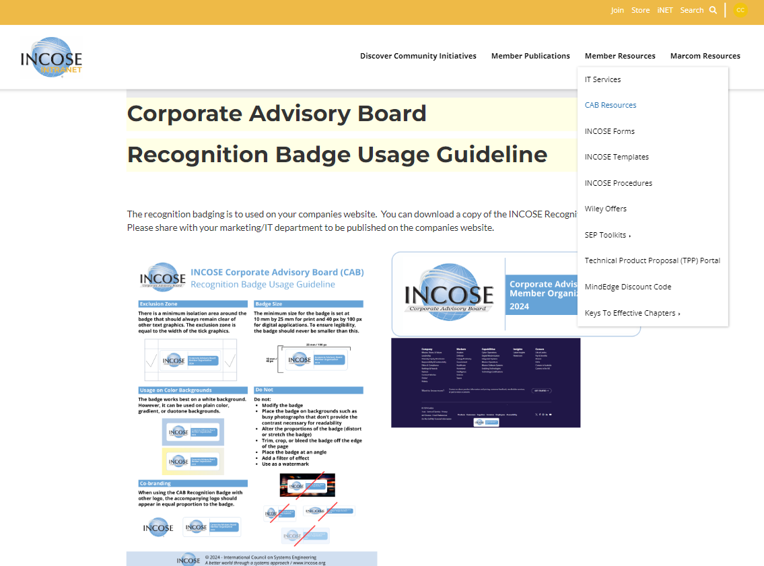
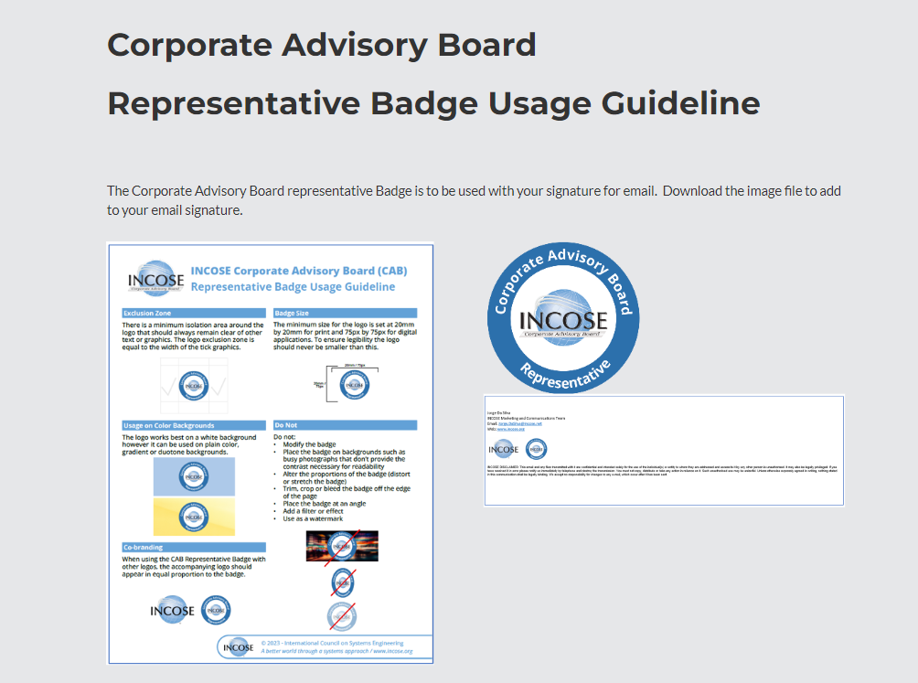
CAB Rep iNet Resources
Here you can find the CAB Recognition badge and CAB Rep badge and guidelines for use on your companies website and your email signature. Forward the Recognition Badge file and instructions to your Marketing/IT contact to add to the companies website.

Slide 33
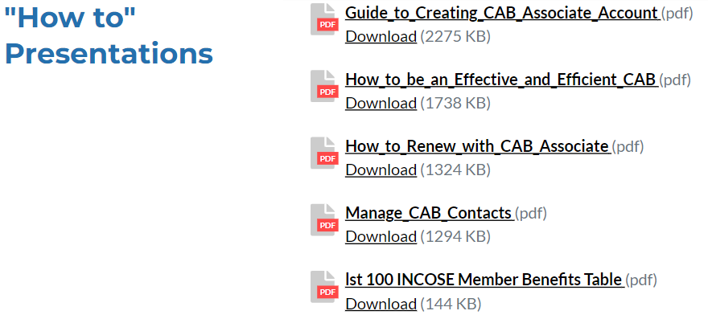
CAB Rep iNet Resources

Slide 34
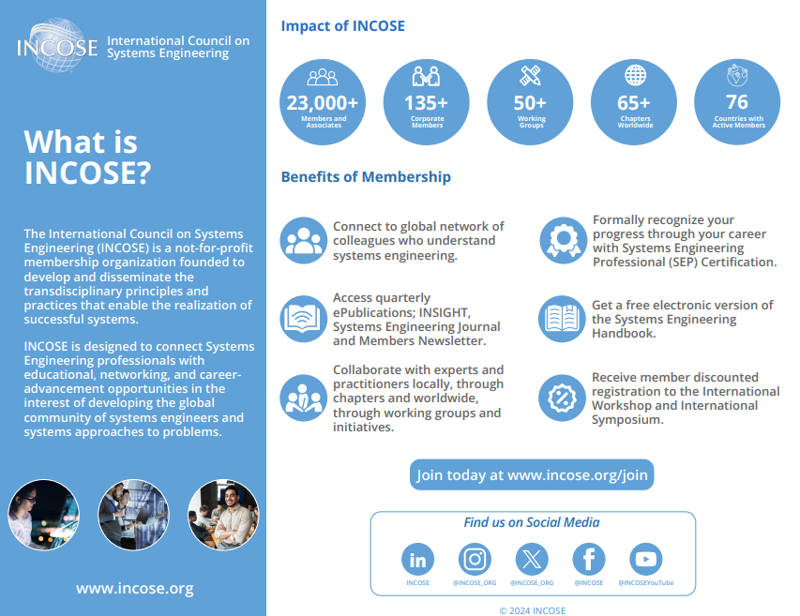
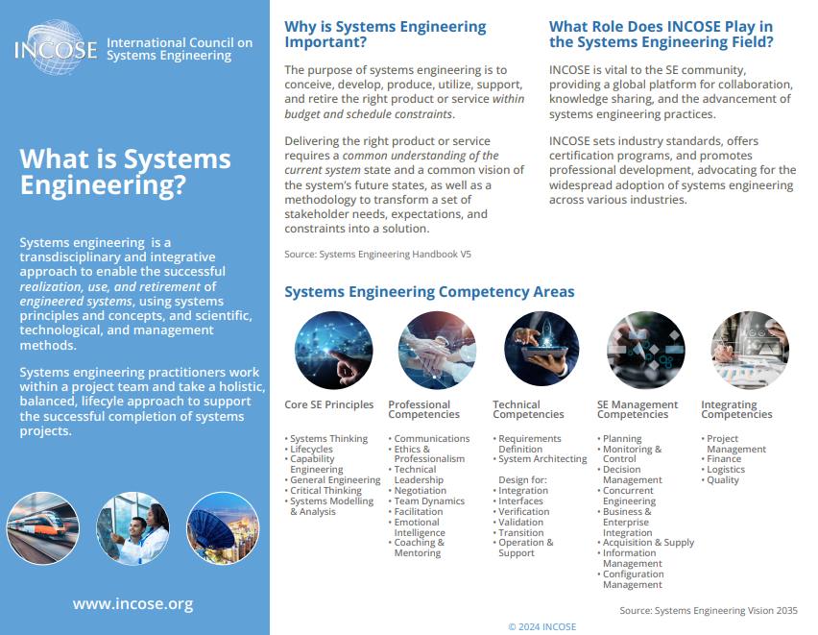
CAB Rep iNet Resources
CAB Brochure Flyers – These flyers can be shared with your CAB Associates.

Slide 35
Online CAB Rep Resources - iNet
The INCOSE iNet is available to access CAB resources
– Unlike Viva Engage, CAB Associates can access the iNet by logging into www.incose.org (the same way they would access the Store).
https://www.incose.org/inet/member-resources/cab-resources
There are additional resources that are available to all Members and Associates.
Most of these resources are linked from the public pages on www.incose.org (see next slide)

Slide 36
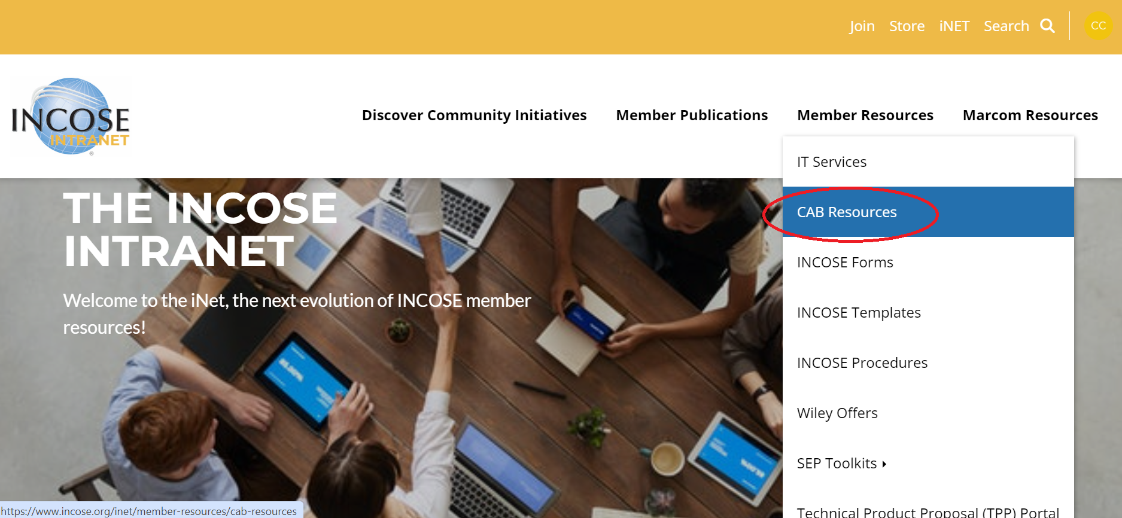
How to find CAB resources
Log in to your INCOSE account and go to iNet for your CAB resources.
Under Member Resources select from the dropdown menu CAB Resources
Only CAB Representatives have access to this resource

Slide 37
CAB resources on iNet
The "How to” presentations can be found on iNet under Member resources/CAB resources

Slide 38
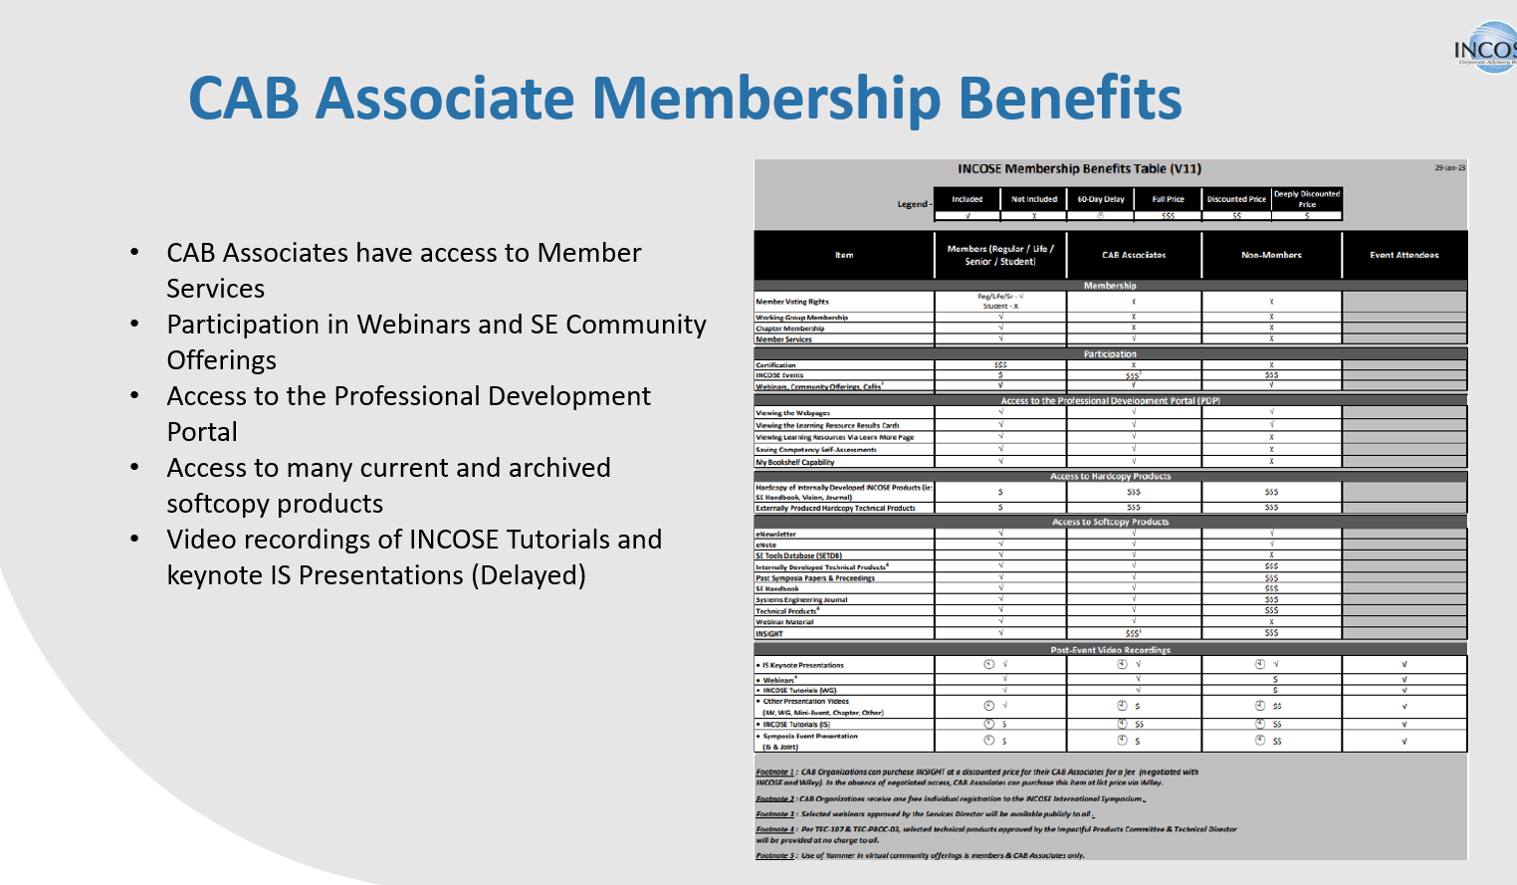

Slide 39
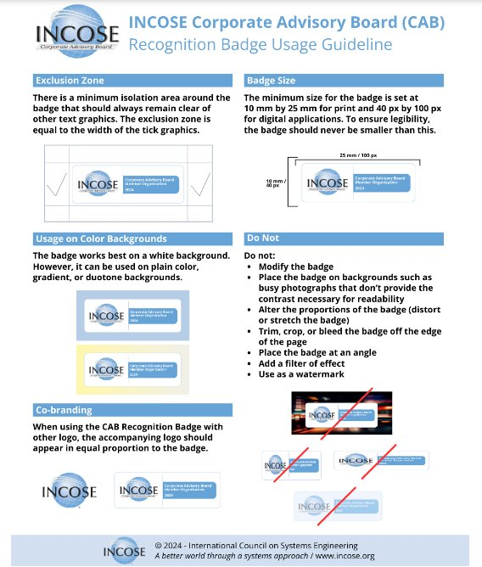


Corporate Advisory Board Recognition Badge Usage Guideline
The recognition badging is to used on your companies website. You can download a copy of the INCOSE Recognition Badge. Please share with your marketing/IT department to be published on the companies website.

Slide 40
CAB Membership Fees
INITIATION FEE (first year only) / ANNUAL MEMBERSHIP FEE
Organization type | Annual fee * | First Year Initiation Fee (1x Only) | Number of CAB Associate Accounts Included
Academic Organization | $5,225.00 | $- | 300
Very small Organization | $2,750.00 | $- | 20
Small Organization | $5,225.00 | $5,500.00 | 150
Medium Organization | $6,600.00 | $6,500.00 | 200
Large Organization | $8,000.00 | $7,500.00 | 300
Additional CAB Associate Accounts |  |  | $35/person/year

Slide 41
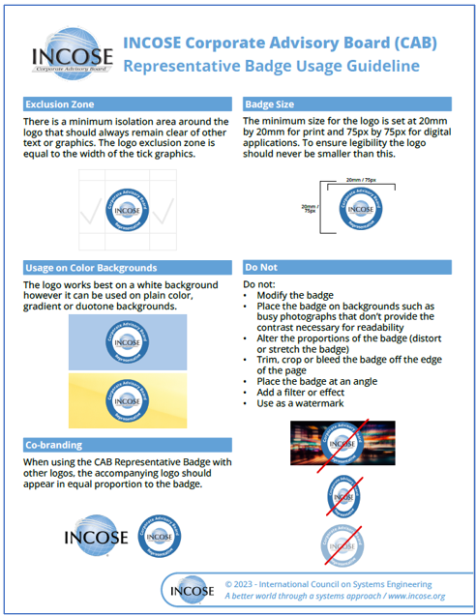

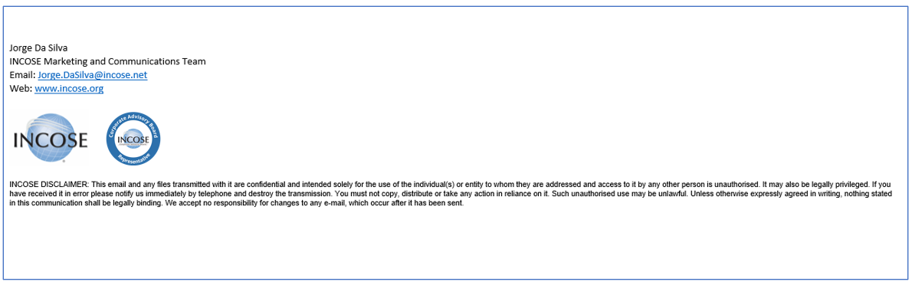
Corporate Advisory Board Representative Badge
The Corporate Advisory Board representative badge is to be used with your signature for email. Download the image file to add to your email signature.

Slide 42
CAB Associate Overview
Employees / Students can gain access to some of INCOSE’s state-of-the art products & publications through these accounts.
Becoming a CAB Associate is easy!
  You can find the Associates’ How-To Guides in the Viva Engage Community & SharePoint Site and provide to the individuals. (Note: These links will NOT work for anyone but the CAB Rep, you will have to download to provide.)
  Or they can send an email to helpdesk@incose.net for further assistance
Managing your organization’s CAB Associate Account List
  Download the Manage CAB Associate Account Guide
  You can find the Representatives’ How-To Guides in the Viva Engage Community & SharePoint Site and provide to the individuals.
  Request assistance from helpdesk@incose.net

