Slide 1

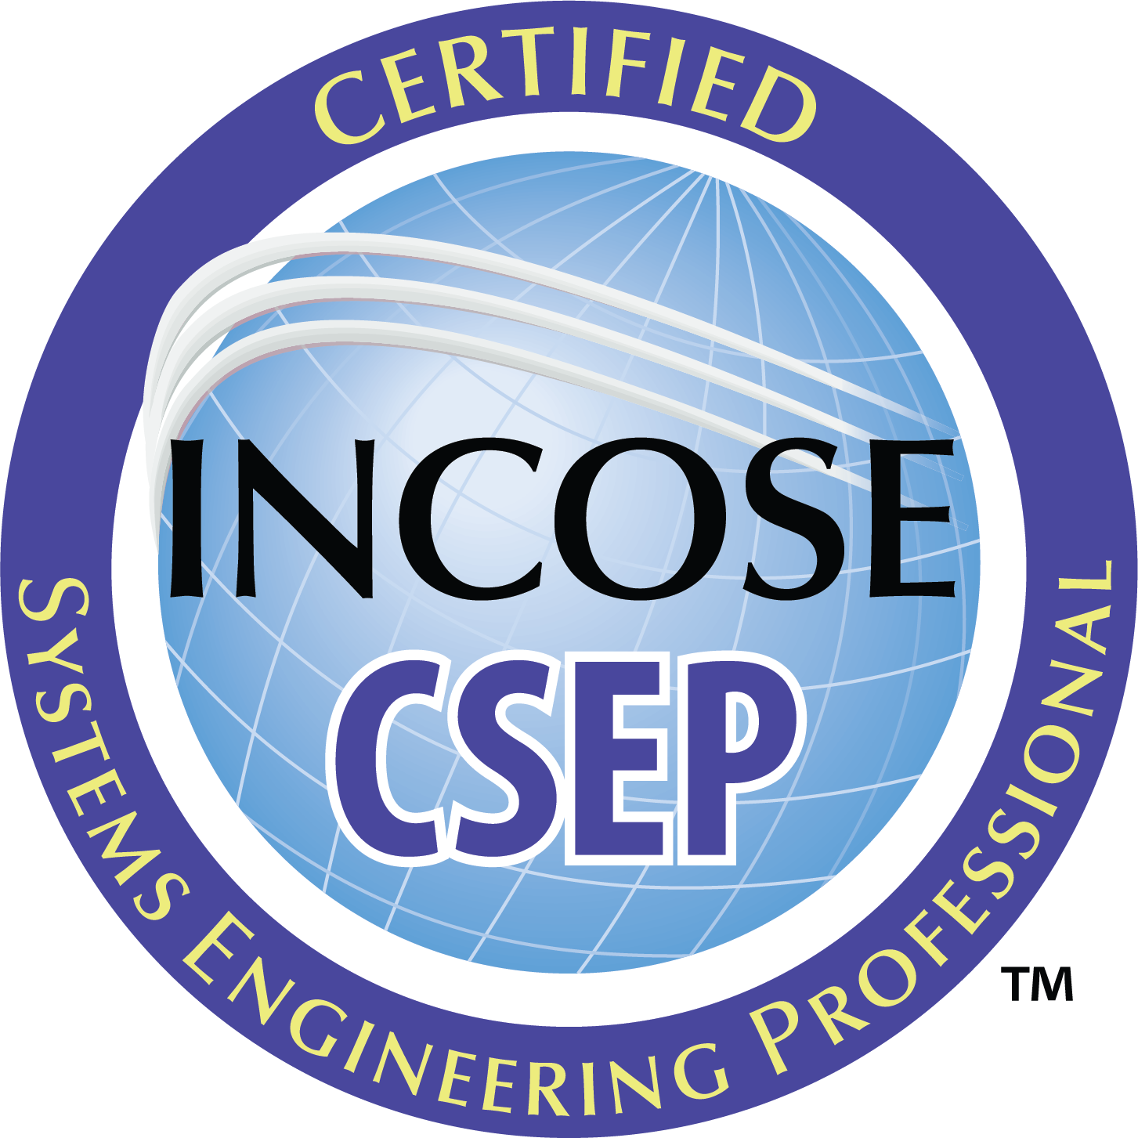


Applying for CSEP

Slide 2


incose.org | 2

Slide 3
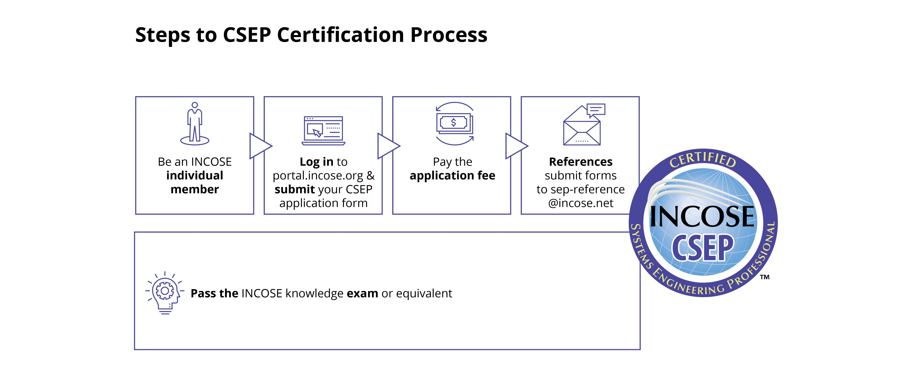
SEP Certification Process

Slide 4
CSEP Requirements
Active Individual Membership
Application Fee: $350
Knowledge Requirement (Two Options)
  Passing the Knowledge exam:
    $30 - $80 USD per attempt
    https://www.incose.org/systems-engineering-certification/taking-the-exam
  Pass approved Equivalency Program
    https://www.incose.org/systems-engineering-certification/university-organizational-agreements
Experience Requirement
  To achieve the desired depth and breadth in the minimum 5 years of SE experience, the CSEP candidate must have at least 1 year or greater increments in at least 3 or more of the 14 systems engineering experience areas.

Slide 5
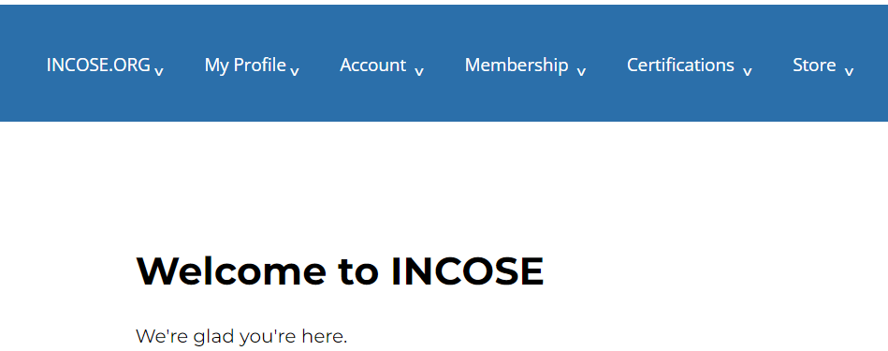
Step 1
1. Log in to www.incose.org. From the banner menu, click on “Certifications.”

Slide 6
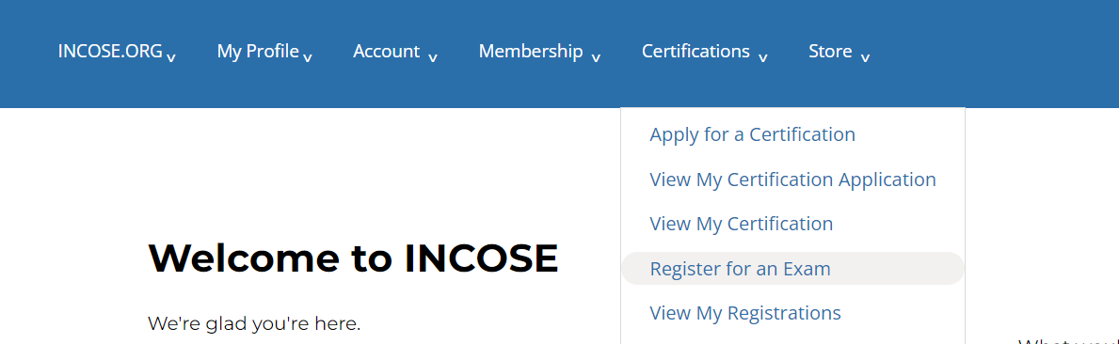
Step 2
1. Click on “Apply for a Certification.”

Slide 7
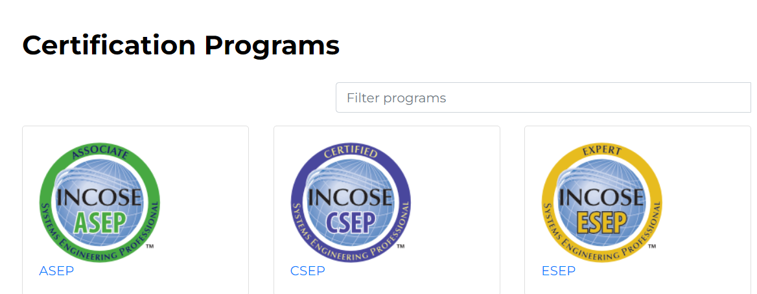
Step 3
3. Click on the hyperlink the SEP Program.

Slide 8
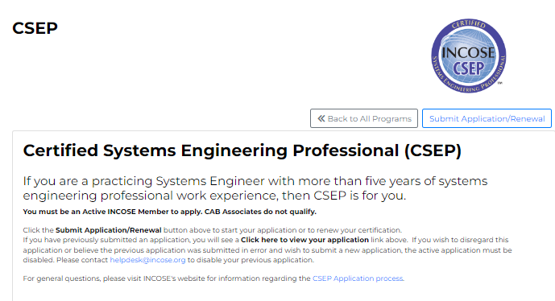
Step 4
4. Click on the “Submit Application/Renewal” button.

Slide 9
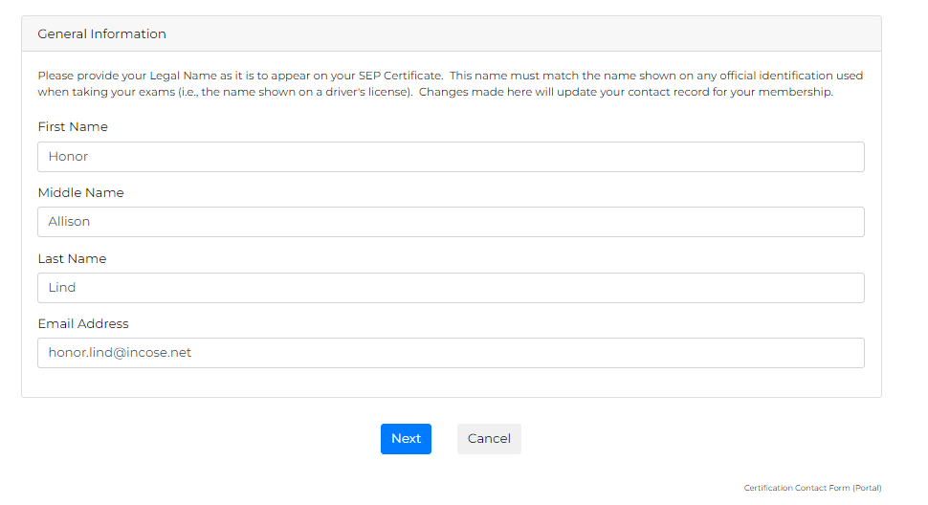
Step 5
5. Verify your information that auto-populates. Click “Next.”

Slide 10
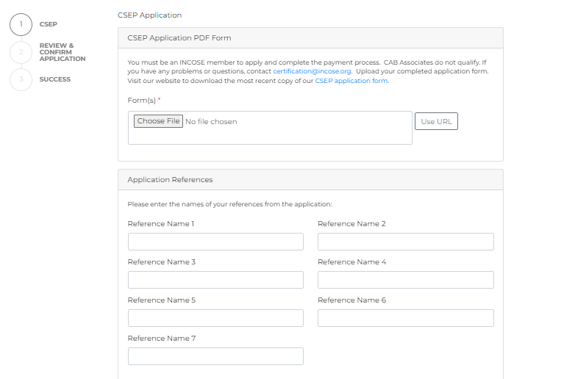
Step 6
6. Upload Form 1. Enter your references names (must match references listed on Form 1).

Slide 11
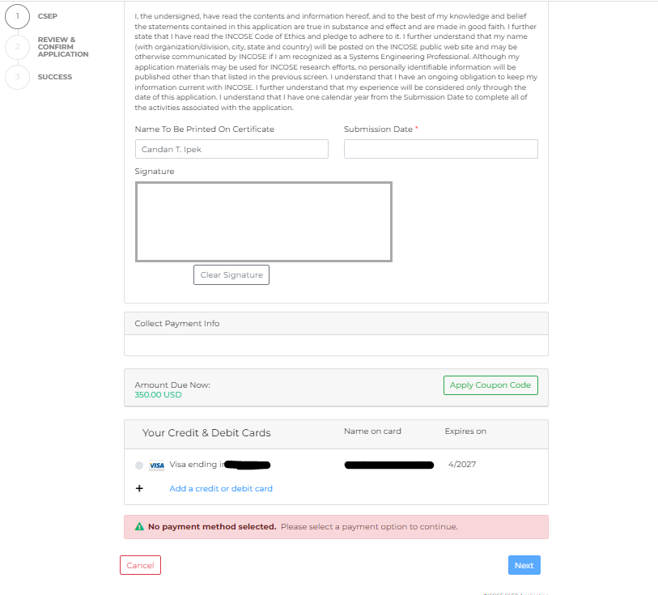
Step 6 - Continued
6. Continued… Read and sign the affidavit. Enter billing information and click next.

Slide 12

Thank you

Slide 13

Any Questions?
Certification Office
certification@incose.net
For more information visit
www.incose.org/certification

Slide 14
INCOSE Copyright Notice
Copyright © 2006-2023 by INCOSE, subject to the following restrictions:
  Author Use. Authors have full rights to use their contributions in a totally unfettered way. Abstraction is permitted with credit to the source.
  INCOSE Use. Permission to reproduce and use this document or parts thereof by members of INCOSE and to prepare derivative works from this document for INCOSE use is granted, with attribution to INCOSE and the original author(s) where practical, provided this copyright notice is included with all reproductions and derivative works.
  External Use. This document may be shared or distributed to non-INCOSE third parties. Requests for permission to reproduce this document in whole are granted, provided it is not altered in any way. Requests for permission to prepare derivative works of this document for external and/or commercial use will be denied unless covered by other formal agreements with INCOSE. Copying, scanning, retyping, or any other form of reproduction of the content of whole pages or source documents is prohibited except as approved by the INCOSE Central Office, 7670 Opportunity Rd #220, San Diego, CA 92111.
  Electronic Version Use. Any electronic version of this document is to be used for personal use only and is not to be placed on a non-INCOSE sponsored server for general use. Any additional use of these materials must have written approval from INCOSE Central.
  Permissions. INCOSE has granted permission to member companies of the INCOSE Corporate Advisory Board to post and use this document internally, subject to the external use restriction.
  Technical Data. This data was prepared by INCOSE for information only. It has been released by INCOSE as Technical Data. It is subject to change without notice and may not be referred to as an INCOSE Technical Product.
  This briefing was created from information from various INCOSE sources as indicated in the Notes section of this slide. Send comments to certification@incose.org.

