Slide 1
Based on a Presentation by Renee Steinwand Applying for ESEP

Slide 2
Motivation
Already a CSEP?
Use your application!
Never renew again!
Get a cool pin, and add to your signature block
Hang out with other ESEPs
Be a role model and mentor

Slide 3
SEP Certification Process

Slide 4
Before we get started….
Start with the Certification website
https://www.incose.org/systems-engineering-certification/becoming-certified
CSEP to ESEP
Number of years of experience - 20
References – 3 required
Fee $$$
What are the primary differences between CSEP and ESEP applications?
Accomplished and recognized leader in systems engineering, assessed via application and oral interview
Experience documented in at least 6 SE areas (of the 14)
References needed for 10 years for all ESEP applicants

Slide 5
Overview – Steps to Apply
Do I qualify?
Download the forms – 41 and 42, 4a and 4b
References
Identify references who are familiar with or are SEPs
Reach out to them so they know the process and what is expected of the process
4. Develop Application - Find your old application (CSEP)
Determine which SE areas you identified in your original application
Determine which SE areas to focus on in this application
Use your current resume
Determine difference’s
Update experience areas
5. Professional Development & Contribution to SE Profession

Slide 6
Step 1 – Do I qualify?
Leadership​ | Experience​ | Education​ | References​ | Knowledge​
Accomplished and recognized leader in systems engineer, assessed via application and oral interview​ ​ | Minimum 25 years (20 if CSEP) SE experience​ (see SE Experience area list below)​ Minimum 5 years of professional development credit​ | Qualifying Degree​ (can be augmented with additional years of experience without a qualifying degree)​ | 3 references (cumulative coverage of at least 10 years of systems engineering experience) participate in phone interview, if required | Not directly measured​
Booz Allen – SE Instructor, Systems Engineer, Certification Coordinator, Proposal Author​ INCOSE – Chapter, Western Region, Americas Sector​ | 38 years experience​ | Bachelors in Mathematics, Masters in Aerospace Engineering​ | Tony Williams (ESEP)​ Kevin Weinstein (CSEP)​ Michael Johnston (CSEP), VP​ | N/A (Upgrading from CSEP)​
Renee's Answers

Slide 7
Step 2 – Forms
https://www.incose.org/systems-engineering-certification/certification/forms
Download the forms – download, then open in Adobe Acrobat
41 – Individual Application form
42 – Instructions for completing form 41
4a – Instructions for references
4b - Reference for CSEP ESEP
CSEP-ESEP Reference Example
Review the forms
Determine challenges for the application and reference process
Contact references and obtain commitment (next slide)
4a – Instructions for references – Qualifications:
Indicate if CSEP, ESEP, or Fellow
Identify the time period during which you had personal knowledge of the applicant’s SE experience. Applicant must provide references to cover a minimum time period (for ESEP, 10 years)
4b - Reference knowledge of applicant
Provide detailed, non-perfunctory, textual account of the applicant’s systems engineering activities, functions, outcomes, work products, tasks, and experience based on your personal knowledge

Slide 8
Step 3 – Select References
Qualifications
Supervisor or associate fellow worker who is equal or at a higher level in abilities and qualifications (SE) and can attest to the applicant’s SE knowledge and past experience in successfully performing SE tasks
At least 1 reference should be a current or former supervisor
All references must report only on experience about which they have first-hand knowledge, performed during a time when they knew the applicant.
Self employed – find a colleague who has an SE background who can vouch for your experience (INCOSE ?)
Slow references are the primary cause of delay in application processing

Slide 9
Reference Forms (4a)
4a – Instructions to References
ESEP References confirm the applicant’s experience
ESEPs are leaders in the field of systems engineering, with a proven history of leading challenging projects
References need:
Description of systems engineering experience to qualify you as a reference
Information about the applicant’s experience and capabilities to qualify him/her as an ESEP
Identify time period for each reference’s knowledge of applicant’s SE experience
Describe business connection with the applicant during this period
If the reference is a CSEP, ESEP, or Fellow, they do not need to provide detailed information in the Reference’s Qualifications section
Reference’s Knowledge of Applicant – Copy this information from your application, for the reference to verify your SE work

Slide 10
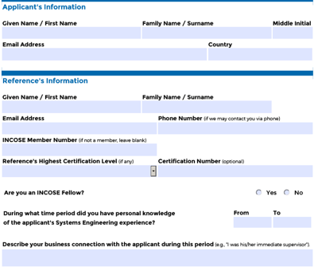
Reference Form (4b)
Ensure all required years are identified
CSEP, ESEP, or Fellow - not required
Business connection

Slide 11
Step 4 Individual Application Form
Sections 1, 2, 3, 4 – self explanatory
Section 5 – Experience
Reverse chronological order
Dates (from/to month & year)
Immediate supervisor
Title/position and reference for each work experience
Work experience positions on form <> positions at a job; can combine many job titles into single position
Depth and breadth requirement (2 years or > in at least 6 SE areas)
Form limits you to 7 positions (or submit a second application for additional)
Caution: do not “double” count work

Slide 12
Step 4
SE Work Area​ | Total Months​
Requirements Engineering​ | 79​
Risk and Opportunity​ | 6​
Baseline Control​ | 13​
Technical Planning​ | 38​
Technical Effort Assessment​ | 80​
Architecture/Design Development​ | 34​
Qualification, Verification, and Validation​ | 12​
Process Definition​ | 3​
Tool Support​ | 0​
Training​ | 30​
Systems Integration​ | 24​
Quality Assurance​ | 0​
Specialty Engineering​ | 0​
Other​ | 0​
Find your old application (CSEP)
Determine which SE areas you identified in your original application
Mine are different than current areas

Slide 13
Step 4 (continued)
SE Work Area (old)​ | SE Work Area (current)​
Requirements Engineering​ | Requirements Engineering​
Risk and Opportunity​ | Risk and Opportunity Management​
Baseline Control​ | Organizational Project Enabling Activities​
Technical Planning​ | Technical Planning​
Technical Effort Assessment​ | Technical Monitoring and Control​
Architecture/Design Development​ | Architecture/Design Development​
Qualification, Verification, and Validation​ | Verification and Validation​
Process Definition​ | Lifecycle Process Definition and Management​
Tool Support​ | N/A​
Training​ | N/A​
Systems Integration​ | Systems Integration​
Quality Assurance​ | Technical Monitoring and Control​
Specialty Engineering​ | Specialty Engineering (see list)​
Other​ | Other​
​ | System and Decision Analysis​
​ | System Operation and Maintenance​
​ | Acquisition and Supply​
​ | Information and Configuration Management​

Slide 14
Extract info from current resume
Use your current resume
Determine difference’s
My application was submitted in 2010, so I’m looking at the last 10 years in my resume to see where I can add experience to my current application
Map previous experience to current SE areas
Renee's Situation
Certification at the expert level (ESEP) will indicate that the individual has a balance between the depth and breadth of SE experience having performed in many, but not all, of the SE experience areas. To achieve the desired depth and breadth in the minimum 25/20 years of SE experience, the ESEP candidate must have at least 2 years or greater increments in at least 6 of the 14 systems engineering experience areas listed above. The acceptability of experience distributions outside this guideline is subject to the decision of the Certification Program Office​
Requirements Engineering​
Architecture Design/Development​
Technical Planning
Systems Integration​
Verification and Validation​
Technical Monitoring and Control

Slide 15
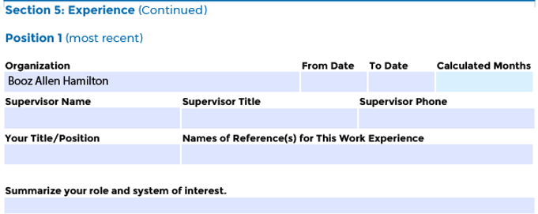
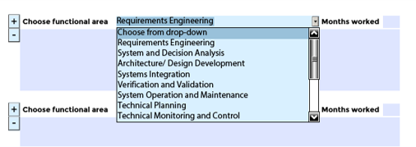
Experience
Pay Attention

Slide 16
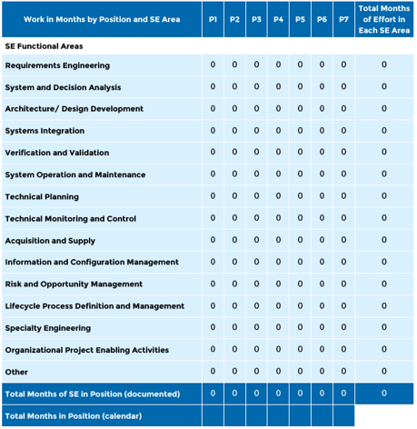
Experience - Summary Table
Print out this table or use spreadsheet to calculate your experience

Slide 17
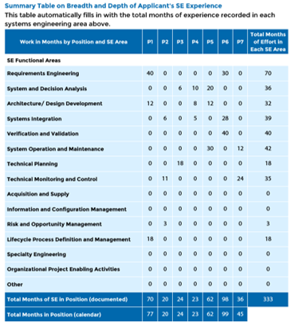
Experience - Populated
6 areas > 24 months

Slide 18
Step 5
Section 6 Professional Development and Contribution to SE Profession​
Demonstrate a minimum of 5 years of post-Bachelor’s leadership and continued professional development contributions​
Product Development or Technical Service Leadership​
Chief Engineer or Development Team Lead – 1 year for each year in a leadership position (No Limit)​
Technical Society Leadership as elected officer or appointed committee chair – ½ year for each year of service (No limit)​
Advanced Academics – Master’s degree in technical field = 1 year​
Ph.D. in a technical field – 2 years if separate credit for Master’s degree; 3 years if separate credit not given for Master’s degree​
SE graduate level teaching as a secondary job – max of 3 years​
SE-related publications and SE-related honors or other examples of sharing knowledge and having an influence​
How has the applicant moved the needle to help others become better Systems Engineers?
Outcome-based – how did actions improve systems engineers?
Focus on technical tasks, not administrative

Slide 19
Step 5
Section 6 Professional Development and Contribution to SE Profession​
Renee's Answers
INCOSE Colorado Front Range Vice President
INCOSE Colorado Front Range President
INCOSE America’s Sector Western Region Assistant Director
1
Masters of Engineering in Space Operations

Slide 20
Step 5
Section 6 Professional Development and Contribution to SE Profession​
Booz Allen Engineering and Science Functional Community

Slide 21
Sections 7 and 8
Affidavit by Applicant: Signature and Date​
Optional Information – Birth Year, Gender
Benjamin Franklin

Slide 22
Reference’s Information
Ask your reference to provide their INCOSE Member Number and Certification Number (if applicable)
Provide your reference with some information that will help get started

Slide 23
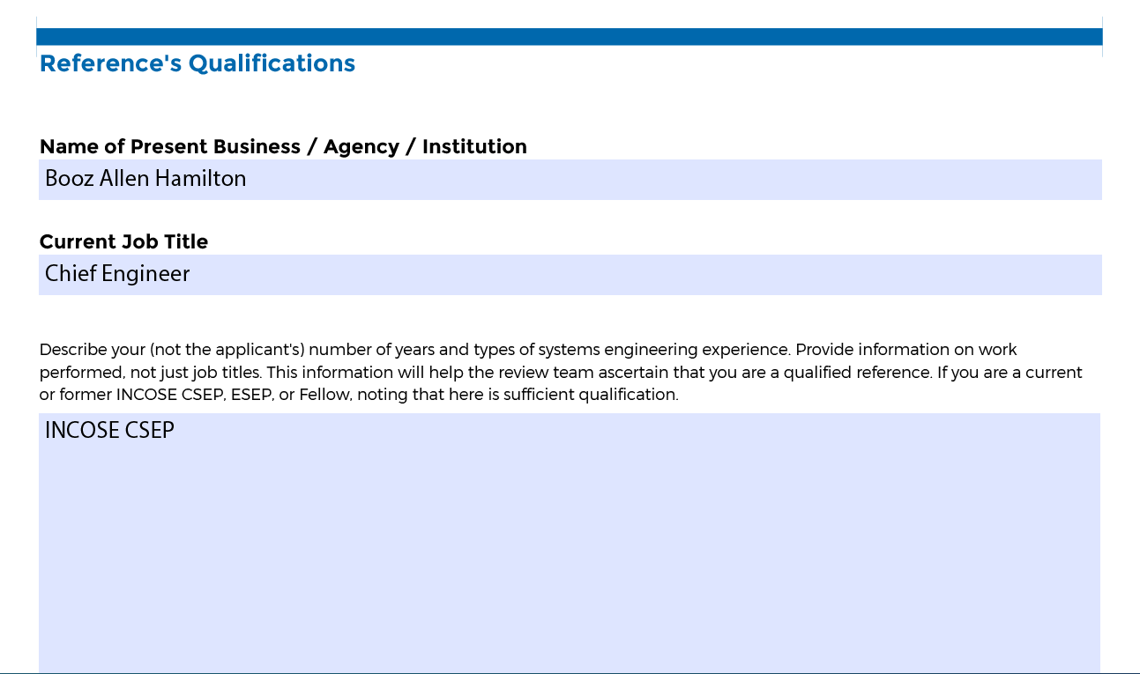
Reference’s Qualifications
If the reference is a current or former CSEP, ESEP, or Fellow, so state
Required, if reference is not a SEP or Fellow

Slide 24
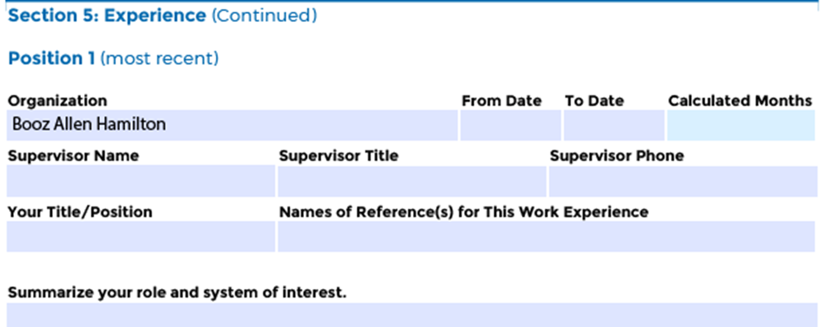
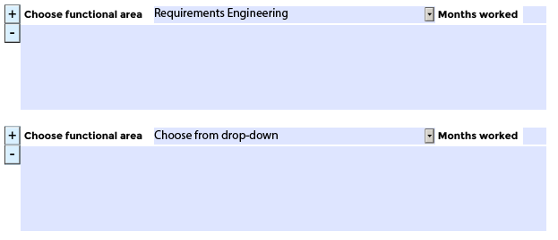
Copy relevant experience from Application Section 5
Copy the information that is relevant for each reference

Slide 25
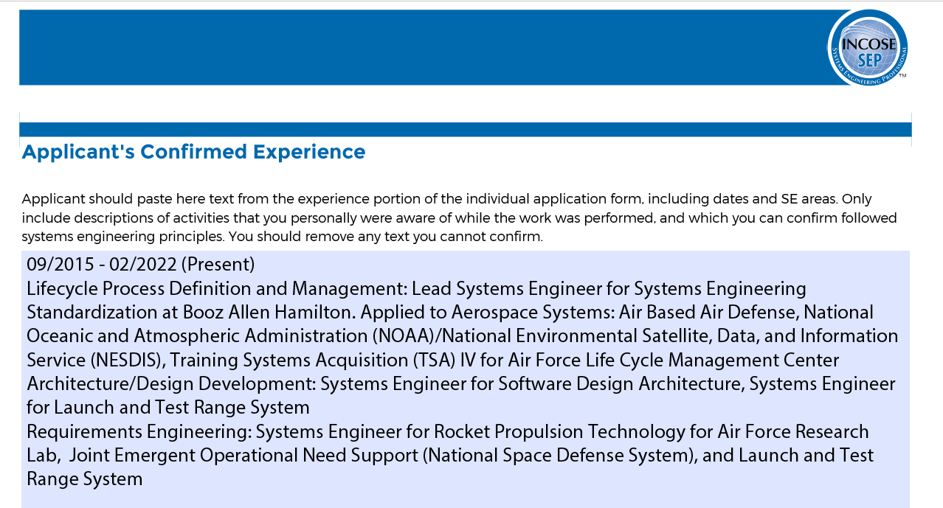
Paste into Reference Form
Renee's Answers
Paste into corresponding reference form

Slide 26
Reference’s Statement
Reference enters this information

Slide 27
Next Steps
Send reference form (filled out) and instructions for references​
Request return in 2 weeks​
Reference will email their completed form to sep-reference@incose.net ​
Follow up with reference to ensure submission in a timely manner​
Submit application​
Log in to INCOSE website to upload application through your member profile​
Pay fee - https://www.incose.org/systems-engineering-certification/about-the-certification-program ​
One year from date of application and payment to complete entire certification process​
All supporting documentation and information must be received​
Additional information, if requested, required within 3 months

Slide 28
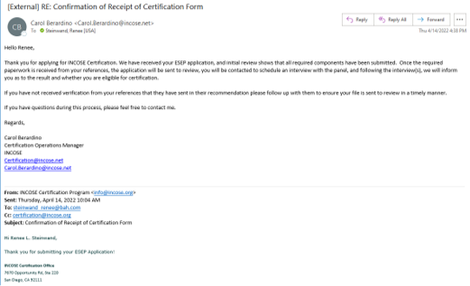
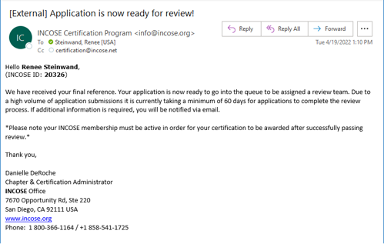
How do I know?

Slide 29
Oral Interview
Board of ESEPs will schedule an interview (virtual)​
Questions about your experience and leadership​
Have your application readily available

Slide 30
Thank you

Slide 31
Any Questions?
Courtney Wright for assisting with this presentation

Slide 32
Questions
How long?
If you carry your application around in your briefcase for 3 years, it does NOT work
Use your resume and the experience table (print)
Map your experience from your resume to the table
My application probably took me about 10 hours over the holidays to populate, review, and update
Do it in chunks
Get off the dime
What would help? A workshop? A Cohort?
Hardcopy forms?
You could do it on an airplane. Need uninterrupted time slots.
Ask someone to review it. I had 2 ESEPs and 1 CSEP review my application.
Recommendations – Ensure that you are showing the impact of your experience, products, and leadership

Slide 33
INCOSE Copyright Notice
Copyright © 2006-2023 by INCOSE, subject to the following restrictions:
Author Use. Authors have full rights to use their contributions in a totally unfettered way. Abstraction is permitted with credit to the source.
INCOSE Use. Permission to reproduce and use this document or parts thereof by members of INCOSE and to prepare derivative works from this document for INCOSE use is granted, with attribution to INCOSE and the original author(s) where practical, provided this copyright notice is included with all reproductions and derivative works.
External Use. This document may be shared or distributed to non-INCOSE third parties. Requests for permission to reproduce this document in whole are granted, provided it is not altered in any way. Requests for permission to prepare derivative works of this document for external and/or commercial use will be denied unless covered by other formal agreements with INCOSE. Copying, scanning, retyping, or any other form of reproduction of the content of whole pages or source documents is prohibited except as approved by the INCOSE Central Office, 7670 Opportunity Rd #220, San Diego, CA 92111.
Electronic Version Use. Any electronic version of this document is to be used for personal use only and is not to be placed on a non-INCOSE sponsored server for general use. Any additional use of these materials must have written approval from INCOSE Central.
Permissions. INCOSE has granted permission to member companies of the INCOSE Corporate Advisory Board to post and use this document internally, subject to the external use restriction.
Technical Data. This data was prepared by INCOSE for information only. It has been released by INCOSE as Technical Data. It is subject to change without notice and may not be referred to as an INCOSE Technical Product.
This briefing was created from information from various INCOSE sources as indicated in the Notes section of this slide. Send comments to certification@incose.org.

