Slide 1
How To: create account with no membership
Revised 7 April 2023

Slide 2
1. Log in to www.incose.org. Click “Join Us” in the top right corner.

Slide 3
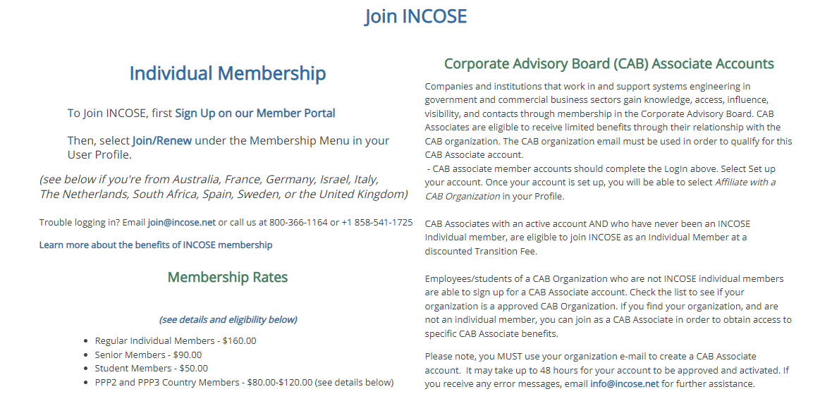
2. Click on “Sign Up on our Member Portal”

Slide 4
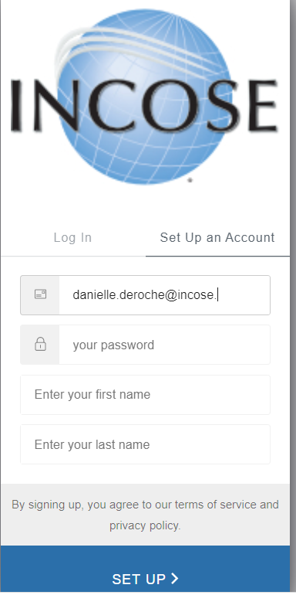
3. Select the tab for “Set up an account.” Enter your contact data. Click Set Up.

Slide 5
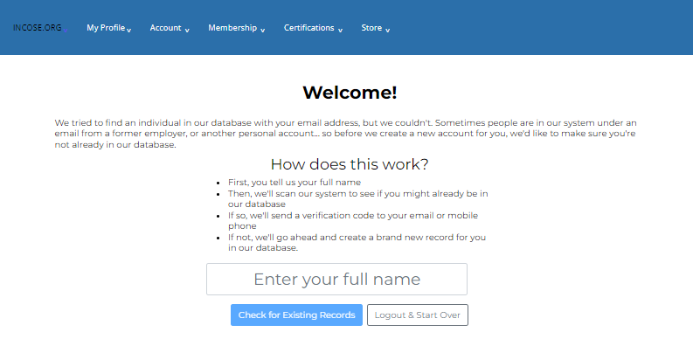
4. Enter your full name to check for duplicate accounts. Click “Check for Existing Records.”

Slide 6
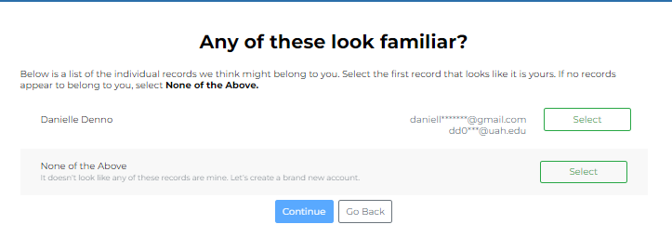
5. If none of the existing accounts belong to you, select “None of the Above.” Click Continue.

Slide 7
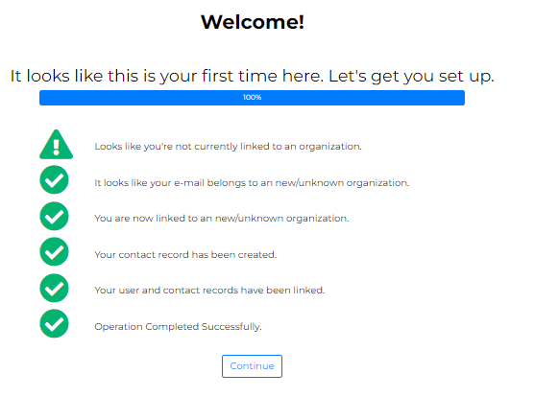
6. Click Continue

Slide 8
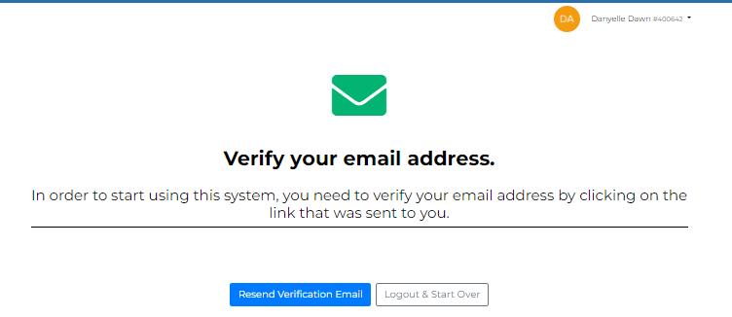
7. Your account has been created. Check your email for a verification email. You will not be able to log back in if you do not click on the link provided in your email
Note: Your account has been created. Your INCOSE ID will be in the top left corner, next to your name.

Slide 9
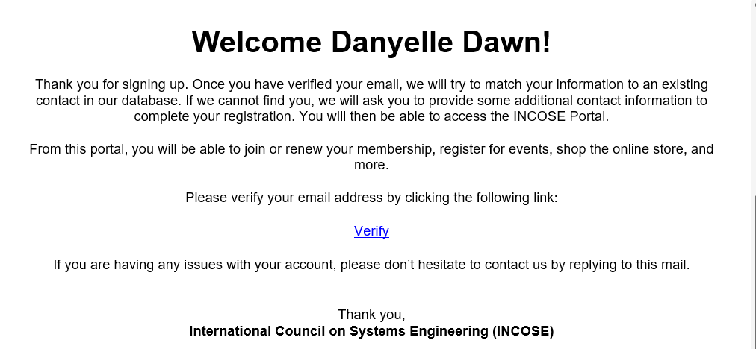
8. From your email, click on the “Verify” link. You will be prompted to log back in with the credentials you created in Step 3.

Slide 10
9. Enter contact information. Click Save.

