Slide 1
How to: Open INCOSE Forms
Revised 22 December 2021

Slide 2
Forms 1, 1A, 1B, & 4B
The following forms were embedded with XML, so that Adobe Pro would not be required to download the forms. In order to open the file, you cannot use a Files Explorer or Preview Application,, including a “Downloads” folder. These options cannot read the XML.
Form1 – CSEP Application
Form 1A – ASEP Application
Form 1B – DAU Streamlined Application for CSEP
Form 4B – CSEP or ESEP reference form

Slide 3
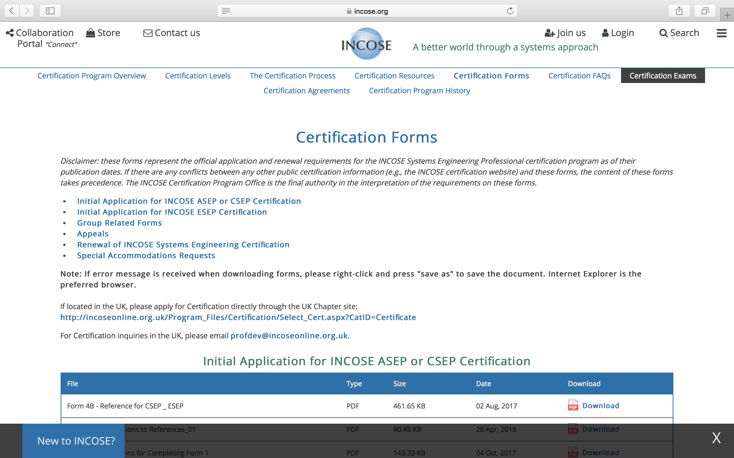
For PC Users:
1. Go to https://www.incose.org/systems-engineering-certification/certification-forms

Slide 4
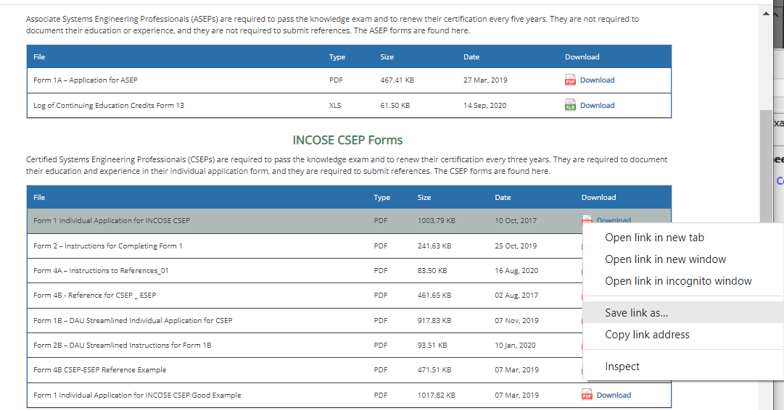
PC Users – Step 1
Right-click and press "save link as" to save the document to your computer.
Helpful tip:
Save the document to your Desktop for easy access. You can change the form name to “Your Last Name – Application Program.”
Ex: John Smith applying for CSEP would title his application “Smith – CSEP.”

Slide 5
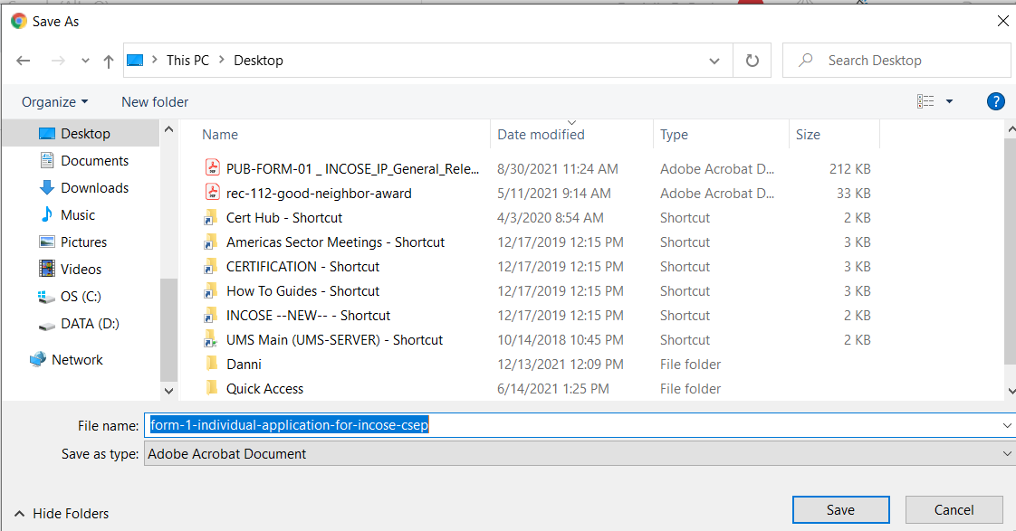
PC Users – Step 2
Save the document to your Desktop for easy access. You can change the form name to “Your Last Name – Application Program.”
Ex: John Smith applying for CSEP would title his application “Smith – CSEP.”

Slide 6
PC Users – Step 3
Once the form is saved to your computer, open the document from the file location, not a Files Explorer or Preview Application. The form has XML embedded so these options will not read the form.

Slide 7
For Mac Users:
1. Go to https://www.incose.org/systems-engineering-certification/certification-forms

Slide 8
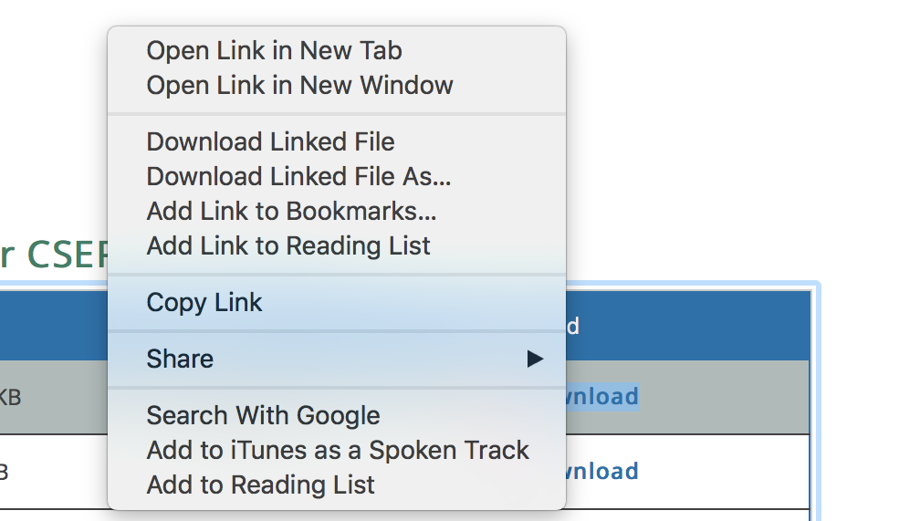
2. Press control (CTRL) key while clicking on the link to down load a form.

Slide 9
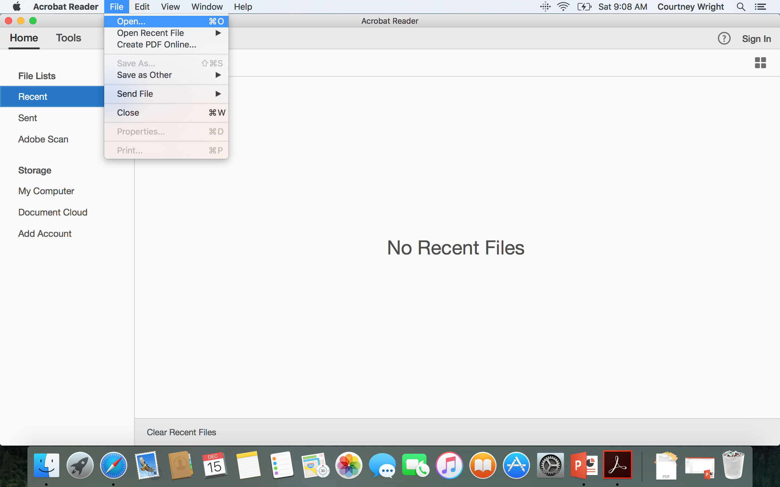
3. Open the Adobe Application. Then go to “File” and click “Open” in order to select which document you would like to open.
Please note “Previewer” on a Mac computer will not open the Adobe forms.

Slide 10
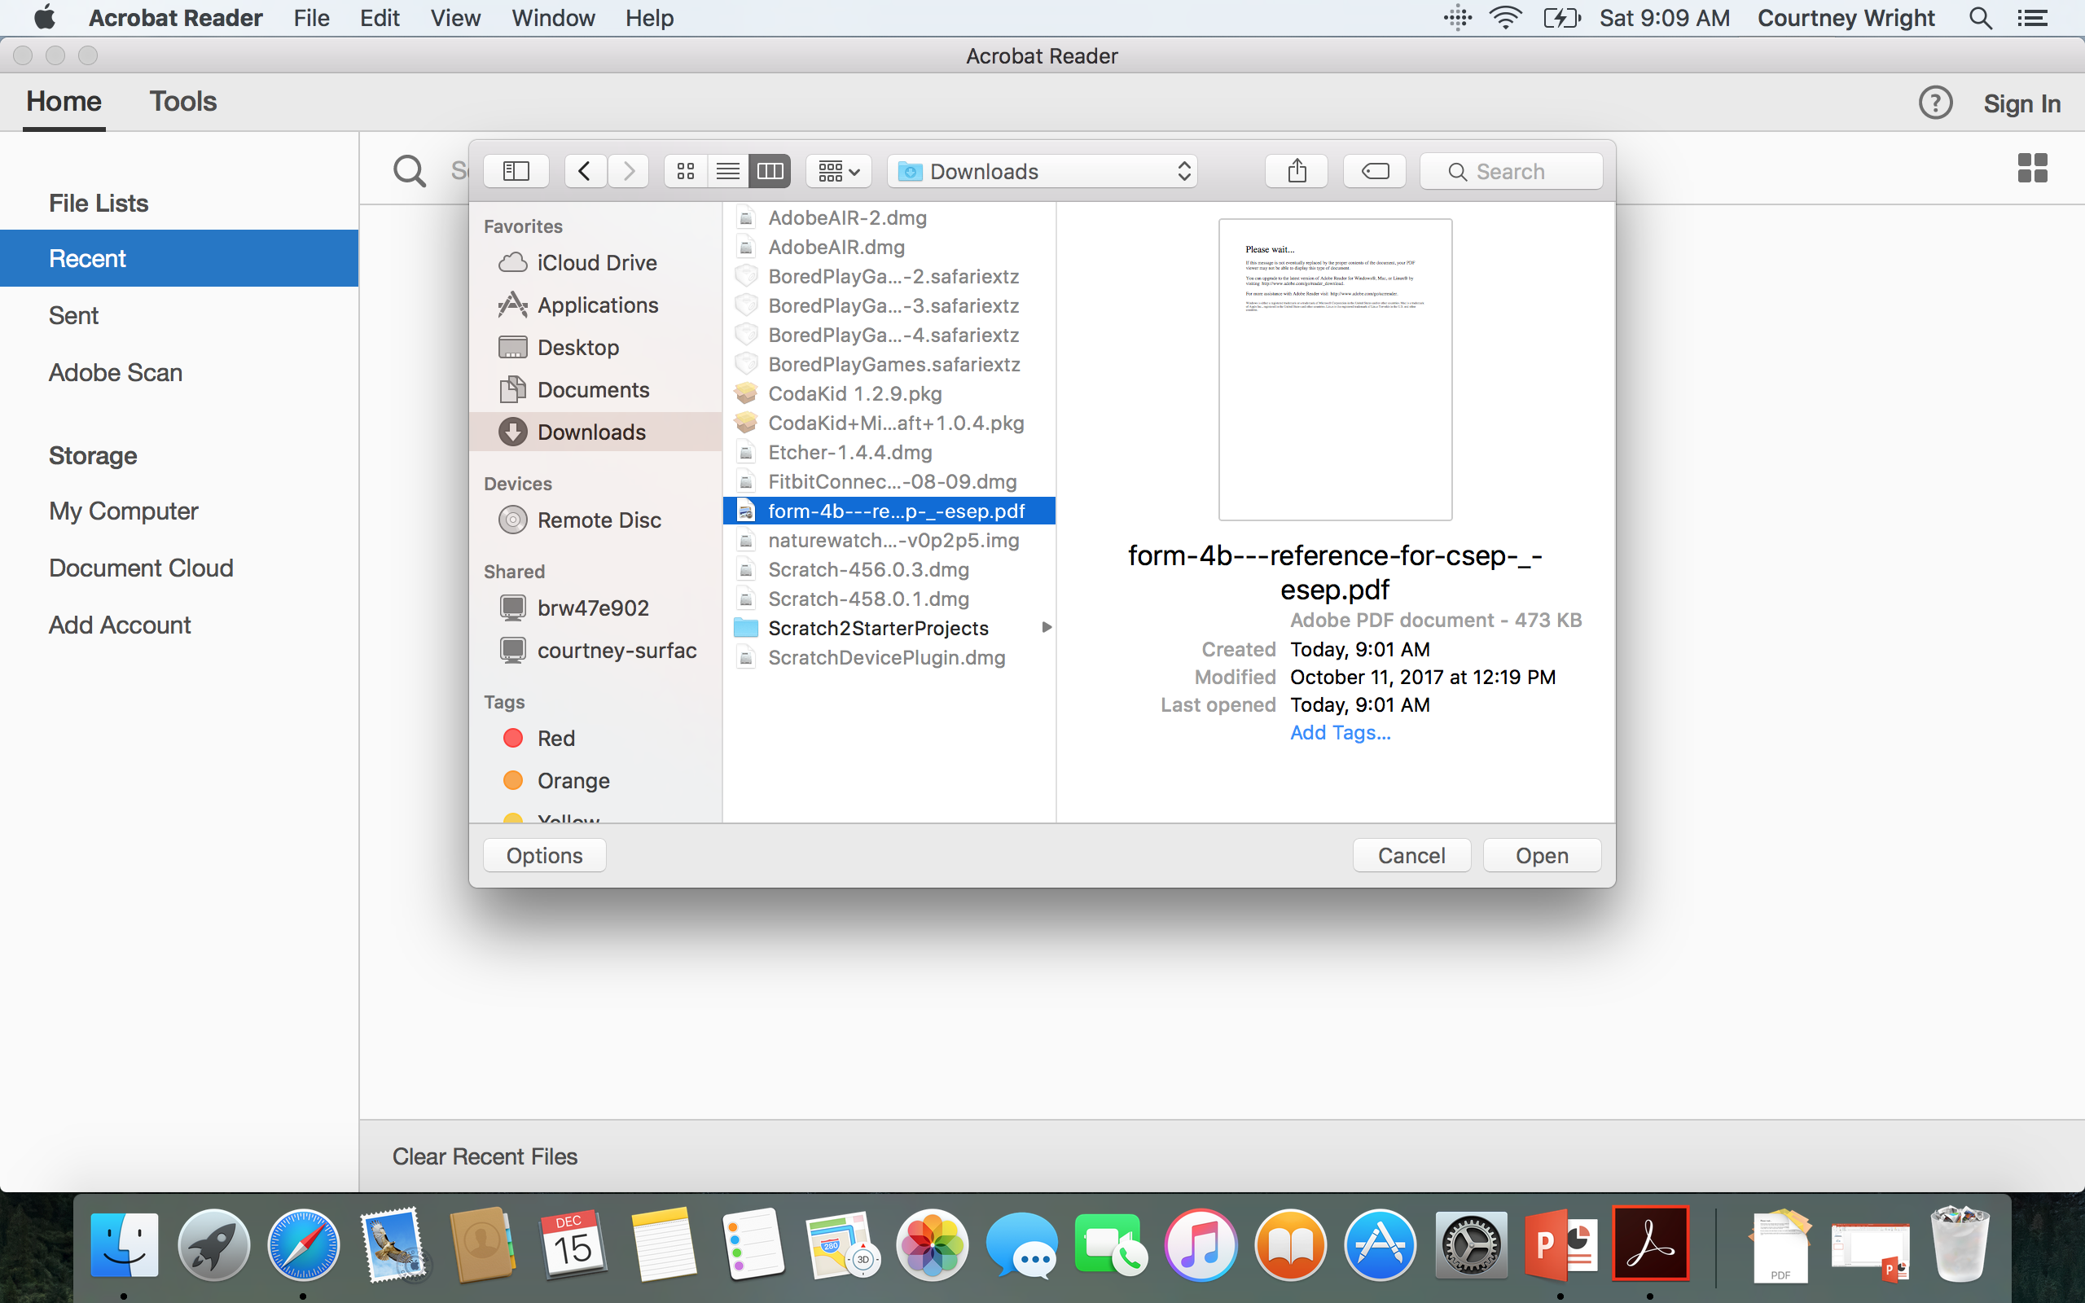

Slide 11
