Slide 1
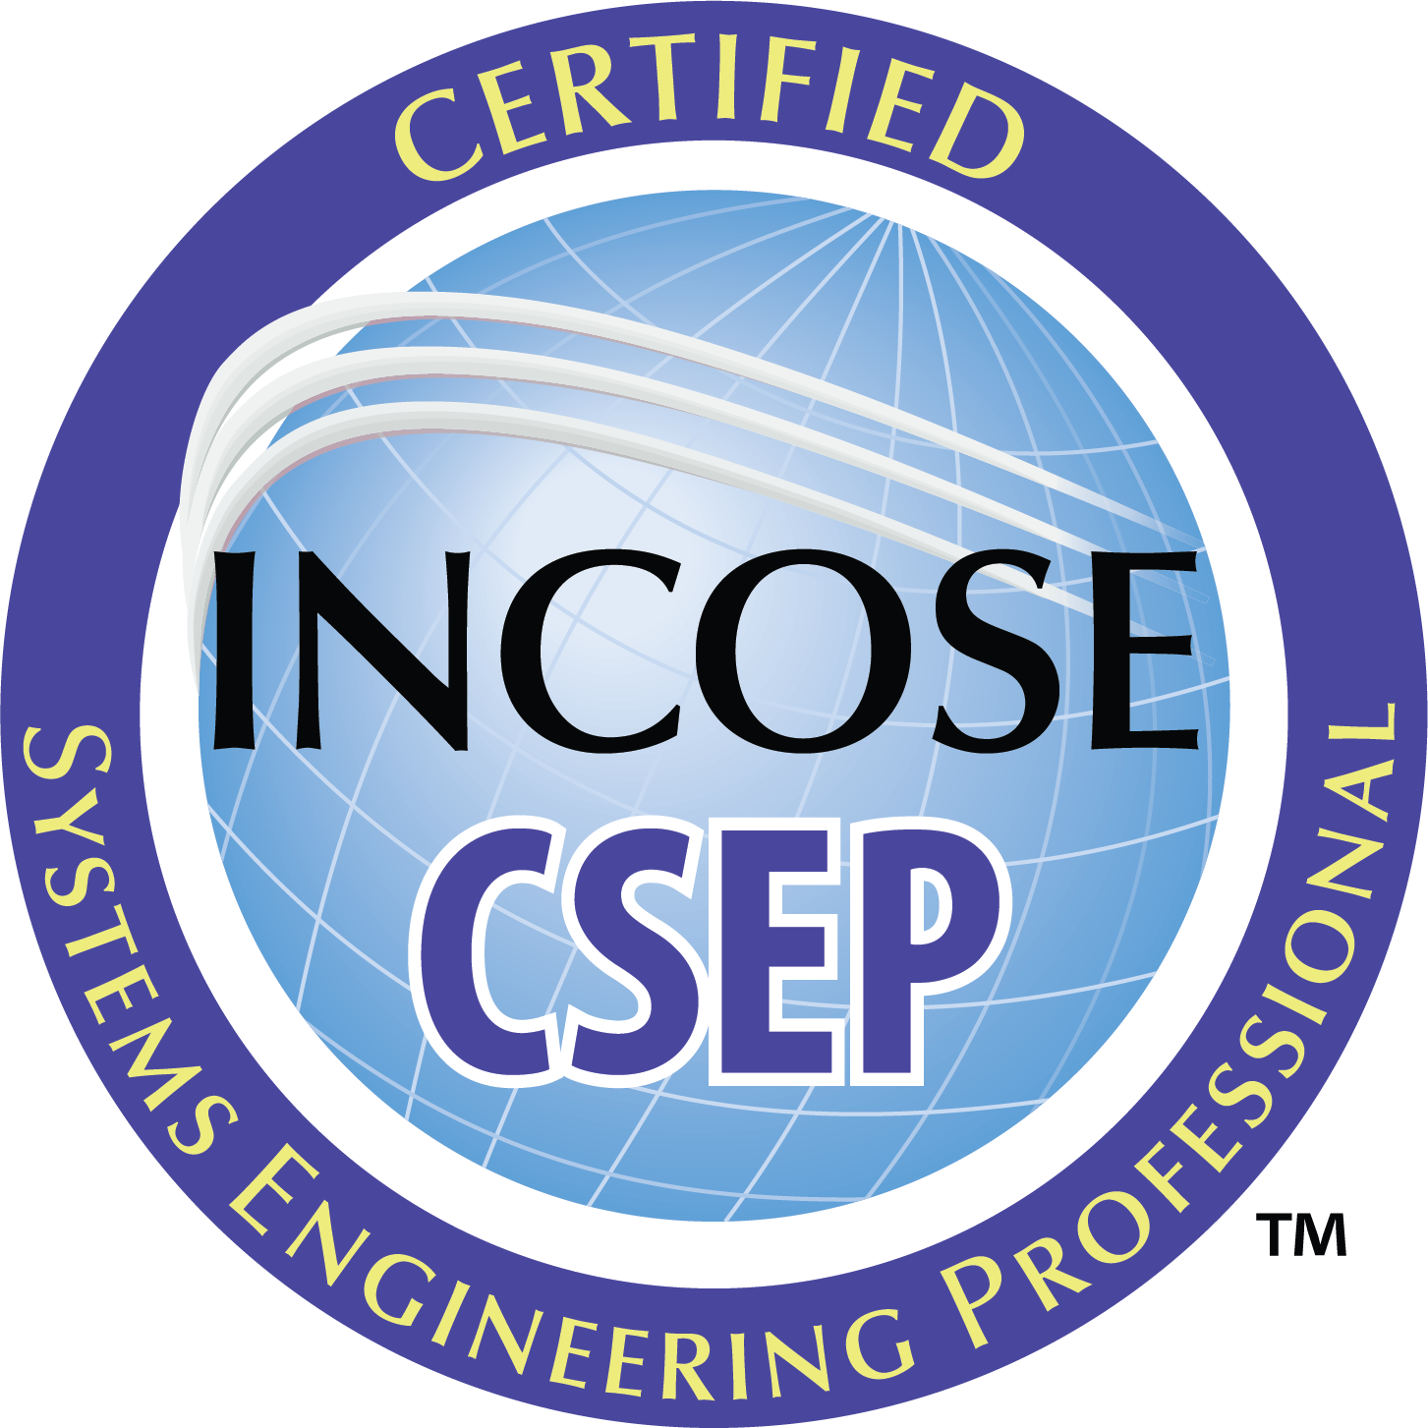
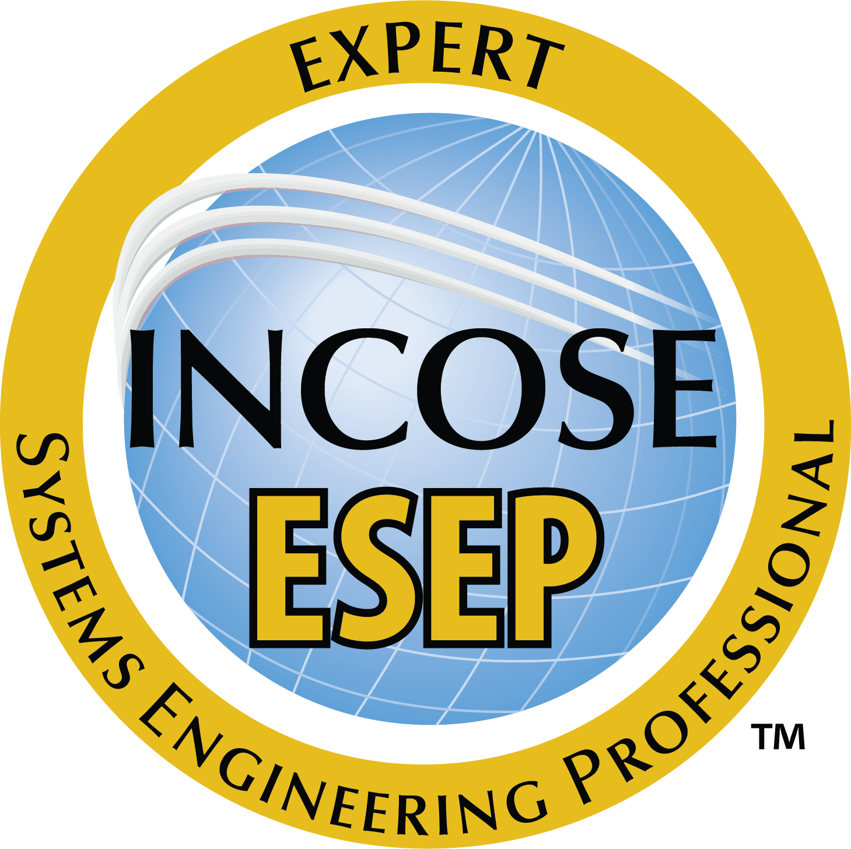
How to: Register for in-person exam
incose.org

Slide 2
incose.org | 2

Slide 3
SEP Application Costs
ASEP:
$180 application fee
Individual, Student, or Senior Membership required
Knowledge exam will also be an additional cost paid directly to testing center.
CSEP:
$350 application fee Individual, Student, or Senior Membership required
Knowledge exam will also be an additional cost paid directly to testing center.
ESEP:
$630 application fee
Individual, Student, or Senior Membership required

Slide 4
SEP Exam Costs
Online: $80 USD paid directly to the proctor service
In person: Varies
Student exam fees: $0
Typical Fee: $30 USD; Hosting Chapter or organization may choose to cover the fees exam registrations.
For more information, please visit: https://www.incose.org/systems-engineering-certification/taking-the-exam

Slide 5
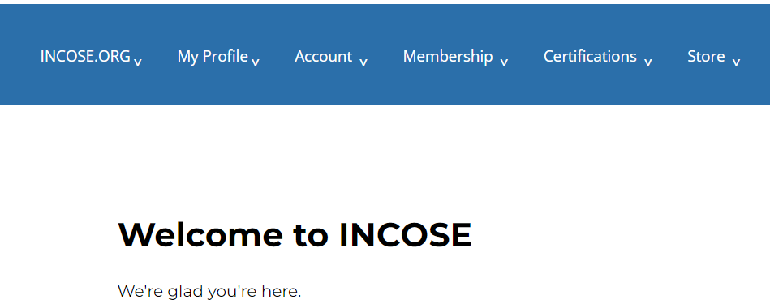
Step 1
Log in to www.incose.org. From the banner menu, click on “Certifications.”

Slide 6
Step 2
Click on “Register for an Exam.”

Slide 7
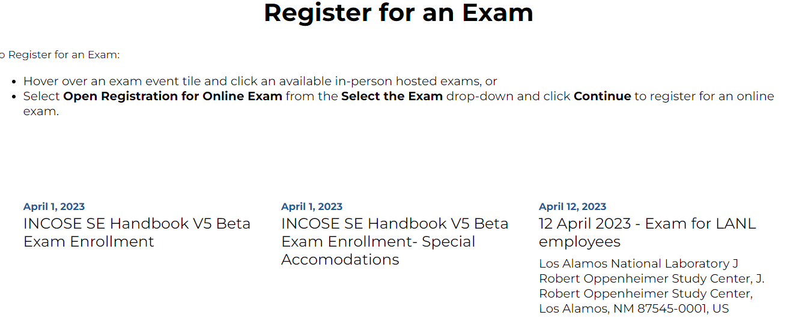
Step 3
Click on the hyperlink for the desired exam.
Please note: The Open Enrollment and Beta exams are not in-person exams. Please email sep-exam@incose.net for more information for these exams.

Slide 8
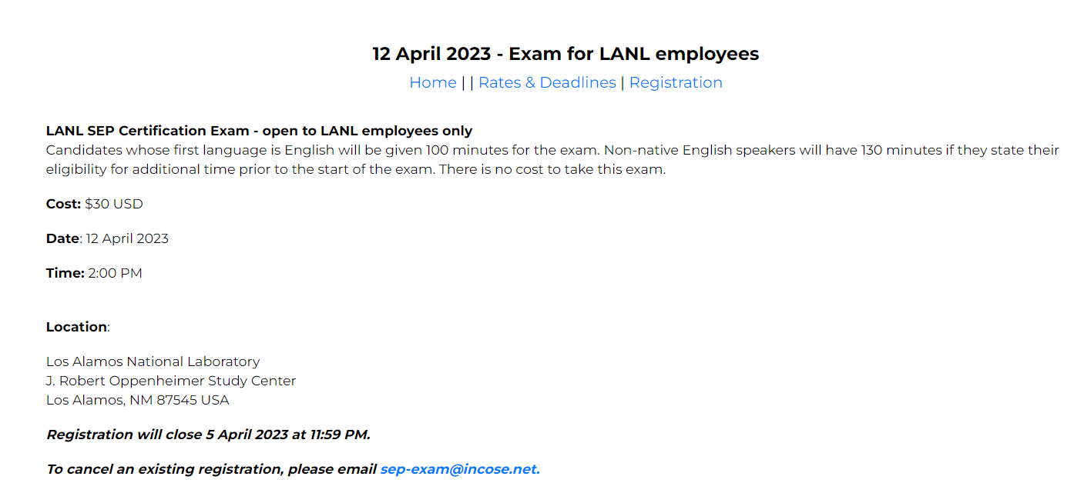
Step 4
Click on the “Registration” hyperlink.

Slide 9
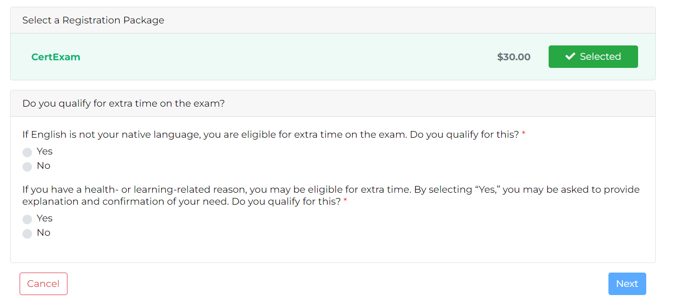
Step 5
Complete the registration question and selections. Click Next.

Slide 10
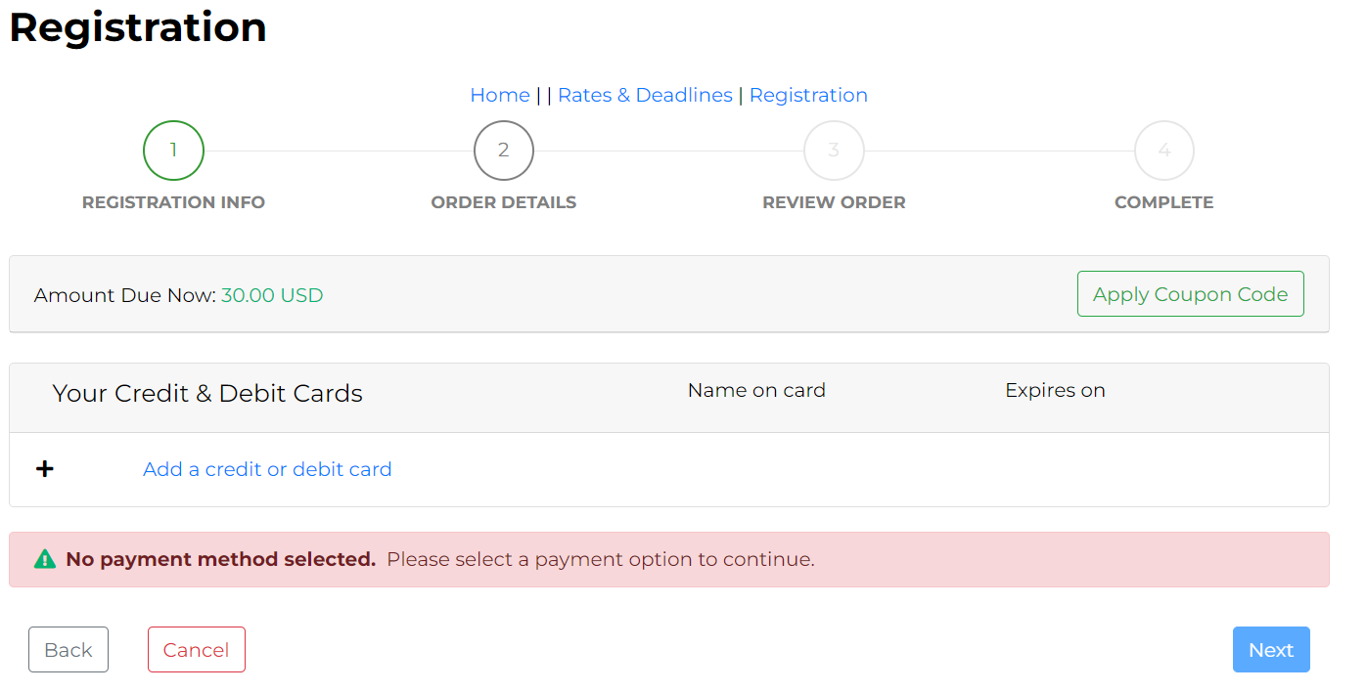
Step 6
Click “Add a credit of debit card.” Complete payment information and click next. Follow the prompts to complete the order.

Slide 11
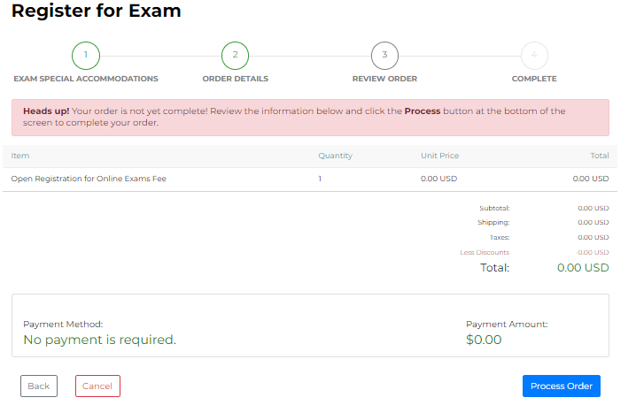
Step 7
Click Process Order.

Slide 12
Any Questions?
Certification Office certification@incose.net
For more information visit www.incose.org/certification

