Slide 1
Enrolling in Online Exams
Revised 22 June 2023

Slide 2
Open Enrollment – what is it?
INCOSE allows members and non-members to take the knowledge exam prior to submitting a certification application. Membership and application fees are not required prior to taking the exam, but both will be required before you can get certified.
After completing exam registration on the INCOSE website, you will be emailed the information required to schedule and pay for an on-line, proctored exam.
You may take the exam up to 3 times in any 12 month period. Please allow for 5-7 business days to process your registration.

Slide 3
Open Enrollment Process Overview
Candidate registers through their INCOSE Portal (login required).
INCOSE Central sends candidate email with URL required to schedule their exam through Certification Management Services (CMS) / Testwise, the online exam provider.
Candidate pays $80 USD directly to CMS / Testwise in order to schedule their exam. Candidate reviews the Examinee Scheduling Guide prior to scheduling and taking the exam: https://www.certmanserv.com/assets/help/Examinee-Scheduling-Guide.pdf
Candidate takes the exam at their scheduled time. Results are displayed on screen upon completion of exam. INCOSE sends candidate a notification email within one week.

Slide 4
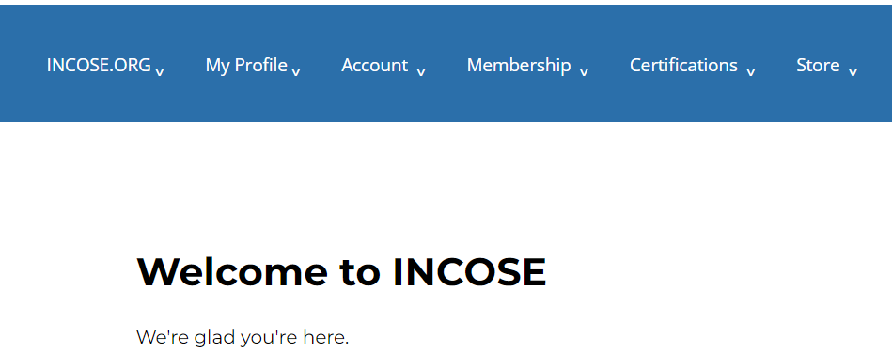
1. Log in to portal.incose.org. From the banner menu, click on “Certifications.”

Slide 5
2. Click on “Register for an Exam.”

Slide 6
3. Click on the drop down for “Select Exam.” Click “Open Enrollment for Online Exam.” Click “Continue.”

Slide 7
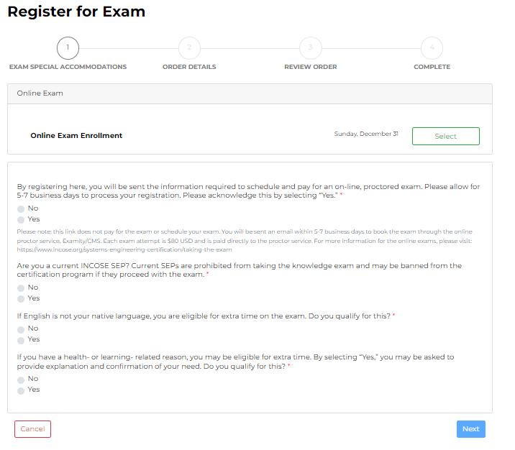
4. Click “Select.” Ignore the date listed to the left of “Select.” Acknowledge the statements and answer the required questions. Click “Next.”

Slide 8
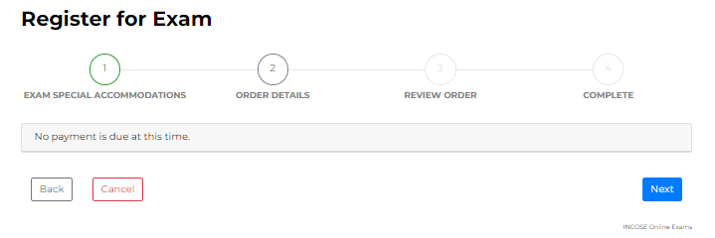
“5. Click Next.”
Note: No payment is required in the INCOSE system. Within 5-7 business days, you will be sent a link to schedule your exam with CMS/Testwise. You will pay the proctor service when you schedule the exam.

Slide 9
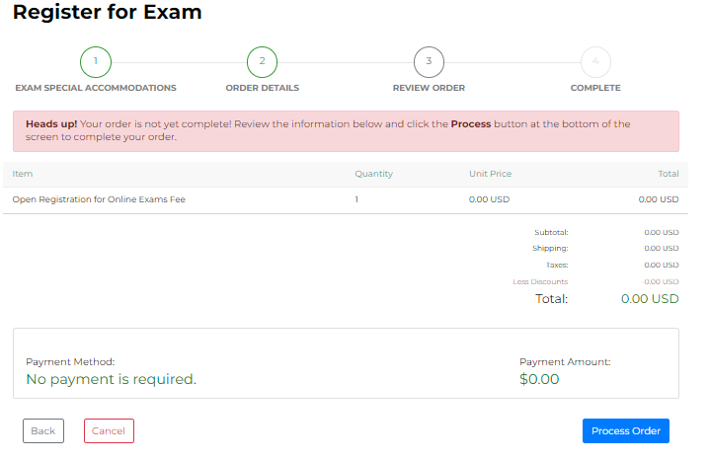
6. Click Process Order.

Slide 10
7. Follow instructions in email to schedule and pay for your exam. This will be done through CMS/Testwise.

Slide 11
SEP Exam Costs
Online: $80 USD per attempt
Paid directly to the exam provider
For more information, please visit: https://www.incose.org/systems-engineering-certification/taking-the-exam

Slide 12
SEP Application Costs
ASEP:
$180 application fee
Individual, Student, or Senior Membership required
Knowledge exam will also be an additional cost paid directly to exam provider.
CSEP:
$350 application fee
Individual, Student, or Senior Membership required
Knowledge exam will also be an additional cost paid directly to exam provider.
ESEP:
$630 application fee
Individual, Student, or Senior Membership required

