Slide 1
Late Renewals and Reinstatements
Updated 16 March 2021

Slide 2
Table of Contents
Page 3: ASEP Late Renewal Fees & Requirements
Page 4: CSEP Late Renewal Fees & Requirements
Page 5: Steps for Renewing late
Page 6: ESEP Re-activation Fees Table
Page 7: Process for re-activating ESEP when lapsed due to membership
Page 8: Certification Resources

Slide 3
ASEP Renewal Fees
SEP renewal = $100
Late SEP renewal Requirements:
0-6 Months: submit log showing 132 or more PDUs, renewal fee ($100), and reactivation fee of $50
Total Cost: $150 USD (Plus active individual membership)
6-12 months: submit log showing 144 or more PDUs, renewal fee ($100), and reactivation fee of $100
Total Cost: $200 USD (Plus active individual membership)
More than 12 months: submit PDU log showing 120 PDUs + 24 PDUs for each year expired, renewal fee ($100), and reactivation fee of $150
Total Cost: $250 USD (Plus active individual membership)
In lieu of additional PDU requirements for late renewal, individuals may pass the INCOSE knowledge exam again. Please contact certification@incose.org if you decide to proceed with the exam instead of PDU requirement.

Slide 4
CSEP Renewal Fees
SEP renewal = $100
Late SEP renewal Requirements:
0-6 Months: submit log showing 140 or more PDUs, renewal fee ($100), and reactivation fee of $50
Total Cost: $150 USD (Plus active individual membership)
6-12 months: submit log showing 160 or more PDUs, renewal fee ($100), and reactivation fee of $100
Total Cost: $200 USD (Plus active individual membership)
More than 12 months: submit PDU log showing 120 PDUs + 40 PDUs for each year expired, renewal fee ($100), and reactivation fee of $150
Total Cost: $250 USD (Plus active individual membership)
In lieu of additional PDU requirements for late renewal, individuals may pass the INCOSE knowledge exam again. Please contact certification@incose.org if you decide to proceed with the exam instead of PDU requirement.

Slide 5
Steps for Renewing Late
Request an invoice from sep-renewal@incose.org for ASEP or CSEP renewal.
Fill out PDU log. Renew membership if expired.
Once you have paid the invoice from your profile home page, submit your ASEP or CSEP renewal documents to sep-renewal@incose.org. The database will not alert the Certification office once the payment has been made, so it is very important to make the payment BEFORE you submit your documents.
Certification Office will review your documents and process your new certificate.

Slide 6
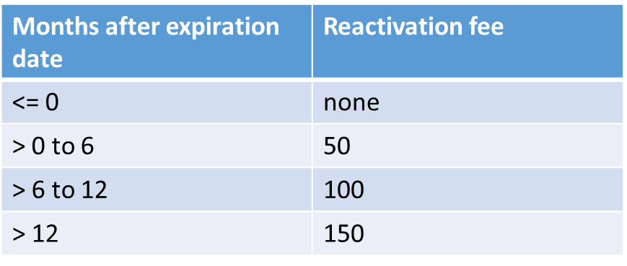
Re-Instating ESEP
ESEPs who lapse due to membership are required to pay a reactivation fee in order to re-instate their certification. See below for fees table, listed in USD:

Slide 7
Re-Instating ESEP
If your ESEP Certification has lapsed due to membership:
Renew your membership from your Profile Home page
-Please make sure not to create a new account. It will not automatically sync with your existing certification.
2. Send an email to certification@incose.org to notify the Certification Office that you have renewed your membership and need an invoice for reactivation fee.
3. Certification office will generate an invoice based on the fees table on previous page. Once you have paid the re-activation fee, please notify certification@incose.org so your ESEP can be re-instated.

Slide 8
Certification Resources
Forms: https://www.incose.org/systems-engineering-certification/certification-forms
How do I renew: https://www.incose.org/systems-engineering-certification/the-certification-process/how-do-i-renew
Late Renewal requirements: https://www.incose.org/systems-engineering-certification/the-certification-process/how-do-i-renew/late-renewals
Qualifying Activities for Earning PDUs: https://www.incose.org/systems-engineering-certification/the-certification-process/how-do-i-renew#Activities
General INCOSE inquiries: info@incose.org
Certification inquiries: certification@incose.org

