Slide 1
Late Renewals and Reinstatements
incose.org

Slide 2
incose.org | 2
slalom.com

Slide 3
Table of Contents
Page 4: ASEP Late Renewal Fees & Requirements
Page 5: CSEP Late Renewal Fees & Requirements
Page 6: Steps for Renewing late
Page 7: ESEP Re-activation Fees Table
Page 8: Process for re-activating ESEP when lapsed due to membership
Page 9: Certification Resources

Slide 4
ASEP Renewal Fees
SEP renewal = $100
Late SEP renewal Requirements:
0-6 Months: submit log showing 132 or more PDUs, renewal fee ($100), and reactivation fee of $50
Total Cost: $150 USD (Plus active individual membership)
6-12 months: submit log showing 144 or more PDUs, renewal fee ($100), and reactivation fee of $100
Total Cost: $200 USD (Plus active individual membership)
More than 12 months: submit PDU log showing 120 PDUs + 24 PDUs for each year expired, renewal fee ($100), and reactivation fee of $150
Total Cost: $250 USD (Plus active individual membership)
In lieu of additional PDU requirements for late renewal, individuals may pass the INCOSE knowledge exam again. Please contact certification@incose.net if you decide to proceed with the exam instead of PDU requirement.

Slide 5
CSEP Renewal Fees
SEP renewal = $100
Late SEP renewal Requirements:
0-6 Months: submit log showing 140 or more PDUs, renewal fee ($100), and reactivation fee of $50
Total Cost: $150 USD (Plus active individual membership)
6-12 months: submit log showing 160 or more PDUs, renewal fee ($100), and reactivation fee of $100
Total Cost: $200 USD (Plus active individual membership)
More than 12 months: submit PDU log showing 120 PDUs + 40 PDUs for each year expired, renewal fee ($100), and reactivation fee of $150
Total Cost: $250 USD (Plus active individual membership)
In lieu of additional PDU requirements for late renewal, individuals may pass the INCOSE knowledge exam again. Please contact certification@incose.net if you decide to proceed with the exam instead of PDU requirement.

Slide 6
Steps for Renewing Late
Fill out Form 13 PDU log with the appropriate amount of PDUs (based on the amount of time since your certification lapsed/expired from slide 4 & 5).
Renew membership if expired.
Login to your member portal and click on “Certification” at the top. Select “View my Certificate” from the drop-down menu.
Click on the certification type; ASEP, CSEP or ESEP link.
Click on the “Apply/Renew” button and follow the prompted steps to complete the renewal submission process.
Certification Office will review your documents and process your new certificate.

Slide 7
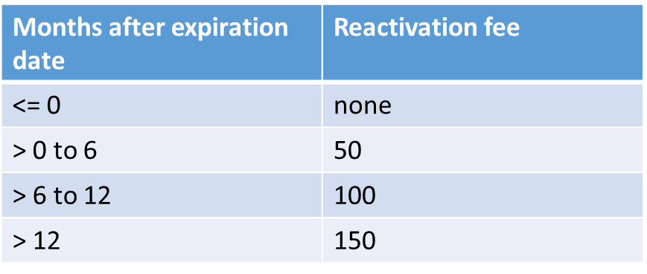
Re-Instating ESEP
ESEPs who lapse due to membership are required to pay a reactivation fee in order to re-instate their certification. See below for fees table, listed in USD:

Slide 8
Re-Instating ESEP
If your ESEP Certification has lapsed due to membership:
Renew your membership from your Profile Home page
-Please make sure not to create a new account. It will not automatically sync with your existing certification.
2. Log in to your member portal
3. Follow the same steps you would, to renew your certification. You will be prompted to pay the reinstatement fee. Once paid and processed your ESEP certification will be reinstated and brought to good standings.

Slide 9
Certification Resources
Forms: https://www.incose.org/systems-engineering-certification/certification-forms
How do I renew: https://www.incose.org/systems-engineering-certification/the-certification-process/how-do-i-renew
Late Renewal requirements: https://www.incose.org/systems-engineering-certification/the-certification-process/how-do-i-renew/late-renewals
Qualifying Activities for Earning PDUs: https://www.incose.org/systems-engineering-certification/the-certification-process/how-do-i-renew#Activities
General INCOSE inquiries: info@incose.net
Certification inquiries: certification@incose.net

Slide 10
Thank you

Slide 11
Any Questions?
Certification Office certification@incose.net
For more information visit www.incose.org/certification

Slide 12
INCOSE Copyright Notice
Copyright © 2006-2023 by INCOSE, subject to the following restrictions:
Author Use. Authors have full rights to use their contributions in a totally unfettered way. Abstraction is permitted with credit to the source.
INCOSE Use. Permission to reproduce and use this document or parts thereof by members of INCOSE and to prepare derivative works from this document for INCOSE use is granted, with attribution to INCOSE and the original author(s) where practical, provided this copyright notice is included with all reproductions and derivative works.
External Use. This document may be shared or distributed to non-INCOSE third parties. Requests for permission to reproduce this document in whole are granted, provided it is not altered in any way. Requests for permission to prepare derivative works of this document for external and/or commercial use will be denied unless covered by other formal agreements with INCOSE. Copying, scanning, retyping, or any other form of reproduction of the content of whole pages or source documents is prohibited except as approved by the INCOSE Central Office, 7670 Opportunity Rd #220, San Diego, CA 92111.
Electronic Version Use. Any electronic version of this document is to be used for personal use only and is not to be placed on a non-INCOSE sponsored server for general use. Any additional use of these materials must have written approval from INCOSE Central.
Permissions. INCOSE has granted permission to member companies of the INCOSE Corporate Advisory Board to post and use this document internally, subject to the external use restriction.
Technical Data. This data was prepared by INCOSE for information only. It has been released by INCOSE as Technical Data. It is subject to change without notice and may not be referred to as an INCOSE Technical Product.
This briefing was created from information from various INCOSE sources as indicated in the Notes section of this slide. Send comments to certification@incose.org.

