Slide 1
How To: Renew SEP
Revised 30 March 2023

Slide 2
SEP Renewal Requirements
ASEP Renewal:
Period: Five years
Fee: $100 application fee
Individual, Student, or Senior Membership required
120 PDUs required
CSEP Renewal:
Period: three years
Fee: $100 application fee
Individual, Student, or Senior Membership required
120 PDUs required
ESEP:
No renewal required
Active membership required

Slide 3
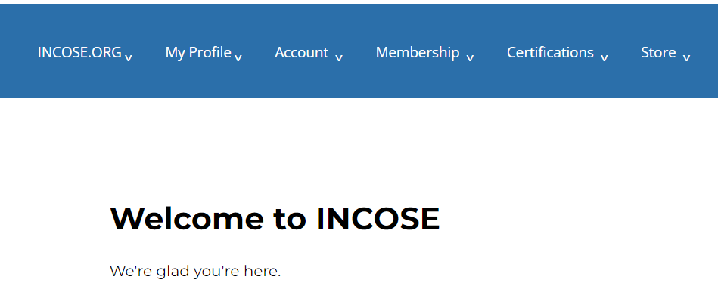
1. Log in to www.incose.org. From the banner menu, click on “Certifications.”

Slide 4
2. Click on “View My Certification.”

Slide 5
3. Click on the hyperlink the SEP Program.

Slide 6
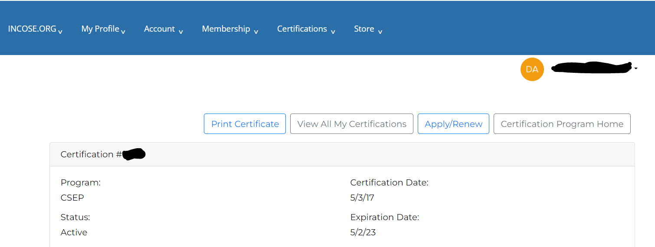
4. Click on the “Apply/Renew” button.

Slide 7
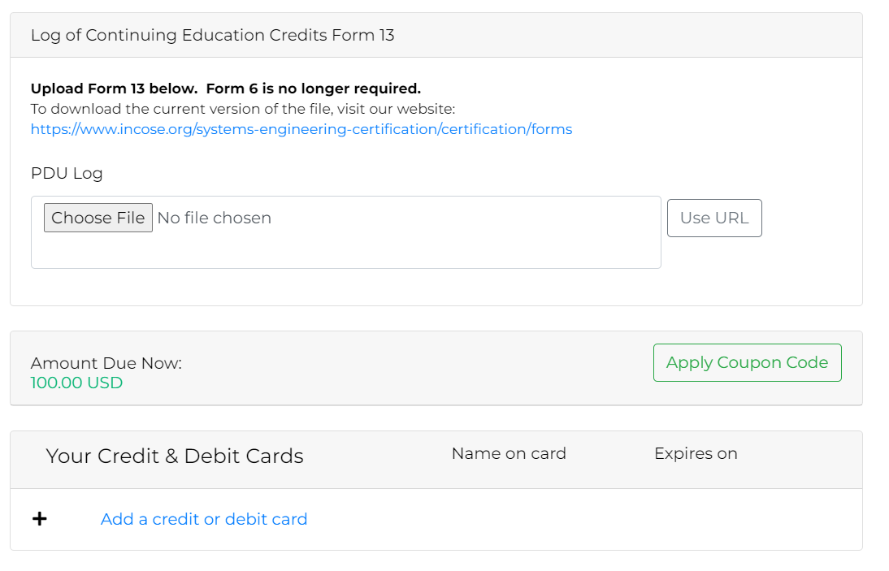
5. Upload Form 13. Click “Add a credit of debit card.” Complete payment information and click next. Follow the prompts to complete the order.

