Slide 1



The Art of Systems Thinking
International Council on Systems Engineering
A better world through a systems approach
Tami Katz, ESEP, INCOSE Technical Director
INCOSE International Symposium 2025 | Ottawa, Canada

Slide 2
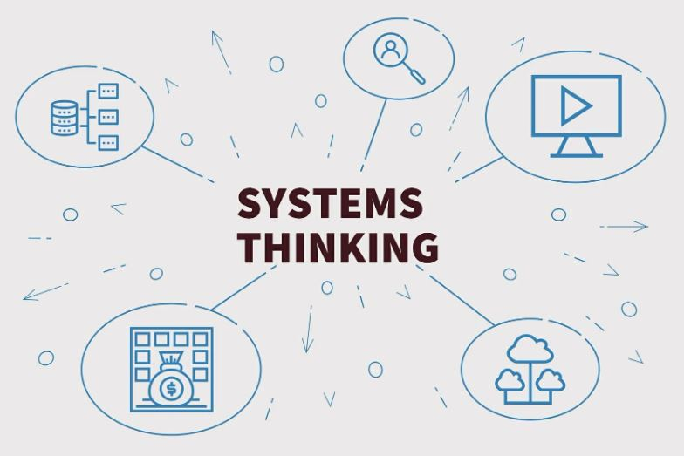
Systems Thinking
Systems thinking is a way of understanding complex problems by looking at how different parts interact within a larger system.
Rather than looking at events or problems in isolation, systems thinking helps us identify underlying causes and connections with other events.

Slide 3
Exploring Systems Thinking
Systems Thinking can be regarded as a diagnostic tool, enabling us to look at problems from multiple angles and help us ask better questions.
“No problem ever exists in complete isolation. Every problem interacts with every other problem and is therefore part of a set of interrelated problem, a system of problems.”
Russell Ackoff

Slide 4

Who Applies Systems Thinking?
Ideally, everyone engineering systems should be applying some level of systems thinking.
For some, systems thinking is an intuitive process….
A natural ability to see related patterns
An understanding of how parts of a system are connected
An ability to predict behaviors based on observed interactions
For others, this is a learned skill using methodical analysis.
In this SE Fundamental presentation skills are shared to highlight how systems thinking can be approached by anyone involved in engineering of complex systems (not just the systems engineers…)

Slide 5
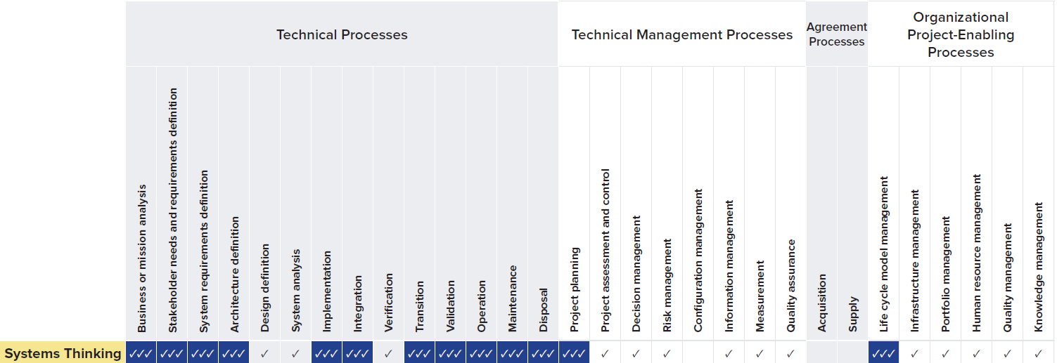
INCOSE Competency Area: Systems Thinking
Per the INCOSE SE Competency Framework, Systems Thinking is a key competency to implement Systems Engineering processes:
INCOSE SE Competency Framework v2

Slide 6
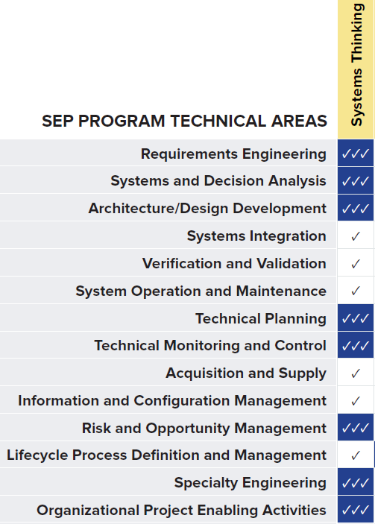
INCOSE Competency Area: Systems Thinking
Systems thinking is involved in every SE technical process area as well.
INCOSE SE Competency Framework v2

Slide 7
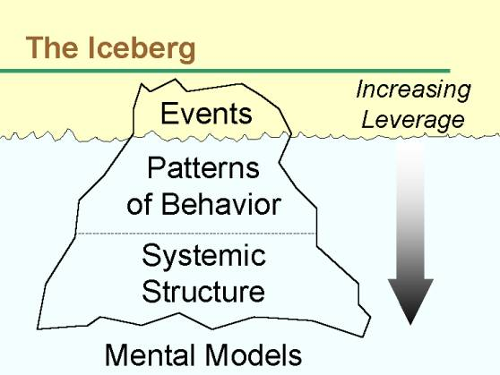
The Iceberg Model
Things are not always as they appear…
Systems thinking addresses the ability to look beyond the obvious and see the underlying structure and behaviors.
This can be demonstrated by the “iceberg model,” which is a metaphor for the hidden interactions that create events.
Each level down the iceberg offers a deeper understanding of the system being examined as well as increased leverage for changing it.
https://agsystemsthinking.net/2017/11/13/iceberg/

Slide 8

Problem Solving Without Using Systems Thinking
Without systems thinking, there is a tendency to address the observed event without digging deeper.
Solving a symptom addresses only the surface-level or immediate issues that are visible, rather than identifying and resolving the root cause of the problem.
This is “Band-aiding” the issue instead of solving it!

Slide 9

Addressing the Symptom
Tire is flat
Replace the Tire
One year later, new tire is flat

Slide 10
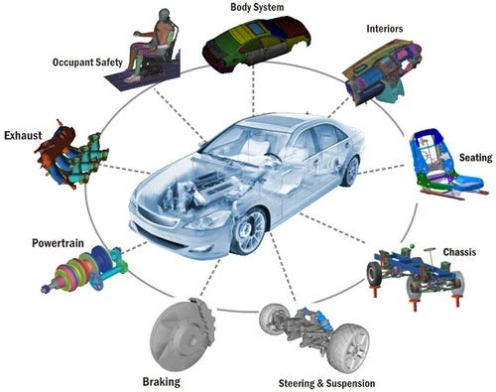
Starting to Apply Systems Thinking
Tire is flat
Assess Road Conditions (no obvious hazards)
Assess Tire
Find wear in the tire
Why is there wear in the tire?
Assess driver ability (careful driver)
Assess vehicle alignment (tire is part of a system)
Find vehicle is misaligned (root cause to degrade tire)
Fix vehicle alignment and replace tire

Slide 11
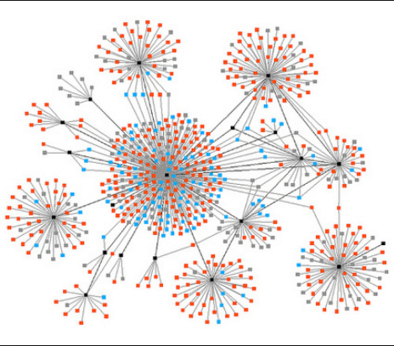
Systems Are Dynamic
Systems can demonstrate emergence, meaning that the whole system can have properties or behaviors that aren't just the sum of its individual components.
A key concept in systems thinking is feedback loops, where changes in one part of a system influence other parts, creating cycles that reinforce or balance the system.
The Iceberg Model alone does not help visualize this set of interactions.
The System Dynamics (SD) is a methodology for understanding, modeling, and analyzing complex systems.

Slide 12
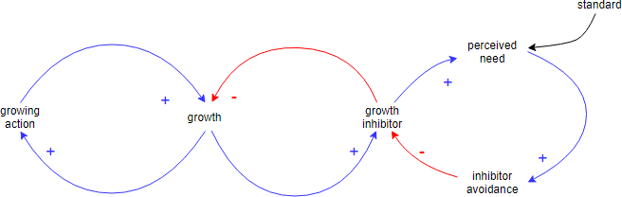
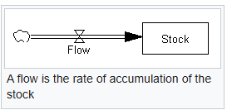
Systems Dynamic Models
SD Models focus on the feedback loops, time delays, and accumulations that drive system behavior. The model helps identify the underlying structure of systems and predict the impact of changes over time.
Key components of the System Dynamics Model include:
  Causal Loop Diagrams: Visual representations of the feedback loops and causal relationships within a system.
  Stock and Flow Diagrams: Diagrams that show the accumulations (stocks) and the rates of change (flows) within a system.
  Simulation Models: Computational models that simulate the behavior of the system over time, allowing for experimentation and analysis.
https://umbrex.com/resources/change-management-frameworks/what-is-system-dynamics-model/

Slide 13
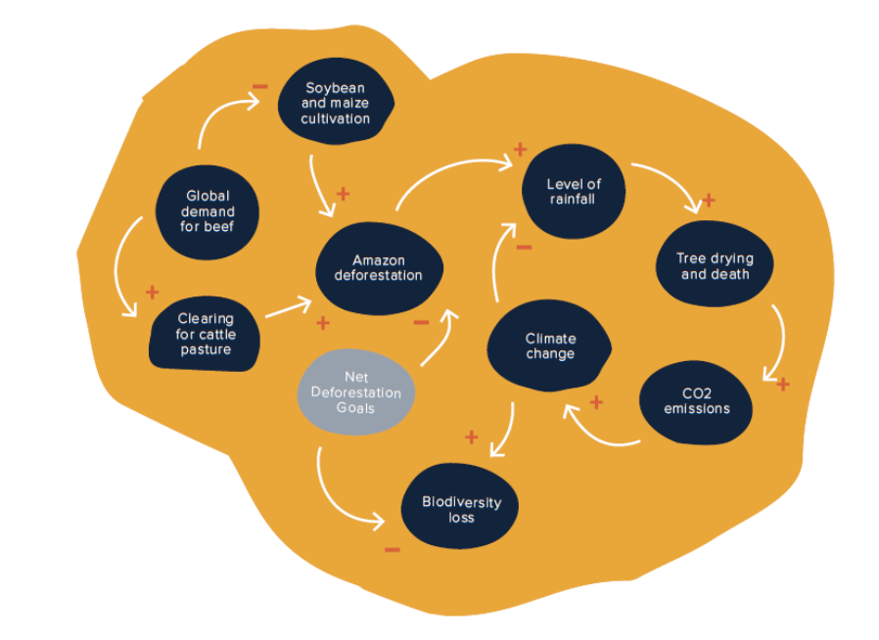
Systems Dynamics uses a “System Mapping” method to enable an understanding of system interactions.
https://marcabraham.com/2022/01/16/my-product-management-toolkit-48-systems-thinking/

Slide 14
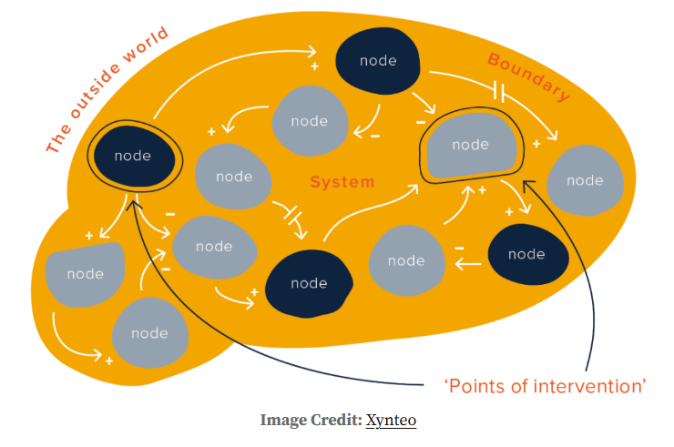
The point of these maps is to spend time identifying and understanding the different components of a system and the problems they might cause or amplify.
The next step is to think about ‘interventions’; areas where taking action would have a desired effect through the system.
https://marcabraham.com/2022/01/16/my-product-management-toolkit-48-systems-thinking/

Slide 15
Systems Dynamic Modeling Tools
Many software tools exist for Systems Dynamics Modeling:
Vensim: A widely used, commercial software with a visual modeling interface that allows users to build diagrams with stocks, flows, and variables.
Stella: Another commercial tool, often praised for its intuitive interface, especially for beginners.
Simantics System Dynamics: A free, open-source tool built on Java and Modelica, with a graphical user interface and simulation capabilities.
Silico Dynamic simulation platform: A proprietary, commercial platform that is free for public projects.
Simcad Pro: A proprietary, commercial tool with a visual interface that also offers a free, full-featured demo.
se-lib: An open-source system dynamics library for the Python programming language.
SD-Tools: A project on GitHub that aims to provide open-source system dynamics tools, including the ability to translate models to C, JavaScript, or WebAssembly.
SageModeler: A free, open-source, web-based tool from the Concord Consortium designed for students to learn systems thinking.
sdCloud: A service that allows users to run and share SD models in the cloud without local setup, as detailed on the System Dynamics Society website.
SDEverywhere: A tool that enables the deployment of interactive SD models in various applications, according to the System Dynamics Society.
SIMLIN: A web-first SD modeling editor and engine that is designed to lower the barrier to entry.
https://systemdynamics.org/tools/
https://youtu.be/w8sWQOOEnh4

Slide 16
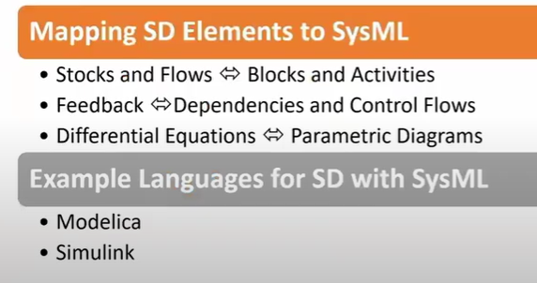
Integrating System Dynamics and SysML
INCOSE IS2025 paper: Integrating System Dynamics with Systems Modelling Language for Resilient System Design.
While Systems Modeling Language (SysML) is excellent for designing system structures, it is limited in simulating dynamic behavior over time.
Systems engineers can identify potential vulnerabilities and failure points by modeling the system structure using SysML
System Dynamics (SD) focuses on feedback loops, stocks, and flows, providing a simulation-based approach to modeling such behavior.
SD simulations allow systems engineers to model the impact of adversities and test mitigation strategies.
Developing a co-simulation enables a holistic look that leverages the best capabilities of both languages.
Watch video: https://youtu.be/ewkmohuj3Ag

Slide 17
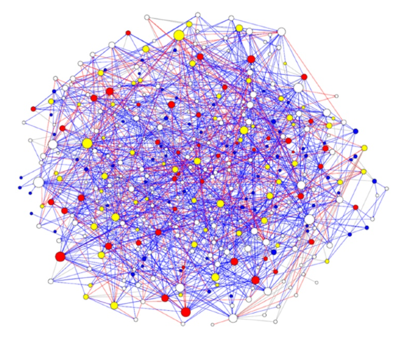
Case Study: Reforming agricultural policy design
Using systems thinking to deliver large-scale, rapid change in agricultural policy design and evaluation
The UK Department for Environment, Food and Rural affairs underwent a systems mapping exercise to understand the agricultural system.
They held workshops to develop the process maps, then integrated within modeling software applications.
The outcome of using systems thinking on this project was a holistic approach for addressing complex, interrelated policy problems as well as a reduction of silos within their organization.
https://www.gov.uk/government/publications/systems-thinking-for-civil-servants/case-studies#case-study-2

Slide 18
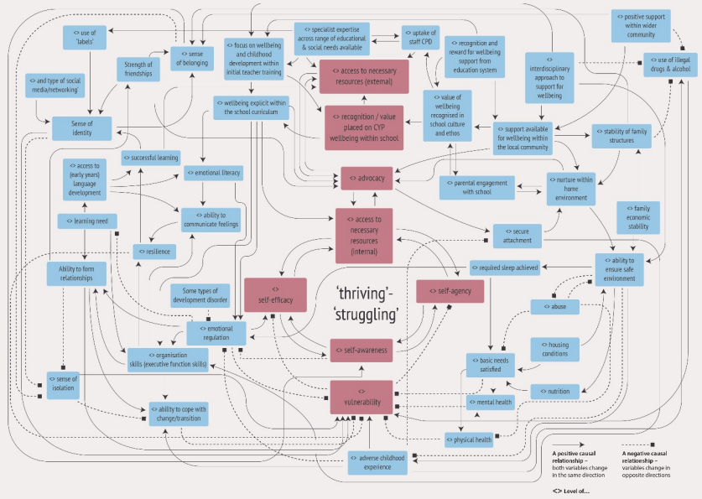
Case Study: Child and Young People (CYP) Wellbeing
Using systems thinking to identify the influences on the wellbeing of young people.
The UK Department for Education performed system mapping as a way of capturing interdependencies and interrelationships which influence the wellbeing of the youth in their community.
The resultant system map helped them identify various factors which resulted in improved wellbeing, this guided an approach to educate school personnel to help realize these results.
https://assets.publishing.service.gov.uk/media/5f2bcb51e90e0732e16a7b3c/A_system_mapping_approach_to_understanding_child_and_adolescent_wellbeing.pdf

Slide 19
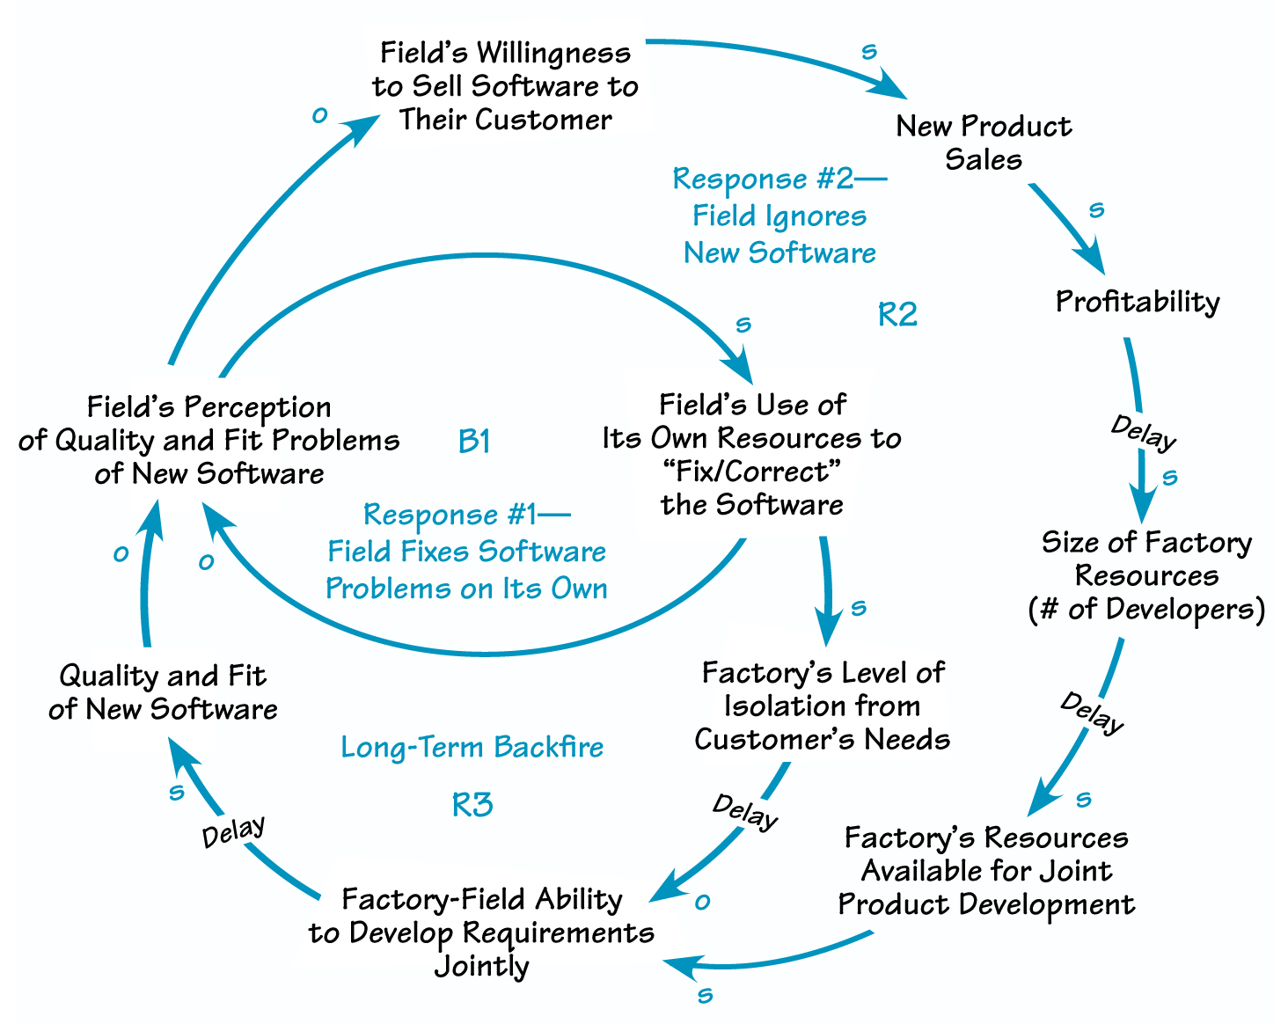
Case Study: Software Product Development
Using systems thinking to improve pace of software products sales
A software organization wanted to improve its time to volume (TTV), the time in months their products took to reach their forecasted sales volume.
Needed to find a way for the “field” (sales, marketing, and service) and the “factory”(software developers) to work together efficiently and leverage their resources to solve the issue of longer than expected duration to reach forecasted sales.
Performed interviews and mapping to understand how the field was isolating from the factory (as-is) and how to improve that condition.
The process and tools of systems thinking both broadened and deepened understanding and ownership of the TTV problem across the field and factory.
https://thesystemsthinker.com/everyones-problem-to-solve-systems-thinking-cross-functionally/

Slide 20
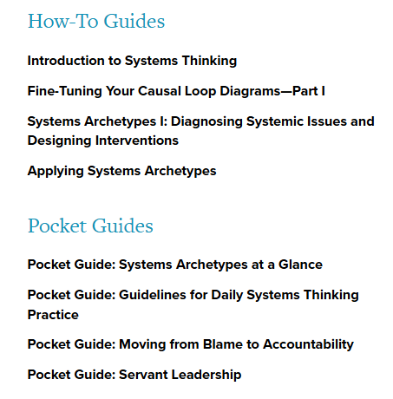
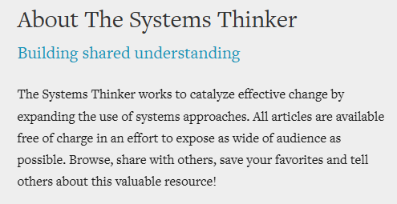
Building System Thinking Skills
Resources exist to help build everyday systems thinking skills.
Making systems thinking part of everyday life helps ensure it can naturally be applied when solving tough system development problems.
https://thesystemsthinker.com/

Slide 21
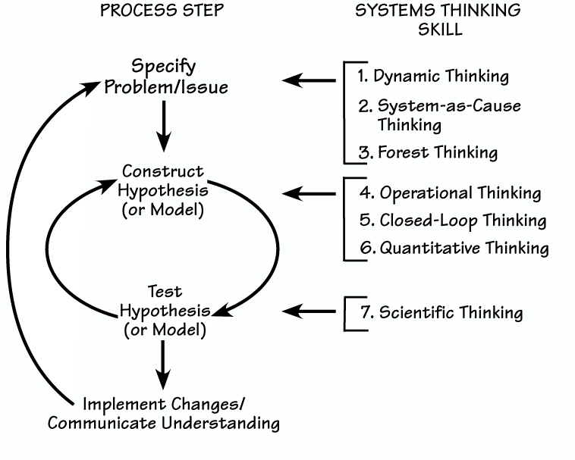
Applying System Thinking Skills
Based on the system being developed and where it is in the lifecycle, different systems thinking skills may be applied to help ensure a successful system.
https://thesystemsthinker.com/the-thinking-in-systems-thinking-honing-your-skills/

Slide 22
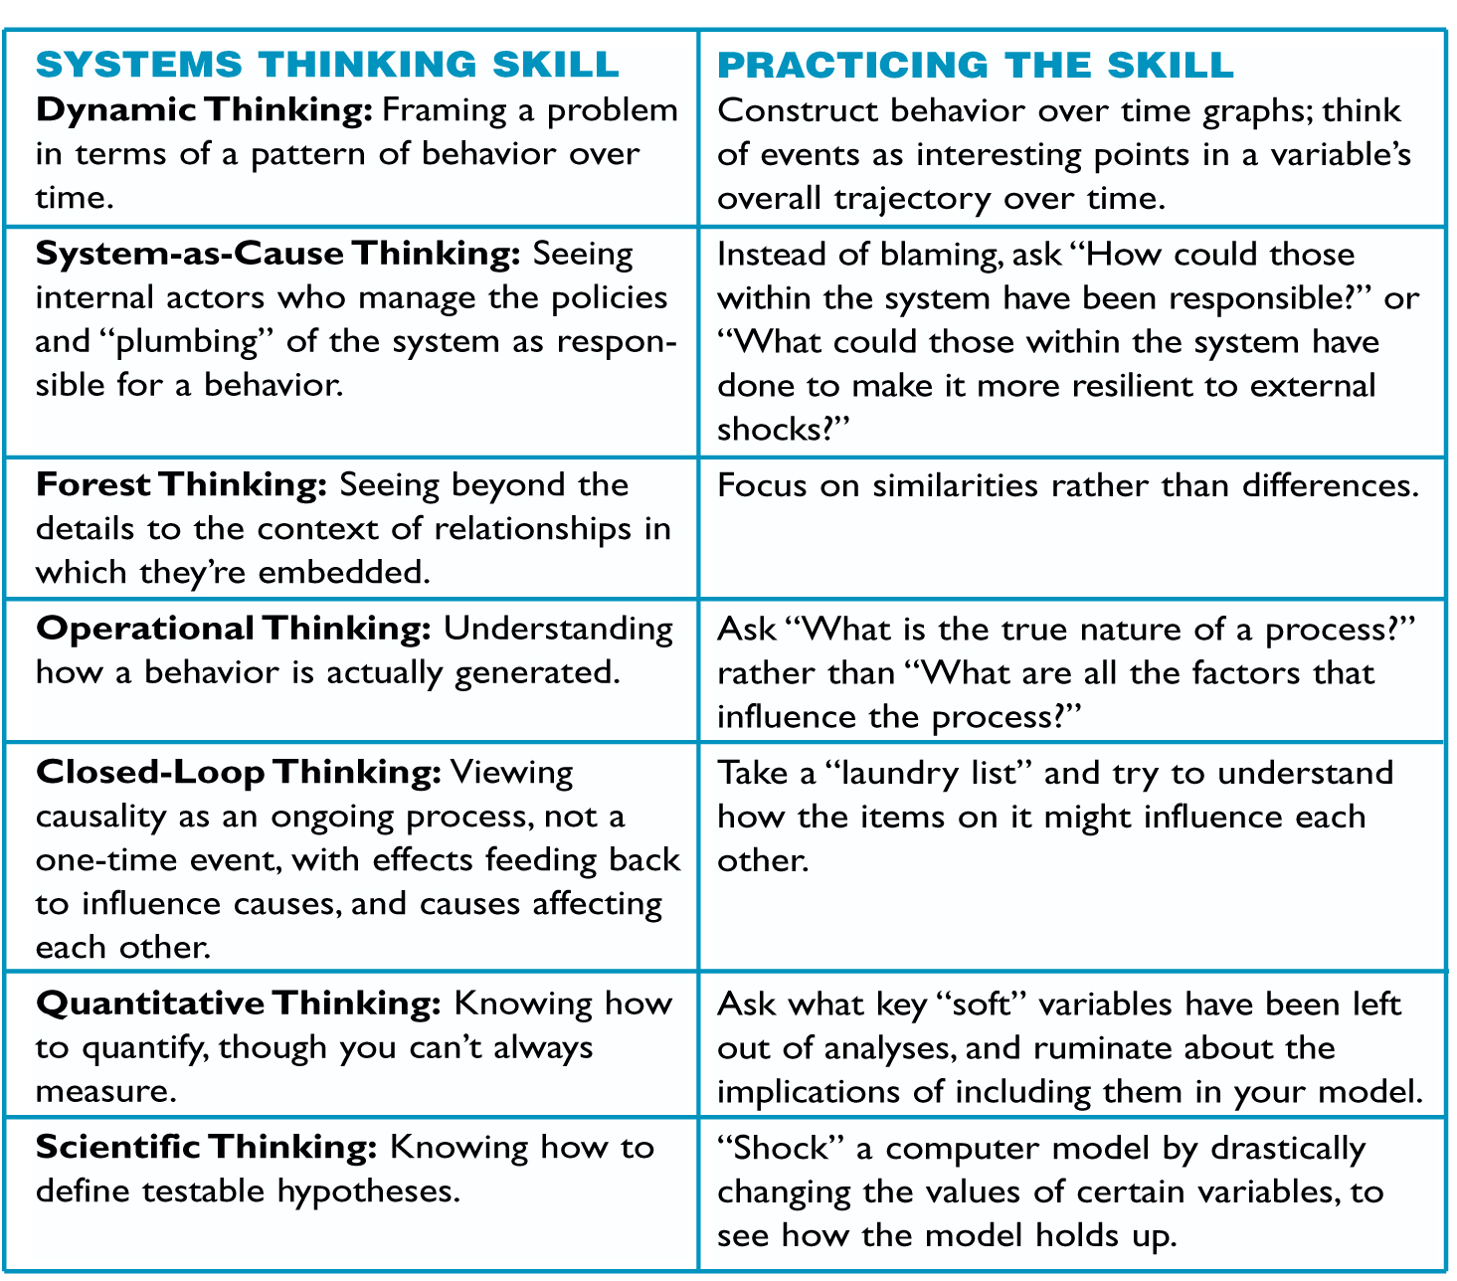
System Thinking Skills
Being able to utilize different thinking skills can enable problem solvers to innovate holistic approaches.
System Thinking is an Art, not an exact science, often experience and context can help define what skills best apply to situations.
https://thesystemsthinker.com/the-thinking-in-systems-thinking-honing-your-skills/

Slide 23
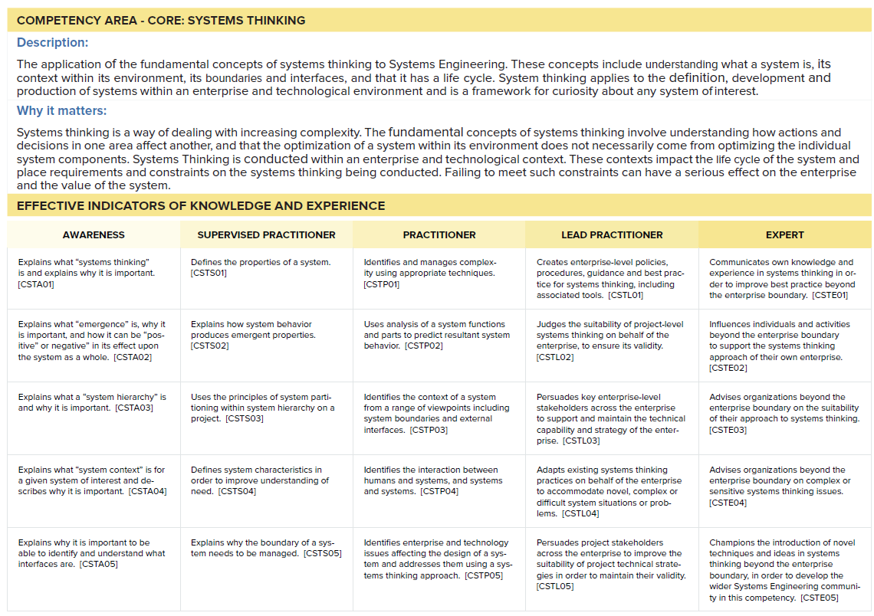
INCOSE Competency Area: Systems Thinking
Systems thinking is a foundational competency for the practice of systems engineering!
INCOSE SE Competency Framework v2

Slide 24
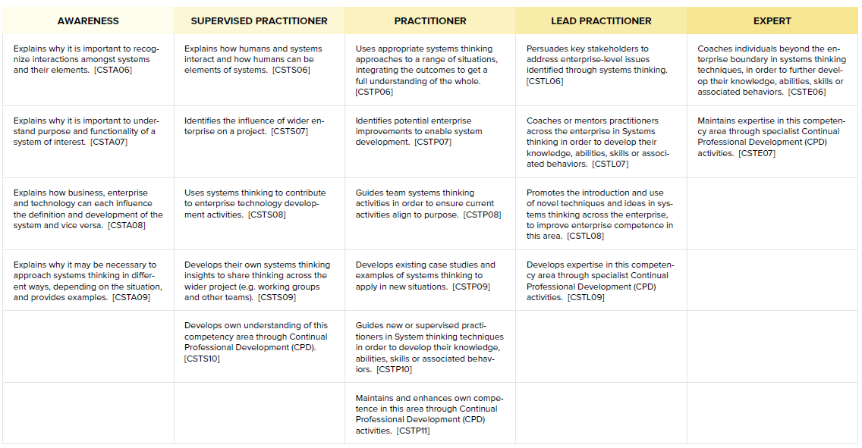
INCOSE Competency Area: Systems Thinking
INCOSE SE Competency Framework v2

Slide 25
Where to Learn More
INCOSE SE Competency Framework v2 (2025), INCOSE Store.
How Systems Thinking contributes to Systems Engineering, INCOSE UK. https://incoseuk.org/Documents/zGuides/Z7_Systems_Thinking_WEB.pdf
SEBoK. https://sebokwiki.org/wiki/Systems_Thinking
The Systems Thinker. https://thesystemsthinker.com/
Introduction to Systems Thinking. The Systems Thinker. https://thesystemsthinker.com/introduction-to-systems-thinking/
The “Thinking” in Systems Thinking: Honing Your Skills. The Systems Thinker. https://thesystemsthinker.com/the-thinking-in-systems-thinking-honing-your-skills/
Intro to Systems Mapping https://youtu.be/wrBDy91M7-0

Slide 26

Thank You!
Dr. Tami Katz, ESEP
INCOSE Technical Director
Systems Engineer, BAE Systems, Inc.
Adjunct Professor, University of Colorado at Boulder

