Slide 1
Analysis of Alternatives
William Lozier

Slide 2
Why MBSE?
Metric progress
  Where are we in the development progress?
  How do we know we have a good technical solution?
  How do we know we have a good model?
Analysis
  To rapidly provide answers to stakeholder concerns.

Slide 3
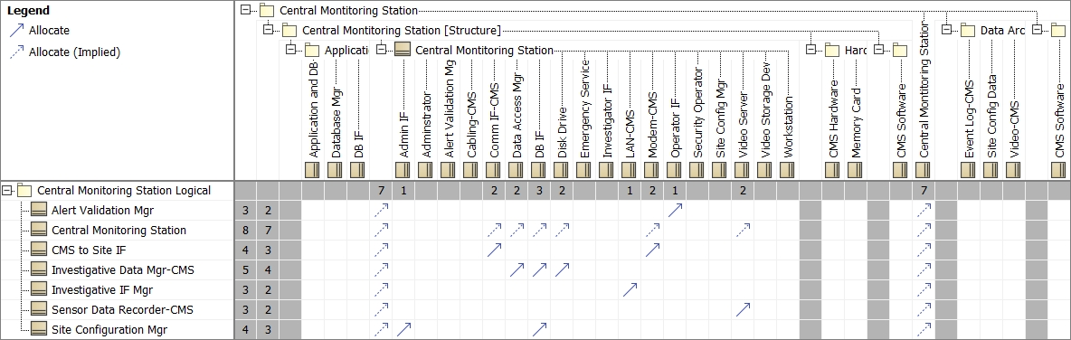
Good Model
Allocation of Logical elements to Physical elements.

Slide 4
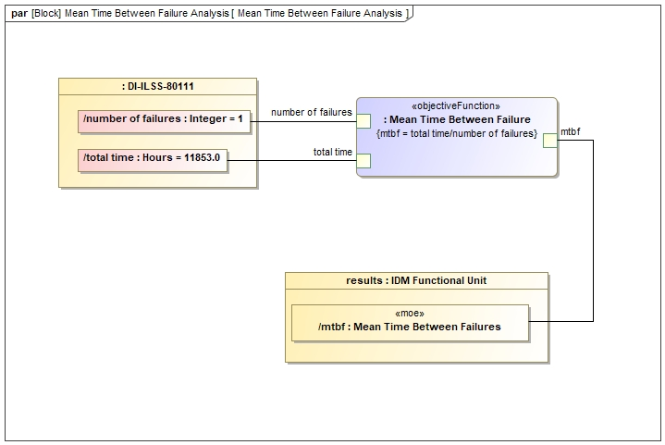
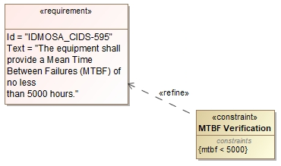
Good Technical Solution
Measures Of Effectiveness satisfied by Parametric Analysis.

Slide 5
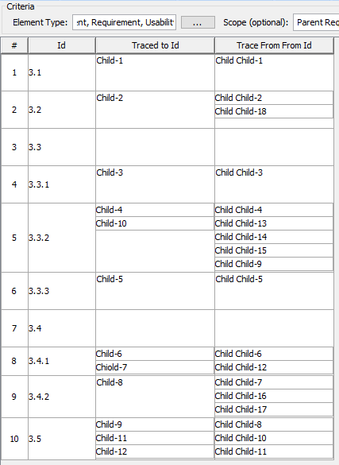
Requirement Trace Analysis

Slide 6
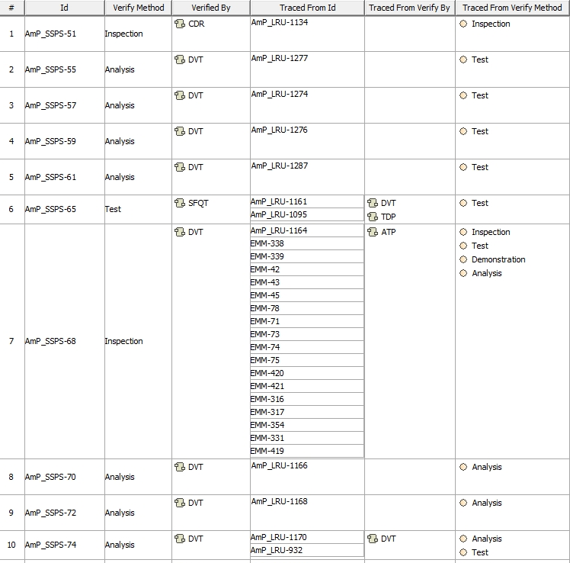
Trace From Analysis Verify by and Method

Slide 7
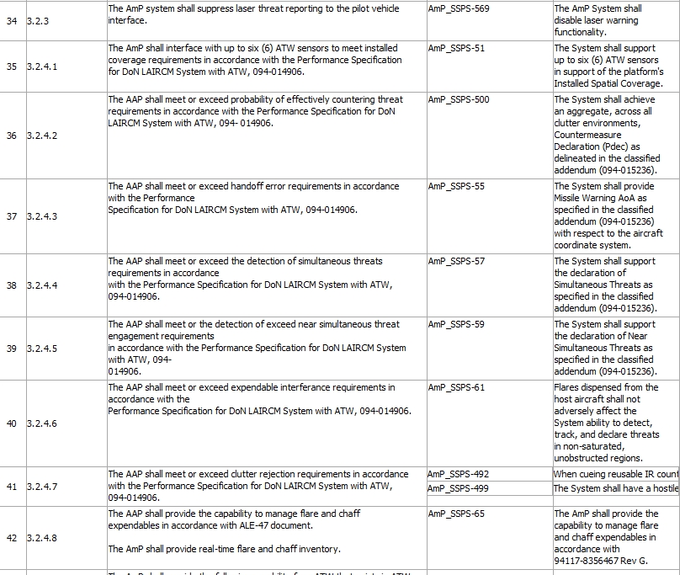
Text Trace Analysis

Slide 8
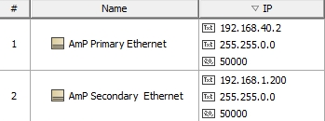

Network Analysis
Ethernet
MIL-STD-1553

Slide 9
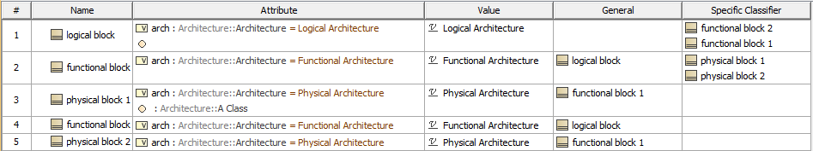
Architecture Analysis

Slide 10
I/O Analysis Report
Name | Connector | Pin | Signal
Sensor 6 Present | J3 | 95 | MWS5PRSNT_L
Sensor 6 Enable | J3 | 97 | MWS5_EN
Sensor 6 Enable Return | J3 | 98 | MWS5_EN_RTN
Sensor 6 Data + | J3 | 23 | MWS5DAT+
Sensor 6 Data - | J3 | 33 | MWS5DAT‐
Sensor 6 Command + | J3 | 45 | MWS5CMD+
Sensor 6 Command - | J3 | 34 | MWS5CMD‐
Sensor 5 Present | J3 | 94 | MWS4PRSNT_L
Sensor 5 Enable | J3 | 90 | MWS4_EN
Sensor 5 Enable Return | J3 | 89 | MWS4_EN_RTN
Sensor 5 Data + | J3 | 21 | MWS4DAT+
Sensor 5 Data - | J3 | 31 | MWS4DAT‐
Sensor 5 Command + | J3 | 7 | MWS4CMD+
Sensor 5 Command - | J3 | 12 | MWS4CMD‐
Sensor 4 Present | J3 | 88 | MWS3PRSNT_L
Sensor 4 Enable | J3 | 99 | MWS3_EN
Sensor 4 Enable Return | J3 | 91 | MWS3_EN_RTN
Sensor 4 Data + | J3 | 11 | MWS3DAT+
Sensor 4 Data - | J3 | 20 | MWS3DAT‐
Sensor 4 Command + | J3 | 13 | MWS3CMD+
Sensor 4 Command - | J3 | 6 | MWS3CMD‐
Sensor 3 Present | J3 | 87 | MWS2PRSNT_L
Sensor 3 Enable | J3 | 92 | MWS2_EN

