Slide 1
HSV INCOSE MBSE WG Challenge 14Jan21

Slide 2
Outline
What was the Challenge?
What did we accomplish?
What is the next step?

Slide 3
What was the Challenge?
MBSE Style Guide for DoD 5000 Program Acquisitions
DoD 5000 Meta Model
Example Model
Validation Suites
Metachain
VelocityScript

Slide 4
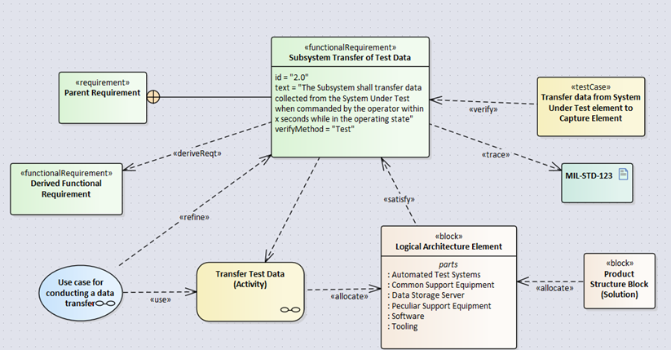
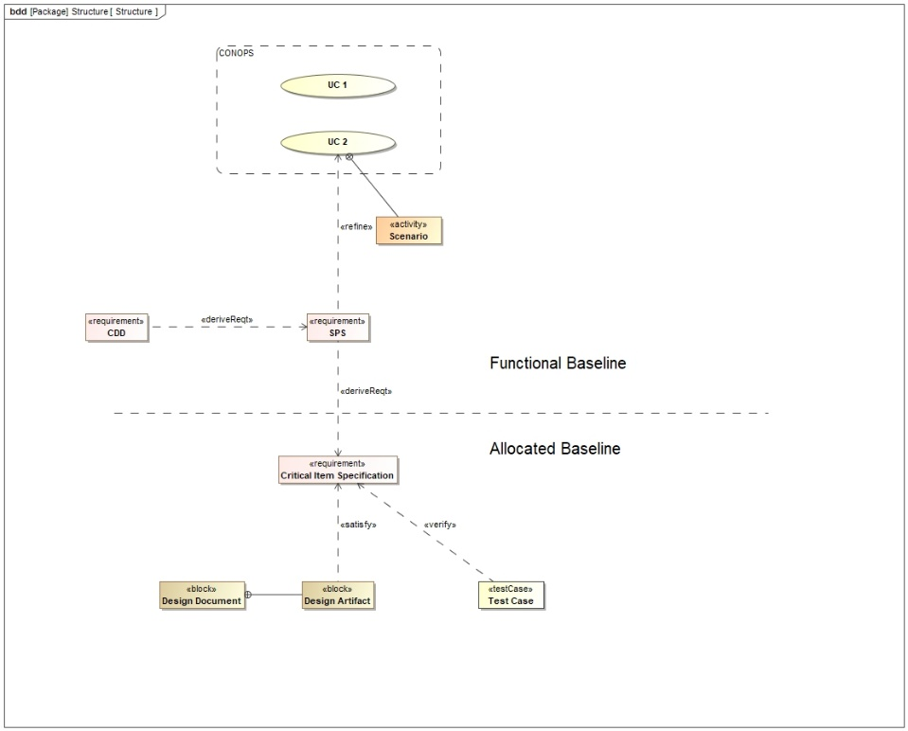
What did we accomplish?
Meta Model

Slide 5
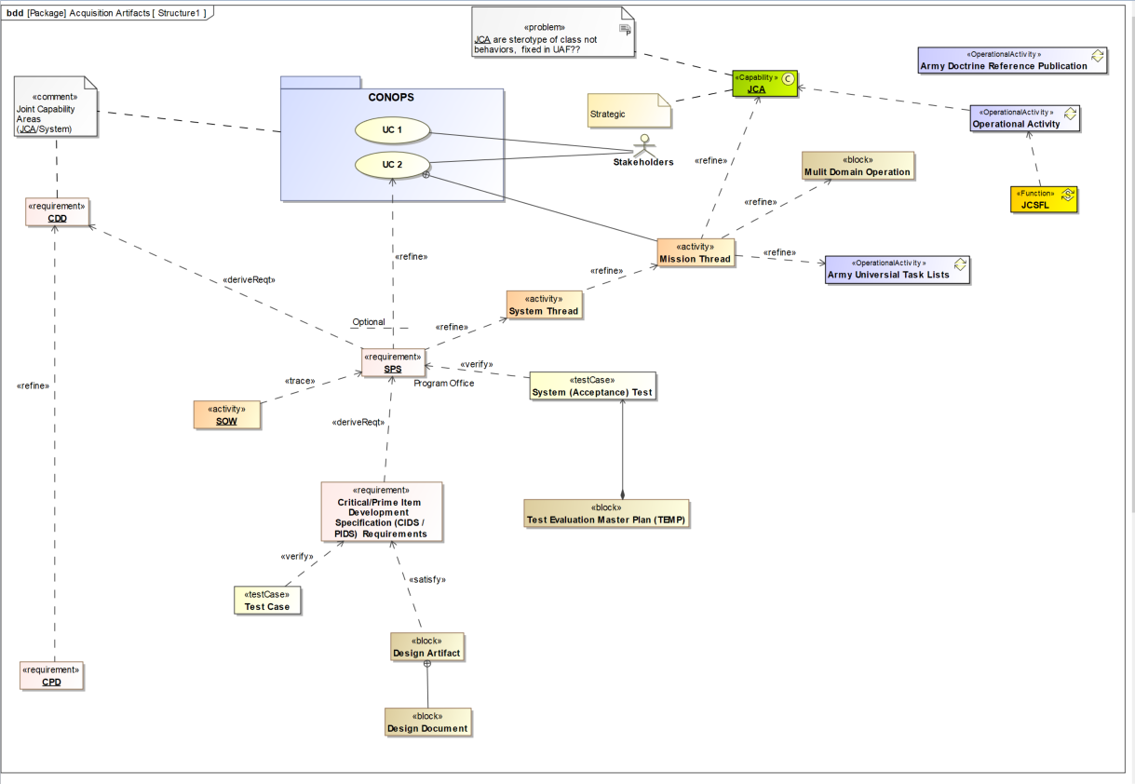
Meta Model

Slide 6
Common Model Library
AUTL ADRP
JCA Library
JICDS UPDM SE Profile
JCSFL Library

Slide 7
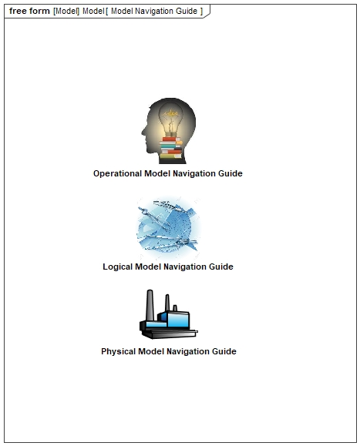
What is the next step?
Example Model

Slide 8
What is the next step?
Split the example model into three models.
Update the Operations Model to the Operational Model Common Libraries.
Identify Gated review for entry and exit criteria.
  Identify how our mode supports those decisions, give examples.
Identify contributing individuals for example model development.
  Send e-mails to wlozier@MITRE.org for self nominations

Slide 9



Model Architecture
<<Dependency >>
Operational Model Library
<<Dependency >>
Logical Model Library
<<Dependency >>
<<Dependency >>
Physical Model Library
<<Dependency >>

Slide 10
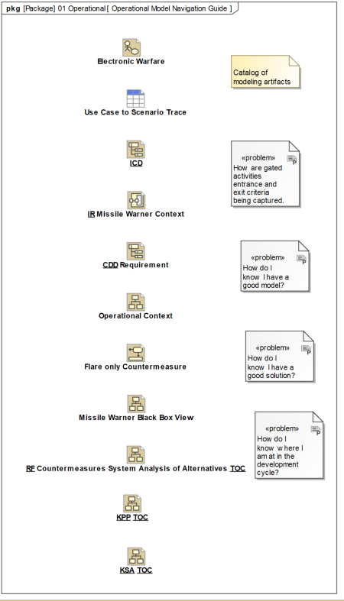
Operational Model Architecture

Slide 11
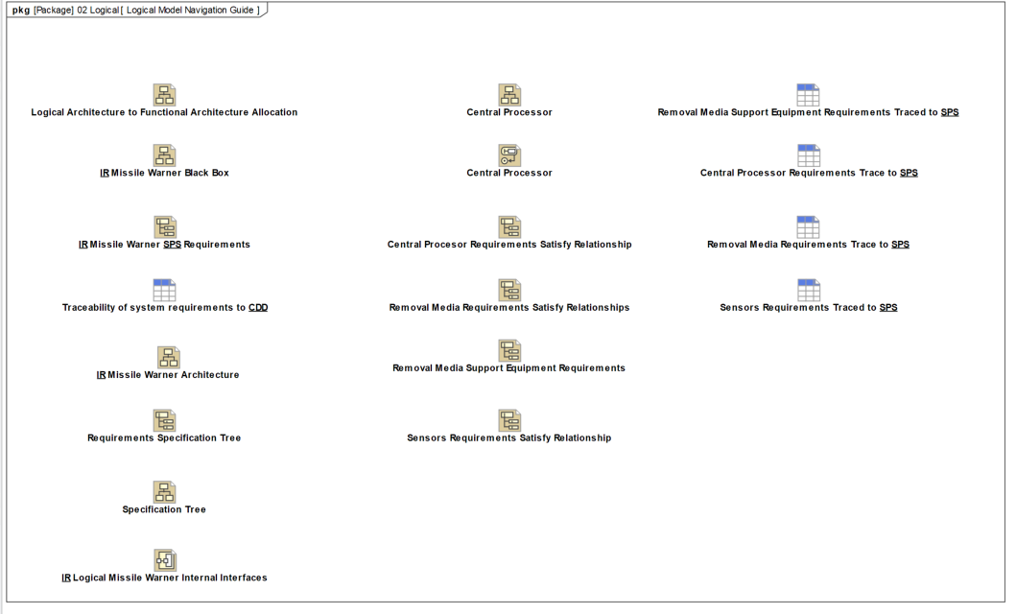
Logical Model Architecture

Slide 12
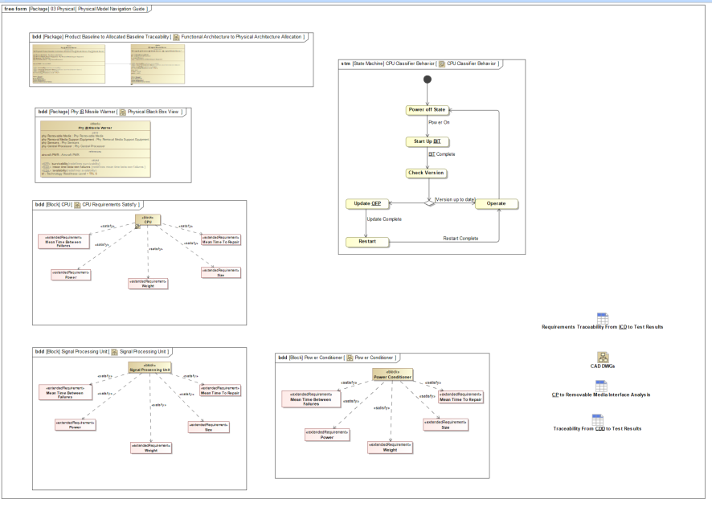
Physical Model Architecture

Slide 13
What is the next step?
Three to six hours of Tutorial information this year
  Topics?
    E-mail wLozier@MITRE.org
  Presenters?

