Slide 1
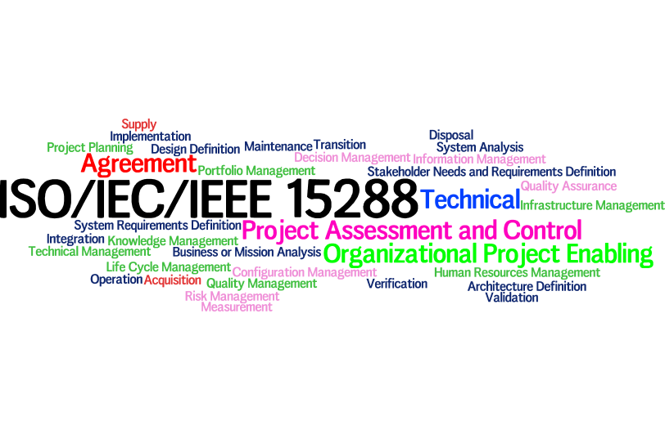
INCOSE – North Texas Chapter
May 9th 2017
Overview of ISO/IEC/IEEE 15288
Octavio Castellanos, CSEP

Slide 2
Agenda
15288 Background
Life Cycle Process
15288-INCOSE Alignment
SE Process Groups
Typical Process Content
Extension 15288.1
Extension 15288.2
Benefits of 15288
Adoption Drivers
5 Steps to Implement 15288

Slide 3
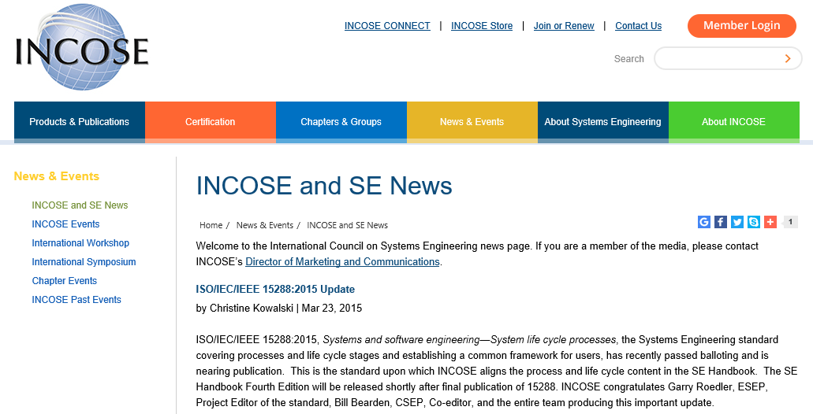

Slide 4
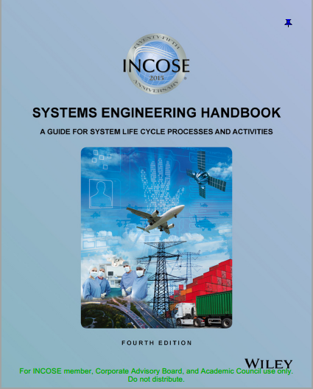
Systems Engineering Discipline
International Council on Systems Engineering (INCOSE)
SE Handbook, v4
SE Body of Knowledge (SEBoK)
ISO/IEC/IEEE 42010:2011 - Systems and Software Engineering - Architecture Description
ISO/IEC/IEEE 15288:2015 - System Life Cycle Processes
IEEE 15288.1:2014 - Standard for the Application of Systems Engineering on Defense Programs
IEEE 15288.2:2014 - Standard for the Application of Technical Reviews and Audits on Defense Programs

Slide 5
Background
The application of systems engineering (SE) processes and practices throughout the system life cycle has been shown to improve project performance, as measured by satisfaction of technical requirements within cost and schedule constraints
ISO/IEC/IEEE 15288 is a systems engineering standard developed by the consensus of SE experts from government, industry, and academia. It is recognized by both industry and the Department of Defense (DoD) as being a common process framework for the performance of effective systems engineering throughout the system life cycle.
IEEE 15288.1 expands on the SE life cycle processes in ISO/IEC/IEEE 15288 with the outcomes, activities, and outputs applicable to DoD projects.
IEEE 15288.2 defines a set of technical reviews and audits that may be conducted for a DoD project and specifies the timing, inputs, review criteria, and outputs for those reviews.
International Organization for Standardization
International Electrotechnical Commission
Institute of Electrical and Electronics Engineers
Adopted on 07 Jul 2015 for use by the Department of Defense (DoD)
Notes:
15288
“Defined set of processes to facilitate communication among acquirers, suppliers and other stakeholders in the life cycle of a system.”
“Applies to the full life cycle of systems, including conception, development, production, utilization, support and retirement of systems”

Slide 6
SE Process Life Cycle
ISO/IEC TR 24748-1 System Life Cycle (SLC)
NEED
DISPOSAL
Concept
Development
Production
Utilization
& Support
15288 does not prescribe a specific life cycle model, but rather provides a process for defining, approving, and managing a life cycle model or models. This is described in Section 6.2.1 of 15288. Other 15288 processes take place within the context of an organization's approved life cycle model.
ISO/IEC TR 24748-1:2010 provides information on life cycle concepts and provides life cycle models that can be used within the frameworks of 15288 and/or 12207. It also provides guidance for tailoring your life cycle based on unique organizational requirements.
Notes:
ISO 15288 does not prescribe any particular life cycle model. Instead it defines a set of processes, termed life cycle processes, that can be used in the definition of the system's life cycle. Also, this International Standard does not prescribe any particular sequence of processes within the life cycle model. The sequence of the processes is determined by project objectives and by selection of the system life cycle model.
Per ISO/IEC TR 24748-1 the typical system life cycle stages include concept, development, production, utilization, support, and retirement.

Slide 7
Aligned… yet, different
What is Systems Engineering?
“Interdisciplinary approach and means to enable the realization of successful systems.” (INCOSE)
“Interdisciplinary approach governing the total technical and managerial effort required to transform a
set of stakeholder needs, expectations, and constraints into a solution and to support that solution
throughout its life” (ISO/IEC/IEEE 15288:2015)

Slide 8
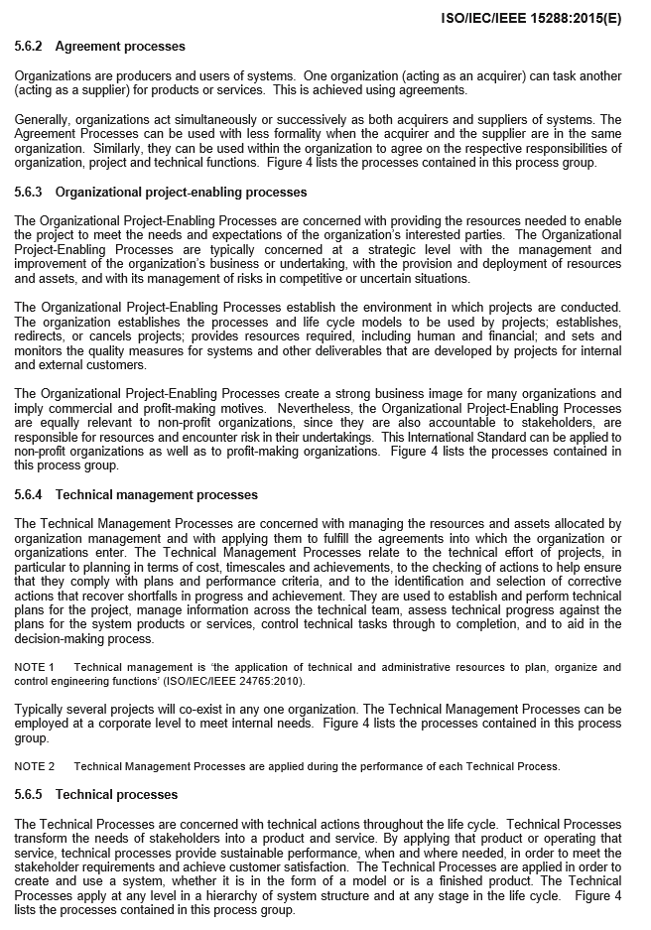
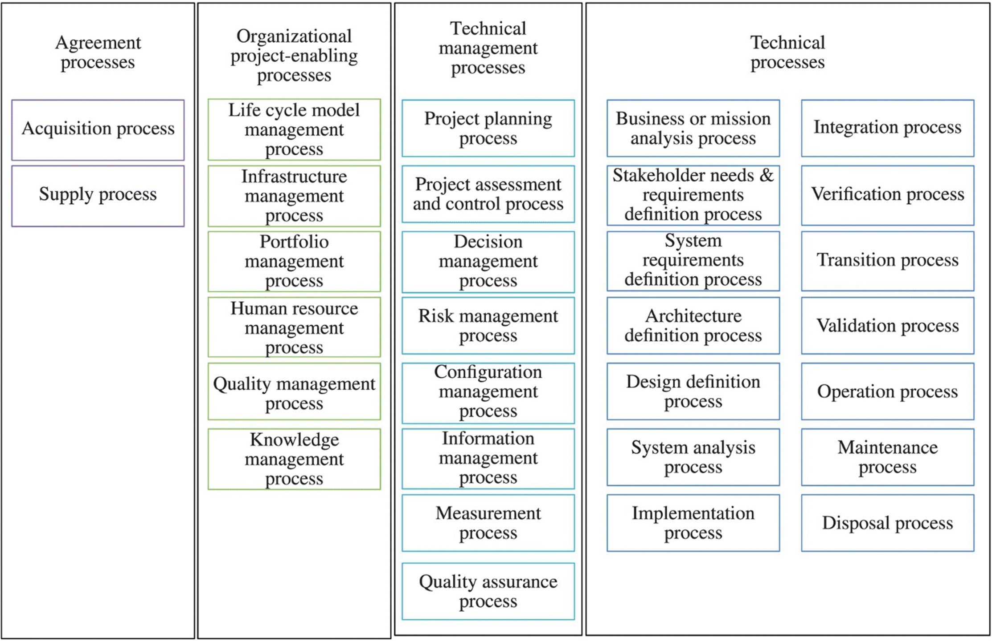
SE Process Groups
Agreement
Organizational Project-Enabling
Technical Management
Technical Processes

Slide 9
ISO/IEC 15288 to INCOSE Alignment
ISO/IEC 15288:2008 System Life Cycle Process | INCOSE SE Handbook v4e Section 4.0
6.4 Technical Processes | 4.0 Technical Processes
6.4.1 Business or Mission Analysis | 4.1 Business or Mission Analysis
6.4.2 Stakeholder Needs and Requirements Definition | 4.2 Stakeholder Needs and Requirements Definition
6.4.3 Systems Requirements Definition | 4.3 Systems Requirements Definition
6.4.4 Architectural Definition | 4.4 Architectural Definition
6.4.5 Design Definition | 4.5 Design Definition
6.4.6 System Analysis | 4.6 System Analysis
6.4.7 Implementation | 4.7 Implementation
6.4.8 Integration | 4.8 Integration
6.4.9 Verification | 4.9 Verification
6.4.10 Transition | 4.10 Transition
6.4.11 Validation | 4.11 Validation
6.4.12 Operation | 4.12 Operation
6.4.13 Maintenance | 4.13 Maintenance
6.4.14 Disposal | 4.14 Disposal

Slide 10
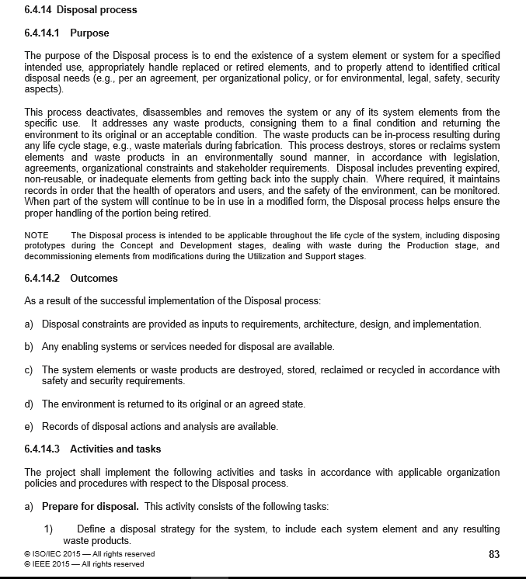
Typical Outline of a Process
Purpose
Outcomes
Activities and tasks

Slide 11
15288.1 Extension
15288.1 IEEE Standard for Application of Systems Engineering on Defense Programs
Scope
This standard establishes the requirements for systems engineering activities to be performed on projects of the United States (US) Department of Defense (DoD) and other defense agencies across the entire system life cycle, including the planning, acquisition, modification, and sustainment of defense systems. It provides the foundation for systems engineering within the context of ISO/IEC/IEEE 152881 and the acquisition environment of DoD and other defense agencies at all levels of system hierarchy. This standard provides detailed requirements for the application of the life cycle processes, activities, and tasks of ISO/IEC/IEEE 15288 for use on any defense system and includes the effective integration of agreement processes, technical processes, technical management processes, and essential specialty engineering requirements.
Purpose
This standard provides requirements for the application of ISO/IEC/IEEE 15288 for defense systems engineering needs. This standard implements ISO/IEC/IEEE 15288 for use by DoD organizations and other defense agencies in acquiring systems or systems engineering support. While primarily supporting the acquirer-supplier agreement mode, this standard also can be used to support the other modes: use by organizations, projects, and process assessors. This standard provides the basis for selection, negotiation, agreement, and performance of necessary systems engineering activities and delivery of products, while allowing flexibility for both innovative implementation and tailoring of the specific systems engineering process(es) to be used by system suppliers, either contractors or government system developers, integrators, maintainers, or sustainers.

Slide 12
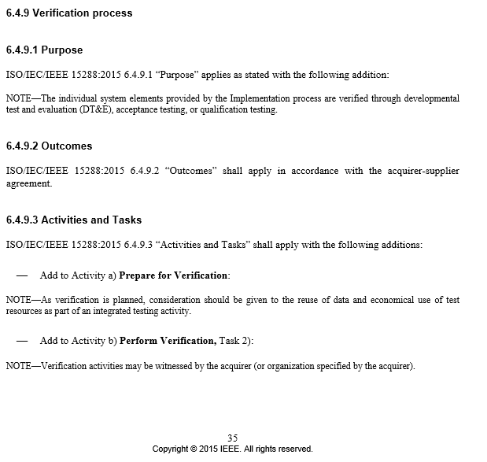
.1 extension (continued)
Only references changes to 15288
as required per DoD programs
Example (Verification Process)

Slide 13
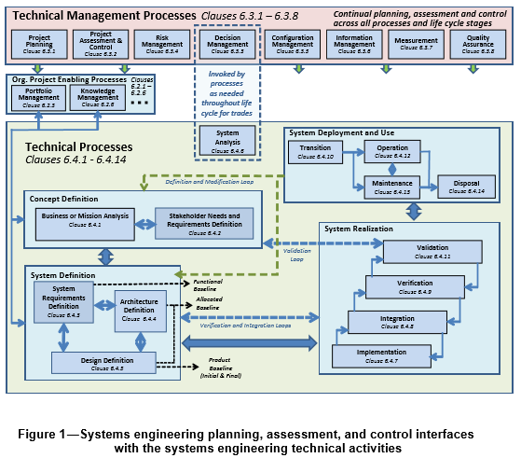

Slide 14
15288.2 Extension
15288.2 IEEE Standard for Technical Reviews and Audits on Defense Programs
Scope
This standard establishes the requirements for technical reviews and audits to be performed throughout the acquisition life cycle for the US Department of Defense (DoD) and other defense agencies. This standard provides the definition, description, and intent, as well as the entry, exit and success criteria, for each technical review and audit. It is to be used to establish agreement between acquirers and suppliers on the technical reviews and audits that are needed for the project, as well as the focus and expectations of each technical review and audit.
Purpose
This standard is intended to elaborate the technical review and audit clause of ISO/IEC/IEEE 15288, System life-cycle processes, for use by the DoD and other defense agencies in acquiring systems (and parts thereof) or services. It amplifies ISO/IEC/IEEE 15288, subclause 6.3.2.3.a, for selection, negotiation, agreement, and performance of the necessary technical reviews and audits, while allowing tailoring flexibility for the variety of acquisition situations/environments when the technical reviews or audits are conducted. While primarily supporting the acquirer-supplier agreement mode, this standard also can be used to support the other modes such as use by organizations, projects, and process assessors.

Slide 15
15288.2 Technical Reviews and Audits
General Technical Reviews and Audits
Alternative Systems Review
System Requirements Review
System Functional Review
Preliminary Design Review
Critical Design Review
Test Readiness Review
Functional Configuration Audit
System Verification Review
Production Readiness Review
Physical Configuration Audit
Domain-Specific Technical Reviews and Audits
Software Requirements and Architecture Review
Software Specification Review
Integration Readiness Review
Flight Readiness Review

Slide 16
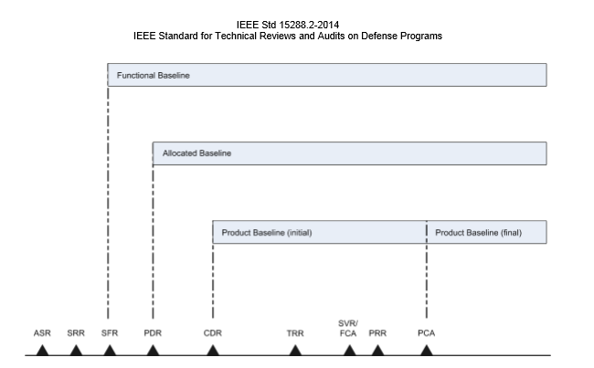
TR ACRONYMS
TR – Technical Review
ASR – Alternative Systems Review
SRR – System Requirements Review
SFR – System Functional Review
PDR – Preliminary Design Review
CDR – Critical Design Review
TRR – Test Readiness Review
SVR – System Verification Review
FCA – Functional Configuration Audit
PRR – Production readiness Review
PCA – Physical Configuration Audit

Slide 17
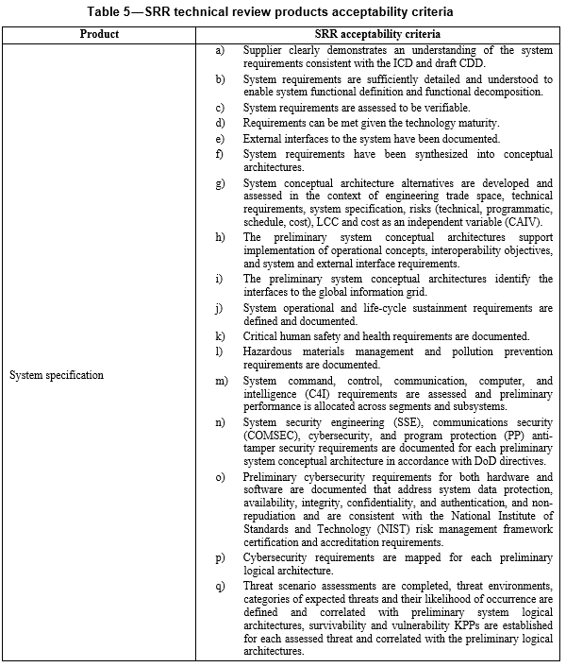
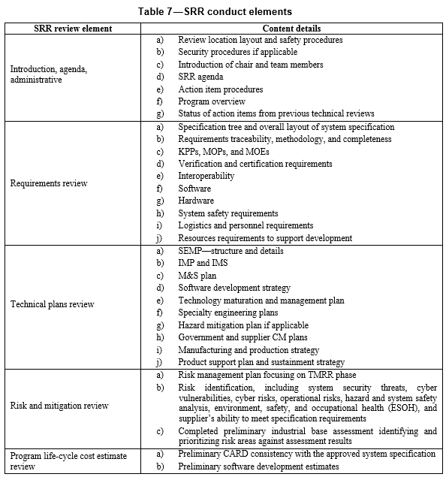
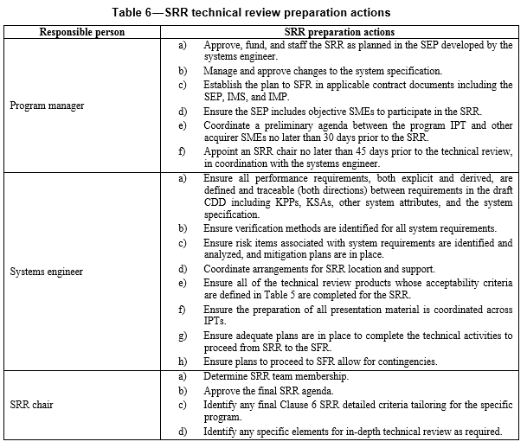
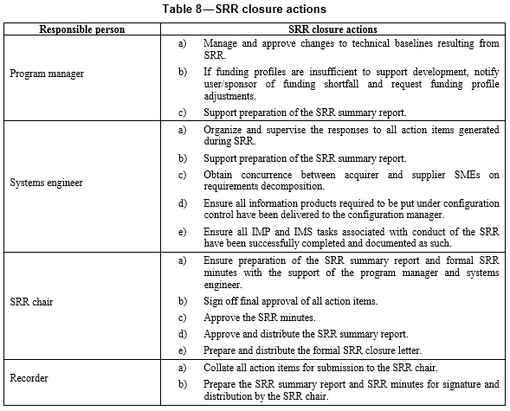
Technical Review Guidelines Examples:
SRR Technical Review Products Acceptability Criteria
SRR Technical Review Preparation Actions
SRR Conduct Elements
SRR Closure Actions

Slide 18
Benefits of Using ISO/IEC/IEEE 15288
Defines the process that a reasonable professional Systems Engineer would expect an organization to use in producing a quality system product.
Provides:
a life cycle framework to perform systems and software tasks/activities in an organized disciplined manner
a process framework that can be tailored to suit
a framework that can reduce risk
a framework for achieving customer expectations
a basis for communications
a basis for coordinating work.

Slide 19
Adoption Drivers
Customer Alignment
Already adopted by DoD
Expected on future programs/ contracts
Potential discriminator in proposals
Best Practices
Leading indicators of program health
Detailed success criteria for planning and execution

Slide 20
What does Conformance to 15288 Look Like?
Two criteria for claiming full conformance
“Full conformance to tasks”
Asserts that all of the requirements of the activities and tasks of the declared set of processes are achieved
“Full conformance to outcomes”
Asserts that all of the required outcomes of the declared set of processes are achieved
Conformance to outcomes permits greater freedom in implementation
ISO/IEC/IEEE 15288:2015, Clause 2.1

Slide 21
5 Steps to Implement ISO 15288: A Simple Approach
Plan
Determine Resources
Preparation & Training
Implementation and Audit
Assess
REWARD
Identify gaps and
non-complaint activities
via mapping of activities
to current process
Determine the 15288
activities and tasks
necessary to satisfy the
needs of the organization
Determine required
Process & Organizational
change
Obtain leadership buy-in
Appoint a 15288
implementation manager
Draft Resource plan and
Schedule for 15288
implementation
Obtain leadership
concurrence on funding
and schedule
Draft Communication &
Training Plan
Update organizational
Policies, Procedures,
and work instructions to
reflect new tasks
Train all levels of the
organization
Implement one action/
item at a time
Perform audits during
a reasonable time period
Schedule Management
Implementation reviews
of new 15288 task
Inform the organization of/upon
project completion
Notes:
Point participants to talk to their companies for obtaining a copy of the standard trough them. All LM peoplecan contact me and I can direct you where you can get a copy through our Network via the agreement with IEEE

Slide 22
References
[1] ISO/IEC/IEE 15288:2015, Systems and Software Engineering – System Life Cycle Processes
[2] IEE 15288.1:2014, IEEE Standard for Application of Systems Engineering on Defense Programs
[3] IEE 15288.2:2014, IEEE Standard for Technical Reviews and Audits on Defense Programs
[4] International Council on Systems Engineering (INCOSE), SE Handbook, v4. 2015
[5] Syntell AB, http://www.15288.com/five_steps.php
[6] International Organization for Standardization, https://www.iso.org/standard/63711.html

