Slide 1
Blockchain State of the Industry 2018
Author: Darren McCarley
Date: 12/10/2018
https://www.linkedin.com/in/darrenmccarley

Slide 2
Disclaimer
The presentation today contains original and publicly available content. While the original content was created by me, on my own time, I recognize that I am a Lockheed Martin employee. Therefore it is important to understand that all words, opinions, answers to questions and any and all statements made by me today are purely my own and do not reflect in any way any one in the Lockheed Martin family, including but not limited to Bethesda, Fort Worth, or Washington, D.C. All opinions are uniquely mine and do not reflect anyone else’s opinion other than my own.

Slide 3
Crypto

Slide 4
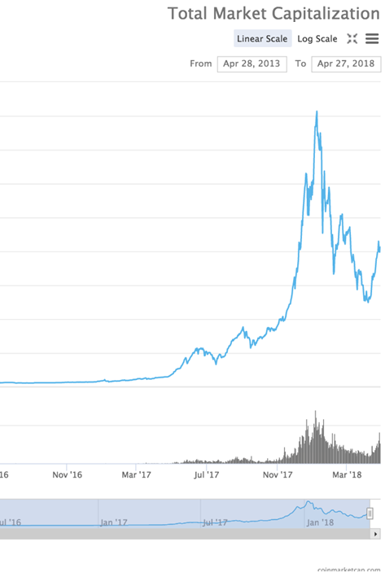
Crypto

Slide 5
Blockchain Use Cases
Industry continues to document new use cases for Blockchain.
Digital Identity
Voting
Conflict Minerals
Land registration
Supply Chain
N Sub Tiers in complex Supply Chains
Distributed Storage
Box, GoogleDrive, etc
Medical records
Ticket Sales
To mitigate Scalpers
Google “Blockchain use cases”

Slide 6
Use case MVP results
Most of Blockchain industry is using the “Minimum Viable Product” (MVP) concept prior to “Pilot” or even Proof of Concept (PoC) to keep costs down
It is generally accepted that 90% of MVP’s fail
This is generally seen as beneficial
Technical teams “learn through doing”
Financially mitigates investment
If 90% fail, that means 10% are successful!

Slide 7
Use case MVP results
Successful MVP’s moving into production
TradesLens – Generally accepted as the front runner of Blockchain in Production
Spin off company between Maersk and IBM
IBM and Maersk video
Note the real time transactions on the TradeLens site
FoodTrust - Protection from food borne illnesses
Walmart, along with 8 other companies and IBM video
September 24, 2018 Walmart announces Food Suppliers will be required to sign up for FoodTrust by January 31, 2019 video
This in response to the E. coli outbreak
West Virginia Voting - Sept 25, 2018 West Virginia allows over-seas voting by military via Blockchain for midterms and extends to November

Slide 8
Technology Partners of Interest
Amazon – Quantum Ledger Database
After denouncing blockchain in 2017, on Nov 28, 2018, during AWS re:Invent, Amazon announced QLDB
FedEx joins Linux Foundation’s Hyperledger –
Sept 26, 2018 FedEx announces joining of The Linux Foundation’s Hyper Ledger Project
Other Hyperledger members
Google – Google Cloud Platform (GCP)
Digital Asset, and BlockApps partner for distributed ledger technology (DLT) frameworks on GCP
IBM – Blockchain Services
Microsoft – Azure Blockchain Workbench
Oracle – Blockchain Applications Cloud
SAP – Leonardo

Slide 9
Primary Blockchain Challenges
Interoperability
In the past, this was true. Today, it is not.
Performance
Continues to be a challenge for very high transaction rates (1k/second)
Storage
Continues to be recognized as a potential challenge. At least a financial one relative to Cloud storage.
How long does it take for a Blockchain has to fill a 1 terabyte drive? Years? Depends on volume of the network.
Complexity
True with ALL budding technologies. There is a learning curve.
New and affordable/free classes all the time
Ignorance
Many still believe Blockchain is Bitcoin

Slide 10
Conclusion
Cryptocurrency
Hype seems to be normalizing
Blockchain for Industry
Education amongst “late comers” continues
Jobs continue to demand high salaries (supply vs demand)
Use cases continue to surface
Consortiums increasing
Blue Chip player count continues to rise

Slide 11
Resources
Bitcoin White Paper – Satoshi Nakamoto
Blockchain Demo – Anders Brownworth
Videos
Blockchain for Business - An Introduction to Hyperledger Technologies - edX.org
Ethereum White Paper
Guardtime – Blockchain like official site
Hyperledger official site - Linux Foundation
IBM Blockchain for Business – IBM Dev Center
IBM Blockchain Essentials Course – IBM Dev Center
IBM Blockchain Foundation Developer – IBM Dev Center

