Slide 1
INCOSE Chicagoland Chapter Meeting Agenda
January, 2018
Please sign the attendance list and
verify that your contact information is current

Slide 2
Agenda
6:00 – 6:30 PM CT – Networking and Dinner
6:30 – 6:50 PM CT – Welcome, Announcements, Intros
6:50 – 8:00 PM CT – Meeting Presentation
8:00 – ??? – Networking

Slide 3
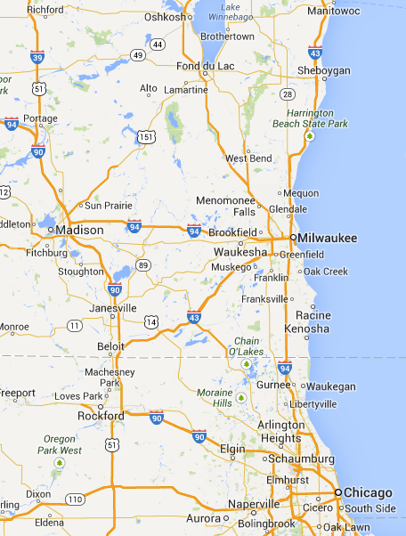
Welcome All Sites
Oshkosh Corp
Oshkosh, WI
bb7
Madison, WI
AbbVie Inc.
North Chicago, IL
IBM
Schaumburg, IL
Design Integrity
Chicago, IL

Slide 4
Welcome All Sites
Many individuals joining remotely from IL, WI, and beyond
Do several people from your office attend? If so, consider establishing a remote site to build interest and networking opportunities:
Start out as a “closed” site for employees only
Could open up to general membership later
Opportunity for ambassadorship
Interested in becoming an ambassador?
Be the liaison between INCOSE and your organization
Contact Mohamed Zaher MHSabry@gmail.com

Slide 5
Renewing Members
Patrick Gustafson
Alan Mindlin
Malcolm Lunn
Paul Sorensen
Bradley Lyon
Justin Schmidt
John Vittallo
Matt Beneke
Jonathan Lenius
Robert Parro
Gary Houchin-Miller
Jeff Kitcheos
John Collins
Philip Santoro
Suresh Putta
Daniela Popovic

Slide 6
New Members
Koye Oyesiku River North Solutions
Denis Pinha Valid USA
Andy Argersinger Baxter Healthcare
Aditya Shah John Deere
David Wyant Sierra Nevada Corporation
Matthew Woods Northrop Grumman
Jason Duerr Chicago Industrial Solutions

Slide 7
Benefits of INCOSE Membership
Professional Development
Monthly speakers on topics relevant to System Engineering (Later in this meeting)
Recordings of speakers from previous months (Click on the ‘Library and Resources’ tab of our home page.)
Access to the output of over 40 INCOSE Working Groups (Google “INCOSE Working Group”): A sample of the working groups includes: Decision Analysis; Defense Systems; Enterprise Systems; Global Earth Observation System of Systems; Healthcare; Human Systems Integration; Infrastructure; etc.

Slide 8
Benefits of INCOSE Membership (Cont.)
Professional Development (Cont.)
INCOSE Connect: content developed by chapters and working groups (Click on “INCOSE CONNECT” on the chapter’s home page)
System Engineering Certification (ASEP, CSEP, ESEP) (Click on “The Certification Process” on the chapter’s home page)

Slide 9
Benefits of INCOSE Membership (Cont.)
Professional Development (Cont.)
Access to a forum on handling System Engineering issues (Click on ‘Reddit’ on the chapter’s home page)
Access list of over 30 Activities Across INCOSE:

Slide 10
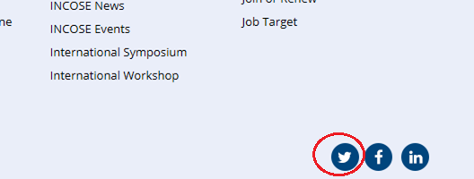
Benefits of INCOSE Membership (Cont.)
Professional Development (Cont.)
Access to Tweets on new job leads:
Access to INCOSE’s System Engineering Job Board: http://incose.careerwebsite.com/

Slide 11
Benefits of INCOSE Membership (Cont.)
Networking Opportunities
11,000+ INCOSE members worldwide
Networking for yourself and for employees!
Before and after Chapter events
Supporting your Chapter
Supporting a Working Group
Workshops/Symposiums
Share SE Job postings at meetings & in members-only e-mail
Leadership Opportunities
Chapter board of directors (listed on chapter website, under ‘About This Chapter’)
Chapter Committee participation
Micro-volunteering Roles Available (Roles as small as data entry or company networking)
Working Group participation (Two board members co-chair working groups!)

Slide 12
Benefits of INCOSE Membership (Cont.)
Help Others
Share SE knowledge/experience with:
New SEs
Professional Societies
K-12, college students
Advance the art/profession of System Engineering
Establish your brand
“Pay It Forward”

Slide 13
How to Join INCOSE
Go to the INCOSE Website – www.incose.org
Click on “Join INCOSE”
Provide information
Select chapter affiliation – “Chicagoland”
Pay $145 for 1-year membership (or select a longer term at a lower rate)
Refer a new member? Get an Amazon gift card!
Email Patrick Gustafson patrick.gustafson@scientificgames.com

Slide 14
Circle Awards Program
Incentive program to encourage chapter activities that support the objectives of INCOSE
Chapter history: Gold every year since 2012
2017 Submitted for Platinum Circle Award

Slide 15
Circle Awards Program (Cont.)
Keep us informed of your System Engr. activities!
GLRC (Great Lakes Regional Conference) participation
INCOSE Working Group participation
Published papers
Presentations given at schools, professional societies, etc.
IS/IW participation, including paper reviews
SEP certification: Goal of 5 new xSEPs
E-mail Chris Freund cfreund7@gmail.com with evidence

Slide 16
Great Lakes Regional Conference 2018
The Crossroads of America Chapter is hosting:
Systems at the Crossroads: GLRC2018
in Indiana this fall
The leading regional conference in INCOSE
Team chairs of the sub-committees planning this conference have just gotten underway in December
Now inviting our neighbor Great Lakes chapters to join these planning sub-committees.
If interested in volunteering with the GLRC planning committees contact: General Chair: Bill Schindel schindel@ictt.com

Slide 17
Upcoming Chapter Meetings & Events
Third Thursday of the Month @ 6:30 PM CT
February 15: Ron Carson, Topic: Modeling
March 15: David Long, Topic: 2025 Vision
Spring Seminar: SE Basics – More information to follow
Meeting ideas are always welcome.
Please send suggestions for topics, speakers, meeting formats to Gary Oswald (oswaldgary33@gmail.com)

Slide 18
Upcoming Board Meeting
Board Meetings on the first Thursday of each month
Meetings are open to all members
Next meeting: Thursday, Feb.1, 7:00 – 9:00 PM CT
via web conference
Plenty of opportunities to get involved!
Leadership and contributor opportunities available
Grow your networking!
Interested in helping?
Contact: gary.houchin.miller@gmail.com

Slide 19
Introductions
Please introduce yourself (within each location):
Name
Title & What do you Do (30 seconds)
How long have you been a member of INCOSE?
Company
Announce job opportunities at your company, if any, or announce if you are looking for an opportunity
Sign the attendance list
Verify your contact information is current

Slide 20
Tonight’s Presentation
Board of Directors Annual Planning Outputs
INCOSE Chicagoland 2018 Board
[Transfer Screen to Presenter - Wait for Starting Slide, Introduce Speaker, Start recording]
Notes:
Christopher Jones has served as Senior Systems Engineer for both Motorola and Continental Automotive, experiencing firsthand the transformation of the Systems role from “the guy who writes the requirements” to a formal engineering discipline that leads rather than follows development. He is a member of INCOSE, and has contributed systems expertise to a number of Telematics projects, including GM OnStar, Ford Telematics, and ERA-GLONASS compliant systems for automotive OEMs operating in Russia. In the fall of 2016, Chris joined the systems team at Shure, Inc. in Niles, IL, with the goal of demonstrating and promoting the benefits of MBSE for a global leader to address the growing complexities of audio products.

