Slide 1
INCOSE
Systems Engineering Professional (SEP)
Certification Program
Program Summary
February 2020
Tony Lindeman, ESEP-Acq, PMP, CBAP
INCOSE-HRC
August 20, 2020

Slide 2
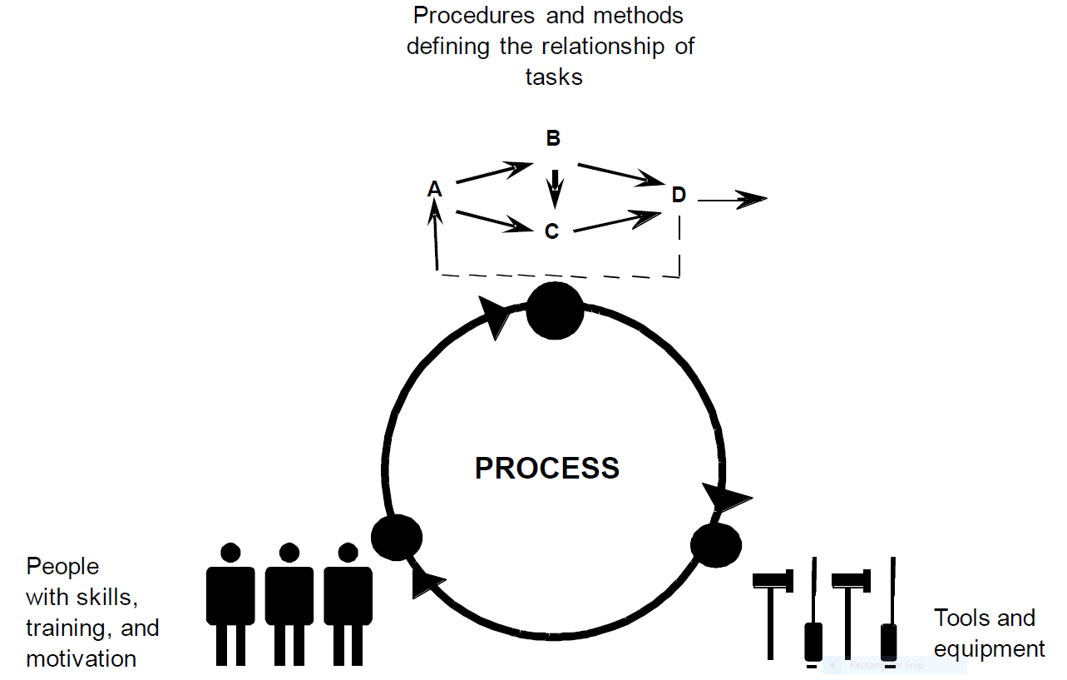
Why certification is important
Organizational Capability
  Processes
  People
  Tools
Translates to…
  Documented processes
  Qualified, experienced, proficient, and competent workforce
  Process-enabling tools
Reference: CMMI® for Development, Version 1.3, CMU/SEI-2010-TR-033; Software Engineering Institute; November 2010

Slide 3
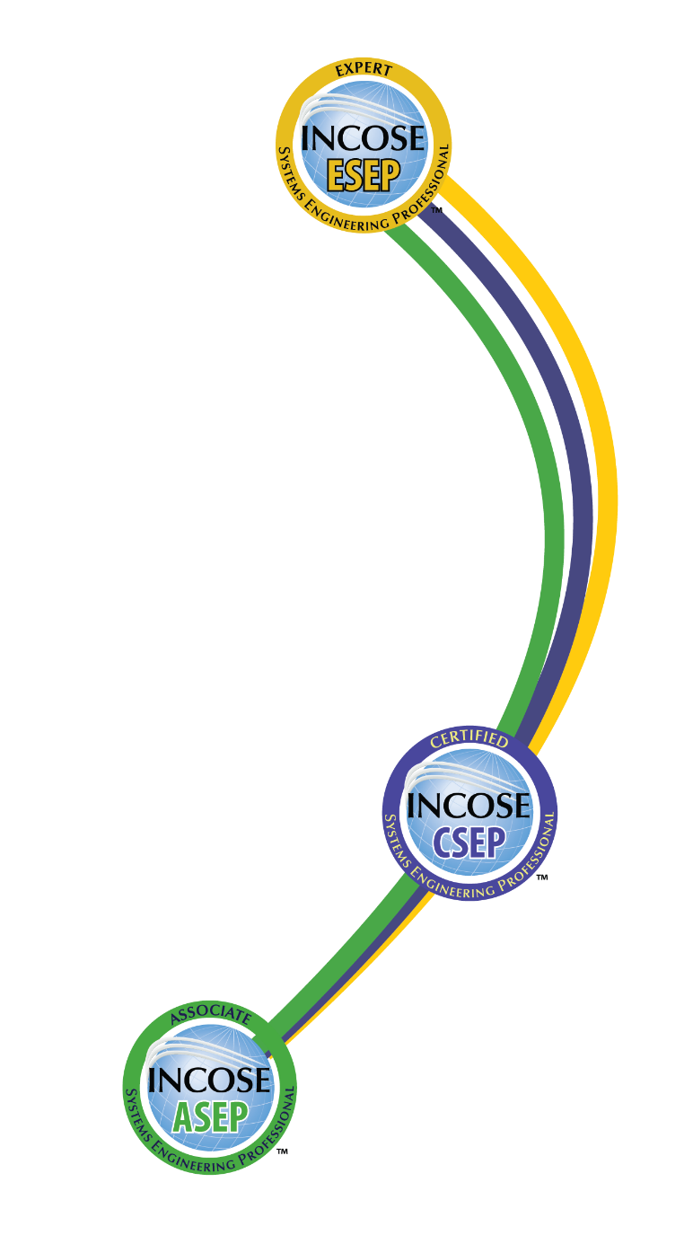
INCOSE SEP Architecture
For wherever you are in your career
Multi-Level Base Credentials
The base ASEP, CSEP, and ESEP credentials cover the breadth of systems engineering at increasing levels of leadership, accomplishments, and experience.

Slide 4
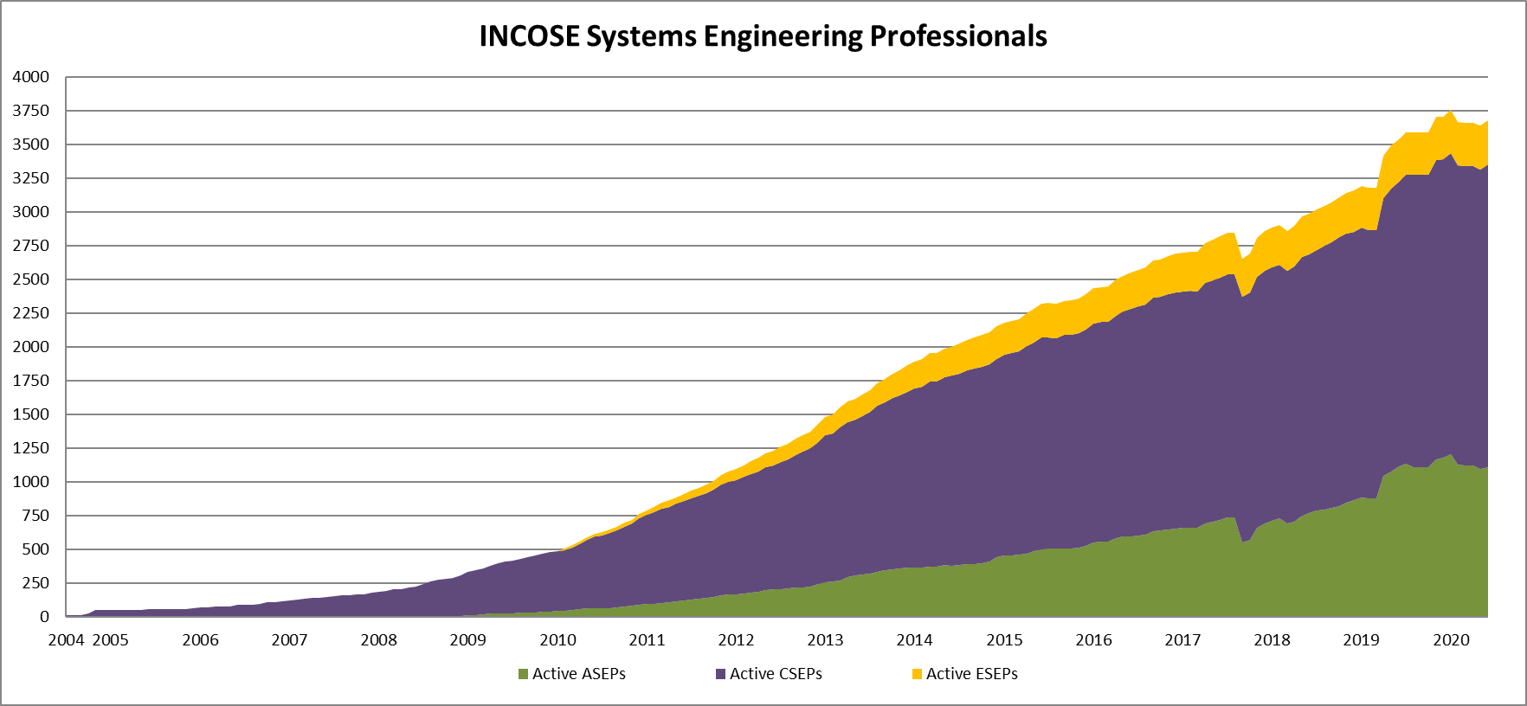
Total SEPs since 2004
As of 30 June 2020:
3679 Total SEPs
1109 ASEPs
2244 CSEPs
326 ESEPs
3195
2882
2700
2436
2180
1887
1476
1093
788
487
331

Slide 5
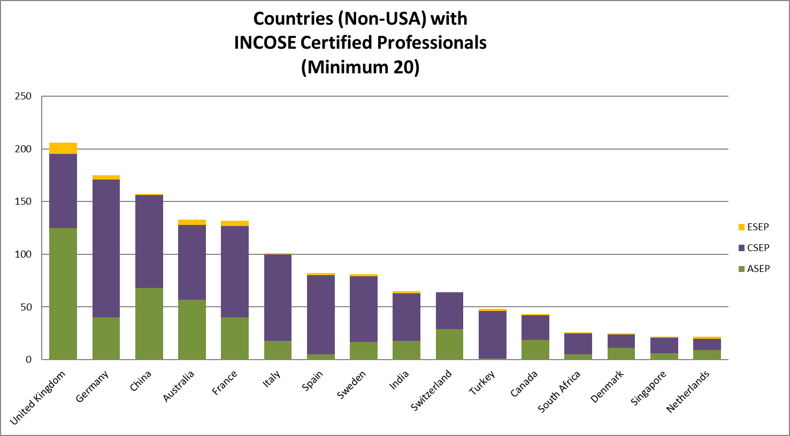
SEPs by Country
As of 30 June 2020:
Top Countries w/ Active SEPs
USA 2233 SEPs
UK 206 SEPs
Germany 175 SEPs
China 157 SEPs
Australia 133 SEPs
France 132 SEPs

Slide 6
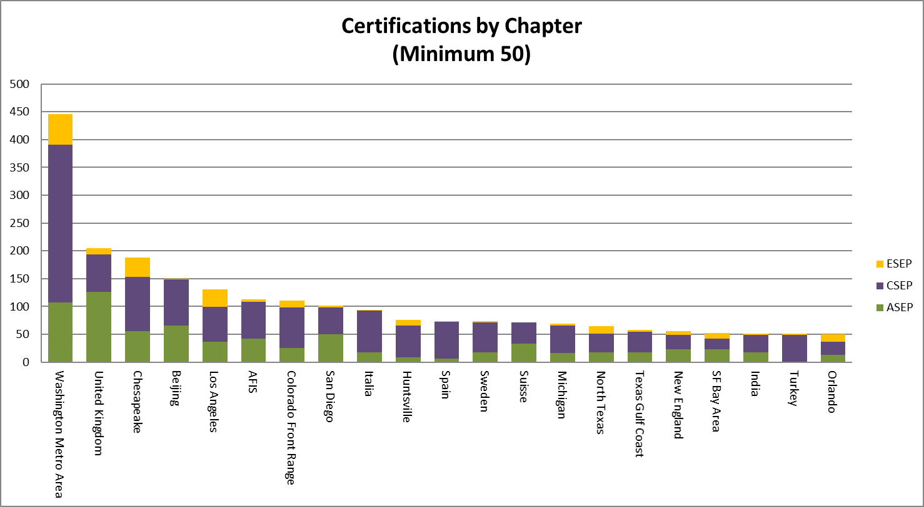
SEPs by Chapter – June 2020
As of 30 June 2020:
Top Chapters w/ Active SEPs
Washington Metro 446 SEPs
United Kingdom 205 SEPs
Chesapeake 188 SEPs
Beijing 150 SEPs
Los Angeles 133 SEPs

Slide 7
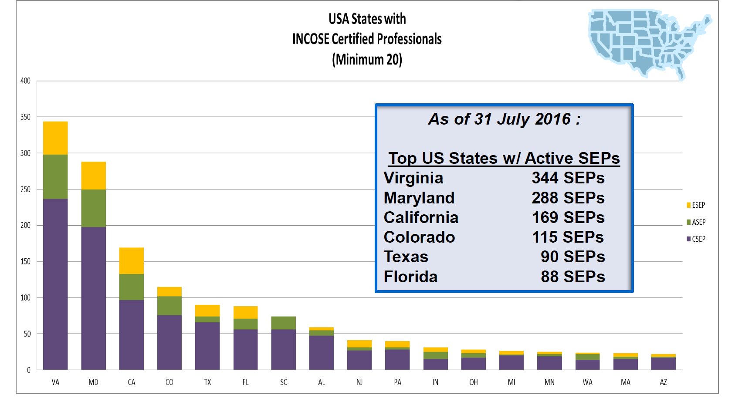
SEPs by U.S. State – July 2016

Slide 8
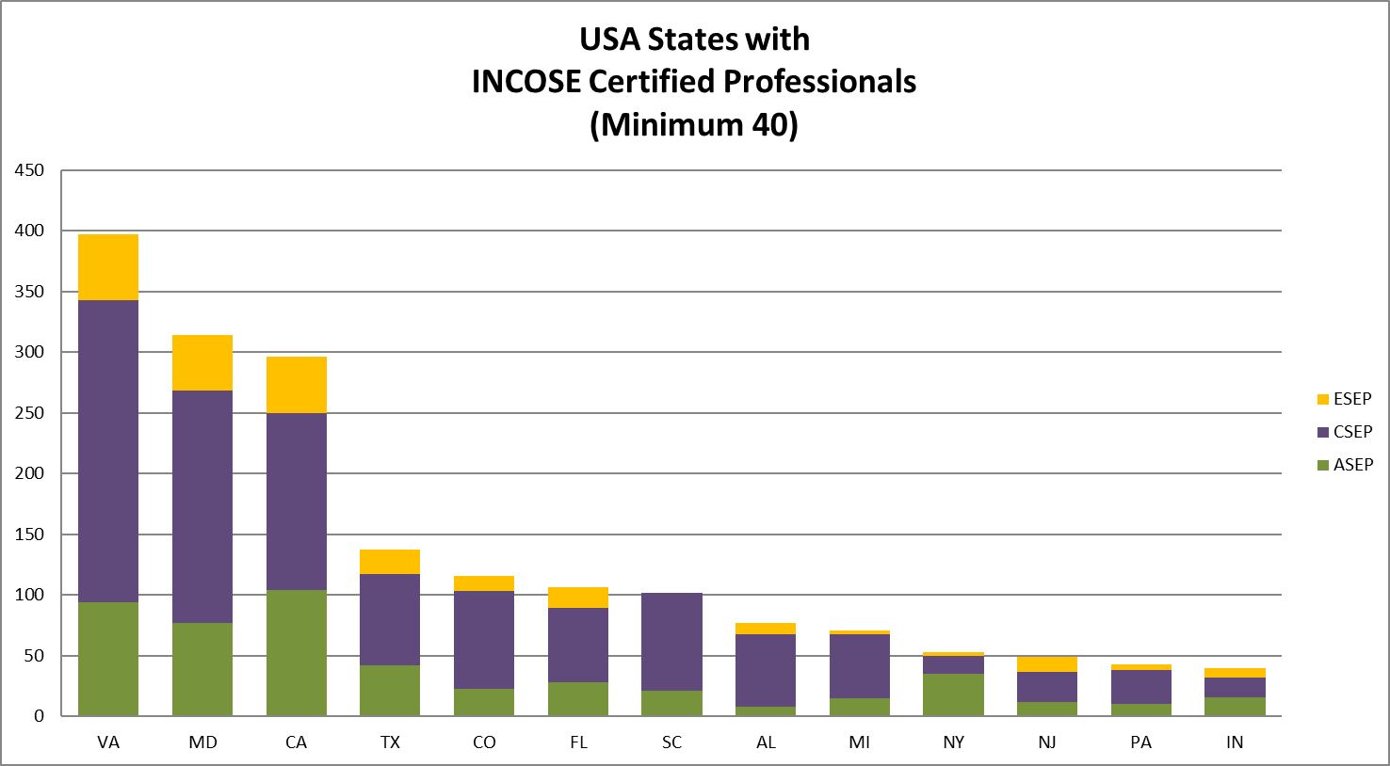
SEPs by U.S. State – June 2020
As of 30 June 2020:
Top US States w/ Active SEPs
Virginia 397 SEPs
Maryland 314 SEPs
California 296 SEPs
Texas 137 SEPs
Colorado 116 SEPs
Florida 106 SEPs

Slide 9
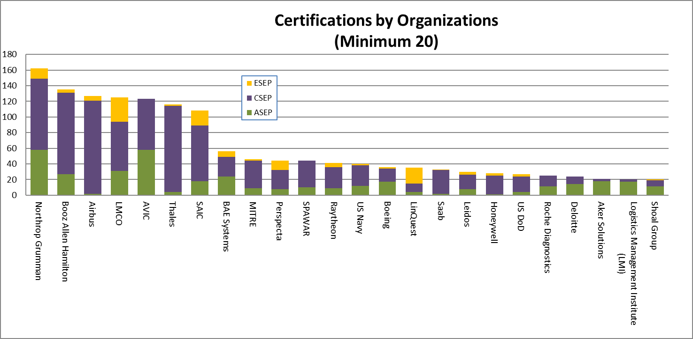
SEPs by Organization
As of 30 June 2020:
Top Organizations w/ Active SEPs
Northrop Grumman 162 SEPs
Booz Allen Hamilton 135 SEPs
The Airbus Group 127 SEPs
Lockheed Martin 125 SEPs

Slide 10
INCOSE SEP Program Purpose and Benefits
The INCOSE SEP program offers independent assessment of system engineering professionals benefiting:
Systems engineering community:
  Creates the standard to identify and develop systems engineering professionals.
  Establishes a formal, recognized body of knowledge for the systems engineering community.
System engineering professionals:
  Provides a portable standard of recognition for attainment of knowledge, education, and experience.
  Serves as a mechanism for continued professional development through recertification requirements.
Organizations/institutions:
  Offers a universal, industry-approved measure of a professional’s knowledge –achieved through the independent evaluation of relevant tasks, projects, and programs.

Slide 11
Topics
What is INCOSE?
Who is recognizing and supporting INCOSE certification?
What are the levels of certification?
What is the application process for certification?
How is certification renewed?

Slide 12
What is INCOSE?
The International Council on Systems Engineering (INCOSE) is a not-for-profit membership organization founded in 1990 to develop and disseminate the interdisciplinary principles and practices that enable the realization of successful systems.
Mission
Share, promote and advance the best of systems engineering from across the globe for the benefit of humanity and the planet.
Vision
The world's authority on Systems Engineering.
Certification is just one of many INCOSE products and offerings.
Notes:
12

Slide 13
Topics
What is INCOSE?
Who is recognizing and supporting INCOSE certification?
What are the levels of certification?
What is the application process for certification?
How is certification renewed?

Slide 14
Job Postings ask for SEP
Aspiration Software
Barrios
Belcan Government Services
Booz Allen Hamilton
Central Intelligence Agency
ClearMotion
DRS Technologies
Engility
Georgia Tech Research Institute
IDEMIA
INNOVIM
JB Management
KBRWyle
Leidos
Lockheed Martin
Logistics Management Institute
The Mitre Corporation
National Geospatial-Intelligence Agency
Newbrook
Noblis
Northrop Grumman Corporation
Oceaneering
OG Systems
Raytheon
SAIC
Sanmina Corporation
Vencore

Slide 15
Certification Agreements: Industry
The Airbus Group
ASTER Technology & Engineering
AVICIT
BAE Systems
Booz Allen Hamilton
Cummins
Engility
Jacobs Technology
KBR Wyle
Lockheed Martin
LinQuest
L-3 Communications
ManTech
MITRE
OPS Consulting
Perspecta
Roche
Thales

Slide 16
Certification Agreements: University
Streamlined Process
  Stevens Institute of Technology
  University of Texas – El Paso
  École Polytechnique
  ISAE/Supaero
  University of New South Wales
  Worcester Polytechnic Institute
  Drexel University
Academic Equivalency
  Cornell University
  University of Detroit – Mercy
  Drexel University
  Missouri S&T
  University of New South Wales
  Worcester Polytechnic Institute

Slide 17
Certification Agreements: Other
Object Management Group (OMG) OCSMP
GfSE (Germany)
SESA (Australia)
INCOSE UK Chapter
US Defense Acquisition University (DAU)

Slide 18
Topics
What is INCOSE?
Who is recognizing and supporting INCOSE certification?
What are the levels of certification?
What is the application process for certification?
How is certification renewed?

Slide 19
SEP Describes Career Path
ESEP focused on:
- LEADERSHIP
- SE ACCOMPLISHMENTS
- SIGNIFICANT SE EXPERIENCE
INCOSE ESEP
CSEP focused on:
- SE EXPERIENCE
- APPLIED SE KNOWLEDGE
INCOSE CSEP
ASEP focused on:
- SE KNOWLEDGE
INCOSE ASEP
SEP Candidates
You can enter at whatever SEP level is appropriate and can seamlessly transition between levels when ready.

Slide 20

Knowledge Level: Associate Systems Engineering Professional
Targeted towards junior/maturing systems engineers and recent college graduates with limited systems engineering work experience
ASEPs are certified against knowledge requirements
Knowledge confirmed through an exam based on the INCOSE SE Handbook
ASEPs must be, and remain, INCOSE members
Renewal every 5 years through ongoing professional development, maximum
duration of 15 years
Available since 2008

Slide 21
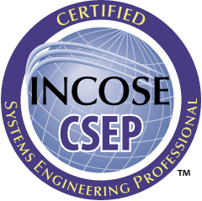
Foundation Level: Certified Systems Engineering Professional
Targeted towards systems engineers with five or more years of systems engineering work experience
CSEPs are certified against substantiated experience, education, and knowledge requirements
Experience must be substantiated by 3-5 work-related references
Knowledge confirmed through an exam based on the INCOSE SE Handbook
CSEPs must be, and remain, INCOSE members
  Does not apply to those who applied in 2015 or earlier
Renewal every 3 years through ongoing
professional development
Available since 2004

Slide 22
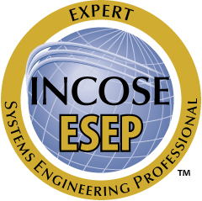
Senior Level: Expert Systems
Engineering Professional
Targeted towards senior systems engineering leaders with recognized systems accomplishments, who have many years of systems engineering work experience
ESEPs are certified against substantiated professional leadership, systems engineering accomplishments, experience, and education requirements
At least 10 years of experience must be substantiated by 3-5 work-related references
Interviews used to validate leadership and significant systems accomplishments
ESEPs must be, and remain, INCOSE members
No renewal requirements other than INCOSE membership
Available since 2010

Slide 23

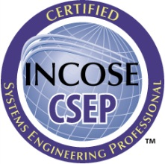

What Certification is Right for You?
If you have just started (or plan to start) practicing systems engineering or have recently graduated and are interested in systems engineering
If you are a practicing Systems Engineer with more than five years of systems engineering professional work experience
If you are a systems engineering leader with recognized systems accomplishments and have many years of systems engineering professional work experience

Slide 24
Topics
What is INCOSE?
Who is recognizing and supporting INCOSE certification?
What are the levels of certification?
What is the application process for certification?
How is certification renewed?

Slide 25


ASEP Application Process
Study
INCOSE SE Handbook
Application
Development
Notify
Applicant
5 year
Certification
Notify
Applicant
Pass
Two weeks
Submit Completed
Application
And Fee
Two weeks
Pay test fee
Schedule & Take Exam
(Prometric Test Center)
Applicant
Information
$
Applicant’s own pace
Applicant has up to one year to pass the test. Test is scheduled directly with Prometric.
Applicant’s own pace
Timeline

Slide 26
CSEP Application Process
Study
INCOSE SE Handbook
Notify
Applicant
Pass
Two weeks
3 year
Certification
3 year
Certification
Application
Development
Notify
Applicant
Pay test fee
Schedule & Take Exam
(Prometric Test Center)
Pass
Submit Completed
Application
And Fee
Two weeks
Applicant’s own pace
INCOSE
Application
Center
1. Verifiable
Education
$
Reference
Submittal
2. Verifiable
Experience
3. Applicant’s
Advocates (three references knowledgeable about SE)
Applicant has up to one year to pass the test. Test is scheduled directly with Prometric.
INCOSE
Evaluation
Applicant’s own pace
References’ own pace
Four to six weeks
Timeline

Slide 27
ESEP Application Process
Application
Development
Pass
INCOSE
Application
Center
Notify
Applicant
Notify
Applicant
Certification
1. Verifiable
Education
Conduct Oral Review
with Applicant and
Up to Two References
(Via telephone conference)
2. Verifiable
Experience
3. Applicant’s
Advocates (three references knowledgeable about SE)
Submit Completed
Application
And Fee
INCOSE
Evaluation
$
Applicant has up to one year to complete the entire process.
4. Verifiable
Professional
Development
Four to six weeks
Mutual
Agreement
Two weeks
Applicant’s own pace
Timeline

Slide 28
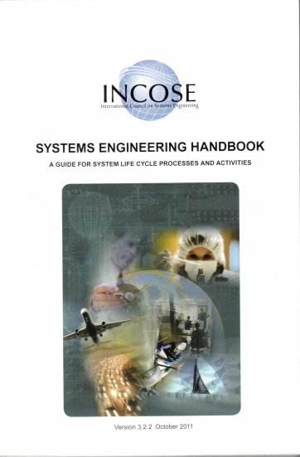
Knowledge verified by exam
CSEP/ASEP Exam Basis
  INCOSE Systems Engineering Handbook v4
Exam is
  100 or 120 questions, 100 or 120 minutes long
  Administered electronically at world-wide Prometric locations
  Offered as a pencil-and-paper test at many INCOSE events
Candidates are eligible for three attempts within one year

Slide 29
Education verified by diploma
Education
  Qualifying Bachelor’s Degree (or international equivalent)
    Acceptable engineering fields of study include: aeronautics, biomedical, chemical, civil, computer, electrical, environmental, industrial, mechanical, nuclear, software, systems
    Other acceptable fields of study include: chemistry, computer science, mathematics, physics
    If the Bachelor’s degree does not come from the above fields, then a Masters or Doctorate degree (or international equivalent) in those fields is acceptable
    INCOSE is the final authority on degree applicability
Additional Experience Can be Substituted
  Minimum of 5 additional years of general engineering experience for non-technical Bachelor’s degree
    Minimum of 10 years (with at least 5 in SE) for CSEP
    Minimum of 25 years (with at least 20 in SE) for ESEP w/ CSEP
    Minimum of 30 years (with at least 25 in SE) for ESEP w/o CSEP
  Minimum of 10 additional years of general engineering experience if no Bachelor’s degree
    Minimum of 15 years (with at least 5 in SE) for CSEP
    Minimum of 30 years (with at least 20 in SE) for ESEP w/ CSEP
    Minimum of 35 years (with at least 25 in SE) for ESEP w/o CSEP

Slide 30
Experience documented across specific areas
Requirements Engineering
Architecture / Design Development
System Integration
Verification and Validation
Technical Planning
Technical Monitoring and Control
Acquisition and Supply
Information Management and Configuration Control
Risk and Opportunity Management
Process and Lifecycle Definition
Specialty Engineering
Organizational Project Enabling Activities
Other
Successful candidates must have balanced experience across multiple areas

Slide 31
CSEP Certification Experience Requirements
CSEP Systems Engineering Experience
  Minimum 5 years of professional level experience in multiple SE functional areas (and any additional general years of experience necessary due to education status)
  Minimum of at least 1 year of professional level SE experience in each of 3 or more of the SE experience areas
  Must be documented on the INCOSE application form
Experience Confirmation
  Recommendations from at least 3 colleagues / peers / managers
  References must cover at least 5 years and 3 areas of SE experience claimed by the applicant (including any additional years)
  References must be knowledgeable in Systems Engineering (or general engineering for any additional years) and have at least five years of relevant experience
  Must be documented on the INCOSE reference form

Slide 32
ESEP Certification Experience Requirements
ESEP Systems Engineering Experience
  Minimum 25 years (20 if already a CSEP) of professional level experience in multiple SE functional areas (and any additional general years of experience necessary due to education status)
  Minimum of at least 2 years of professional level SE experience in each of 6 or more of the SE experience areas
  Must be documented on the INCOSE application form
Experience Confirmation
  Recommendations from at least 3 colleagues / peers / managers
  References must cover at least 10 years of SE experience claimed by the applicant
  References must be knowledgeable in Systems Engineering and have at least five years of relevant experience
  Must be documented on the INCOSE reference form

Slide 33
ESEP Professional Leadership Requirements
Minimum of 5 years of professional leadership.
  Product Development Leadership Years
    Years of leadership in a product development position, such as chief engineer or development team lead
    1 year credit for each year in a leadership position - no limit
  Technical Society Leadership Years
    Leadership of a professional technical society, such as elected officer, appointed committee chair, editor, or thought leader
    0.5 year credit for each year of service – no limit
  Advanced Academics Years
    Technical Master’s degree (or international equivalent)
      1 year credit
    Technical Doctoral degree (or international equivalent)
      2 years credit if separate credit is given for a Master’s degree
      3 years credit if separate credit is not given for a Master’s degree
    Systems engineering graduate-level teaching
      1 year of credit for each 500 hours of classroom instruction spread over a 3 year time period, limited to a maximum of 3 years
    Category limited to a maximum of 4 years credit

Slide 34
ESEP leadership verified by oral review
Applicant must be willing to participate in an oral review
  Purpose of the oral review is to confirm the applicant is a Systems Engineering leader and to verify the applicant’s accomplishments and experience
  The oral review questions are in behavior-based format
At least two (2) of the references must be willing to participate in an oral review (if required)
  Purpose of the reference oral review(s) is to confirm/supplement the applicant’s information
The oral reviews
  Are done via phone
  Typically do not exceeding 60 minutes (30 minutes for references)
  Are in the English language
  Are conducted by an evaluation panel consisting of INCOSE ESEPs trained as Certification Application Reviewers (CARs)
The oral reviews focus on verifying the applicant’s leadership, accomplishments, and experience.

Slide 35
How Long Will It Take to Get CSEP?
There is no one answer. Much depends on the applicant.
Applicant
Downloads information from INCOSE web page
Collects information
Fills out and submits forms via e-mail
Pays fee on-line
Applicant
Schedules exam with test organization
Takes exam at test site
Receives results immediately
Schedules exam, if needed
References submit recommendations via e-mail to INCOSE. Applicant submits missing material.
A. ??????
C. Averaging 50 days
E. Averaging 62 days
Time
B. < 2 weeks
D. Approx. 30 days
F. < 2 weeks
INCOSE
Receives application & fee
Checks completeness of submittal
Notifies applicant by e-mail that application was received and is complete or has missing material
INCOSE
Receives recommendations from references and missing information
Evaluates education and experience
Notifies applicant of evaluation results. If minimum requirements are met, authorizes exam
INCOSE sends CSEP certificate via postal mail to applicant
While the times vary, the average time for CSEP is ~200 days.

Slide 36
Topics
What is INCOSE?
Who is recognizing and supporting INCOSE certification?
What are the levels of certification?
What is the application process for certification?
How is certification renewed?

Slide 37
Certification maintained through continuing education or re-test
Certification is Valid for
  3 Years for CSEP, and must maintain INCOSE membership
  5 Years for ASEP and must maintain INCOSE membership
  Indefinite for ESEP, must maintain INCOSE membership
  Extensions (e.g., Acq) are renewed concurrent with the base certification, regardless of when earned
Certification renewal requires
  Minimum of 120 Professional Development Units (PDUs)
  Or, pass knowledge exam again once certification expires

Slide 38
PDUs for Certification Renewal (1 of 2)
Professional Development Activities (All must be relevant to the practice of systems engineering) | Credit | 3/5 Year Limit
Technical Society Participation Category
Be an INCOSE individual, senior, or student member | 5 PDU/year | 15 PDU
Attend professional technical society local event/chapter presentation/exhibit | 1 PDU/hour attendance | 30 PDU
Attend professional technical society conference/symposium | 1 PDU/hour attendance | 72 PDU
Participate on professional technical society working groups, committees, etc. | 1 PDU/hour of effort | No limit
Perform leadership role in professional technical society at local, national or international level | 1 PDU/hour of effort | No limit
Volunteer activities with youth in schools or community related to science, technology, engineering, and math (STEM) | 1 PDU/hour of effort | 72 PDU
Volunteer activities with community, school, or non-profit organizations that help them accomplish their technical needs | 1 PDU/hour of effort | 30 PDU
Earn an SE-relevant, exam-based, professional certification other than INCOSE SEP | 5 PDU/certification (Up to 2 per renewal period) | 10 PDU
Notes:
Highlight that this table identifies ways for earning continuing education credits.
Point out that these credits may be earned over a three year time period, and that as many as 30 PDUs may be carried forward.

Slide 39
PDUs for Certification Renewal (2 of 2)
Professional Development Activities (All must be relevant to the practice of systems engineering) | Credit | 3/5 Year Limit
SE Course Work & Publication Category
Complete a technical graduate level course | 2 PDU/class hour | No limit
Attend educational course, tutorial, or seminar | 1 PDU/hour | No limit
Teach professional development coursework, including presentations not part of job function. | 2 PDU/hour (prep) 1 PDU/hour (teach) | 40 PDU
Write & publish SE article | 5 PDU/article | No limit
Write & publish SE book | 30 PDU (primary author)/book 10 PDU (contrib. author)/book | No limit
Attend vendor presentation with educational value | 1 PDU/hour attendance | 15 PDU
SE Job Function Participation Category
Receive patent award | 10 PDU/award | No limit
Serve as designated lead systems engineer for a system, product or service | 15 PDU/year | 45 PDU
Lead organization to increase INCOSE systems engineering certifications | 5 PDU/year | 15 PDU
Volunteer (i.e., non-compensated) activities within your organization related to engineering and science | 1 PDU/hour of effort | 30 PDU
Notes:
Highlight that this table identifies ways for earning continuing education credits.
Point out that these credits may be earned over a three year time period, and that as many as 30 PDUs may be carried forward.

Slide 40
Any Questions?
Certification Office:
certification@incose.org
Courtney Wright, CSEP
Certification Program Manager:
Courtney.Wright@incose.org
For more information visit:
www.incose.org/certification/

Slide 41
INCOSE Copyright Notice
Copyright © 2006-2020 by INCOSE, subject to the following restrictions:
  Author Use. Authors have full rights to use their contributions in a totally unfettered way. Abstraction is permitted with credit to the source.
  INCOSE Use. Permission to reproduce and use this document or parts thereof by members of INCOSE and to prepare derivative works from this document for INCOSE use is granted, with attribution to INCOSE and the original author(s) where practical, provided this copyright notice is included with all reproductions and derivative works.
  External Use. This document may be shared or distributed to non-INCOSE third parties. Requests for permission to reproduce this document in whole are granted, provided it is not altered in any way. Requests for permission to prepare derivative works of this document for external and/or commercial use will be denied unless covered by other formal agreements with INCOSE. Copying, scanning, retyping, or any other form of reproduction of the content of whole pages or source documents is prohibited except as approved by the INCOSE Central Office, 7670 Opportunity Rd #220, San Diego, CA 92111.
  Electronic Version Use. Any electronic version of this document is to be used for personal use only and is not to be placed on a non-INCOSE sponsored server for general use. Any additional use of these materials must have written approval from INCOSE Central.
  Permissions. INCOSE has granted permission to member companies of the INCOSE Corporate Advisory Board to post and use this document internally, subject to the external use restriction.
  Technical Data. This data was prepared by INCOSE for information only. It has been released by INCOSE as Technical Data. It is subject to change without notice and may not be referred to as an INCOSE Technical Product.
  This briefing was created from information from various INCOSE sources as indicated in the Notes section of this slide. Send comments to certification@incose.org.
Notes:
This presentation was extracted and updated from:
The INCOSE Certification web site: http://www.incose.org/educationcareers/certification/
Certification Status Report, INCOSE IW & IS, Certification Program Manager, January/February & June/July 2006, 2007, 2008, 2009, 2010, 2011
Associate Systems Engineering Professional (ASEP) Certification: A Credential Tailored for Students and Junior Engineers, Steven Walter, CSEP & David Walden, CSEP 2010 Annual ASEE Conference & Exposition in Louisville, KY , June 2010
Leveraging Certification: Individually and for Your Organization, David Walden, CSEP, INCOSE North Star Chapter Presentation, January 2010
Certification of Systems Engineers, INCOSE-TD-2006-001-01, John Clark, CSEP and Karl Geist, CSEP, August 2007
INCOSE Certification of Systems Engineers, Certification Program Briefing for Chapters, CB0104, Karl C. Geist, CSEP, 9 Nov 2005 and CB0607, Karl C. Geist, CSEP, 6 Jun 2007
INCOSE Certification of Systems Engineers Program, Program Status Report, John Muehlbauer, CSEP, January 2007
New Member Introduction & Orientation, INCOSE IS 2006, Bruce Shelton, CSEP, 10 July 2006
Presentation to INCOSE IW06, Kenneth J. Kepchar, CSEP, 28 Jan 2006

