Slide 1



Topic:
Chapter Meeting – February 2021
The MBSE Workshop Report from INCOSE’s IW January 2021
Presenter: Mark E. Sampson, INCOSE MBSE Initiative Chair
Presentation Site:
Remote.
Online attendance only due to COVID-19.
Thursday, February 18, 2021
Date:
6:30 - 7:00 PM CT – Announcements & Introductions
7:00 - 8:15 PM CT – Feature Presentation and Q&A
Agenda:
Abstract
This is the update on the MBSE Initiative Transformation from the annual INCOSE International Workshop, held January 29-31, 2021.
Model-Based Systems Engineering (MBSE) technology is accelerating while at the same time the organization and preparation to utilize the technology is falling behind. Document-oriented organization processes and behavior changes are required to take advantage of the productivity improvements available through models—but where do you start? Given, an organization is a complex system, we members of INCOSE should be able to apply our SE knowledge to implementing MBSE in organizations.
Mark Sampson (INCOSE MBSE Initiative Chair) will provide an update on the INCOSE MBSE Transformation progress along with advice on how organizations can align themselves with emerging MBSE technologies.
About Our Speaker
Mark Sampson is the Chair of the INCOSE MBSE Initiative pursuing systems engineering transformation to a model-based discipline. After graduating with a BS in Computer Engineering from BYU, Mark started his career at Texas Instruments where he quickly discovered how other domains effected his product’s success, prompting him to join a fledgling System Engineering Professional Society (INCOSE membership #950) and pursue a MS in Systems Engineering at USC and putting him on a career path around scaling systems engineering. Mark was a founding member of the INCOSE N. Texas Chapter, has served in a variety of local and international-level leadership roles including INCOSE Technical Board overseeing modeling and tools strategies including MBSE Initiative which covers SE data exchange standards, SysML system modeling languages, and continuing programs such as the popular annual INCOSE MBSE Workshops and the MBSE Lightning Rounds. Mark has published a number of articles on MBSE in various journals including INCOSE Symposia, Insight, IEEE Spectrum, and a number of blogs (google: Mark Sampson Siemens MBSE blog). In addition, Mark is an adjunct professor at SMU where he teaches graduate-level Systems Engineering courses. Mark lives outside Zion National Park in Southern Utah where he and his wife are experiencing raising a teenager.
Questions?
For more information, go to http://www.incose.org/Chicagoland/.

Slide 2
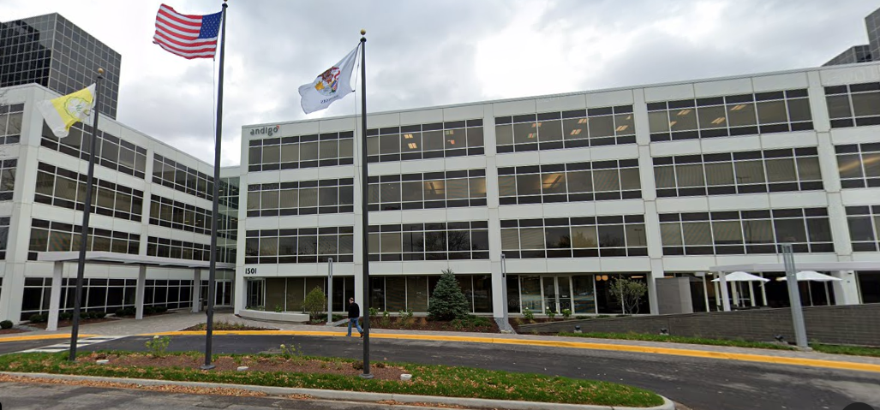
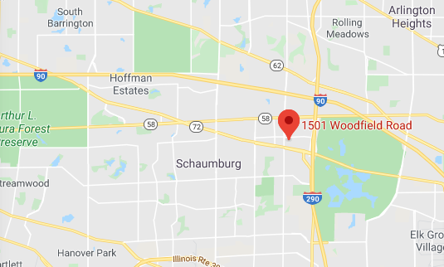
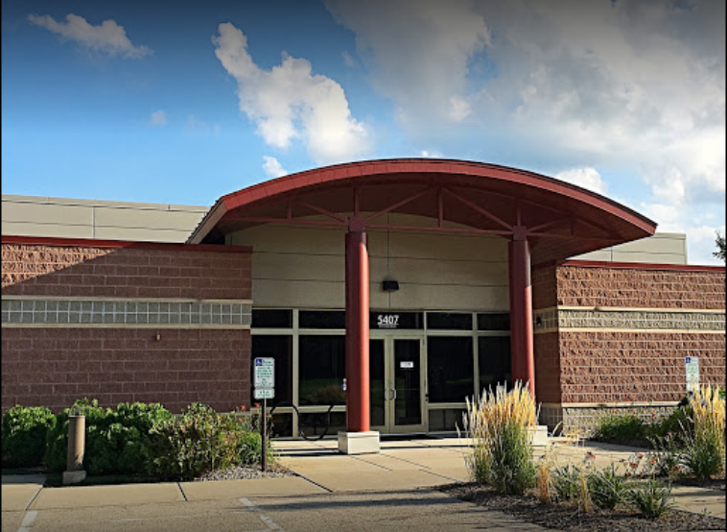
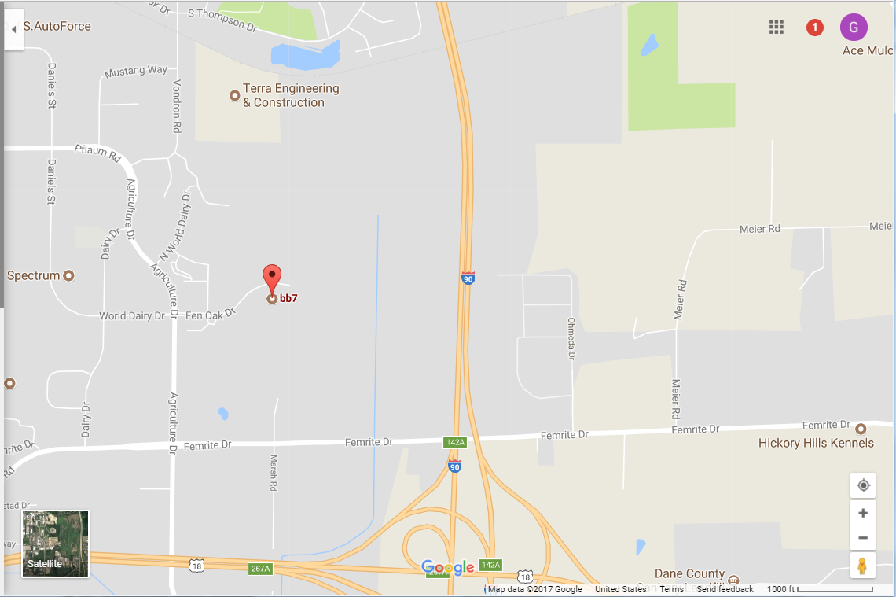
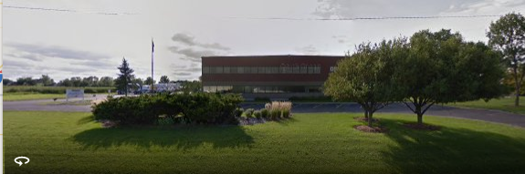
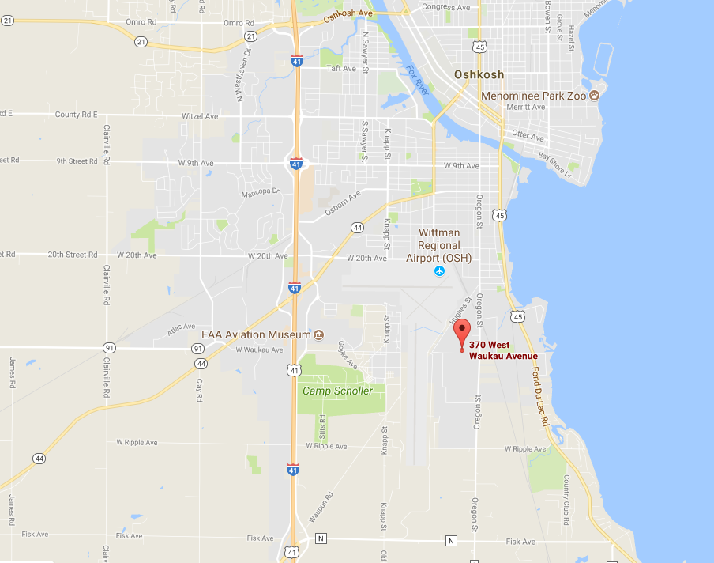
Topic:
Chapter Meeting – February 2021
The MBSE Workshop Report from INCOSE’s IW January 2021
Presenter: Mark E. Sampson, INCOSE MBSE Initiative Chair
Attendance:
Online attendance only due to COVID-19.
INCOSE Chicagoland Sites
Aerotek / EASi offices
1501 E. Woodfield Rd. Suite 300N
Schaumburg, IL 60173
3rd Floor Conference Room
BB7, 5407 Fen Oak Dr.
Madison, WI 53718
Mendota Conference Room
Online attendance only due to COVID-19.
Attend live, on-line. Meeting begins at 6:30 PM CT.
Video URL:
https://incose.pgimeet.com/INCOSEResourceTwelve12
Audio Dial-In:
Access Number: 1-646-307-1479
Guest Passcode: 493 659 0982
Oshkosh Corp (Limited to Oshkosh Employees)
370 W. Waukau Ave
Oshkosh, WI 54902
Questions?
For more information, go to http://www.incose.org/Chicagoland/.

