Slide 1
INCOSE Systems Engineering Professional (SEP) Program
Program Statistics
as of
28 February 2022

Slide 2
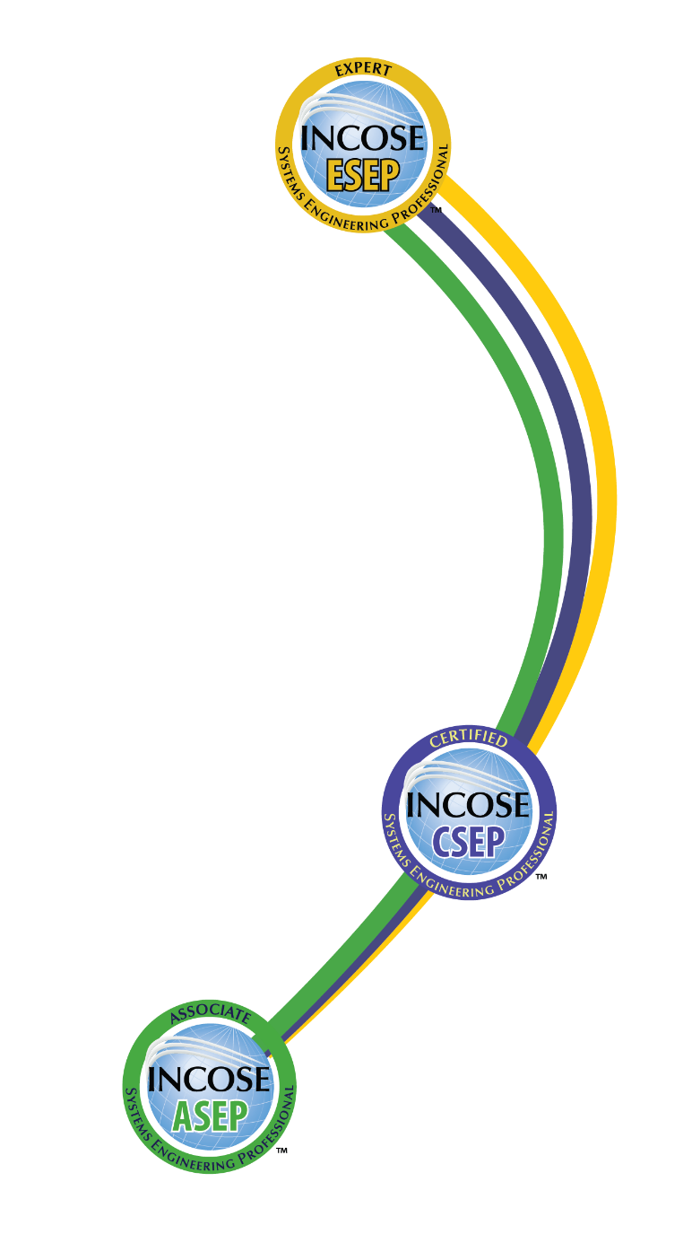
INCOSE SEP Architecture
For wherever you are in your career
Multi-Level Base Credentials
The base ASEP, CSEP, and ESEP credentials cover the breadth of systems engineering at increasing levels of leadership, accomplishments, and experience.

Slide 3
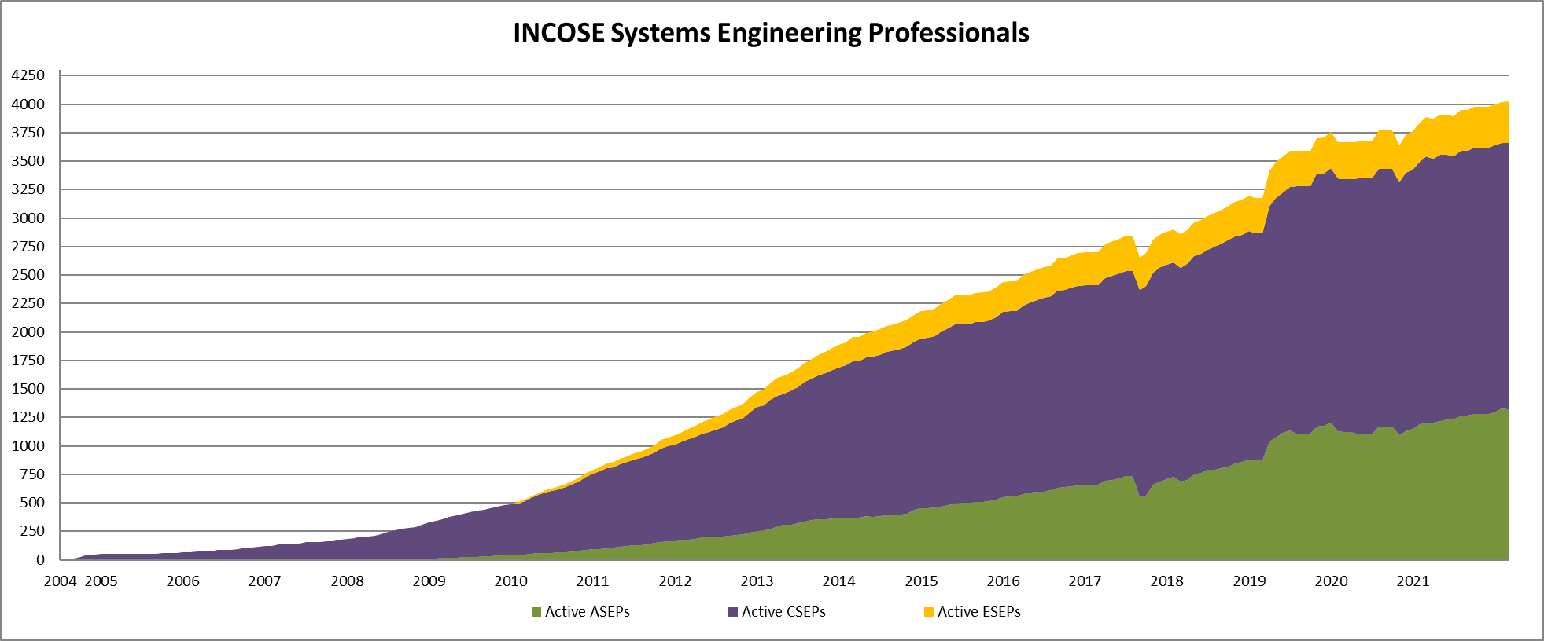
Total SEPs since 2004
As of 31 March 2022:
4025 Total SEPs
1320 ASEPs
2341 CSEPs
364 ESEPs

Slide 4
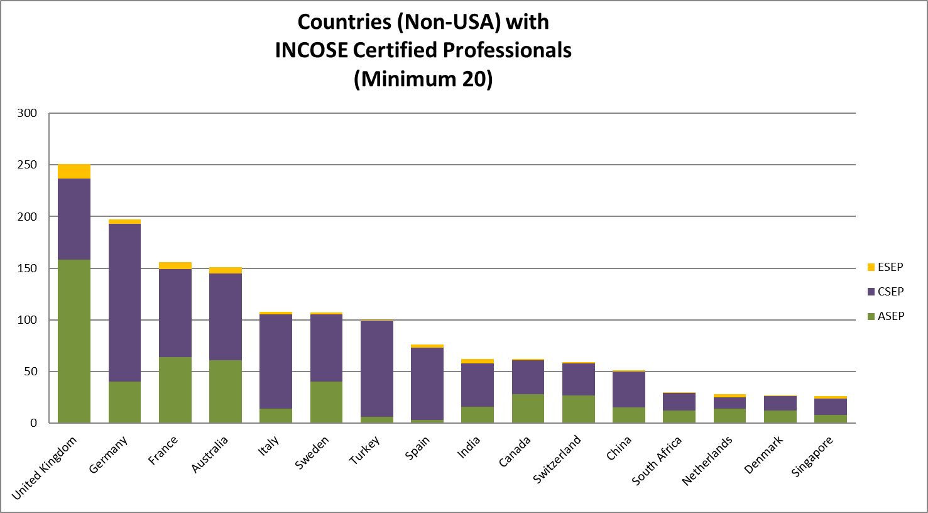
SEPs by Country
As of 31 March 2022:
Top Countries w/ Active SEPs
USA 2428 SEPs
UK 251 SEPs
Germany 197 SEPs
France 156 SEPs
Australia 151 SEPs

Slide 5
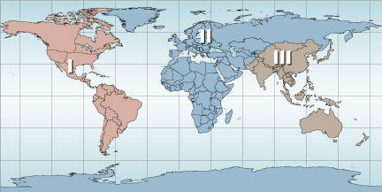
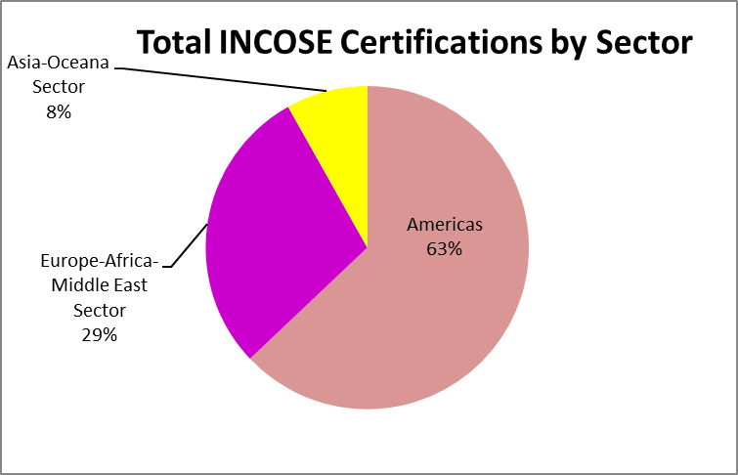
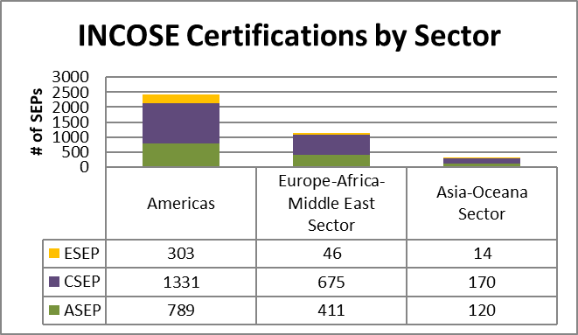
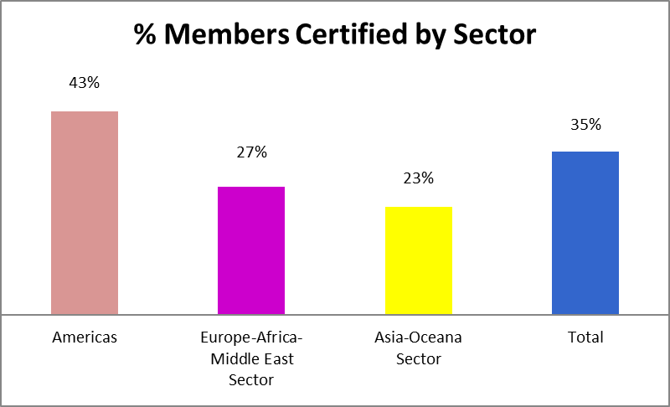
SEPs by Sector
As of 31 March 2022

Slide 6
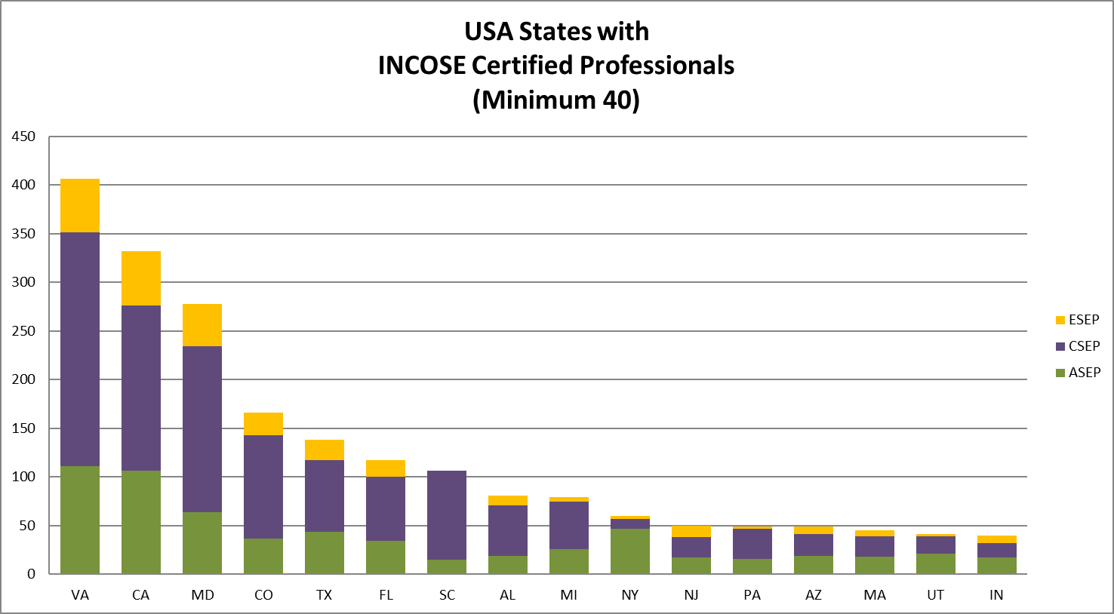
SEPs by US State
As of 31 March 2022:
Top US States w/ Active SEPs
Virginia 406 SEPs
California 332 SEPs
Maryland 278 SEPs
Colorado 166 SEPs
Texas 138 SEPs
Florida 117 SEPs

Slide 7
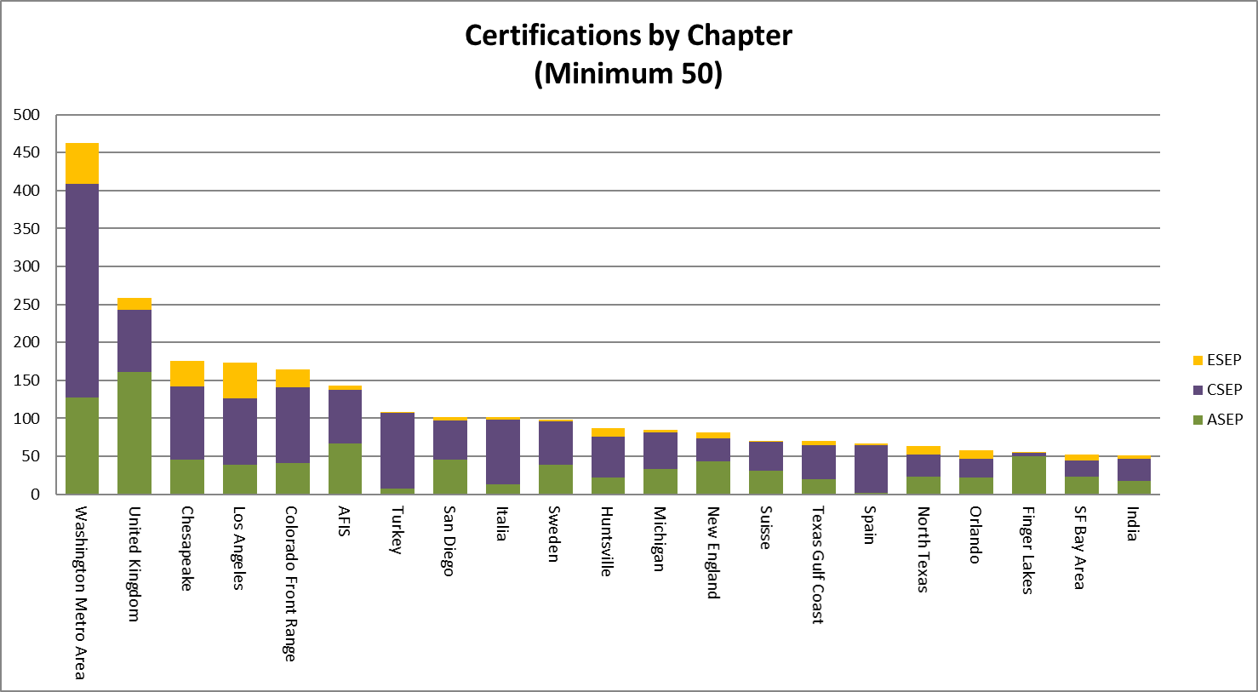
SEPs by Chapter
As of 31 March 2022:
Top Chapters w/ Active SEPs
Washington Metro 462 SEPs
United Kingdom 258 SEPs
Chesapeake 176 SEPs
Los Angeles 173 SEPs
Colorado 164 SEPs

Slide 8
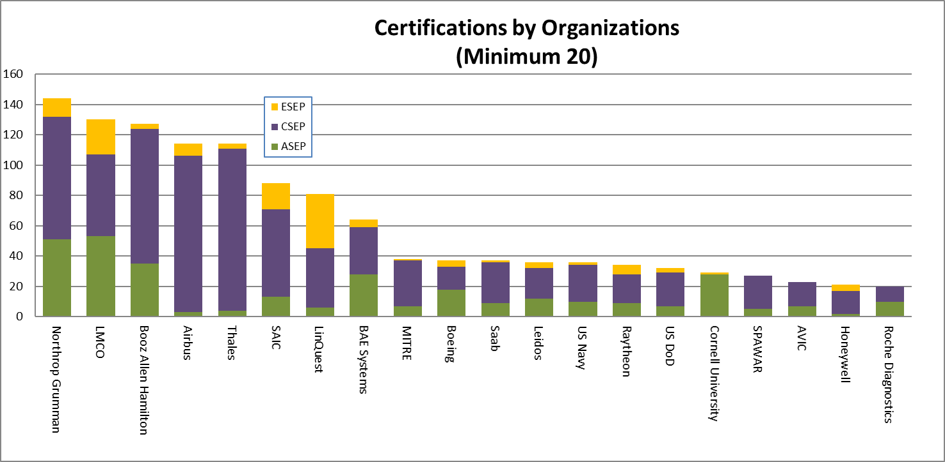
SEPs by Organization
As of 31 March 2022:
Top Organizations w/ Active SEPs
Northrop Grumman 144 SEPs
Lockheed Martin 130 SEPs
Booz Allen Hamilton 127 SEPs
Airbus 114 SEPs
Thales 114 SEPs

Slide 9
Any Questions?
Email Contacts
Certification Office:
certification@incose.net
Courtney Wright, CSEP
Certification Program Manager:
Courtney.Wright@incose.net
For more information visit:
www.incose.org/certification

