Slide 1
Analysis of Alternatives
William Lozier

Slide 2
Introduction
This brief details the Analysis of Alternatives between an Angle Deception Jammer and Barrage Jammer.
The architecture is taken from Air Force Pamphlet 51-3 Electronic Warfare Principles.
However the values used in this example are entirely made up and in no way represents a real system.

Slide 3
Angle Deception Jammer
Notes:
The architecture for an Angle Deception Jammer is as shown. Depicted is all the elements that compose an Angle Deception Jammer. Notice the “/” preceding each of the value attributes. This indicated that the value is calculated and not assigned. We will address that later.

Slide 4
Barrage Jammer
Notes:
Also the architecture for a Barrage Jammer is as shone. Depicted of all the elements that compose a Barrage Jammer.

Slide 5
Angle Deception Jammer
Notes:
For each element that composes the Angle Deception Jammer values for size, weight and power are established.

Slide 6
Barrage Jammer
Notes:
Like wise for the Barrage Jammer.

Slide 7
Weight Constraint
Notes:
Constraint blocks for the size, weight and power are provided. The Constraint blocks provides a formula for calculating the total weight of a Jamming system.
The calculation here is rather simplistic however the formula could be tied to external solvers such as Maple, Mathematica, Matlab or SQL.

Slide 8
Parametric Evaluation
Notes:
Parametric Evaluation of the weigh values are performed and sets the value for the Jammer system. Similar evaluations for size and power are performed.

Slide 9
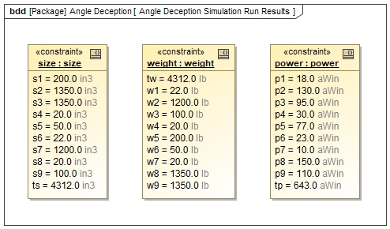
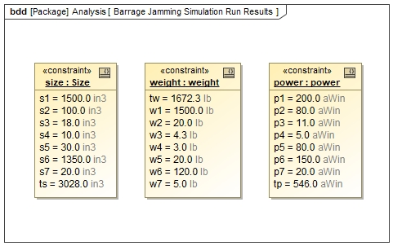
Total size, weight and power Calculations
Notes:
Execution of the parametric evaluation shows the Barrage Jammer total power 546 watts, total weight of 1672.3 pounds and total size of 3028 cubic inches. And the Angle Deception Jammer total power 643 watts, total weight 4312 pounds and total size 4312 cubic inches.

