Slide 1
Analysis of a SysML Model
William Lozier
WLozier@MITRE.org
Rod Wheeler
RWheeler@mitre.org

Slide 2
Acknowledgements
Dr. Aurelijus Morkevicius, Head of Solutions Department at No Magic Europe
  Visual Model Analysis
    https://www.youtube.com/watch?v=AaPdonhuQM4
  custom_metrics_how_to_convert_list_of_elements_into_number
    https://www.youtube.com/watch?v=8hlw5fSnEa8
Michael Vinarcik, Associate Booz Allen Hamilton
NMWS2016 MetaChain Navigation
https://www.youtube.com/watch?v=vapQ7nRiVAI
Edgaras Dulskis Developer at No Magic Europe
Generating Reports from Model Data
https://www.nomagic.com/events/webinars/item/generating-reports-from-model-data?category_id=6
MAGICDRAW REPORT WIZARD 18.1 user guide
https://docs.nomagic.com/display/MD190SP3/Specifying+criteria+for+querying+model
https://docs.nomagic.com/display/MD190SP3/Case+Studies+for+Querying+the+Model

Slide 3
Outline
Example Model Introduction
Metachain/Generic Tables
Smart Packages
Metrics
Relation Maps
Velocity Script
Dependency Matrix

Slide 4
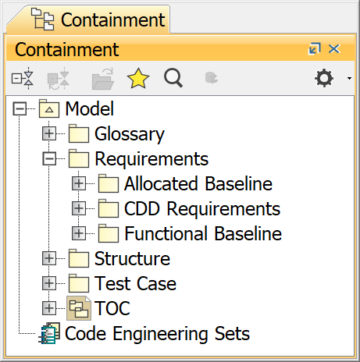
Example Model Introduction
Consider a model as shown with a Functional Baseline that traces to the CDD. And the Allocated Baseline that traces to the Functional Baseline.

Slide 5
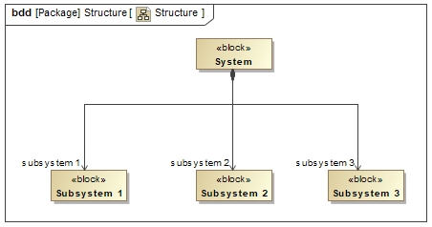
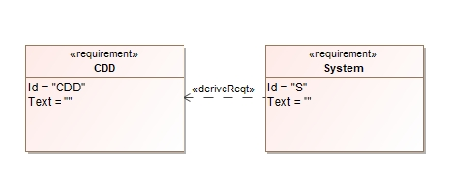
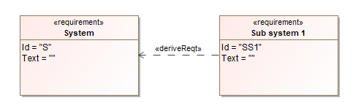
Example Model Introduction
Consider the following situation in which the <<Derive>> relationship is used to trace from one baseline to another and has a structure as shown. In this example the System Requirements Specification is derived from the CDD and the Sub Systems Specification is derived from the System Specification.

Slide 6
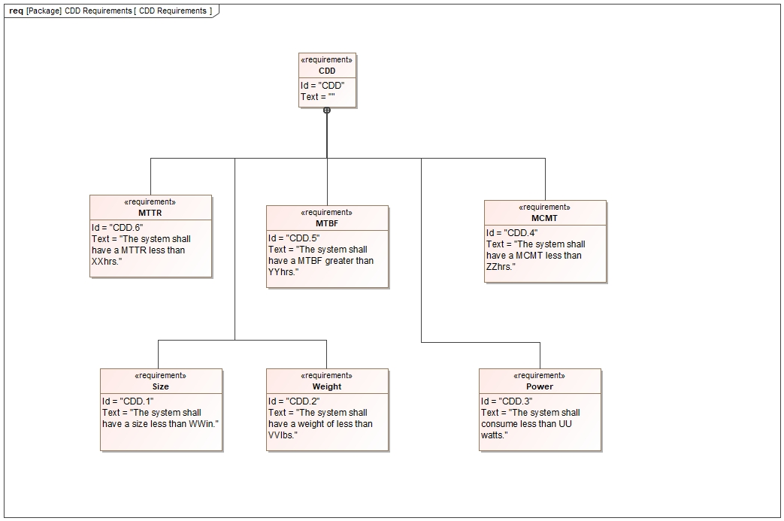
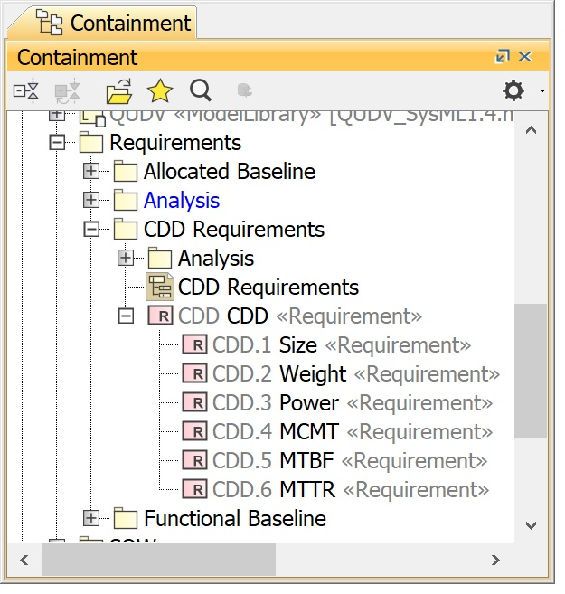
Example Model Introduction
The CDD owns its requirements.

Slide 7
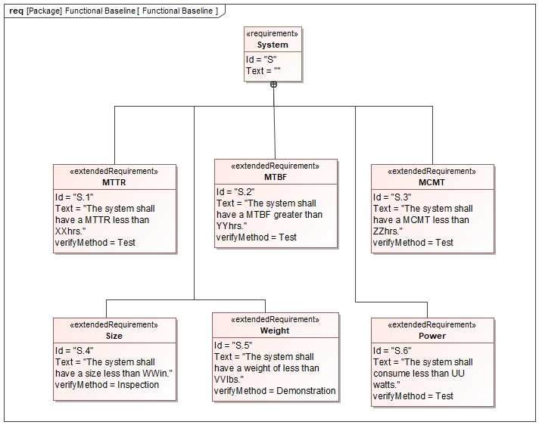
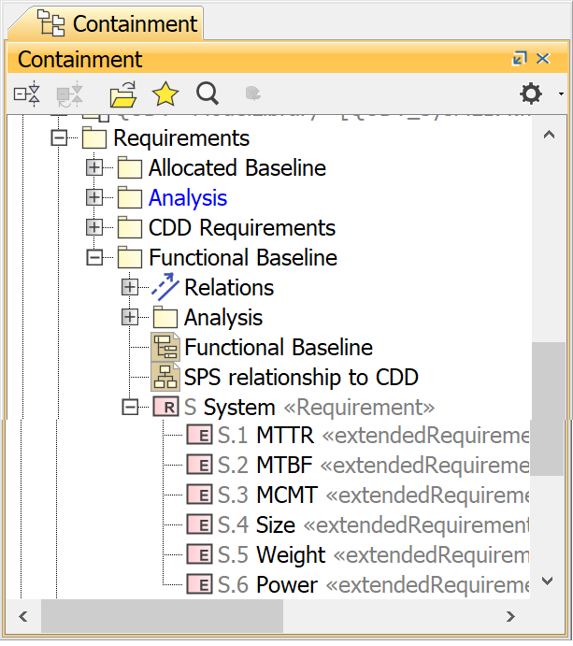
Example Model Introduction
The System owns its requirements.

Slide 8
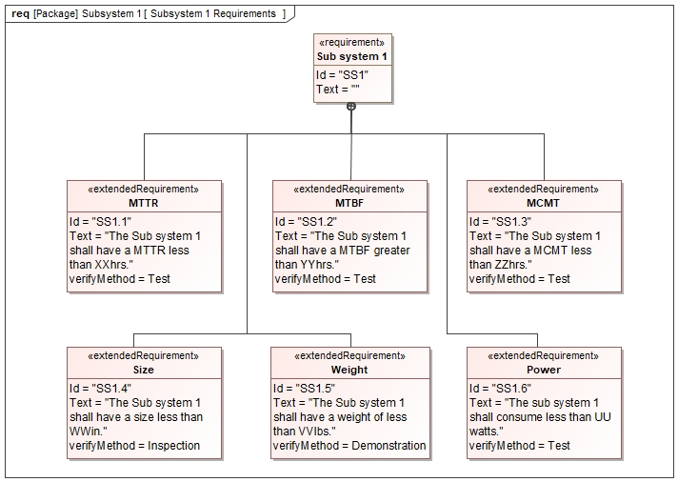
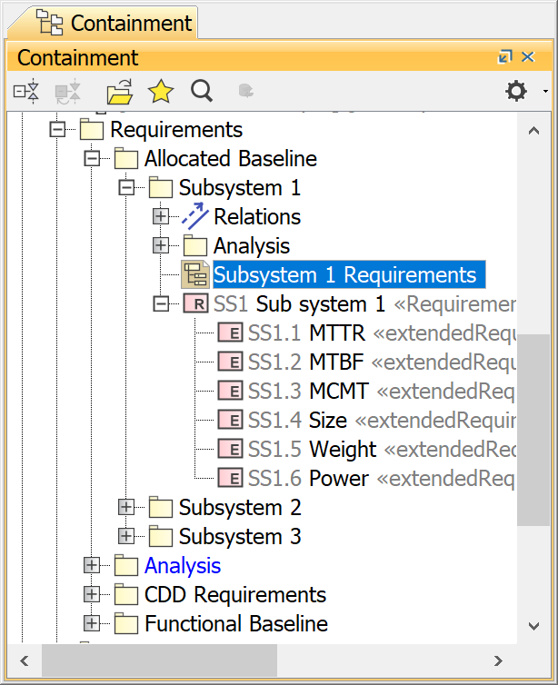
Example Model Introduction
Each Sub System owns its requirements.

Slide 9
Meta Model Architecture
All SysML model analysis techniques requires understanding of the SysML modeling topology.
All modeling techniques shown herein are not part of the SysML standard but are implementations defined within the NoMagic specification.

Slide 10
Meta Model Architecture
All graphical languages to some degree can be thought of as an instance of Graph Theory.
Graph Theory concerns itself with two things:
Nodes, Vertices or Points; the endpoints of an Edge.
Edges, Links or Lines; defined by two Nodes.

Slide 11
Meta Model Architecture
A SysML model can be viewed as a collection of Nodes, or Model Elements and their relationships, or Edges.
In the example shown, a graph with three Nodes, (A, B and C) and three Edges ({A,B}, {A,C} and {C,B}).
A
B
C

Slide 12
Meta Model Architecture
If you think of a Node or model element as a collection of Nodes or Properties, each of these Properties having Edges, or Relationships to other Nodes.
A
Property x
B

Slide 13
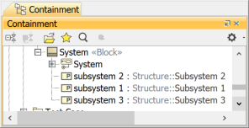
Meta Model Architecture
Ownership is a particular relationship in SysML. In the example shown the Block System owns the State Machine B.

Slide 14
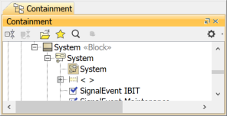
Meta Model Architecture
The State Machine System owns a State Machine Diagram and a Region.

Slide 15
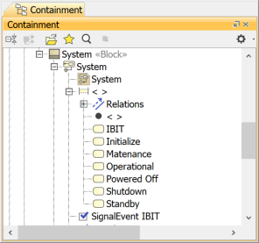
Meta Model Architecture
The Region contains States and Transitions.
If you wish to have information about a Blocks State information, you have to transverse the relationships of ownership.

Slide 16
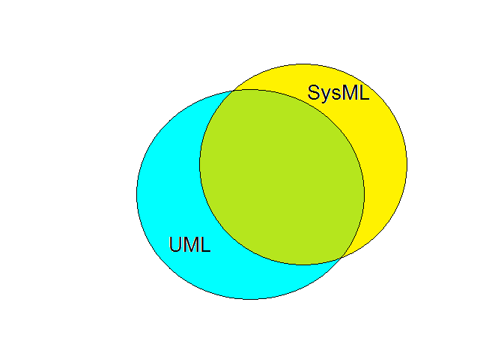
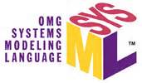

SysML relationship to UML
SysML extends a subset of UML 2.0
Notes:
SysML is a profile extension of UML.

Slide 17
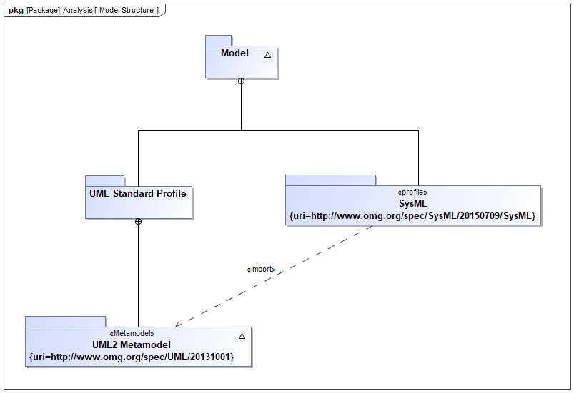
Meta Model Architecture
Taking a closer look into that Venn diagram. You can see that any SysML model you create comes with a SysML Profile importing the UML2 Metamodel.

Slide 18
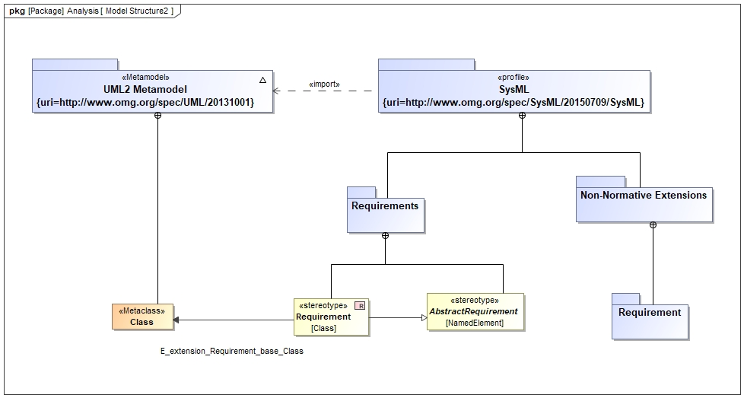
Meta Model Architecture
The Requirement specification is not part of UML. But found in the SysML Profile. Requirement is an extension of the Base Class, Class.

Slide 19
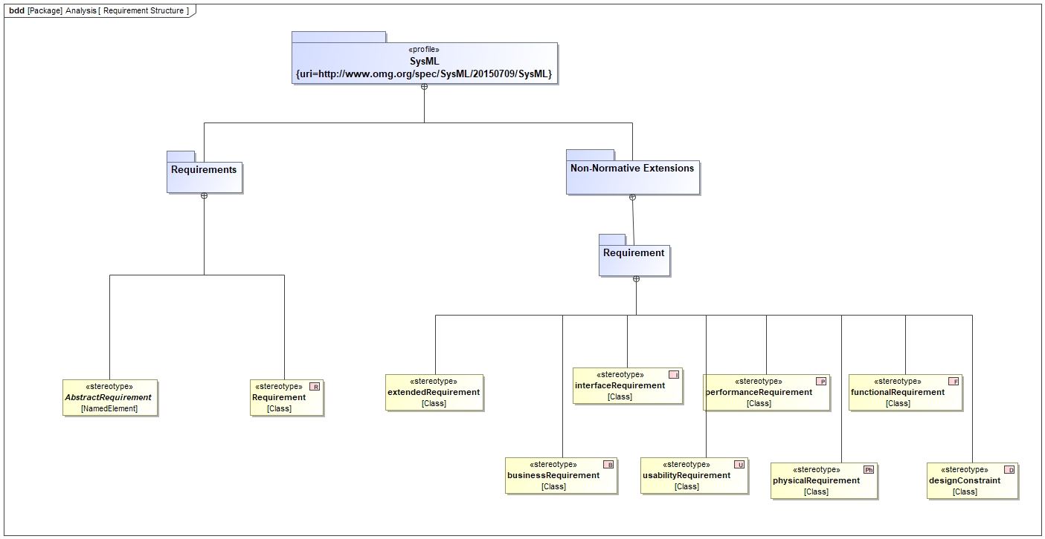
Meta Model Architecture
From a containment perspective only the Abstract Requirement and Requirement stereotypes are defined in the SysML::RequirementsPackage.

Slide 20
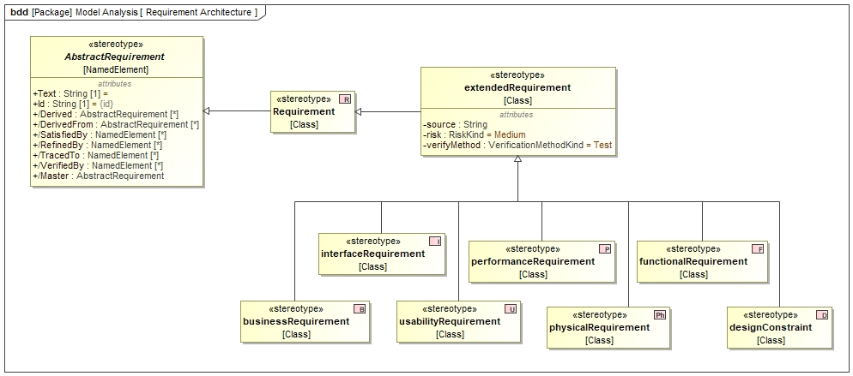
Meta Model Architecture
Abstract Requirement and Extended Requirement are the only two Requirement definitions that owns any Attributes.

Slide 21
Metachain
Metachain and Generic Tables are quick way to gain understanding on what is happening in your model. It is my first go to for performing analysis, from simple cataloging model elements to trace analysis.

Slide 22
Metachain
We will now create a metachain query.

Slide 23
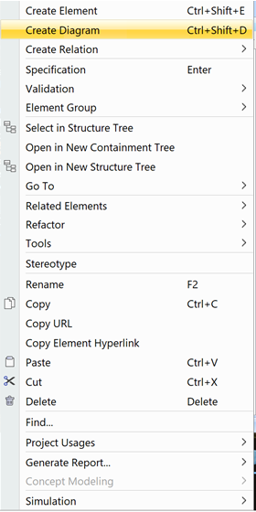
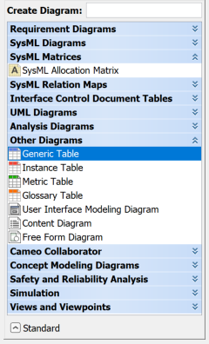
Generic Table
Within the Allocated Baseline Package is another Package for each subsystem named Analysis. Choose a subsystem Analysis Package. In that Package create a Diagram. We will create a Generic Table.

Slide 24
Metachain
Metachain operation is one of the operation types used to specify criteria for querying models. Use the Metachain Navigation operation type when specifying indirect (multi-level) relations between elements through the chains of properties.
Ref: MagicDraw 19.0 LTR User Guide

Slide 25
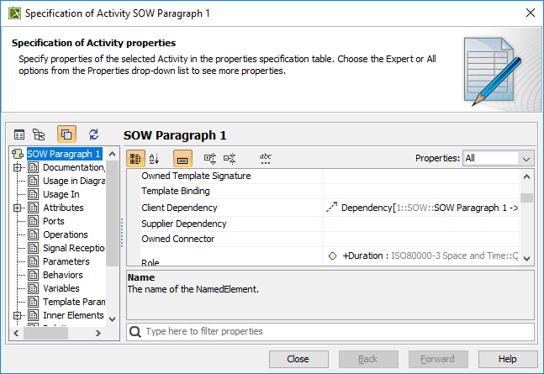
Metachain
The “chains of properties” referred to is the Properties as defined in the model element Specification.

Slide 26
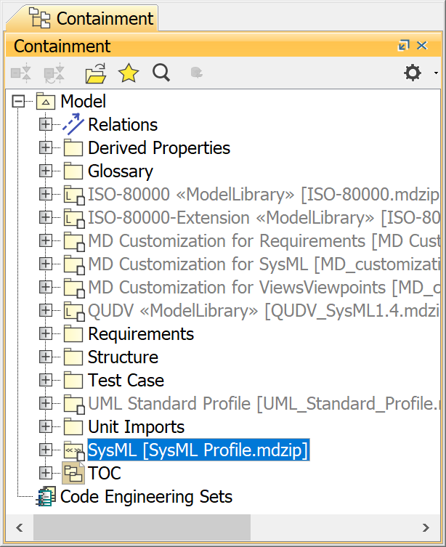
Metachain
Metachains are stored in the Derived Properties package.

Slide 27
Metachain
Limitation!
Metachain queries returns a collection not an array.

Slide 28
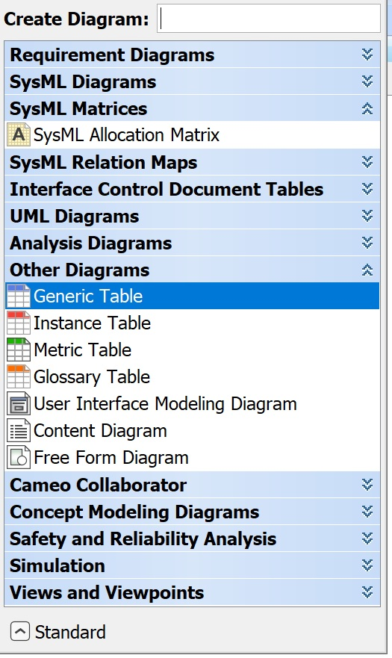
Generic Table
The Generic Table is found in the Other Diagrams Category.

Slide 29
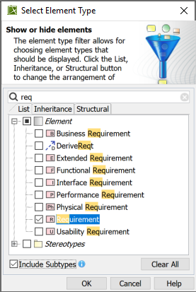
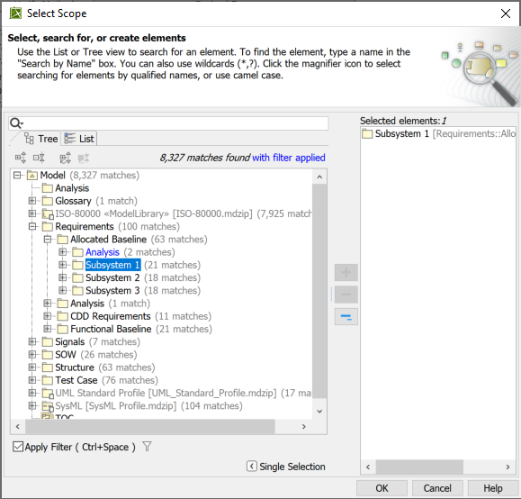
Generic Table
Set Element Type to Requirement, Include Subtypes. Set Scope to the Sub system Package.

Slide 30
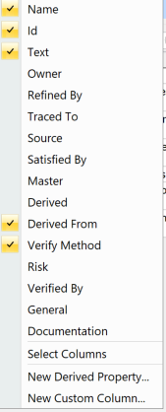
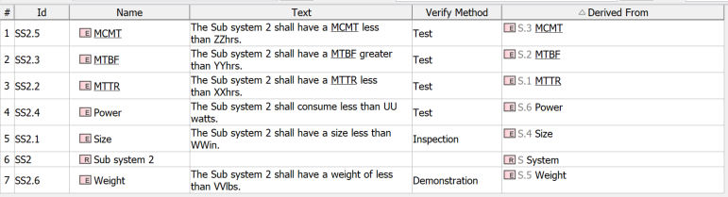
Generic Table
In the Columns pull down choose Name, Id, Text, Derived From and Verify Method .

Slide 31
Generic Table
We need to show that the Verify Method for the Derived From requirements match. For that we will need a metachain.

Slide 32
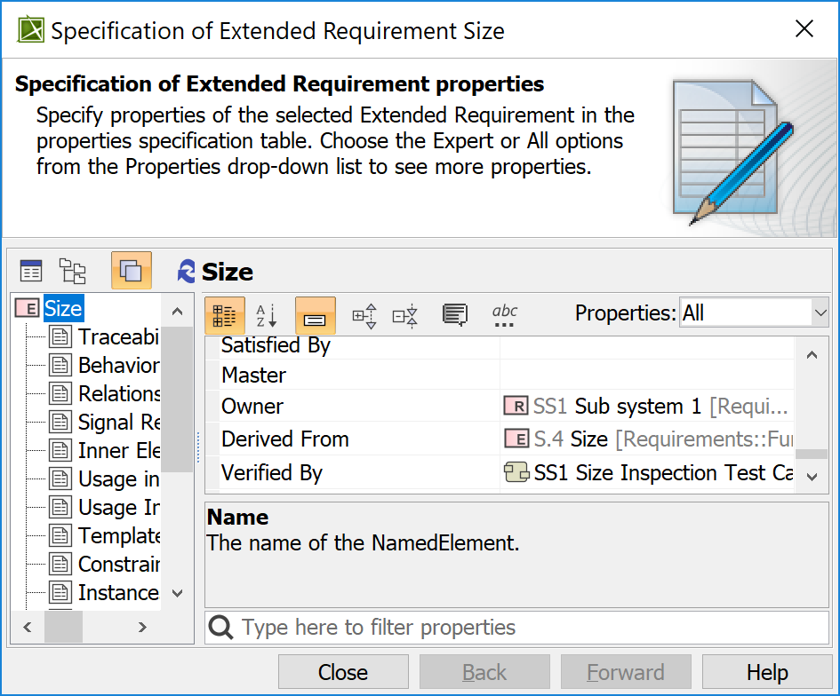
Metachain Creation
A
Property x
B
Open the specification of one of the subsystems requirement, in the properties pane find the relationship we are interested in, Derived From.

Slide 33
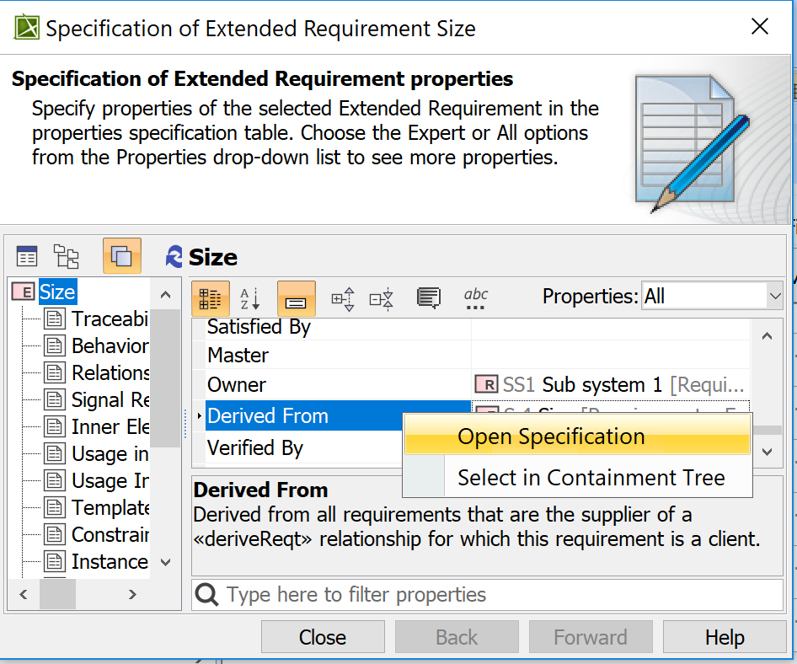
Metachain Creation
Right click on the Derived From Properties field and select Open Specification.

Slide 34
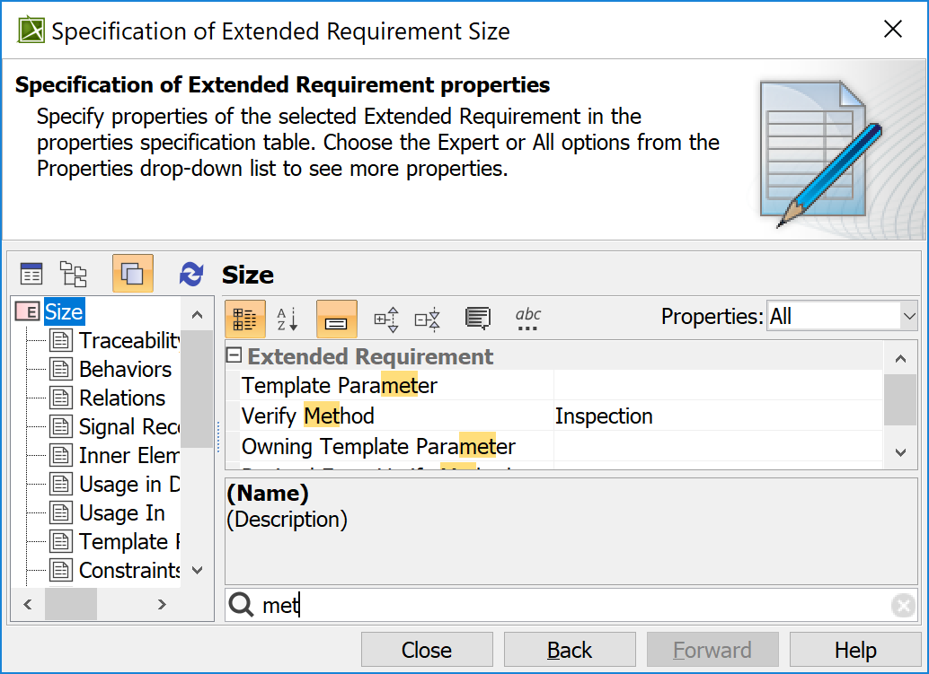
Metachain Creation
In the system Specification Extended Requirements navigate to the Verify Method Property. Which is the value of the property we want.

Slide 35
Metachain Creation
We will now take that Property transversal and capture it in a Metachain.

Slide 36
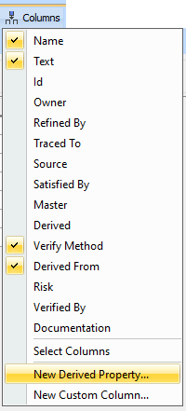
Metachain Creation
On the Generic Table for the subsystem requirements
from the Show Columns pull down select New Derived Property.

Slide 37
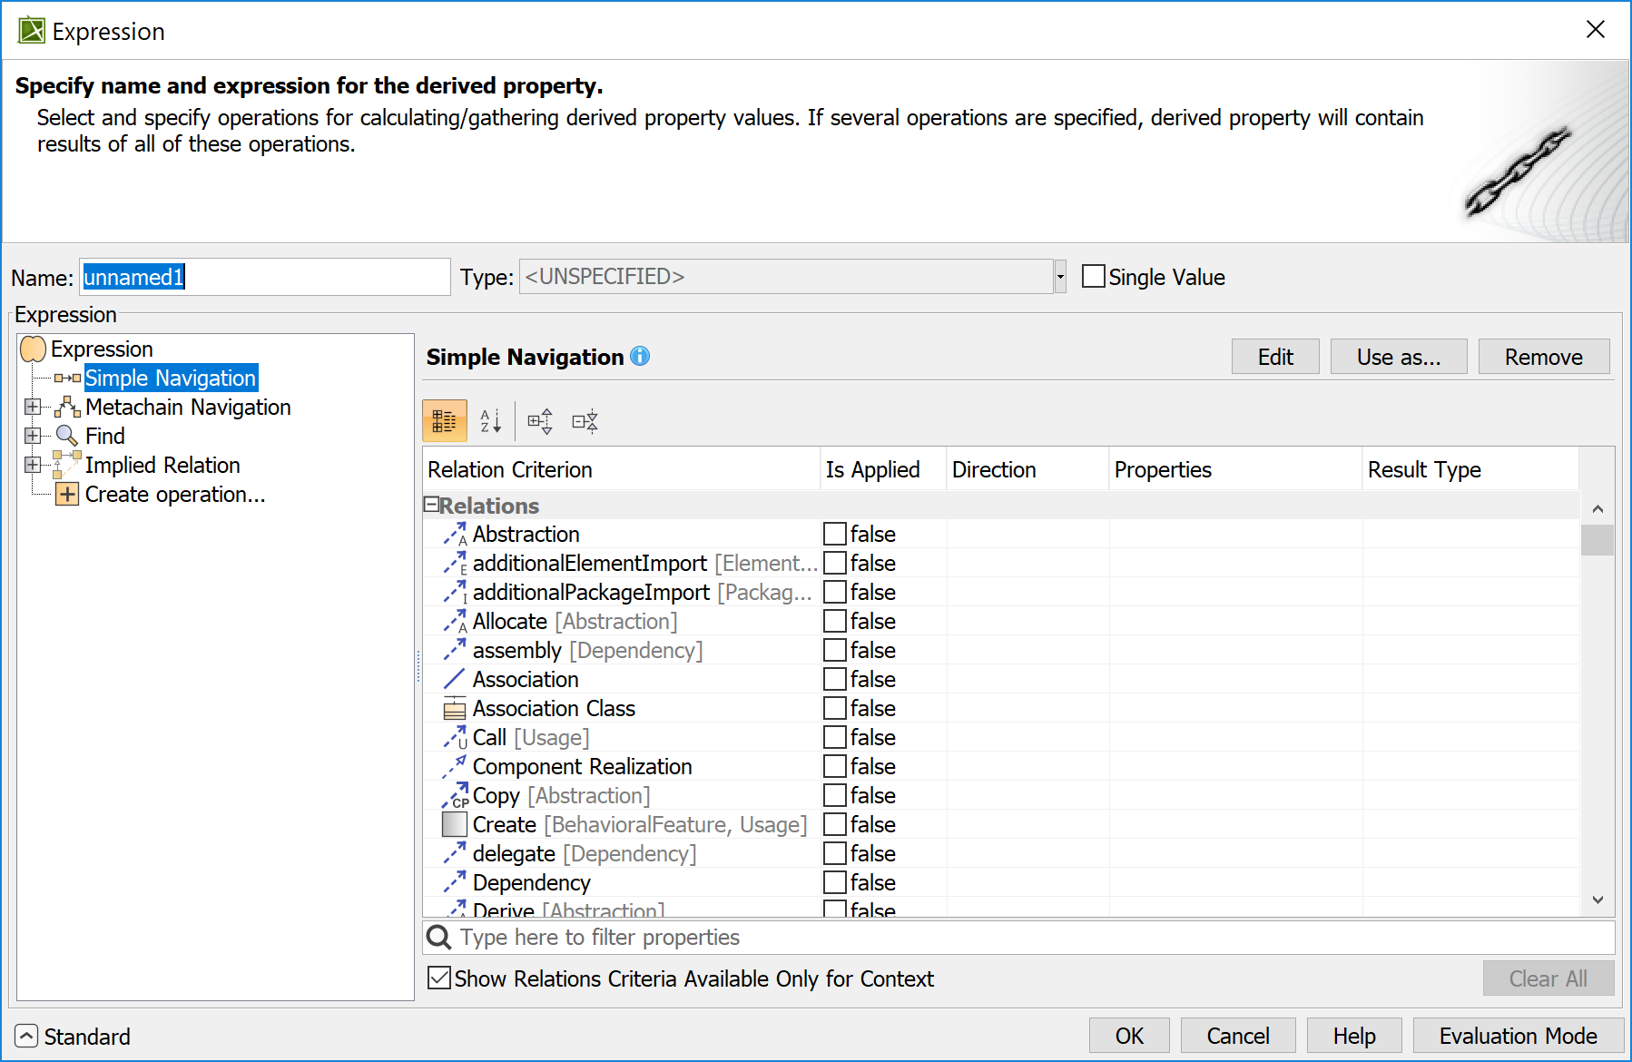
Metachain Creation
In the Expression Pane select Metachain Navigation and give it a name.

Slide 38
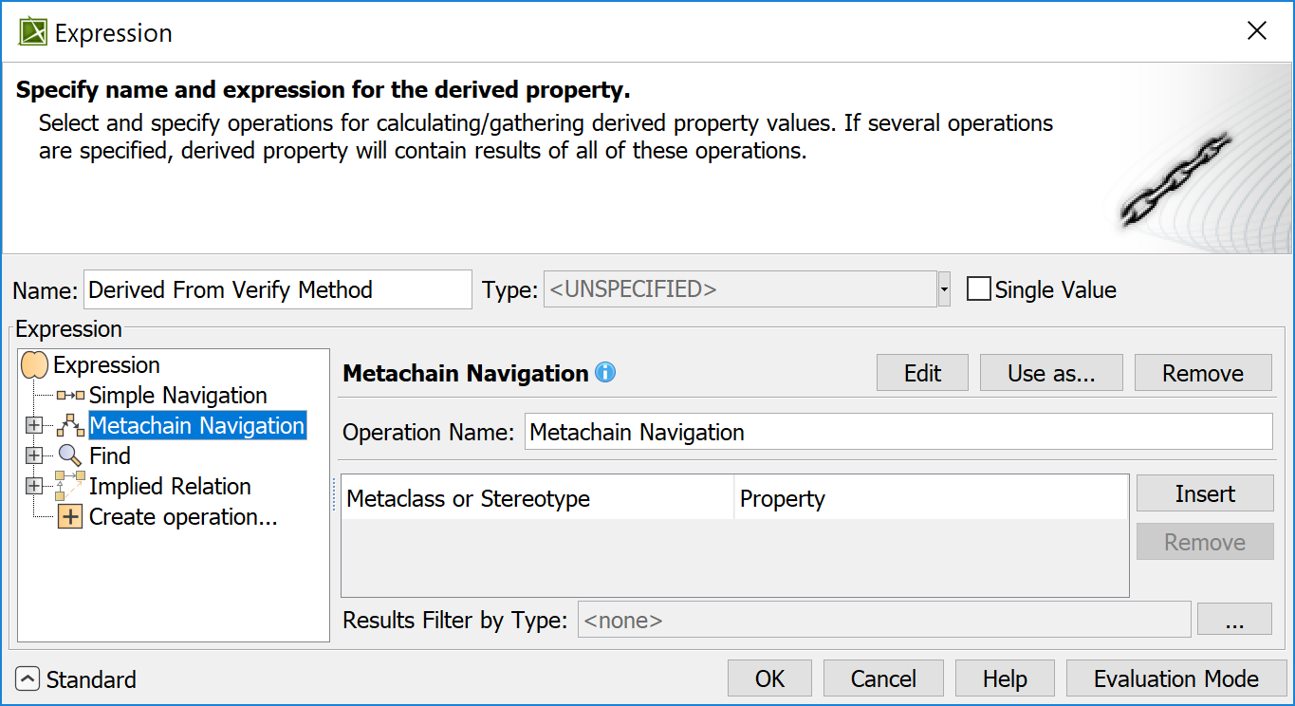
Metachain Creation
Select Insert.

Slide 39
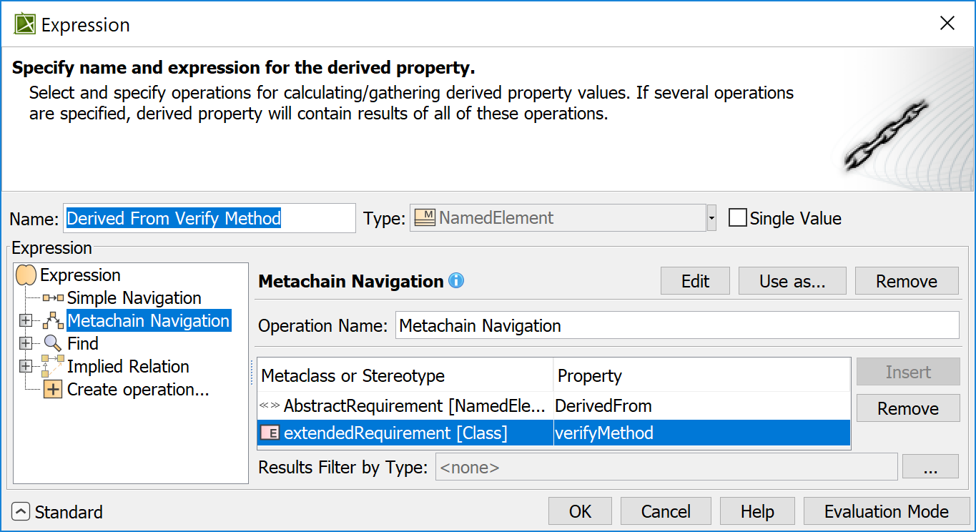
Metachain Creation
Enter the following metachain expression.

Slide 40
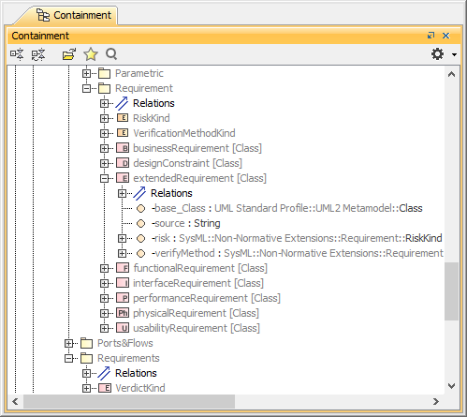
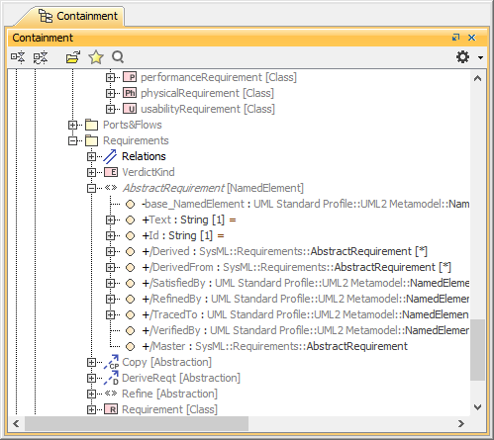
Metachain Creation
Why did we use extended requirement in one line and abstract requirement in the other?

Slide 41
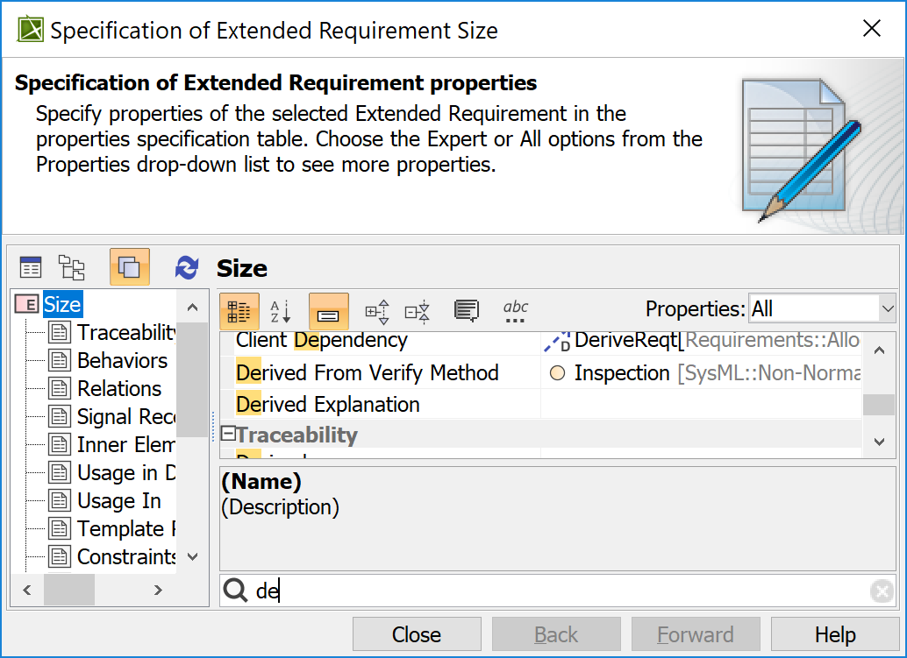
Metachain Creation
Note that we now have a new Property defined for requirements.

Slide 42
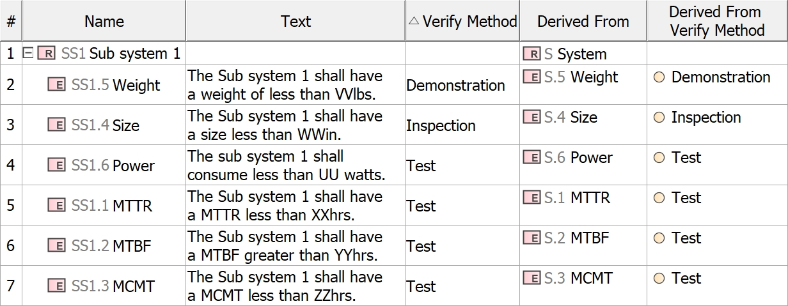
Results of metachain

Slide 43
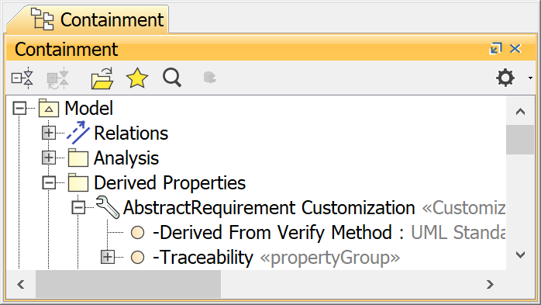
Results of metachain
This is how the Metachain will appear in the Containment tree.

Slide 44
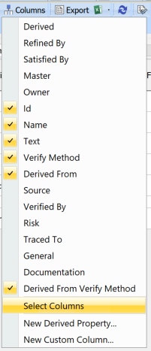
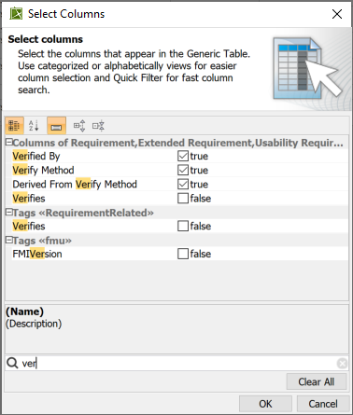
Metachain
To use this Metachain expression in another Generic Table from the Columns pull down select Select Columns and from the Select Columns pop up select the Metachain Name.

Slide 45
Metachain
Metachain are Properties of stereotypes.
The next example will illustrate this.

Slide 46
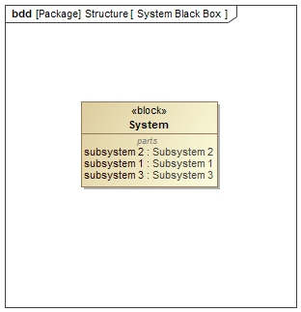
Metachain
We will now build a Query to catalog all of the signals a block receives. Open the specification of the Block System.

Slide 47
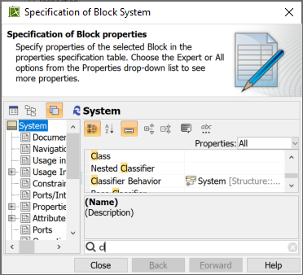
Metachain
Note the Block System has a Classifier Behavior.

Slide 48
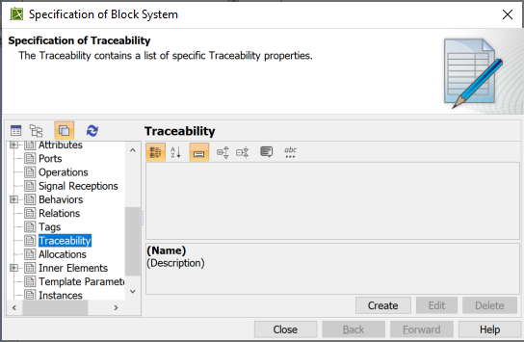
Metachain
Click on Traceability and then Create.

Slide 49
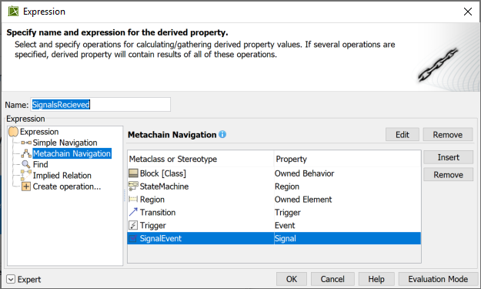
Metachain
Click on Metachain Navigation, give it a name, SignalsReceived. No spacing! And enter the Metachain Query as shown.

Slide 50
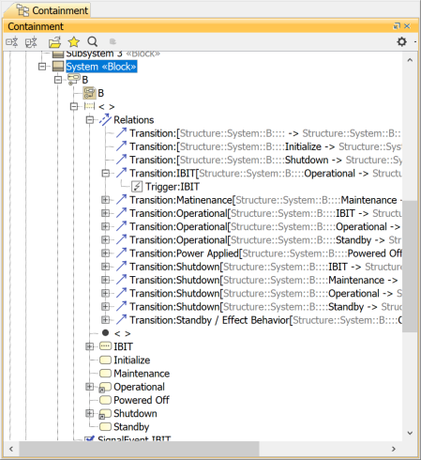
Metachain
Why did we build the Query as we did?.
We have a Block which owns a State Machine, which owns a Region, which owns Transition, which owns a signal.

Slide 51
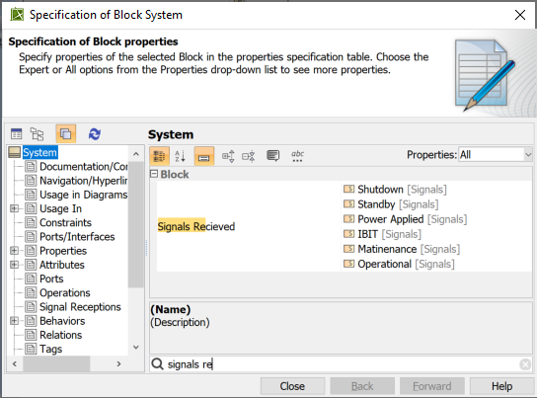
Metachain
Note the change in the Specification of the Block System. A new Property for Blocks has been defined.

Slide 52
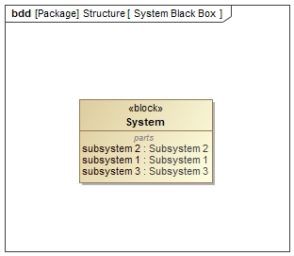
Metachain
Build a Black Box view of the System Block.

Slide 53
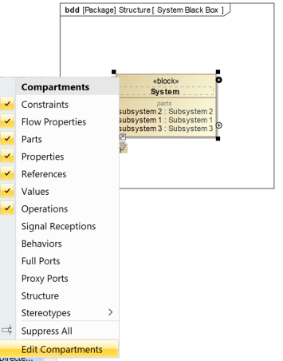
Metachain
Select the System Block in the View. Then select the ellipses in the upper left-hand corner of the Block. In the pop up select Edit Compartments.

Slide 54

Metachain
Select the Element Properties tab. Select Signals Received in the left-hand pane, use the > to add it to the right-hand pane. And then select OK.

Slide 55

Metachain
Observe the effect in the System Black Box View.

Slide 56

Metachain
To suppress the <<Signal>> prefix, in Symbol Properties change Show SysML Element Type to false.

Slide 57

Metachain
The view will now look like this.
The Signals Received Block Property will be used again in this presentation, so it is important to get it right.

Slide 58
Smart Package
A Smart Package is a way to collect elements throughout the model into a single location. In software speak it is a copy by reference rather than a copy by value.
When collecting elements in a smart package the smart package contains a collection of pointers or addresses of model elements not the model element itself.
Useful for building user views as well as doing some analysis.

Slide 59

Smart Package
A Smart Package is a Package with the additional Applied Stereotype SmartPackage.

Slide 60

Smart Package
The additional stereotype provides an additional Property, Query.

Slide 61
Smart Package
We will build a Smart Package that will contain only Non-Satisfied Requirements.

Slide 62

Smart Package
In your model create a SmartPackage and name it Non-Satisfied Requirements.

Slide 63

Smart Package
To enter a Query for the SmartPackage click on the ellipses.

Slide 64

Smart Package
The Query pane will appear. Change the pane to Expert mode.

Slide 65

Smart Package
Select Create Operation. The Query pane will appear.

Slide 66
Smart Package
Query Strategy
  Collect all the requirements in the model
  Collect all the requirements that are satisfied
  Exclude the list of satisfied requirement from the list of all requirements.
  This will give me a listing of all Non-Satisfied Requirements

Slide 67

Smart Package
Click on the Exclude icon and note change in the left-hand pane. There two new attributes, From and Excluded.

Slide 68

Smart Package
Collect all the requirements in the model.
Click on the From attribute. Then select the Find Operation.

Slide 69

Smart Package
Select Type.

Slide 70

Smart Package
Select Requirements and Include Subtypes. Select OK.

Slide 71

Smart Package
This will give us all of the requirements in the model. Give the Operation a name.

Slide 72

Smart Package
Click on the Evaluation Mode button.

Slide 73

Smart Package
Click on the Evaluate button. Note this shows that the Find query finds 35 requirements.

Slide 74

Smart Package
Next, we will need a list of the Satisfied Requirements. Click on the Exclude attribute.

Slide 75
Smart Package
We will use a Metachain to find the Satisfied Requirements.

Slide 76

Smart Package
Note the change in the Exclude Query.

Slide 77

Smart Package
Select Context attribute. We need to set the scope for the THIS Value. Select the Reset.

Slide 78

Smart Package
Remember when we did the Generic Table, we set the Context by setting the Element Type.

Slide 79

Smart Package
We will use Find to find all Satisfy Requirements.

Slide 80

Smart Package
We will use Type to find the relations we will need.

Slide 81

Smart Package
From the Select Element Type choose Satisfy. Then select OK.

Slide 82

Smart Package
Select OK.

Slide 83

Smart Package
This will take you all the way back to the Smart Package’s Specification.

Slide 84

Smart Package
Reopen the Query.

Slide 85

Smart Package
Now that the Context is set to Satisfy Relationships. Select Insert.

Slide 86

Smart Package
Enter the Query as shown. Click OK.

Slide 87

Smart Package
The Smart Package now shows all the Requirements.

Slide 88
Smart Package
To check out the functionality of the Smart Package.

Slide 89

Smart Package
Open the Specification of one of the Sub-System Requirements.

Slide 90

Smart Package
Set the Satisfied Property by clicking on the ellipses.

Slide 91

Smart Package
A Select Elements pop up will appear. Choose a Subsystem from the pane.

Slide 92

Smart Package
The selected element will appear in the Specification. Click on the Close.

Slide 93

Smart Package
To view the effects of the change to the model, we will need to Refresh the Smart Package.

Slide 94
Smart Package
Suppose the test team wants a package that contains all the requirements that are testable for Subsystem 2.

Slide 95


Smart Package
Create a Smart Package.

Slide 96

Smart Package
Name it Subsystem 2 Testable Requirements.

Slide 97

Smart Package
Edit the Query Property for the Smart Package.

Slide 98

Smart Package
We will use a Find for the Query.

Slide 99

Smart Package
Set the Query pane to Expert mode.

Slide 100

Smart Package
Give the Find Operation a Name. Select type

Slide 101

Smart Package
Select Requirement and Include Subtypes.

Slide 102

Smart Package
Set the Scope.

Slide 103

Smart Package
Select Subsystem 2.

Slide 104

Smart Package
Select Properties.
Properties of what? Properties of the Requirements we set for Type.

Slide 105

Smart Package
The Select properties has two columns, Name and Value. For the Name select verifyMethod.

Slide 106

Smart Package
For the Value select Test from the pulldown. Then OK.

Slide 107

Smart Package
The results should look like this.

Slide 108
Metrics
A metric is the item of information about the specific aspect of a model. The collection of various metrics can be used to evaluate the current state of the model. Calculated at regular intervals they can help to track the evolution of model development.
MagicDraw 19.0 LTR User Guide

Slide 109
Metrics
Concept | Description
Metric Suite | A collection of parameter and metric definitions used to calculate the metrics that evaluate specific aspects of your model.
Metric Definition | The formula for calculating metrics according to the parameter values.
Parameter Definition | The variable that is used to calculate metrics. It can be an element type (including both relationship and DSL element types), particular element, data type, or data type value.
Target | A target specifies model elements, for which metrics of the particular metric suite can be calculated. The target value can be any type of elements or even a particular element of your model.
MagicDraw 19.0 LTR User Guide

Slide 110

Metrics
A Metric Suite is a class of Applied Stereotype MetricSuite.
Metric Suites are defined in a Profile.

Slide 111


Metrics
Parameter and Metric Definitions are attributes of a Metric Suite.

Slide 112

Metrics
Metric Definitions are attributes of Applied Stereotype MetricDefinition.

Slide 113

Metrics
Parameter Definitions are attributes of Applied Stereotype of ParameterDefinition.

Slide 114
Metrics
Lets now build a simple Metric Table.

Slide 115

Metrics
In the Allocated Baseline Package create another Package, name it Analysis.

Slide 116

Metrics
In that Package create Metric Table. It is listed in the Other Diagrams category.

Slide 117

Metrics
Choose a Metric Suite.

Slide 118

Metrics
The Select Metric Suite Pane appears. Select the List Tab. Select Requirement Coverage.

Slide 119

Metrics
Your Metric Table now looks like this.

Slide 120

Metrics
The Metric Suites resides here in the model. As you can see it’s a MagicDraw Profile within the UML Profile.

Slide 121

Metrics
From the Calculate Metric pull down select Add New Metric with Different Parameters.

Slide 122

Metrics
This will add a row to the table.

Slide 123

Metrics
From the Columns pull down add scope and coveringScope.

Slide 124

Metrics
Double click on the Scope cell. And then the ellipses.

Slide 125

Metrics
Make sure it is in the Tree Tab. From the Select Package pop up select the Allocate Baseline Package. Use the plus button to add it to the Selected Elements pane. Then OK.

Slide 126

Metrics
Repeat the process for Covering Scope, choose Model. Then OK

Slide 127

Metrics
From the Calculate Metrics select Recalculate.

Slide 128

Metrics
Your Table should look something like this.

Slide 129

Metrics
In the Metric Table we created we used the Metric Suite Requirement Coverage (Treat Owner As Grouping Element). It uses inheritance to inherit all of the Attributes of a Basic Metric Suite.

Slide 130
Metrics
We will now build our own Metric Suite from scratch.

Slide 131

Metrics
Create a Profile Package. Let’s call it Metric Suite.
Remember a Profile is a UML entity not a SysML entity.

Slide 132

Metrics
In that Package create a Profile Diagram.

Slide 133

Metrics
The Base Metric Suite is contained in the UML Standard Profile.

Slide 134

Metrics
Drag and drop the BaseMetricSuite from the containment tree into the View. Create a MetricSuite name it My Metric Suite.

Slide 135

Metrics
In the Specification of the Metric Suite, select the Target Property.

Slide 136

Metrics
Select Package.

Slide 137
Metrics
We will now create a Metric Suite to count the number of Requirements.

Slide 138

Metrics
Create a Metric Definition and name it Requirements make it of type Integer. Use the UML Integer definition not the SysML definition. Remember a Profile is a UML construct not a SysML.

Slide 139

Metrics
The value of the Metric is defined in the Default Value Property. Select Value Specification then Opaque Expression.

Slide 140

Metrics
From the pop up for the Default Value select StructuredExpression as the Language.
Set to Expert mode.

Slide 141

Metrics
We will use a Find to get a collection of all of the Requirements. Select Type.

Slide 142

Metrics
From the pop up select Requirements, Include Subtypes. Then select OK.

Slide 143

Metrics
We will now set the Scope. This will be where the Query will start looking for the Requirements.

Slide 144

Metrics
Select where the Query will start looking for Requirements. Choose Model, Requirements or one of the sub Packages.

Slide 145

Metrics
We have a list of requirements. We will now need to convert that list into a number.
We will now Create operation.

Slide 146

Metrics
Select Script.

Slide 147

Metrics
Drag and drop the Find into the Script.

Slide 148

Metrics
Select the Script set Language to JavaScript and enter the formula as shown.
This formula is using the results of the Find operation as an input argument, arg2 and calculates the size of the list, size().

Slide 149

Metrics
Give it a name.

Slide 150

Metrics
Build a Metric Table as before but use the Metric Suite you just built.

Slide 151
Relation Maps
Relation Maps are a quick way to visualize relationships between model elements.

Slide 152

Relation Maps
To create a Relation Map right click on the System Requirement in the containment tree select Create Diagram. The Relation Map Diagram is found under Analysis Diagrams.

Slide 153

Relation Maps
A Relation Map will be generated with the Context set to System which is the name of the owning model element.

Slide 154
Relation Maps
To start displaying related elements click on the ellipses for the Relation Criteria field.

Slide 155

Relation Maps
When selected the Relation Criteria pop up appears, select the Owned Element.

Slide 156

Relation Maps
Click the Style and then the ellipses.

Slide 157

Relation Maps
On the Style pop up choose another color.

Slide 158

Relation Maps
Select the Derived Property and set it to true. Select OK.

Slide 159

Relation Maps
The following graph is shown.

Slide 160

Relation Maps
We will now use the new Property we created for Blocks in a Relation Map.
Select the Analysis package and Create a Diagram.

Slide 161

Relation Maps
Select Relation Map Diagram.

Slide 162

Relation Maps
Drag from the containment tree the System Block into the Context. Set Relation Criteria to Signals Received.

Slide 163

Relation Maps
The View will look like this.

Slide 164
Velocity Scripts
Velocity Scripts provides the model analysis the best control as to how the model information or query results are displayed.

Slide 165
Velocity Scripts
Apache Velocity is a Java-based template engine that provides a template language to reference objects defined in Java code.
Velocity is an open source software project hosted by the Apache Software Foundation. It is released under the Apache License.
The user guide for Velocity (VTL) can be found at:
http://velocity.apache.org/engine/devel/user-guide.html.
The template can be a Word document or an Excel worksheet.
If the script is a Word document, then the output will be another Word document.
If the script is an Excel worksheet, then the output will be another Excel worksheet.

Slide 166


Velocity Scripts
A Velocity Script describes what the output should look like.

Slide 167
Velocity Scripts
An example of a Velocity Script.
#foreach ($diagram in $Diagram)
# if ($diagram.name == “System Context Diagram”)
$ diagram.name
$ diagram.image
# end ##endif diagram.name
#end ##endfor diagram

Slide 168
Velocity Scripts
Velocity is a Java-based template engine.
Velocity Template Language (VTL) statements, begins with the # character
Variables begins with the $ character.
A single line comment begins with ##.
Multi-line comments, which begin with #* and end with *#.

Slide 169
VelocityScripts
Formatting Template Code
Report Wizard supports the Tab key to help you format template code at ease. The Tab key is useful to indent velocity code. You can press the Tab key after the symbol "#" or "$" followed by the velocity code. The Tab key can help you format the template code, but it does not affect the output of a generated report.

Slide 170
Velocity Scripts
Variables
  The notation of a variable consists of a leading "$" character followed by a VTL Identifier. A VTL variable must start with an alphabetic character (a .. z or A .. Z).
  The rest of the characters are limited to the following types of characters:
    alphabetic (a .. z, A .. Z)
    numeric (0 .. 9)
    underscore ("_")
Example
  $diagram
  $date

Slide 171
Stereotypes are Variables
$Activity
$extendedRequirement
$Requirement
$Block
$Connector
$ValueType
$UseCase
$Class
$FullPort

Slide 172
Velocity Scripts
Methods
  Methods are references that consist of a leading "$" character followed a VTL Identifier, followed by a VTL Method Body. A VTL Method Body consists of a VTL Identifier followed by a left parenthesis character ("("), followed by an optional parameter list, followed by right parenthesis character (")").
Example
  $bookmark.create($object.ID, $text)

Slide 173
Velocity Scripts
Properties
  The notation consists of a leading $ character followed a VTL Identifier, followed by a dot character (".") and another VTL Identifier.
Example
  $activity.name
Note that the Property starts with a lower-case character.

Slide 174
Velocity Scripts
Set
  The #set directive is used for setting the value of a reference.
Example
  #set($bar = $foo)

Slide 175
Velocity Scripts
If / ElseIf / Else
  The #if directive in Velocity allows for text to be included when the web page is generated, on the conditional that the if statement is true
Example
  #if ($diagram.name == “System Context Diagram”)
  $ diagram.name
  $ diagram.image
  #end ##endif diagram.name

Slide 176
Velocity Scripts
#forrow Directive
  allows looping inside the table structure
  Example
    #forrow <query data> #endrow
#forcol Directives
  This directive provides looping over the column.
  Example
    #forcol <query data> #endcol

Slide 177
Velocity Scripts
Relational and Logical Operators
  = assignment
  == equals
  < less than
  > greater than
  && and
  ! Not
  || or

Slide 178
Velocity Scripts
Math Operators
  + add
  - substract
  * multiply
  / divide
  % modulo
Example
  #set( $foo = $bar + 3 )
  #set( $foo = $bar - 4 )
  #set( $foo = $bar * 6 )
  #set( $foo = $bar / 2 )
  #set( $foo = $bar % 5 )
When a division operation is performed between two integers, the result will be an integer, as the fractional portion is discarded. Any remainder can be obtained by using the modulus (%) operator. The remainder is only accurate to the tenths place.

Slide 179
Velocity Scripts
Foreach Loop
  The #foreach element allows for looping.
Example
  #foreach ($s in $b.SignalsRecieved)
  $ s.name
  #end ##foreach $s
  #foreach ($s in [0..10])
  $ s.name
  #end ##foreach $s

Slide 180
Velocity Scripts
Include
  Allows you to import another template. The contents of the file will not be rendered through the template engine.
Parse
  Allows you to import another template. The contents of the file will be rendered through the template engine.

Slide 181
Velocity Scripts
Break
  The #break directive stops any further rendering of the current execution scope.
Stop
  The #stop directive stops any further rendering and execution of the template.

Slide 182
Velocity Scripts
Evaluate
  The #evaluate directive can be used to dynamically evaluate VTL.
Define
  The #define directive lets one assign a block of VTL to a reference.
$image
  Is an image tool that provides a rich set of image manipulation methods that enable you to transform images during report generation. With $image, you can scale, rotate, and resize images.

Slide 183
Build a Script
We will now build a simple script.
In a Word document type the code fragment;
#foreach ($r in $extendedRequirement)
$ r.Name
#end ##end Foreach $r
Remember tab not spaces.

Slide 184

Add Script to Report Wizard
From the Tools pull down select Report Wizard.

Slide 185

Report Wizard
The following pop up appears. Select New.

Slide 186

New Template
Give the Script a name you wish to have displayed in the tool.
You can provide a description.
With the ellipses navigate to the Word Script.
You can add the Script to a Category.

Slide 187

Report Wizard
Your Script will be added to the Report Wizard.
Select it and hit Next>.

Slide 188

Report Wizard
Next>

Slide 189

Report Wizard
Select the Package from the pane add it to the Selected objects with the “+” button and then select Next>.

Slide 190

Report Wizard
Give the report a name and set the location with the ellipses.
Select Generate Button.
CAUTION the script file can not be open in the Word editor. You will get a permissions lock error. Same for output file.

Slide 191
Results
Weight
MTTR
Power
Power
MTBF
Weight
MCMT
MTTR
Power
Size
MTTR
The output Word file will look like this.

Slide 192
Add Id to output
Update the Script to add the id as shown.
SS1.5 Weight
SS2.2 MTTR
SS2.4 Power
SS1.6 Power
SS3.2 MTBF
SS2.6 Weight
SS3.5 MCMT
SS3.4 MTTR
SS3.6 Power
SS3.1 Size
SS1.1 MTTR
SS2.1 Size
SS2.5 MCMT
SS3.3 Weight
S.6 Power
SS1.3 MCMT
#foreach ($r in $extendedRequirement)
$r.id $r.Name
#end ##end Foreach
The output will look like this.

Slide 193
Add Text to output
Update the Script to add the Text as shown.
SS1.5 Weight The Sub system 1 shall have a weight of less than VVlbs.
SS2.2 MTTR The Sub system 2 shall have a MTTR less than XXhrs.
SS2.4 Power The Sub system 2 shall consume less than UU watts.
SS1.6 Power The sub system 1 shall consume less than UU watts.
SS3.2 MTBF The Sub system 3 shall have a MTBF greater than YYhrs.
SS2.6 Weight The Sub system 2 shall have a weight of less than VVlbs.
SS3.5 MCMT The Sub system 3 shall have a MCMT less than ZZhrs.
SS3.4 MTTR The Sub system 3 shall have a MTTR less than XXhrs.
#foreach ($r in $extendedRequirement)
$ r.id $r.Name $r.text
#end ##end Foreach
The output will look like this.

Slide 194
Velocity Scripts
New properties that are added by customization are also visible to the Velocity Scripts.
We will now build a new script using the new Block Property we created. Create a script as shown.
#foreach ($b in $Block)
$ b.name
# foreach ($s in $b.SignalsRecieved)
$ s.name
# end ##foreach $s
#end ##foreach $b

Slide 195

Velocity Scripts
The output will look like this.
We want it to look better so we will use an Excel worksheet.

Slide 196

Velocity Scripts
Let's rewrite the script into an Excel Worksheet. Create an Excel Worksheet. Add Block Name and Signals Received as shown in blue. With no # this will be interpreted as just plane text.

Slide 197
Velocity Scripts
There are three cells to the script enter the formula in the first cell as shown.
#forrow($b in $Block) $b.name

Slide 198
Velocity Scripts
Enter the formula for the second cell as shown. For the third cell enter #endrow.
#foreach ($s in $b.SignalsRecieved) $s.name #end

Slide 199

Velocity Scripts
Save the Script. Add the Script to the Report Wizard and run it. The Excel output file will look like this.

Slide 200
Dependency Matrix
Dependency Matrixes provides an interactive view of model elements and their relationships.

Slide 201
Dependency Matrix
We will create a matrix of requirements vs blocks to show the Satisfy relationships.

Slide 202

Dependency Matrix
Right click on the Analysis Package and Create Diagram.

Slide 203

Dependency Matrix
Choose the Dependency Matrix from the Analysis Diagrams category.

Slide 204
Dependency Matrix
The Matrix is a row by column of Elements Types within defined Scopes.

Slide 205

Dependency Matrix
Click on the ellipses of the Row Element Type. Set it to Requirement, Include Subtypes.

Slide 206

Dependency Matrix
Click on the ellipses of the Row Scope set it to Allocated Baseline.

Slide 207

Dependency Matrix
For Column Element Type set it to Block. Requirement may be set automatically; you may have to deselect it.

Slide 208

Dependency Matrix
Select the Structure Package for the Column Scope.

Slide 209

Dependency Matrix
For the Dependency Criteria select Satisfies.

Slide 210

Dependency Matrix
Your Matrix will now look like this.

Slide 211

Dependency Matrix
The cells of the matrix are alive. Click on one of the cells of the matrix, from the pop up choose Create New (Column to Row) Satisfies. After having done this Refresh your Smart Package.

Slide 212

Dependency Matrix
Earlier we built a new Property for the Block stereotype named Signals Received. Build a new Dependency Matrix to show this relationship.

