Slide 1
Verification and Validation of Behavior Models using Lightweight Formal Methods An Overview for the INCOSE North Texas Chapter
Kristin Giammarco, Ph.D.
NPS Department of Systems Engineering
13 February 2018
This work was made possible by sponsorship from CRUSER, NRP, NAVAIR, and MCSC.

Slide 2
What is Monterey Phoenix?
MP is a Navy-developed framework for modeling human, technology, and environment behaviors all in one framework
Behavior is defined as a set of events with two basic relations: precedence and inclusion

Slide 3
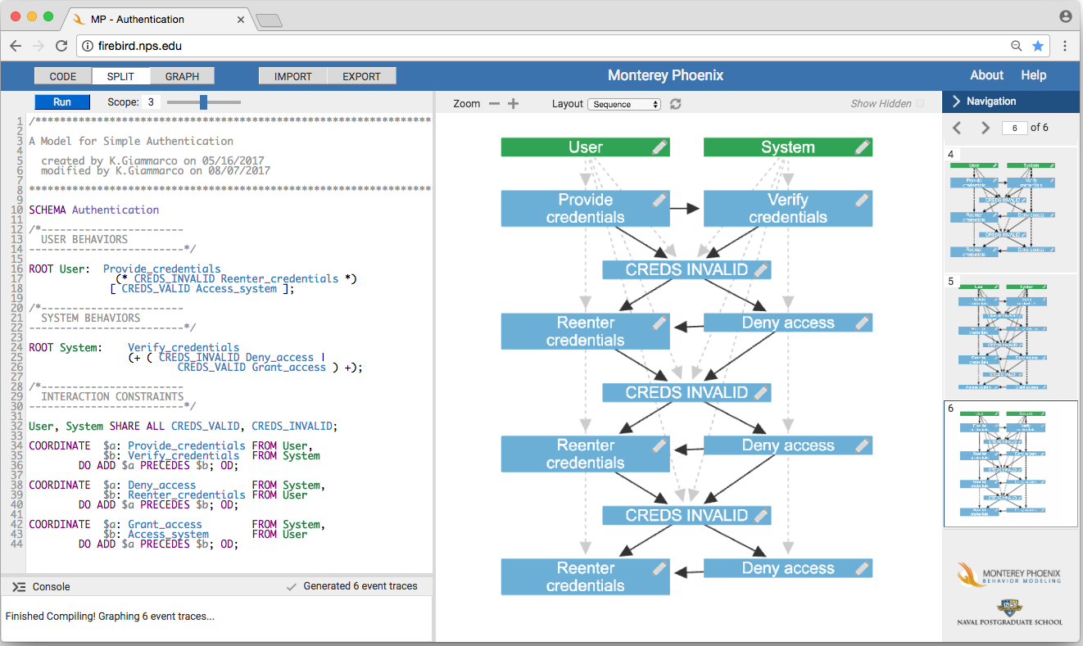
MP Analyzer Layout
The Small Scope Hypothesis: most flaws in models can be demonstrated on small counterexamples
Run the model.
Inspect event traces output.
Type model here.
Model system behaviors separately
System interactions treated as constraints
Exhaustive generation of SoS behaviors up to a specified scope
2 possible SoS behaviors at scope 1
4 possible SoS behaviors at scope 2
6 possible SoS behaviors at scope 3

Slide 4
Some Use Cases for MP
To verify and validate activity models developed in notations such as SysML [1]
To generate comprehensive use case scenario variants for activity models [2]
To count function points and estimate cost [3]
To discover and document templates for behavior patterns [8]
To detect, classify, predict and control emergent behaviors [7][9]

Slide 5
Emergent Behaviors Found using MP Modeling
An order processing system enters a waiting state after a transaction is cancelled. (Pilcher 2015)
A first responder administers rescue medication to an unconscious patient, unaware that the medication was already administered. (Bryant 2016)
The International Space Station is unaware of a hazardous condition within a supply spacecraft as that spacecraft approaches to dock. (Nelson 2015)
A UAV on a search and track mission reaches a return-to-base condition, then finds and begins to track a new target. (Revill 2016)
A UAV on a humanitarian assistance and disaster relief mission reports acceptable system status, then the operator suddenly commands the UAV to abort the mission without provocation (Reese 2017 on Beaufait, Constable, and Jent 2017).

Slide 6
An order processing system enters a waiting state after a transaction is cancelled.
Valid Scenarios: Orders conclude normally.
Invalid Scenario: This order hangs in a waiting state.
Example Found Requirement: The Order Processing System shall end all started transactions in either the Cancelled or Delivered state.
Pilcher, Joanne D. “Generation of department of defense architecture framework (DODAF) models using the Monterey Phoenix behavior modeling approach.” Master's Thesis, Naval Postgraduate School, Monterey, CA. September 2015.

Slide 7
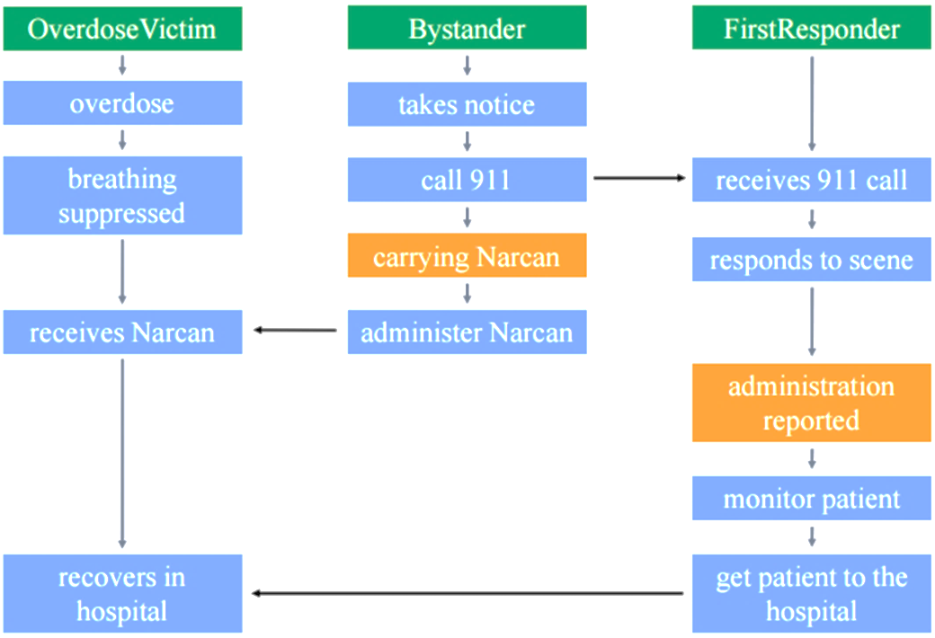
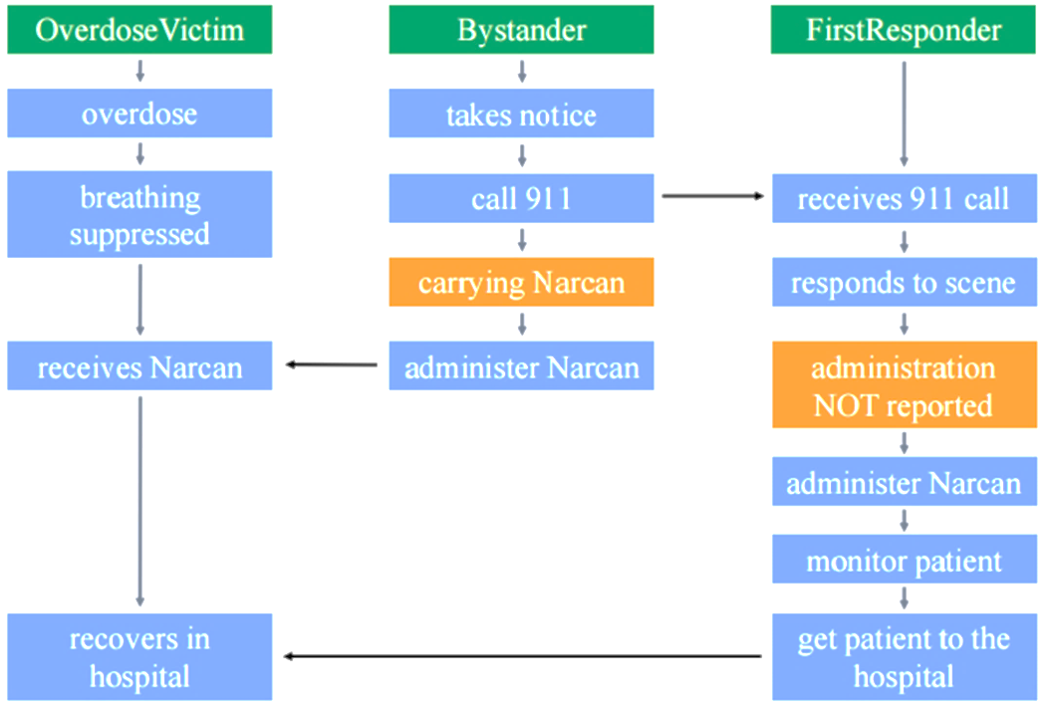
A first responder administers rescue medication to an unconscious patient, unaware that the medication was already administered.
Example Found Requirement: Any Bystander who administers Narcan to an Overdose Victim shall place a band around the Overdose Victim’s wrist that indicates the amount and time of the Narcan dose administered.
Bryant, Jordan. “Using Monterey Phoenix to analyze an alternative process for administering Naloxone.” Capstone Research Project, Science and Math Academy, Aberdeen, MD. June 2016.

Slide 8
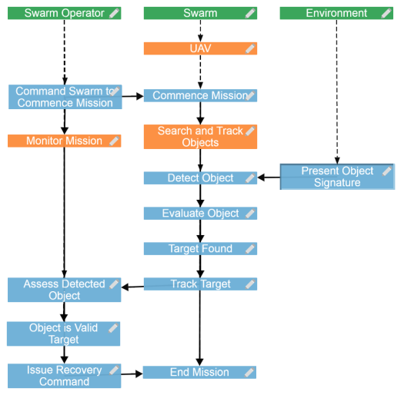
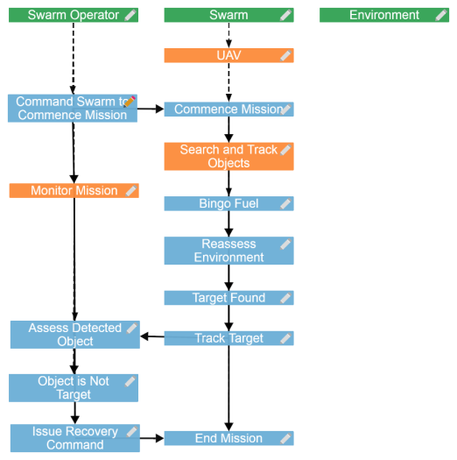
A UAV on a search and track mission reaches a return-to-base condition, then finds and begins to track a new target.
Valid Scenario: Object detected, tracked, and determined by Swarm Operator to be a valid target
Invalid Scenario: Target tracked after bingo fuel condition
Example Found Requirement: A UAV that has reached a bingo fuel condition shall request permission from the Swarm Operator to track any new targets found.
or
Example Found Requirement: A UAV that has found a possible target after reaching bingo fuel shall relay the LKL of the target to the Swarm Operator, then continue to return to base.
or
Example Found Requirement: A UAV shall only track targets found before reaching bingo fuel conditions.
Revill, Michael B. “UAV swarm behavior modeling for early exposure of failure modes.” Master's Thesis, Naval Postgraduate School, Monterey, CA. September 2016.

Slide 9
General Analysis of Emergent Behaviors
Detection: Initial discovery of emergent behavior.
Classification:
Simple: derived from element properties and relationships in non-complex or ‘ordered’ systems [5].
Weak: desired (or at least allowed) emergence produced by a complex system [5].
Strong: unexpected emergence not observed until simulation, testing, or operations [6].
Prediction: Postulation of potential future states of emergence based on detected behaviors.
Control: Management of positive or negative emergent behaviors through M&S or other analysis.
Definition set paraphrased from [4]

Slide 10
Example Analysis of Emergent Behaviors with MP
Example | Slide | Detection | Classification | Prediction | Control
Pilcher’s Order Processing System | 6 left | Automatic and scope-complete with MP | Simple positive emergence | Order Cancelled | -
 | 6 middle |  | Simple positive emergence | Order Delivered | -
 | 6 right |  | Simple negative emergence | Order hangs in a Waiting state: Customer inconvenience; employee inconvenience; Cyber security vulnerability | Behavior logic modification in system model to prevent sequences that end in Waiting state
Revill’s UAV Mission | 8 left | Automatic and scope-complete with MP | Weak positive emergence | Valid target detected and tracked | -
 | 8 right |  | Strong positive emergence | UAV is successfully recovered after tracking an object of interest after bingo fuel | Add details to the model to be explicit about requirements to ensure this outcome
 |  |  | Strong negative emergence | UAV forced to emergency land / crash after tracking an object of interest after bingo fuel | Add details to the model to be explicit about requirements to mitigate this risk
Analysis from Table 1 in [7].

Slide 11
Conclusions
Unspecified and potentially invalid behaviors have been exposed by students ranging from high school to graduate level education.
Suggests that MP’s lightweight formal method approach is user friendly for practitioners with basic skills in logic and logical thinking.
To expose emergent behaviors for analysis:
model possible events in systems, and
treat interactions among events in different systems as constraints that can be relaxed or restricted.

Slide 12
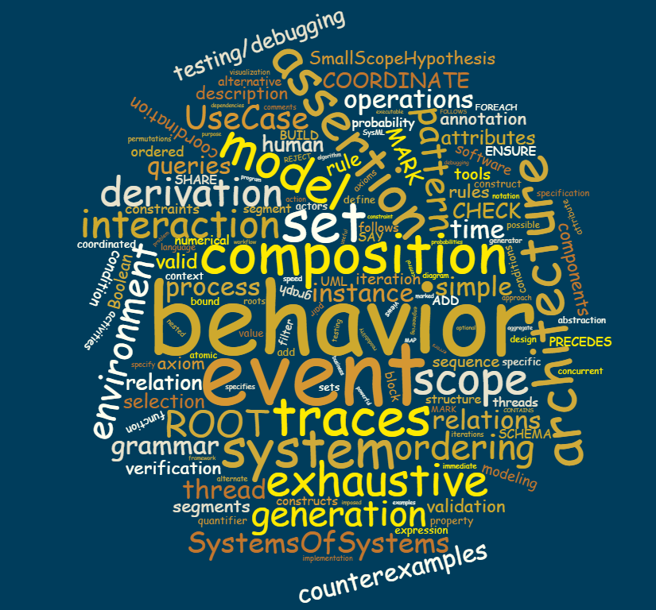
Questions?
Monterey Phoenix and Related Work:
https://wiki.nps.edu/display/mp
firebird.nps.edu
kmgiamma (at) nps.edu

Slide 13
References
Giammarco, Kristin. “Practical Modeling Concepts for Engineering Emergence in Systems of Systems.” Proceeding of the 12th Annual System of Systems Engineering Conference, Waikoloa, HI, June 18-21, 2017.
Giammarco, Kristin, Kathleen Giles, and Clifford A. Whitcomb. “Comprehensive use case scenario generation: An approach and template for modeling system of systems behaviors.” Proceeding of the 12th Annual System of Systems Engineering Conference, Waikoloa, HI, June 18-21, 2017.
Farah-Stapleton, Monica. “Executable behavioral modeling of system- and software- architecture specifications to inform resourcing decisions.” Doctoral Dissertation, Naval Postgraduate School, September 2016.
Rainey, Larry and Mo Jamshidi. “Introduction and Overview for Engineering Emergence: A Modeling and Simulation Approach,” Chapter 1 in Engineering Emergence: A Modeling and Simulation Approach, edited by Larry Rainey and Mo Jamshidi. Boca Raton, FL: CRC Press Taylor & Francis Group.
Page, S.E. 2009. Understanding Complexity. The Great Courses. Chantilly, VA, USA: The Teaching Company.
SEBoK authors. 2017. “System of Systems (SoS),” in BKCASE Editorial Board. 2016. The Guide to the Systems Engineering Body of Knowledge (SEBoK), v. 1.8. R.D. Adcock (EIC). Hoboken, NJ: The Trustees of the Stevens Institute of Technology. Released 27 March 2017, http://sebokwiki.org/wiki/Systems_of_Systems_(SoS)#Definition_and_Characteristics_of_Systems_of_Systems (accessed 12 July 2017).
Giammarco, Kristin and Mikhail Auguston. “Behavior modeling approach for the early verification and validation of system of systems emergent behaviors,” Chapter 17 in Engineering Emergence: A Modeling and Simulation Approach, edited by Larry Rainey and Mo Jamshidi. Boca Raton, FL: CRC Press Taylor & Francis Group.
Quartuccio, John and Kristin Giammarco. “A model-based approach to investigate emergent behaviors in systems of systems,” Chapter 18 in Engineering Emergence: A Modeling and Simulation Approach, edited by Larry Rainey and Mo Jamshidi. Boca Raton, FL: CRC Press Taylor & Francis Group.
Giammarco, Kristin and Kathleen Giles. “Verification and validation of behavior models using lightweight formal methods.” Proceedings of the 15th Annual Conference on Systems Engineering Research. Redondo Beach, CA. March 23-25, 2017. Best paper award.

