Slide 1

Kathy carnell – Defense acquisition university
18 June 2020
Logistician’s Value To Your Program
**Also Known As…. Why Loggies and Engineers Should Be Best Friends!
Notes:
Thank you for allowing me to speak with you this evening.
I’m Kathy Carnell from the Defense Acquisition University South in Huntsville, AL
Do you remember the television show The Courtship of Eddie’s Father? The theme song was Let Me Tell You About My Best Friend…..
Well let me tell you why Logisticians and Engineers should be best friends.

Slide 2
What is Product Support?
The term “product support” means the package of support functions required to field and maintain the readiness and operational capability of major weapon systems, subsystems, and components, including all functions related to weapon system readiness ……..
(Source: 10 U.S.C. § 2337)
Notes:
Product support is codified in US Law; specifically 10 U.S.C. 2337
Definition is a LOT of word but what do they mean?
Product support is a package. It is not a single item.
It covers all support functions and activities required to field and MAINTAIN system readiness.
These support functions include supply, maintenance, training, publications and other activities.
The product support package is documented in the Life Cycle Sustainment Plan.

Slide 3
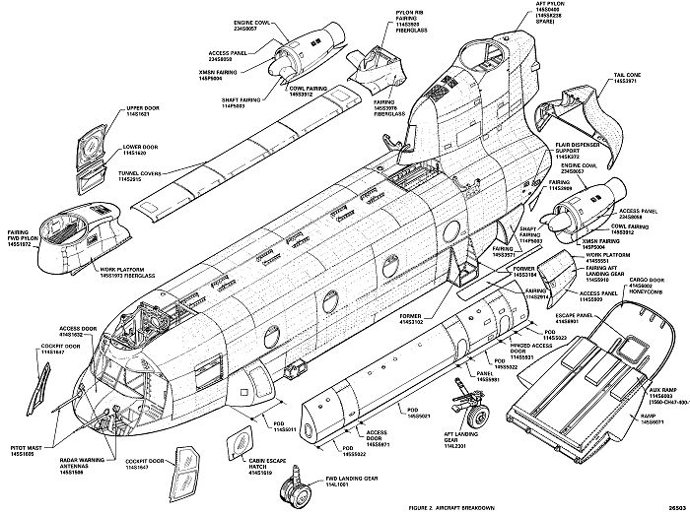
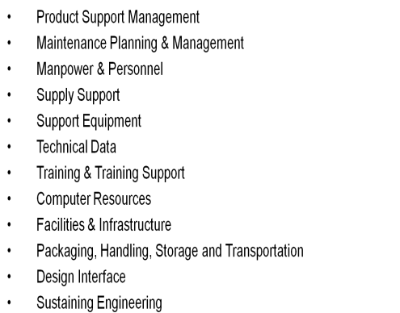
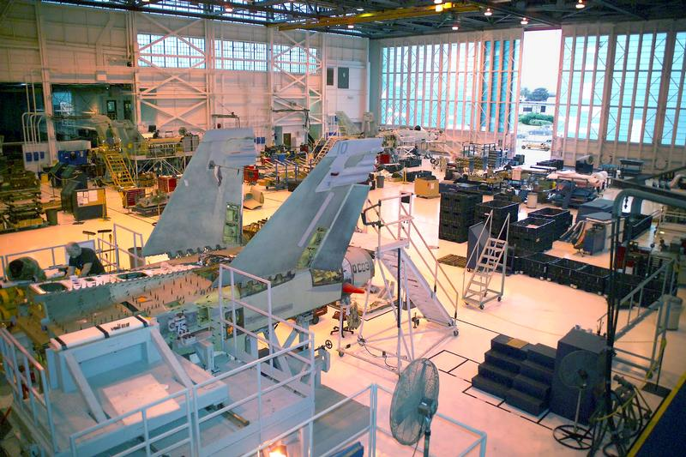
Logistician’s Focus
Design FOR Support
Design THE Support
SUPPORT the Design
Notes:
Influence design of the system from a supportability aspect.
Discuss 3 major aspects of maintainability – accessibility (ease of accessing parts), modularity (being able to remove/replace components of a system to quickly return to a ready state), testability (ability to quickly diagnose problems).
Accessibility example – “hiding” parts behind access panels with multiple screws instead of quick lock fasteners.
Modularity example – removing and replacing components of an engine rather than sending an entire engine to depot level repair facility.
Testability example – thorough built in test to identify faults to a single replaceable component rather than an ambiguity group
Design the support – crafting the product support package
Support the design – after providing equipment to the end user. Ensuring adequate technical manuals; training; spares, etc.

Slide 4
100
80
60
40
20
0
Life Cycle Cost (LCC)
Determination
Why Involve Logistics?
When to Involve Logistics?
CUMULATIVE PERCENT
Actual
Funds
Spent
Approximately
10% of Life Cycle Cost Spent
A
Technology
Maturation
& Risk
Reduction
B
Eng & Mfg
Development
C
Production & Deployment
Operations & Support
Pre-Systems Acquisition
Systems Acquisition (Engineering
& Manufacturing Development, Demonstration, Low Rate Initial Production, & Production
Sustainment
Science & Technology: Technology Opportunities & User Needs
  Logistician’s must be involved in design planning to influence the design to ensure supportability - Once designed - much of the support costs
  are locked in!!!
Notes:
Why involve logistics?
By the time a program reaches Milestone C, 90% of it’s life cycle costs will be determine. However, at this same point in time, only 10% of life cycle costs have been expended.
The greatest opportunity to influence design and the product support outcomes is EARLY!
Engineers are GREAT at engineering business but logisticians are GREAT at logistics business.
When to involve logistics?
If you are thinking…..I wonder if we should involve logistics….the answer is YES!!

Slide 5

The Product Support Package
100%
90%
PSP
80%
70%
20% Integrated Product
Support Elements
Supt Equip
Computer
Example:
Availability shall be greater than or equal to 0.8
60%
PHS&T
50%
Maintenance Planning & Management
Training
40%
Man/Personnel
30%
60%
Reliability &Maintainability
Facilities
20%
Tech Data
Supply Support
10%
Notes:
Acronyms:
Supt Equip – Support Equipment
PHS&T – Packaging Handling Storage & Transportation
Man/Personnel – Manpower/Personnel
Tech Data – Technical Data
Why do we have a Product Support Package?
The Product Support Package is the DIFFERENCE between achieved availability (as designed in through reliability) and operational availability (the warfighter’s requirement).
The ONLY way to make up the difference is through the product support package….consisting of the Integrated Product Support Elements.
Example – item with poor reliability that has to be frequently replaced, should be easily accessible.

Slide 6
Why does the Logistician care?
Ensure system supportability requirements are aligned with CUSTOMER need
Ensure trade studies consider long-term sustainment impacts
Risk identification and mitigation
Document hardware and software support requirements
Provisioning concepts and strategies are compatible with maintenance concept
Supply chain assessments
Technical manuals document actual configuration
**60-80% of life cycle costs are spent in SUSTAINMENT
Notes:
Foot stomper – 60-80% of life cycle costs are spent in Sustainment.
Must ensure supportability requirements are traceable to the CUSTOMER need
View through the lens of long term sustainment
Identify risk and mitigate

Slide 7

The Value of the Integrated Product Team
  A stakeholder is “any group or individual who can affect or is affected by the achievement of the organization’s objectives.” - R. E. Freeman
  Leverage subject matter expertise
  TEAMWORK makes the DREAM WORK!
  Works across organizational boundaries
Notes:
Definition of stakeholder.
Why why why?
Everybody brings SOMETHING to the table
Leverage unique expertise
IPTs works across organization boundaries
TEAMWORK makes the DREAM WORK

Slide 8

Fantastic Logisticians and Where to Find Them
Program Offices
The next hallway
Friends/Neighbors
Integrated Product Teams
Doing important Logistics work ☺
International Society of Logistics Engineers
Defense Acquisition University
Behind this door…
Lives a GREAT LOGISTICIAN
Notes:
Where to find logisticians?
Reach out! Invite a Logistician to a meeting.
Be a part of a logistics IPT
Lunch-n-learns
Use a life line – phone a friend ☺

Slide 9
EXAMPLES
Commercial vs Standard Generator
Undocumented System Modifications
Multiple Configurations
Notes:
Examples –
Commercial generator vs Army standard. Challenges in maintainability; sparing; training; specialized equipment.
Undocumented system modifications – where to start!! Lack of data leads to lack of spares which leads to greater down time which is less availability for operations.
Multiple configurations – technical data management (duplicative databases). Sparing; forecasting; publications

