Slide 1
Innovate or Die:
The Imperative for Change
Jon Clauss - LM Fellow
INCOSE North Texas Chapter
July 2020

Slide 2
Innovate
Innovation is production or adoption, assimilation, and exploitation of a value-added novelty(new) in economic and social spheres; renewal and enlargement of products, services, and markets; development of new methods of production; and the establishment of new management systems. It is both a process and an outcome.
- Crossan and Apaydin
Notes:
Everyone talks bout innovation like it is a good idea. I believe that history shows that is good idea but an imperative and that organizations/companies that don’t innovate are often disappear as they become non longer relevant or productive
Note, that innovation can be about Products,. Processes and organizations

Slide 3
A Little History
Lockheed Martin can trace its’ heritage back to the Wright Brothers through two paths
  Wright-Martin Aircraft Corporation → Martin Aircraft → Martin Marietta
  Dayton-Wright Company → Consolidated Aircraft → GD → Lockheed
From the same heritage
  Wright-Martin Aircraft Corporation → Wright Aeronautical → Curtis -Wright
So How Many People Here Have Heard of Curtis-Wright?
Notes:
I’m a bit of both an airplane and a history geek, so the idea of working for a company that can trace it’s roots back to the Wright Brothers is pretty neat
But how did we get from the Wright Brothers to LM?

Slide 4
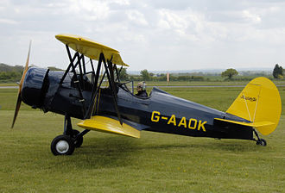
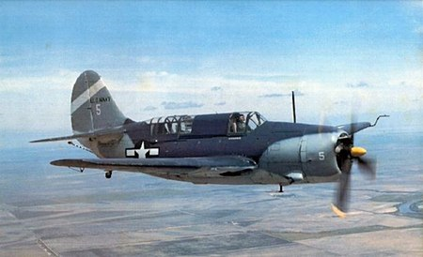
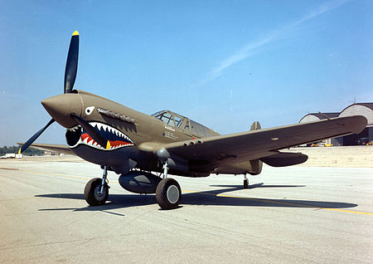
Curtis-Wright?
1929-45 - Largest aerospace supplier to USG
2017 – 8000 employees, $2.11 Billion (LM 100K+ , $51.6B)
Notes:
CW is still a going concern
1929 -45 largest Aerospace supplier
2nd in WWII production contracts, behind GM
Today a 2nd/3rd tier supplier

Slide 5


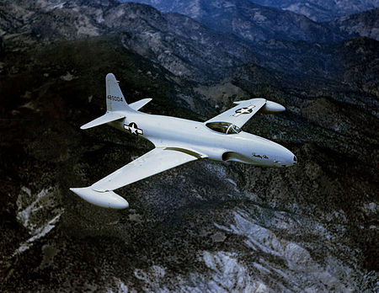
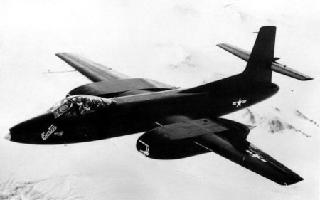


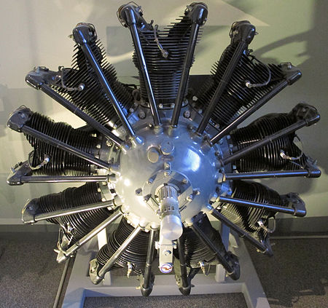
Innovation ?
1900-09 |  | 1910-19 |  | 1920-29 |  | 1930-39 |  | 1940-49
Largest Aerospace Supplier
1903
1909
1912
1915
1916
1919
1925
1926
1929
1938
1944
1948
The Wright Company Founded
Martin Company Founded
Wright-Martin Aircraft Corporation
Frederick Rentschler leaves Wright Aeronautical to found Pratt & Whitney Aircraft Company.
Lougheed Aircraft Founded
Founded
XP-40 1st Flight
Lockheed XP-80 1st Flight
XF-87 Canceled
Wright Brothers 1st Powered Flight
Wright-Martin becomes Wright Aeronautical
1926
1st PW Wasp runs
Lockheed Founded
1949
Martin Aircraft founded
Curtis-Wright sells Aviation assets to North American Aviation
From the Leader to Out of the Business in 20 years
Notes:
1912 1st version on Lockheed
Frank R left because he couldn’t get his engine built radial air-cooled, Wright had one it was under powered, company was making money selling water cooled, Navy wanted air cooled(radiators fail), and he said, ‘you know what they act like one company’
Found money and space with a small company “Pratt and Whitney Machine Tool Company, who had excess space and was reviewing the company’s future after WWI and saw aviation as an opportunity.
He would later leave and keep the name and become part of United Aircraft and Transportation Company with Boeing and others, the fore runner of UTC/Boeing, that is another story
Irony – 1st flight of the WASP was on a Curtis aircraft
Wasp they built 34,000+ powered
Declared a Historic Engineering Landmark
The R-1830, 173,000+ produced, B-24
During the war CW spent very little research and development, never figured out a jet
All the wartime designs were incremental.
They also had a scandal related to engine production
1949 – sold aeronautics to NAA now part of Boeing

Slide 6
Sobering Thought
“In the world we have today, we can either maintain our process or we can maintain preeminence, but we probably can’t do both, …..Our acquisition system is built for a period of time in which, first of all, American preeminence was not really questioned,” he said. “We had the luxury of time to make decisions as if others couldn’t catch up. Now we know – we should know – that they can. We can either devote ourselves to the maintenance of the structure that we have or we can devote ourselves to remaining on top. That’s the choice we face.”
Hon. Michael D. Griffin, under secretary of Defense Research and Engineering, Feb 21, 2018
“When the rate of external change exceeds the rate of internal change, the end of your business is in sight.” - Jack Welch
Notes:
Change gears a bit and focus on innovation is more than just products – talk about organization and process
It isn’t enough to innovate around the products, but how we develop and build then, which is both a process and organization focus
- Jack Welch love him or hate him in left an indelible mark on the American business world – Bottom 10% of managers, shareholder value is a result not a strategy

Slide 7
Digital Equipment Corp(DEC)
DEC defined the market, for what were called minicomputers
Largest seller of minicomputers
  2nd largest computer maker of the 1980’s
  2nd largest employer in Massachusetts
  400,000+ units sold
DEC equipment was common, competed with IBM mainframes for multi-user uses
  PDP-11
  VAX 750, 785, 8350
VT100 is still the ubiquitous remote terminal definition
Notes:
How many have heard of DEC?
Before PC’s DEC filled a niched below ‘mainframes’ for multi-user computing

Slide 8
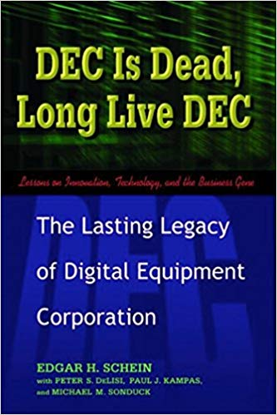
What Happened ?
“Why would anyone need a computer in their home” - Ken Olson, president of DEC
Developed 1 chipset in the time it took Intel to develop 2
Could not adapt organizationally, process or product wise when the market changed
Bought by Compaq in 1998
  Compaq – 1st company to build IBM personnel computer
  1st startup to hit $100M in 2 years
  Largest seller of personnel computers in 1990
  Merged with HP in 2002
Notes:
When I started it WAS THE computers engineers used unless you where on a mainframe
Failed because of high overhead costs and incapable of adapting the corporate culture and processes to a changing market.
- High overhead, when you bought DEC, you bought the computer from one person, the external storage from someone else, and the printers from a third person,
Compaq 1st company to produce a IBM personnel computer, 1st startup to hit $100M in 2nd yr of operation
In the 1990 was the largest seller of personnel computers
Wanted DEC to get into the server market, the weight of the failed org contributed to the downfall
The book was written by a org psychologist who was part of DEC from the beginning and fascinating study of a company unable to redefine itself when the world changed faster than it could

Slide 9
Innovation is about opening your ‘aperture’
“Heavier-than-air flying machines are impossible.“ - Lord Kelvin, president, Royal Society, 1895
"Everything that can be invented has been invented.“ - Charles H. Duell, Commissioner, U.S. Office of Patents, 1899
“I think there is a world market for maybe five computers.” - Thomas Watson, chairman of IBM, 1943
"I have traveled the length and breadth of this country and talked with the best people, and I can assure you that data processing is a fad that won't last out the year.“ - The editor in charge of business books for Prentice Hall,1957
“But what ... is it good for?“ - Engineer at the Advanced Computing Systems Division of IBM, 1968,commenting on the microchip.
"640K ought to be enough for anybody.“ - Bill Gates, 1981
They All Failed to See the Potential of a World Different Than They Knew
Notes:
None of these people were not intelligent
Many of us have 5 computers with us right now, we are surrounded by them
Data processing, what would that person think of today’s data analytics
Bill Gates made billions, but innovative products weren’t how he did it.
Innovation requires to think the beyond confines of what we know today.

Slide 10
So What is the Lesson here?
Innovate or Die is why;
  Evolving organizations are important
  Evolving our processes are important
  INCOSE Vision 2025 is important
  Hackathons and Grand Challenges are important
  You are important
Innovate or Die – Innovation is an Imperative
Notes:
I can find dozens of example that shows that organizations/companies that innovate thrive and those that don’t wither, Innovate or Die is the imperative.

Slide 11
Questions ?

