Slide 1
Data Repositories for Parametric Workflow Models
Using model libraries in Teamwork Cloud to store and retrieve SIS and Launch Vehicle data

Slide 2
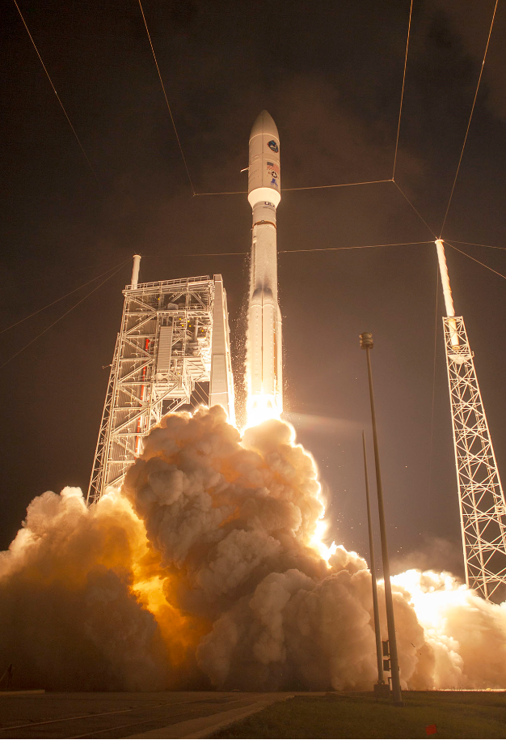
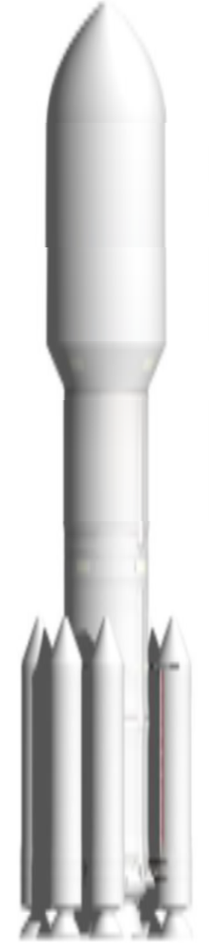
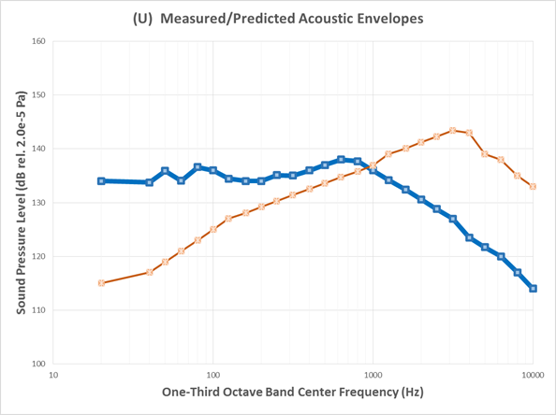
Mission Integration: The Acoustics Problem
Potential areas of interest
Acoustic loads create tremendous mechanical stresses on the entire launch vehicle.
This acoustic environment occurs in two stages –
1) hold down, when all the first stage engines are firing and building thrust, followed by
2) lift-off when the rocket actually starts to fly.

Slide 3
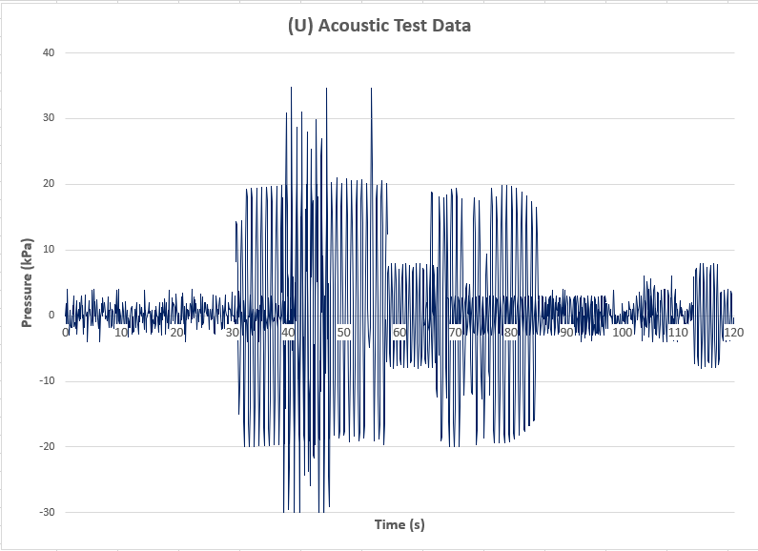
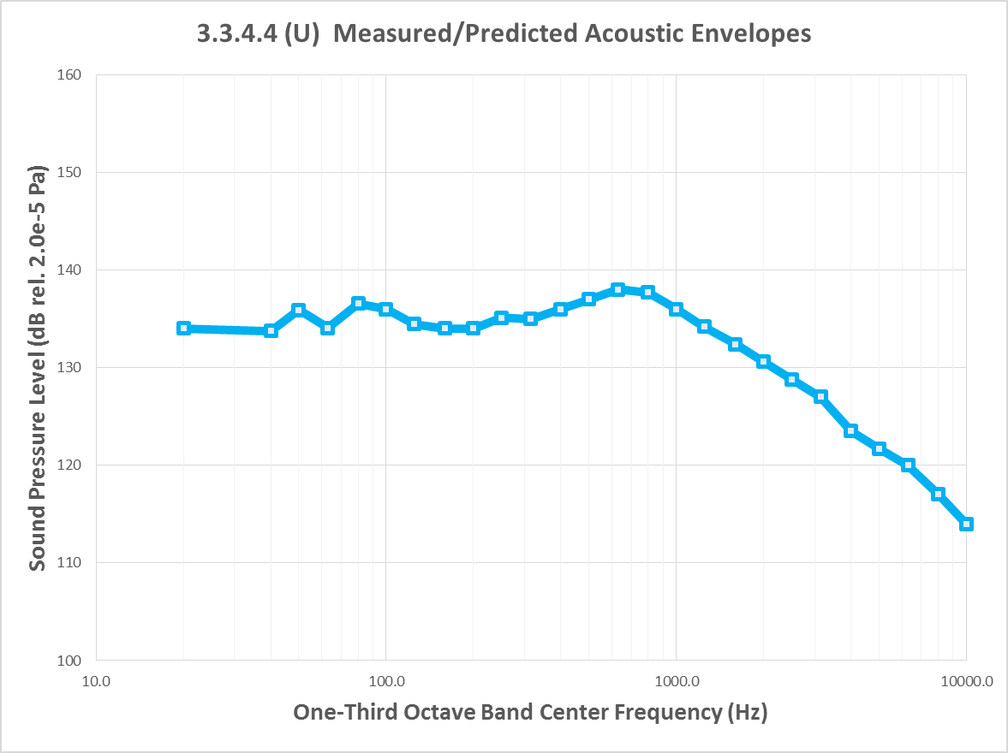
Converting Acoustic Signal into Sound Pressure Levels
OASPL = 10*log10(E) [units: dB]
Measurement of acoustic signal in time domain (test lab, simulation, or other technique)
Converting time signal to frequency domain. Compare curves from different references and vehicles.
SIS provides general guideline as an envelope which constrains this freq curve.
Integrate under freq curve to find Overall Acoustic Sound Pressure Level (OASPL)
Calculate the total energy contained in the spectrum, E = ∫ S(f) df
Calculate Overall Sound Pressure Level, OASPL = 10*log10(E) [units: dB]

Slide 4
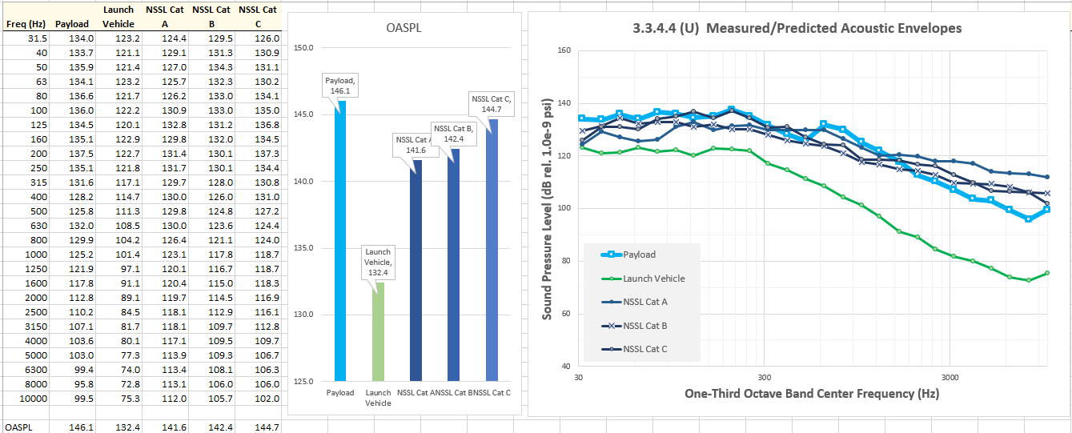
Acoustics Algorithm
OASPL results shown on dashboard as a bar chart
Payload SPL vs freq submitted as raw data file, then imported into SysML table
Freq curves juxtaposed to reveal crossing points, underlaps and overlaps
PL Under Consideration
SIS Categories
(GovCloud)
LV Under Consideration
(LSP Cloud)
Measure or Predict
  20 in from PL Skin
Freq points from other vehicles and/or references
Summary of main steps
Assumptions
  P95/50 (95% Probability with 50% Confidence)
  PL shall be designed to tolerate the acoustic levels generated by LV
  From liftoff through SV separation
  Reference pressure 20 μPa
Workflow Steps
  Obtain V(t) [voltage time trace from microphone]
  Calc p’(t) = mic.constant * V(t)
    where p’(t) = pressure fluctuation
  Normalize p’(t) using reference pressure 20 μPa
  Calc S(f) using FFT
    where S(f) = spectrum of normalized p’(t)
  Correct S(f) for mic response and atmospheric absorption
  Compute Sound Pressure Level (SPL) Spectrum
    SPL(f) = 10*log10(S(f)) [units: dB/Hz]
  Compute Overall Sound Pressure Level (OASPL)
    E = ∫ S(f) df [total energy contained in the spectrum]
    OASPL = 10*log10(E) [units: dB]
  Identify SPL and OASPL exceedances

Slide 5
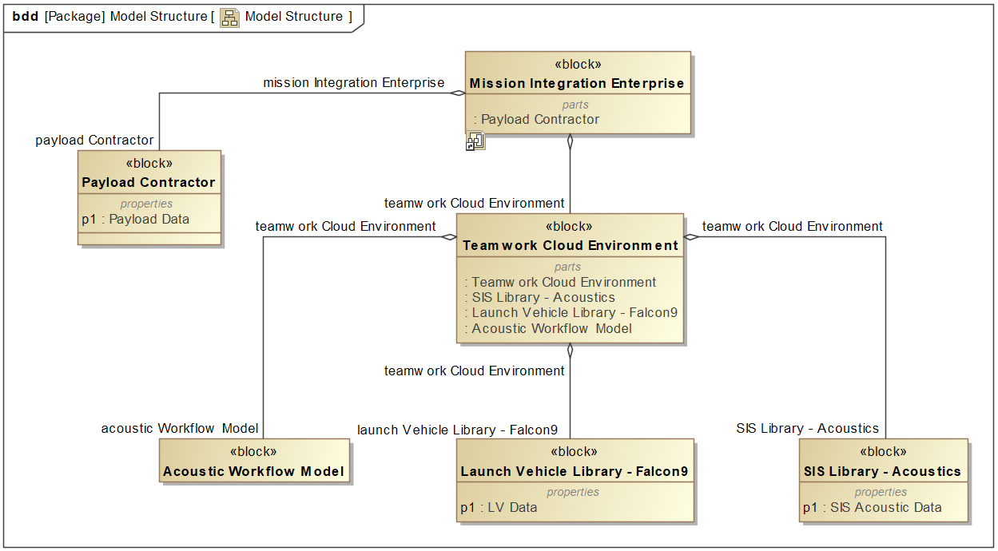
Workflow Analysis Model Structure

Slide 6
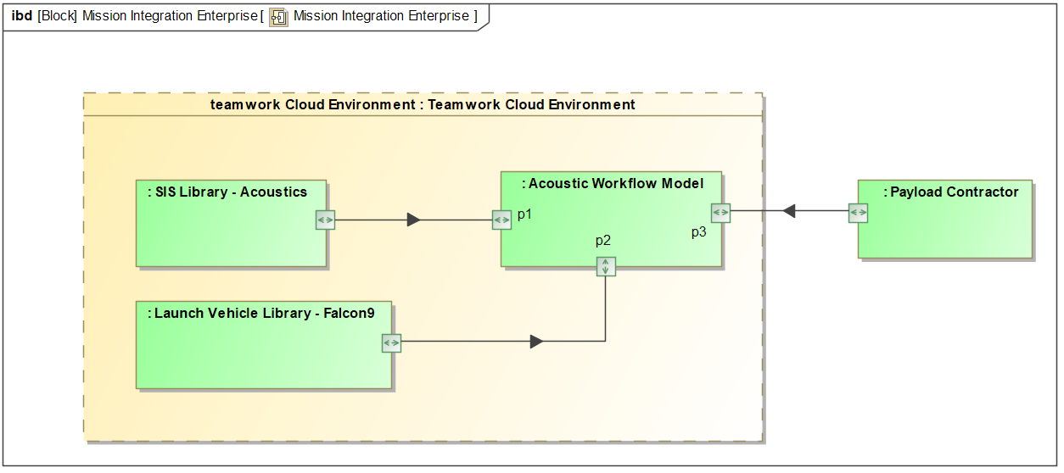
Mission Integration Enterprise Internal Connectivity
Payload data is read in via Excel interface with Cameo
Workflow model draws launch vehicle and interface specs from TWC data models

Slide 7
SIS Library Model

Slide 8
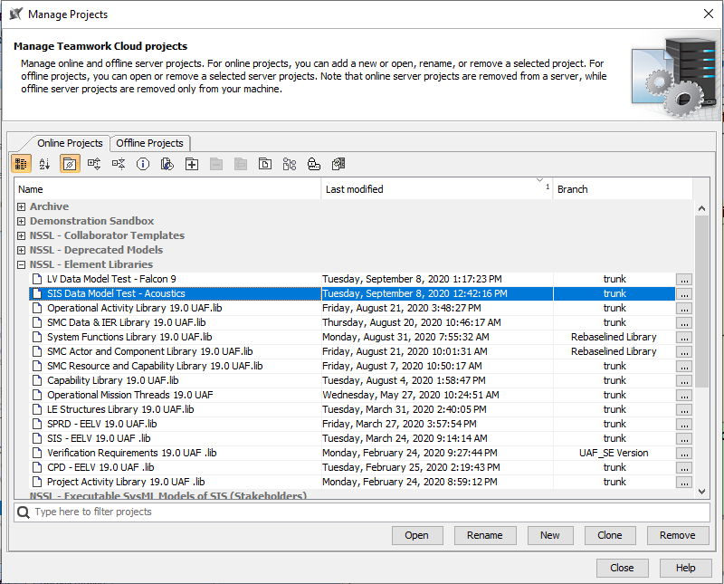
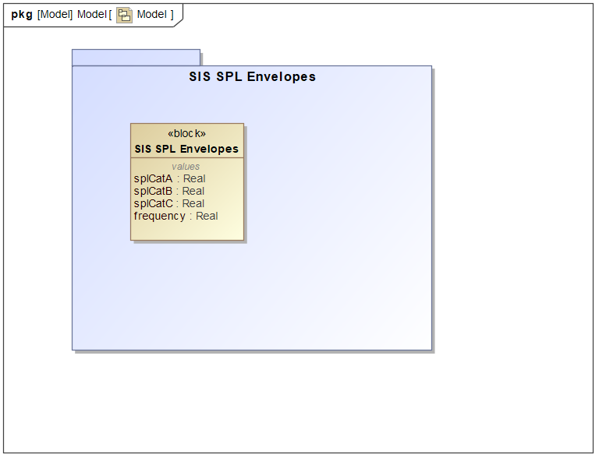
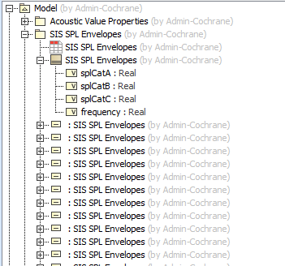
SIS data model is an online server project in Teamwork Cloud
Structure similar to UAF Logical Data Model (LDM)
SIS data model could be part of the actual requirement set, or a separate model for each workflow.
Acoustic envelope data stored as instances

Slide 9
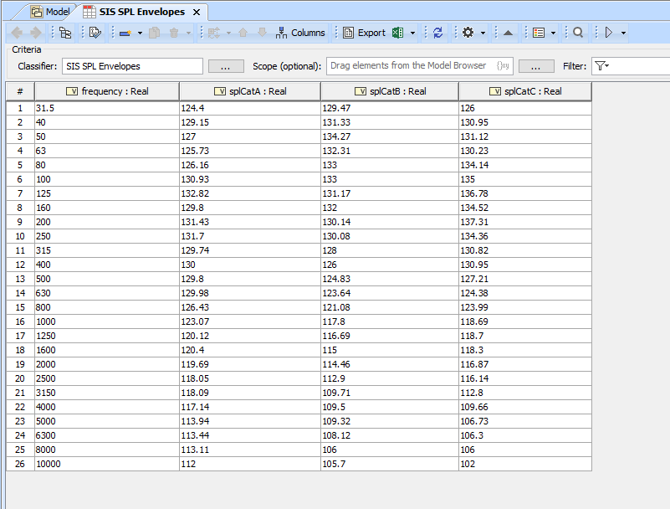
Instance table for SIS data model - acoustics

Slide 10
Launch Vehicle Library Model

Slide 11
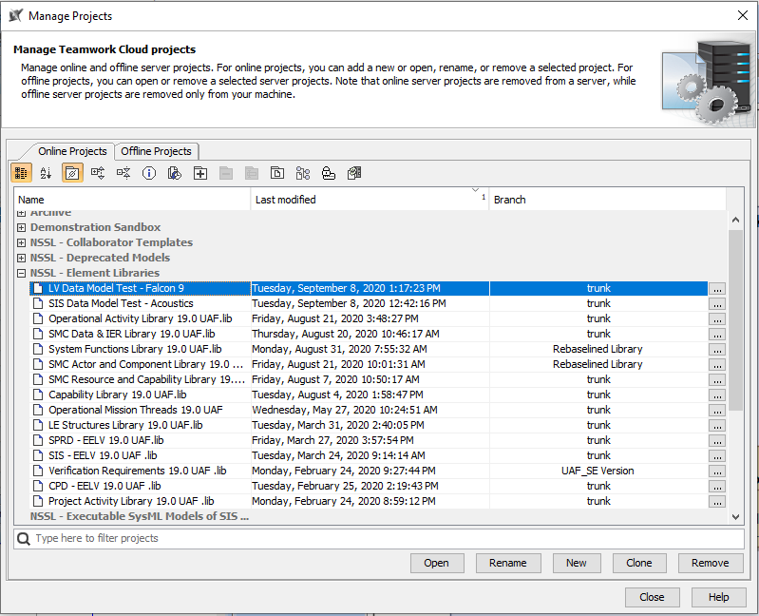
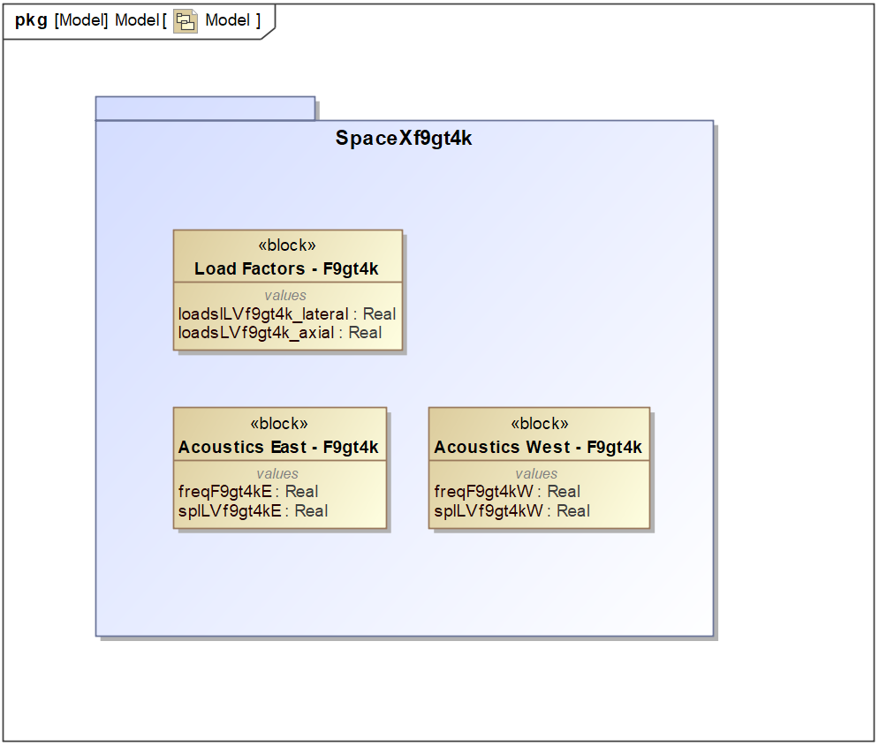
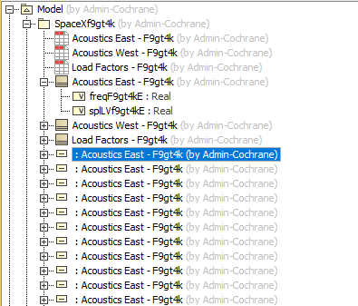
Packages and data elements for LV variants based on workflow
Separate TWC library model for each launch vehicle

Slide 12
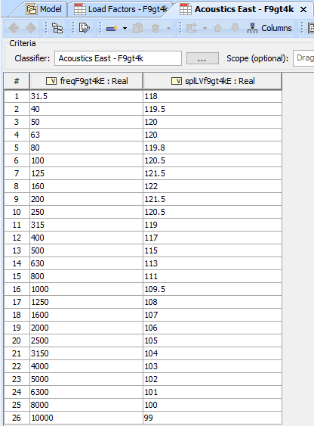
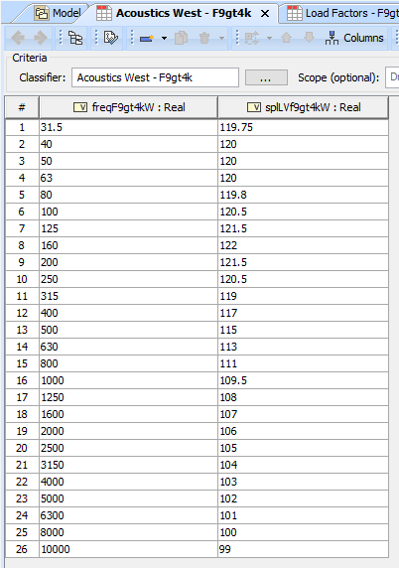
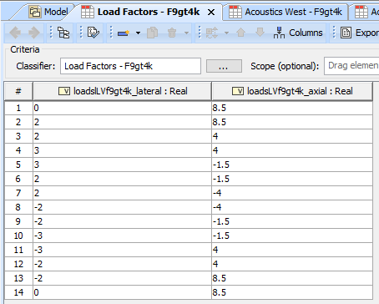
Falcon 9 (> 4k lbs) acoustics and loads instance tables

Slide 13
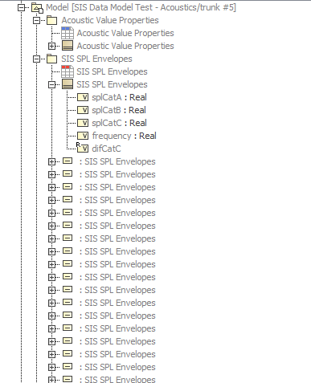
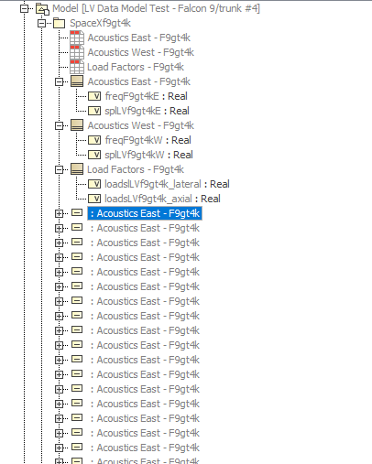
Project Usages
Each library is brought into the acoustics workflow model as a “used project”

Slide 14
Using the Library Models

Slide 15
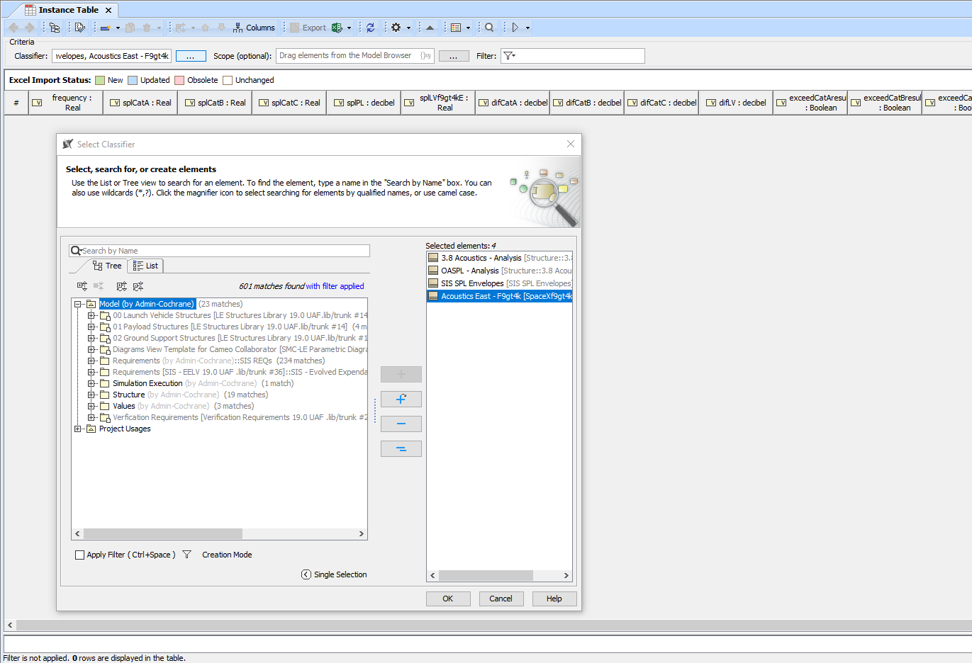
Step 1
Empty instance table in acoustics workflow parametric model
Column headings correspond to value properties in the blocks

Slide 16
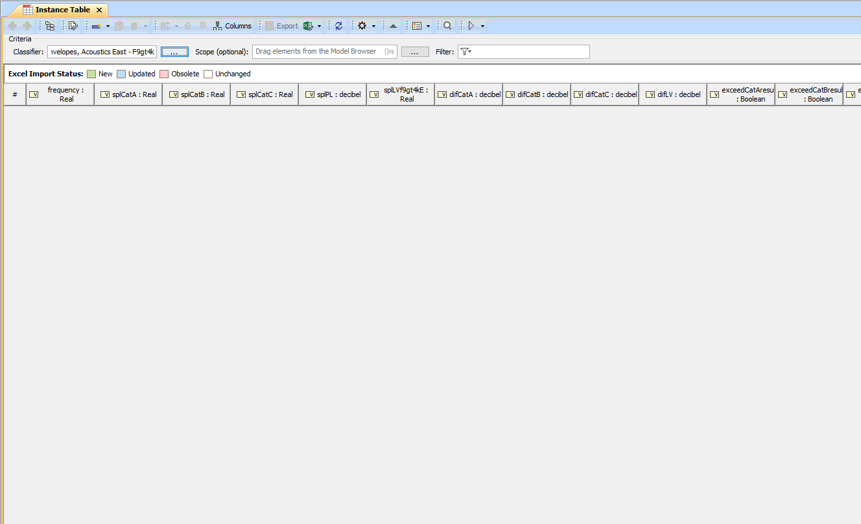
Step 1
This column will be populated with instance data from the LV library
These columns will be populated with SIS data
This column is synced to Excel file for payload input data

Slide 17
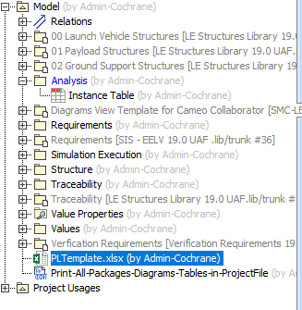
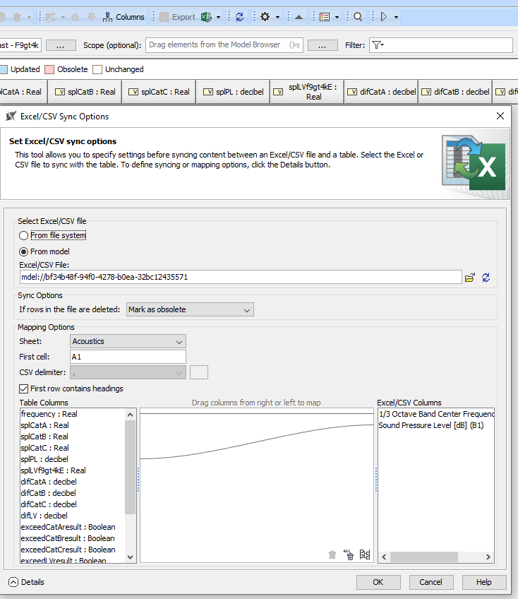
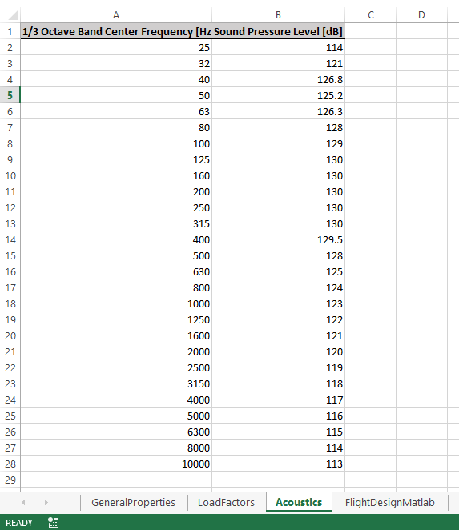
Step 2
Read in payload data from synced Excel file
PLTemplate.xlsx file attached to Cameo model

Slide 18
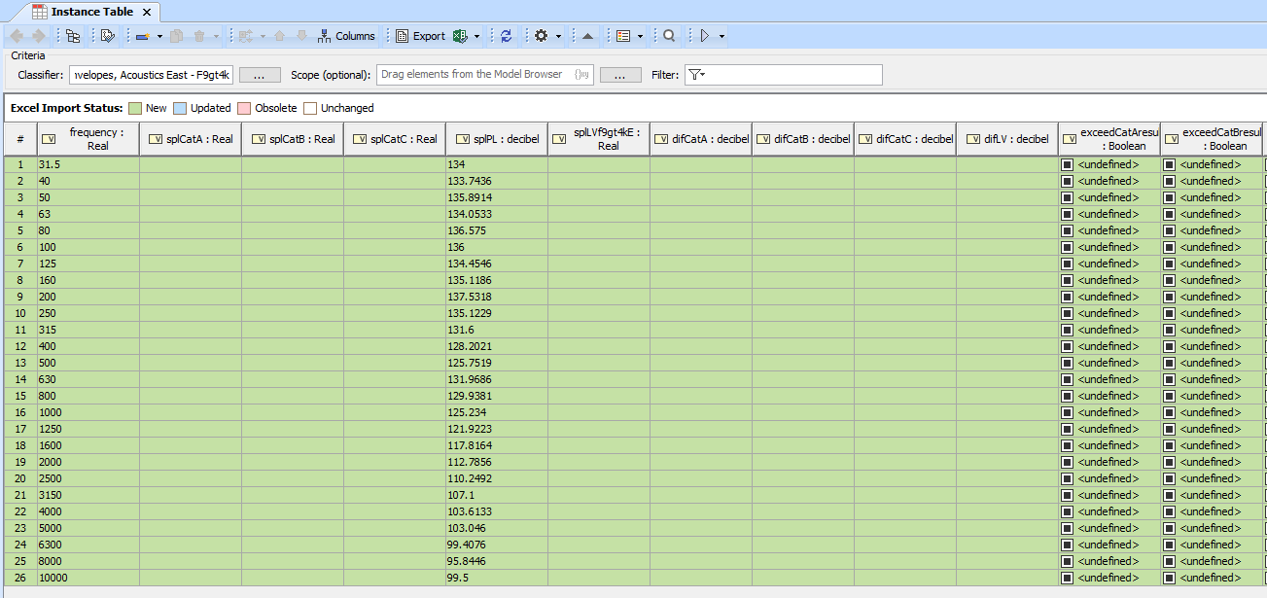
Step 2
Read in payload data from synced Excel file

Slide 19
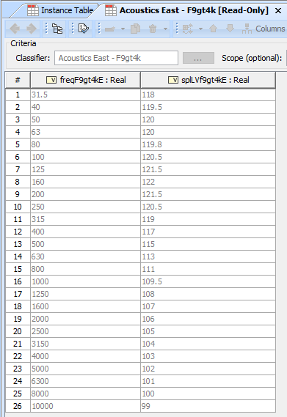
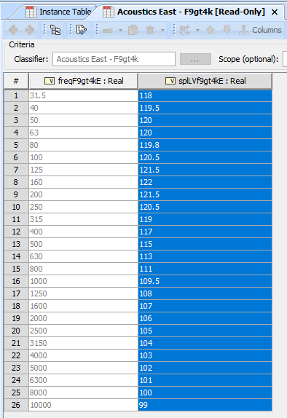
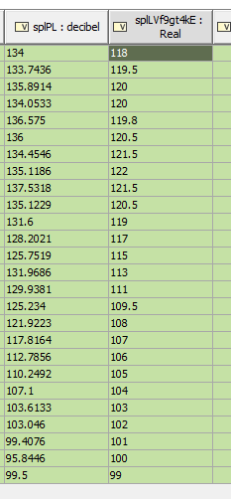
Step 3
Open read-only instance table from LV library
Copy sound pressure levels for Falcon 9 > 4k lbs (East)
Paste into splLVf9gt4kE column of analysis instance table

Slide 20
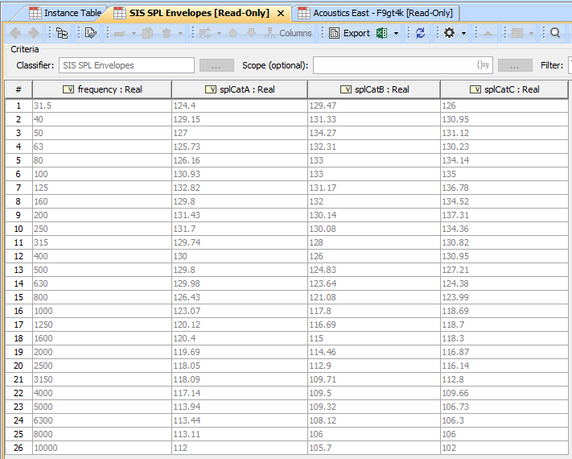
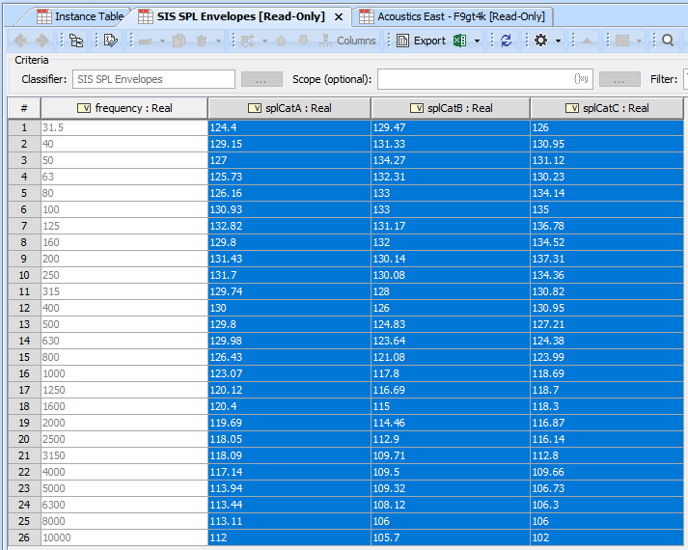
Step 4
Open read-only instance table from SIS data model library
Copy sound pressure levels for Payload Categories A, B and C

Slide 21
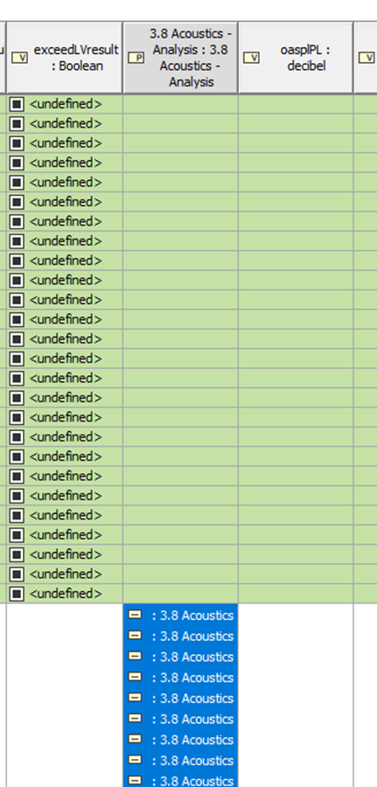
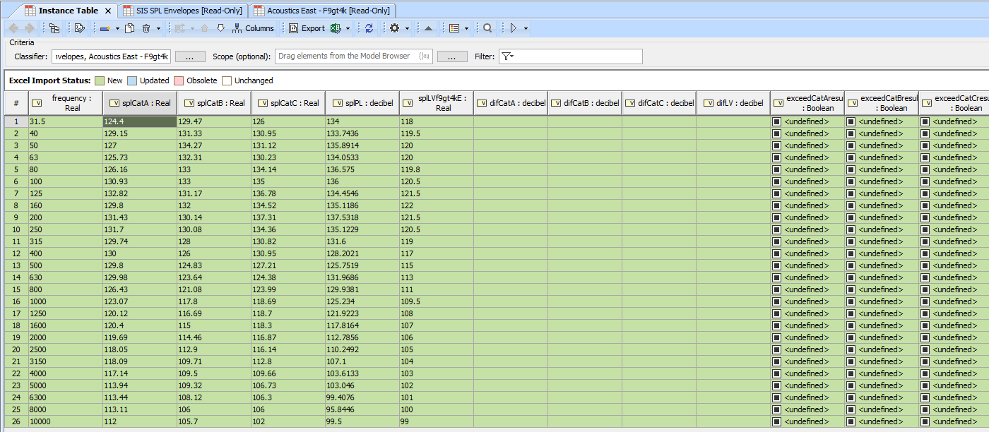
Step 4
Analysis instance table is nearly ready to run the simulation. Final step is to add an instance to receive the sums of the SPL transforms to calculate OASPL

Slide 22
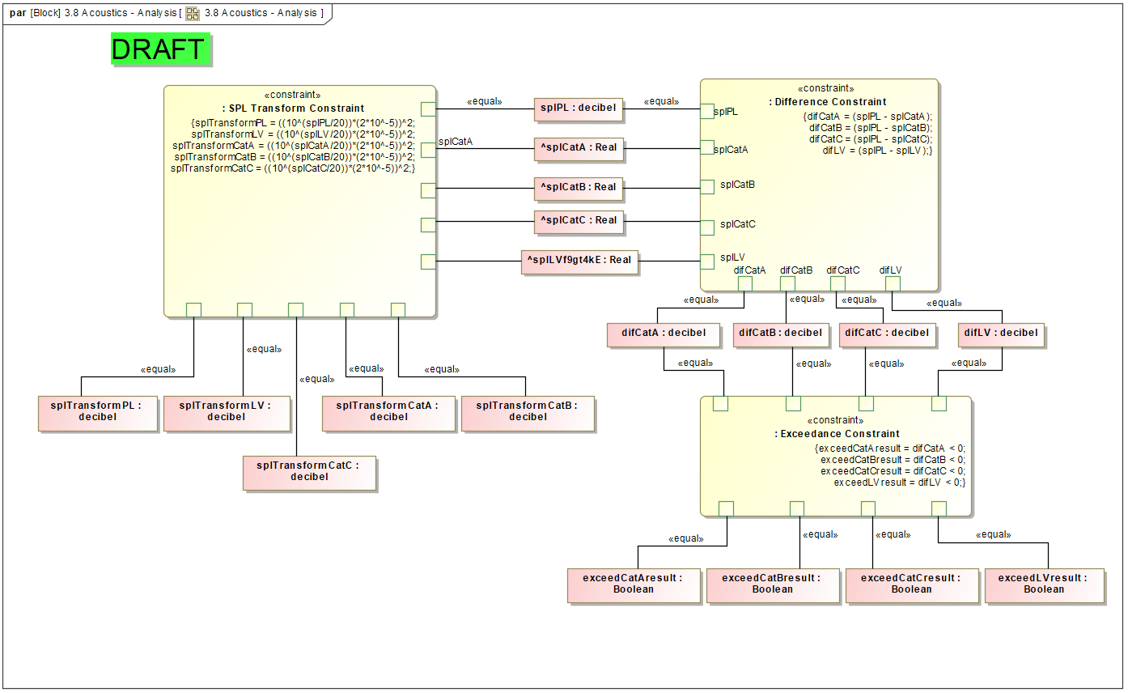
Parametric diagram calculates differences between PL SPL profile and SIS and LV profiles and notes exceedances
Carat symbol signifies these value properties inherited from used project
Parametric diagram also calculates transforms of each instance of SPL value

Slide 23
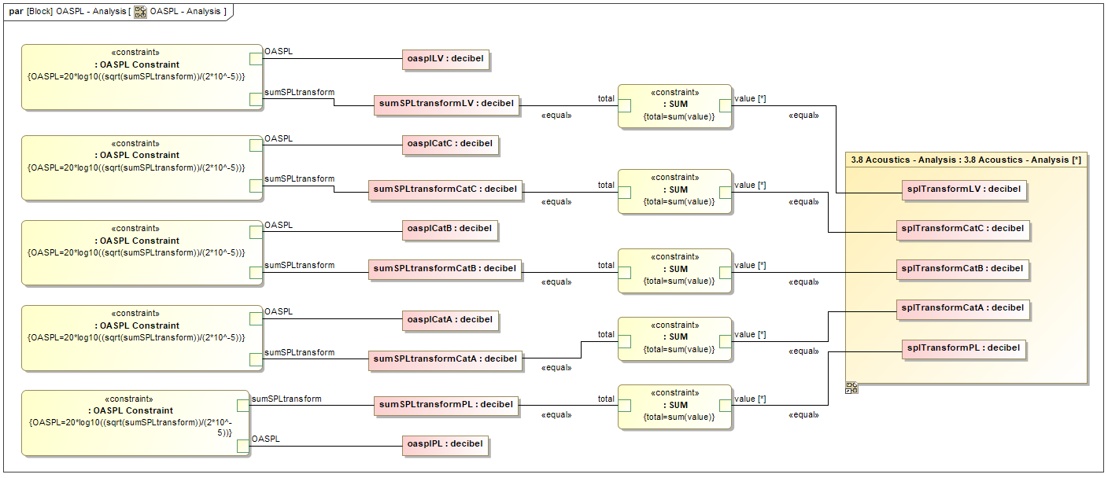
OASPL Parametric diagram sums the SPL transform instances and converts them into OASPL values

Slide 24
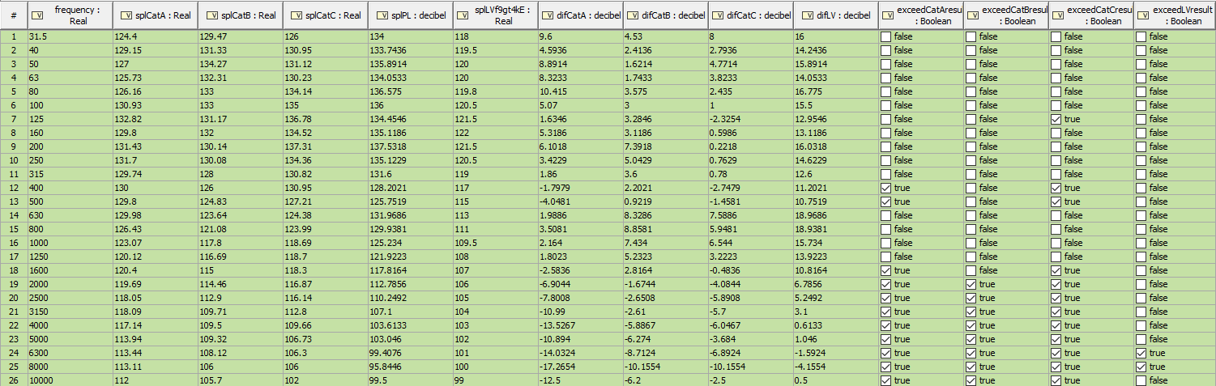
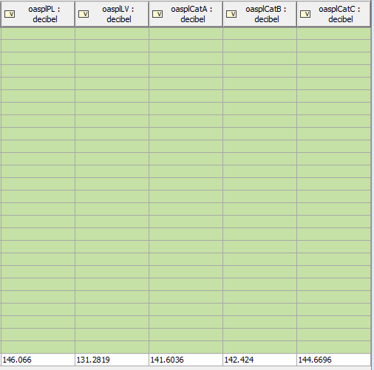
Overall Sound Pressure Level values for payload, launch vehicle and SIS payload fairing categories
Differences calculated
TRUE checked if exceedance exists

Slide 25
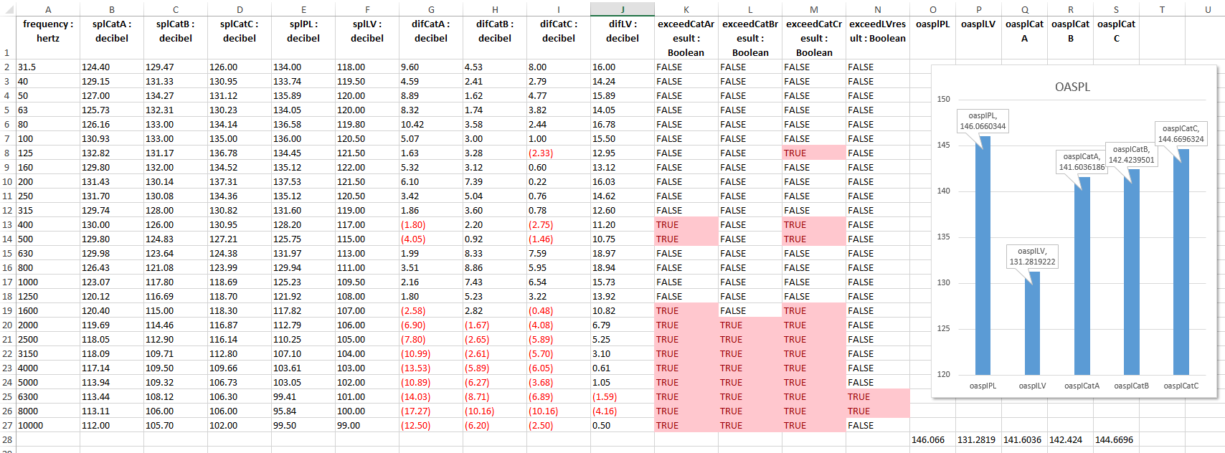
Export Results to Attached Excel File
Differences and exceedances in red
Graph displays OASPL values

Slide 26
Questions?

