Slide 1

An Overview and Guidebook for Data Element Mapping and Analysis (DEMA)
A Novel Approach for the Standardized Capture, Mapping, and Analysis of Data Flows for Digital System Understanding and Architecture

Slide 2
Outline of Presentation
Introduction to DEMA
Background of DEMA
Overview of DEMA
Achieving the Functional Level View
Achieving the Data Vessel Level View
Achieving the Data Element Level View
Data Element Analysis
Conclusion
Allison Ledford and Dr. Gregory Harris

Slide 3
Introduction to DEMA
I N C R E A S I N G C O M P L E X I T Y A N D S Y S T E M U N D E R S T A N D I N G
  Data Element Mapping and Analysis (DEMA) is a novel visual mapping approach for the standardized capture, mapping, and analysis of data flows for digital system understanding and architecture.
  The three steps of DEMA are outlined in the graphic below and described in detail in the remainder of this presentation:
1. Functional Level Mapping and Analysis
2. Data Vessel Level Mapping and Analysis
3. Data Element Level Mapping and Analysis
Figure 1: Steps of the Data Element Mapping and Analysis and Approach

Slide 4
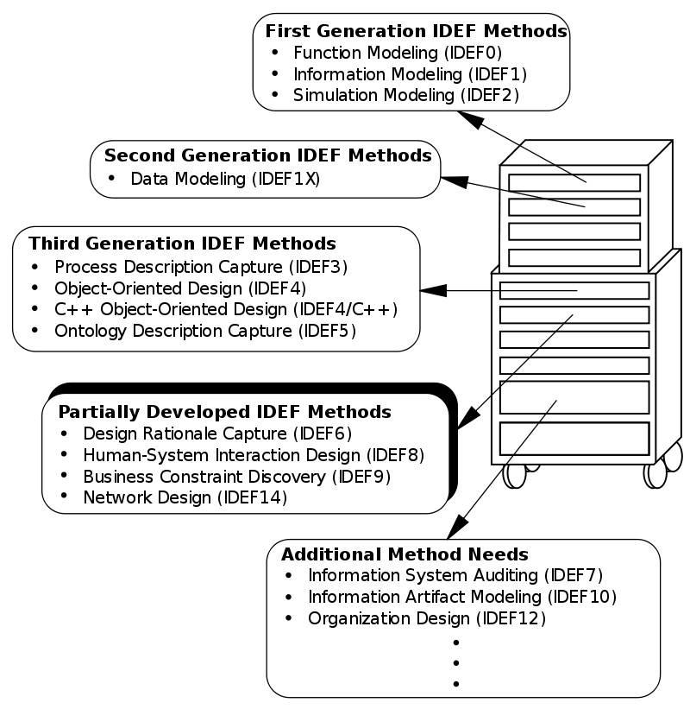
Background of DEMA
In 1980’s, the computer introduced a new way of communicating, capturing, and managing information.
  Engineering, business, science, and all aspects society disrupted by this.
With this revolution in the use of data and information came the need for visual mappings that could be used to better understand and improve digital processes.
In 1993, the National Institute of Standards and Technologies (NIST) released standards for the Integration Definition for Function Modeling (IDEF0).[1]
  IDEF0 was based on the tool created by the Air Force Wright Aeronautical Laboratories Integrated Computer-Aided Manufacturing (ICAM) Architecture, Part II, Volume IV-Function Modeling Manual (IDEFO) from June 1981. [1]
  Since the, an entire family of modeling languages known collectively as “IDEF” have been created, and they collectively cover a wide range of use for data and information modeling design and applications.[2]
The figure shown to the left showcases each of the IDEF methods as well as their stage of development as many of them are not ready for use. [2]
Figure 2: IDEF Methods [2]
https://nvlpubs.nist.gov/nistpubs/Legacy/FIPS/fipspub183.pdf
https://en.wikipedia.org/wiki/IDEF

Slide 5
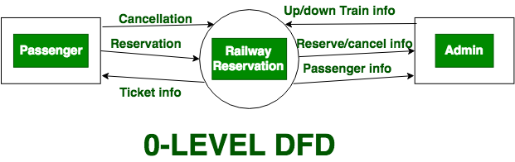
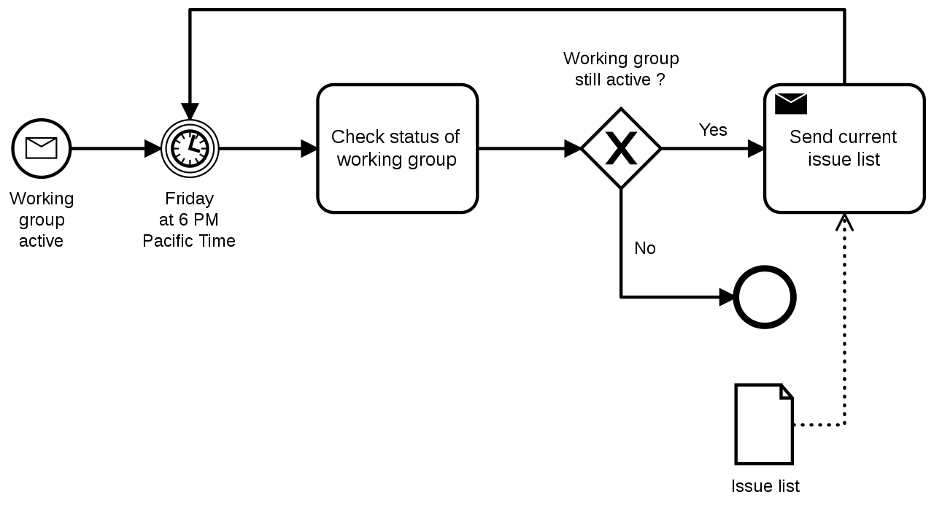
Background of DEMA (Part 2)
As shown in the previous slide, the diversity in the IDEF modeling types shows the many different functional views can be taken to visually map data and information.
  It also indicates that some are more ideal than others for specific applications.
To meet the needs for different functional views for data and information, even more visual mapping tools have been created and are summarized below:
  Control Flow Diagrams (CFD)- a diagram developed in the 1950’s that shows functional process flows with the addition of control mechanisms such as if-then-else conditions, repetition, as well as and/or conditions. [1]
  Data Flow Diagrams (DFD)- a functional mapping technique popularized in the 1970’s that shows the flow of data in information from a document perspective. [2] Example DFD shown to the right in Figure 9.
  Business Process Modeling Notation (BPMN)- a standard for business process modeling popularized in the 2000’s that functionally maps business elements and actions. [3]
Figure 3: Data Flow Diagram Example [4]
Figure 4: Business Process Model and Notation Example [3]
https://en.wikipedia.org/wiki/Data-flow_diagram
https://en.wikipedia.org/wiki/Control-flow_diagram
https://en.wikipedia.org/wiki/Business_Process_Model_and_Notation
https://www.geeksforgeeks.org/levels-in-data-flow-diagrams-dfd/

Slide 6



Background of DEMA (Part 3)
The Fourth Industrial Revolution is now upon us and is centered around the adoption of cyber-physical systems and the Internet of Things. [1]
Digital Transformation is an integral part of the Fourth Industrial Revolution, and it is rapidly becoming a major focus of corporations. [2]
  A study conducted by the Economist Intelligence Unit found that 40 percent of CEOs placed digital transformation as a key boardroom agenda. [2]
Two of the key topics associated with digitalization are the Model-Based Enterprise and the Digital Thread.
  The Model-Based Enterprise (MBE) emphasizes the use of models as a single source of authority in engineering and manufacturing activities. [3]
  The Digital Thread is connection of life cycle data that has been traditionally “siloed” to integrate smart manufacturing systems in a way that achieves reduced lead times and enhanced competitiveness. [4]
Despite popular belief, Digital Transformation can not be achieved by simply digitizing information or implementing digital technologies. [2][3]
https://www.forbes.com/sites/bernardmarr/2018/08/13/the-4th-industrial-revolution-is-here-are-you-ready/?sh=cf8ff37628b2
Digital Transformation: Survive and Thrive in an Era of Mass Extinction. (2019) Thomas M. Siebel
Bringing Clarity to Issues with Adoption of Digital Manufacturing Capabilities: an Analysis of Multiple Independent Studies. (2021) Harris et al., Journal of the Knowledge Economy, https://doi.org/10.1007/s13132-021-00832-8
https://www.nist.gov/programs-projects/digital-thread-smart-manufacturing

Slide 7
Background of DEMA (Part 4)
Although the implementation of digital technologies does not necessitate Digital Transformation, it is a key enabler of its realization, and several technologies have risen as popular choices.
Within the field of Model Based Systems Engineering (MBSE), SysML has emerged as the “de facto standard”. [1]
  SysML is a modeling language for systems engineering applications created in 2003. [2] It provides graphic representations that can be used to model system requirements, behavior, structure, and parametrics. [3]
  Various companies have capitalized on SysML and created software tools to support its use. [4]
Product Lifecycle Management (PLM) software is “a solution that manages all of the information and processes at every step of a product or service lifecycle” including “data from items, parts, products, documents, requirements, engineering change orders, and quality workflows.” [5]
  Various companies have created PLM software. It is advertised as the “foundation” for the Digital Thread. [6]
In conclusion, SysML and PLM software are technologies that can serve as mechanisms for connecting the Digital Thread, but they themselves do not constitute or automatically create the Digital Thread or the Model Based Enterprise.
  Therefore, there is a need to create tools that can be used to create the Digital Thread.
https://www.nasa.gov/consortium/ModelBasedSystems
https://sysml.org/
https://www.omgsysml.org/what-is-sysml.htm
https://en.wikipedia.org/wiki/List_of_SysML_tools
https://www.oracle.com/scm/product-lifecycle-management/what-is-plm/
https://www.ptc.com/en/technologies/plm/digital-thread/plm-engineering

Slide 8
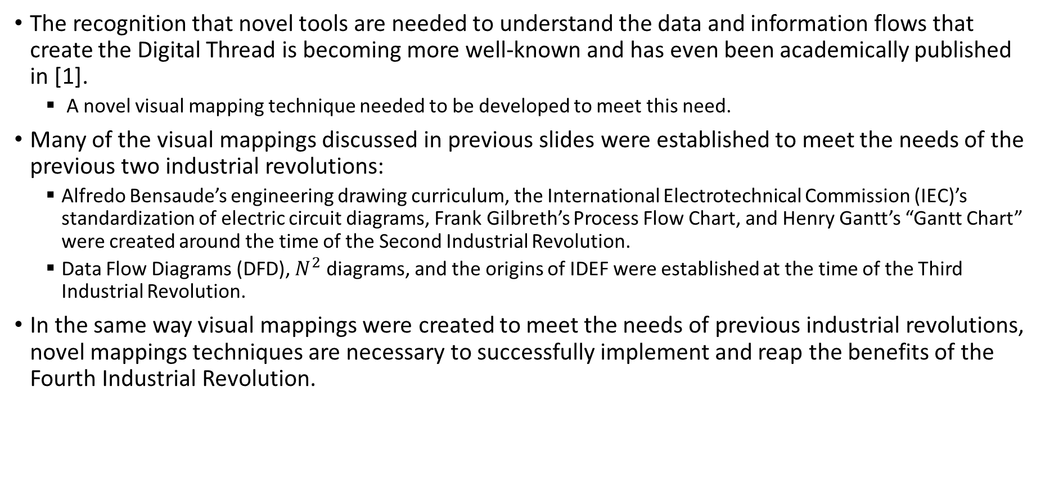
Background of DEMA (Part 5)
The recognition that novel tools are needed to understand the data and information flows that create the Digital Thread is becoming more well-known and has even been academically published in [1].
  A novel visual mapping technique needed to be developed to meet this need.
Many of the visual mappings discussed in previous slides were established to meet the needs of the previous two industrial revolutions:
  Alfredo Bensaude’s engineering drawing curriculum, the International Electrotechnical Commission (IEC)’s standardization of electric circuit diagrams, Frank Gilbreth’s Process Flow Chart, and Henry Gantt’s “Gantt Chart” were created around the time of the Second Industrial Revolution.
  Data Flow Diagrams (DFD), $N^{2}$ diagrams, and the origins of IDEF were established at the time of the Third Industrial Revolution.
In the same way visual mappings were created to meet the needs of previous industrial revolutions, novel mappings techniques are necessary to successfully implement and reap the benefits of the Fourth Industrial Revolution.
1. Bringing Clarity to Issues with Adoption of Digital Manufacturing Capabilities: an Analysis of Multiple Independent Studies. (2021) Harris et al., Journal of the Knowledge Economy, https://doi.org/10.1007/s13132-021-00832-8

Slide 9

Background of DEMA (Part 6)
Although many of the visual mappings shown in the previous slides can be used to visualize the flow documents, their functional perspective inhibits the ability to isolate threads of data.
  Also, none of the mapping techniques offer a systematic method for uncovering the complexities in hidden data and information flows that are found in real-life systems.
It is hard to analyze data threads when mapping objects such as functional blocks are used, and it is impossible to see clearly where there are breaks in the threads of data.
  Therefore, functional-based visual mappings can be used to enable digitization (the computerization of manual activities [2]), but they are not ideal for digitalization.
Therefore, previously used visual mapping techniques are insufficient, and a novel mapping technique that identifies and isolates data threads is ideal for enabling Digital Thread or Model-Based Enterprise (MBE) implementation.
Figure 5: MIST Model-Based Enterprise Graphic

Slide 10
Background of DEMA (Part 7)
In light of the information presented on the previous slides, DEMA was developed serendipitously during a research project with a prototyping organization.
  When analyzing the data and information flows of the organization, it was discovered that none of the visual mapping techniques described in the previous slides were suitable for isolating the threads of data that would make up the Digital Thread/Model-Based Enterprise.
  Trial and error led to the discovery of a generalizable method that became the subject of Allison Ledford’s dissertation work.
We are now finishing the first application of DEMA at the prototyping organization and have refined the steps of DEMA.
  Provisional patent applied for through the university to protect the intellectual property for the sake of future AU research and potential commercialization.
Although the steps of DEMA are now defined, there is significant opportunity to improve its application and capabilities.
Allison Ledford and Dr. Gregory Harris

Slide 11
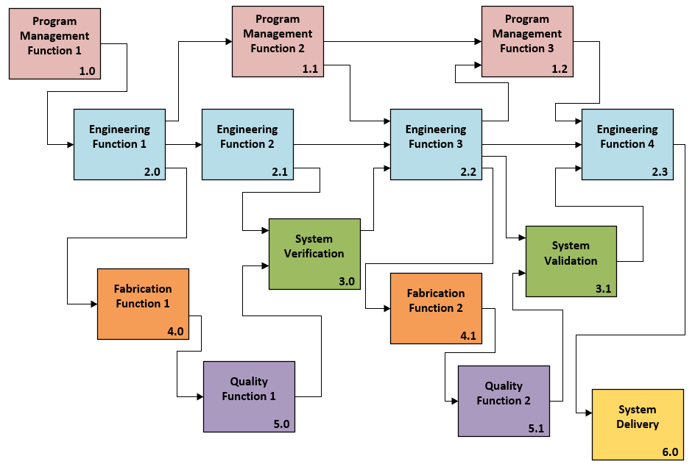
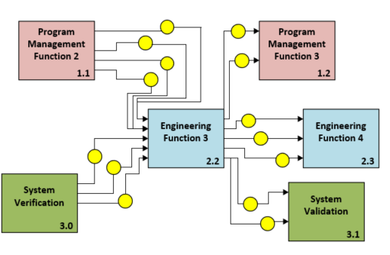


Overview of DEMA
1. FUNCTIONAL LEVEL VIEW
2. DATA VESSEL LEVEL VIEW
3. DATA ELEMENT LEVEL VIEW
A Novel Approach for the Standardized Capture, Mapping, and Analysis of Data Flows

Slide 12
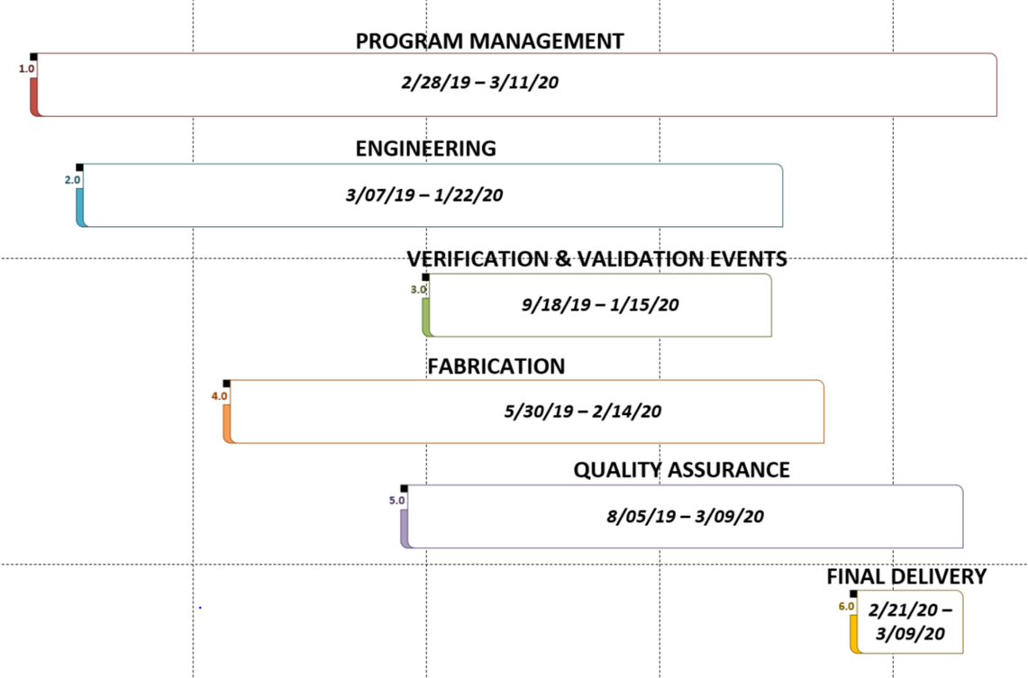
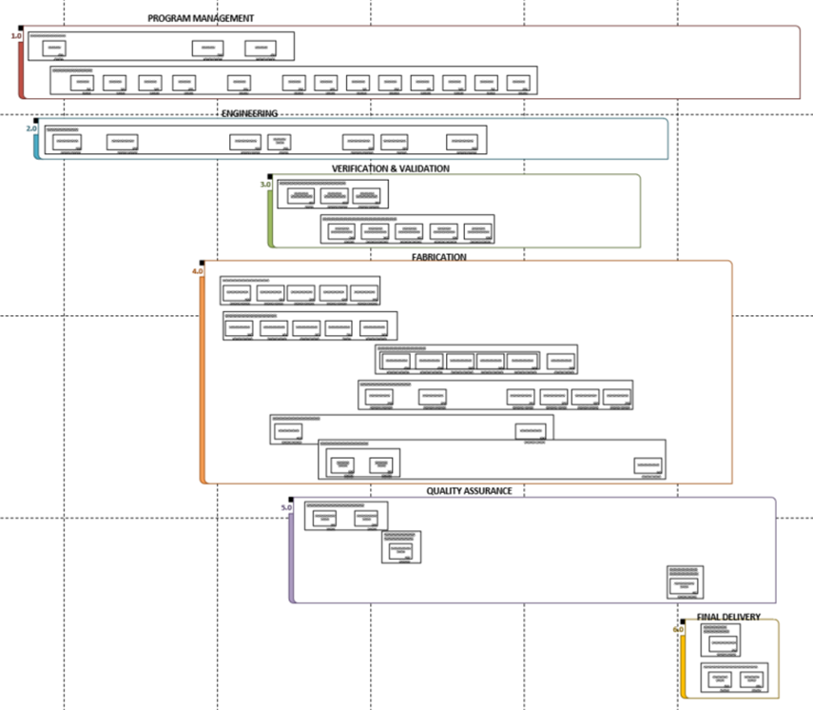
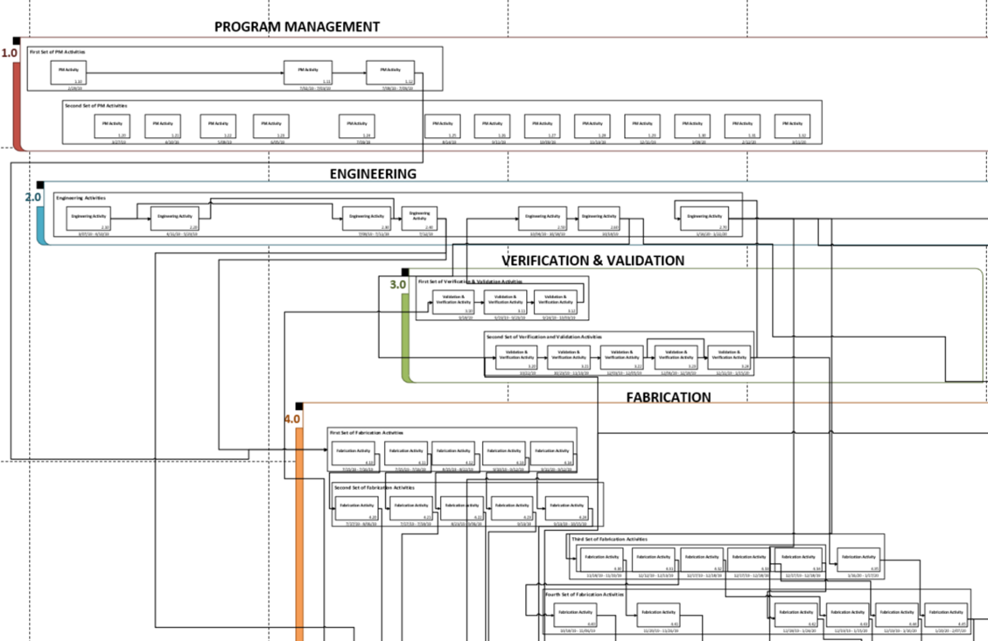
Achieving the Functional Level View
The first step in DEMA is the Functional Level View and Mapping.
The output of this step is the identification and visual mappings of the high-level functions of the system to be analyzed.
  Created using whatever program management data and work procedures available to identify the high-level view of the process and their flow throughout the system.
  Mappings created using FBD, FFBD, and investigation of program management data and work procedures.
  Examples shown below of the visual mappings created to achieve the Functional Level View and Mapping.
Figure 6: Example Visual Mapping of the Functional Areas of a System
Figure 7: Example FBD of the High-level Functions within the Functional Areas of a system
Figure 8: Example FFBD of the High-level Functions within the Functional Areas of a system

Slide 13
Achieving the Data Vessel Level View
The second step in DEMA is the Data Vessel Level View and Mapping.
The output of this step is the identification and visual mappings of the flow of Data Vessels across the high-level functions of the system to be analyzed.
  This step begins with interviewing representatives from each of the Functional Areas identified in Step 1. The mappings from Step 1 are presented to each interviewee, and they are asked to identify which of the high-level functions they were involved in.
  Then, a standardized questionnaire (shown in Figure 9 on next slide) is used to elicit from the interviewee and record the Data Vessels from each of the functions in which the interviewee was involved. Information such as the place of storage, form, means of transfer, and people who handled the data are also recorded for each Data Vessel.
    For clarification, Data Vessels are the documents, emails, personal notes, drawings, CAD files, and any other possible container (i.e. vessel) of data. Data not contained in vessels such as conversations and visual observations are also identified and recorded.
  Then, a mapping technique derived from combination of IDEF0 and DeMarco’s Data Flow Diagrams is used to map the flow, storage, and access of data vessels across the high-level functions (shown on in Figure 10 on next slide).

Slide 14
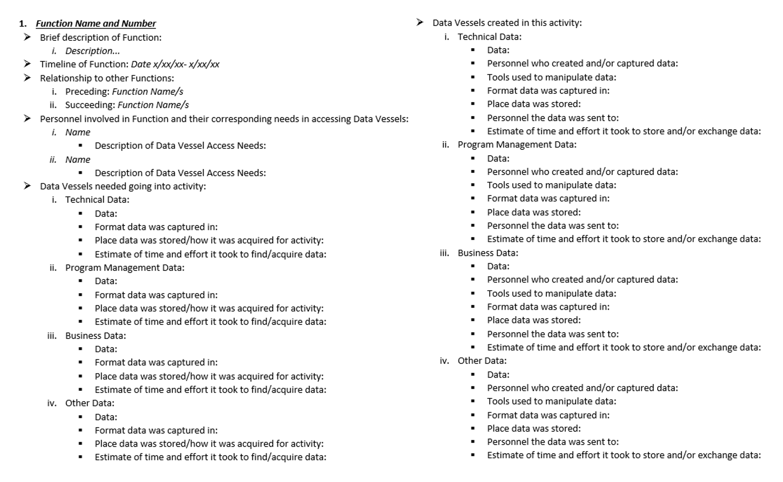
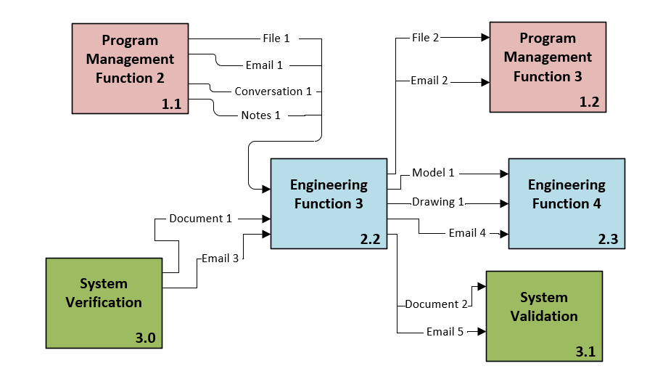
Data Vessel Level View Questionnaire and Mapping
Figure 10: Example Mapping of Data Vessel Level View
Figure 9: Standardized Questionnaire Used to Elicit and Record Data Vessels Across Functions

Slide 15
Data Element Level View and Mapping
The third step in DEMA is the Data Element Level View and Mapping.
The output of this step is the identification, listing, and visual mapping of the Data Elements within each of the Data Vessels as they flow through-out the high-level functions of the system to be analyzed.
  This is accomplished by collecting the Data Elements from each of the Data Vessels identified in Step 2 and then listing them using a novel method that shows the flow of Data Elements.
  The listing is currently done in Excel, and each row in the sheet corresponds to an instance of Data Element access.
  When the threads of Data Elements are isolated, you can see the current state of data flows to then determine what must happen for the right people to access the right information, at the right time, and in the right form.
  An example of the Data Element Listing is shown on the next slide.

Slide 16
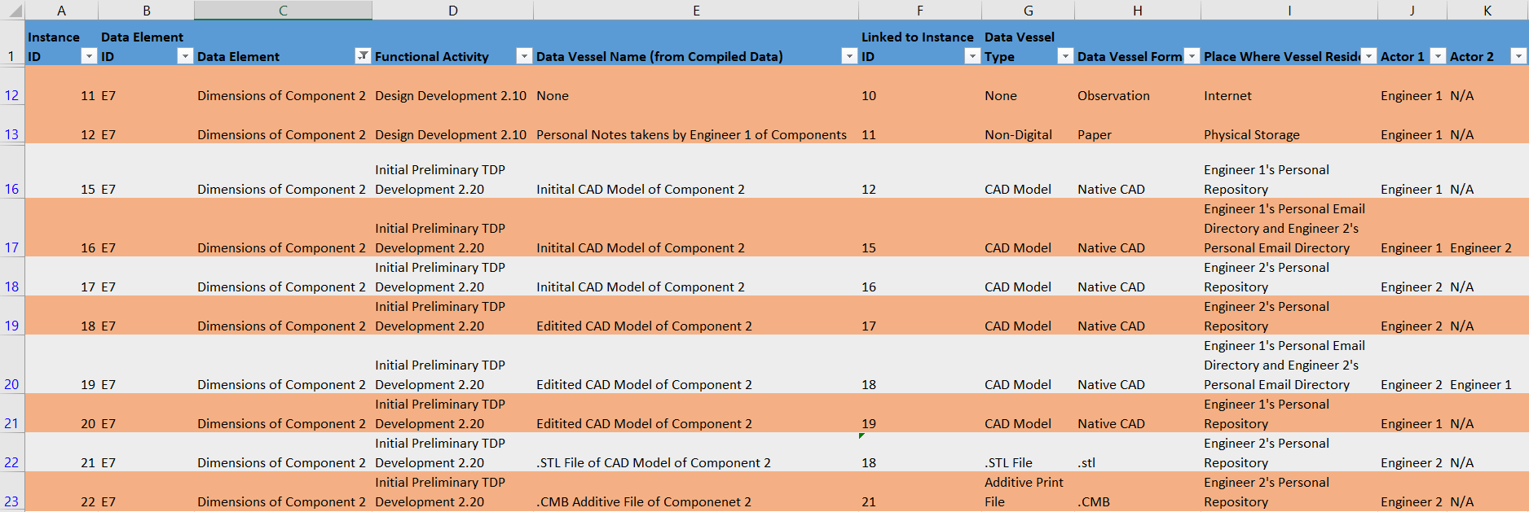
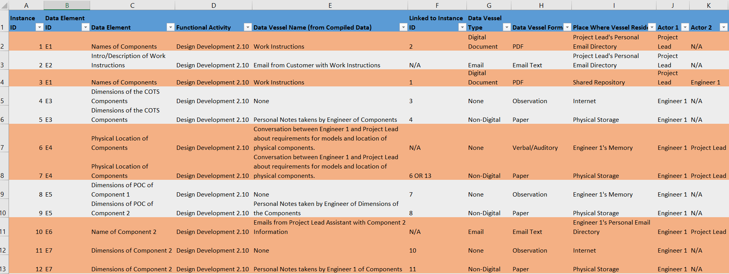
Data Element Listing
The filter function in Excel can be used to sort the Data Elements (circled in red in Figure 11).
  This isolates the threads and by doing this, you can see where there are breaks in digital connectivity.
We are currently developing a systematic method to analyze, categorize, reorganize, and connect each of the threads, and on the next slide, you can see a visual mapping that can be used to see the threads a little more clearly than in the Excel sheet.
Figure 11: Example of Data Element Listing

Slide 17
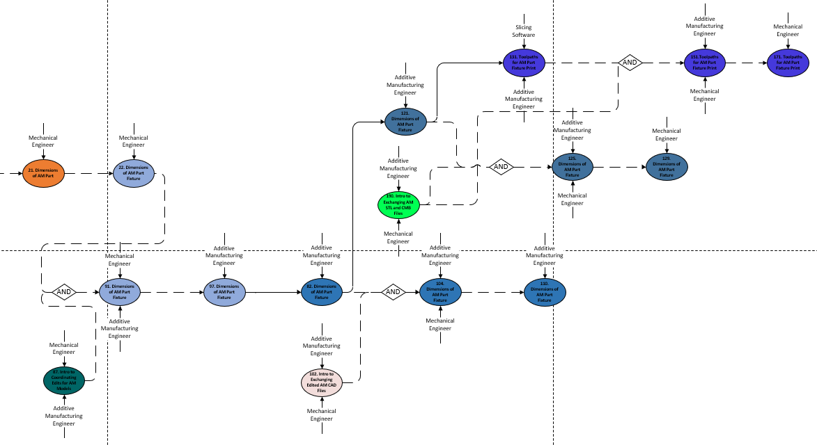
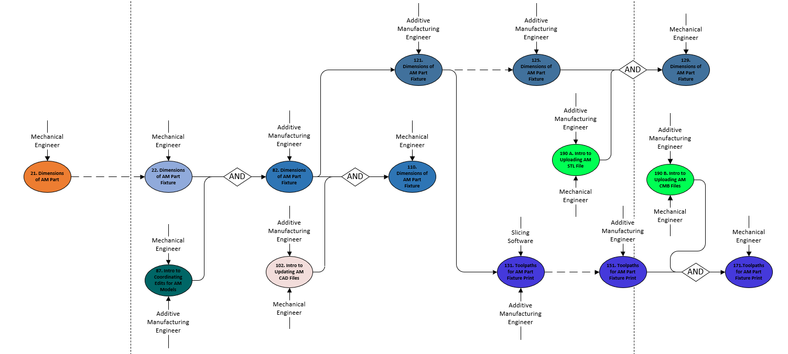
Data Element Visual Mapping
Below is an example of a Data Element Visual Mapping. In the figure on the left (Figure 12), the current state of the Data Element flow (as captured in the Data Element Listing) is shown. The figure on the right (Figure 13) shows a potential future state of the Data Element when connected using digital technologies.
  And what we see in this example, is that by connecting the Data Element (i.e. creating the Digital Thread), we would be able to eliminate 3 (19%) of the 16 of the data element instances. And where there used to be only 25% connectivity, there is now 77%. Not only that, but where there used to be only 27% value-added data relationships, there is now 61.5%.
    This improvement translates to reduced system lead-time and therefore cost savings.
Figure 13: Example of Future State Data Element Mapping
Figure 12: Example of Current State Data Element Mapping

Slide 18
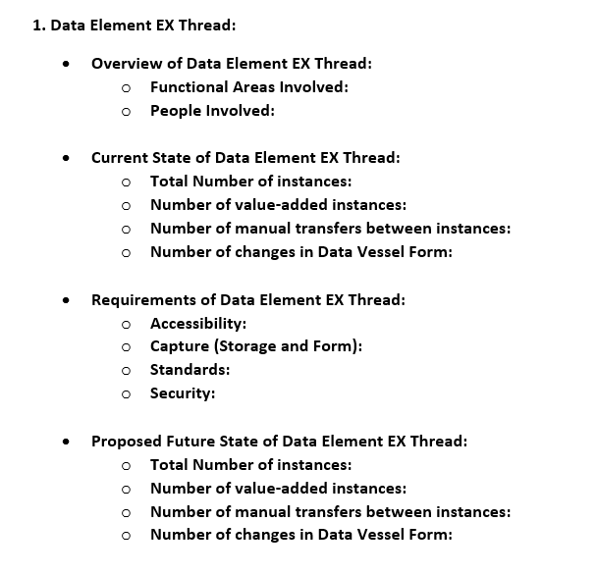
Data Element Analysis
Creating visual mappings of each data element (such as the ones shown on the previous slide) is not practical.
  In our first application of DEMA, there were over 1000 data elements and 10,000 data element instances in the Engineering Functions alone.
  A DEMA software could potentially automate visual mappings.
To accomplish this without a software, we have created a template for manual data element analysis.
  This template is shown to the right in Figure 14.
  The analysts would isolate the data elements threads in Excel and then record in the template what must happen for the right people to access the right data element, at the right time, and in the right form.
  This recorded analysis captures the requirements of each data element as well as the possible metrics of improvement.
  It is possible that changes may occur to this template (Figure 14), as it was recently developed and is in its first trial of use.
Figure 14: Data Element Analysis Template

Slide 19
Conclusion
Traditional visual mapping techniques such as Business Process Model and Notation (BPMN), Value Stream Mapping, IDEF0, and Data Flow Diagrams can be used to visualize the flow documents, but their functional perspective inhibits the ability to isolate threads of data.
  Also, none of these techniques offer a systematic method for uncovering the complexities in hidden data and information flows that are found in real-life systems.
Therefore, previously used visual mapping techniques are insufficient for digitalization, and a novel mapping technique that identifies and isolates data threads is ideal for enabling Digital Thread or Model-Based Enterprise (MBE) implementation.
Digital Transformation cannot be achieved by simply digitizing information or implementing digital technologies. [1][2]
  SysML and PLM software are technologies that can serve as mechanisms for connecting the Digital Thread, but they themselves do not constitute or automatically create the Digital Thread or the Model Based Enterprise.
The Data Element Mapping and Analysis (DEMA) Approach is as a novel tool for the standardized capture, mapping, and analysis of data flows for digital system understanding and architecture.
  DEMA has successfully been used to enable the realization of the Digital Thread at the Prototype Integration Facility (PIF), and we are continuing its validation in other applications.

