Slide 1
Exposing and controlling emergent behaviors with Monterey Phoenix
Kristin Giammarco, PhD
NPS Department of Systems Engineering
January 2021

Slide 2

Consider these scenarios.
A medical first responder administers a rescue medication to an unconscious patient, unaware that a bystander already administered it.
Bryant, Jordan (2016). "Using Monterey Phoenix to analyze an alternative process for administering Naloxone," mentored by Kristin Giammarco (NPS) and Rick Schlegel (EMT).

Slide 3
Consider these scenarios.
The International Space Station is preparing to receive an unmanned resupply ship, unaware that the communication systems used for docking are out of sync.
Nelson, Cassie. “Modeling a spacecraft communication system using Monterey Phoenix: a systems engineering case study.” Master’s Project, Stevens Institute of Technology, Hoboken, NJ. November 2015.

Slide 4

Consider these scenarios.
An Unmanned Aerial Vehicle (UAV) on a search and track mission reaches a low fuel condition, then finds and begins to track a new target.
Low Fuel
Revill, Michael B. "UAV swarm behavior modeling for early exposure of failure modes." Master's Thesis, Naval Postgraduate School, September 2016.

Slide 5
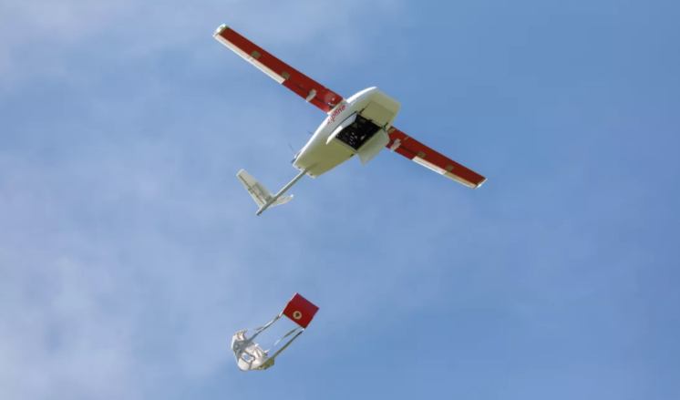
Consider these scenarios.
A UAV on a small package delivery mission is commanded to drop its payload before reaching the target vessel.
Giammarco, K; Carlson, C., Blackburn, M. "Verification and Validation (V&V) of System Behavior Specifications." Final Technical Report SERC-2018-TR-116; Systems Engineering Research Center: Hoboken, NJ, USA, 2018.

Slide 6

These and other scenarios were discovered in models by students at different levels of education
  Graduate
  College
  High School
They used Monterey Phoenix, a Navy-developed language, approach, and tool for modeling and reasoning about behavior.
Monterey Phoenix and Related Work:
https://wiki.nps.edu/display/mp
https://firebird.nps.edu
Auguston, M. Software Architecture Built from Behavior Models. ACM SIGSOFT Softw. Eng. Notes 2009, 34, 1–15.
Auguston, M. Monterey Phoenix, or How to Make Software Architecture Executable. In Proceedings of the 24th ACM SIGPLAN conference companion on Object oriented programming systems languages and applications (OOPSLA’09), Orlando, FL, USA, 25–29 October 2009; pp. 1031–1038.

Slide 7
Goals for design of system behavior
A system should
  behave in acceptable and expected ways consistent with its designers' intent
  avoid behaving in ways that contradict its designers' intent
What behaviors have we not thought about but, if we knew could manifest, should be accounted for by the design and prevented from manifesting in an unacceptable way?
Outside of field of awareness
(don’t know)
Inside field of awareness
(know)
👍
Unexpected Acceptable
Behavior
Expected Acceptable
Behavior
Acceptable
Unexpected
Expected
Unexpected Unacceptable
Behavior
Expected Unacceptable
Behavior
Unacceptable
Difficult to know
in early design
Usual focus in early design
Notes:
A system should behave in acceptable and expected ways consistent with its designers' intent, and avoid behaving in ways that contradict its designers' intent. As thorough as ``shall'' statements of requirements may be, there may still be room for excess behaviors to manifest---extra behaviors that have not been restricted---some of which may be unacceptable or unexpected, or both. System designers have long been challenged to thoroughly anticipate all possible unacceptable and unexpected behaviors, stumped by the question: ``What behaviors have we not thought about but, if we knew could manifest, should be accounted for by the design and prevented from manifesting in an unacceptable way?''

Slide 8
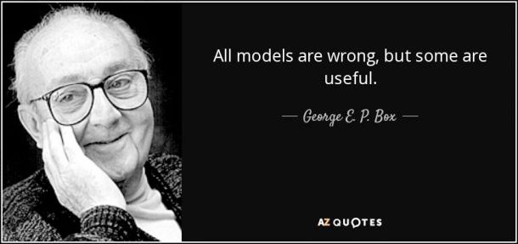
We build models to answer questions.
What assumptions were made when designing this process or system?
How can we change the design to make it more resilient against the exposed threats?
  Which unexpected behaviors should be folded into the design?
  How should the system or process handle disruptions?
  What formal constraints / requirements will prevent unacceptable behaviors?
Which events must be managed as an enterprise risk?
  Which are the critical decision points?
  What are their likelihoods and impacts?
  What is the scenario risk? The overall risk?
What is the duration of a behavior scenario?
  What is the expected duration over all scenarios? The min/max duration?
What behavior patterns are present in the model?
  Is a presented pattern also applicable in other domains?
Notes:
We create models to answer typical questions about typical system properties, like those listed here.
Many typical questions have to do with system requirements: what the system is supposed to do, or not supposed to do. Also, system design: the process by which the system accomplishes its objectives. And critically, system testing: providing evidence that the system design will meet the requirements and also the other implicit expectations we have for the system.

Slide 9
What is Monterey Phoenix?
Monterey Phoenix (MP) is a Navy-developed language, approach, and tool for modeling and reasoning about behavior – the way in which something conducts activity.
  Software
  Hardware
  People
  Organizations
  Operational and Business Processes
MP-Firebird is an easy-to-use behavior modeling tool that implements MP.
  https://firebird.nps.edu/
MP-Gryphon is an open source, locally installable MP tool.
  https://gitlab.nps.edu/monterey-phoenix
MP
is easy to use
is an executable​ modeling language
is supported by automated tools
Informs what kinds of behaviors are possible/ impossible​
has well-structured, annotated event traces
supports probability, risk estimates, resource estimation including timing (real time systems modeling)
extends and verifies popular notations like UML and SysML and also DoDAF, the DoD standard for architecture frameworks.
Notes:
Monterey Phoenix (MP) is a behavior modeling framework. We use it to model behaviors of systems, software, hardware, people, organizations, and operational and business processes. Since 2015 it's received two best paper awards and over $1M have been invested in its development. It's supported Navy programs with exhaustive scenario generation, safety and risk analysis, and business process modeling and analysis. 60 National Security Agency (NSA) interns learned and applied MP last summer in a virtual program designed to take the place of a cancelled in-person internship. They found 11 unexpected emergent behaviors and several behavior patterns across different models.
We have two tools called MP-Firebird and MP-Gryphon. You'll have the opportunity to see some screenshots and browse these tools today.

Slide 10
MP is a language based on events and their relations.
An event is the fundamental building block for behavior.
Events have two basic relations: precedence and inclusion.
root
Event A
precedes
includes
Event A
Event B
composite
Event C
Basic Relations
includes
Event b1
includes
includes
atomic
atomic
Event D
Event E
PRECEDES
INCLUDES
Notes:
The fundamental building block for behavior in MP is called an event. An MP event has two basic relations: precedence and inclusion. Precedence is a causal dependency that is imposed to put events in a sequence, and inclusion is a parent/child dependency that is imposed to put events in a hierarchy. Using inclusion, we have three types of events in MP: root, composite and atomic. A root event is a top-level event (has no parent), and is typically named for a top-level system activity or the after the system itself. composite event is a mid-level event (has at least one parent and one child), and is normally used to bundle a number of related events into one event within another composite or root event. Finally, a atomic event is a leaf-level event (has no child), and represents behavior at the lowest level of granularity to be modeled.

Slide 11
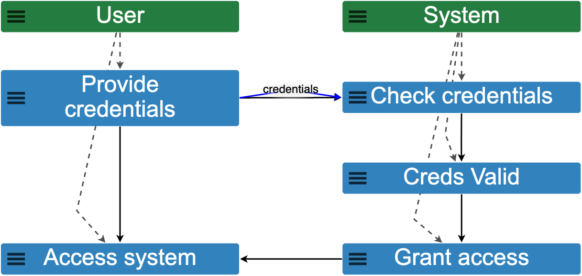
Example MP Event Trace
Notes:
An example MP event trace, as it appears in MP-Firebird. The boxes are staggered to show the dashed inclusion relations that are hidden behind the solid precedence arrows by default. The blue arrow labeled “credentials” is an example of an optional user-defined relation.

Slide 12
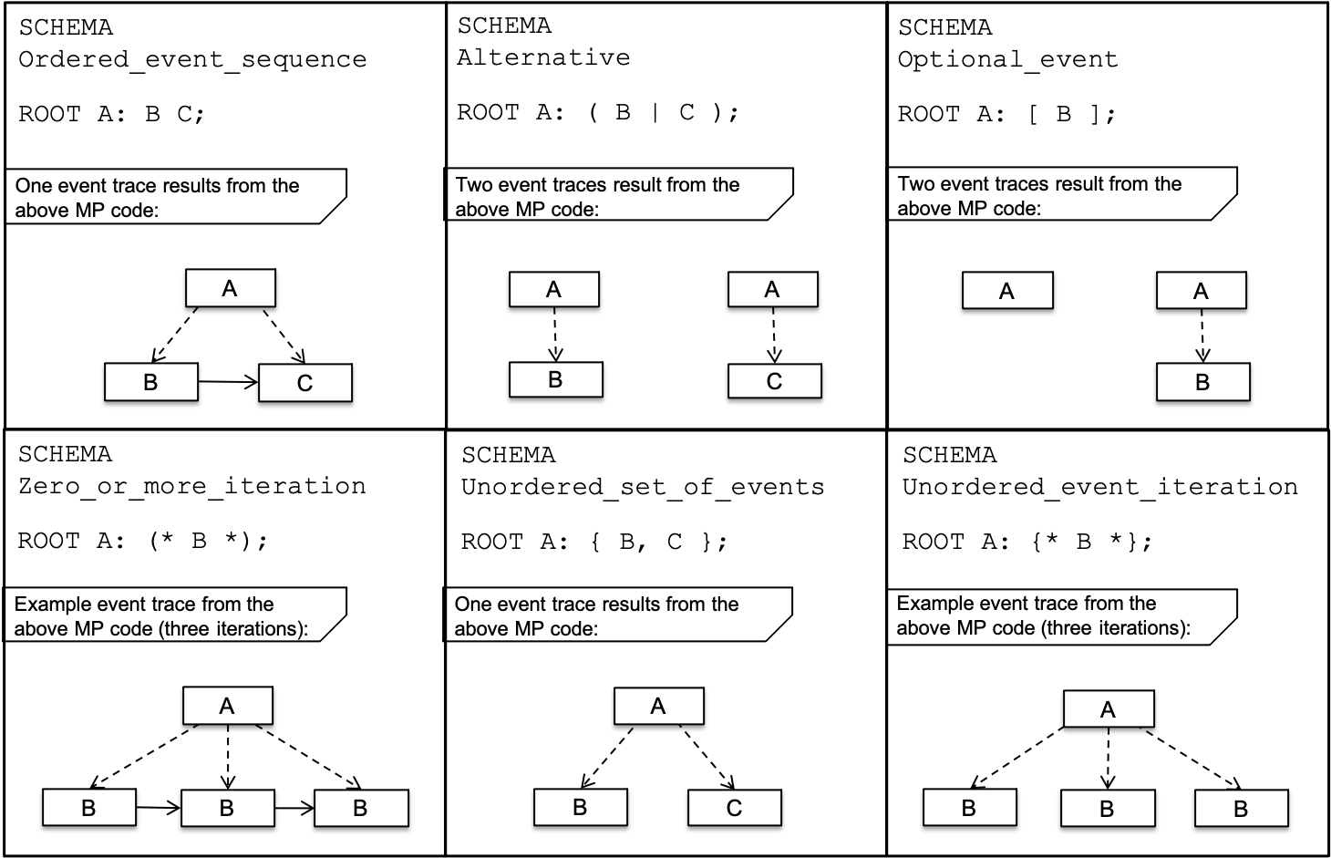
MP Event Grammar
Example:
SCHEMA Authentication
ROOT System: Check_credentials Creds_Valid Grant_access
;
space denotes
precedes
semicolon denotes end of rule
colon denotes
includes
A: B C;
event name
an event in A
Notes:
The basic relations provide the foundation for an event grammar that is used to compose rules for behaviors and interactions within and among the modeled systems or processes. Grammar rules are formal specifications for dependencies among events. For example, the rule ROOT A: B C; means A is a root event that includes (B precedes C). The colon denotes inclusion, a space or new line between events on the right hand part of the rule denotes precedence, and a semicolon denotes the end of the rule. A named collection of related grammar rules and constraints comprises an MP schema, which is typically saved as a text file. If the rules in the schema are not contradictory or over-constrained, executing the MP schema will produce one or more valid event traces.

Slide 13
Example Patterns for Event Grammar Rules and
Example Trace Instances
Notes:
In addition to defining precedence relations (upper left), event grammar rules can be used to define other patterns, such as alternate (upper middle), optional (upper right), zero or more iterations (lower left) or one or more iterations ( A: (+ B +); ) unordered sets of events (lower middle), and unordered iterations of an event (lower right). Because these patterns can be used in sequence and nested one within another, the right hand part of the grammar rule builds up into an algorithm for the left hand part. These patterns can be applied in any combination to events within a grammar rule.

Slide 14
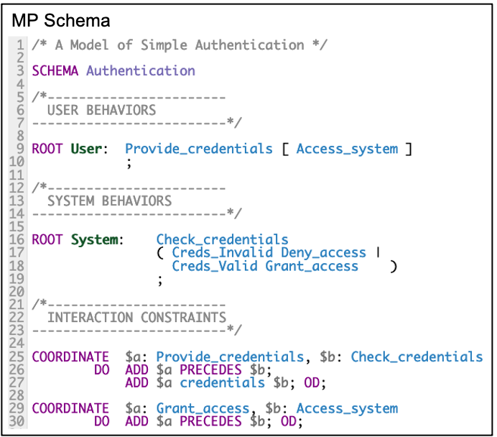
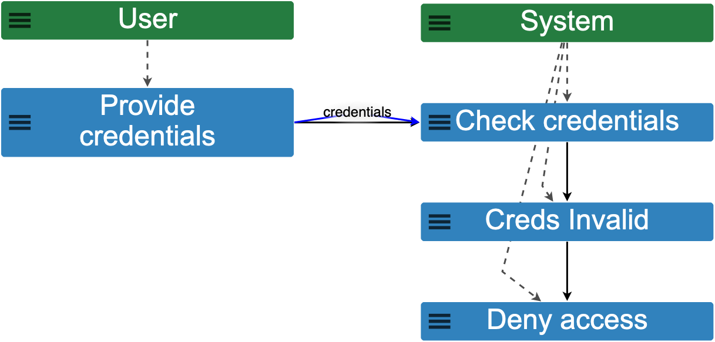
Example MP schema and corresponding event traces from MP-Firebird
Event Trace 1
Event Trace 2
Notes:
Here is an example of a simple MP schema (left) and the event traces (right) that are produced when the schema is run using MP-Firebird. Conventionally, we set up a separate grammar rule for each system or component to describe its algorithm of behavior independent of each other. So in the schema shown here, there is a root for User behaviors and a root for System behaviors. The user accessing the system is an optional event, dependent on valid credentials. When there are dependencies among events in different roots, we use constraint statements. COORDINATE constraints, for example, allow one to add dependencies such as precedence, inclusion, user-defined, and other types of relations for reasoning about behavior.
The COORDINATE constraints shown here exemplify how to enforce dependencies between events in different roots. The MP schema on the left, when run, results in the two event traces on the right: one in which the user with invalid credentials is denied access, and the other in which the user with valid credentials is granted access. However, if we had forgotten to add the constraint on lines 29-30 that places a precedence dependency between the System's Grant_access and the User's Access_system, we would have generated a third event trace showing a combination of behavior in which the User accesses the system despite having invalid credentials and being denied access by the System. Let’s try it in MP-Firebird right now.
(DEMO, including SMALL SCOPE HYPOTHESIS)

Slide 15
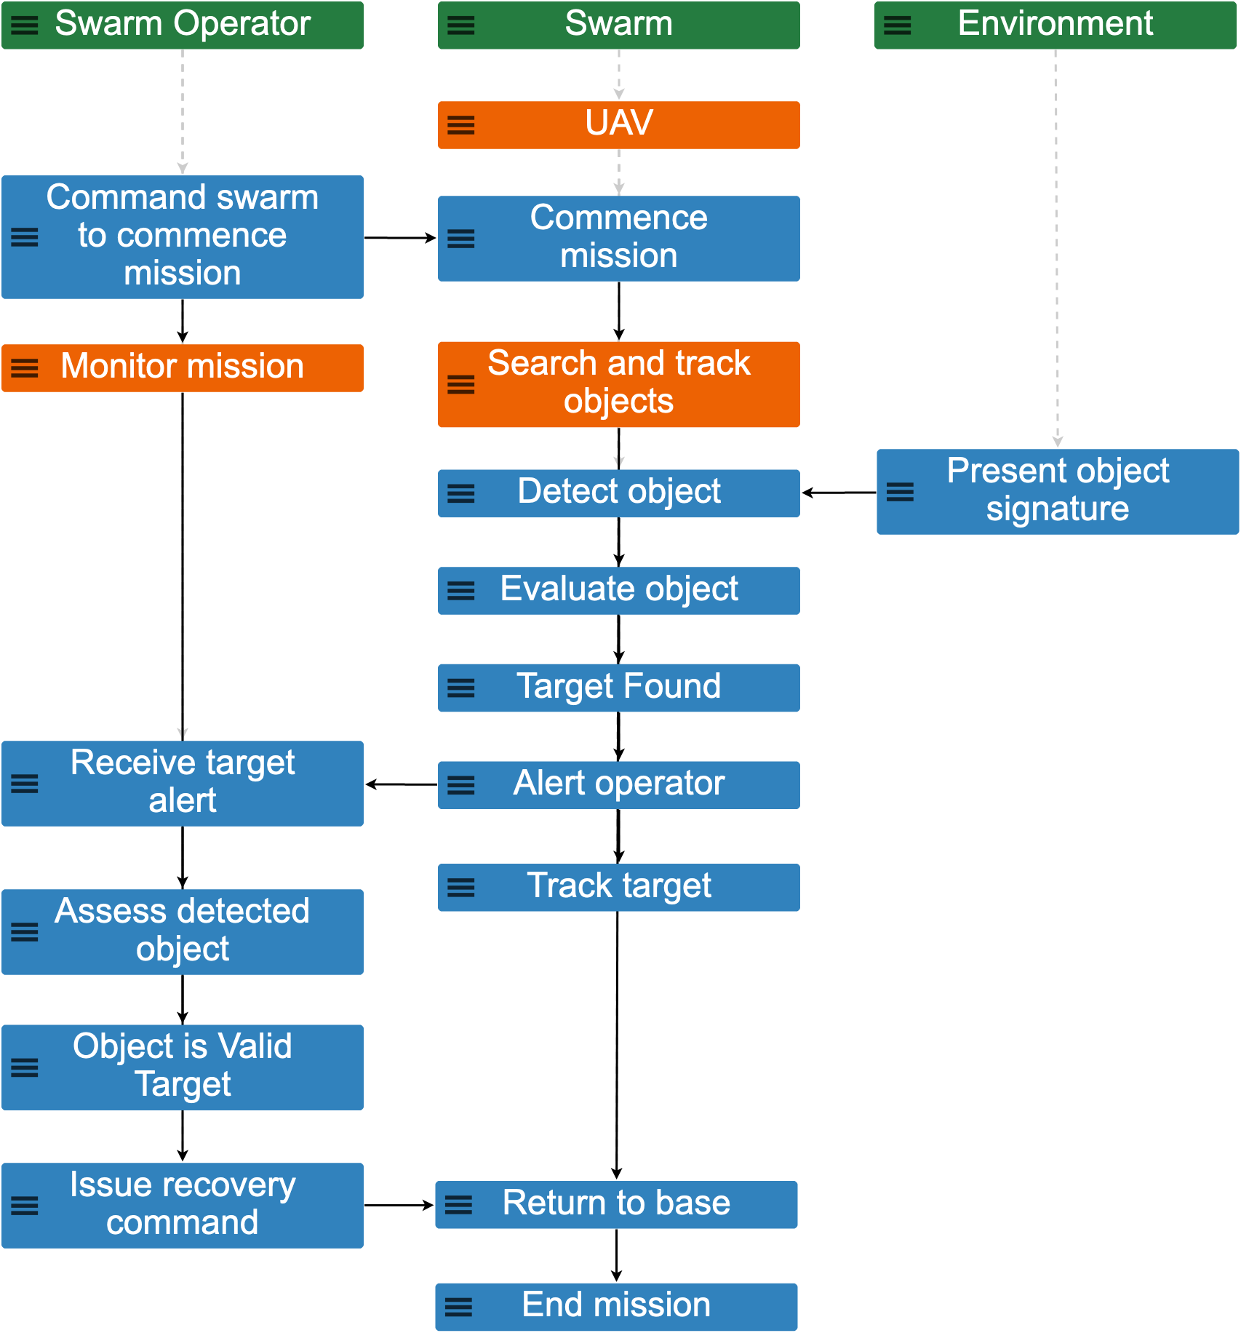
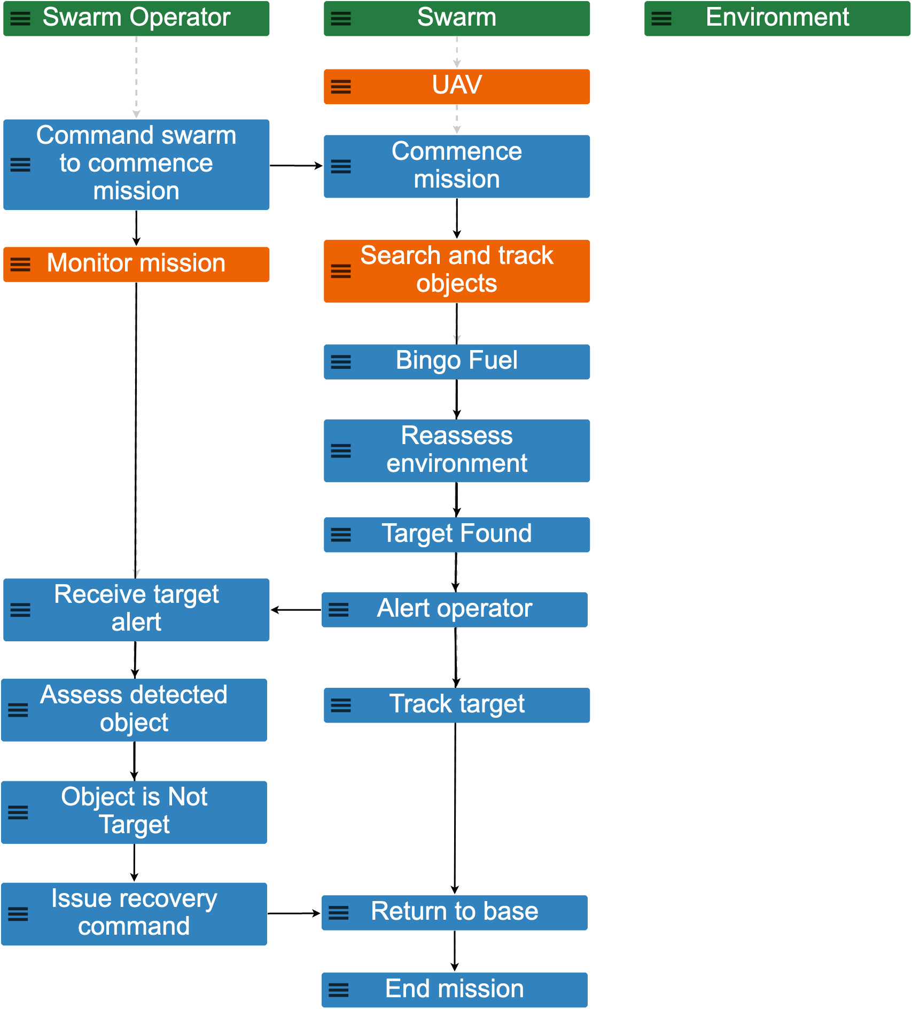
A UAV goes on a mission
It detects and evaluates an object in the environment
It alerts the Swarm Operator who assesses the target's validity
The object is deemed a valid target
The UAV tracks the target
The UAV is called back to base
Example 52
scope 1, trace 5
Example 52
scope 1, trace 8
Notes:
For his Systems Engineering Management Master's thesis, Brant Revill used MP to model a UAV on a search and track mission for the purpose of identifying failure modes and failsafe behaviors. He modeled the UAV as part of a swarm that is launched to search and track objects in an environment. A Swarm Operator controls the UAV on the mission, which may find objects of interest that turn out to be valid targets or non-targets. A low fuel condition (bingo fuel) was also included as a possibility.
The scenario on the left is the baseline trace showing an expected behavior: the UAV detects and evaluates an object in the environment, begins to track it, and alerts the Swarm Operator who assesses and deems the object a valid target of interest before tracking the target and finally being recalled to the base. The scenario on the right shows an unexpected behavior in which the UAV reaches a low fuel condition and then subsequently finds a target and begins to track it.

Slide 16

Prediction Activity:
A UAV goes on a mission
The UAV returns to base and makes a successful landing after tracking a target in a low fuel condition.
Unexpected Acceptable
Emergence
It becomes low on fuel
👍
It finds a target and alerts the Swarm Operator
The UAV is forced to land at an alternative site or is lost in a crash before the end of the mission.
The object is deemed an invalid target
The UAV tracks the target
👎
Unexpected Unacceptable
Emergence
Example 52
scope 1, trace 8
The UAV is called back to base
Notes:
Revill and his advisor imagined a couple of different future states for the scenario on the right. The first future state is that the UAV returns to base and makes a successful landing after tracking a target in a low fuel condition. A second possibility is that the UAV could be forced to land at an alternative site or could be lost in a crash between the events Return_to_base and End_mission. These were both unexpected behaviors that were realized via this prediction activity – the first one is acceptable and the second one is unacceptable.
When noticing unexpected behaviors, they should be documented immediately to preserve them before changes to the model remove them from one's field of awareness. Save a copy of the model containing the unexpected behavior(s) and annotate the model to describe any circumstantial events and predictions leading to the realization of the presence of unexpected behavior.

Slide 17
Emergent Behavior Analysis Workflow
Analysts work with MP to expose and control/mitigate unexpected and unacceptable behaviors.
START
Unexpected Unacceptable
Emergence
Unexpected Acceptable
Emergence
A new skill area / job function enabled by Monterey Phoenix
Expected Unacceptable
Emergence
logic modification and/or insertion of circumstantial event(s)
insertion of circumstantial event(s)
mitigation of risk
Expected Acceptable
Emergence
END
Notes:
After generating predictions, the analysis workflow involves controlling unacceptable behaviors and downgrading “unexpected” behaviors to “expected” behaviors until all that remains in the model are expected acceptable and unacceptable behaviors. The design progression is unexpected to expected, and unacceptable to acceptable. It makes sense to leave, a number of realistic unacceptable behaviors in with the acceptable behaviors to maintain awareness that they could occur, even if we don’t want them to. These can be managed as known risks, or further developed to show partial or full recovery from the unacceptable behavior. Including unacceptable behaviors enables reasoning about failure modes and available recovery procedures along with normal modes of operation.

Slide 18
Take Aways
We can systematically generate behavior scenarios and probe them for unexpected and unacceptable behaviors.
This approach stands in contrast to the typical informal approach of specifying the known acceptable behaviors.
We can uncover more behavior possibilities before they occur in the real system.
  It brings assumptions to the surface so that they can be formalized as requirements, achieving a more complete capture of expectations.
MP enables a new field of practice in which the human analyst develops and deploys
  cognitive skills in ideation and reasoning, together with
  automated tools that handle the computationally intensive aspects of scenario generation and querying

Slide 19
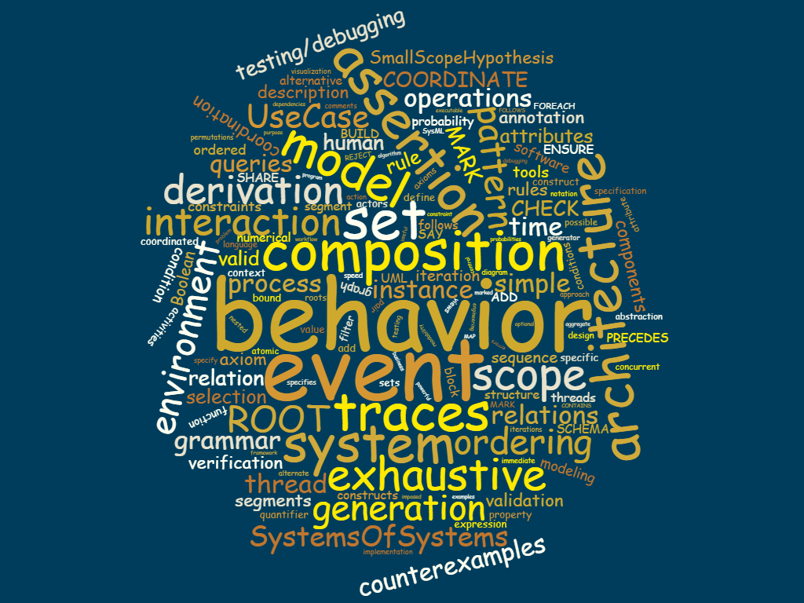
Questions?
Monterey Phoenix and Related Work:
https://wiki.nps.edu/display/mp
https://firebird.nps.edu
Kristin Giammarco: kmgiamma (at) nps.edu

Slide 20
Control Activity:
Find and remove unnecessary redundancy in model logic.
Add new circumstantial events Land_at_alternative_site and Crash to the UAV composite event as alternatives to returning to base.
Downgrade elucidated behaviors to expected behavior.
Discovered Requirements:
In order from least to most conservative:
If in a bingo fuel condition, the UAV shall request permission from the Swarm Operator to change course to track any new targets found.
If a possible target emerges during a bingo fuel condition, the UAV shall send the last known location of the target to the Swarm Operator and continue to return to base.
The UAV shall track targets only if it is in a non-bingo fuel condition.
The UAV is forced to land at an alternative site or is lost in a crash before the end of the mission.
👎
Unexpected Unacceptable
Emergence
Notes:
We control the unexpected behaviors as follows.
If a logic error is discovered in the model (e.g., a misplaced event or parenthesis) as the cause of the unexpected emergence, fix the error(s) and run the model until the changes have had the desired effect on the event traces.
Also, update the model with the necessary circumstantial events} to document the prediction inspired by the unexpected behavior. Discern which circumstantial events need to be explicitly added as new events to the model to formalize the prediction. These additions should result in new alternatives and event traces that incorporate the formerly unexpected behavior, now as expected behavior.
When the mechanism for the emergence is understood and the element of surprise vanishes, the behavior classification is downgraded from unexpected to expected.
Ideas for new or previously overlooked requirements may surface during the control step. Document and share them with members of the project so they can prevent the unacceptable behavior observed in the model from manifesting in the actual system.

Slide 21
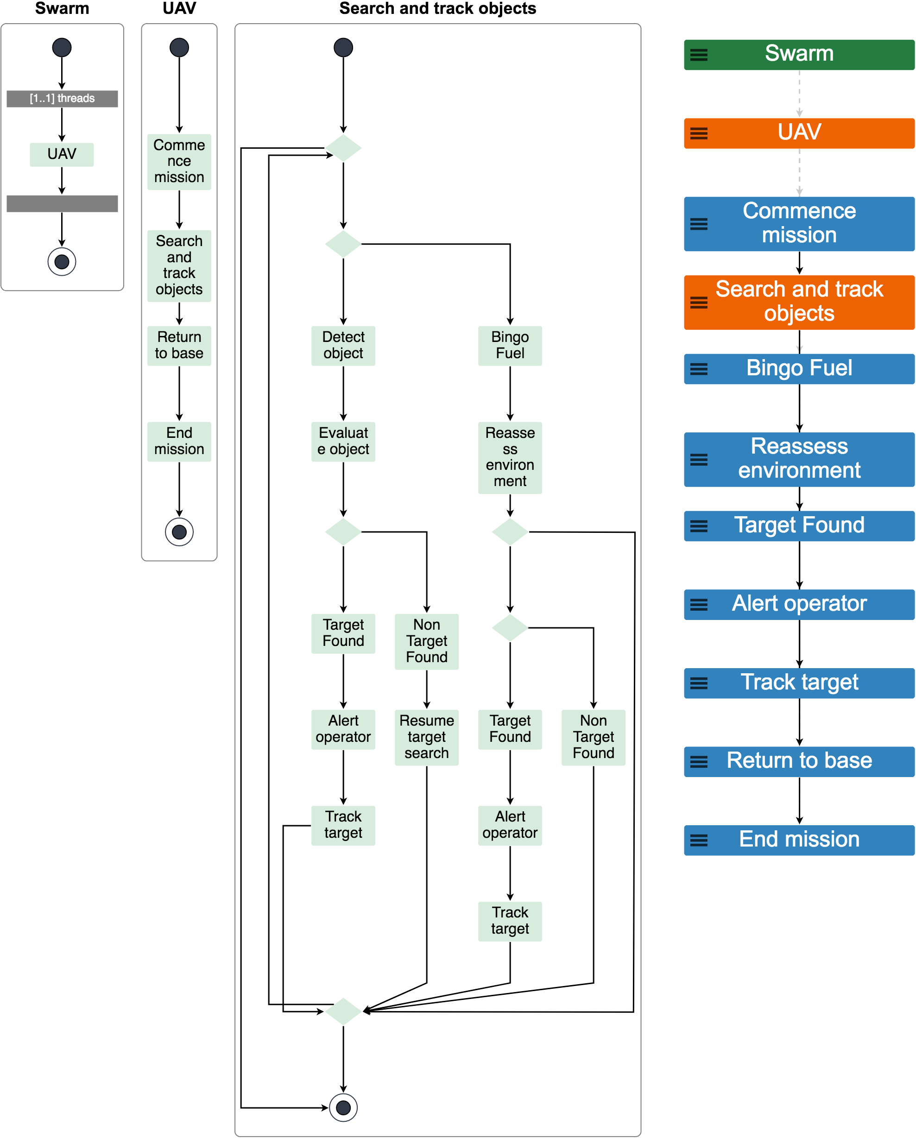
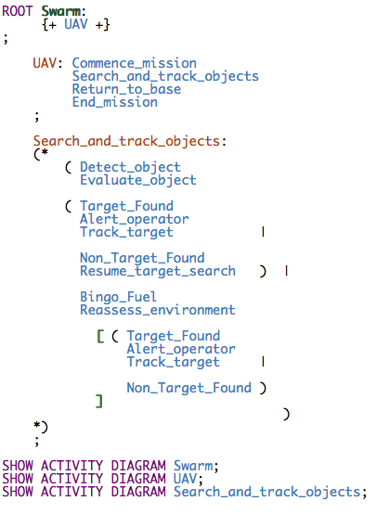
Find and remove unnecessary redundancy in model logic.

Slide 22
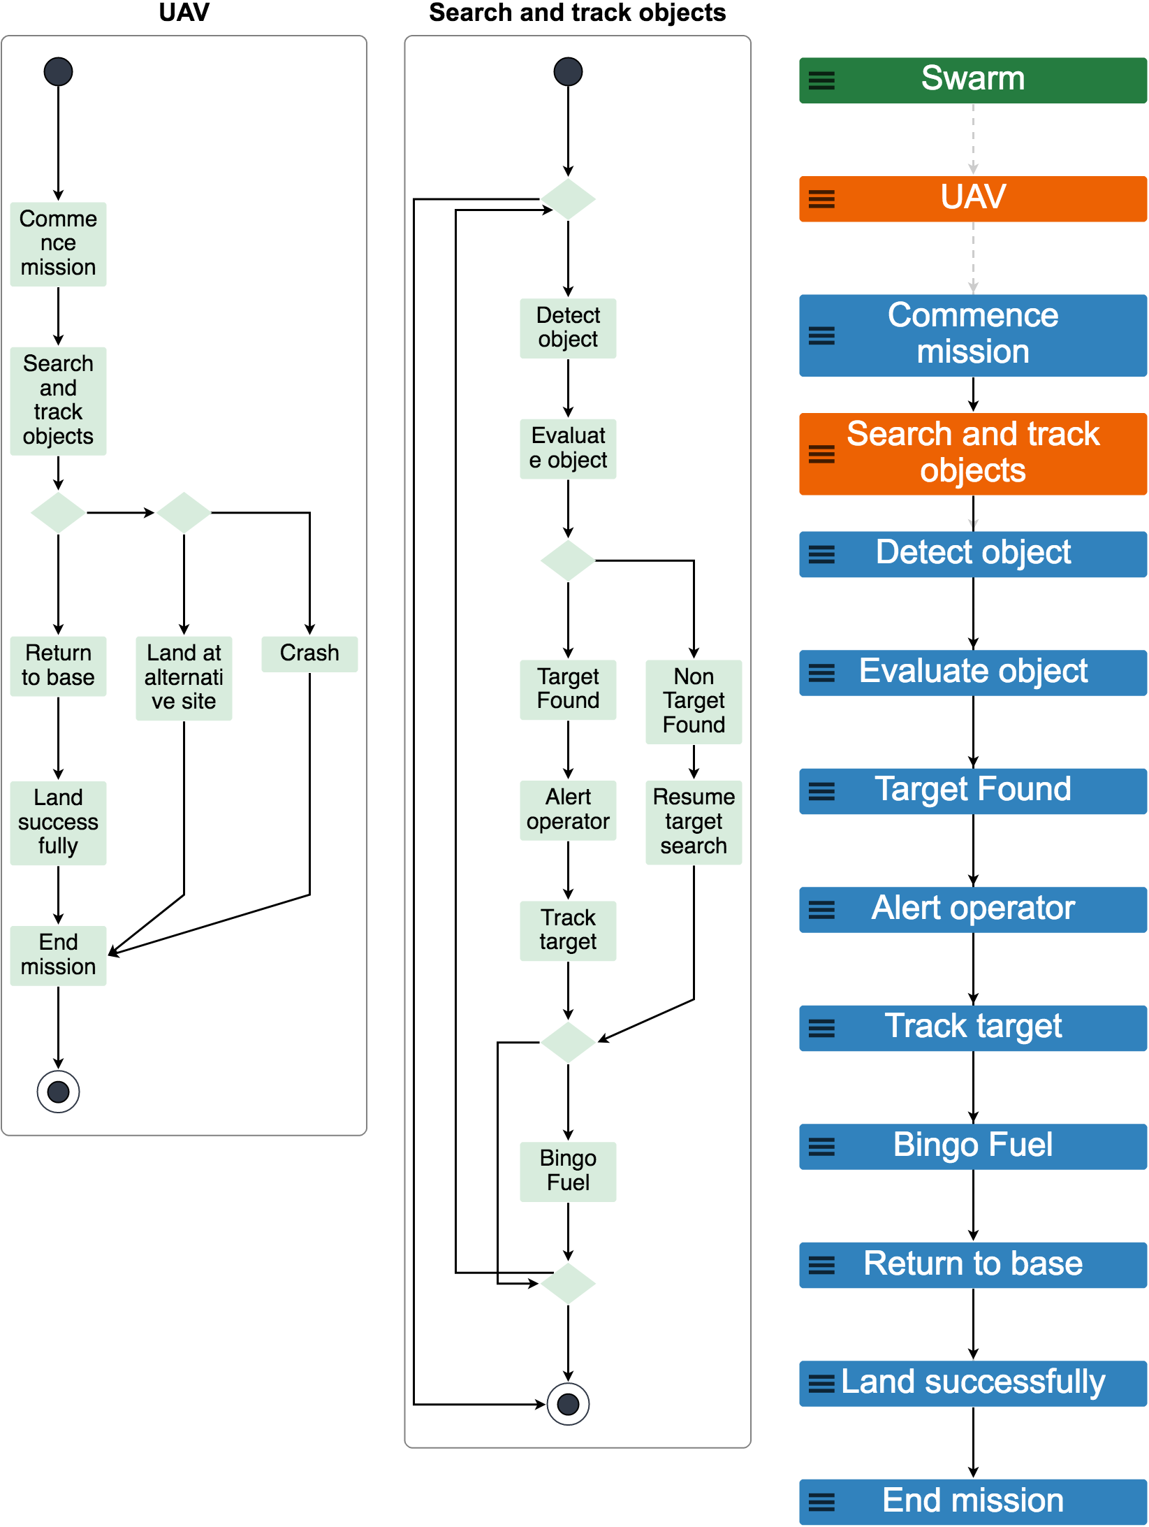
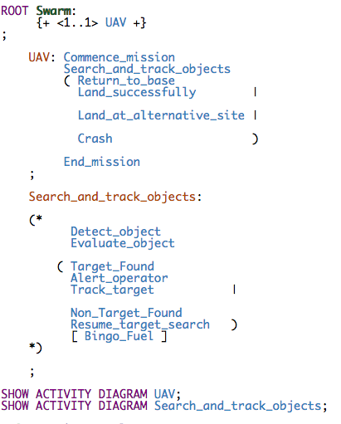
Add new circumstantial events Land_at_alternative_site and Crash to the UAV composite event as alternatives to returning to base.

