Slide 1
HSV INCOSE MBSE WG Challenge 13May21

Slide 2
What was the Challenge?
MBSE Style Guide for DoD 5000 Program Acquisitions
  DoD 5000 Meta Model
  Example Model
  Validation Suites
  Metachain
  Velocity Script

Slide 3
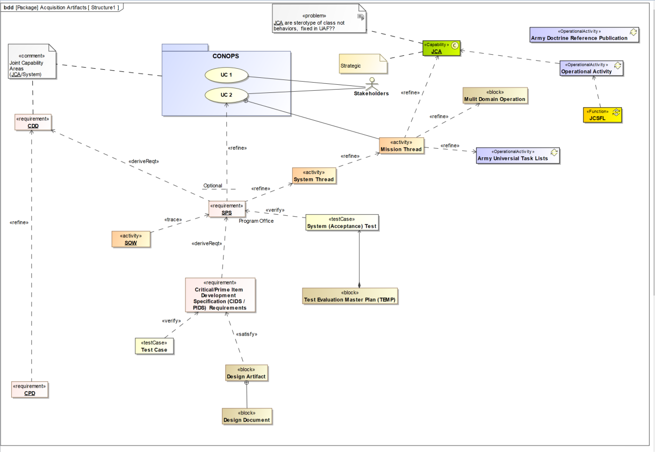
Meta Model

Slide 4



Model Architecture
<<Dependency >>
Operational Model Library
<<Dependency >>
Logical Model Library
<<Dependency >>
<<Dependency >>
Physical Model Library
<<Dependency >>

Slide 5
Operational Common Model Library
AUTL ADRP
JCA Library
JICDS UPDM SE Profile
JCSFL Library
Technology Readiness Levels in the United States Department of Defense (DoD)
MDO CFT Architecture_IF_Model
Army Performer Library

Slide 6
Logical Common Model Library
MITRE PM Profile
SOW
Data Item Descriptions
Pins & Wires
Interfaces Protocols

Slide 7
Operational
Initial Technical Review (ITR)
  The Initial Technical Review (ITR) is a multi-disciplined technical review to support a program’s initial Program Objective Memorandum (POM) submission in the Materiel Solutions Analysis (MSA) Phase . This review ensures a program’s Technical Baseline is sufficiently rigorous to support a valid cost estimate and enable an independent assessment. The ITR assesses the capability needs and materiel solution approach of a proposed program and verifies that the requisite research, development, test and evaluation, engineering, logistics, and programmatic bases for the program reflect the complete spectrum of technical challenges and risks.
  Additionally, the ITR ensures the historical and prospective drivers of system Life-Cycle cost (LCC) have been quantified to the maximum extent and that the range of uncertainty in these parameters has been captured and reflected in the program cost estimates. The basic Cost Analysis Requirements Description (CARD) technical and programmatic guidance, tailored to suit the scope and complexity of the program, should be followed to ensure all pertinent design-related cost drivers are addressed.

Slide 8
Operational
Alternative Systems Review (ASR)
  AOA is complete
  Capability Gap identified
  KPP, KSA
  Draft SRD
  An Alternative Systems Review (ASR) is a technical review that assesses the preliminary materiel solutions that have been developed during the Materiel Solution Analysis (MSA) Phase. The review ensures that one or more proposed materiel solution(s) have the best potential to be cost effective, affordable, operationally effective and suitable, and can be developed to provide a timely solution to at an acceptable level of risk to satisfy the capabilities listed in an Initial Capabilities Document (ICD).

Slide 9
Logical
Integrated Baseline Review (IBR)
  Cost and schedule variances
  An Integrated Baseline Review (IBR) is a joint assessment conducted by the government Program Manager (PM) and the contractor to establish a mutual understanding of the Performance Measurement Baseline (PMB). This understanding provides for an agreement on a plan of action to evaluate the risks inherent in the PMB and the management processes that operate during program execution. PM’s are required to conduct IBRs on all cost or incentive contracts that require the implementation of Earned Value Management (EVM) (contracts valued at or greater than $20 million).
System Requirements Review (SRR)
  Understanding Requirements complete and defined
  A System Requirements Review (SRR) is a formal review conducted to ensure that system requirements have been completely and properly identified and that a mutual understanding between the government and contractor exists. It ensures that the system under review can proceed into initial systems development and that all system and performance requirements derived from the Initial Capabilities Document (ICD) or draft Capability Development Document (CDD) are defined and testable, and are consistent with cost, schedule, risk, technology readiness, and other system constraints.

Slide 10
Logical
System Functional Review (SFR)
  The System Functional Review (SFR) is a technical review to ensure that the system’s functional baseline is established and can satisfy the requirements of the Initial Capabilities Document (ICD) or draft Capability Development Document (CDD) within the currently allocated budget and schedule. It also determines whether the system’s lower-level performance requirements are fully defined and consistent with the system concept and whether lower-level systems requirements trace to top-level system performance requirements.
  Functional Baseline
  Definition of the required system functionality describing functional and interface characteristics of the overall system, and the verification required to demonstrate the achievement of those specified functional characteristics. This baseline is derived from the Capability Development Document (CDD) and normally includes a detailed functional performance specification for the overall system and the tests necessary to verify and validate overall system performance.

Slide 11
Logical
Preliminary Design Review (PDR)
  The Preliminary Design Review (PDR) is a technical assessment that establishes the Allocated Baseline of a system to ensure a system is operationally effective. A PDR is conducted before the start of detailed design work and is the first opportunity for the Government to closely observe the Contractor’s hardware and software design. This review assesses the allocated design documented in subsystem product specifications for each configuration item in the system and ensures that each function, in the Functional Baseline, has been allocated to one or more system configuration items. The PDR establishes the allocated baseline (hardware, software, human/support systems) and underlying architectures to ensure that the system under review has a reasonable expectation of satisfying the requirements within the currently allocated budget and schedule.
  Allocated Baseline
  Definition of the configuration items making up a system, and then how system function and performance requirements are allocated across lower-level configuration items (hence the term allocated baseline). It includes all functional and interface characteristics that are allocated from the top-level system or higher-level configuration items, derived requirements, interface requirements with other configuration items, design constraints, and the verification required to demonstrate the traceability and achievement of specified functional, performance, and interface characteristics. The performance of each configuration item in the allocated baseline is described in its preliminary design specification as are the tests necessary to verify and validate configuration item performance.

Slide 12
Physical
Critical Design Review (CDR)
  A Critical Design Review (CDR) is a multi-disciplined technical review to ensure that a system can proceed into fabrication, demonstration, and test and can meet stated performance requirements within cost, schedule, and risk. A successful CDR is predicated upon a determination that the detailed design satisfies the Capabilities Development Document (CDD). Multiple CDRs may be held for key Configuration Items (CI) and/or at each subsystem level, culminating in a system-level CDR. The CDR is conducted during the Engineering & Manufacturing Development (EMD) Phase and when the product baseline has been achieved and the CDR entrance criteria detailed in the Systems Engineering Plan (SEP) have been met, allowing fabrication of hardware and coding of software deliverables to proceed.
  Product Baseline
  Documentation describing all of the necessary functional and physical characteristics of a configuration item; the selected functional and physical characteristics designated for production acceptance testing; and tests necessary for deployment/installation, operation, support, training, and disposal of the configuration item. The initial product baseline includes “build-to” specifications for hardware (product, process, material specifications, engineering drawings, and other related data) and software (software module design— “code-to” specifications). The Initial product baseline is usually established and put under configuration control at each configuration item’s Critical Design Review (CDR), culminating in an initial system product baseline established at the system-level CDR.

Slide 13
Physical
Production Readiness Review (PRR)
  The Production Readiness Review (PRR) assesses a program to determine if the design is ready for production. It assesses if the prime contractor and major subcontractors have accomplished adequate production planning without incurring unacceptable risks that will breach thresholds of schedule, performance, cost, or other established criteria. PRRs are normally performed as a series of reviews toward the end of Engineering, Manufacturing and Development (EMD) Phase and should be conducted during System Capability and Manufacturing Process Demonstration to identify and mitigate risks as the design progresses.

Slide 14
Physical
Test Readiness Review (TRR)
  A Test Readiness Review (TRR) is conducted to determine if the system under review is ready to proceed into formal testing by deciding whether the test procedures are complete and verify their compliance with test plans and descriptions. A TRR is normally conducted before each major test configuration item including hardware and software and provides management with the assurance that a system has undergone a thorough test process and is ready for turnover to the next test phase. The Flight Readiness Review (FRR) is a subset test of the TRR.
    Why are we testing?
    What is the purpose of the planned test?
    Does the planned test verify a requirement that is directly traceable back to a system specification or other program requirement?
    What are we testing (subsystem, system, a system of systems, other)?
    Is the configuration of the system under test sufficiently mature, defined, and representative to accomplish planned test objectives and or support defined program objectives?
    Are we ready to begin testing?
    Have all planned preliminary, informal, functional, unit level, subsystem, system, and qualification tests been conducted, and are the results satisfactory?
    What is the expected result and how can/do the test evaluation results affect the program?
    Is the planned test properly resourced (people, test article or articles, facilities, data systems, support equipment, logistics, etc.)?
    What are the risks associated with the tests and how are they being mitigated?
    What are the hazards and ESOH risks associated with the specific testing?
    Have the necessary “Safety Releases” from the Program Manager (PM) been provided to developmental and operational testers prior to any test using personnel?

Slide 15
Physical
System Verification Review (SVR)
  The System Verification Review (SVR) is a product and process assessment to ensure the system under review can proceed into Low-Rate Initial Production (LRIP) and Full-Rate Production (FRP) within cost, schedule, risk, and other system constraints during the Engineering, Manufacturing, and Development (EMD) Phase. It assesses the system functionality and determines if it meets the functional requirements in the Capability Development Document (CDD) and draft Capability Production Document (CPD) documented in the functional baseline. The SVR establishes and verifies final product performance and provides inputs to the CPD.

Slide 16
Physical
Functional Configuration Audit (FCA)
  A Functional Configuration Audit (FCA) examines the functional characteristics of the configured product and verifies that the product has met the requirements specified in its Functional Baseline documentation approved at the Preliminary Design Review (PDR) and Critical Design Review (CDR). It has to do more with systems engineering and program management than official auditing. The FCA is a review of the configuration item’s test and analysis data to validate the intended function meets the system performance specification. The FCA is normally performed prior to Low-Rate Initial Production (LRIP) and prior to or in conjunction with a Physical Configuration Audit (PCA). A successful FCA typically demonstrates that Engineering and Manufacturing Development product is sufficiently mature for entrance into LRIP. A FCA may also be conducted concurrently with the System Verification Review (SVR).

Slide 17
Physical
Functional Configuration Audit (FCA)
  A Functional Configuration Audit (FCA) examines the functional characteristics of the configured product and verifies that the product has met the requirements specified in its Functional Baseline documentation approved at the Preliminary Design Review (PDR) and Critical Design Review (CDR). It has to do more with systems engineering and program management than official auditing. The FCA is a review of the configuration item’s test and analysis data to validate the intended function meets the system performance specification. The FCA is normally performed prior to Low-Rate Initial Production (LRIP) and prior to or in conjunction with a Physical Configuration Audit (PCA). A successful FCA typically demonstrates that Engineering and Manufacturing Development product is sufficiently mature for entrance into LRIP. A FCA may also be conducted concurrently with the System Verification Review (SVR).

Slide 18
Physical
Physical Configuration Audit (PCA)
  The Physical Configuration Audit (PCA) examines the actual configuration of an item being produced and is conducted around the time of the Full-Rate Production Decision. It verifies that the related design documentation matches the Configuration Item (CI) as specified in the contract and confirms that the manufacturing processes, quality control system, measurement, and test equipment, and training are adequately planned, tracked, and controlled. The PCA validates many of the supporting processes used by the contractor in the production of the item and verifies other elements of the item that may have been impacted or redesigned after completion of the System Verification Review. The PCA is also used to verify that any elements of the CI that were redesigned after the completion of the Functional Configuration Audit (FCA) also meet the requirements of the CI’s performance specification.

Slide 19
Three Questions
How do we know we have a good model?
  No duplicated relationships or model elements
  Single parent for each child requirement
  No orphan model elements
  All model elements documented
  Model conforms to meta-model style guide
  Each connection in a ibd had a data flow/signal
  All connectors are typed in a ibd
  All diagrams contains at least one model element
How do we know we have a good solution?
  Parametric evaluations verifies meeting Non-functional requirements
  All requirements verified
How do we know where we are at in the acquisition progress?
  Model shows meeting gated activities entrance and exit criteria

