Slide 1
RegEx:
Text Searching and other Text Parsing using Regular Expressions
INCOSE Huntsville Chapter, 2021
Linda Lantz Brock, CSEP 2016, Northrop Grumman Corp.

Slide 2
Purpose of this Presentation
This was requested as a follow-on, in the form of a Deep-Dive, after my 2/20/2020 Presentation entitled “Log Analysis with AWK”.
  That slide deck is available at incose.org/huntsville -> PresentationLibrary (link at right).
  Refer to it for detail on how to access and use awk, and why to use command line interfaces.
Purpose of this presentation is to be a “prequel” to that.
  This will introduce the basics of constructing regular expressions.
    This provides much more detail on regexes, for a beginning audience.
    It assumes the audience understands basic concepts of Unix commands, delimiters, escapes, and quotes.
  The prior presentation focused on AWK which happens to contain regexes.
    It showed many ways to use AWK’s pattern-and-action pairs to process .csv files.
    It assumed the audience was already familiar with the regex concepts used to build the “pattern” part.
Topics covered here:
  Basic building blocks of the syntax (literals, wildcards & quantifiers, anchors, capture & reproduce)
  Contextual connective tissue: joining the building blocks within the regex, putting the regex within a command itself, and getting data into and out of a command
  Differences in syntax when using them for search specifications versus for accurate replacement actions

Slide 3
Problem Description
Picture this:
  You have a large text-only file.
    Perhaps it is a .csv file or log file, exported from Excel or spit out from a modeling run.
    Perhaps it is a large set of code, html, or xml files.
    Perhaps it consists of a generated list of filenames, or a filepath of a fairly standard format.
  It contains thousands of lines or paragraphs, tens of thousands of words.
  If it is xml or html, it has a lot of semi-repetitive almost-matching occurrences.
You want to FIND and/or tweak certain strings.
  These strings are in a known format but have unknown (variable) portions within them.
    e.g. ./<unknown/root/path>/FTG_<allFlightTests>/FinalResults/<allFiles>.log
    That is a pretty specific – and complex – specification.
  In most editors, an automated search can only specify one CONTIGUOUS KNOWN (a literal constant). This is often insufficient, so you do much of the work (picking through irrelevant results) by hand, looking for a “FinalResults” subdirectory containing one or more “.log” files.
You want to AVOID inaccuracies:
  If you have to edit the information, you certainly do NOT want to introduce junk, by doing a ReplaceAll and creating something weird.
  Even if you are just searching (to produce a count or list), you must NOT produce a search results hit-list that is either incomplete (leakage) or overly-inclusive (by-catch).

Slide 4


Problem Gets Worse, then Better
You’re Never Done:
  Later, you find you didn’t have the latest version of the text, so you spend more hours doing it all again.…
  Perhaps you have a dozen such logs or code-files, and a tight timeframe.
  Perhaps you have to do this weekly, in a consistent manner, for a report.
Tools that Save the Day:
  The Regex (Regular Expression) concept, and its syntax, are specifically designed for the parsing of textual data, also known as lexical analysis.
  The concept of a Regex is available in many contexts:
    For instance: Perl, Python, Java, MATLAB, and Unix (including Linux, POSIX, Cygwin).
    Within Unix, it is implemented in tools such as grep, sed, vi, awk, and other commands.

Slide 5
This Can Be So Easy
ls -1 | grep 'Aegis.*\.txt' # find Aegis<anychars>.txt
That's it.
Let's break that down.
  The Aegis part is given as a literal (fixed, pre-known) search pattern.
  The dot-star (“.*”) means any number of wildcard characters. The dot indicates ANY character – including symbols and whitespace – except the end-of-the-searchtext-area (which is usually the end-of-line).
  The \.txt is another literal (fixed, pre-known) search pattern. The dot is escaped (with a backslash) to indicate that it is literally a period and not to be interpreted.
The entire regex is in single quotes, although grep and many other commands will also accept double quotes.
  Some commands (sed, awk) require it within slashes (or other delimiters) within the single quotes ('/searchstring/').
  A search within vi or vim needs nothing but a leading slash, the search string, then Enter. No quotes at all.
For our original problem from the first page, we just alternate known and unknown parts.
  I’ve added spacing to show you the parts, but in reality the spacing must not be there. I’ve also added color-coding, with the known parts in black and unknown parts in green and purple.
  # For our problem: . /<unknown/root/path>/FTG_<allFlightTests>/FinalResults/<allFiles>.log
  find . –type f | grep '\. / [-_/A-Za-z]* /FTG_ [A-Za-z]* /FinalResults/ .* \. log'

Slide 6


Your Preparation and Our Goals
Purpose of the regex syntax:
  Parsing and Editing of TEXT STRINGS (input->search->parse->capture->edit->output)
Inputs are a text string (including any line-feeds), of potentially infinite length.
  Can be the contents of a code or log file, of a variable or csv-cell, of the output piped from a command
  Can be multi-line, but generally is operated upon using a per-line basis
Big goal: Specify exactly what you want, avoiding leakers and bycatch.
  Example of bycatch (we’ve all been through this fiasco in Word or PowerPoint):
    Change project name from ATI to ORI
      It catches every "international" and "patient" to "internORIonal" and "pORIent"
    Oops, so change it back
      Now it catches every "priority" and "oriented" to "priATIty" and "ATIented"
    Ultimately it must be cleaned up by hand, reading every sentence very carefully.
  Example of leakers: when you’re showing a slide to customer and realize it still shows the old name here.
Your net should be shaped exactly like the fish you aim to catch!
  That is what a regex can do for you. It provides the means to make such a net.
False positives
False negatives

Slide 7


Outline
This assumes you already have a good familiarity with the particular variations of the items you want to search for, and can describe in words a robust search criterion. For initial “poking around” to learn what your potential finds look like, using the GUI is best.
The most common building blocks, and each one’s purpose in preventing leakers or bycatch.
  Literals, dots, character-groups (and which taxonomy they can appear in)
  Wildcard quantifiers: asterisk, question, plus, counted (and non-greedy of each)
  Anchors to start-of-string and/or end-of-string
  Capture and replay of wildcard values
The interfaces between building blocks, and the access from the outer world.
  Just concatenate the building-block vocabulary into a regex.
  Surround it with delimiters (such as slashes).
  Lead the regex with a command (such as grep).
  Put a pipe or redirect between the command and the outside world of input data; with some commands a filename can be an argument.
The examples generally use filenames (as if the input is a list of files), which is easy to visualize and enables lots of variation.
The examples of external command context use bash (grep, sed) so you can learn it. For Perl or Java or MATLAB, see your manual.
The regex itself is fairly venue-agnostic, and I’ll point out where it isn’t fully portable.

Slide 8
Overview
These are some of the “building blocks” (analogous to alphabet letters or vocabulary) and “mortar” (analogous to spelling and grammar rules).
We will cover these each in turn, alternating between “BUILDING BLOCKS” and “MORTAR”.
    This gives you the basics up front, with just-in-time information on how to put the pieces together.
How to Put It Together in Context
<input> | <command> ‘<subcommand><delimiter><searchregex><delimiter><searchregex><delimiter><globality>’ | <output>
cat myfile.txt | sed ‘s/FTG\(.*_[0-9]+\)/GTI\1/g’ | sort > outfile.txt

Slide 9


Literals and Wildcards
Vocab
A
'/Aegis.*\.txt/' # find Aegis<anychars>.txt
The most ubiquitous/prevalent two building blocks are literals and dots.
The literal text and the dots typically alternate, representing sections of "care" and "don't-care" text.
The literal text just means “search for this” or “output/replace with this”.
  You need to escape it (backslash) if it is a meaningful/keyword pattern symbol (such as a dot). Escape means "do not interpret".
    E.g.: To search for “test.dat”, say test\.dat or it will also catch "test_dat","test1dat“, meaning any character between “test” and “dat”.
  This is also true of many other keywords you will learn today: [], ^$, *?+, \
The dot wildcard means “any character”: letters, numbers, symbols, whitespace of various types.
The wildcard is followed by a quantifier clarifying how many you want to allow, to qualify as a match.
  If you don’t put a quantifier, no quantifier means “once”.
straitjacket
joker

Slide 10
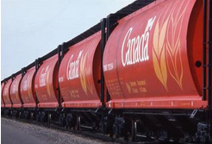

Concatenation, Delimiters
Mortar
#1
/TestQ.*_[0-9]+[A-C]?\.log/ # find this multi-part pattern
#testlogs/FTX[0-9]*#testFTX# # find this filepath ...testlogs/FTX#...
We put these together into a much more complex regex, just by concatenating.
  /TestQ.*_[0-9]+[A-C]?\.log/
  Means the literal “TestQ“, then zero or more of any characters, one underscore immediately followed by one or more digits, then optionally a single A or B or C, then a period, then "log“
  Finds, for example, “TestQual_January-10-2021_743A.log” or “TestQ_6B.log”
Any delimiter can be used, in some venues like sed or vi. A slash is used in the box above. (In other venues it is just in quotes with no slash delimiter.)
  Whatever is at the beginning, the first character, is treated as the delimiter.
  If a slash will be part of your literals (often the case when parsing a filepath), you CANNOT use a slash as your delimiter. I like to delimit paths with a hash sign (#), because it cannot appear in a filepath, and it stands out boldly, and it does not compete with the escapes: 's#testlogs/FTX[0-9]*#testFTX#'

Slide 11

Wildcard Quantifiers (p.1)
Vocab
B
ll | egrep "Apollo.+1968.*\.doc" # find Apollo<somechars>1968<anychars>.doc
The wildcard is followed by a quantifier clarifying how many you want to allow, to qualify as a match.
No quantifier means “once”.
Quantifiers can be: (more detail on next page)
  None , Asterisk *, Plus-sign +, or Question-mark ?
  Meaning Once, Zero or more, One or more, Zero or one
Actually even a literal character can have a quantifier.
  It only applies to the single character preceding the quantifier.
  This can be very useful for a list of filenames that may contain mixed Office products with or without the “x” (docx, pptx, xlsx).
    ls -1 | egrep "Apollo.+1968.*\.docx?"
    # find Apollo<somechars>1968<anychars>.doc<optional-x>
How many? Countless? One?

Slide 12
Wildcard Quantifiers (p.2)
Vocab
B
ll | egrep "Apollo.+1966.*\.docx?" # find Apollo<somechars>1966<anychars>.doc<optional-x>
The wildcard is followed by a quantifier clarifying how many you want to allow, to qualify as a match. No quantifier means “once”.
The most common possible quantifiers are star, question, plus. Not all are available for all commands (only egrep and awk have beyond-star).
  Dot, Star e.g. "test.*log\.dat"
    Means any character, even whitespace or hyphens, any number of times (even none!)
    Catches test/log.dat, test1/log.dat, test1A-old/log.dat
  Dot, Question-mark "test1.?"
    Means any character, zero or one times (a single optional char), e.g. a trailer such as 1 or 1A
    Catches test1, test1A, test1B, test1_, test19
  Dot, Plus-sign "test1.+"
    Means any character, one or more times (at least once); will not match if none occurs
    Catches test1A, test1BC, test1XYZ, test1_ _Backup_Old (..but does not catch “test1”)
    This is exactly the same as “.” followed by “.*” (..*) – which means once then optionally additional ones.
      However, if the wildcard-pattern is more complex than a mere dot, use of the plus sign avoids repeating the wildcard pattern and so is more readable and maintainable. Available only in awk and egrep, not sed.
how many stars?

Slide 13

Commenting Your Concatenations
Mortar
#2
# Find the logs of the add-on quality tests from the test-procedure appendices A-C.
# “TestQ" optional-any-chars underscore at-least-one-digit one optional-A|B|C ".log"
cat myfile.log | egrep /TestQ.*_[0-9][0-9]*[A-C]?\.log/ # find the ABC logfile
Do comment your intent! Since the actual regex is all juxtaposed with no spacing, it can be obscure to comprehend and maintain.
  Provide a comment for the benefit of the future reader (even if you usually don’t comment).
  Typically comment it on a full line, just above the regex. I usually append it to the block comment that already explains why I’m doing this step at all.
  Even just repeating the pattern, but spaced apart in groups, with literals quoted, will help.
    You can do this when reading or debugging a pre-created regex that wasn’t commented: merely copy the regex to a new line and start “opening it out” to make it readable.
  Convey your intent, piece by piece.
“The life you save may be your own.”
  Perhaps a year hence, it will make a minor change be easy as opposed to impossible.

Slide 14

Constrained Wildcards: Character Sets
Vocab
C
/[A-Z]+/ # find at least one capital letter
/.*N[0-9]*$/ # find anything then an N followed by 0 or more digits, at the end
/Curr[-_A-Za-z]*/ # find Curr<alpha-phrase> with – or _ but no spaces or numbers
A quite common search-lexicon building block is a semi-specific search character set.
  Often you want to be a bit more specific than the “any-character” fully-wild dots.
  You want to match only a certain type of text. The next character “must be one of this group of characters”.
  Frequent usage is “capital letters” or “digits” or “an alphanumeric phrase with underscores (no other symbols)”.
  As with the dot wildcards, these can be concatenated together: literals with wildcards with search-groups.
Such a group is specified using a square-bracket pair: [].
The square brackets enclose the entire set of single-character possibilities.
  A set consisting of a range (such as A-Z) can be specified with a hyphen. (Need a real “-” or “]”: put it first.)
  Like a dot, the [] group can be followed by a quantifier, which appears just after the close-bracket.
  Example: “[A-Z]*”).
    They will match in any order (taking from the set with replacement). This is usually intuitive, like using letters to form words. But don’t try to use it to do “[elm|oak]” because that means any word built up of the letters a,e,o,k,l,m and the symbol pipe, in any order; don’t use brackets to do that.
  Other commonly used groups: [0-9], [A-Z], [a-z]
    Custom groups: [-_ ] or [NSEW] or [MTWHF] or [A-G] or [0-9A-F] or [aeiou]
      Means: a hyphen or underscore, a compass direction, a weekday, a musical note, a hex digit, a vowel
    There is a rather robust set of named groups like [[:alnum:]] and [[:alpha:]] and [[:blank:]].
  You can stack them up, to allow any group of characters, e.g. alphanumerics [0-9A-Za-z]
  Multiple sets can be concatenated, e.g. [A-Z][a-z_]* means one capital letter followed by small letters-and-underscores.

Slide 15


Two Lexicons: Search, Replacement (p.1)
Mortar
#3
'/[0-9]$/For2021/' # find <digit><CR>, change digit to For2021
'/N[0-9]$//' # find N<digit><CR>, drop digit (just change it to null)
'/Curr\(.*\)\.pptx/Old\1.ppt/' # change Curr<stuff>.pptx to Old<stuff>.ppt
Two main kinds of regex grammars: search regex and replacement regex
  Some things don’t make sense in the replacement (only in search):
    Wild cards (such as the dot), EOL/BOL (line edge identifiers), or “capture” directives
  Some things don’t make sense in the search (only in replacement):
    The replay of the “captured” wildcard-parts, or a null string
  Some things make perfect sense anywhere:
    Literals (find this known string and replace it with that known string)
So there are two lexicons (grammars), two sets of syntax rules.
  They have lots of overlap, but are distinct sets.
Many commands accept and perform only the search (shown in orange): grep, awk, etc.
The “s” (substitute) subcommand accepts both lexicons: the search and the replacement. The s command is available in sed and in vi/ed/ex.
search for it
digested output

Slide 16
Two Lexicons: Search, Replacement (p.2)
Mortar
#3
sed 's/Susan.*/Stephen.txt/' # change Susan<anychars> to Stephen.txt
sed 's/Susan.*\.txt/Stephen.txt/' # change Susan<anychars>.txt to Stephen.txt
We already saw the ubiquitous building blocks of literals and dots.
  The literals can appear in the search pattern lexicon, or replacement lexicon.
  The wildcards, such as dot and set, appear only in the search lexicon.
    If “.” appears in a replacement, it merely means a literal dot (a period).
The sed (string edit) “s” (substitute) subcommand is one that uses both lexicons: the search and the replacement.
  The two sections (two complete regexes) are separated by a delimiter, usually a slash.
  The part between the first two slashes is the pattern, your search criteria.
  The part between the second two slashes is the changed output, what you want to spit out. When the search-regex criteria is met (found), it spits out the edited value in place of the search-found value.
    This part often is empty, when your intent is to just drop/remove the found part (replace with null).
    Many commands do not even allow this part; they strictly search and do not replace.

Slide 17

Capture and Reproduce (p.1)
Vocab
D
's/myStart\(.*\)myPattern\(.*\)/\1MyReplace\2/' # myStartXXXmyPatternYYY -> XXXMyReplaceYYY
Two more very useful building blocks are Capture and Reproduce.
  You may be wondering about how we can skip the don't-care characters, but not lose track of what they were, so we can retrieve the chars and replay (echo) them back out.
  Capture: an escaped parenthesis - \( and \)
    Only valid in the search lexicon
    Can repeat to capture up to 9 of them (more in some venues)
  Retrieve: an escaped digit - \1 thru \9
    Only valid in the replacement lexicon (in sed or vi)
    Numbered by the sequence in which they were captured
    They can be retrieved out of order, to perform a swap: blah\2blah\1
Used only during Search and Replace (via substitute command, inside sed or vi).
  The sed manpage calls it “re-use with a numbered back-reference”.

Slide 18
Capture and Reproduce (p.2)
Vocab
D
/FTG\([A-Za-z]*\)[Tt]est\([0-9]*\)dat/GTI\1-demo\2.log/
# FTGNovGoodTest138dat -> GTINovGood-demo138.log
Other examples of replacement, and capture-retrieve, in substitute:
echo "DataForTest9" | sed 's/[0-9]/For2021/'
  = => “DataForTestFor2021” (change the number to a year-phrase)
echo "DataForTest9" | sed 's/[0-9]//'
  = => “DataForTest” (drop the found number)
echo "ResultsCurrPartA-2021.pptx" | sed 's/Curr\(.*\)\.pptx/Old\1.ppt/'
  = => “ResultsOldPartA-2021.ppt”
echo "LogArchive9July2021.dat" | sed 's/LogArchive\(.*\)\.dat/Data\1.log/'
  = => “Data9July2021.log”

Slide 19

Using It in a Command Statement (p.1)
Mortar
#4
sed 's/xxx/yyy/g' myfile.txt
grep "xxx" testlog.csv
ls -l | grep -v "[Bb]ackup“
echo "$userInputFilepath" | sed 's#/share/projects/##g' # remove the root portion
Ultimately you need to use the regex in an entire command statement, in a format pertinent to that command.
You need a command name, some kind of delimiters around each of the search and (if applicable) replace, possibly other arguments, plus any options or switches that apply.
  In bash, to use sed’s substitution subcommand, it looks like this: ls -l | sed 's/xxx/yyy/g'
    More detail on next page.
  In vi or vim, to use sed’s substitution subcommand, it looks like this: :s/xxx/yyy/g
  In vi or vim, to use its search, it looks like this: :s/xxx/2 or just /xxx
  In bash, to use grep, it looks like this: ls -l | grep "/xxx/"
  In bash, to use awk, it looks like this: cat mylog.csv | awk -F, '/xxx/ {myfound=1; print $7}'
  Note that the Unix “tr” command does NOT take a regex, only a single character.
Generally the entire regex or search/replace pair, along with its switch, must be in some kind of quotes. Sometimes the entire command must be in single quotes.
  This is true even in Perl, MATLAB, et cetera. However, there are no quotes needed in vi or vim. The awk is unusual in that it insists on single-quotes (apostrophes).
  Sometimes you must drop out of quotes: 'xxx'\''xxx' is a frequent meme, used to put a real escaped apostrophe.
The log file being read may be listed at the right as an argument, or piped in from the left. More later.

Slide 20
Using It in a Command Statement (p.2)
Mortar
#4
sed 's/xxx/yyy/g' myfile.txt
The sed substitute command is one of the most-often-used. It is available inside vi (and ed and ex if you’re bare-bones) as well as inside sed.
  The s means substitute, typically followed by a / indicating the delimiter is a slash.
  The sed substitution command takes an option, aka switch: which occurrence.
    It goes at the end, just after the final delimiter.
    It can be an integer N (to change only the Nth occurrence found on the line), or a “g” (to make the change globally). If omitted, it defaults to 1.
      e.g. "INTERNATIONAL ATI PROJECT" -> 's/ATI/OCI/2'
      This will rename it to the “INTERNATIONAL OCI PROJECT”.
    Most commonly you will use a “1” (or not specify it at all), or a “g”.
  If using filepaths (which contain lots of slashes), you can use any delimiter in sed.
    This is much more readable than escaping each “/”.
    Sed uses whatever single character you use right after the s (for substitute): s<delimiter>…<delimiter>
    Suggestion: hash/sha/pound (#) stands out with lots of black ink, and never occurs in file paths. A pipe can also be quite readable. You can use any other single character (other than a closing quote).

Slide 21

Start / End Anchors Avoid Bycatch (p.1)
Vocab
E
/^MeditAegis/ # find this literal text at the beginning
/ABC123\.txt$/ # find this literal text at the end
/^ABCfileA$/ # find this literal string as the entirety of the searched string
Two very common search-lexicon building blocks are the start-of-line or end-of-line anchoring marker.
It denotes the expected position of the start/end of the string being searched.
  The caret (^) specifies the start of the search text (line, string, or block).
  The dollar ($) specifies the end of the search text (line, string, or block).
Put the symbol as if it were a literal, before and/or after the rest of the regex.
Using these is a good habit to get into - as a precaution to avoid bycatch.
  This acts as an anchor to prevent "catching" extra “hits”, e.g. because "ABCfile100" fulfills the criteria when we stated we wanted "ABCfile1".

Slide 22
Start / End Anchors Avoid Bycatch (p.2)
Vocab
E
/^MeditAegis/ # find this literal text at the beginning
/ABC123\.txt$/ # find this literal text at the end
/^ABCfileA$/ # find this literal string as the entirety of the searched string
Some examples:
  Start: to avoid text "EastMeditAegis" when we want "MeditAegis", use "^MeditAegis" as your regex
  End: to avoid text "ABC123.txt_savBKUP" if we want "ABC123.txt", use "ABC123\.txt$" as your regex
  Both: to avoid text "oldABCfile100" when we want "ABCfile1", use "^ABCfile1$“ as your regex
If you have both a caret and a dollar, the part between will not match unless it constitutes the entirety of the searched string.
  This is not as big a constraint as it sounds, because it may have plenty of wildcards of unconstrained length within it.
Using these is interdependent with using leading and trailing ".*" around your spec. If you put a "^.*" at the beginning, the caret and dotstar basically cancel each other out.
Often – with a filepath, for instance – you will want a don't-care leading part, meaning you don't know the root of the path but just the limb/branch/twig/filename.
  Even then, however, you may want to do one of these:
    Capture the unknown leading part, for replay in the edited output. (This is described a few slides later.)
    Ensure it starts with a dot or a root-slash (/) character. To ensure this, you should spec it as caret, then a [./] group, meaning a dot or a slash, then the wildcard-star: "^[./][A-Za-z0-9 _-/]*/MYKNOWNTEXT" which would pick up: a dot or slash, followed by any valid path characters (alphanumerics, underscores or hyphens or spaces, or slashes between levels) of any quantity 0 or more, followed by a slash, followed by the known text. When it hits /MYKNOWNTEXT it will stop the grab of the any-valid-path characters.

Slide 23
Availability of Keywords in Commands
Mortar
#5
Not all Lexical “building block” Vocabulary is available within all contexts.
This is a table of when different symbols are valid (interpreted vs. literal).
  Adapted from my valuable 1999 O'Reilly “Unix in a Nutshell”
This is a list I’ve aggregated over the years, of some various escapes.
  Sometimes multiple escapes are needed, if it is being passed
  through intervening commands like ssh.
This is a list I’ve made of possible delimiters.
  grep, egrep double quotes "regex"
  same with a literal $ in it single quote 'regex'
  ed,ex,sed slash /regex/ or any delimiter, whatever 1st character is
  awk slash /regex/ only
Symbol | ed,ex,vi | sed | awk | grep,egrep | Notes
. * ^$ \ [] | YYY | Y | Y | YY | Universal symbols
+ ? |  |  | Y | NY | Quantifiers
| ( ) ! |  |  | Y | NY | Or, Group, Not
\( \) \integer | YYY | Y |  |  | Match, replay
\n |  |  | Y |  | Match a newline in awk
\{ \} | YYY | Y | P | YP | Numeric quantifier; P means Yes with POSIX syntax=no “\” { }
\< \> | YYY |  |  |  | ^$ for words
Desired Char to Match | Nr escapes | Venue tested
Tab | 2 | sed search
Square bracket | 2 | Cygwin awk
Parenthesis | 1 | Cygwin
Asterisk | 2 | nawk
Brace | 0 (important) | Cygwin
Slash, Hyphen | 0/1 optional
Backslash | 2 | Linux
Double quotes | 0/1 optional | Cygwin awk

Slide 24

Regex Inputs and Outputs
Mortar
#6
isgood=`echo "$filepath" | grep "^[./$]"` # ensure path is absolute (root,$HOME,pwd)
ls -l | awk -F'\t' '/drwx/ {print $2}' # print date of writeable directories
awk -F, '$2~/^BOOST$/ {print $8}' tracklog.csv # print time column when boosting
grep "test[0-9]\{3\}\.txt" fileslist.lis > testfiles.lis # find only the test###.txt
cat myfile.log | grep -v "%" |head -2 > logheader.txt # grab top two only
Your interface with the world outside of the regex, specifies:
  the source of the text (one or more lines)
    If the input is multi-line, it will test the regex against EACH line separately.
  the destination to which the found or edited text gets output
Input is from file -or- STDIN -or- cell
  Line of a file (specified as an argument to some commands: sed, grep, awk)
  Piped-in from STDIN (output of a prior command)
    A line from an ls command, a cat, or a prior grep or other search
    A string from an echo command, e.g. of a script variable value
  Cell value (that was exported from Excel to a csv/tsv file), specified within awk
Output is to STDOUT
  In bash this goes:
    to screen session, or
    through a pipe to another operation (e.g. sort), or
    redirect to an output file
  In MATLAB this would go into the specified variable in the workspace, or to screen.

Slide 25

Counted Quantifiers
Vocab
F
Opt: DoNotPresent
grep "9[A-Z]\{3\}9$"" # find exactly 3 capital letters, between two 9s, at the end
grep '.*N[0-9]\{2\}$' # find anything then an N followed by 2 digits, at the end
Yet another workhorse building-block is less commonly used, but useful.
This is an additional kind of quantifier after a wildcard (dot or brackets).
  This is another alternative to the ones we have learned already, which are:
    asterisk (0..inf), question-mark (0 or 1), plus-sign (1..inf)
    .* [0-9]* .? [0-9]? .+ [0-9]+
  This allows you to specify an exact numeric quantity (other than one), instead.
Use \{ and \} to surround a literal number of occurrences.
  It can be multi-digit (greater than 9).
  This is often useful if you know the number of occurrences, but it is more than one.
  This is especially useful for numbers, if your text number is zero-padded.
  e.g. To match three digits: "test[0-9]\{3\}" will match test000 to test999.

Slide 26
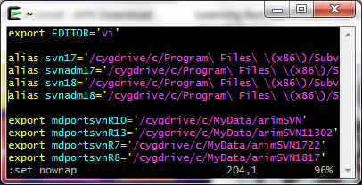


Other (non-Bash) Venues
Mortar
#7
Opt: DoNotPresent
There are many other contexts for use, other than in bash; this is a small sample.
Within vi (or vim), when in command (non-Insert) mode, you can just type in a regex starting with a slash. You may already know how to search for literal text like that, but perhaps didn't know you have access to the full regex panoply.
  /[Ii]tem.*[Cc]ount
  To do search-and-replace, preface the slash with ":s" to use the substitute command:
    :s/xxx/yyy/2 -- will change the second xxx on the line to yyy
  To limit it to a small block of lines, meaning just part of the file being edited:
    :20,80 s/xxx/yyy/g -- will change all (global) xxx in lines 20..80
Within MATLAB or awk or source-code language, your regex - or pair of search&replace regexes - will be in the form of 2 or 3 arguments to a function call. They will be within double quotes.
  One of the arguments will be your input string variable. The input string must not be a file or pipe when used in this context (but it may be the equivalent, if you have already read in the file into a variable which contains multiple lines; the function method will assume that each line should have the search operation performed on it).
  MatLab “regexp” function will NOT stop properly at the next literal after a wildcard. This lack is somewhat mitigated by the existence of an “extractBetween” function that will stop, but it only can be used for one wildcard.
Java has the “<classinstance>.matcher” class member function.

Slide 27
“Anti” Character Set
Vocab
G
DoNotPresent
/.*[^0-9]?/ # find anything up to, but not including, numbers
/.*_[^_]*/ # find anything that is not an underscore (up to the next underscore)
Yet another search-lexicon building-block is fairly uncommon, but sometimes handy.
You can “negate” a character set (in brackets) to search for anything that is NOT them.
  [^aeiou] = NOT a vowel
  [^0-9] = NOT a numeral
  [^-_] = NOT an underscore or hyphen (remember a hyphen has to come first to be counted as a literal)

Slide 28

Greediness Qualifiers
Vocab
H
DoNotPresent
NOT tested (I have never done this)
#[A-Z]+?logs/# # find capital letters up to the first “logs/” dir
/.*N[0-9]/ # find anything up to the last “N-then-a-digit” (default greedy)
/.*?N[0-9]/ # find anything up to the first “N-then-a-digit” (non-greedy)
Yet another search-lexicon building-block is fairly uncommon, but good to at least know it exists, if only to better understand the default behavior.
This is another kind of quantifier after wildcards; this impacts its greediness.
  By default, a search is “greedy” meaning it will take as much as it can, that will still leave enough to satisfy the rest of the specification.
  For instance, '\([a-z]*\)HIT' will match and capture almost all of aaaaaHITbbbbbHIT because it still has the HIT at the end to satisfy it.
  If the second HIT were not there (aaaaHITbbb), then the spec could only match the aaaa at the beginning, before the first HIT.
You can change this behavior (to be non-greedy, known as “lazy” or “reluctant”, and match only up to the first HIT), by using the symbol “?” AFTER the normal quantifier.
  Thus you would have, instead of * or ? or + or {3}, a *? or ?? or +? or {3}? quantifier.

Slide 29
Parameterizing the Regex Pieces
Mortar
#8
DoNotPresent
NOT tested (although I have done this similarly before, often)
You can, to a large extent, use variables when constructing your desired building blocks into a regex.
Change some of the literal part that may sometimes be a different constant value.
  For example, it may vary whether the files are TestQblahblah99A.log or TestQblahblah99A.txt or other extensions.
  fileExtension="log" # sometimes maybe it is not log, might even be an argument
  myregexPrefix="TestQ.*_[0-9]+[A-C]?" # invariant part TestQ<stuff>_<numbers><optionalappendixletter>
  myregex="${myregexPrefix}\.${fileExtension}" # concatenate them using ${x} for each varname
  echo "$1" | sed '/'"$myregex"'/' > found.lis # drop out of tics, insert "$myregex" in dbl-quotes
Allow user to pass in his desired number of digits into this script that contains the search.
  For example, it may vary whether the TestIdName is Test_00 with a two-digit year or Test_0000 with a four-digit year.
  export filename="$1" # the first argument to this .sh file that contains the search
  export nrdigits="$2" # the second argument to this .sh file that contains the search
  cat "$filename" | grep '/[Tt]est_[0-9]\{'"$nrdigits"'\}/'
Note that in a situation, which occurs often, where a regex is in single-quotes (aka tics, apostrophes), you will need to drop out of tics, so that you can insert your variable part "$variablePartOfYourRegex" in dbl-quotes so that it will be interpreted. Unix does not interpret anything (such as your $var) inside of single-quotes.
  You do not actually need the double-quotes around your variable if you are certain it will never contain spaces. There MUST be some kind of quotes around anything with spaces.

Slide 30

Summary
Hopefully this has demystified the use of regexes while illustrating some of their power and versatility.
It presented the most common building blocks, and each one’s purpose in preventing leakers or bycatch.
  Literals, dot-wildcards, character-sets (and which taxonomy they can appear in)
  Wildcard quantifiers: none, asterisk, question, plus, counted (and non-greedy of each)
  Capturing and reproducing (replaying) wildcard values
  Anchors to start-of-string and/or end-of-string
It presented the interfaces between building blocks, and the access from the outer world.
  Just concatenate the building-block vocabulary into a regex.
  Surround it with delimiters (such as slashes or double-quotes or apostrophes).
  Lead the regex with a command (such as grep or sed 's').
  Put a pipe or redirect between the command and the outside worlds of input data and output data; with some commands a filename can be an argument.

Slide 31
Regular Expressions: Cheat Sheet
Building blocks (Vocabulary)
  Literals: any character. Escape it if it appears below as meaningful symbol.
  Wildcards:
    dot = (any char including symbols)
    character-set: [aeiou] [0-9] [-_A-Za-z] [[:alnum:]]
    not-character-set: [^_]* = anything but underscore (up till the next underscore)
  Wildcard quantifiers:
    null = once
    asterisk = 0 or more .*
    plus = 1 or more .+ (sed, egrep)
    question mark = 0 or 1 .? (sed, egrep)
    counted: phone number is \{3\}-\{3\}-\{4\}
  Capturing and reproducing: s/xxxx\(.*\)xxx/yyy\1yyy/ (sed)
  Anchors: /^xxx.*xxx$/
Mortar (Interfaces)
  Concatenate building-block vocabulary into a regex
  Delimiters surround the regex(es): usually slash or hash/pound
  Command (such as grep or sed 's') leads the regex, and likely all goes in quotes
  Input data: pipe (from cat,echo,etc.). With sed/grep/awk a filename can be an argument.
  Output data: pipe (|) or redirect (>)

Slide 32
Conclusion
Now you have a repeatable method of mass-editing field-delimited logs.
  Mistake-proof, Boredom-proof, Forgetfulness & Personnel-turnover-proof
  Serial I/O: independent of file size, crash-proof, no file too big. Data is written out, not ephemeral.
It can be parameterized, using user arguments or config files.
It can be repeated over and over, or called inside an all-night loop driver.
Its results can be output to a smaller file, which can then be processed more if you decide you want to.
  For instance: summarize, aggregate, cross-compare, plot with gnuplot or grace.
It runs on many types of freeware, is portable, and needs no licenses.
Its language is mature, concise, and “right for the job”.
Repeatable, Consistent, Communicable, Portable, Wrapper-extensible, Error-free, Boredom-free

Slide 33
Backups

Slide 34
Brief Recap of 2/20/2020 Presentation
“Log Analysis with AWK”
Venues where regexes are available (see more detail on p.10 of 2020 “awk” slides)
  Perl, Python, Java, MATLAB
  Unix/Linux/bash
    Natively on a Unix box, or over ssh using PuTTY to one, or using Cygwin to emulate one
    It is implemented in tools such as awk, sed, vi, and other Unix/Linux/POSIX commands.
Advantages of a Command Line Interface are: (see more detail on p.9 of 2020 “awk” slides)
  Communication (an exact, clear record/transfer of “what we did” in CM)
    Repeatability (up-arrow, history log, fully editable but also retrievable a year later)
    Shareability (to record for team/customer/self the exact process used, rather than 20 pages of screenshots)
    Version control (text-only means a cfg-mgmt tool can do diffs)
  Serial Read (works like a paper tape reader, or a lengthy grocery receipt)
    Speed (no waiting while it “loads” it all before beginning)
    Memory (no crashing when it can’t “fit” it all)
  Extensibility (wrappers)
    Add additional post-processing, put it inside a loop, put it on a timer, no limit
JUST THINK: A recorded “process used”
JUST THINK: No maximum file size
JUST THINK: No idle processors at midnight

Slide 35
History of Regular Expressions
The Regex (Regular Expression) concept, and its syntax, are specifically designed for parsing textual data, also known as lexical analysis.
  From Wikipedia: “The [regex] concept arose in the 1950s [with] the American mathematician Stephen Cole Kleene. … The concept came into common use with Unix text-processing utilities. … Regular expressions are used in search engines, search and replace dialogs of word processors and text editors, in text processing utilities such as sed and AWK[,] and in lexical analysis. Many programming languages provide regex capabilities either built-in or via libraries.”
  The regex syntax was used (within the AWK language created at Bell Labs in the 1970s) to compile the “C” compiler, until C got advanced enough to compile itself.
The concept of a Regex is available in many contexts:
  For instance: Perl, Python, Java, MATLAB, and all flavors of Unix (including Linux, POSIX, Cygwin).
  Within Unix, it is implemented in tools such as awk, sed, vi, and other commands.

Slide 36
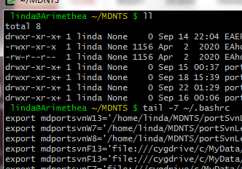
Context of Examples; Zig-zag Flow
My examples:
  Use bash code as the command context around the regex, because:
    Simple without a lot of overhead verbiage (e.g. “grep <regex>”).
    Well-known to some of you, while some want to learn it (so I’ve used the accessible parts of the syntax).
    The regex itself, the inner workhorse part, is fairly venue-agnostic. (For other contexts, such as Java or MATLAB function call syntax, see your language’s manual.)
  Use a filenames list, usually, as the input string into the regex, because:
    Commonly encountered, has lots of variants and symbols, easy to digest and comprehend.
My order of presentation:
  Zig-zags between “BUILDING BLOCKS” and “CONTEXT”.
    This provides “sentence structure” of how-are-pieces-put-together, with “vocabulary” of what-do-they-look-like.
How do we specify Search vs Replace strings?
How do we aggregate Bldg Blocks into a RegEx? (make a phrase)
How do I insert the regex into a command? (add a verb)
How do I specify the input text to the command? (add a subject-noun)
Putting It Together
Defining the Vocabulary
Example of a “Building Block”
Another type of “Building Block” (build vocabulary)
Less-common types of “Building Block”

Slide 37
Low Level Vocabulary, High Level Structure
This page gives you a preview of some of the vocabulary building blocks we will cover, and also of the ways they get put together in context. We will zig-zag back and forth learning more about each.
Vocabulary of Building Blocks to Choose From:
Known Literal
Capture/Release
Subset Search
Anything
How to Put It Together in Context
<input> | <command> ‘<subcommand><delimiter><searchregex><delimiter><searchregex><delimiter><globality>’ | <output>
cat myfile.txt | sed ‘s/FTG\(.*_[0-9]+\)/GTI\1/g’ | sort > outfile.txt

Slide 38
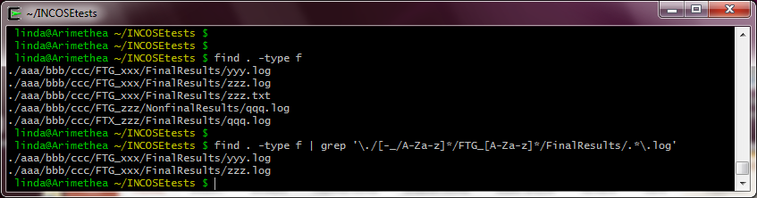
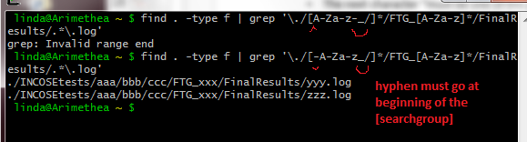
Backup Slide: Testing
This screenshot shows a simple test directory-tree, which I used to test each sample.
  Added using “touch” command; files are empty.
For each test that used grep or sed, I changed any ? and + to *
I removed the for-readability-only spacing.
I did a find to get the sublist I wanted, then ran the list through the regex command.
p.7 “Easy”

Slide 39
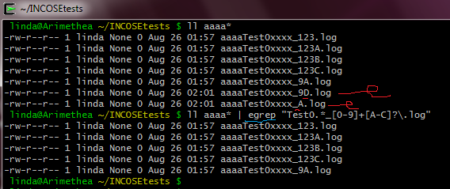
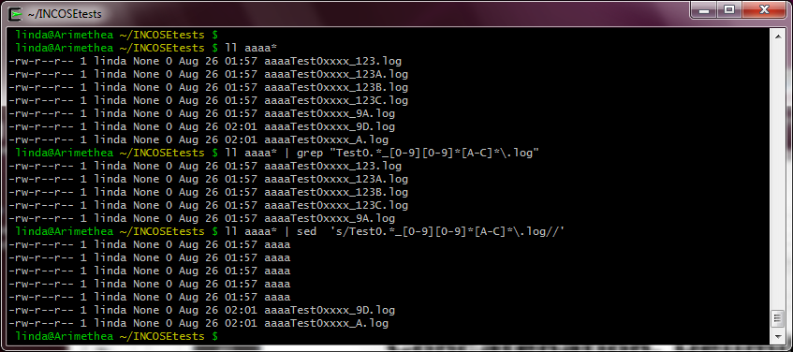
Backup Slide: Testing
This screenshot shows a simple test directory-tree, which I used to test each sample.
  Added using “touch” command; files are empty.
I did an ls –l to get the sublist I wanted, then ran the list through the regex command.
p.7 “Easy”
p.13 “Concat”

Slide 40
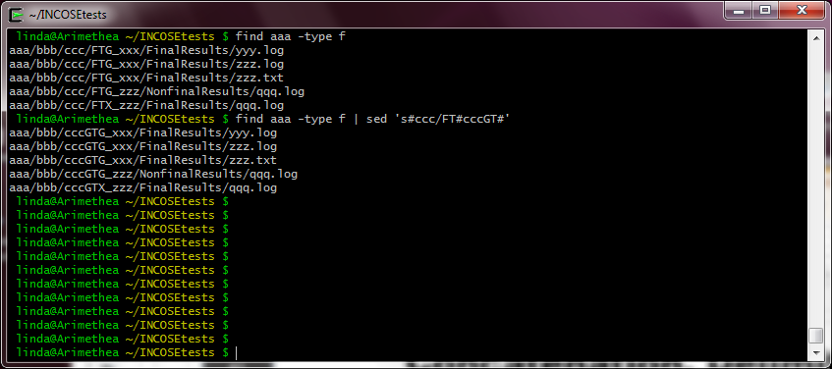
Backup Slide: Testing
This screenshot shows a simple test directory-tree, which I used to test each sample.
  Added using “touch” command; files are empty.
I did a find to get the sublist I wanted, then ran the list through the regex command.
p.7 “Easy”
p.13 “Delimiters”

Slide 41
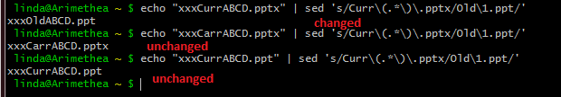
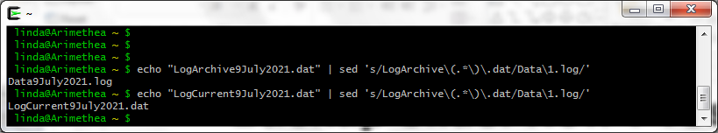
Backup Slide: Testing
p.16 “Search&Replace”

Slide 42
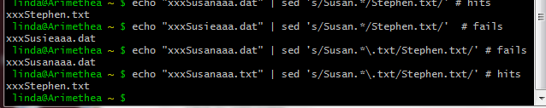
Backup Slide: Testing
p.17 “Search&Replace”

Slide 43
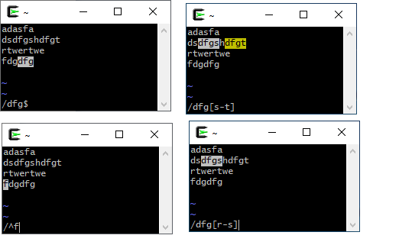
Backup Slide: Testing
regex in vi

Slide 44
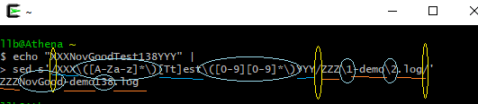
Backup Slide: Testing
p.18 “CaptureReproduce”

Slide 45
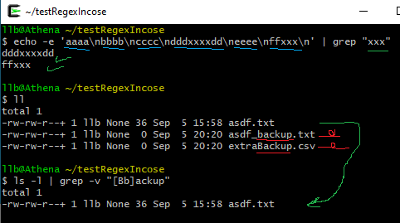
Backup Slide: Testing
p.19 “Command”

Slide 46
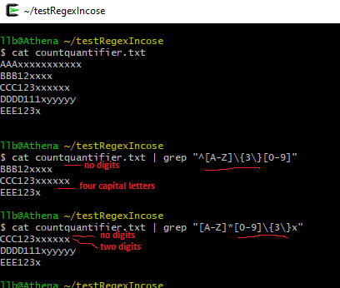
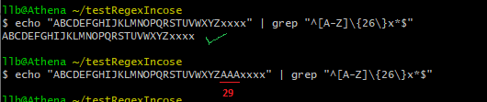
Backup Slide: Testing
p.24 “Counted Pattern”

Slide 47
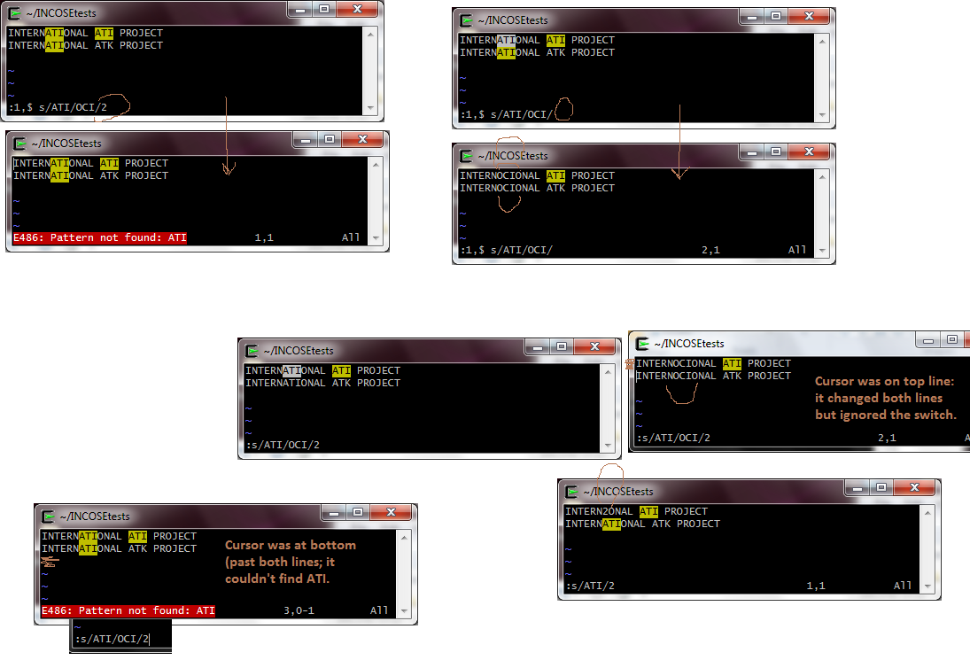
Backup Slide: Testing

Slide 48
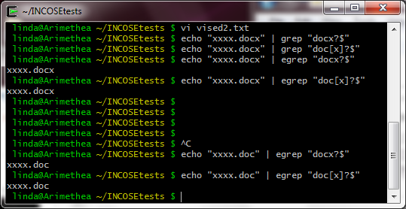
Backup Slide: Testing
“x? quantifier inside vi and egrep”
Works with egrep, with or without brackets around the x. “[x]?” “x?”
Doesn’t work with plain grep, even with brackets.

Slide 49
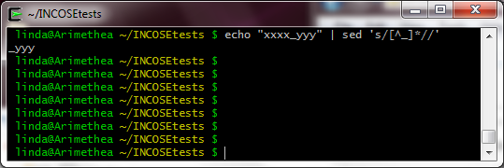
Backup Slide: Testing
“anti-charset ^ in sed”

Slide 50
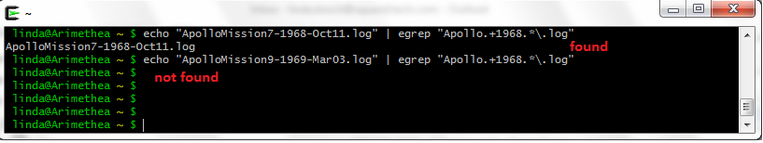
Backup Slide: Testing
“quantifiers”

Slide 51
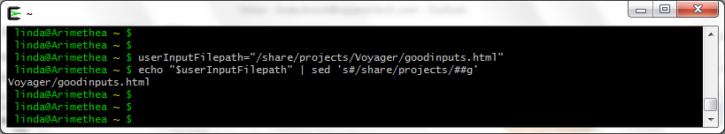
Backup Slide: Testing
“command statement”

Slide 52
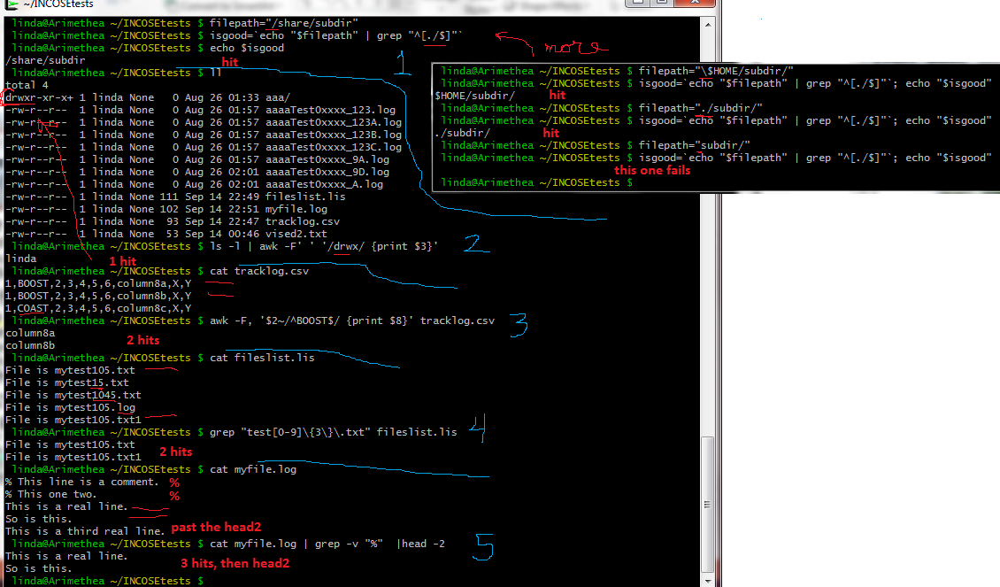
Backup Slide: Testing
“regex i/o”

Slide 53
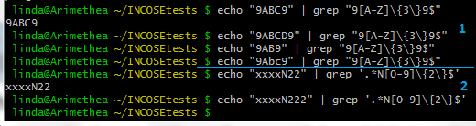
Backup Slide: Testing
“counted”

Slide 54
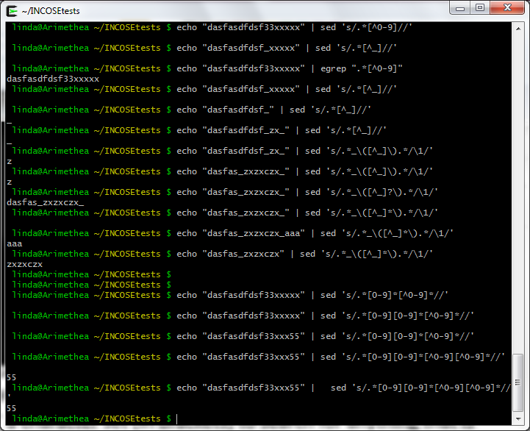
Backup Slide: Testing
“anti-charset”

Slide 55
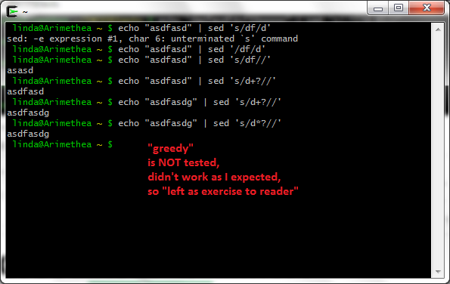
Backup Slide: Testing
“greedy”

