Slide 1
“(Don’t) Tell Me What To Do!”
A Half-Baked Discussion on Process Standardization in the Age of Digital Transformation
8 Nov 2022
Ken Garlington, CSEP
Kennie.E.Garlington@LMCO.com

Slide 2

Happy World Standards Day!
More at https://www.world standardsday.org/
Notes:
SDGs: Sustainable Development Goals

Slide 3
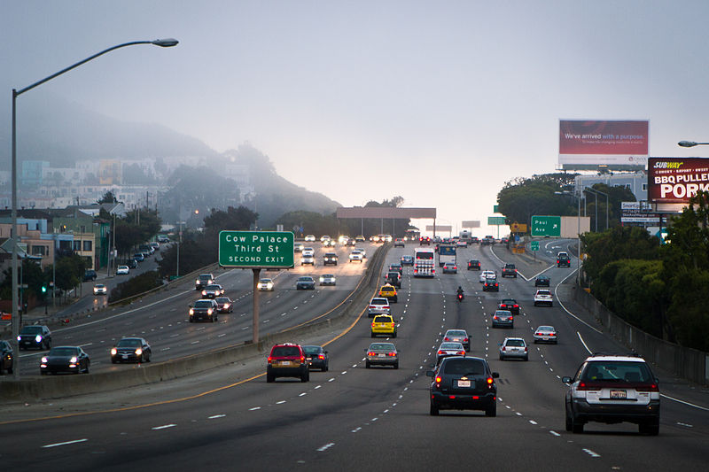
Process Standards are Useful…
Source: https://commons.wikimedia.org/wiki/File:San_Francisco_Bayshore_Freeway_Route_101_6015052908.jpg by Tony Webster. Terms of use: CC-BY-SA-4.0.
Notes:
More at https://www.rd.com/article/why-drive-on-different-sides-of-the-road/

Slide 4
… but Dangerous if Misapplied
U.S. diplomat's wife pleads guilty over fatal UK car crash
-- Reuters, October 20, 2022
“Anne Sacoolas, the wife of a U.S. diplomat, pleaded guilty on Thursday to causing the death of a teenager by driving carelessly in England three years ago, a case that led to diplomatic friction between Britain and the United States.
“Harry Dunn, 19, died in August 2019 after his motorcycle was hit by a Volvo car driven on the wrong side of the road by Sacoolas near RAF Croughton, an air force base in the English county of Northamptonshire that is used by the U.S. military.”
About 35% of the world’s population drives on the left

Slide 5
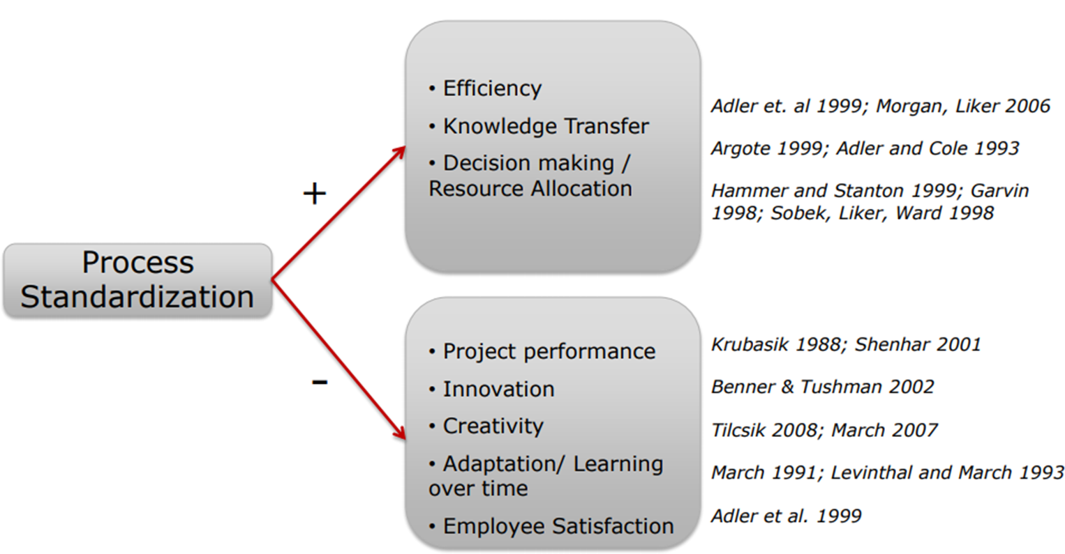
Effects of Process Standardization
Source: Sid Rupani, “Standardizing Product Development Processes,” Massachusetts Institute of Technology Lean Advancement Initiative Web Knowledge Exchange Event, December 1, 2010. At https://dspace.mit.edu/handle/1721.1/84493 . Terms of use: Attribution-NonCommercial-ShareAlike 3.0 United States http://creativecommons.org/licenses/by-nc-sa/3.0/us/

Slide 6
US Dept. of Defense Standards (circa 1980s)
MIL-STD-483
Configuration Management Practices
MIL-STD-490
Specification Practices
MIL-STD-499
System Engineering Management
MIL-STD-1521
Technical Reviews and Audits
MIL-STD-1679
Weapon System Software Development
DOD-STD-2167
Defense System Software Development

Slide 7
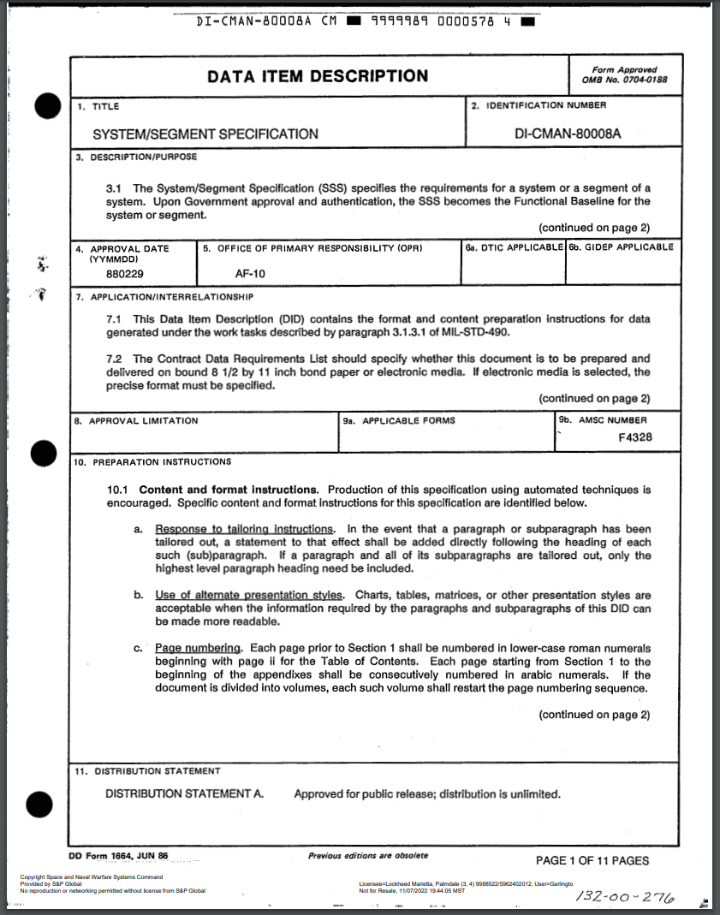
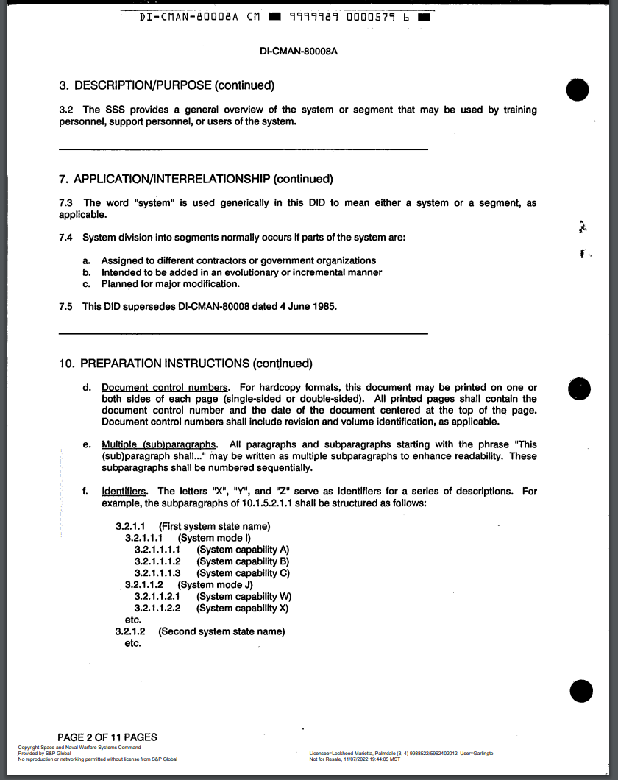
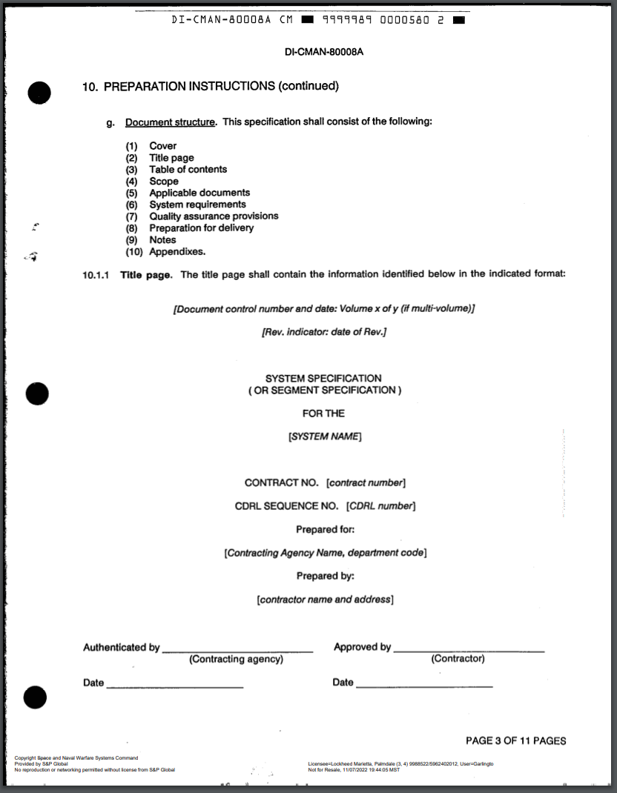
Data Item Descriptions (DIDs)

Slide 8
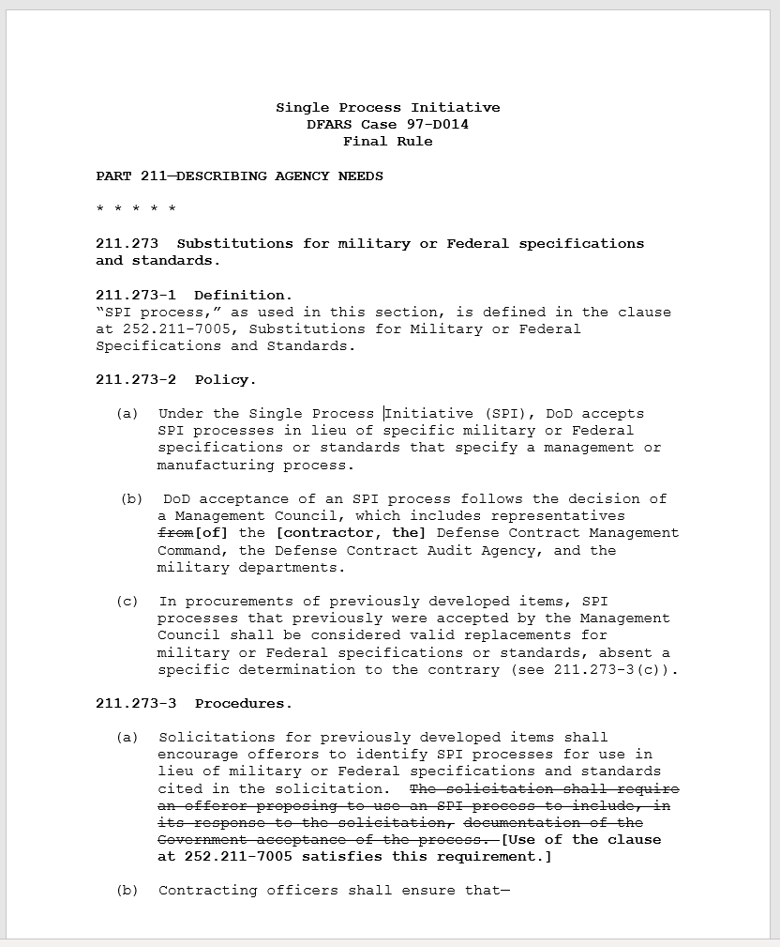
US Single Process Initiative (circa 1997)
Notes:
See https://asc.army.mil/docs/pubs/alt/2000/4_JulAug/articles/28_Single_Process_Initiative_200004.pdf for an example of the value/issues with SPI implementation

Slide 9
Digital Engineering-Related Standards
ISO/IEC 19505
Unified Modeling Language (UML)
ISO/IEC 19514
Systems Modeling Language (SysML)
ISO/IEC 19540
Unified Architecture Framework (UAF)
ISO/IEC/IEEE DIS 24641
Methods and Tools for Model-Based Systems

Slide 10
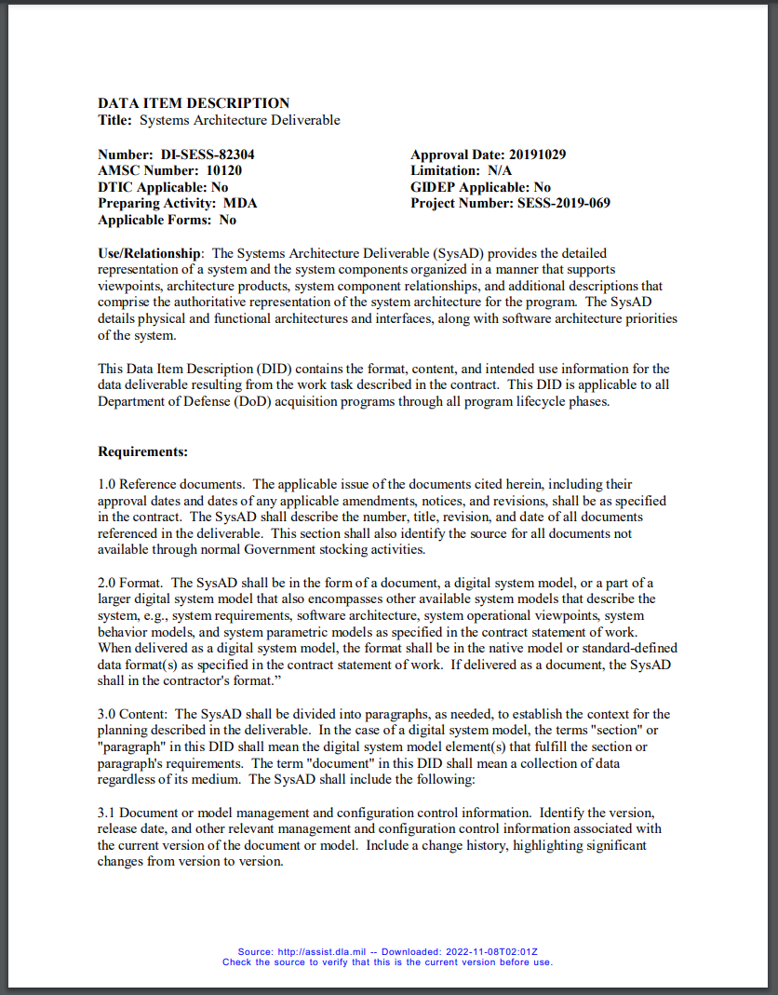
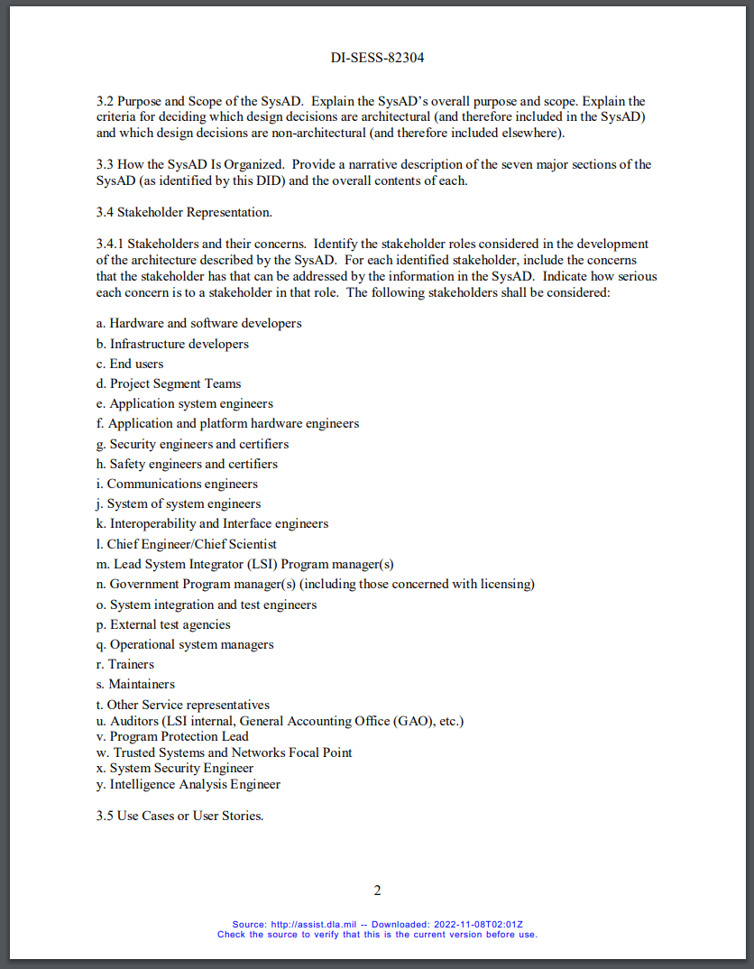
Systems Architecture DID (2019)
Notes:
Full DID available at https://quicksearch.dla.mil/qsDocDetails.aspx?ident_number=283330

Slide 11
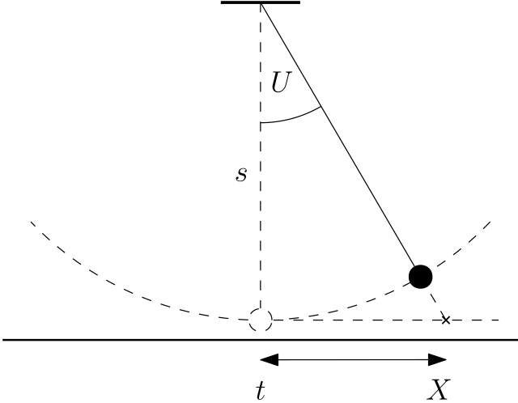
How Do We Know if We’ve Gone Too Far?
Standards considerations for the near-term
  Are the right people contributing?
  Will there be sufficient infrastructure? (tools, etc.)
  Will developers adopt them?
  Will our customers accept them? (e.g. UAF vs. DoDAF)
Standards considerations for later
  Intelligent assistants?
  Model checkers/provers?
  Additive manufacturing?
Notes:
Image source: https://commons.wikimedia.org/wiki/File:Pendulum_Cauchy.svg. Terms of use: Creative Commons Attribution-Share Alike 4.0 International license.

Slide 12
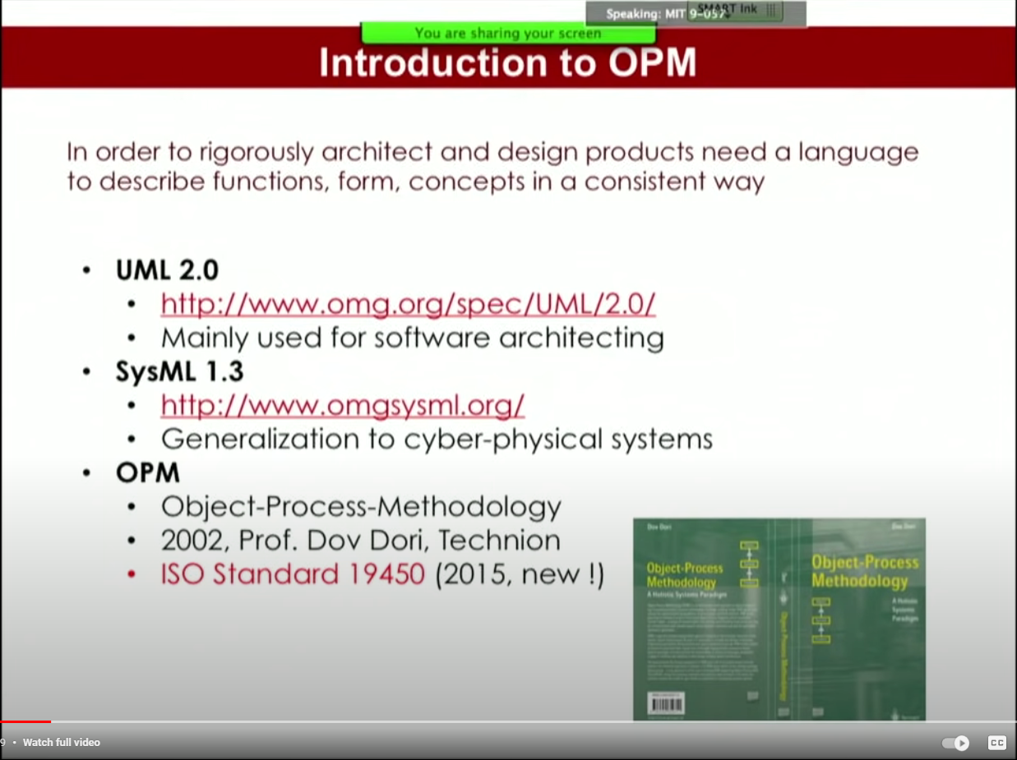
Postscript: Predicting the Future is Hard
https://www.youtube.com/clip/UgkxfC08M1ZBeGPhxuoWvYZAW3abAiSaLYIP

