Slide 1
May 20, 2021
INCOSE UK Chapter Rail Interest Group
Combined Monthly Meeting
TWG + RIG + APTA SE Subcommittee

Slide 2
AGENDA:
Introductions (time permitting) & Intro
TWG Organization & Call for volunteers
APTA & INCOSE: MOU and collaboration
Status / Updates
  Co-chairs
  Products: Standards, Newsletter, Case Studies
  Events: IW, IS, Webinars
  Services: Website, LinkedIn, survey/census
  Membership: Outreach, Contacts, Volunteers
  Working Group Communications

Slide 3
INCOSE APTA Collaborative Efforts

Slide 4
Transportation Working Group
Five Key Functions of our Working Group
APTA SE Subcommittee

Slide 5
Transportation Working Group
This is a bit fluid…..

Slide 6
Transportation Working Group
Co-Chairs Update
Dale
Allison
Mike
Denis

Slide 7
Transportation Working Group – IW2021
PRODUCTS
SE Handbook Revisions – Domain Section (Mike)
APTA Systems Lifecycle Engineering Standard (Dale)
SE 101 Guides
Others…

Slide 8


Design-Build …Are You Ready?
Featured Presentation

Slide 9
Design-Build – Are You Ready?
Understanding the differences in Contract Mechanism
Requirements Management for Design-Build project methodology
Organizational Readiness for Design Build
Design Build approach at MTA
Organization Preparations at MTA
Adopting Industry Standards for Systems & Software Lifecycle Processes and Deliverables for Design- Build Projects

Slide 10

Design-Build & System Lifecycle Engineering
Presenter 1:
Dale Brown: Co-Chair, INCOSE Transportation WG and Configuration Management WG. Current chair of the APTA Systems Engineering Subcommittee. Dale is also the relationship manager for the APTA/INCOSE cooperative agreement.
Dale joined Hatch in 2019 as Director, Systems Engineering bringing 38+ years of Transit and Rail experience. He is a licensed professional engineer (electrical) with extensive R&D, design, management, and business development experience. Dale has travelled to forty-seven countries and has further been awarded several design patents in the rail sector for rolling stock control systems/inter-consist communications.
Dale has acquired expertise in digital electronics design, software development and embedded control of specialty equipment, mining, heavy construction, military, and rail vehicles throughout the US, Canada, South America, and Europe.

Slide 11


Brief Overview: Contract Mechanisms
A small sampling – there are many!
Lump Sum
Unit Price
Cost Plus
Incentive Contracts
Guaranteed Maximum Price
Design-Bid-Build
Design-Build
IPDT, PPP

Slide 12
Risk-O-Meter Notes
Original meter use was intended to show relative risk between parties, but later analysis and discussion shows that it only approximately reflects the overt initial ‘accounts payable’ risk to each party.
Other risk factors appear, often the result of very poor requirements management and integration management due to the siloed approach that many contract mechanisms deploy. (tendency to silo disciplines)
There are many other risk vectors that need to be holistically considered such as:
System Performance
Lifecycle Cost (i.e., Maintenance)
Mission Survivability
Safety
Security
Availability
Reliability
Relative Risk between parties
The Risk meter should be driven by consideration of all dimensions of risk to an agency.
(including Lump-Sum)
Risk-O-Meter

Slide 13
Brief Overview: Contract Mechanisms
Lump Sum
The agency has essentially assigned all the risk to the contractor. The supplier is expected to ask for a higher markup in order to mitigate the extra risk.
Note that the agency is still responsible to operate and maintain the transit system safely and securely when the supplier if finished – not 100% of the risk is transferred!
When/Why Use
A lump sum contract is a suitable if the scope and schedule of the project are sufficiently defined to allow the supplier to fully estimate project costs.
Risk-O-Meter
Relative Risk between parties

Slide 14
Brief Overview: Contract Mechanisms
Unit Price
The work to be performed is broken into various parts, usually by trade or discipline. This contract type is based on anticipated quantities of items which are counted in the project in addition to their unit prices.
When/Why Use
Unit price contracts are seldom used for an entire infrastructure project, but they are frequently used for agreements with subcontractors which involve accurate identification of different types of items, but not their numbers, in the contract documents. They are also often used for maintenance and repair work.
Risk-O-Meter
Relative Risk between parties

Slide 15
Brief Overview: Contract Mechanisms
Cost Plus
An agreement which involves agency consent to pay the complete cost for material and labor in addition to the amount for supplier overhead and profit. Supplier profit is agreed, based on a formula such as:
Cost + Fixed Percentage Contract - Compensation is a percentage of cost.
Cost + Fixed Fee Contract - Compensation is based on a fixed sum
Cost + Fixed Fee with Guaranteed Maximum Price
When/Why Use
This contract type is favored where the scope of work, types of labor, material, and equipment are highly uncertain in nature or indeterminate.
Risk-O-Meter
Relative Risk between parties

Slide 16
Brief Overview: Contract Mechanisms
Incentive Contract
Compensation is based on the contracting performance according an agreed target - budget, schedule and/or quality. Two basic types are:
  Fixed Price Incentive Contract
  Cost Reimbursement Incentive Contract
When/Why Use
Fixed Price Incentive Contracts can be used when costs and performance requirements understood and reasonably certain.
Cost Reimbursement Incentive Contract specifies a target cost, a target fee, minimum and maximum fees, and a fee adjustment formula. After project executes, the fee payable to the contractor is determined in accordance with the agreed formula.
Risk-O-Meter
Relative Risk between parties

Slide 17
Brief Overview: Contract Mechanisms
Guaranteed Maximum Price
A cost- type contract where the supplier is compensated for actual costs incurred plus a fixed fee subject to a ceiling price. Also known as “not to exceed”. The supplier is responsible for cost overruns, unless the GMP has been increased.
Notes:
Savings resulting from cost underruns are returned to the agency. This is different from a lump-sum contract where cost savings are typically retained by the supplier and essentially become additional profits. Savings may be shared between the agency and the supplier as an incentive to keep costs down.
Risk-O-Meter
Relative Risk between parties

Slide 18
Brief Overview: Contract Mechanisms
Design-Bid-Build
Many Transit contracts have been awarded using a design-bid-build system, where the agency starts by hiring a designer or architect – depending on the project nature.
Prescriptive Requirements are written (forcing a solution that may not be optimum)
Once the designer has finished the design phase, the project is put out for bid to general contracting companies (creating a disconnect between the designer and the supplier)
The supplier with the lowest bid is awarded the project and is responsible for completing the job according to the design.
Notes:
There are numerous variations of this approach, some agencies have engaged specialist design firms or have attempted to tackle some of the design aspect element internally, assuming they have the necessary competencies internally.
Risk-O-Meter
Relative Risk between parties

Slide 19
Brief Overview: Contract Mechanisms
Design-Bid-Build … Continued
When adjustments are needed, each supplier must decide how to make the changes within the context of timeline, budget, materials and the surrounding processes. Even with best intentions, they often miss the optimal solution due to prescriptive requirements constraining each individual supplier.
A key issue: each niche discipline is incentivized to remain siloed. As a result, electrical traction power specialists don’t know what structural engineering is doing, who, in turn don’t understand the needs of the EMI/EMC or grounding specialists, etc.
With all the silos operating – who is the system integrator? Hint: Usually defaults to the agency.
The net result is that:
System view is missing
disparate design solutions may not integrate.
opportunity for innovative solutions is minimal.
any changes are fraught with risk.

Slide 20
Brief Overview: Contract Mechanisms
Design-Build
In its simplest terms, the design-build construction delivery method replaces the traditional method of awarding separate contracts for design and construction. It provides a single point of responsibility between the many suppliers and the agency D-B is expected to reduce the project delivery lifecycle and improve innovative approaches.
Warning:
There is more than one way to execute design-build. Unfortunately, the term “design-build” has become a catch-all for many different alternative project delivery methods such as:
  Developer-manager
  Engineer-led design-build
  CM at risk (also called CM/GC or CMAR)
(Design-Build Institute of America)
Risk-O-Meter
Relative Risk between parties

Slide 21
Brief Overview: Contract Mechanisms
Design-Build … continued
according to Construction Dive, it’s expected that design-build will deliver almost half of U.S. projects by 2021 approaching 350 Billion USD.
The has been a significant increase in state and local government Support.
43 states now have full or widely permitted authorization to utilize design-build for public agency projects.
In direct opposition to the siloed D-B-B approach:
“Design-build is a method of project delivery in which one entity–the design-build team–works under a single contract with the project owner to provide design and construction services”
Design-Build Institute of America (DBIA)

Slide 22

Brief Overview: Contract Mechanisms
Other project delivery mechanisms:
Design, build, operate and maintain (D-B+OM = DBOM)
Public-private partnership (P3)
Integrated project delivery (IPD) (ref: OEM use of IPDT)
Each of these has features and benefits that could be further explored in a proposed section of the APTA Systems Lifecycle Engineering Standard

Slide 23
So… you have selected Design-Build
… now what?
Process Development & Management
ConOps is even more critical now
Requirements Management
Supplier Engagement Strategies
Cultural Change

Slide 24
Process Assets Tailored for Design-Build
Prepare for D-B by developing agency process standards that leverage international standards and governing laws and policies
Re-use these agency standards for all projects (APTA SLE proposal)
Supply chain must conform to your processes & templates
Pre-Qualify only suppliers that can do this!

Slide 25
Process Management for Design-Build
Development of Processes, Procedures, tool specifications and training is NOT trivial!
Each of these Agency process assets are highly re-usable and should be prepared in advance to ensure optimum pre-qualification and eventual oversight of the Design-Build supplier.

Slide 26
Process Preparation Summary for D-B
Develop agency standards and templates based on existing global standards (Process Asset Library tailored for Design-Build)
Require use of agency templates for all CDRLS
Create an agency “supplier surveillance team” to audit suppliers against agency standards - both during pre-qualification and after contract award – option to extend to subcontractors if necessary.
Asking for 60+ supplier process plans at NTP+30 is a waste of time & proves very little. D-B supplier should already be audited for process conformance and vetted during pre-qualification.
Passively asking for a copy of CMMi or ISO Certifications is not good enough – Agency needs to be actively auditing the supply chain
Ideally start moving away from Document Centric to Data Centric culture for CDRLS and evidence for V&V.

Slide 27
ConOps Development for D-B
Identify, Analyze and Engage Stakeholders
Capture Executive Level Business Case
Model Current vs. Desired Concepts
Review solution space with Stakeholders
Develop key Stakeholder Requirements
Iterate: Refine, Review & Approve

Slide 28
ConOps Development for D-B
Risks of poor Stakeholder Engagement
What is stakeholder engagement?
Create the emotional and intellectual connection between the stakeholder and the project
Uncertainty of outcome
Likelihood of reactive planning
Emotional Ineptness
Diversion and distraction of resources
Silo thinking, factions and division amongst all levels: individual, group, organizational
Unprofessional and unethical behaviors

Slide 29
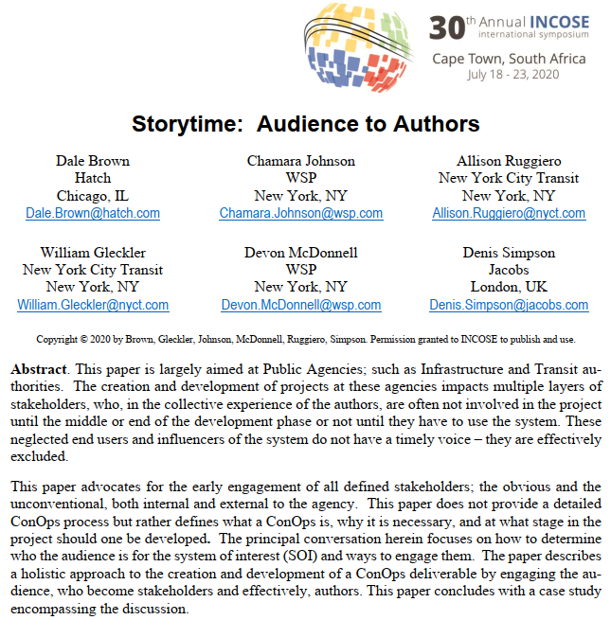
ConOps Development for D-B
One example of INCOSE references available to help guide in the preparation of a ConOps for your Agency (see also PMI)
Intention is to include pragmatic approach material from this paper into the APTA SLE Standard

Slide 30
Requirements Management for D-B
An intended feature of Design-Build is to improve accountability between the agency and supply chain.
Requirements Management can facilitate this, especially deploying traceability and configuration management of requirements.
Use a ‘single-source-of-truth’ set of requirements, configuration-controlled by the agency.
The entire supply chain shall use that single source of truth as a basis for all lifecycle processes.

Slide 31


Requirements Management for D-B
Design-Build ideally provides the supplier with concept level needs well-vetted by key agency stakeholders through ConOps and Stakeholder Requirements.
Unfortunately, some ‘design-build RFPs’ provide the supplier with RFP binders containing 10,000 requirements for a “COTS” system?
So… who is the actual designer??
(Hint – not the frustrated supplier)
10K Requirements likely conflicts with D-B approach & the intent of asking for a COTS-based solution!

Slide 32
Requirements Summary for D-B
Don’t overly constrain the design – write requirements based on the actual functions needed and the supporting ‘ilities’ such as RAM, Safety, Survivability and Security.
Training or re-training of requirements writers will be required! ISO29148 is a great resource along with the INCOSE Requirements Working Group publications
Less “hands on” of Design necessitates greater trust in supplier. Trust but verify. Accountability through Traceability, is key.
Single Source of Truth in requirements is critical – loss of configuration control could fail the project
Ideally start moving away from Document Centric to Data Centric culture for CDRLS and evidence for V&V.

Slide 33
Design-Build – Supplier Engagement
Consider alternative methods for selection of the D-B Prime or other suppliers of complex subsystems:
TEE = Technical Early Engagement – Active vs. passive approach (staffing?)
Design Competition (Mini-Project) – budget from 1% to 10%? - risk based decision
Analyze the results based on PERFORMANCE of each Supplier Team!
(Data driven decision vs. reading & scoring a paper proposal)

Slide 34
Design-Build – Supplier Engagement
Advantages – Technical Early Engagement
  More time to develop and refine Requirements/Architecture
  Competitors become involved in Requirements/Architecture reviews
    Higher overall program quality with expanded review expertise
    Selected candidate is well familiar with program by RFP issue point
      More accurate RFP quotations
      Shorter Bid analysis time
  Reliability growth starts earlier (i.e., with design competition)
  Accurate, objective final selection – i.e., based on supplier performance
  Significantly shorter overall program time possible
  Better supplier understanding minimizes “buffer costs” built into bids
Disadvantages
  More tasks operating concurrently – Need supporting roles to execute!!
  Infrastructure must be flexible enough to execute non-waterfall

Slide 35
Design-Build – Supplier Engagement
Concept:
Early Engagement supporting
Pre- Qualification

Slide 36
Design-Build – Supplier Engagement
Mitigating Risk - Solution Approach Scoring

Slide 37
Design-Build – Supplier Engagement
Mitigating Risk - Solution Approach Summary
SUMMARY :
Smallest area from the spider diagram represents the smallest estimated relative program risk overall
Waterfall + RFI represents the most risk as there is little return on investment from the extra program time / resources consumed
The combination of performing Technical Early Engagement (TEE) and running a Project Design Competition (PDC) presents the lowest relative risk based on the 6 dimensions used in the spider analysis
A significant risk exists in the area of providing staffing resources to support the TEE + PDC activities

Slide 38
Design-Build – Supplier Engagement
Preparing the RFP or REOI and evaluating Proposals using Respondent Data:

Slide 39
Design-Build – Organizational Readiness
Who is the actual designer? (scope discussions during ConOps) – Limit Solution Constraints
Agree how to select the supplier – e.g., data driven bid analysis, mini projects
Prepare ConOps – this is a non-trivial task – requires stakeholder buy-in and “patient capital”
Learn to write StRS – keep to hundreds or less! (i.e., not 10K)
Need support of key enabling Processes: RM, CM and QA
Without Configuration Control of Requirements, the RM Process will fail
Without support of QA, all processes will likely fail (human nature – shortcuts)
When RM fails – the project fails (ref: 80% Chaos Report)
All the above will represent change to the organization!
Use the Stakeholder Engagement processes mentioned in ConOps slides and the OCM concepts presented a few months ago to assure success in Organizational Change Management!

Slide 40
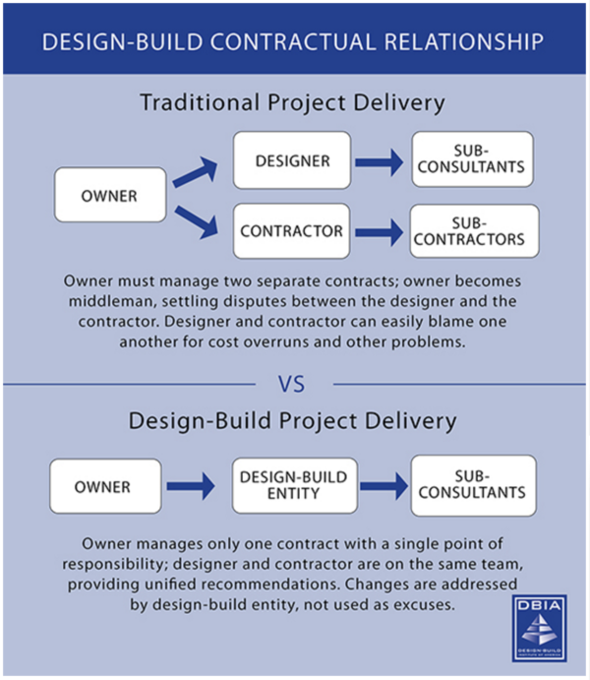
Project Delivery Methods Summary
Design Build removes much of the D-B-B incentive toward silo behaviors….it does not eliminate them.
D-B it is not a panacea
System Lifecycle Engineering with RM, V&V, CM, QA executing are still needed!

Slide 41
MTA Design Build Approach

Slide 42
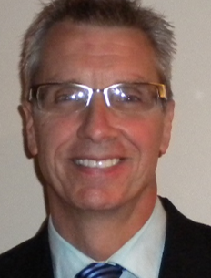
Design-Build Approach at MTA
Presenter 2:
William Gleckler – Principal Systems Engineer, MTA
Bill is a TWG Director at Large and provides mentoring and advice to the INCOSE Transportation Working Group membership
William Gleckler is the Principal Systems Engineer for the MTA Construction & Development (MTA C&D) business unit. After 18 years in the design and manufacturing of products and systems used in the automotive, defense and aerospace industry.
Bill joined the MTA-NYCT agency in 2003 to work in Subway Operations. In 2005, he joined the Capital Program Management Department as Deputy Commissioning Officer eventually transitioned into his current role within Systems Engineering.

Slide 43

Design-Build Approach at MTA
Presenter 3:
Allison Ruggiero - Systems Engineer for MTA Construction & Development.
Allison is Co-Chair of the INCOSE Transportation Working Group (TWG)
Allison joined the agency in 2013 after completing a M.S. in Systems Engineering from Johns Hopkins University.
Allison previously worked as a Project Manager for the NYC Fire Department, managing a portfolio of personnel accountability and safety-related communications capital projects.
Originally from New Mexico, Allison was a Packaging Design Engineer and Project Lead at Sandia National Laboratories for 7 years, During this time, Allison worked in the Organic Materials Department designing and building satellite sensor packaging, and later leading the effort to complete the Production builds.

Slide 44
MTA Construction & Development
Systems Engineering
Systems Engineering Practices on Design-Build Projects
May 20, 2021
William Gleckler, CSEP, MTA C&D
Principal Engineer - Systems Engineering
Allison Ruggiero, CSEP, MTA C&D
Administrative Staff Analyst – Systems Engineering

Slide 45
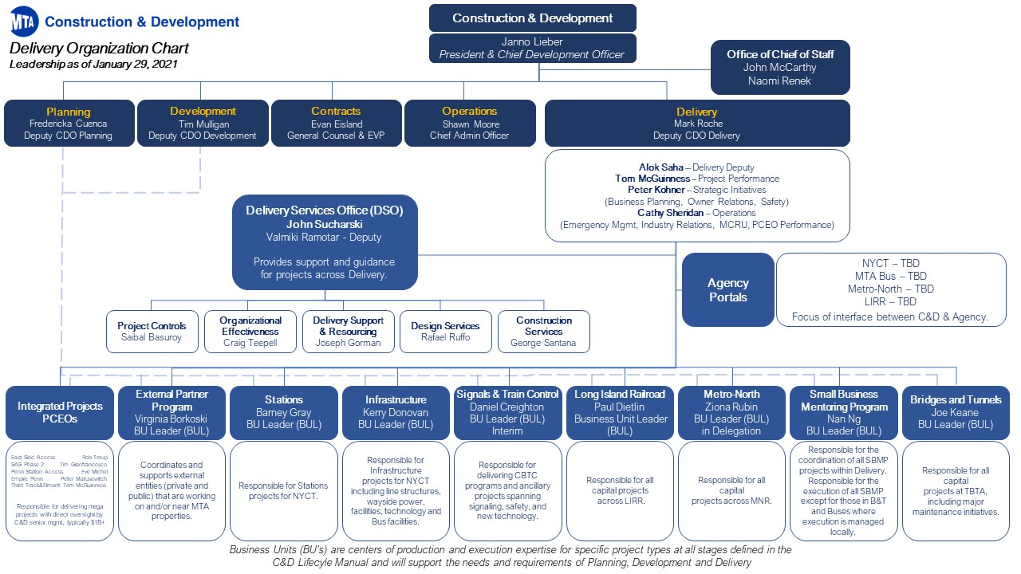
MTA C&D Organization Chart
Systems Engineering resides here
Systems Engineering practices to be applied across all program areas

Slide 46
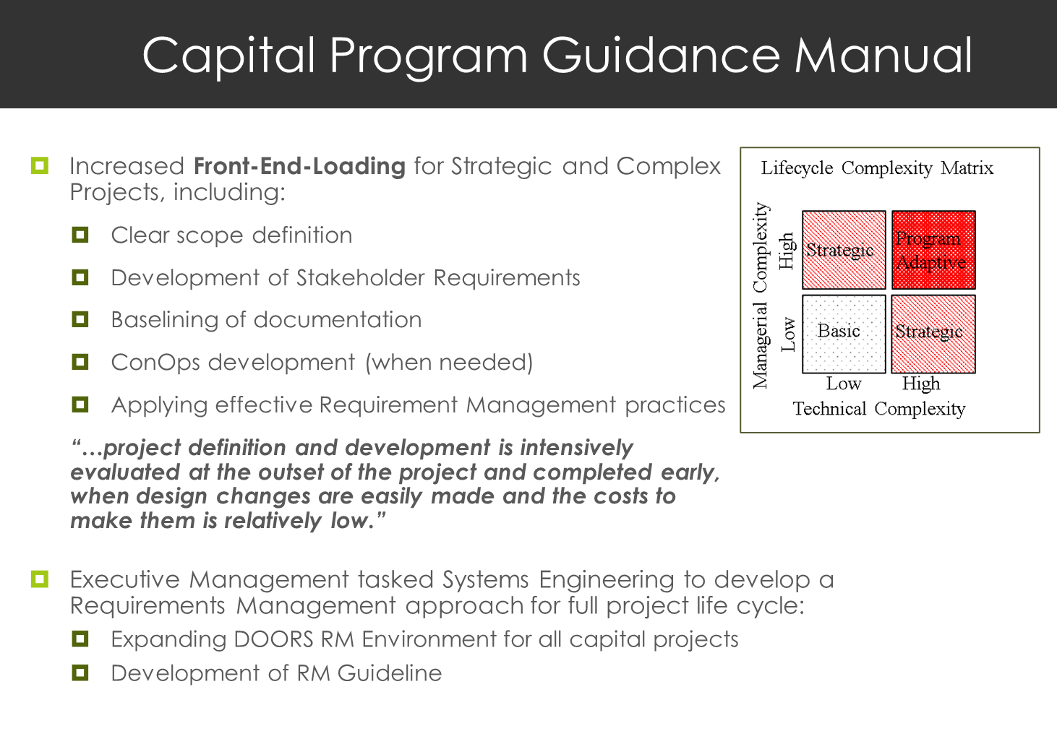

Slide 47
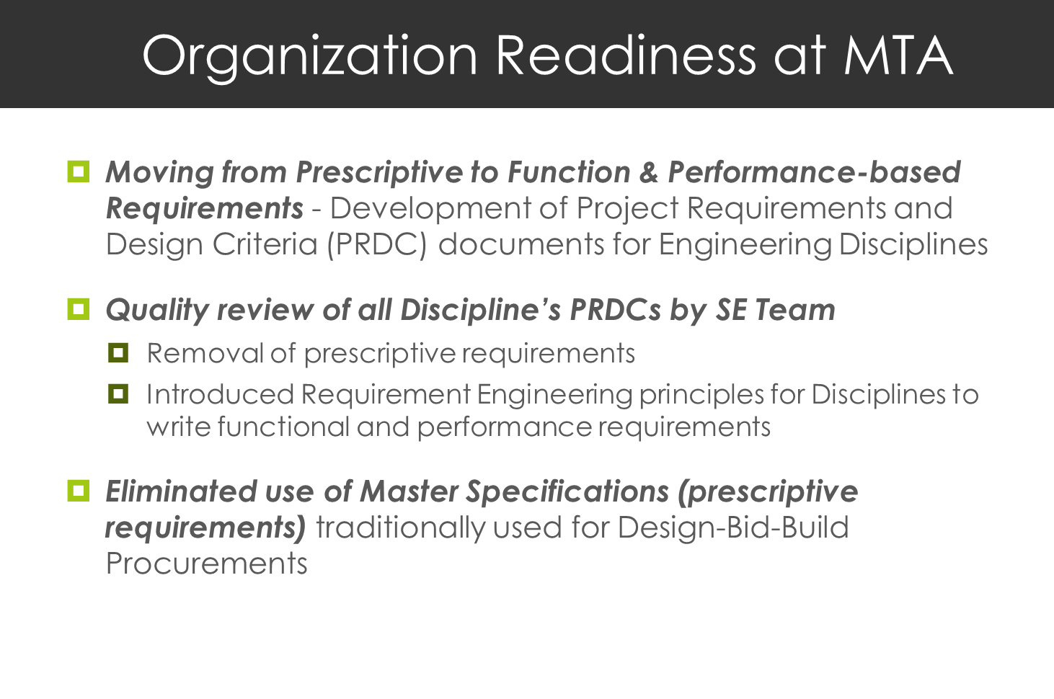

Slide 48
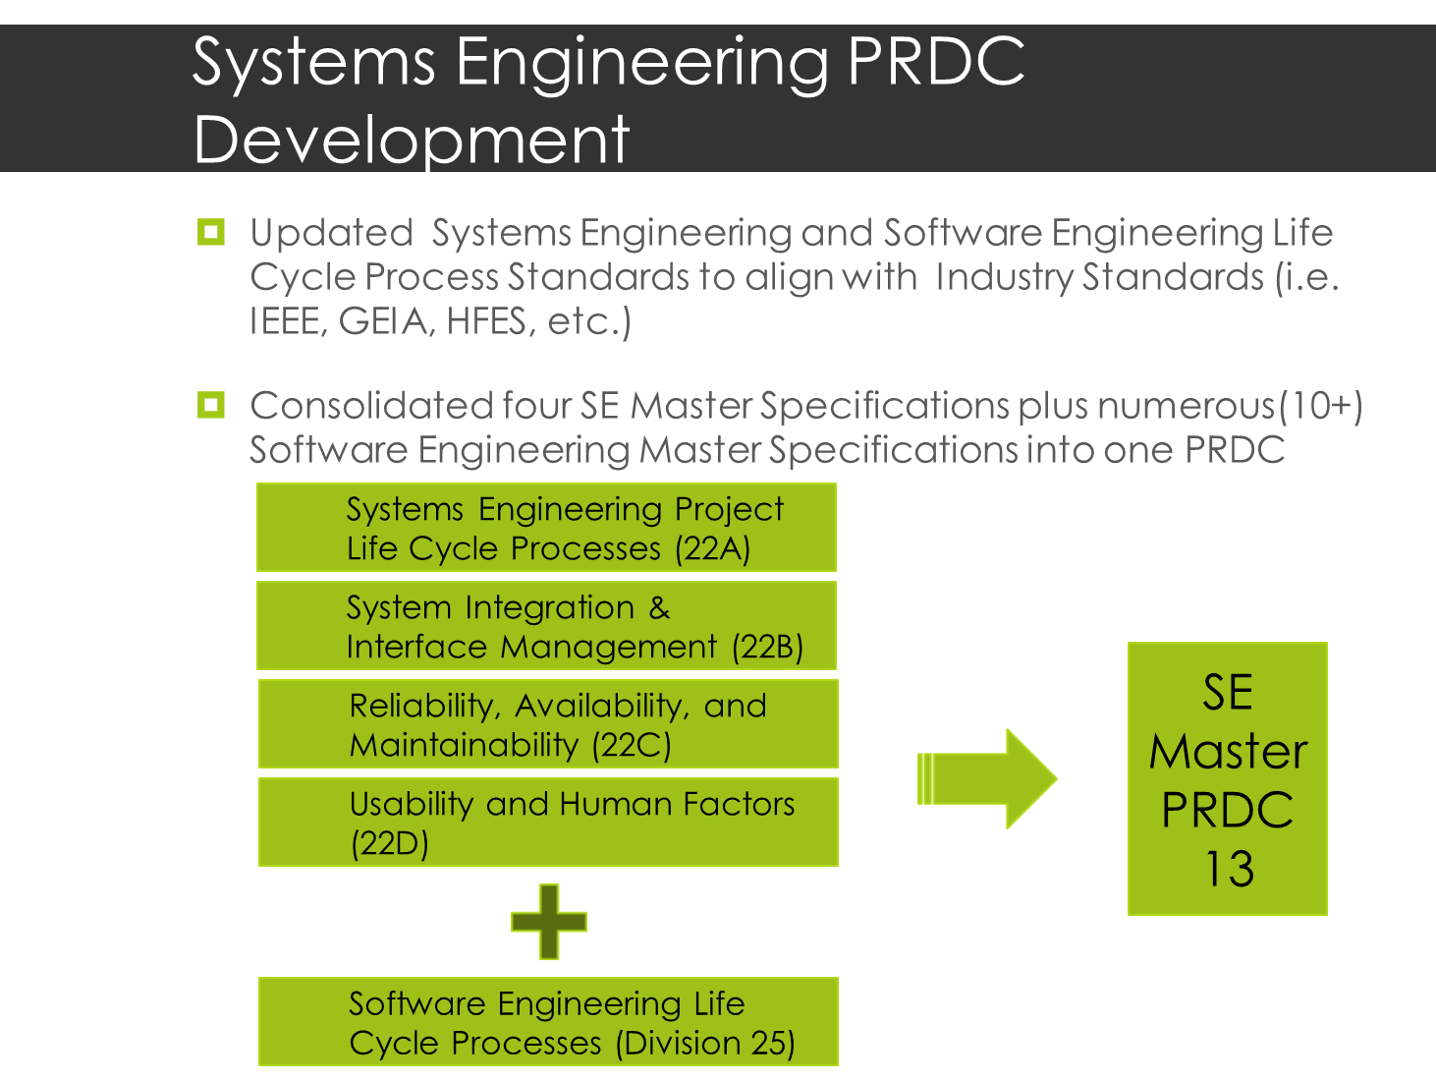

Slide 49
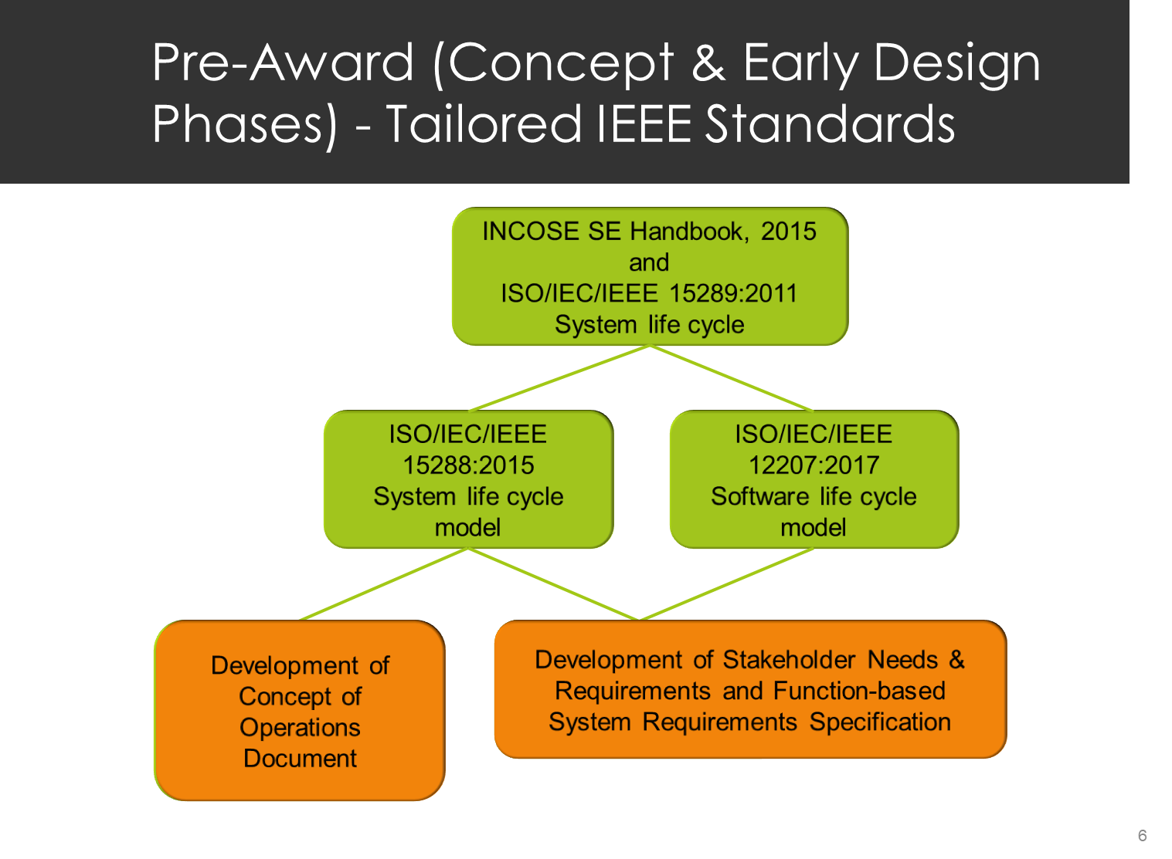
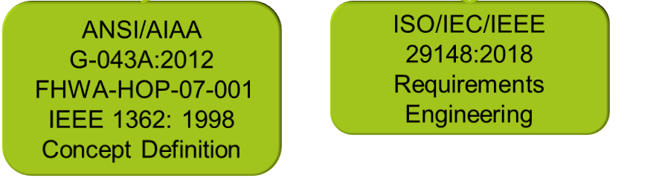

Slide 51
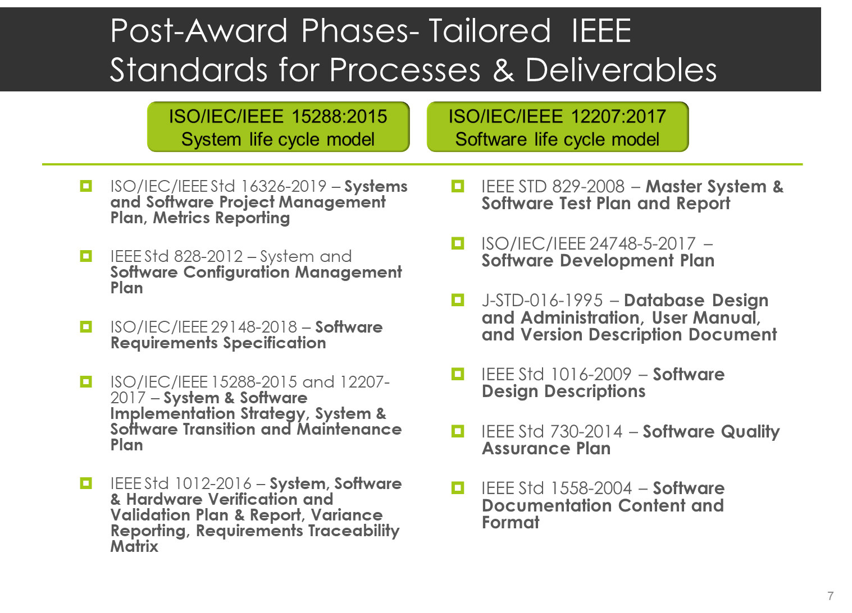

Slide 52
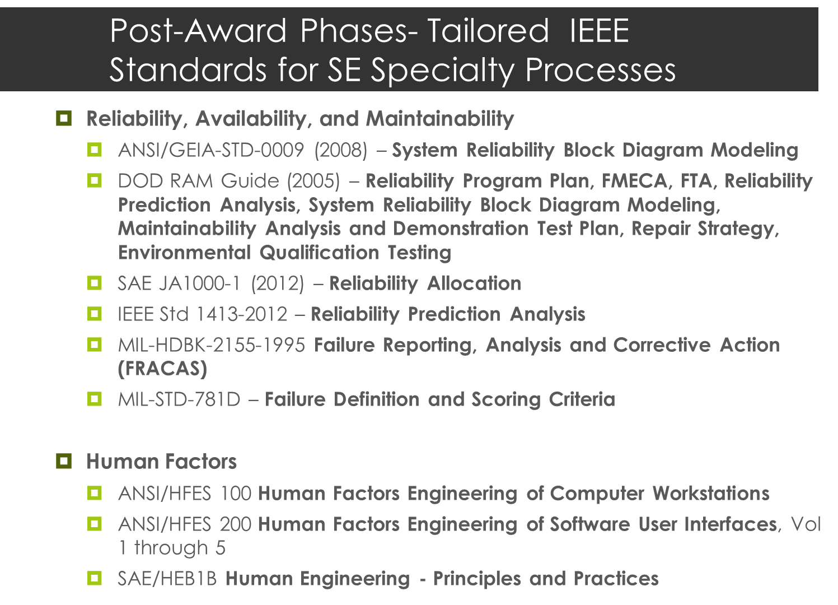

Slide 53
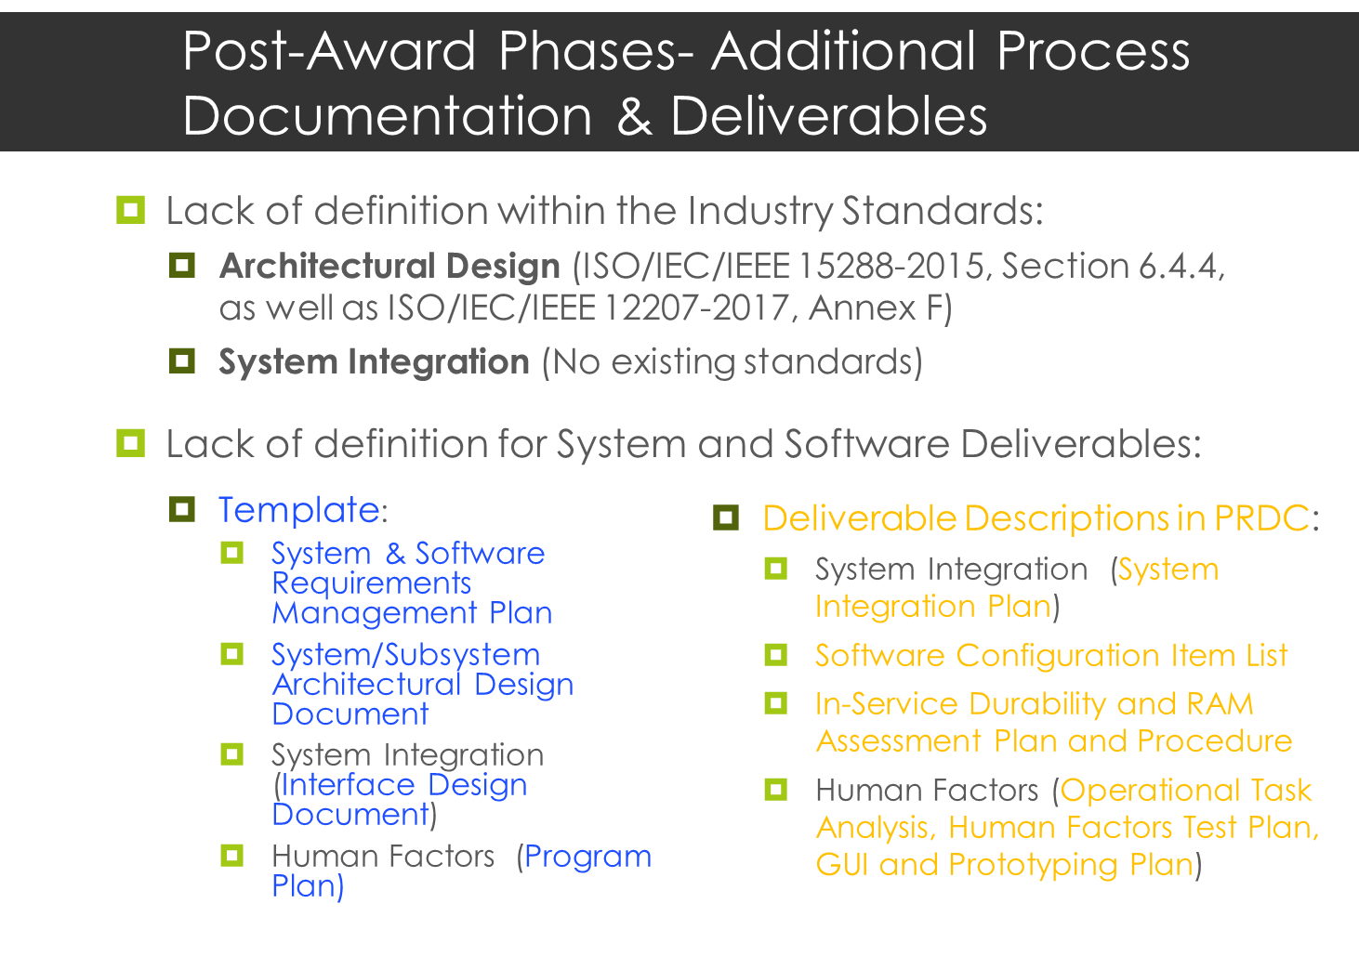

Slide 54
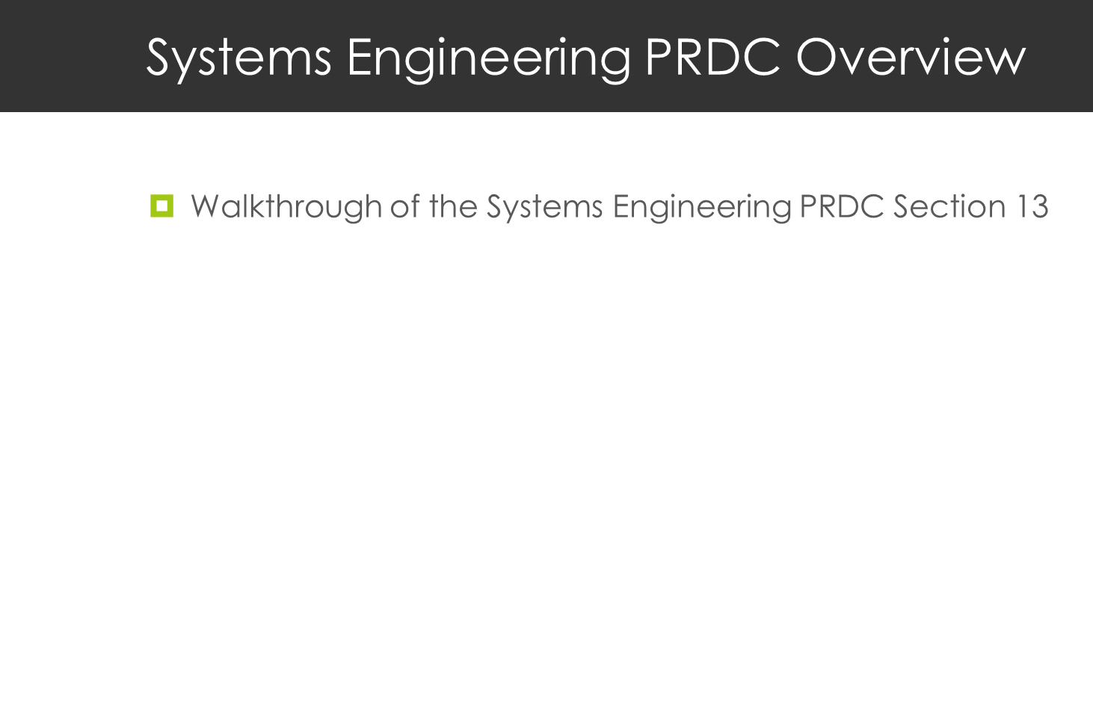

Slide 55
Candidate Section: Project Delivery Methods
Systems Lifecycle Engineering (SLE) APTA standard – Working Approach
5 work threads started in late 2018
Business Case Library being developed by a sub-team and will inform the Senior Leadership Team (SLT) promotional materials
Main Document Authoring meeting monthly and progressing on some chapters. This effort will inform the Training materials
MOU Signed between APTA & INCOSE Fall of 2020
We now want to include our RIG and INCOSE collaboration partners in this work effort!
Proposed: Combined APTA INCOSE Product

Slide 56
Wrap-Up
Thank You
Questions & Discussion

