Slide 1
Advanced Manufacturing, Digital Thread, and Industry 4.0
INCOSE DFW
Dr. Don A. Kinard
Senior Fellow

Slide 2
Agenda
Lockheed Martin Overview
The Digital Thread –
Phase 1 - The Beginning of the Digital Thread.
Phase 2 - Automation
Phase 3 - Taking it to the streets
Phase 4 - Tying the knot in the Digital Thread
Phase 5 - Industry 4.0

Slide 3
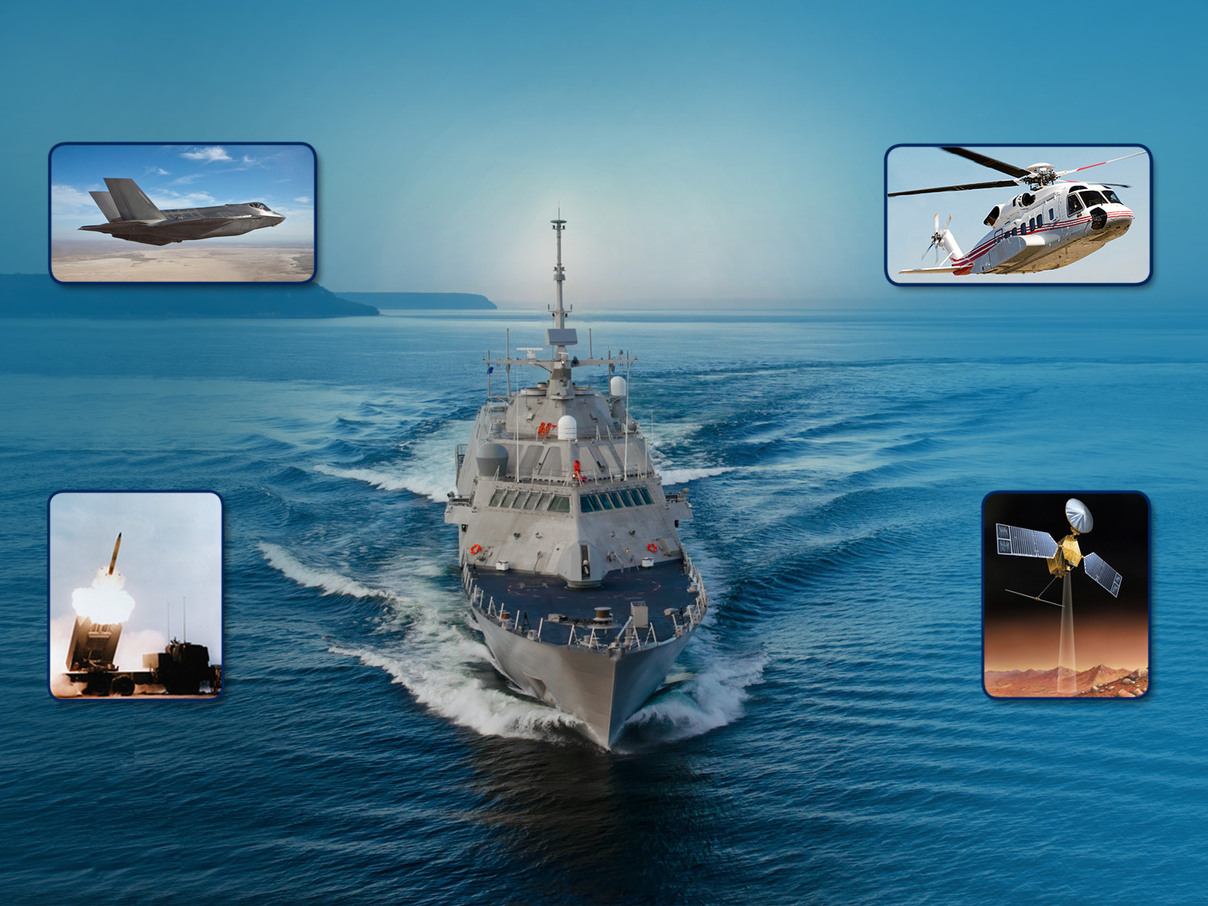
Lockheed Martin Corporation
AERONAUTICS
Tactical fighters
Tactical and strategic airlift
Advanced Development
ROTARY AND MISSION SYSTEMS
Maritime Solutions
Radar and Surveillance Systems
Aviation Systems and Rotorcraft Platforms
Training and Logistics Solution
MISSILES & FIRE CONTROL
Air and missile defense
Fire control and situational awareness
Nuclear systems and solutions
SPACE SYSTEMS
Surveillance and navigation
Global communications
Human space flight
Strategic and defensive systems
Copyright 2018, Lockheed Martin Corporation. All Rights Reserved.
Notes:
AER201705008 p2

Slide 4
Aeronautics Production Lines
F-35
11/mo Rate
400+ deliveries
C-130J
2/mo Rate
2500 deliveries (60 yrs)
F-16
Moved to Greenville SC
Line restarting this Fall
4500 deliveries (40 yrs)
Copyright 2018, Lockheed Martin Corporation. All rights reserved.
Notes:
AER201705008 p4

Slide 5
Sustainment Operations
F-22
F-16
C-130
C-5
P-3
U-2
Copyright 2018, Lockheed Martin Corporation. All rights reserved.
Notes:
AER201705008 p5

Slide 6
Phase 1 - The Digital Thread Beginning
Solid Models for Engineering and Tooling Began the Digital Thread
Notes:
AER201409013 – P18

Slide 7
Early Benefits and Lessons Learned
Benefits of the Digital Thread
Direct connection to suppliers and a common 3D digital design database
Seamless Production and Sustainment access to all released engineering.
Use of 3D models for integration and interfaces.
Huge reductions in engineering and tooling drawing changes from 3D exact solids.
Lessons Learned
Systems engineering required for data strategy and IT architecture
Standardization is important - Engineering, Planning, Tooling, Specifications, etc.
Static graphics are expensive to maintain for developmental programs
Focus on recurring downstream consumption and configuration management.

Slide 8
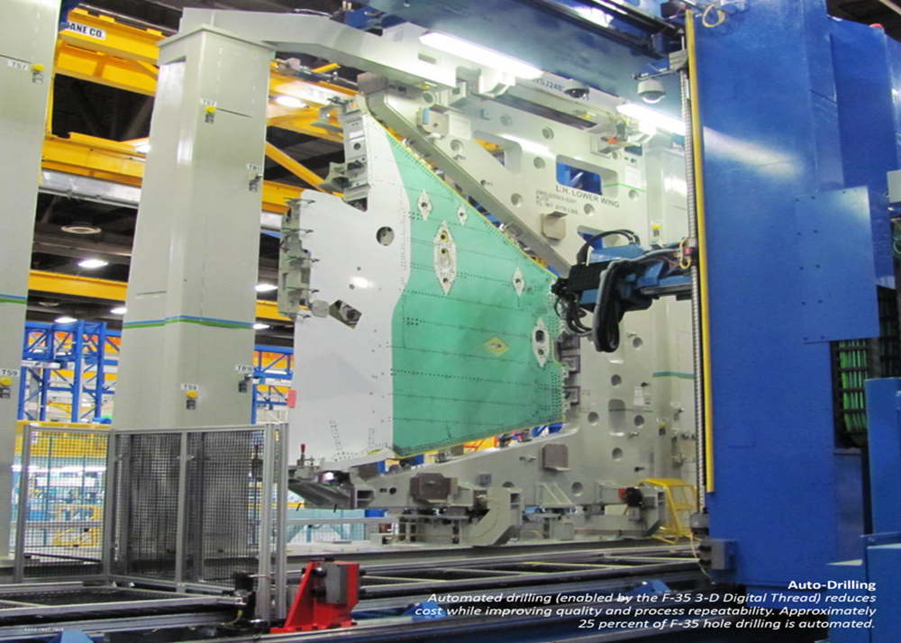
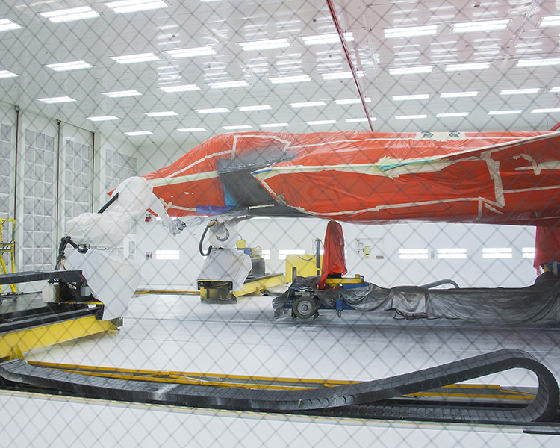
Phase 2 - Automation is Enabled by the Digital Thread
Data is Constructed to Enable Automation
Notes:
Finishes Photo
Autodrill photo from - AER201411026

Slide 9
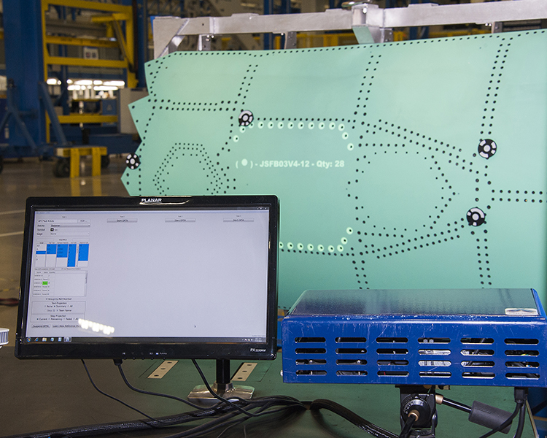
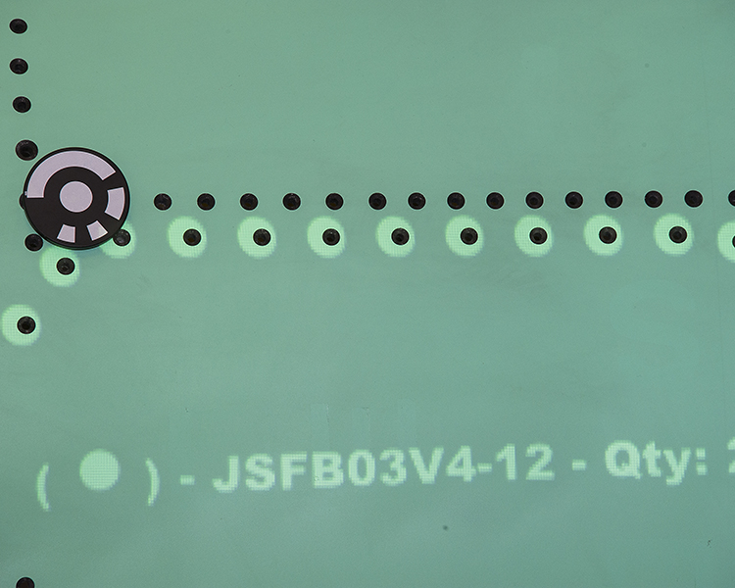
Phase 3 - Taking it to the Streets
Engineering Data is Projected onto the Work Surfaces
Notes:
Right figure - FP141411-0004PR.jpg
Left Figure – FP141411-003PR.jpg

Slide 10
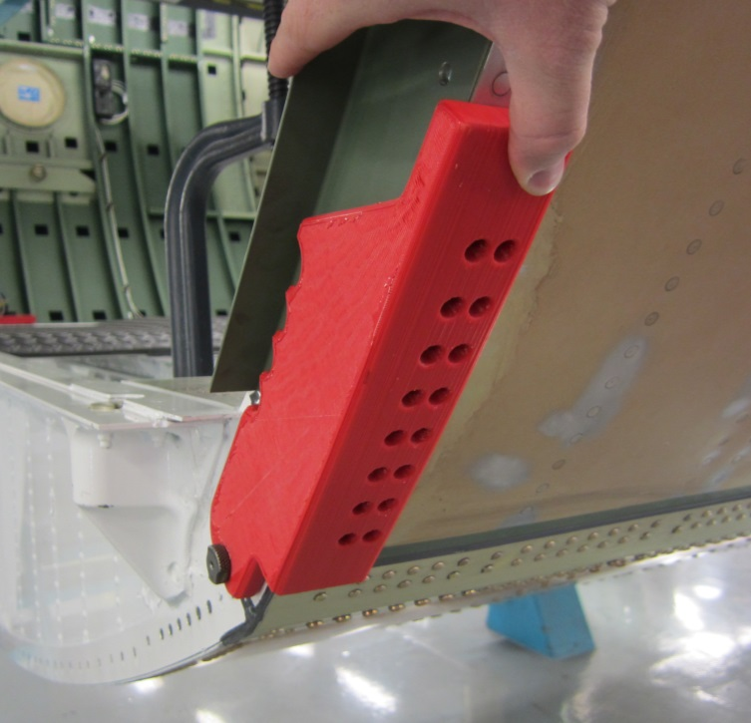
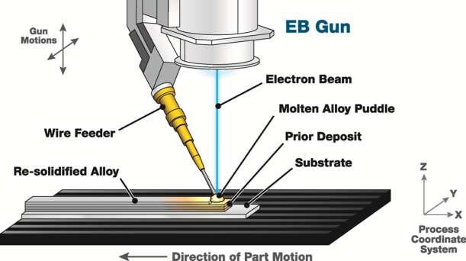
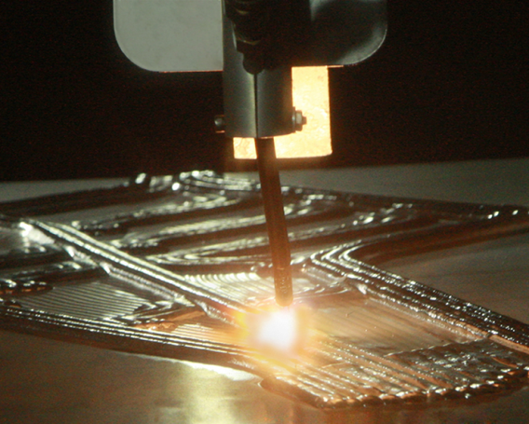
Additive Manufacturing Development
Notes:
Right hand side images AER201709030 p. 7
Left hand red tool image from AER 201504010 p.9

Slide 11
Augmented Reality
Notes:
PIRA # AER201708044 – P16

Slide 12
Remote Augmented Reality
Notes:
PIRA # AER201708044 – P12

Slide 13
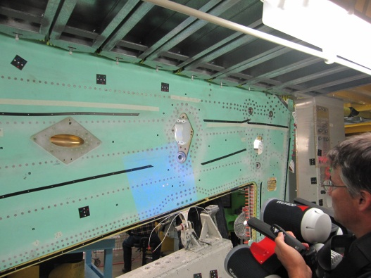
Phase 4 – Tying the Knot in the Digital Thread Non-Contact Metrology Applications Development
Virtual Opening Verification
Fastener Flushness Inspection
Seam Validation
Coating Thickness Inspection
Detail Part Validation
Notes:
AER201306001 p.2

Slide 14
Digital Thread Phases 1-4 Summary
Significant savings from the use of 3D solid models for BTP (build to package(models, drawings, tooling, work instructions) development.
Consumption of 3D data (drawings) by production still problematic. Optical/laser projection technologies continue to develop.
Alternate technologies include AR, tablets, direct 3D model and simulation access
Additive manufacturing for temporary tooling is proven. AM for support equipment and non critical applications maturing. Primary structure applications perhaps a decade away.
Automation opportunities depend on the volume of production, technology, and economic ground rules. Rise of the robots?
Validation of as-designed to as-built configuration is now possible and will soon be standard practice for at least first article parts, tools, and assemblies if not for real time monitoring of Production and Sustainment.

Slide 15
Phase 5 – Industry 4.0 The Revolution of Data

Slide 16
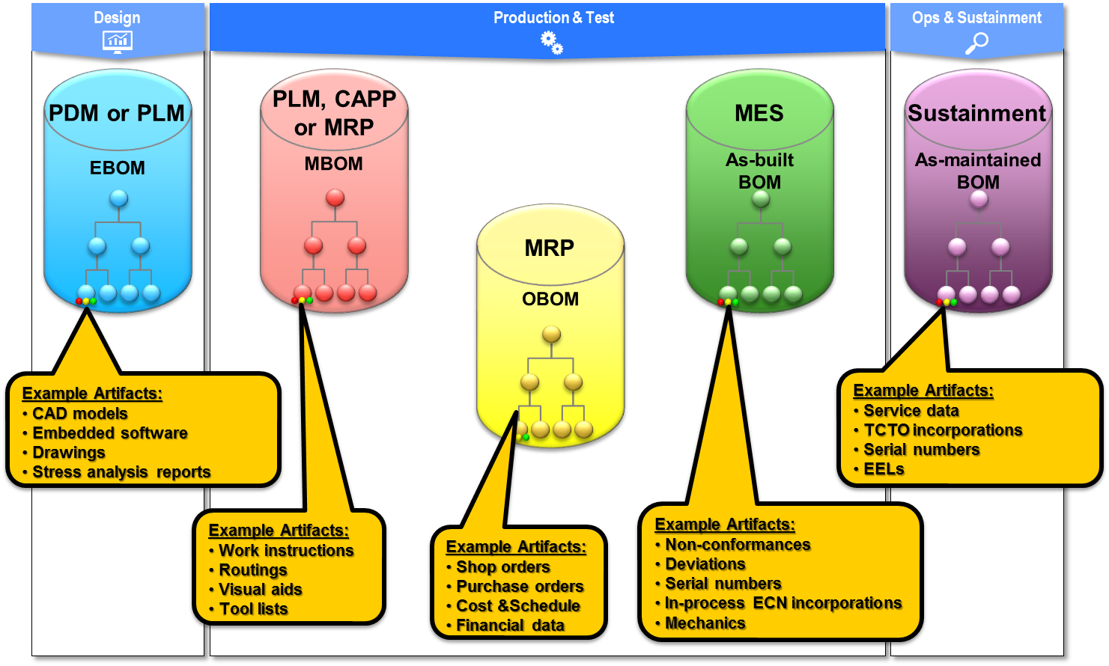
Enterprise Data Systems
Data is Often Functionally Silo’d and Not
Well Integrated for Enterprise Accessibility and Analysis
Notes:
New Cartoon

Slide 17
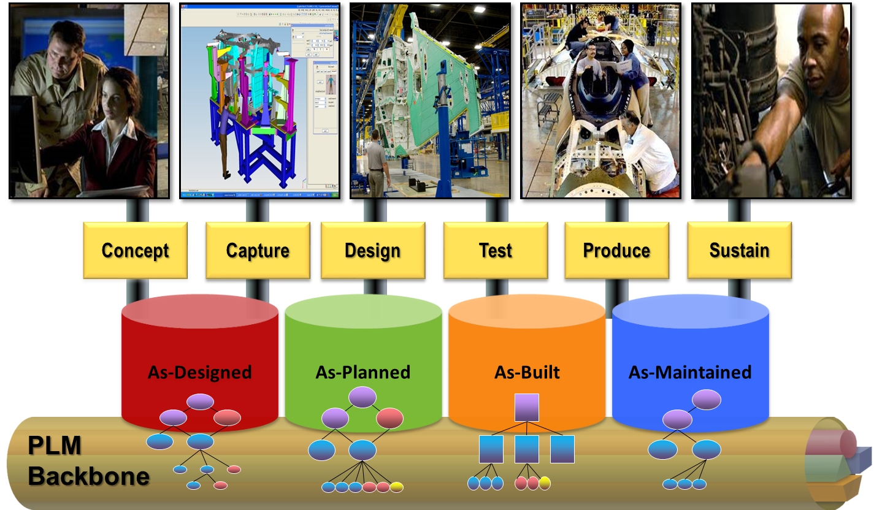
The BOM is the Golden Thread
Notes:
AER201109003 approved p.4

Slide 18
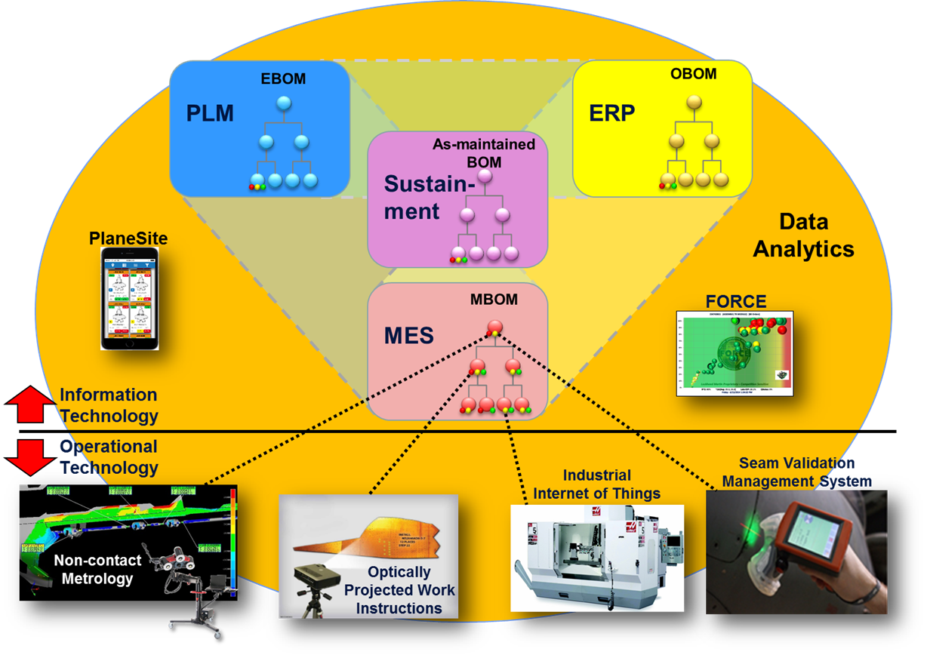
The Connected Enterprise – Industry 4.0
The Connected Enterprise Enables Automated Metrics, Financial Reporting, Data Analytics, Integration with Factory Equipment, and Real Time Management Visibility
Notes:
New Cartoon

Slide 19
The Future of the Digital Thread
Advance the Digital Thread for Product Development, Manufacturing, and Sustainment
Digital Twin, Automated Analysis, Cognitive Assistants, Robotics, Simulation, Augmented Reality, etc.
Apply systems engineering philosophy to integrate tools and seamlessly connect the enterprise systems (PLM, MES, SAP, Sustainment) – MBE/BOM is the Golden Thread
Embrace Industry 4.0 –
Descriptive Analytics - Desktop access to task level/program level performance that crosses functional boundaries and early warning alarm systems for future problems.
Predictive Analytics and Machine Learning – Analysis of future performance based on current performance and predicted future disruptions.
How Will We Design, Build, Sustain, and Manage the
Starship Enterprise?

