Slide 1
Some Practical Considerations for Systems Engineers in a Lean-Agile Airborne Weapons System Program
June 12, 2018
Ken Garlington
(kennie.e.garlington@lmco.com)

Slide 2
Introduction to Lean-Agile

Slide 3
What is Lean-Agile?
Historically, Agile thinking emphasizes four things
  Individuals and interactions over processes and tools
  Working products and services over comprehensive documentation
  Customer collaboration over contract negotiation
  Responding to change over following a plan
Lean thinking works well with Agile
  Customer value delivery not work accumulation
  Organizing by value streams not functional “stovepipes”
  Continuous flow not large batches of work in queues
  Mutual respect, trust and cooperation
  Drive for perfection not meeting a minimum standard
Lean-agile Has many implementations, but common principles
See: http://agilemanifesto.org/
See: INCOSE-TP-2003-002-04, INCOSE Systems Engineering Handbook (4th Edition), 2015, p. 206

Slide 4
Why use Lean-Agile?
Lean-Agile is typically used for projects where:
Requirements are dynamic
Activities are performed iteratively
Deliveries are frequent and in small increments
The goal is to provide customer value via frequent deliveries and feedback
Agile manages the risk of changing CUSTOMER requirements
See: Agile Practice Guide (Project Management Institute, 2017)

Slide 5
Why should Systems Engineers care?
Systems engineering principles (e.g. ISO/IEC/IEEE 15288) work with Lean-Agile
However, organizations that use predictive life cycle models (e.g. “waterfall”) may see issues in areas like:
  Technical reviews (decision gates) and related technical plans and work products
  Managing technical specifications
This talk shares what we’re doing for our military aircraft programs using Lean-Agile to address the issues we’ve seen so far
SOME ORGANIZATIONS MAY NEED TO ADAPT CURRENT PRACTICES FOR LEAN-AGILE
See: Vargas, et. al. “Is There Any Agility in Systems Engineering?” INCOSE Insight, December 2017

Slide 6
Technical Reviews

Slide 7
Concern: Technical Reviews and Small Batches
ASR
SRR
SFR
PDR
CDR
TRR
FCA
PRR
PCA
?
?
Demo and/or Deliver
Demo and/or Deliver
Demo and/or Deliver
Demo and/or Deliver
R
D
I
T
R
D
I
T
R
D
I
T
R
D
I
T
R
D
I
T
R
D
I
T
R
D
I
T
R
D
I
T
R
D
I
T
R
D
I
T
R
D
I
T
R
D
I
T
R
D
I
T
R
D
I
T
R
D
I
T
R
D
I
T
Concept Development/Architecture

Slide 8
Option: Implement Technical Review Intent
Intent (IEEE 15288.2): assess project by
  Establishing technical baseline
  Evaluating fitness for use
  Identifying and assessing risks
Make decisions using assessment
Agile demonstrations can meet intent
  Mix of “live” operation and supporting data
  Results used as input to plan adjustments
Review
Re-plan
Demo and/or Deliver
R
D
I
T
R
D
I
T
R
D
I
T
R
D
I
T
See: IEEE Std 15288.2™-2014, “IEEE Standard for Technical Reviews and Audits on Defense Programs”, 10 December 2014

Slide 9
Option: “Re-purpose” Technical Reviews (1/3)
Customer may require “traditional” reviews
  e.g. U.S. DoDI 5000.02 references PDR/CDR
Approach: Identify review priorities
  Risk (uncertainty) burndown
  End-user importance
  Critical event support (e.g. certification)
Assign values to work that reflect priorities
Establish thresholds as review entry criteria
“big batch” technical reviews can be supported in lean-agile if needed
See: U.S. Department of Defense Instruction 5000.02 Change 3, “Operation of the Defense Acquisition System,” 10 August 2017

Slide 10
Option: “Re-purpose” Technical Reviews (2/3)
Risk
Demo and/or Deliver
Risk
Demo and/or Deliver
Risk
Demo and/or Deliver
1
R
D
I
T
3
R
D
I
T
1
R
D
I
T
2
R
D
I
T
1
R
D
I
T
1
R
D
I
T
5
R
D
I
T
2
R
D
I
T
2
R
D
I
T
2
R
D
I
T
8
R
D
I
T
2
R
D
I
T

Slide 11
Option: “Re-purpose” Technical Reviews (3/3)
ASR
SRR
SFR
PDR
CDR
TRR
FCA
PRR
PCA
CDR Level
PDR Level

Slide 12
Backlogs and Specifications

Slide 13
Agile Backlogs
Epic
Feature
Story
Story
Feature
Story
Large Work Item*
Demonstration/ Delivery
Team
Used to plan and track work
Contains all the work that may be done by Agile organization
Decomposed to organizational elements (which may relate to product system architecture)
Decomposed to small-duration elements to maximize flow
Identifies stakeholder(s), need, and associated customer value
Contains “build-to” (acceptance) criteria
* Particularly for projects using Earned Value techniques, recommend aligning with Work Breakdown Structure (WBS)

Slide 14
Specification Tree
Spec
Spec
Spec
Spec
Spec
Spec
System
Sub-System
Item
Used to manage requirements
Decomposed using product system architecture (with some organizational considerations)
Implementation duration not typically driving criteria
Contains “build-to” (requirement/verification) criteria
Describes “as-built” (cumulative) configurations

Slide 15
Concern: Duplicate “Build-To” Criteria Causes Confusion
Option 1: Abandon specifications – might work, but…
  May need cumulative product-oriented requirements
  External certifications expect specifications
  Subcontractors may need specifications
  May be needed for technical data package
Option 2: Backlog references specs – can work, but…
  Specification criteria may not support small batches
  Different decomposition rules between two views
Option 3: Specs are “as-built” only – can work, but…
  Need to ensure spec update is part of “definition of done”
  Specification update processes must be highly efficient
  Different decomposition rules between two views
Agile backlogs and technical specifications MAY need to be harmonized

Slide 16
Roadmaps and Integrated Master Plans (IMPs)

Slide 17
Agile Roadmaps
Release 1
Feature
Feature
Release 2
Feature
Feature
Release 3
Feature
Feature Group
Program management tool
Top-level view of current and future work
References backlog for hierarchical description of related accomplishments and accomplishment criteria
Usually organized by events and/or time periods
Can be used as a basis for more detailed schedules

Slide 18
Possible Impacts of Lean-Agile to Integrated Master Plan
Concern 1: IMP events often tied to decision gates
  If technical reviews change, IMP will be affected
Concern 2: Backlog purpose/content overlaps with IMP
  Option: Don’t use IMP
  Option: Use IMP when part of project is “outside Agile”
  Option: Use IMP for early planning, backlog “cross-check”
Traditional integrated master plan (IMP) may require re-thinking for lean-agile
See: http://acqnotes.com/acqnote/careerfields/integrated-master-plan

Slide 19
Technical Performance Measures

Slide 20
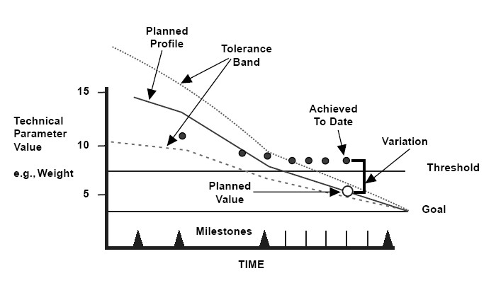
Concern: Technical Performance Measure (TPM) Milestones
Decision gate changes may affect TPM measurement frequency and associated presentation
Can use demonstration and/or release events as alternate basis for measurement frequency
Public domain image: https://commons.wikimedia.org/wiki/File:Technical_Performance_Measurement_Concept.jpg

Slide 21
Summary

Slide 22
Systems Engineers Should be Part of Lean-Agile Systems
All of the general principles, practices (and benefits) of good systems engineering still matter
However, some organization-specific life cycle models, techniques, and work products will likely need to be reconsidered if the benefits of Lean-Agile are to be realized
If your organization is implementing a Lean-Agile initiative, make sure you consider these effects
Many times, considering the purpose – the intent – of good SE practices helps uncover the best solutions
Lean-agile: more than a “software team thing”

