Slide 1
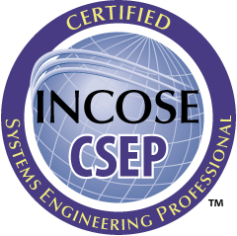
INCOSE Systems Engineering Professional (SEP) Program
TM The INCOSE SEP Logos are trademarks of INCOSE
© 2006-2016 International Council on Systems Engineering

Slide 2
INCOSE
International Council on Systems Engineering (INCOSE)
Mission
Vision
Not-for-profit membership organization founded to develop and disseminate the interdisciplinary principles and practices that enable the realization of successful systems
Share, promote and advance the best of systems engineering from across the globe for the benefit of humanity and the planet
The world's authority on Systems Engineering
Goals
Provide a focal point for dissemination of systems engineering knowledge.
Promote international collaboration in systems engineering practice, education, and research.
Assure the establishment of competitive, scale-able professional standards in the practice of systems engineering.
Improve the professional status of all persons engaged in the practice of systems engineering.
Encourage governmental and industrial support for research and educational programs that will improve the systems engineering process and its practice

Slide 3
INCOSE Certification
Multi-Level Base Credentials
Certification is a formal process whereby a community of knowledgeable, experienced, and skilled representatives of an organization, such as INCOSE, provides confirmation of an individual's competency (demonstrated knowledge, education, and experience) in a specified profession.
Certification differs from licensing in that licenses are permissions granted by a government entity for a person to practice within its regulatory boundaries.
Certification also differs from a "certificate" that documents the successful completion of a training or education program.
The credentials cover the breadth of systems engineering at increasing levels of leadership, accomplishments, and experience.
Senior Level
Foundation Level
Entry Level
For more information visit:
www.incose.org/educationcareers/certification/

Slide 4
Purpose and Benefits
The INCOSE SEP program has been developed as the highest quality, independent assessment of system engineering professionals benefiting:
Systems engineering community:
Creates the standard to identify and develop systems engineering professionals.
Establishes a formal, recognized body of knowledge for the systems engineering community.
System engineering professionals:
Provides a portable standard of recognition for attainment of knowledge, education, and experience.
Its recertification requirements serve as a mechanism for continued professional development.
Organizations/institutions:
A universal, industry-approved measure of a professional’s knowledge –achieved through the independent evaluation of relevant tasks, projects, and programs.

Slide 5
Why Certification is Important
For organizations…
Formally recognizes the Systems Engineering capabilities of your professional staff
Can provide a discriminator for your proposals
Can be used as part of the hiring and promotion process
Provides an independent external assessment
Encourages employee participation in continuing education
For individuals…
Formally recognizes your Systems Engineering capabilities
Provides a discriminator for job applicants
Provides a competitive advantage in your career
Provides a portable Systems Engineering designation that is recognized across industry domains
Participation in continuing education indicates your commitment to personal development

Slide 6
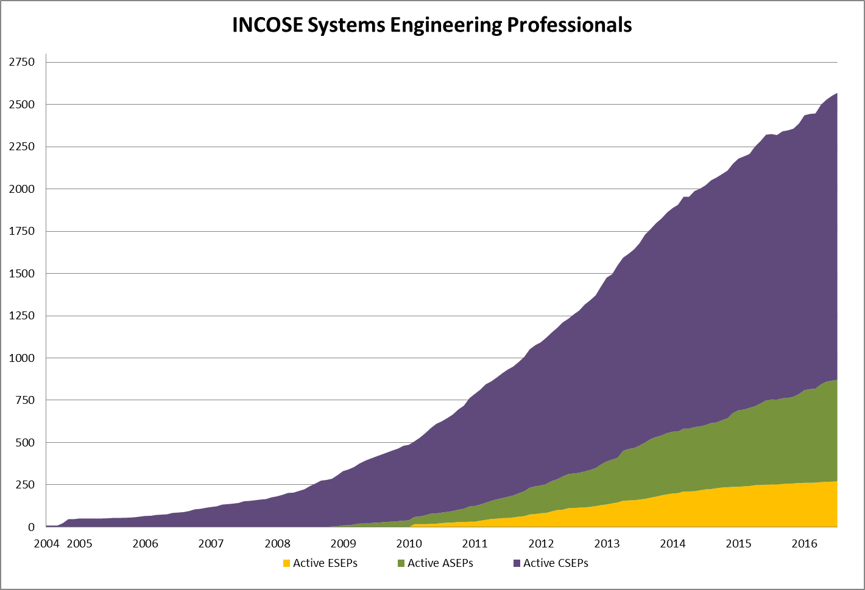
Counts
As of 31 July 2016:
2569 Total SEPs
1698 CSEPs
600 ASEPs
271 ESEPs
2387
INCOSE’s certification program continues to grow due to the increasing recognition of its value to professionals, to organizations/ institutions, and to the overall systems engineering community.
2180
1887
1476
1093
788
481
331

Slide 7
INCOSE Certification Requirements
Experience | Education | References | Exam | Renewal
None | None | None | CSEP exam | 5 years
At least 5 years SE | Technical Degree | 3 | CSEP exam | 3 years
25 years | Technical Degree | 3 | None, panel review | None

Slide 8
SE Experience Areas (1/2)
Requirements Engineering:
Risk and Opportunity Management:
Baseline Control:
Technical Planning:
Technical Effort Assessment:
analyze customer and stakeholder needs, generate/develop requirements, perform functional analyses, derive requirements, ensure requirements quality, allocate requirements, control requirements, maintain requirements database, develop and implement Requirements Management Plans, develop measures of effectiveness and performance.
develop and implement Risk and Opportunity Management Plans, identify risk issues and opportunities, assess risk issues and opportunities, prioritize risks and opportunities, develop and implement risk mitigation and opportunity achievement plans, track risk reduction and opportunity achievement activities.
develop and implement Configuration Management Plans, establish and update baselines for requirements and evolving configurations/products, establish and implement change control processes, maintain traceability of configurations, participate in Configuration Control Boards, participate in configuration item identification and status accounting, participate in functional and physical configuration audits.
identify program objectives and technical development strategy; prepare Systems Engineering Management Plans, Product Breakdown Structures, program Work Breakdown Structures, Integrated Master Plans, and Integrated Master Schedules; identify program metrics including product technical performance measures and key performance parameters, identify program resource needs in terms of equipment, facilities, and personnel capabilities.
collect, analyze, track, and report program metrics including product technical performance measures and key performance parameters; conduct audits and reviews; assess process and tool usage compliance; conduct capability assessments; recommend and implement process and product improvements.
Architecture/Design Development:
identify baseline and alternate candidate concepts and architectures, prepare Trade Study Plans, conduct and document trade studies, evaluate and optimize candidate concepts and architectures, prepare system/solution description documents.

Slide 9
SE Experience Areas (2/2)
Qualification, Verification, and Validation:
Process Definition:
Tool Support:
Training:
Systems Integration:
Quality Assurance:
Specialty Engineering:
Other:
develop and implement Qualification, Verification, and Validation Plans; develop verification requirements and pass/fail criteria; conduct and record results of qualification, verification, and validation efforts, and corrective actions; prepare requirements verification matrix and qualification certificates.
define enterprise processes and best practices, tailor enterprise processes for program/project applications.
specify requirements for, evaluate, select, acquire, and install SE computer programs/tools.
develop and implement Training Plans, develop and give training courses on processes and tools.
define technical integration strategy, develop Integration Plans, develop integration test scripts, develop and implement integration test scenarios, conduct and document integration tests, track integration test results and retest status.
develop and implement a Quality Assurance Plan, perform quality audits, report quality audits, define and track quality corrective actions.
develop and implement Specialty Plans as part of, or an addendum to, the Systems Engineering Management Plan to cover such specialties as reliability, maintainability, supportability, survivability, logistics support, security, safety, electromagnetic environmental effects, environmental engineering, packaging and handling, etc.
describe other functions that you have performed and can justify as system engineering activities

Slide 10
Certification Process
Pick the level that is right for you.
Apply
Maintain certification
Renew certification
ASEP
CSEP
ESEP
Extension
Application Form
Reference Forms
Fee
Education
Experience
Exam/Interview
Maintain individual, senior, or student INCOSE membership*
Earn Professional Development Units
Renewal Form
PDU log
Fee
5 yr cycle for ASEP
3 yr cycle for CSEP
Not required for ESEP
*CSEPs maintain membership if applied in 2016 or later. Note that CAB limited access accounts do not qualify as membership.

Slide 11
Certification Costs
 | Certification Name | Application Fee | Examination Fee | Renewal Fee (and Period) | Membership fee
Knowledge Level | ASEP | $150 | $80 | $100 (every 5 years) | $145 (yearly)
Transition | ASEP to CSEP | $200 | No exam required | N/A | N/A
Foundation Level | CSEP | $300 | $80 | $100 (every 3 years) | $145 (yearly)
Senior Level | ESEP | $550 | No exam required | No renewal required | $145 (yearly)
*INCOSE membership is required for all applicants starting in 2016. Membership is not required for renewal for CSEPs who paid their application fee before 1 January 2016.

Slide 12
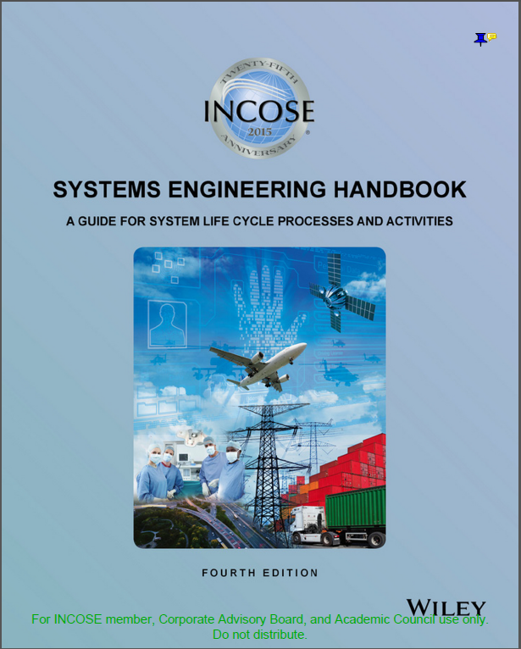
Exam
CSEP/ASEP Exam Basis
INCOSE SE Handbook 4th Edition July 2015
Free download available to INCOSE members
Exam is
2 hours in length
120 questions
Computer exam | Paper exam
Any Prometric location, any time | UTA June 17 9am-12pm
Pass/Fail results immediate | Pass/Fail results take up to a month
$80 | No exam fee
Must apply first | Can apply after exam

Slide 13
Exam Structure
100 scored items
20 additional unscored items
120 minutes (1 minute per question)
Pass/Fail
Multiple versions of the exam exist
Not all candidates will take the same version

Slide 14
Company Support
Contact your CAB representative for more info
IBM: Barclay Brown
L3: Keith Robinett
Lockheed Martin: Mike Yokell
No Magic Inc: Saulius Pavalkis
Raytheon: Kent Varnum
University of Texas at Dallas: Stephen Yurkovich

Slide 15
Ways to earn PDUs
Professional Development Activities | Units Earned | Maximum
Technical Society Participation Category
Be an INCOSE individual, senior, or student member | 5 PDU/year | 15 PDU
Attend Professional Technical Society local event/chapter presentation/exhibit | 1 PDU/hour | 30 PDU
Attend Professional Technical Society Conference/Symposium | 1 PDU/hour | 72 PDU
Participate on Professional Technical Society working groups, committees, etc | 1 PDU/hour of effort | No limit
Perform Leadership Role in Professional Technical Society at local, national or international level | 1 PDU/hour of effort | No limit
Volunteer activities with youth in schools or community related to science, technology, engineering, and math(STEM) | 1 PDU/hour of effort | 72 PDU
Volunteer activities with community, school, or non-profit organizations that help them accomplish their technical needs | 1 PDU/hour of effort | 30 PDU
Earn an SE-relevant, exam-based, professional certification other than INCOSE SEP | 5 PDU/certification | 10 PDU

Slide 16
Ways to earn PDUs
Professional Development Activities | Units Earned | Maximum
SE Course Work & Publication Category
Complete a technical graduate level course | 2 PDU/class hour | No limit
Attend educational course, tutorial, or seminar | 1 PDU/hour | No limit
Teach professional development coursework, including presentations not part of job function. | 2 PDU/hour (prep) 1 PDU/hour (teach) | 40 PDU
Write & publish SE article | 5 PDU/article | No limit
Write & publish SE book | 30 PDU (primary author)/book 10 PDU (contributing author)/book | No limit
Attend vendor presentation with educational value | 1 PDU/hour | 15 PDU
SE Job Function Participation Category
Receive Patent Award | 10 PDU/award | No limit
Serve as designated lead systems engineer for a system, product or service | 15 PDU/year | 45 PDU
Lead organization to increase INCOSE systems engineering certifications | 5 PDU/year | 15 PDU
Volunteer (i.e., non-compensated) | 1 PDU/hour of effort | 30 PDU

Slide 17
Preparation Resources
The INCOSE Training Working Group and the INCOSE Hampton Roads Area Chapter recorded free training webinars
INCOSE members and employees of INCOSE CAB organizations can access via INCOSE Connect https://connect.incose.org/Library/Tutorials/training/SitePages/Home.aspx,
scroll to SE Handbook V4.0 Tutorial, click on Tutorial ID: 01_October 2015, the Tutorial Session you want, and download the files
Tutorial consists of weekly 90-minute sessions
Shared documents include tutorial slides, questions, and audio and video recordings for downloading and using at your convenience
Most slides contain speaker notes

Slide 18
INCOSE Copyright Notice
Copyright © 2006-2016 by INCOSE, subject to the following restrictions:
Author Use. Authors have full rights to use their contributions in a totally unfettered way. Abstraction is permitted with credit to the source.
INCOSE Use. Permission to reproduce and use this document or parts thereof by members of INCOSE and to prepare derivative works from this document for INCOSE use is granted, with attribution to INCOSE and the original author(s) where practical, provided this copyright notice is included with all reproductions and derivative works.
External Use. This document may be shared or distributed to non-INCOSE third parties. Requests for permission to reproduce this document in whole are granted, provided it is not altered in any way. Requests for permission to prepare derivative works of this document for external and/or commercial use will be denied unless covered by other formal agreements with INCOSE. Copying, scanning, retyping, or any other form of reproduction of the content of whole pages or source documents is prohibited except as approved by the INCOSE Central Office, 7670 Opportunity Rd #220, San Diego, CA 92111.
Electronic Version Use. Any electronic version of this document is to be used for personal use only and is not to be placed on a non-INCOSE sponsored server for general use. Any additional use of these materials must have written approval from INCOSE Central.
Permissions. INCOSE has granted permission to member companies of the INCOSE Corporate Advisory Board to post and use this document internally, subject to the external use restriction.
Technical Data. This data was prepared by INCOSE for information only. It has been released by INCOSE as Technical Data. It is subject to change without notice and may not be referred to as an INCOSE Technical Product.
This briefing was created from information from various INCOSE sources as indicated in the Notes section of this slide. Send comments to certification@incose.org.
Notes:
This presentation was extracted and updated from:
The INCOSE Certification web site: http://www.incose.org/educationcareers/certification/
Certification Status Report, INCOSE IW & IS, Certification Program Manager, January/February & June/July 2006, 2007, 2008, 2009, 2010, 2011
Associate Systems Engineering Professional (ASEP) Certification: A Credential Tailored for Students and Junior Engineers, Steven Walter, CSEP & David Walden, CSEP 2010 Annual ASEE Conference & Exposition in Louisville, KY , June 2010
Leveraging Certification: Individually and for Your Organization, David Walden, CSEP, INCOSE North Star Chapter Presentation, January 2010
Certification of Systems Engineers, INCOSE-TD-2006-001-01, John Clark, CSEP and Karl Geist, CSEP, August 2007
INCOSE Certification of Systems Engineers, Certification Program Briefing for Chapters, CB0104, Karl C. Geist, CSEP, 9 Nov 2005 and CB0607, Karl C. Geist, CSEP, 6 Jun 2007
INCOSE Certification of Systems Engineers Program, Program Status Report, John Muehlbauer, CSEP, January 2007
New Member Introduction & Orientation, INCOSE IS 2006, Bruce Shelton, CSEP, 10 July 2006
Presentation to INCOSE IW06, Kenneth J. Kepchar, CSEP, 28 Jan 2006

