Slide 1
Converting from Document Based to Model Based Systems Engineering
A Real-Life Example
David Butler, Ryan Roy, Sean Conway
Presentation to Huntsville INCOSE MBSE WG
November 12, 2020
Notes:
16x9 Template_MasterPPT_2020_16x9_v3.potx

Slide 2
Background
Program history
  This MBSE effort was conducted on a DoD program that was approaching Milestone C
  Previous modeling was accomplished with System Architect (SA) Rational System Architect (RSA)
  No logical architecture was developed
  Modeling focused on data exchange
What we started with
  DOORS Requirements Database
  Use cases
  SA use cases and sequence diagrams at the MEI Level RSA sequence diagrams at the CSCI/SW Level
Program Entering MS C

Slide 3
MBSE Objectives
Objectives of the MBSE Effort
  Gradually transform from document based to model based
  Support transition to Agile development
  Support impact analyses to support system improvements and upgrades as well as Foreign Military Sales (FMS)
  Support system sustainment activities
MBSE is Key to Supporting Agile Development

Slide 4
MBSE Conversion Process
Re-created the system architecture in Cameo while maintaining legacy traces and information the best of our ability
Created a logical architecture
Converted sequence diagrams to functions/activities
  Custom script used
  Resulted in many duplicate functions and duplicate swim lane actors
Imported requirements and traces from DOORS
Began building activity diagrams from functions/activities derived from sequence diagrams
Began developing physical architecture, software and hardware libraries from existing artifacts and previous modeling efforts by the Government office
Allocated SW to HW to develop a configuration managed deployment model
Demonstrated model capabilities to team leads to gain their interest and support
Began training SE team and extending that training to specialty engineers
Training is the key to conversion

Slide 5
MBSE in Support of the Agile Process
As part of the DoD Agile Technical Insertion initiative, the program was designated among a number of high priority programs to adopt an agile development methodology to enable maturation of the system.
The prime contractor and the Army are partnering to prototype an Agile development process in order to build, test and field capabilities faster to respond to current and emerging needs.
Regular feedback among the team members and the customer is a core tenet of Agile methodology, which involves the delivery of products or capabilities in regular Program Increments (PIs). For this program, they are three-month PIs, comprised of three-week “sprints”.
Utilizing the Scaled Agile Framework (SAFe 5.0).
MBSE supports the Agile development process

Slide 6
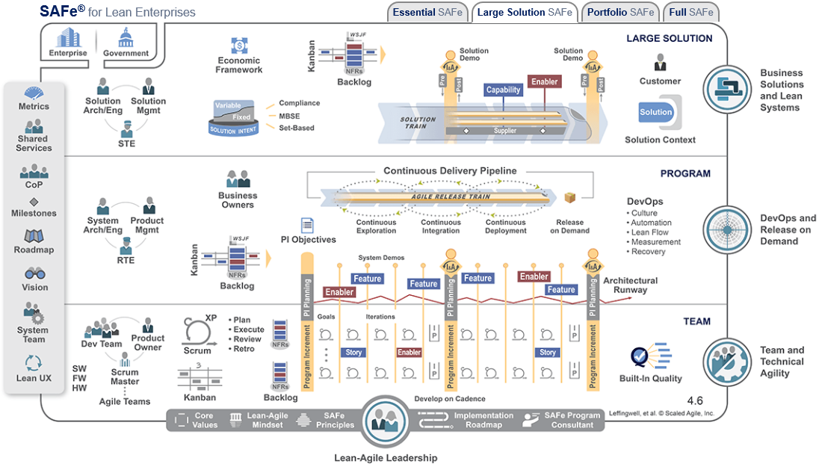
Scaled Agile Framework
System of Systems Processes and Products
Program Processes and Products

Slide 7
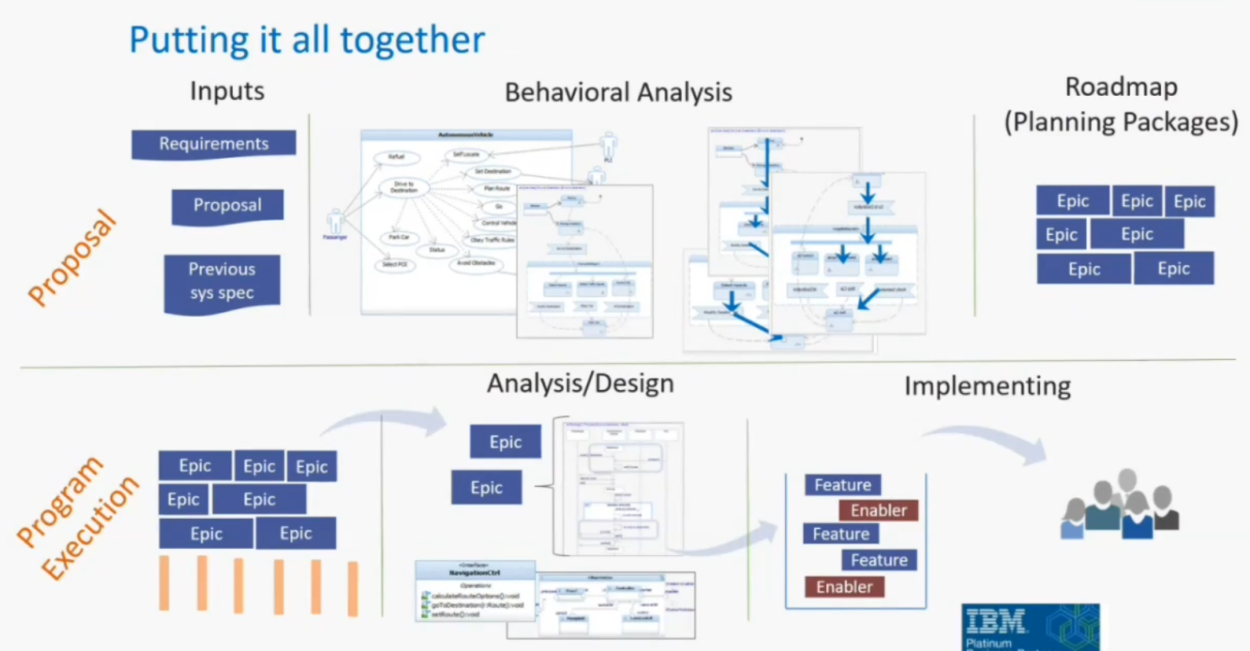
Scaled Agile Framework

Slide 8
Process to be executed for each Program Increment
IMPLEMENTATION
Define Goals
Prior to PI Planning Event
Identify Model Backlog Items
ANALYSIS
Specify Black Box Behavioral Flow for Each Goal
Complete Traces
System/PIDS level activity diagrams
Complete Model Artifacts
Identify Interactions and Perform Impact Analysis
Ensure system context supports activities/flows
BDDs and IBDs for each flow
Identify/Specify Component Interfaces
Specify White Box Behavioral Flow and Allocate Behavior
DESIGN
SRS level activity diagrams

Slide 9
Scaled Agile Framework Process Execution (1 of 2)
Define Goals
  Identify areas to be developed or modified
  Review/develop system level or enterprise level flows/threads
  Identify supporting diagrams to be developed
  Capture the feature in a model element
Analysis
  Develop/modify System and/or PIDS level activity diagrams
  Identify interface requirements/changes
  Perform analysis to find impacts to system and requirements
  Capture the story as a model element with traceability to the feature

Slide 10
Scaled Agile Framework Process Execution (1 of 2)
Design
  Develop white box (SRS level) activity diagrams
  Specify interfaces with BDDs and IBDs (OOSEM process). Defines interaction between logical components to realize each system action or operation
  Actions from activity diagrams are captured as allocated activities or operations; logical interfaces can be captured as component ports; persistent stores captured as store properties; performance properties captured as value properties of the block, or properties of the activity allocated to the block
  Define logical component state machine
  Model test cases with sequence and activity diagrams
  Capture verification objectives with traceability to story and existing requirements if applicable
Implementation
  Complete model artifacts to support the increment
  Capture verification results
  Identify model backlog items
  Branch models

Slide 11
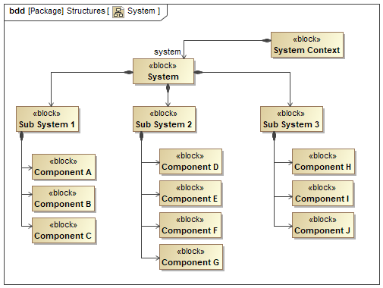
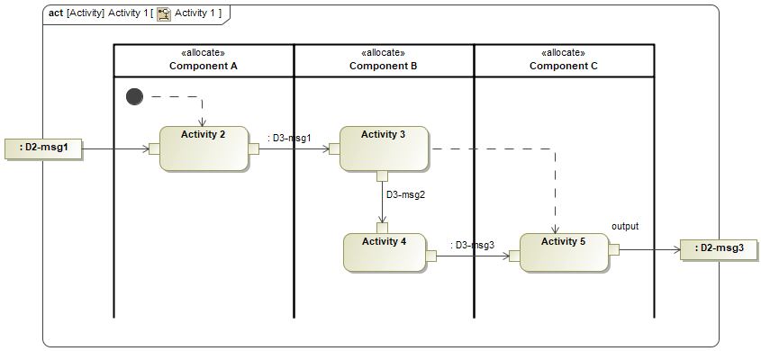
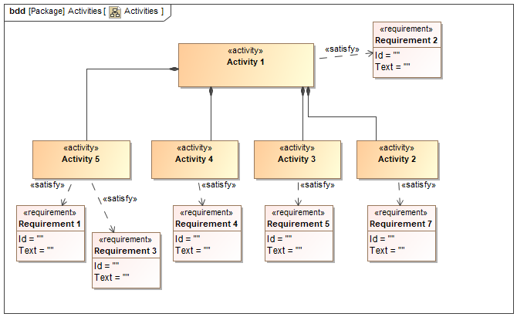
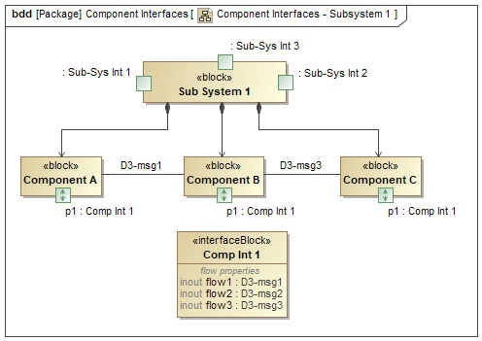
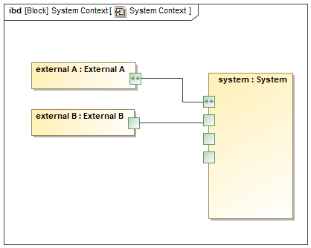
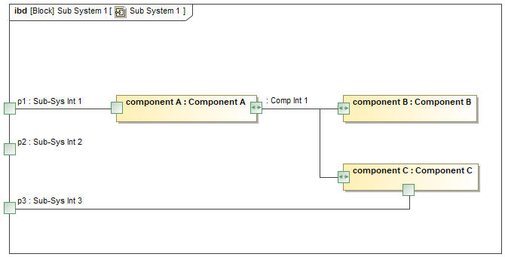
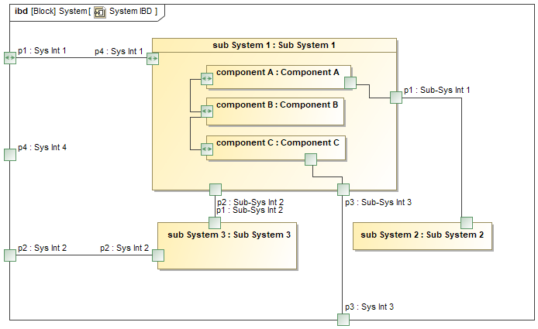
Modeling Pattern
Define Logical Decomposition
Functional hierarchy and requirements allocation
Activity/sequence diagrams to specify mission threads
Establish flows between part property and port
System context for the current thread
Define flows between logical performers
Specify interaction between logical performers

Slide 12
Challenges
Culture change
  It is difficult to break old habits
  Getting past the “This is the way we have always done it”
  Culture change takes time
  Lack of existing SE practices and processes
Training personnel
  Training should start with top-level management to get their buy-in to the process
  Training should go beyond tool usage and language mastery and include how to use the tool to perform systems engineering
Program currently at Milestone C
  With the program transitioning into production and fielding, the focus is shifted away from architecture and design
Inability to break model into components due to read-only limitations
  Cannot properly establish relationships with read-only projects leading to development of one comprehensive model
  Breaks the SysML modeling paradigm – limits usefulness of the language
  May cause problems due to project size
Lack of SE knowledge and processes makes transition more difficult

Slide 13
Path Ahead
Continue building out the model
  Develop system logical architecture
  Initial focus is on behavior model
    Continue development of activity diagrams and complete the functional architecture
    Modeling of the states and modes
  Gain help from hardware and network teams in populating the model
  Focus on deliverables that can be generated by the model
    The drives which elements are populated first
  Leverage Northrop-Grumman MBSE libraries and templates where applicable
Nurture MBSE culture
  Continue to drive the culture change through continuous training and demonstration of usefulness
  Demonstrate how the model can be used in daily activities and to produce program deliverables
Use the model to support impact analyses to support system upgrades and for maintaining fielded configurations
Use model to support Foreign Military Sales configurations
  The model enables development of various configurations
  Use the model to identify exportable/non-exportable components

Slide 14
Conclusion and Takeaways
MBSE being implemented into existing DoD program
MBSE being used to support Agile development process
MBSE requires adequate training and culture change
Training should begin with leadership who can then drive the effort and assist in culture change as opposed to hindering it
Sound systems engineering knowledge, practices, and processes are required to implement MBSE

