Slide 1
INCOSE Texas Gulf Coast Chapter (TGCC) February 2022 Monthly Meeting
February 17, 2022

Slide 2
Agenda
New Members January and February 2022
INCOSE International Workshop (IW) 2022 Key Takeaways
Upcoming Membership Event
INCOSE at Offshore Technology Conference (OTC)
INCOSE TGCC Yammer for Chapter Members
Introduction Speaker for February 2022 (Ed Leggott/Siemens)

Slide 3
New Members
6 New Members in January 2022
Derek Summers, Chad Reynolds, Lauren Maples, Levi Grinestaff, Rene Julien, Kirsten Van Rens
4 New Members in February 2022
Garrett Speed, Chris Hartwig, Peter Mbua, Enoch Capps

Slide 4
IW 2022 Key Takeaways
For digital transformation, it takes twice as long and twice as much money to implement due to cultural readiness
Univ. of Michigan is changing the way systems engineering is being taught by incorporating systems engineering principles and tools in group projects
Good series of MBSE talks at IW 2022, presentations at https://www.omgwiki.org/MBSE
Digital engineering (DE) is coming...but it's hard and will take some time
Additionally, implementations of DE will vary from program to program and project to project
DE will not be a tool you install and suddenly you have insight into everything, and all the tools are talking
Instead, DE is going to include purpose-built connections and viewpoints that will be different based on the needs of each program and product, or at least at first until we learn how to operationalize it
DoD seems to be leading the way
CAD is not called Model Based Mechanical Engineering, MBSE should just be called Systems Engineering
SE Vision 2035 is out and it's awesome - put it on your must-read list: https://www.incose.org/about-systems-engineering/se-vision-2035

Slide 5
IW 2022 Key Takeaways
Would be great for chapter members to volunteer to join and help various working groups to help refine and develop SE capabilities. 47 total (INCOSE Connect site)
Digital Engineering Information Exchange WG (DEIXWG)
Working on digital interfaces/standardization of data fields between a wide range of MBSE and Design Tools
Digital models, items, and other things from SE tools such as MBSE, digital requirements, MATLAB models, CAMEO models
System of Systems Working Group
Discussing Systems of Systems and Complexity in SE
Complex Systems Working Group
Working to enhance the ability of the SE community to deal with complexity
Current topics on Emergence in Complex Systems
Small Business Systems Engineering (SBSE)
Used to be Very Small Business Systems Engineering. Expanded to include large but still small businesses
Working on Kits that small businesses can use to apply good PM and SE practices, which conforms to ISO standard profiles in 29110
Requirements Working Group
Needs, Requirements, Verification & Validation, Life Cycle Manual (NRVVLM) Published
Working on companion products
Looking for volunteer chairs and helpers
Project Management – System Engineering Working Group (PM-SE WG)
Explores the linkages necessary to create effective integration and collaboration between SEs and PMs
Be the interface point where SEs and PMs can collaborate
PMI representation in the WG

Slide 6
IW 2022 Key Takeaways
LA Chapter presented low cost equipment to host hybrid meetings
LA chapter performed trade study on equipment needed for Hybrid Chapter Meetings
Less than $1000
Easy to setup
Provided draft instructions, purchase list
TGCC may want to adopt this. Allows flexibility for people to attend remotely and maintain opportunity for face to face networking

Slide 7
Upcoming Membership Event
Membership Survey sent out on 2/14
Membership event: March 2nd from 12pm to 1pm Central via Zoom
Invite your colleagues and friends to learn about INCOSE!
Introduction To INCOSE and The Benefits of Membership with Tony Williams
New Needs, Requirements, Verification & Validation, Life Cycle Manual with Lou Wheatcraft
New SE Vision 2035 with Garry Roedler
Zoom RSVP: https://us02web.zoom.us/meeting/register/tZErd-yurj0qH9RQzM4CVTLZmTZo3XagF2tP

Slide 8
INCOSE at OTC
Date: May 2 to May 5, 2022
Will have a booth at OTC
Will be asking for member volunteers to man the booth soon

Slide 9
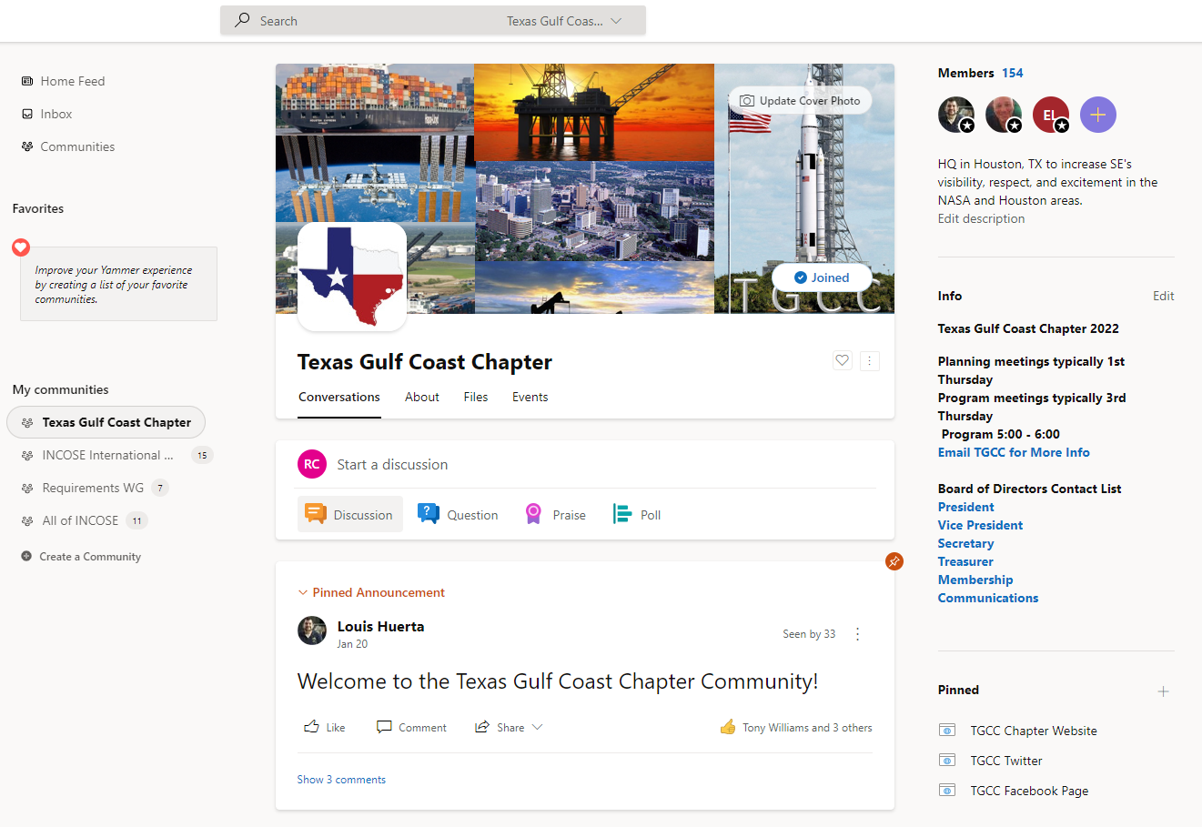
INCOSE TGCC Yammer for Chapter Members
All TGCC members have an incose.buzz account for the INCOSE TGCC Yammer site
Mainly for TGCC wide information
Will post TGCC activities
https://web.yammer.com/main/groups/eyJfdHlwZSI6Ikdyb3VwIiwiaWQiOiI5MjY0NDEzOTAwOCJ9/all

Slide 10
Resources
Chapter Information
https://www.incose.org/incose-member-resources/chapters-groups/ChapterSites/texas-gulf-coast/chapter-home
LinkedIn https://www.linkedin.com/groups/3790414/
Facebook https://www.facebook.com/groups/tgccincose
Twitter https://twitter.com/tgcc_incose
Any chapter questions or suggestions for future speakers
Email tgcc.incose@outlook.com
INCOSE Homepage
https://www.incose.org/

Slide 11
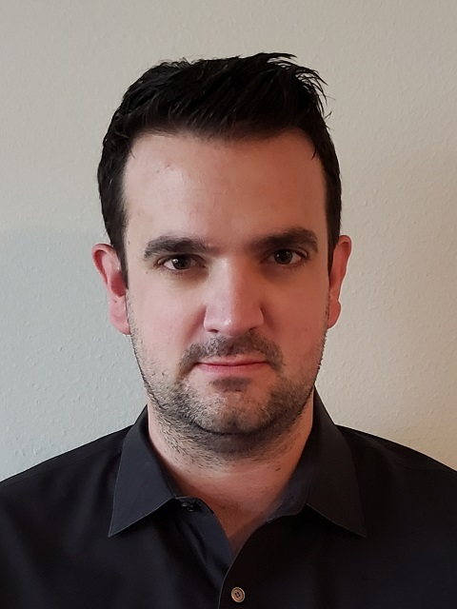
Speaker Introduction Ed Leggott/Siemens
Title: Digital Trends in the Oil and Gas Industry
Ed Leggott is a Systems Engineer with over 10 years industry experience from both Oil & Gas and Aerospace.
Ed has held multiple project, engineering management and digital initiative responsibilities before joining Siemens in 2019 with the US Presales team.
Today Ed supports the largest Energy accounts as a trusted advisor to help business teams understand bigger picture concepts and digital maturity as they embark on their digitalization journey.

Slide 12
Back up

