Slide 1
INCOSE Texas Gulf Coast Chapter (TGCC) April 2022 Monthly Meeting
April 21, 2022

Slide 2
Agenda
New Members March/April 2022
MagicDraw Tutorial This Saturday
INCOSE at Offshore Technology Conference (OTC)
Introduction Speaker for April 2022 (Don Gelosh/WPI)

Slide 3
New Members
3 New Members in March/April 2022
Matthew Jackson, Darisha Vidrine and Sao-Dung Lu

Slide 4
MagicDraw Tutorial 4/23
MagicDraw Tutorial by Jason Wilson of Dassault Systemes
Saturday, 4/23 from 9am to 1pm
Registration is closed
If you are interested in a future MagicDraw tutorial, please email tgcc.incose@outlook.com.
If there is enough interest, we can hold another tutorial

Slide 5
INCOSE at Offshore Technology Conference (OTC)
Offshore Technology Conference | OTC 2022 | 2-5 May 2022 (otcnet.org)
OTC booth number 353
2022 Offshore Technology Conference - Event Map (otcnet.org)
May 2 to May 5
Hours: 9am to 5pm

Slide 6
Resources
Chapter Information
https://www.incose.org/incose-member-resources/chapters-groups/ChapterSites/texas-gulf-coast/chapter-home
LinkedIn https://www.linkedin.com/groups/3790414/
Facebook https://www.facebook.com/groups/tgccincose
Twitter https://twitter.com/tgcc_incose
Any chapter questions or suggestions for future speakers
Email tgcc.incose@outlook.com
INCOSE Homepage
https://www.incose.org/

Slide 7
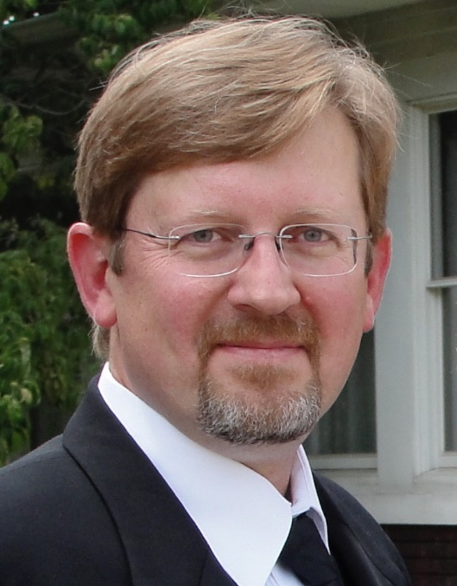
Speaker Introduction: Dr. Don Gelosh
Title: INCOSE Systems Engineering Competency Framework Overview
Dr. Don Gelosh is the Director of Systems Engineering Programs at Worcester Polytechnic Institute (WPI)
Over 46 years of experience including 26 years serving in the US Air Force and post-retirement work in government, industry and academia
Before coming to WPI, Dr. Gelosh was Deputy Director for Workforce Development in the Office of Systems Engineering at the Pentagon, Dean of Learning and Technology at the National Defense University, Deputy Department Head at the Air Force Institute of Technology
Member of NASA’s Vehicle Integration and Test Team supporting the Space Shuttle
Dr. Gelosh holds an ESEP-Acquisition certification from INCOSE and is a member of the Washington Metro Area Chapter
Dr. Gelosh also serves as the INCOSE Associate Director for Education and Training and is one of the founding coaches for the Institute for Technical Leadership

Slide 8
Back up

