Slide 1
Cullen Dansby
Adult Services Librarian, Benbrook Public Library
Making Ourselves Relevant:
Libraries & MakerSpaces

Slide 2
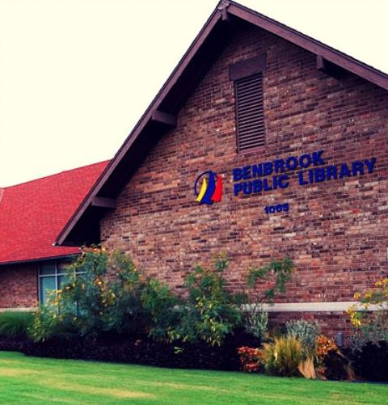
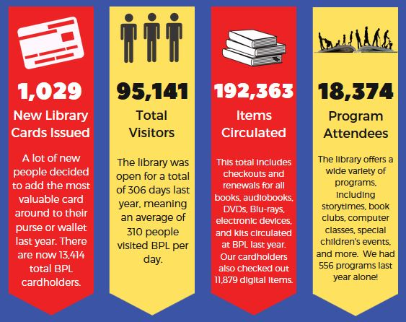
Meet the Library

Slide 3
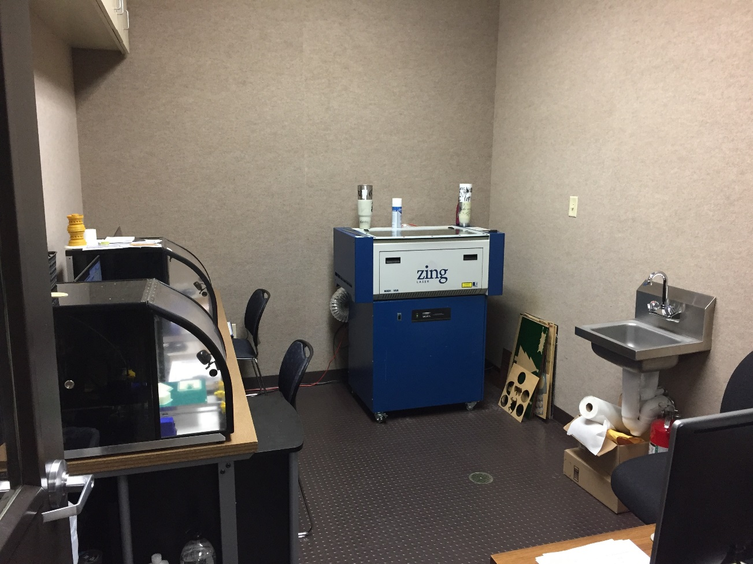
-Established Spring 2014
-Renovated Spring 2017
-Space with a lowercase s
-Open to all
-Available M-Th 8 AM – 8PM,
Fri & Sat 10 AM – 5 PM
Our MakerSpace

Slide 4
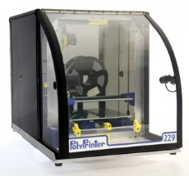
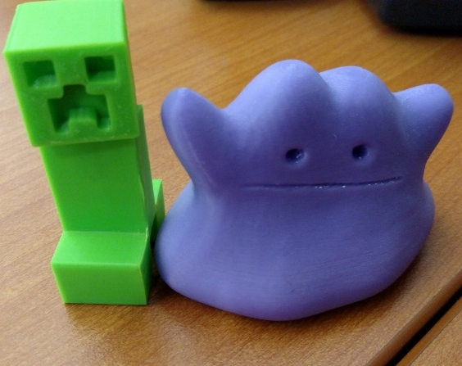
-Two PolyPrinters
-Print ABS, PLA, and Flex
-Charge by weight (10 cents/gram)
-Print .STL files
3D Printers

Slide 5
-Many options available
-Some are free and easy to use (TinkerCAD, SketchUp)
-Some are free and have a steep
learning curve (Blender, FreeCAD)
-Use whichever you’re comfortable with – we just need the .STL
3D Modeling Programs

Slide 6
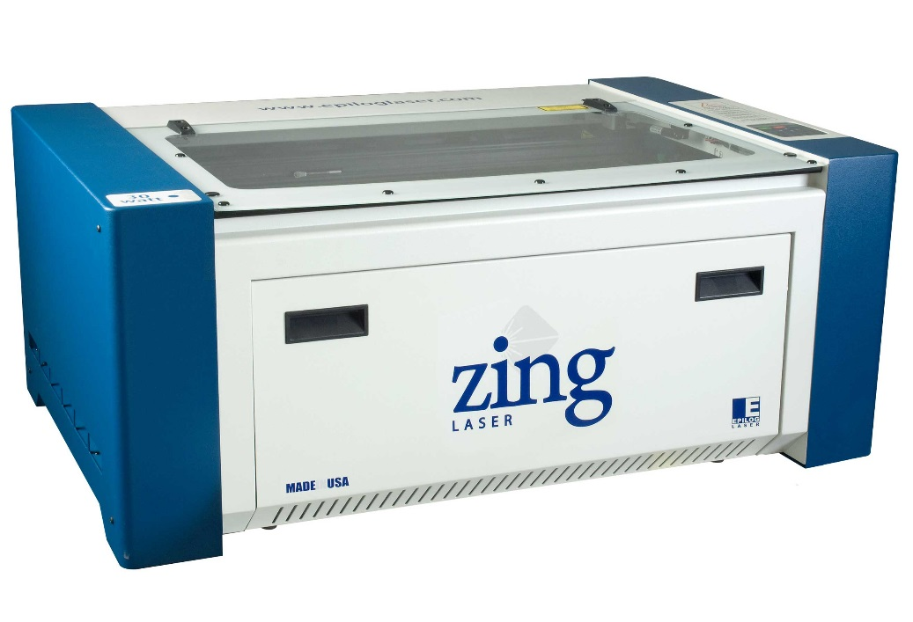
-Zing 24 Engraver (50 watt)
-Engraves wood, acrylic, leather, glass, stainless steel, aluminum, rubber, marble, and more
-Cuts wood, acrylic, leather, rubber, and more
-Charge by material used
Laser Engraver

Slide 7
Prepare a design
in CorelDraw
OR
Prepare a design using another program and import into CorelDraw
Acceptable File Types
Pixel Art | BMP, JPG, GIF, TIF
Vector/ Line Art | EPS, AI, PLT, DWG, DXF, WMF, SVG
Preparing an Engravable File

Slide 8
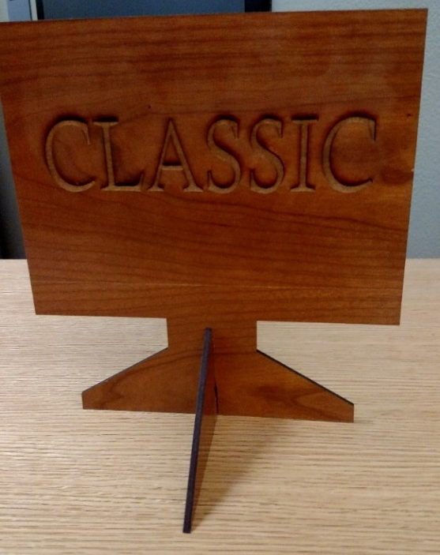
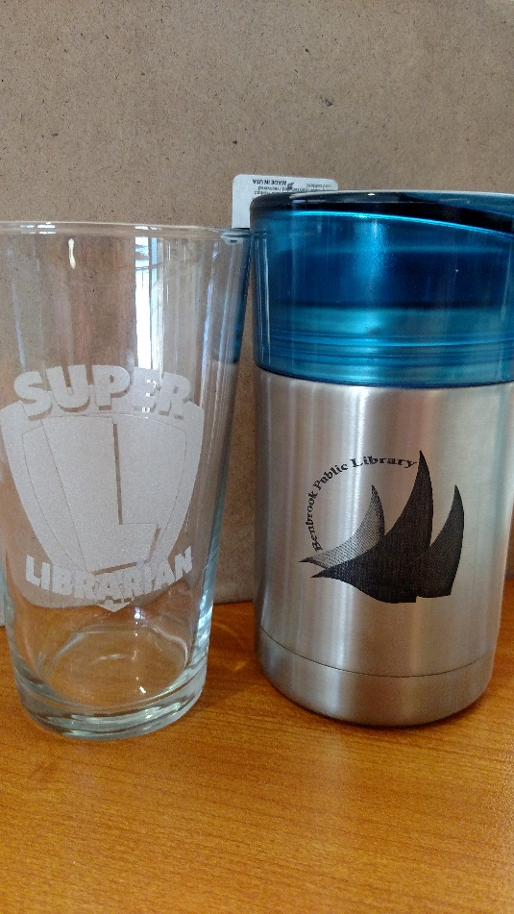
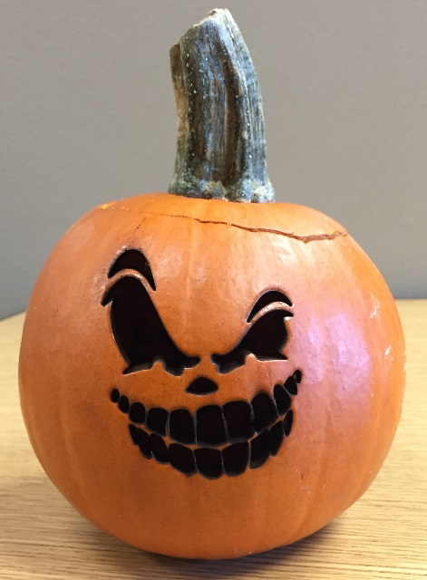
Engraving Examples

Slide 9
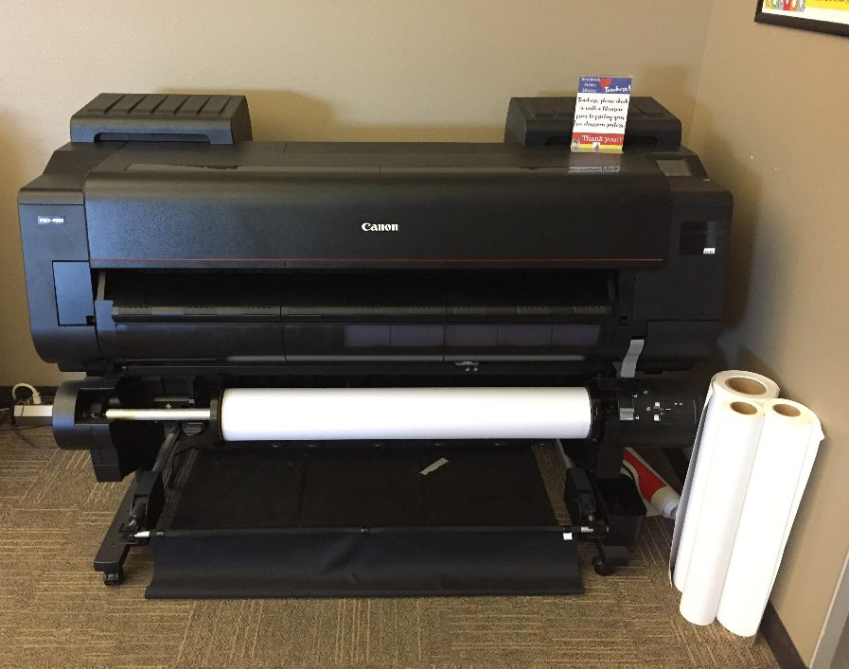
-Canon PRO-4000
-Can customize size
-Glossy, bond paper, & canvas
-Design poster with software of your choice, bring in JPEG or PDF on a flash drive
-Price depends upon type/amount of paper used and ink used
Poster Printer

Slide 10
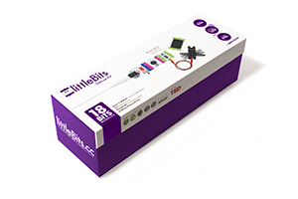
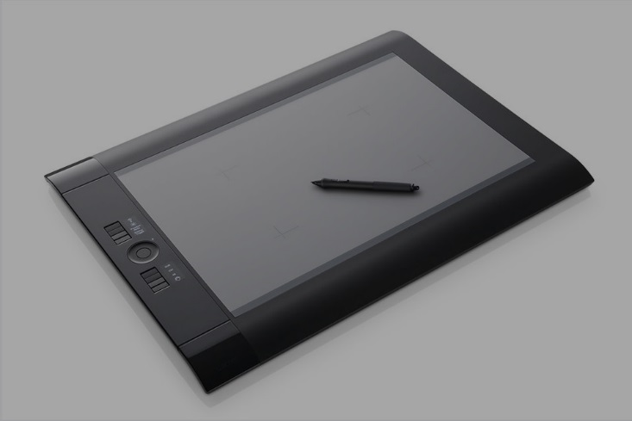
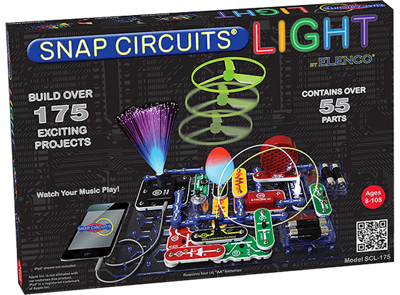
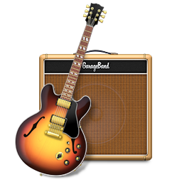
Other MakerSpace Items

Slide 11
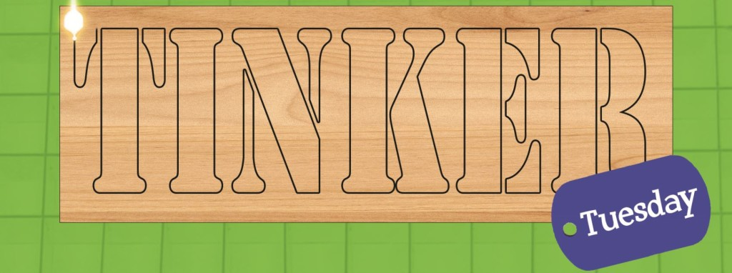
-Fourth Tuesdays @ 6:30 PM
-Start-to-finish demonstration of specific project
-Past project instructions on library website
Tinker Tuesday

Slide 12
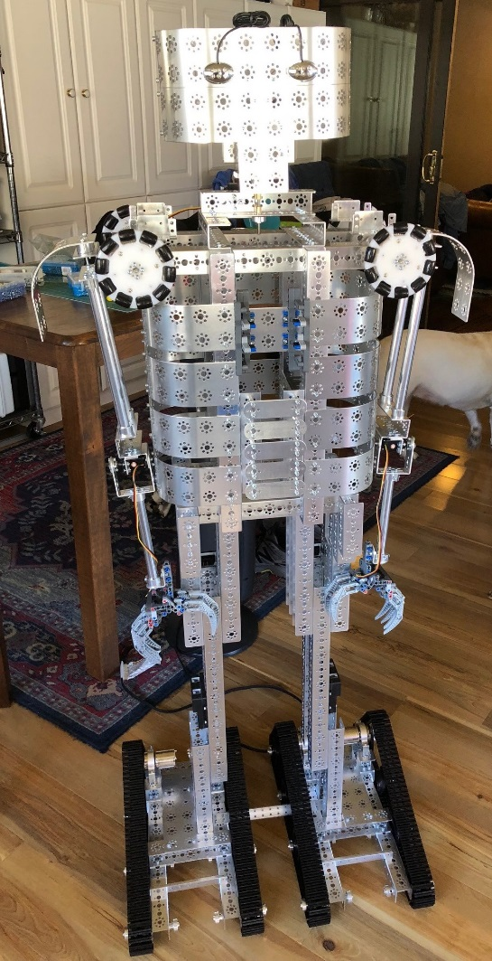
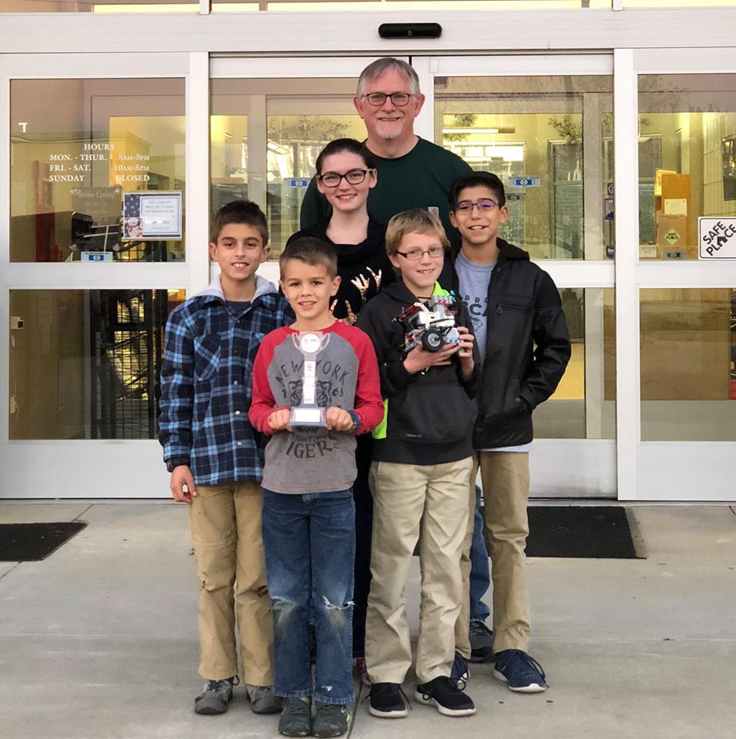
-Team of elementary & middle school-age kids
-Led by a volunteer
-Members learn programming skills
-Mr. Robot
Robotics Team

Slide 13
Want to volunteer?
Contact Cullen at
cullen@benbrooklibrary.org
Volunteers

Slide 14
Other Area MakerSpaces

Slide 15
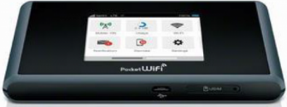
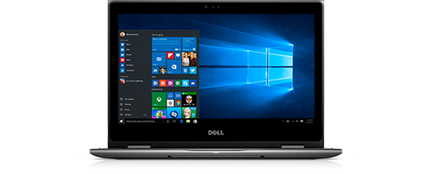
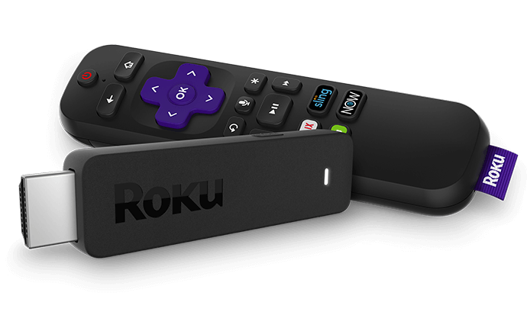
-Circulating WiFi hotspots, laptops, & Roku Streaming Sticks
-Check out for 3 weeks
-Benbrook cardholders only
More Unconventional
Library Stuff

Slide 16
Community Center-Style Programming
More Unconventional
Library Stuff

Slide 17
-For Benbrook Residents: Apply in person with a valid, state-issued ID & a piece of recent first class mail
-For library cardholders of Fort Worth, Burleson, Haltom City, Keller, Richland Hills, or Watagua: Your card is good here!
-If neither of the above situations applies to you: Apply in person for a Benbrook Non-Resident card with a valid, state-issued ID & a piece of recent first class mail
Get a Library Card!

Slide 18
Cullen Dansby
Adult Services Librarian, Benbrook Public Library
cullen@benbrooklibrary.org
817-249-6632
www.benbrooklibrary.org
Questions?

