Slide 1
Life Without Systems Engineering…..
Is That an Option?
Kelly DeFazio, P.E.
Director, Lockheed Martin
F35 Production Engineering

Slide 2
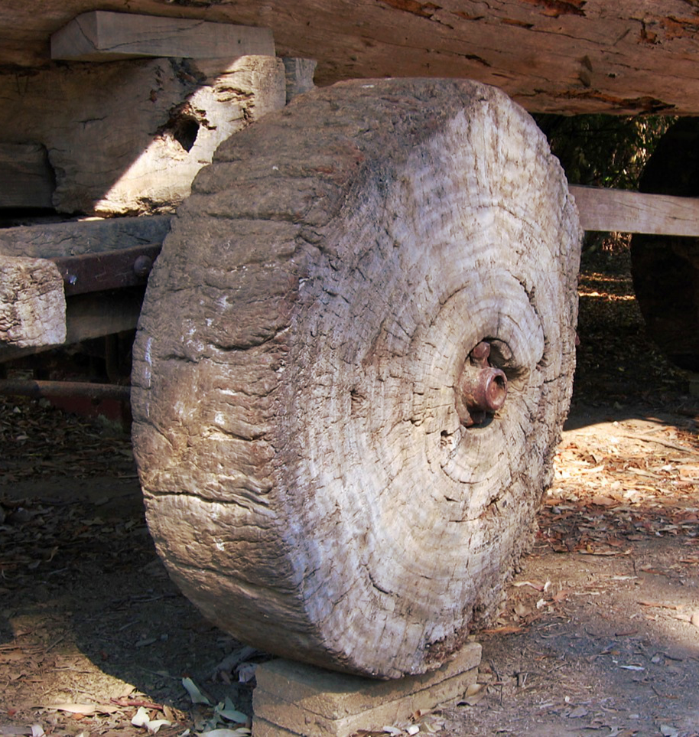
what is the first documented Form of Engineering?
Invention of the Wheel?
4500–3300 BCE: Chalcolithic, invention of the potter's wheel; earliest wooden wheels (disks with a hole for the axle); earliest wheeled vehicles, domestication of the horse
3300–2200 BCE: Early Bronze Age
2200–1550 BCE: Middle Bronze Age, invention of the spoked wheel and the chariot
A wheel greatly reduces friction by facilitating motion by rolling together with the use of axles.
Source: Wikipedia online

Slide 3

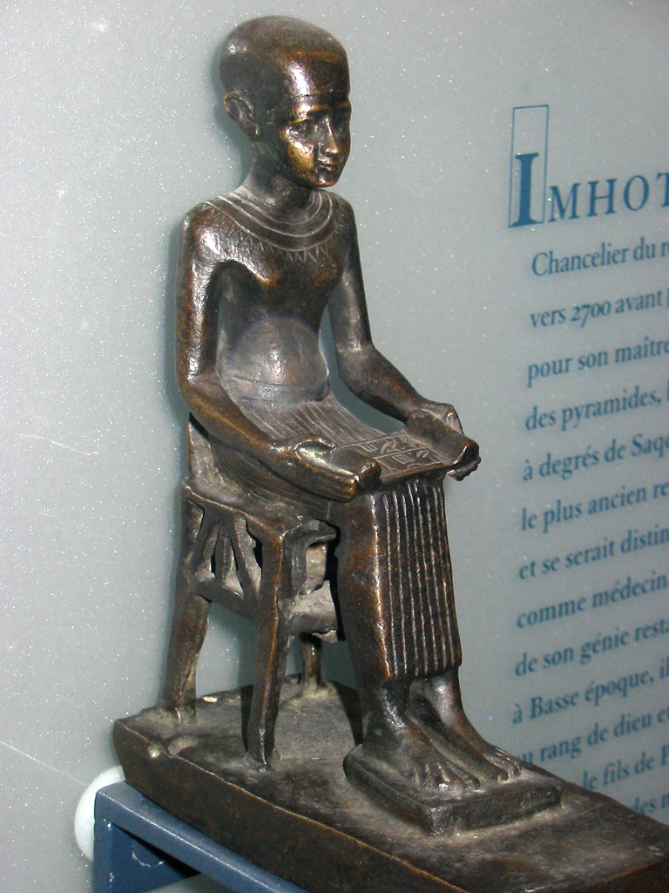
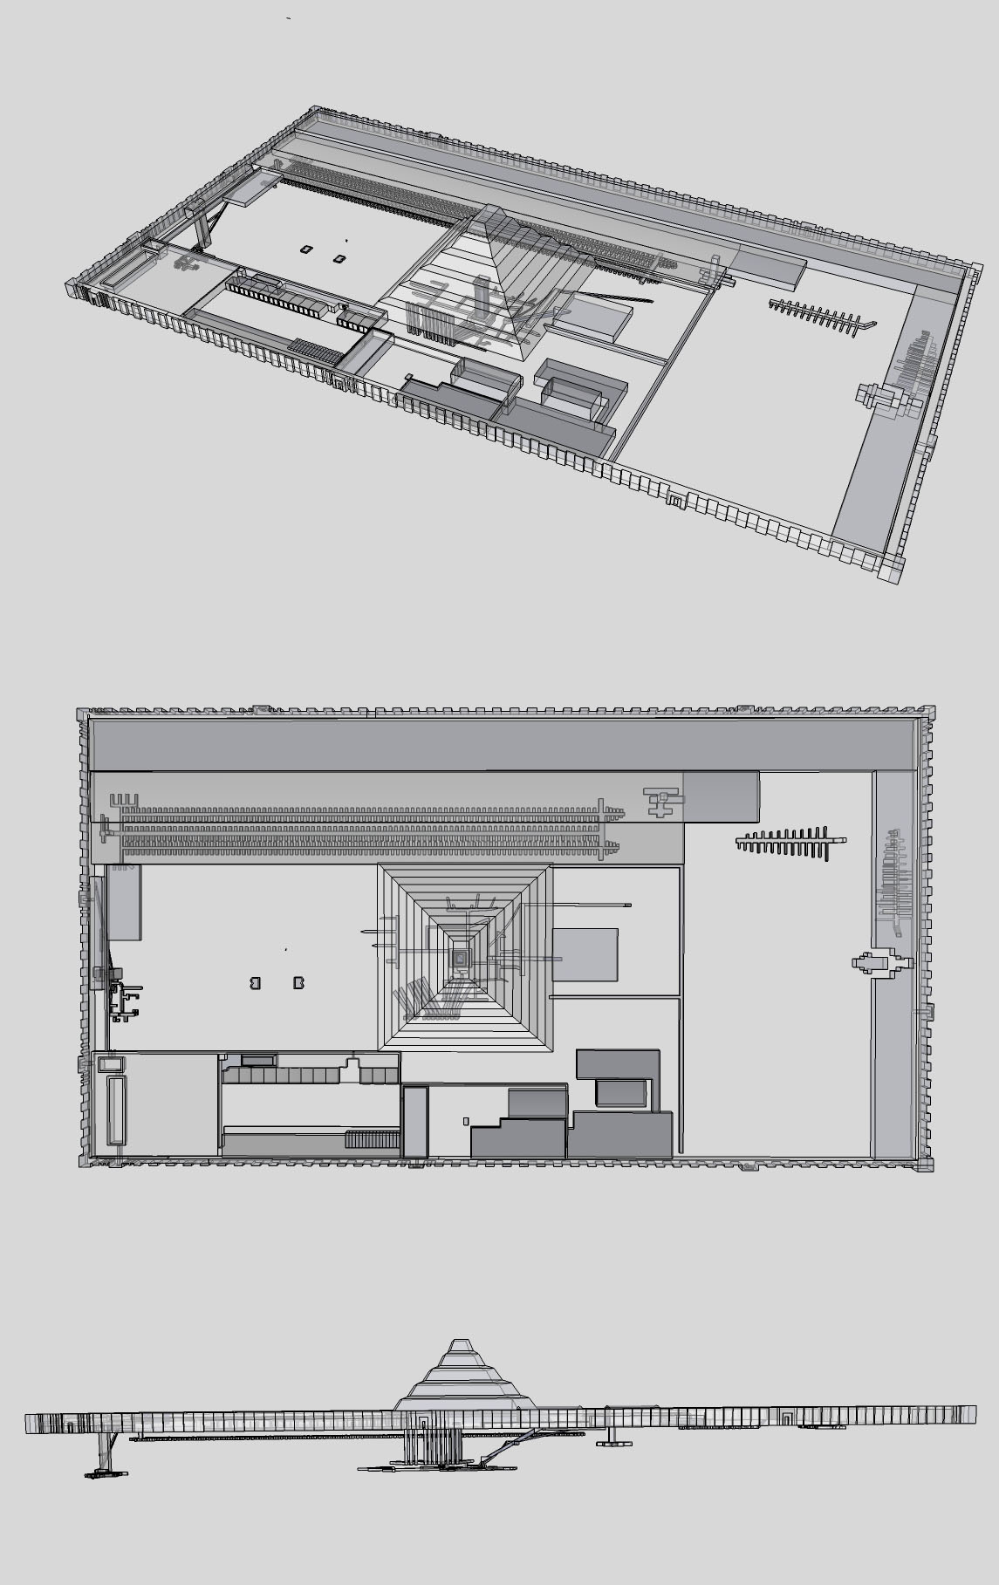
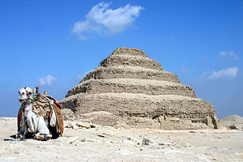
Imhotep (/ɪmˈhoʊtɛp/; 27th century BC (c. 2650–2600 BC); Egyptian: ỉỉ-m-ḥtp *jā-im-ḥātap meaning "the one who comes in peace, is with peace") was an Egyptian polymath[2] who served under the Third Dynasty king Djoser as chancellor to the pharaoh and high priest of the sun god Ra at Heliopolis. He is considered by some to be the earliest known architect,[3] engineer,[4] and physician in history,[5]
Imhotep, played by Boris Karlof in The Mummy (1932)
Who is the first documented Engineer?
The Pyramid of Djoser (or Djeser and Zoser), or step pyramid is an archeological remain in the Saqqara necropolis, Egypt, northwest of the city of Memphis. It was built during the 27th century BC for the burial of Pharaoh Djoser by, Imhotep. It is the central feature of a vast mortuary complex in an enormous courtyard surrounded by ceremonial structures and decoration.
This first Egyptian pyramid consisted of six mastabas (of decreasing size) built atop one another. The pyramid clad in polished white limestone.^{[2]} The step pyramid (or proto-pyramid) is considered to be the earliest large-scale cut stone construction,^{[3]}.
203 ft
358 ft X 410 ft
Source: Wikipedia online
Notes:
In Ancient ERA: The earliest civil engineer known by name is Imhotep.^{[4]} As one of the officials of the Pharaoh, Djosèr, he probably designed and supervised the construction of the Pyramid of Djoser (the Step Pyramid) at Saqqara in Egypt around 2630–2611 BC.^{[7]}

Slide 4

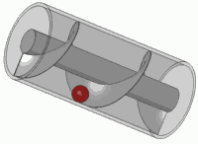
“Give me a lever long enough and a fulcrum on which to place it, and I shall move the world. ”
Who stated the following?
Archimedes of Syracuse
https://commons.wikimedia.org/wiki/File%3AArchimedes-screw_one-screw-threads_with-ball_3D-view_animated_small.gif
born 278 BC, is often credited as the father of engineering
Source: Wikipedia online
Notes:
Ancient ERA: mechanical inventions of Archimedes are examples of early mechanical engineering

Slide 5
The beginning of Engineering in “Renaissance & modern times”……….
Leonardo da Vinci
  Mechanical Engineering
  15 April 1452 – 2 May 1519
Thomas Savery
  Mechanical Engineering
  1650 - 1715
John Smeaton
  Civil Engineering
  8 June 1724 – 28 October 1792
Alessandro Giuseppe Antonio Anastasio Volta
  Electrical Engineering
  18 February 1745 – 5 March 1827
Michael Faraday
  Electrical Engineering
  22 September 1791 – 25 August 1867
The Building Blocks
Source: Wikipedia online
Notes:
Renaissance ERA: Among famous historical figures, Leonardo da Vinci is a well-known Renaissance artist and engineer, and a prime example of the nexus between art and engineering. Leonardo is revered for his technological ingenuity. He conceptualised flying machines, a type of armoured fighting vehicle, concentrated solar power, an adding machine,^{[8]} and the double hull. Relatively few of his designs were constructed or even feasible during his lifetime, as the modern scientific approaches to metallurgy and engineering were only in their infancy during the Renaissance.
Renaissance ERA: The first steam engine was built in 1698 by Thomas Savery and English Inventor/Engineer.^{[12]} The development of this device gave rise to the Industrial Revolution in the coming decades, allowing for the beginnings of mass production
Modern ERA: John Smeaton was the first self-proclaimed civil engineer and is often regarded as the "father" of civil engineering. He was an English civil engineer responsible for the design of bridges, canals, harbours, and lighthouses. He was also a capable mechanical engineer and an eminent physicist.
Modern ERA: Alessandro Giuseppe Antonio Anastasio Volta (Italian pronunciation: [alesˈsandro ˈvɔlta]; 18 February 1745 – 5 March 1827) was an Italian physicist, chemist, and a pioneer of electricity and power,^{[2][3][4]} who is credited as the inventor of the electrical battery and the discoverer of methane
Modern ERA: English Scientist Faraday's breakthrough came when he wrapped two insulated coils of wire around an iron ring, and found that upon passing a current through one coil a momentary current was induced in the other coil.^{[2]} This phenomenon is now known as mutual induction. It was by his research on the magnetic field around a conductor carrying a direct current that Faraday established the basis for the concept of the electromagnetic field in physics. Faraday also established that magnetism could affect rays of light and that there was an underlying relationship between the two phenomena.^{[1][2]} He similarly discovered the principles of electromagnetic induction and diamagnetism, and the laws of electrolysis. His inventions of electromagnetic rotary devices formed the foundation of electric motor technology, and it was largely due to his efforts that electricity became practical for use in technology

Slide 6
The Rise of Systems Engineering formally begins – 20th Century
Bell Laboratories
  Telecommun-ications
  1940’s
Department of Defense
  Missile Defense
  Late 1940’s
NASA
Aerospace and Systems Analysis
  1950’s
Simon "Si" Ramo
GE, TRW, Bunker-Ramo (Honeywell)
  (May 7, 1913 – June 27, 2016)
Harold (Hall) Chestnut Control Theory & Systems Engineering
  November 25, 1917 – August 29, 2001
Interdisciplinary field of engineering focused on design and management of complex systems over their life cycles
Source: Wikipedia online
Source: Wikipedia online
Notes:
Simon "Si" Ramo (May 7, 1913 – June 27, 2016) was an American engineer, businessman, and author. He led development of microwave and missile technology and is sometimes known as the father of the intercontinental ballistic missile (ICBM). He also developed General Electric's electron microscope. He has been partly responsible for the creation of two Fortune 500 companies, Ramo-Wooldridge (TRW after 1958) and Bunker-Ramo (now part of Honeywell). Some consider Ramo a founder of modern systems engineering. His definition of the discipline is:
...a branch of engineering which concentrates on the design and application of the whole as distinct from the parts, looking at a problem in its entirety, taking account of all the facets and all the variables and linking the social to the technological.^{[6]}
Harold (Hall) Chestnut (November 25, 1917 – August 29, 2001) was an American electrical engineer, control engineer and manager at General Electric and author, who helped establish the fields of control theory and systems engineering. Born in Albany, New York, where his father, educated as a civil engineer, worked in the family candy business. Chestnut was raised in the 1920s and went on a scholarship to MIT in 1934 to study chemical engineering. In the first year he was awarded for his outstanding performance in chemistry, but switched anyway to electrical engineering and became co-op student. After five years of study he received a combined B.S. and M.S. degree in electrical engineering in 1940.^{[1]} Later he worked in the Aeronautics and Ordnance Department and the Systems Engineering and Analysis branch of the Advanced Technology Laboratory, where he served as manager from 1956 to 1972. Here he worked on a wide variety of technical problems including reliability issues in rapid transit and the Apollo mission to the moon. The methods seek to optimize the overall system functions according to the weighted objectives and to achieve maximum compatibility of its parts."^{[11]} — Systems Engineering Tools by Harold Chestnut, 1965.

Slide 7
Bell Laboratories
First Documented Systems Engineering Approach – 1940’s
  Grown out of Business Need:
    Cost effective strategy to deploy technical products across broad geographical region
    Standardized approach for optimization:
      Staff training – sales, installation, and troubleshooting
      Supply chain – raw material, fabrication and AI&T
      Customer – training, operations and maintenance
Source: Wikipedia online

Slide 8
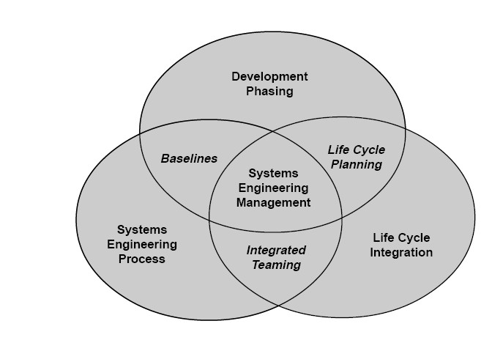
Systems Engineering
The scope of systems engineering activities

Slide 9
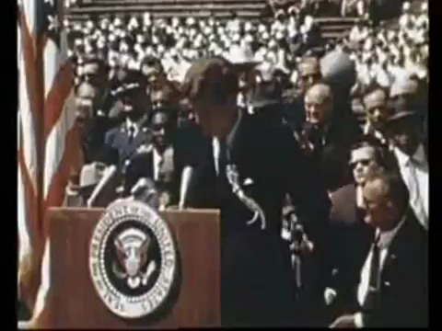
NASA and Systems Engineering
Kennedy moves a nation to action
Source: Wikipedia online
Notes:
"System engineering is a robust approach to the design, creation, and operation of systems. In simple terms, the approach consists of identification and quantification of system goals, creation of alternative system design concepts, performance of design trades, selection and implementation of the best design, verification that the design is properly built and integrated, and post-implementation assessment of how well the system meets (or met) the goals."^{[8]} — NASA Systems Engineering Handbook, 1995

Slide 10
Once Kennedy had defined a goal, this time based complex problem could only be solved by a systems engineered approach
Four possible mission modes were considered:
A rocket system and spacecraft that could meet Kennedy’s goal while minimizing risk to human life, cost, and demands on technology and astronaut skill required a complex solution.
Additionally: Apollo program employed over 500 contractors
And NASA's procurement actions rose from roughly 44,000 in 1960 to almost 300,000 by 1965
Douglas Aircraft Corporation
Boeing Company
International Business Machines (IBM)
Rocketdyne Division of North American Aviation
North American Aviation
Source: Wikipedia online
Project Apollo: A Retrospective Analysis
Notes:
Early Apollo configuration for Direct Ascent and Earth Orbit Rendezvous, 1961
In early 1961, direct ascent was generally the mission mode in favor at NASA. Many engineers feared that a rendezvous—let alone a docking—neither of which had been attempted even in Earth orbit, would be extremely difficult in lunar orbit. Dissenters including John Houbolt at Langley Research Center emphasized the important weight reductions that were offered by the LOR approach. Throughout 1960 and 1961, Houbolt campaigned for the recognition of LOR as a viable and practical option. Bypassing the NASA hierarchy, he sent a series of memos and reports on the issue to Associate Administrator Robert Seamans; while acknowledging that he spoke "somewhat as a voice in the wilderness," Houbolt pleaded that LOR should not be discounted in studies of the question.[34]
Seamans' establishment of an ad-hoc committee headed by his special technical assistant Nicholas E. Golovin in July 1961, to recommend a launch vehicle to be used in the Apollo program, represented a turning point in NASA's mission mode decision.[35] This committee recognized that the chosen mode was an important part of the launch vehicle choice, and recommended in favor of a hybrid EOR-LOR mode. Its consideration of LOR—as well as Houbolt's ceaseless work—played an important role in publicizing the workability of the approach. In late 1961 and early 1962, members of the Manned Spacecraft Center began to come around to support LOR, including the newly hired deputy director of the Office of Manned Space Flight, Joseph Shea, who became a champion of LOR.[36] The engineers at Marshall Space Flight Center (MSFC), which had much to lose from the decision, took longer to become convinced of its merits, but their conversion was announced by Wernher von Braun at a briefing on June 7, 1962.[37]
For example, the prime contracts awarded to industry for the principal components of just the Saturn V included the Boeing Company for the S-IC, first stage; North American Aviation--S-II, second stage; the Douglas Aircraft Corporation--S-IVB, third stage; the Rocketdyne Division of North American Aviation--J-2 and F-1 engines; and International Business Machines (IBM)--Saturn instruments. These prime contractors, with more than 250 subcontractors, provided millions of parts and components for use in the Saturn launch vehicle, all meeting exacting specifications for performance and reliability. The total cost expended on development of the Saturn launch vehicle was massive, amounting to $9.3 billion.

Slide 11
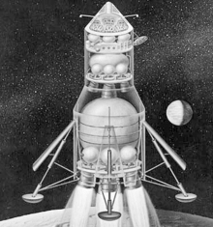
Four Options - Moon Landing
Classic Systems Engineering Problem
Direct Ascent: The spacecraft would be launched as a unit and travel directly to the Moon and land. It would return, leaving its landing stage on the Moon.
Earth Orbit Rendezvous (EOR): Multiple rocket launches would carry parts of a Direct Ascent spacecraft and propulsion units for translunar injection (TLI). These would be assembled into a single spacecraft in Earth orbit.
Early Apollo configuration for Direct Ascent and Earth Orbit Rendezvous, 1961
Source: Wikipedia online
Notes:
Direct Ascent: The spacecraft would be launched as a unit and travel directly to the Moon and land. It would return, leaving its landing stage on the Moon. This design would have required development of the extremely powerful Nova launch vehicle.
Earth Orbit Rendezvous (EOR): Multiple rocket launches (up to 15 in some plans) would carry parts of a Direct Ascent spacecraft and propulsion units for translunar injection (TLI). These would be assembled into a single spacecraft in Earth orbit.

Slide 12
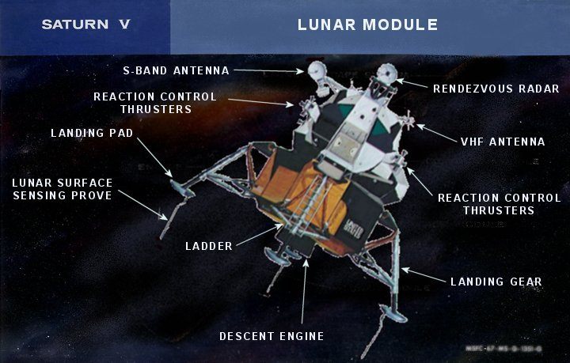
Four Options - Moon Landing – Cont’d.
Classic Systems Engineering Problem
  Lunar Orbit Rendezvous (LOR): A single Saturn V could launch a spacecraft that was composed of a mother ship which would remain in orbit around the Moon, while a smaller, two-stage lander would carry two astronauts to the surface, return to dock with the mother ship, and then be discarded. Minimizing total mass to be launched from Earth.
Lunar Surface Rendezvous: Two spacecraft would be launched in succession. The first, an automated vehicle carrying propellant for the return to Earth, would land on the Moon, to be followed some time later by the manned vehicle. Propellant would have to be transferred from the automated vehicle to the manned vehicle.
Source: Wikipedia online
Notes:
Lunar Orbit Rendezvous (LOR): A single Saturn V could launch a spacecraft that was composed of a mother ship which would remain in orbit around the Moon, while a smaller, two-stage lander would carry two astronauts to the surface, return to dock with the mother ship, and then be discarded. Landing only a small part of the spacecraft on the Moon and returning an even smaller part to lunar orbit minimized the total mass to be launched from the Earth.
Lunar Surface Rendezvous: Two spacecraft would be launched in succession. The first, an automated vehicle carrying propellant for the return to Earth, would land on the Moon, to be followed some time later by the manned vehicle. Propellant would have to be transferred from the automated vehicle to the manned vehicle.^{[33]}

Slide 13
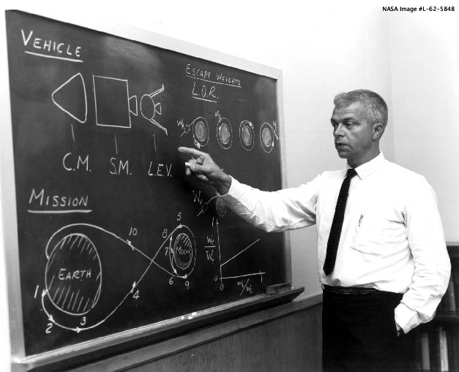
If Systems Engineering was mature the option selected might have gone much smoother but… Controversy ensued
Early position favored by NASA was
- Direct Ascent and Earth Orbit Rendezvous, 1961
Many engineers feared a rendezvous
—let alone a docking
—would be extremely difficult
Dissenters including John Houbolt at Langley Research Center
emphasized the important weight reductions that were offered
by the Lunar Orbit Rendezvous (LOR) approach in 1960.
NASA Associate Administrator established an ad-hoc committee to recommend a launch vehicle in 1961 to be used in the Apollo program which turned NASA’s mission mode decision toward a LOR-EOR hybrid approach.
Wernher von Braun, Director of Marshall Space Flight Center (MSFC) announced the adoption of LOR as the preferred approach on June 7, 1962
Source: Wikipedia online
Notes:
In early 1961, direct ascent was generally the mission mode in favor at NASA. Many engineers feared that a rendezvous—let alone a docking—neither of which had been attempted even in Earth orbit, would be extremely difficult in lunar orbit. Dissenters including John Houbolt at Langley Research Center emphasized the important weight reductions that were offered by the LOR approach. Throughout 1960 and 1961, Houbolt campaigned for the recognition of LOR as a viable and practical option. Bypassing the NASA hierarchy, he sent a series of memos and reports on the issue to Associate Administrator Robert Seamans; while acknowledging that he spoke "somewhat as a voice in the wilderness," Houbolt pleaded that LOR should not be discounted in studies of the question.[34]
Seamans' establishment of an ad-hoc committee headed by his special technical assistant Nicholas E. Golovin in July 1961, to recommend a launch vehicle to be used in the Apollo program, represented a turning point in NASA's mission mode decision.[35] This committee recognized that the chosen mode was an important part of the launch vehicle choice, and recommended in favor of a hybrid EOR-LOR mode. Its consideration of LOR—as well as Houbolt's ceaseless work—played an important role in publicizing the workability of the approach. In late 1961 and early 1962, members of the Manned Spacecraft Center began to come around to support LOR, including the newly hired deputy director of the Office of Manned Space Flight, Joseph Shea, who became a champion of LOR.[36] The engineers at Marshall Space Flight Center (MSFC), which had much to lose from the decision, took longer to become convinced of its merits, but their conversion was announced by Wernher von Braun at a briefing on June 7, 1962.
Without NASA's adoption of this stubbornly held minority opinion in 1962, the United States may still have reached the Moon, but almost certainly it would not have been accomplished by the end of the 1960s, President Kennedy's target date.

Slide 14
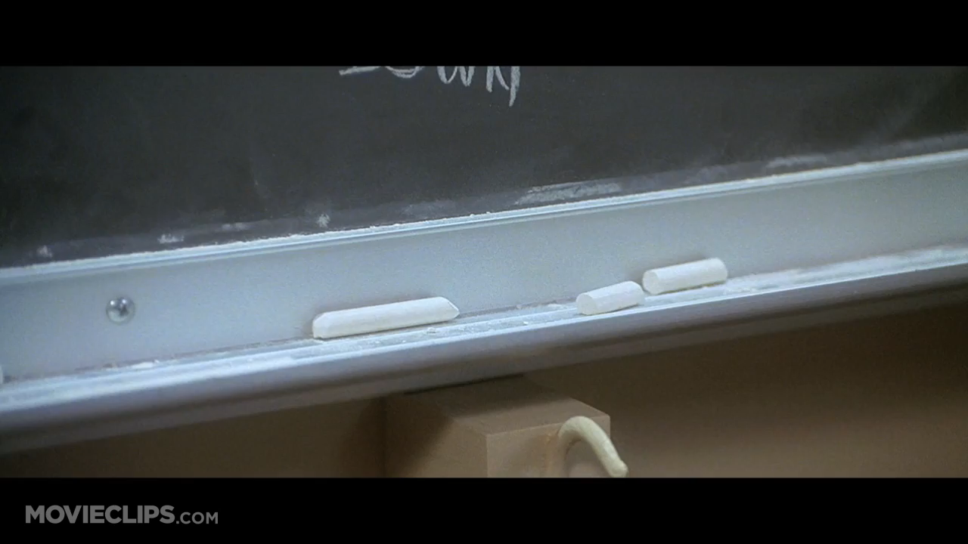
Systems Engineering – Risk Based Decisions
If the command ship failed, LOR method had the advantage of the lander spacecraft - the Lunar Excursion Module (LEM) being used as a “lifeboat” – Contract Awarded to Grumman Aircraft
A 1964 MSC study concluded, "The LM [as lifeboat] ... was finally dropped, because no single reasonable CSM failure could be identified that would prohibit use of the Service Propulsion System SPS.“
Source: Wikipedia online
Notes:
Ironically, just such a failure happened on Apollo 13 when an oxygen tank explosion left the CSM without electrical power. The Lunar Module provided propulsion, electrical power and life support to get the crew home safely.
In July 1962, eleven firms were invited to submit proposals for the LEM. Nine companies responded in September, answering 20 specific questions posed by the NASA RFP in a 60-page limited technical proposal. Grumman Aircraft was awarded the contract two months later. Grumman had begun lunar orbit rendezvous studies in the late 1950s and again in 1961. The contract cost was expected to be around $350 million.
It was sometime during the Transposition and Docking that the "SPS Thrust" light on the Entry Monitor System part of the control panel came on. The Service Propulsion System (SPS) was the rocket engine of the CSM and this particular light was used to indicate the valves in the engine were open and that the rocket should be firing, something that was not in fact happening

Slide 15
Cape Canaveral Launch Complex 41
Unique Centaur Upper Stage Mission Requirements
A Personal Experience as A Systems Engineer
Source: ULALaunch.com
History of the Titan Centaur Launch Vehicle
Notes:
After the Challenger accident, just months before Shuttle-Centaur was scheduled to fly, NASA realized that it was far too risky to fly the Centaur on the Shuttle.^{[8]} Galileo, Ulysses, and Magellan would all eventually be boosted by the much less powerful solid-fueled Inertial Upper Stage, with Galileo requiring multiple gravitational assists from Venus and Earth to reach Jupiter.
The decision to terminate the Shuttle-Centaur program spurred the United States Air Force to create the Titan IV, which, in its 401A/B versions, used the Centaur-T, also with a 14-foot-diameter (4.3 m) hydrogen tank, as its final stage. This vehicle was capable of launching payloads which had originally been designed for the Shuttle-Centaur combination. In the Titan 401A version, a Centaur-T was launched nine times between 1994 and 1998. Titan-Centaur would launch the Cassini-Huygens probe to Saturn in 1997 on the debut flight of the Titan 401B, which would launch an additional six times, with one failure. The last flight of the Titan IV/Centaur was in 2003

Slide 16
Titan Centaur Upper Stage – Cryogenic Propellant
Mission Unique Requirements:
High Performance Propulsion for orbit insertion – LH2/LO2 propellant
Thermal Blanket requirement for on orbit environment – No Moisture/No Ice
Derived Requirements:
PLF HVAC requirements (Tight Tolerance):
0% Humidity
Negative Dew point
Temperature
Cleanliness
Source: ULALaunch.com & Wikipedia
History of the Titan Centaur Launch Vehicle
Notes:
T-160 minutes – transfer air to GN2 on hvac to dry atmosphere, T-150 minutes cryo systems start cool down
To exist as a liquid, H₂ must be cooled below hydrogen's critical point of 33 K. However, for hydrogen to be in a fully liquid state without boiling at atmospheric pressure, it needs to be cooled to 20.28 K^{[3]} (−423.17 °F/−252.87 °C).
Liquid oxygen has a pale blue color and is strongly paramagnetic: it can be suspended between the poles of a powerful horseshoe magnet.^{[1]} Liquid oxygen has a density of 1.141 g/cm³ (1.141 kg/L or 1141 kg/m³) and is cryogenic with a freezing point of 54.36 K (−218.79 °C; −361.82 °F) and a boiling point of 90.19 K (−182.96 °C; −297.33 °F)
The Centaur, by virtue of its use of high specific-impulse (Isp) LO2/LH2 propellants, has initial mass-to-orbit launch requirements less than half of those upper stages using storable propellants. That is, for Earth escape or GSO missions the Centaur is half the launch weight of a storable propellant upper stage. A drawback to the use of Liquid oxygen and liquid hydrogen, at 90 K and 20 K respectively, over storable propellants is the necessity of efficient cryogen storage techniques that minimize boil-off from thermal radiation in space. Thermal blankets have been used successfully to shield both the Atlas Centaur and Titan Centaur.

Slide 17
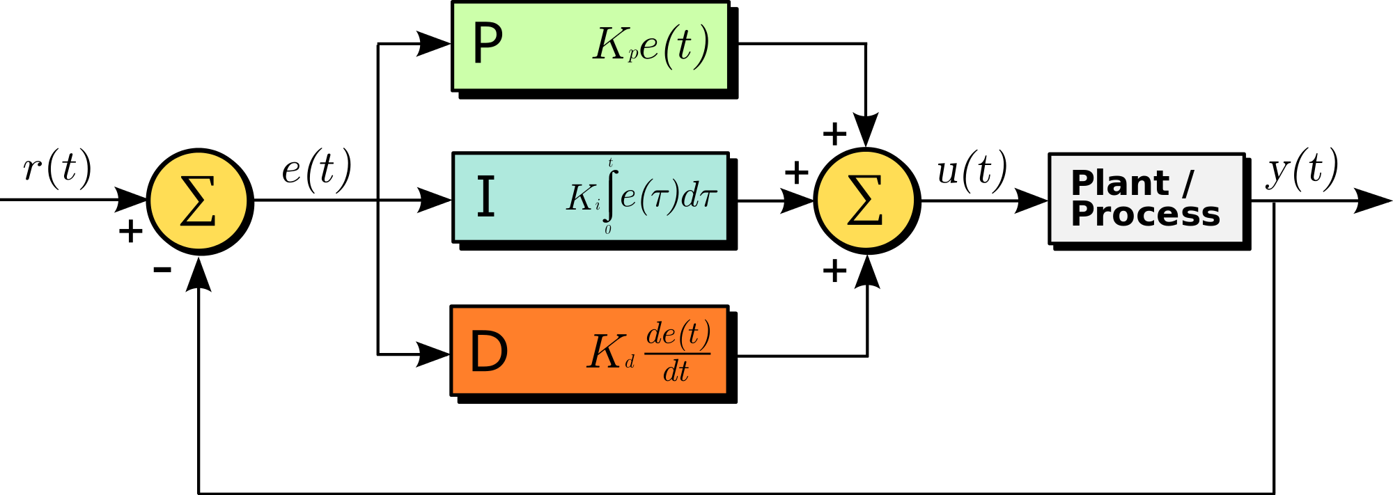
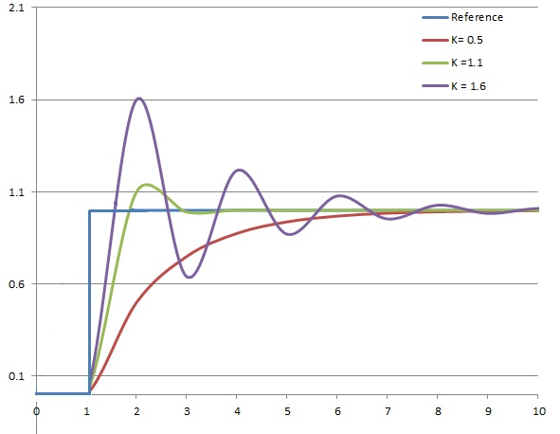
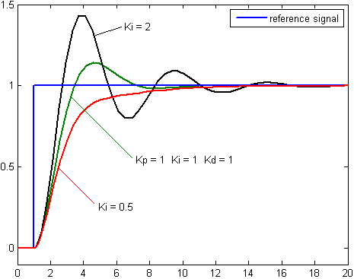
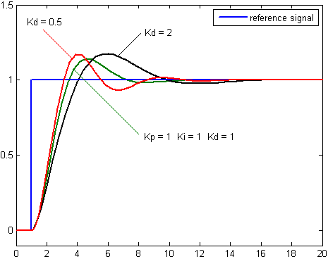
HVAC System –Programmable logic controller
A block diagram of a PID controller in a feedback loop. r(t) is the desired process value or "set point", and y(t) is the measured process value.
Plot of PV vs time, for three values of K_{p} (K_{i} and K_{d} held constant)
Plot of PV vs time, for three values of K_{i} (K_{p} and K_{d} held constant)
Plot of PV vs time, for three values of K_{d} (K_{p} and K_{i} held constant)
Notes:
A proportional–integral–derivative controller (PID controller) is a control loop feedback mechanism (controller) commonly used in industrial control systems. A PID controller continuously calculates an error value e ( t ) {\displaystyle e(t)} as the difference between a desired setpoint and a measured process variable and applies a correction based on proportional, integral, and derivative terms (sometimes denoted P, I, and D respectively) which give their name to the controller type.

Slide 18
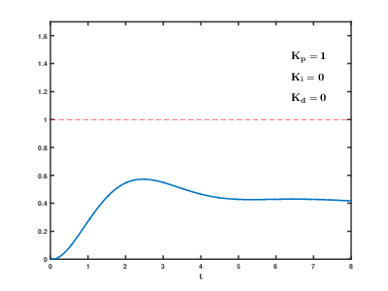
HVAC System –Programmable logic controller
PID tuning is a difficult problem - it must satisfy complex criteria within the limitations of PID control.
Multiple (and often conflicting) objectives such as short transient and high stability make designing and tuning a PID controller difficult.
Some processes have a degree of nonlinearity and so parameters that work well at full-load conditions don't work when the process is starting up from no-load;
this drives special programming to correct
one example: gain scheduling (using different parameters in different operating regions).
Effects of varying PID parameters (K_{p},K_{i},K_{d}) on the step response of a system
Notes:
Tuning a control loop is the adjustment of its control parameters (proportional band/gain, integral gain/reset, derivative gain/rate) to the optimum values for the desired control response. Stability (no unbounded oscillation) is a basic requirement, but beyond that, different systems have different behavior, different applications have different requirements, and requirements may conflict with one another.
There are accordingly various methods for loop tuning, and more sophisticated techniques are the subject of patents; this section describes some traditional manual methods for loop tuning.
Usually, initial designs need to be adjusted repeatedly through computer simulations until the closed-loop system performs or compromises as desired.
Some processes have a degree of nonlinearity and so parameters that work well at full-load conditions don't work when the process is starting up from no-load; this can be corrected by gain scheduling (using different parameters in different operating regions).

Slide 19
HVAC System –Air to GN2 Transition at T-4 hours
Complex Projects without
a robust Systems Integration Approach
without
risk mitigating Simulation Verification Modeling
WILL MOST LIKELY Fail upon system startup
5500 PSI
Cross country line GN2
100 “
W.C.
AHU 1
AHU 2
AHU 3
2700 PSI
180 PSI
100 “ W.C.
AHU 4
AHU 5
Air Inlets
Air Inlets
Air Inlets
Air Inlets
HVAC Control Shelter - Triplicated PLC System

Slide 20
HVAC System –Air to GN2 Transition at T-4 hours
Lessons Learned: Complex Projects ALWAYS employ Simulation Modeling
AND NEVER allow safety device lockout control
100 “
W.C.
180 PSI
Redundant
Accumulators
Redundant
Accumulators
5500 PSI
Cross country line GN2
AHU 1
AHU 2
AHU 3
2700 PSI
AHU 4
AHU 5
Air Inlets
Air Inlets
Air Inlets
Air Inlets
HVAC Control Shelter - Triplicated PLC System

Slide 21
Programs without Systems Engineering strength
A Personal Experience as Program Manager
Day One:
Walked in –
program behind schedule and over budget
First 30 Days:
Program Review –
Revealed team was working on their THIRD SRR –
Requirements untenable
Customer did not understand
Systems Engineering Lead at odds with Customer Engineering leads
Delayed SRR#3:
Held Customer requirements partnering event –
Positioned Systems Engineering team players with good communication and relationship skills with customer

Slide 22
Programs with Systems Engineering strength
Customer Requirements
Engineers
Customer
Engineers
Customer
Engineers
Customer
SRR 1
SRR 2
SRR 3
SRR #3 a Success!!!
BUT
Schedule still behind and cost overrun
Do-Loop driving POP up and therefore cost driver had ended
- Contract waiver authored and signed

Slide 23
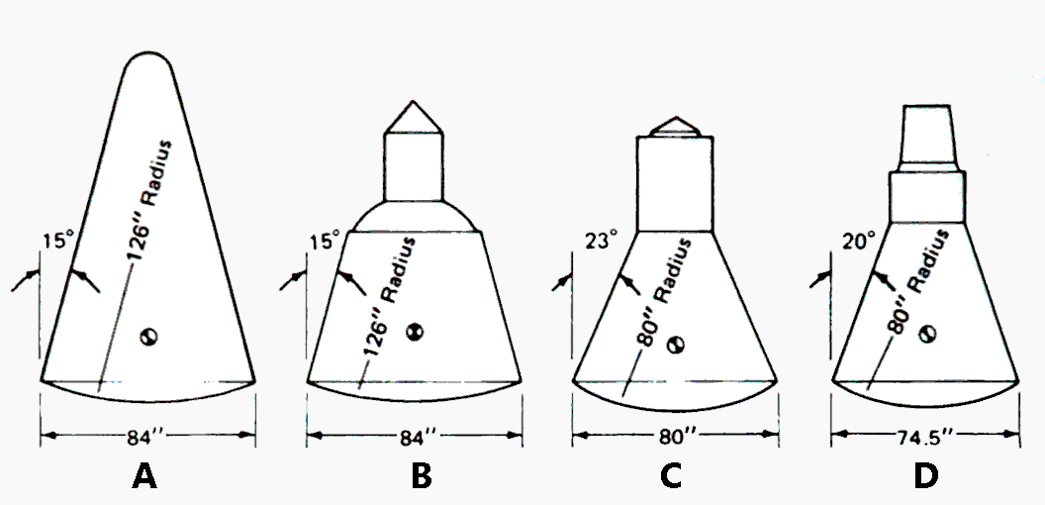
So how did we make up time and cost???
Programs with Systems Engineering strength
Systems Engineering Risk Based Decision:
Requirements Verification Performance
Evidence from Mass Properties Verification of first builds
Criticality of in flight dynamic requirements for early missions
Knowledge of duration and cost of each Mass Property Verification Test and Evaluation phase
Knowledge of build process – repeatability
Evolution of capsule design, 1958–59 NASA
Mass Properties and Aero Dynamics Critical
Elimination of Mass Properties Verification shortened POP significantly
Enabled by Integration of information from above and MOST importantly Relationship with Customer
Systems Engineer Idea Shortens POP – Returns Program to Green

Slide 24
Yes – We can live without Systems Engineering
BUT at what cost

Slide 25
Slow integration of World Communication
Loosing the Space Race to the Moon
Taking undue Technical Risk on High Stakes Programs
Costing more money to realize new products than necessary
Longer to market on new products and defense systems
And what about in our personal lives?
Walk outside and manually adjust the temperature in my spa
Have to turn on the Weather Channel to find out about the weather
Actually drive my car using my hands and feet

Slide 26
Tailoring of this process has to be done carefully to avoid the introduction of substantial unseen risk and uncertainty. Without the control, coordination, and traceability of systems engineering, an environment of uncertainty results which will lead to surprises. Experience has shown that these surprises almost invariably lead to significant impacts to cost and schedule.
Systems Engineering Fundamentals
Department of Defense
Systems Management College
SUPPLEMENTARY TEXT
PREPARED BY THE
DEFENSE ACQUISITION UNIVERSITY PRESS
FORT BELVOIR, VIRGINIA 22060-5565
Systems Engineering engagement should be directly proportional
to the complexity, maturity and risk of the project.

Slide 27
No Systems Engineering………
That’s a world I’d rather not experience!
Without Systems Engineering
Programs would Fail
Without Systems Engineering
Our future would not progress
Thanks to Bell Labs, DOD and NASA for getting us going on the road to integrated solutions

Slide 28
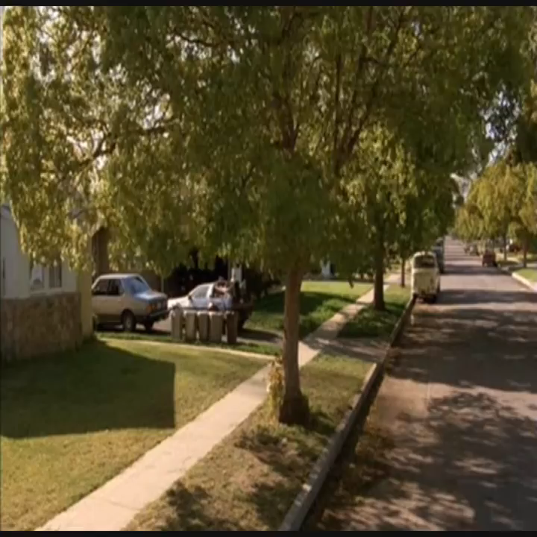
A Call to all Systems Engineers
Imagine the Possibilities

