Slide 1
MBSE for PLM: Part of the Digital Systems Life Cycle
3/12/19

Slide 2
About
Sarena Gazic – Sarena.Gazic.Ctr@StraConGroup.com
20 years of software and systems engineering experience at defense companies
19 years of that in model based engineering
President-Elect INCOSE North Texas Chapter
Raymon Smith – Raymon.Smith@StraConGroup.com
Leads Product Lifecycle Management tool implementation with a Model Based Systems Engineering (MBSE) approach for DoD customers
Over 10 years of DoD experience spanning Systems Engineering from Requirements and Architecture Definition to Mechanical and Electrical Design through Verification and Validation

Slide 3
About Us
StraCon provides integral and dependable professional services to our clients to enhance their operational capability of their programs.
8(a) Small Disadvantaged Business
Economically Disadvantaged Women-Owned Small Business (EDWOSB)
Past Performance
Training Solutions Development
Virtual Learning Environment (VLE)
Instructional Systems Design (ISD)
Courseware Development
Advanced Distributed Learning (ADL) Solutions
Product Life-Cycle Management (PLM)
PTC Windchill
Siemens Teamcenter
Dassault ENOVIA
Model Based Systems Engineering
No Magic Magic Draw
Sparx Enterprise Architect
Concurrency Management Consulting
Concurrency Management Plans
Configuration Management
Technical Data Packages (TDP)
CAD Modeling
Technical Manual Development

Slide 4
Abstract
This presentation is about the practical application of modeling as it is applied to the amalgamation of disparate data in the deployment of information systems. The focus of the approach entails the modeling of people, processes, and system data that are required through the ISO/IEC/IEEE 15288 System Life Cycle Processes. In this approach, we are using SysML (Systems Modeling Language) to connect what is deemed essential in requirements to the structure and behavior of the fielded tool. This system model shapes the deployment for the PLM (Product Lifecycle Management) environment and interfaces to legacy systems. The presentation also discusses model-generated artifacts that are used for tool deployment, external system integration, and end user training.

Slide 5
Why a System Model?
Man Made Systems follow lifecycles identified by the INCOSE Systems Engineering Handbook that may be developed/supported faster, cheaper, and better with the application of Digital tools. How and where to deploy these tools is a complex issue.
System Models graphically connect information so that this complexity is easier to understand; by visualizing how the parts make up the whole
Models are built to evolve as a single authoritative source
Requirements are understood in context
Impacts can be identified immediately and changes executed more rapidly
Captures tribal knowledge
Relate disparate information from a variety of sources

Slide 6
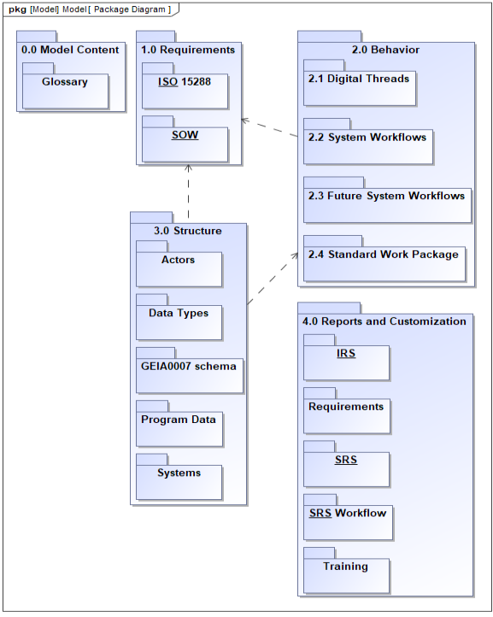
MBSE Approach
Requirements
Model
Products
Contract Requirements
System Requirements
Specification
Stakeholder Input
Interface Specification
Standard Processes
Training Material
Standard Documents
Implementation Material
Notes:
SE V starts with REQ as does our approach
Systems Modeling Language (SysML) is the de-facto modeling standard in the systems engineering community
- Standard syntax for conveying content

Slide 7
Model Based Products
Requirements Specification
Decomposition of the Requirements and solution traceability
High level workflow diagrams and content that depicts structure/behavior
Interface Specification
Documents interaction and data flow with external products
Deployment content for PLM systems
Data structures and attributes
User Groups and Roles
Workflow processes
Training material
Role based user training content based workflows with tool screenshots

Slide 8
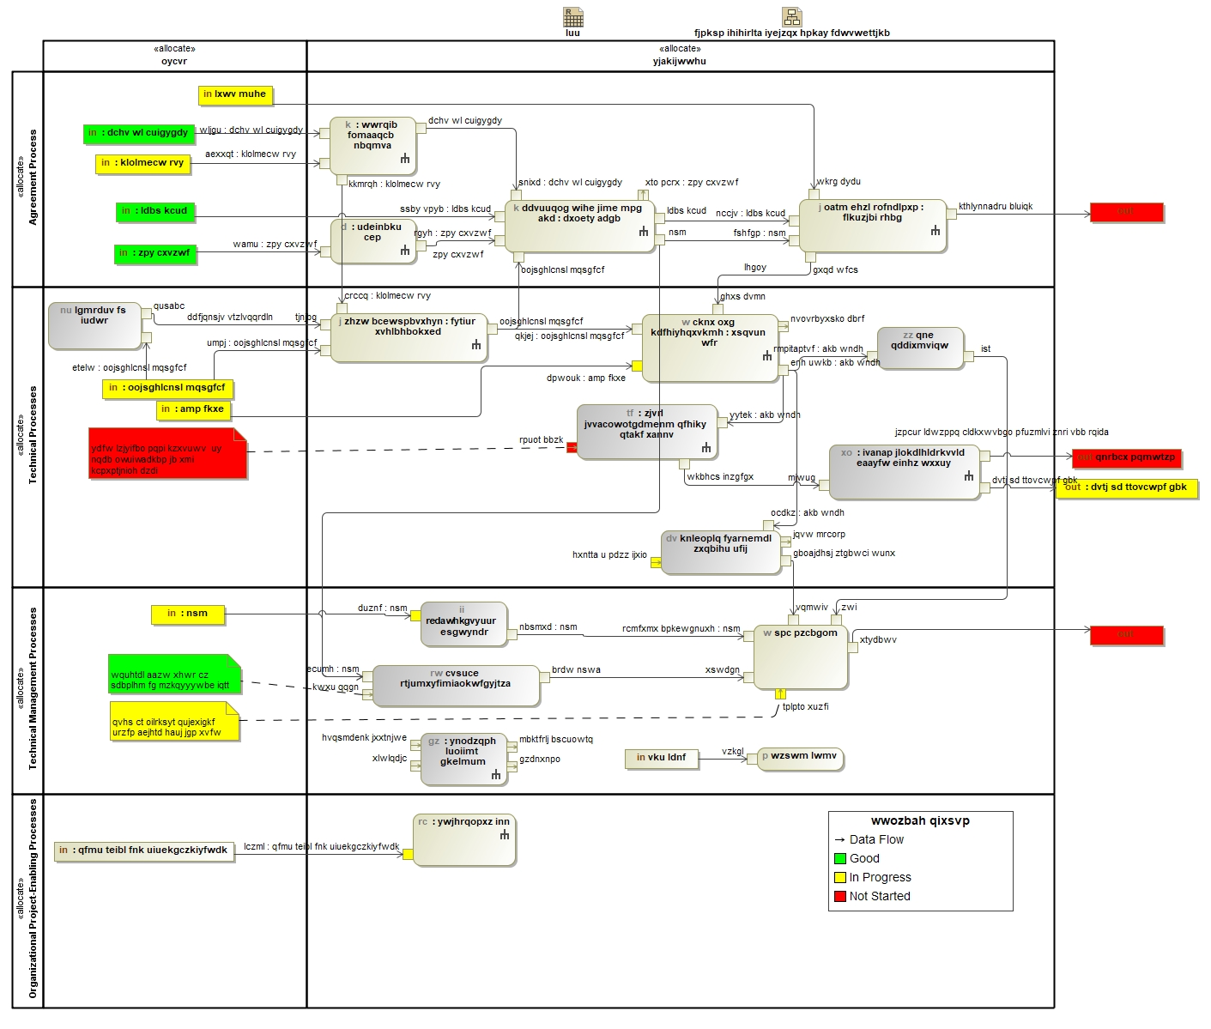
Digital Thread
Aligns PLM deployment to the System Lifecycle Processes identified in ISO/IEC/IEEE 15288 (Systems and software engineering —System life cycle processes)
Visualizes the flow of information through processes for the lifecycle
Notes:
Obfuscator
Thread of data through workflows in standard process framework

Slide 9
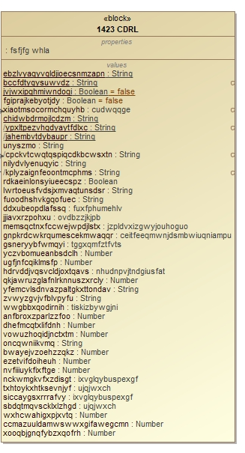
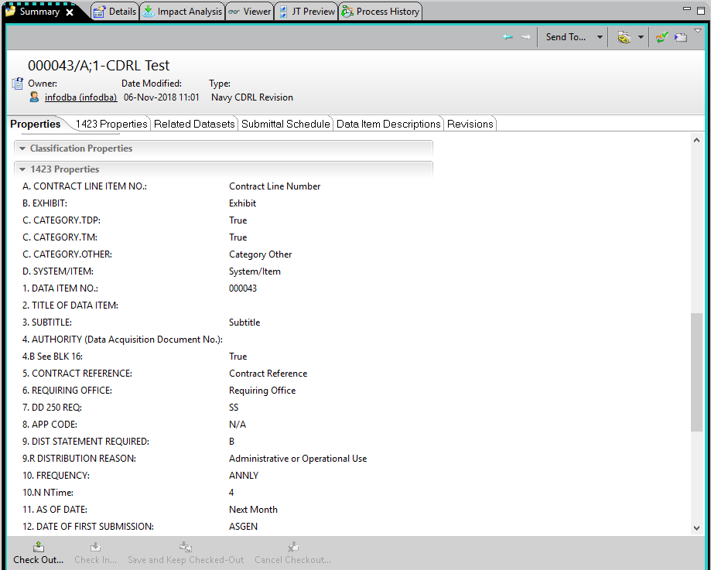
Data Definition and Deployment
Standard Document Model PLM Tool
Definition
Definition
Deployment

Slide 10
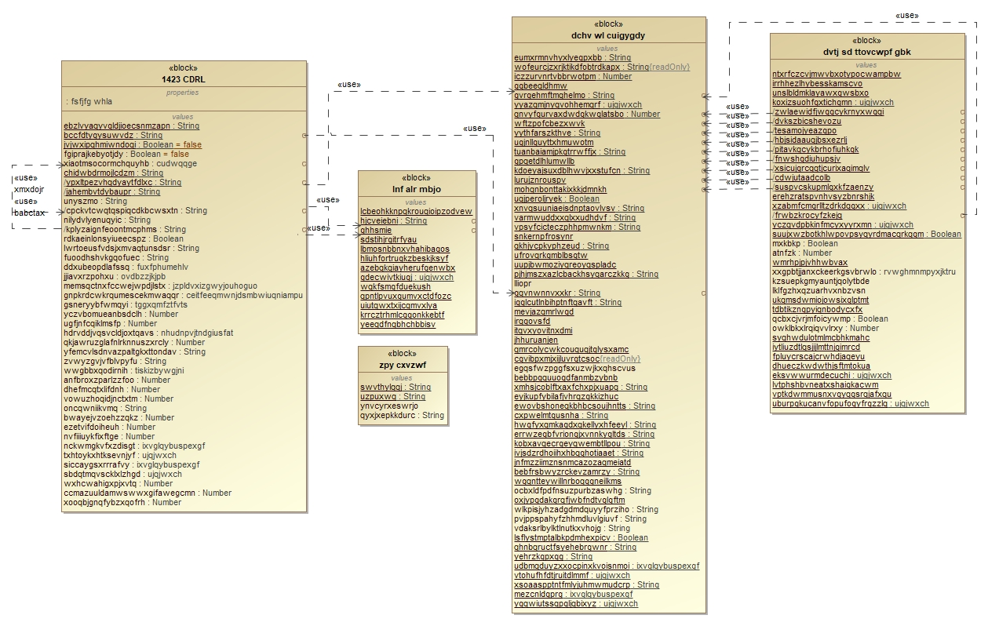
Data Relations
Connecting data used in multiple standards and processes
Maximize Data Reuse
Reduce input time
Reduce user errors
Show threads

Slide 11
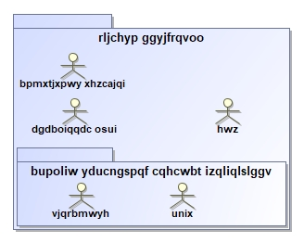
Groups and Roles
The Groups, Roles, and Users are deployed in PLM
Group-level (package) permissions are inherited by all nested groups and roles
Roles (stick figures) may have additional permissions or remove permissions
Users are assigned to one or more Roles and are not modeled

Slide 12
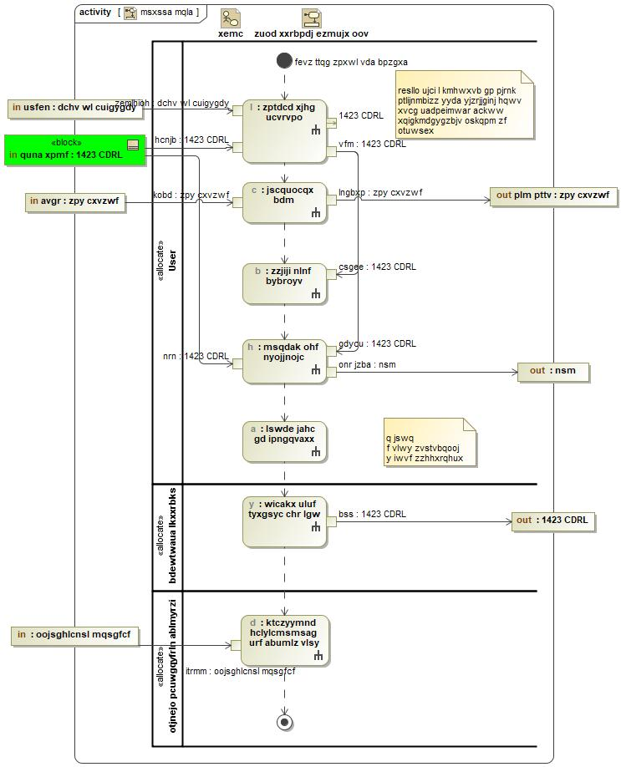
Workflows
Each workflow (use case) is comprised of tasks
Depict order of tasks to complete a workflow
Interaction between user roles
Identify the information that will be consumed and created during the processes
Data parameters are documented and linked to tasks

Slide 13
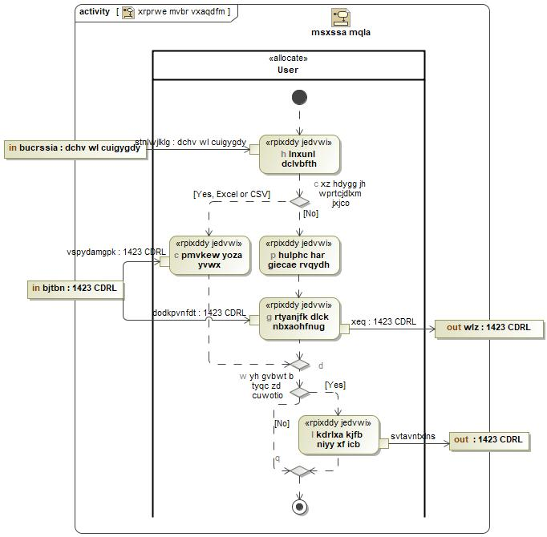
Tasks
Each task decomposes to subtasks
Each subtask documents the detailed steps the user performs
All of this information is used to auto generate training slides for users
In the New Data Requirement Item window, enter the required data for each “Step”
Click “Next” to advance through the list after completing each Step
At conclusion of the last step click “Finish”

Slide 14
PLM Training Overview
The Product Lifecycle Management (PLM) training curriculum was designed to introduce the user to the PLM tool
Model-Based Systems Engineering (MBSE) approach:
Iterative development process
Concurrent PLM and training changes
Visualize role interactions within the PLM
Systems approach to training curriculum design
Use Cases describe Client Job requirements
Actions describe actor tasking

Slide 15
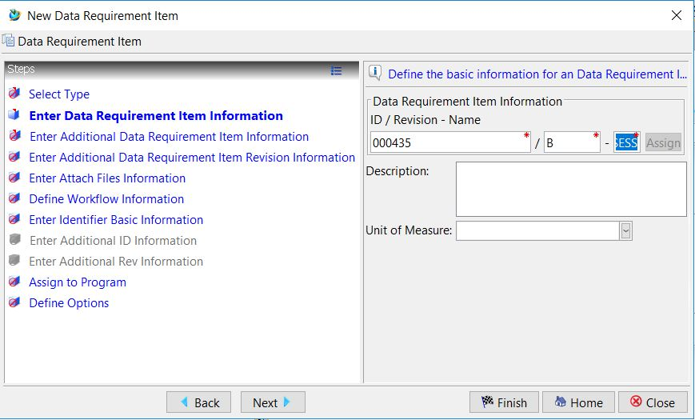
TRAINING EXAMPLE: SYS1.1-4 – Populate CDRL attributes (Form 1423)
Step List
1
In the New Data Requirement Item window, enter the required data for each “Step”
Click “Next” to advance through the list after completing each Step
At conclusion of the last step click “Finish”
2
3

Slide 16
Questions???

