Slide 1
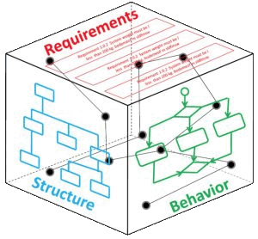
MBSE Process for JCIDS
Loyd Baker and Monte Porter

Slide 2
AGENDA
Problem Statement
Unified Profile for DoDAF and MODAF
Drafting a Process for JCIDS

Slide 3
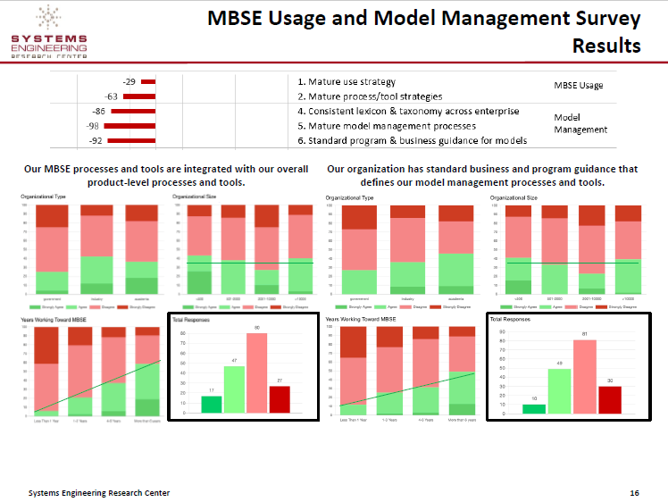
Tom McDermott, Stevens Institute of Technology et. al.
Benchmarking the Benefits and Current Maturity of Digital Engineering/
Model Based SE, March 26, 2020
https://sercuarc.org/results-of-the-serc-incose-ndia-mbse-maturity-survey-are-in/

Slide 4
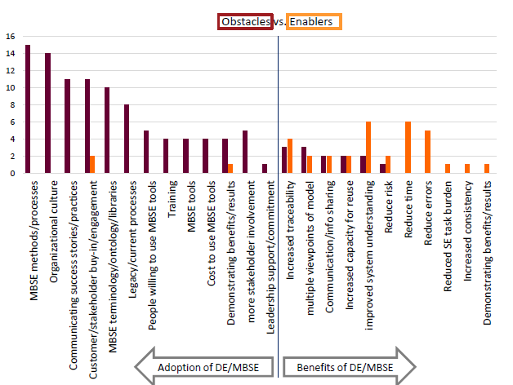
Tom McDermott, Stevens Institute of Technology et. al.
Benchmarking the Benefits and Current Maturity of Digital Engineering/
Model Based SE, March 26, 2020

Slide 5


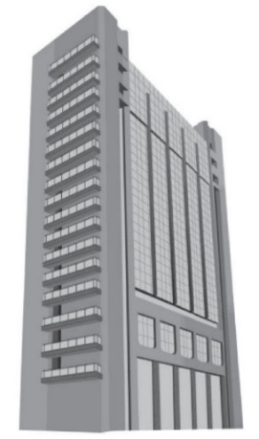
Understanding the Approach
Grady Booch’s Taxonomy of Approaches
Dog House
My House
City Block
Advanced Requirements
Quality Materials
Advanced tools
Advanced Skills
  -Builders, architects and
  electricians
  -Communication/ coordination
  -Monitoring the plans
Complex processes
Massively Increased scale and complexity
  -Legal/Permits/Codes
  -Diverse Stakeholders
Volatile requirements
Integrated processes
  IMS/Configuration Mgmt
Advanced materials
Integrated tools
Enterprise Skills
  Planners, Architects, Zoning Commission…etc.
  Communication/coordination
Basic Requirements
Basic Materials
Basic tools
Basic building skills.
-Basic hand-to-eye
co-ordination
JCIDS Demands the “City Block” Approach
¹ Booch G., Rumbaugh J., Jacobson I. The Unified Modeling Language User Guide. 2nd edn. Addison-Wesley:Boston, MA; 2005

Slide 6
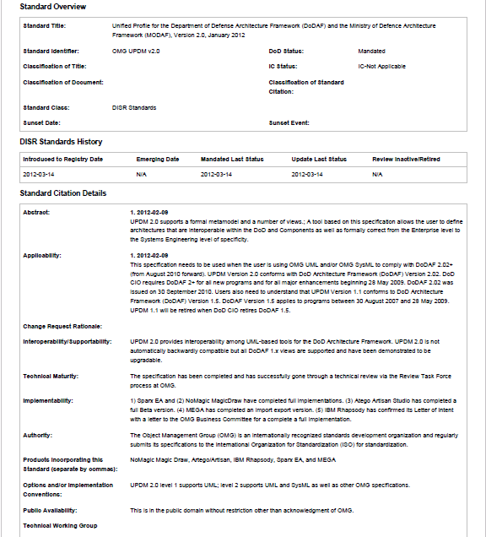
MBSE for JCIDS VISION – Leverage SysML and System Engineering Processes to Better Connect With User
SysML System Engineering
Flow and Related Diagrams
Block Definition, Requirement and Use Case Diagrams
User
Use Case, Activity, State and Sequence
Diagrams
PM
BDD, Internal Block and Parametric
Diagrams
User Requirements Analysis
Requirements
Validated System Model
Functions
Parametric
Trade
Studies
Functional Definition
Unified Profile for DoDAF and MODAF
(UPDM) Mandate
Potential Solutions
Physical Definition
Design Validation
DISR mandated UPDM 2.1 in 2013
…UPDM 2.1 (L1) merges SysML and DoDAF

Slide 7
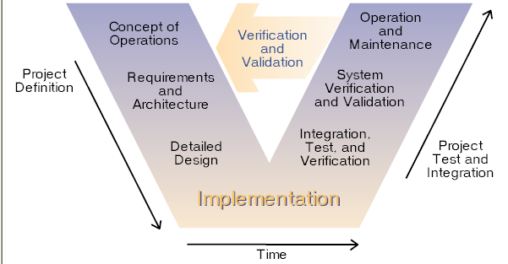
Systems Engineering Processes
A Project needs a documented Process that defines the various activities to be performed and the information to be captured
A Project needs a common Systems Engineering Modeling Language to capture and manage Project Information (i.e., Digital Data).
Technical Methods
• Requirements Development
• Logical Architecture
Physical Architecture
• Design Solution
• Implementation
• Integration
• Verification
• Validation
• Transition
Generation of Work Products
Management Methods
• Decision Analysis
• Technical Assessment
• Requirements Management
Architecture Management
• Risk Management
• Configuration Management
• Technical Data Management
• Interface Management
Traceability Management
…why is it that 15288 is not a model?

Slide 8


System Engineering Challenge for Acquisition
Why
What
How
Conceptual Architecture
(User)
Logical Architecture
(System)
Project Office
Physical Architecture
(Subsystem)
Vendor
-ID Gaps
-ID Stakeholders
-ID Relevant Doctrine/Organization
-ID Operational Context
-ID and Establish Concept of Operations
-Establish KPPs, KSAs
-Establish Design Constraints
-Develop System Functional Models and reference models
-Establish Traceability from requirement to test case (functions satisfy functional requirements)
-Define and communicate logical I/O
-Allocate Functions to Systems
-Allocate Logical I/O to Interfaces
-Establish contract Deliverables
-Develop Sub-System Functional Models
-Establish Traceability from requirement to test case (functions satisfy functional requirements)
-Define Physical I/O
-Produce and Deliver CAD Models and System Models
-Identify Test Cases and required evidences that requirements are satisfied
-Establish Subsystem Spec (s)
AUTL
Mission 1
Mission 2
System of Systems
METL
Operational Scenario #1
Technical Data Package
Operational Scenario #1
Operation Scenario #3
Pre
Operation Scenario #3
-
Launch
Operational Scenario #2
Launch
On
Pre
-
orbit
Pre
Pre
-
-
-
Launch
Launch
Launch
Operational Scenario #2
Launch
Launch
Launch
On
On
On
-
-
-
orbit
orbit
orbit
Pre
Pre
Pre
Pre
-
-
-
-
Launch
Launch
Launch
Launch
Launch
Launch
Launch
Launch
On
On
On
On
-
-
-
-
orbit
orbit
orbit
Point camera
Take picture
orbit
Point
Take
Store picture
Pre
Store
-
Launch
Launch
On
Pre
-
orbit
-
-
Launch
Launch
On
Camera
picture
-
orbit
picture
Product Development
R
Specifications
-Risk Assessment
-Capture Issues / Risks / Decisions
-Compliance & Cost Assessment
-Configuration Management
-Develop Requirements Spec
-ID Functional / Non-Functional Req
-ID Interfaces
-Design Verification & Validation
-ID Verification Objectives
-Test Planning
-Metrics
R1
R2
R1.1
Issue
Analysis Results
Risk
Use Standards, and conventions to communicate effectively between Why, What and How
Unclassified

Slide 9
Apply System Engineering Activities in Layers to Reduce Risk
Conceptual Layer
(OV)
Stakeholder Needs, Concerns, and Desired Capabilities
Mission Threads and Scenarios
(Usage Stories)
Stakeholder Requirements
&
External Interfaces
Product
Validation
Objectives
&
Document
Generation
Project
Purpose
&
Source
Material
Stakeholders,
Needs,
Concerns, Assumptions,
Desired Capabilities
Project and Systems Engineering Management Plans
Concept of Operation (Con Ops) Mission Threads
Operational Scenario
Behavior
(Nominal &
Off-Nominal) & CONOPS
Define
System
Operational
Context
Define
System
Operational
External
Interfaces
Define
Stakeholder
RQMTs with
Traceability
Back to
Con Ops
Design
in Layers
ICD, CDD, CPD
Logical Layer
(SV)
Requirements Analysis
&
Refinement
Logical Architecture Analysis
(i.e., Behavior)
Physical Architecture
Analysis
(i.e., Structures)
Product
Verification
Objectives,
Test Cases
&
Document
Generation
Analyze
RQMTs Defined during
Previous
Specification
Layer
Derive System RQMTs & Draft Component Part
RQMTs &
Verification
Objectives
Define
System
Threads to Support Mission Threads
Define
Draft
Behavior
for each
Component
Part
Define
Component
Parts (one
level down)
& Physical
Interfaces
Allocate
Behavior
to Primary
Entity and
Component
Parts
Establish
RQMT
Traceability
to
Architecture
Entities
Specifications
Solution Layer
Requirements Analysis
&
Refinement
Logical Architecture Analysis
(i.e., Behavior)
Physical Architecture
Analysis
(i.e., Structures)
Product
Verification
Objectives,
Test Cases
&
Document
Generation
Analyze
RQMTs Defined during
Previous
Specification
Layer
Derive Subsystem RQMTs & Draft
Component Part RQMTs &
Verification
Objectives
Define
Component
Behavior
from
Subsystem
RQMTs
Define
Draft
Behavior
for each
Component
Part
Define
Component
Parts (one
level down)
& Physical
Interfaces
Allocate
Behavior
to Primary
Entity and
Component
Parts
Establish
RQMT
Traceability
to
Architecture Entities
Specifications

Slide 10
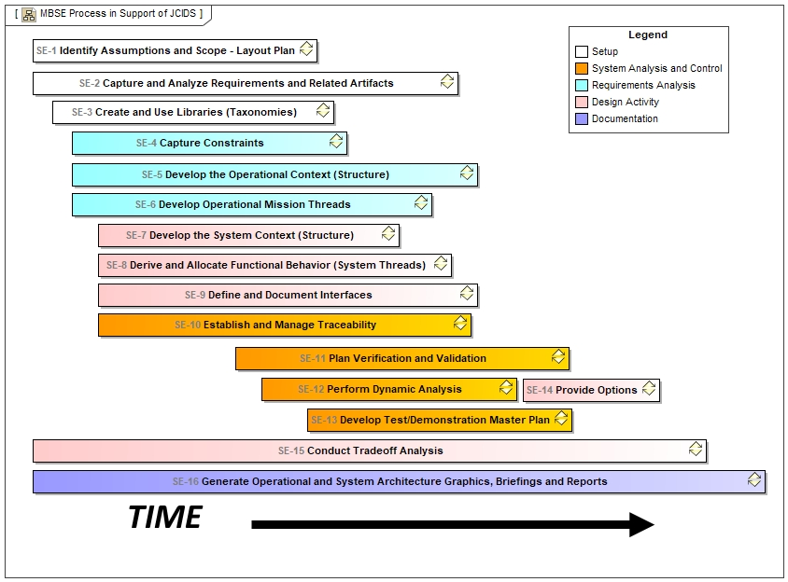
MBSE Processes
Inspired by Steven Dam in his book DoD Architecture Framework - A Guide to Applying System Engineering to Develop Integrated, Executable Architectures

Slide 11
MBSE Processes
Conceptual
Logical
Physical
Logical
Physical
Conceptual
Logical
Physical
Conceptual
Logical
Physical
Logical
Physical
Inspired by Steven Dam in his book DoD Architecture Framework - A Guide to Applying System Engineering to Develop Integrated, Executable Architectures

Slide 12
Process SE-1: Identify Assumptions, Define Scope and Project Plan
Identify Assumptions (can be independent of decisions)
Capture Issues / Risks / Decisions
Work with stakeholders to validate assumptions (may change over time)
Capture project scope
Develop project plans (process, information, and configuration management plans)
Capture glossary terms
Key Assumptions
Schedule
AV-1
AV-2
Issues,
Risks and
Decisions
Project Information Repository
SEMP
Stakeholder(s)
Work Product Templates
Project Scope
Work Product Templates
Templates
Glossary Terms

Slide 13
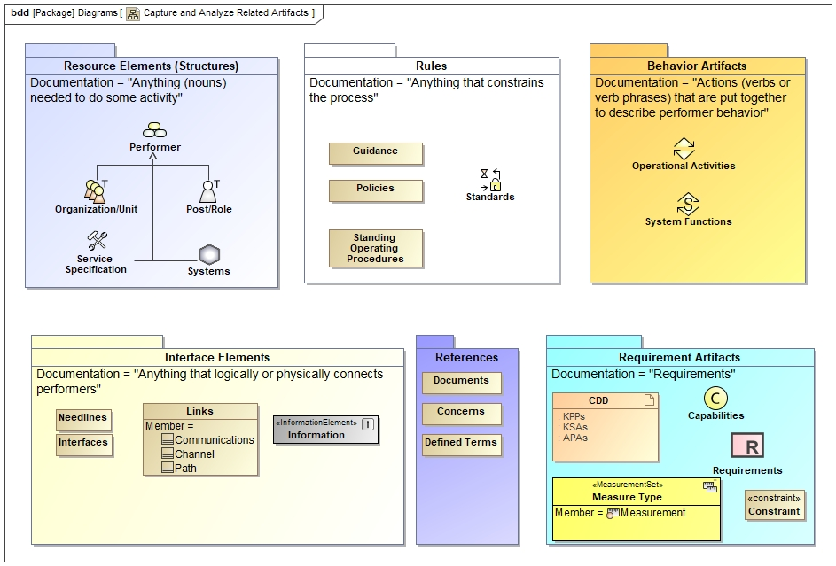
Process SE-2: Capture and Analyze Requirements and Related Artifacts
Identify what systems, organizations, roles and services currently exist that might affect this architecture both “as is” and “planned”

Slide 14
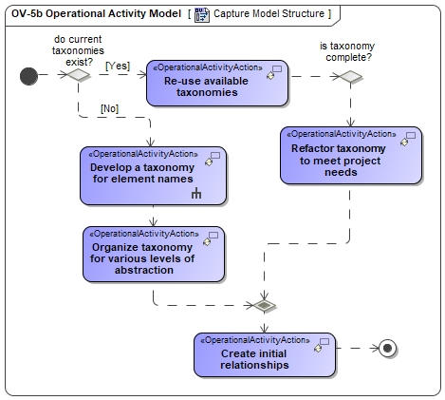
Process SE-3: Create and Use Libraries (Taxonomies)
Organize known requirements into libraries
Identify Information/Data exchange libraries
Organize or identify actor/component libraries (organization, posts, systems and services)
Begin to build draft function libraries (conceptual and logical placeholders)

Slide 15
Process SE-4: Capture Constraints
Constraints are things that a system must do for legal, policy or other reason
Standards that must be used e.g. Link 16 Interface
Laws and policies that govern development, operations and support e.g. environmental constraints
Frequency Allocation constraints
Operational Constraints e.g. requires 24X7 coverage
Physical constraints e.g. “paint it gray”(for the Navy)
System of system constraints e.g. must be operable by a soldier using his/her current equipment set (no new widget to carry)

Slide 16
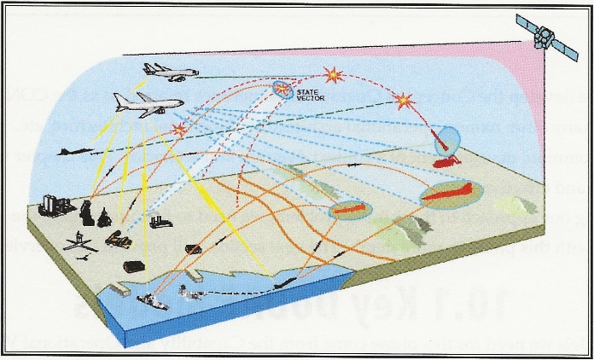
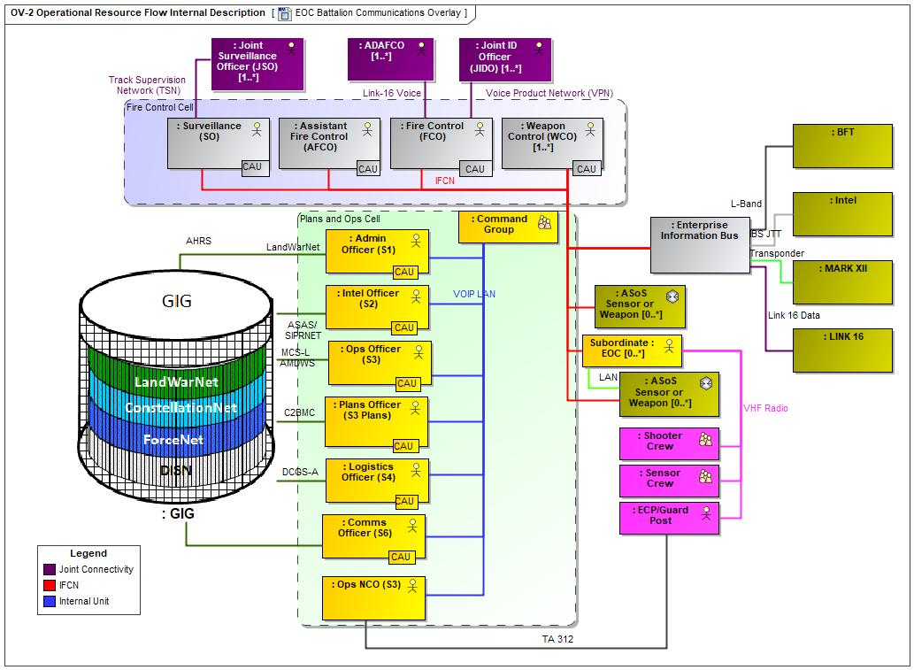
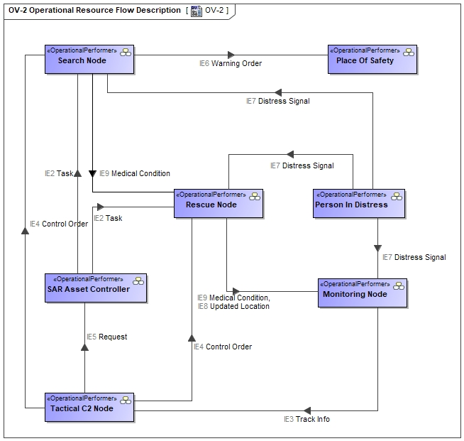
Process SE-5: Develop the Operational Context
OV1
Fit for Purpose View
OV2
Create “structure” diagrams to facilitate understanding of the behaviors

Slide 17
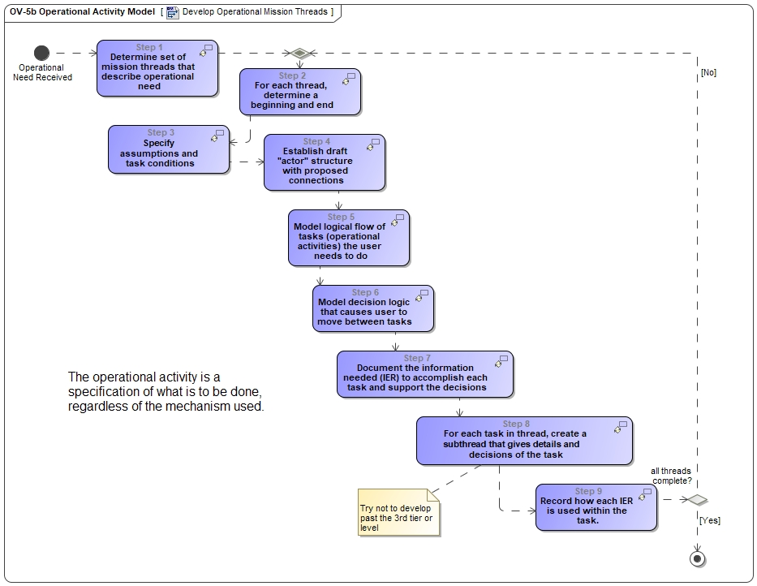
Process SE-6: Develop Operational Mission Threads
logical flow of the tasks the user needs to do
decisions that cause the user to move between tasks in the flow
the information needed to execute each task and to support the decisions
- independent of system or function
developed from the stakeholder’s
viewpoint NOT the developer’s

Slide 18
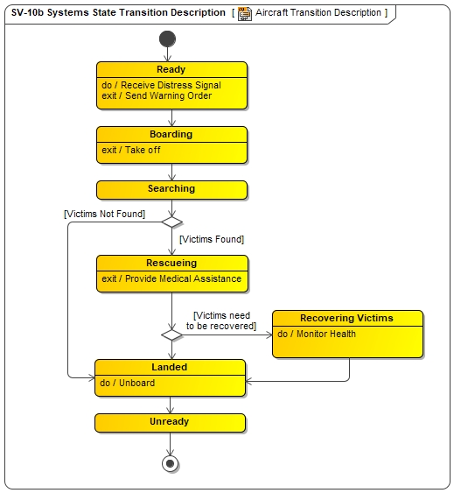
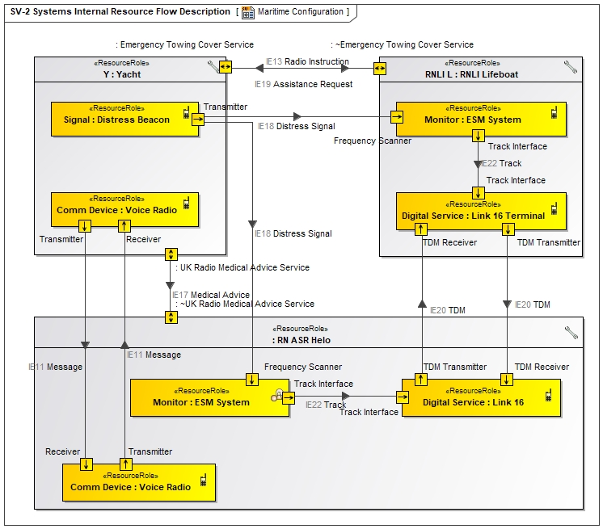
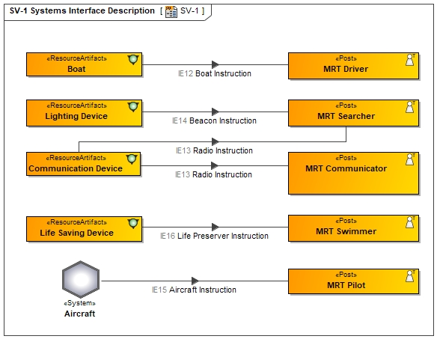
Process SE-7: Develop the System Context (Structure)
In this process the specific assets are described with interfaces for a specific capability configuration
States for the System
Specific Configuration [1..*]

Slide 19
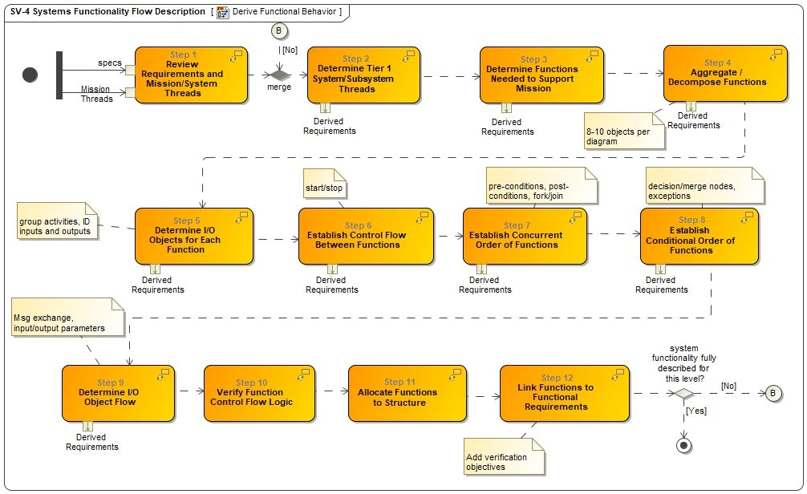
Process SE-8: Derive and Allocate Functional Behavior
(System Threads)

Slide 20
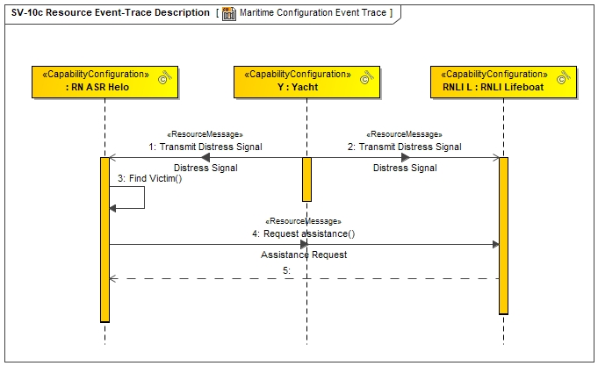
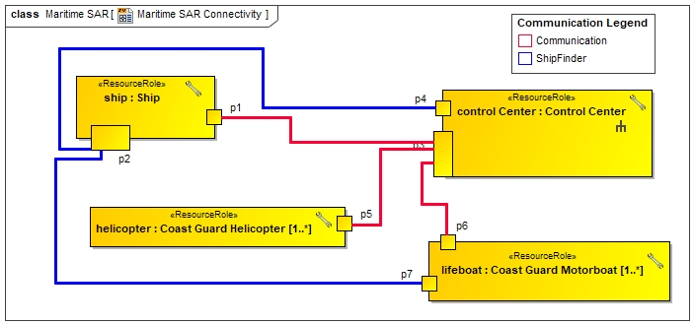
Process SE-9: Define and Document Interfaces

Slide 21
Process SE-10: Establish and Manage Traceability
Functional, non-functional, and interface requirements are derived for each level of the system structure hierarchy, traced to one or more previous level source requirements (i.e., «derived Reqt»), and traced to the architecture elements that «satisfy» the requirements.
Analyze the requirements defined in each layer to ensure they are valid requirements of type functional, non-functional, or interface requirements.

Slide 22
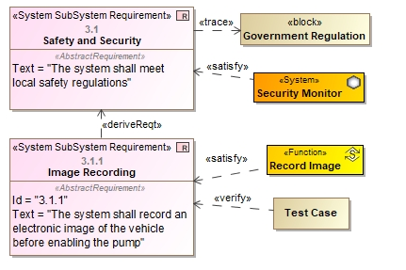
Process SE-10: Establish and Manage Traceability
(cont)
Trace requirements to the architecture elements that «satisfy» and «refine» them, and to their parent requirements at the higher level Specification using «derivedReqt» relationship.
Define Verification Objectives using the «verify» relationship to link the «testCase» to the «requirement» element.

Slide 23
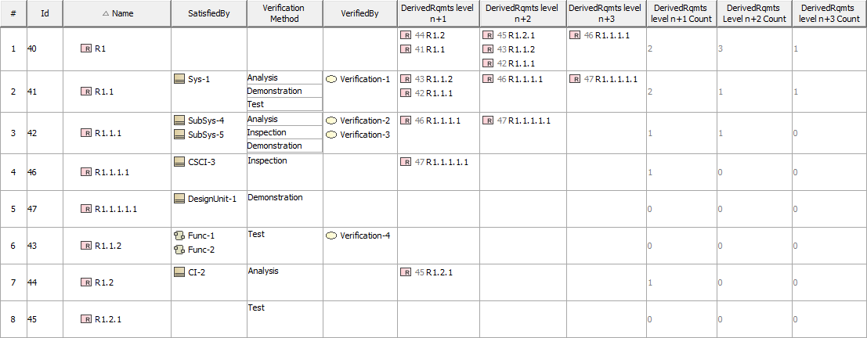
Process SE-10: Establish and Manage Traceability
(cont)
A Table is used to create audit reports to show folks what is in the repository and the traceability
List of all REQs
Architecture Entities that satisfy REQ
REQ Verification Methods
REQ Verification Objectives
3 Levels of Traceability of derived REQs
Count of derived REQs at each Level

Slide 24
Process SE-11: Plan Verification and Validation
Capture the status of each V&V activity in the database with traceability back to the impacted requirement or stakeholder operational mission threads.
Verification Traceability. The purpose of the Verification Process is to confirm that the specified System Requirements are fulfilled by the system design.
Validation Traceability. The purpose of the Validation Process is to provide objective evidence that the services provided by a system when in use comply with stakeholders’ requirements, achieving its intended use in its intended operational environment.

Slide 25
Process SE-12: Perform Dynamic Analysis
“Model Based” Acquisition Toolbox
(has many components)
(use the right tool to “think through” the question being asked)
Force-on-Force Simulations/
Few-on-Few Experiments (L/V)
Feasibility Study/Concept Exploration
MBSE – UPDM/SysML
(Descriptive AND Analytical)
Operations and Maintenance
Retirement/ Replacement
Regional Architecture(s)
Lifecycle Processes
Concept of Operations
System Validation Plan
System Validation
Technology Refresh
System Requirements
System Verification Plan
(System Acceptance)
System Verification & Deployment
TEST
MBDesign
High Level Design
Subsystem Verification (Subsystem
Acceptance)
Subsystem Verification
Rapid Prototyping
Decomposition and Definition
Integration and Recomposition
Analytical Models
Detailed Design
Unit/Device Test Plan
Unit/Device Testing
Software/Hardware
Development
Field Installation
Implementation
Software Design
Mechanical System Design
Electrical System Design
Electro-mechanical System Design
CAD/CAM
Performance Analysis Tools
HWIL/SWIL
Integration
Sim/Stim
Data Collection/Reduction
Timeline
Unclassified

Slide 26
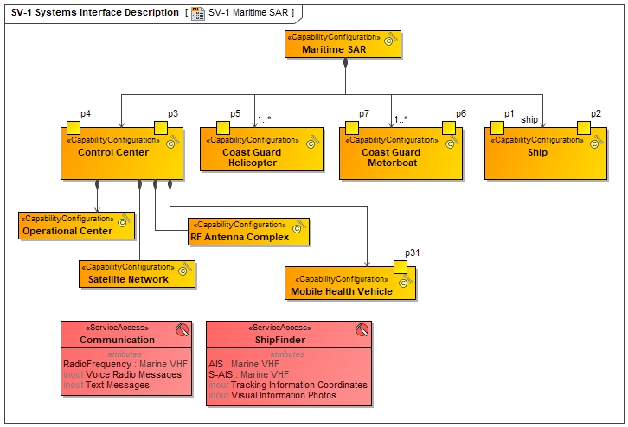
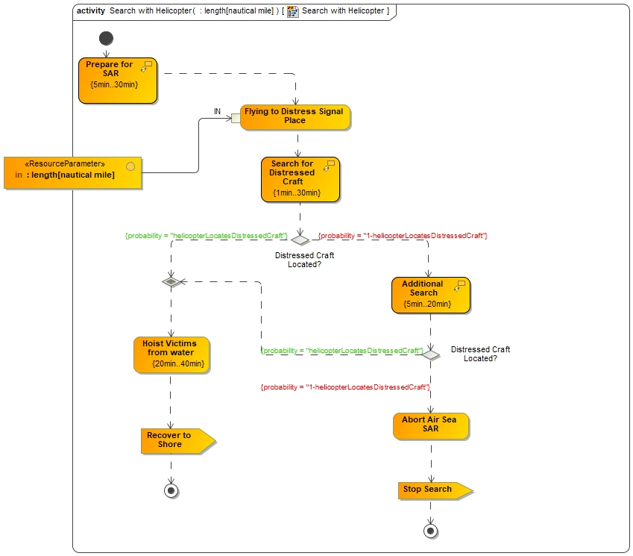
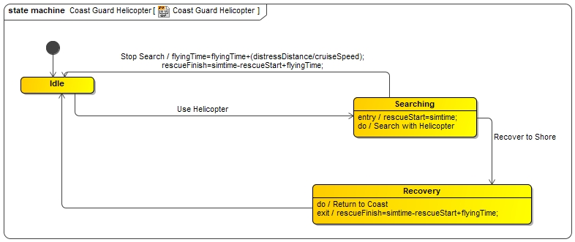
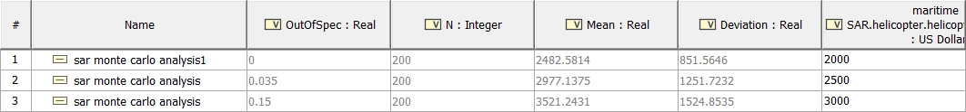
Process SE-13: Develop Test/Demonstration Master Plan
MagicDraw has a report wizard that allows users to capture test configurations, sequence diagrams, instance tables, and other artifacts

Slide 27
Process SE-14: Provide Options
When supporting management decisions, trade studies, architecture models, detailed (and readable) diagrams go a long way in providing value
Using a collaborative environment, stake-holders can be “in-the-loop” as the system engineering artifacts are developed, vetted and approved.
Options can be shown by a series of capability configurations. Decisions can also be documented

Slide 28
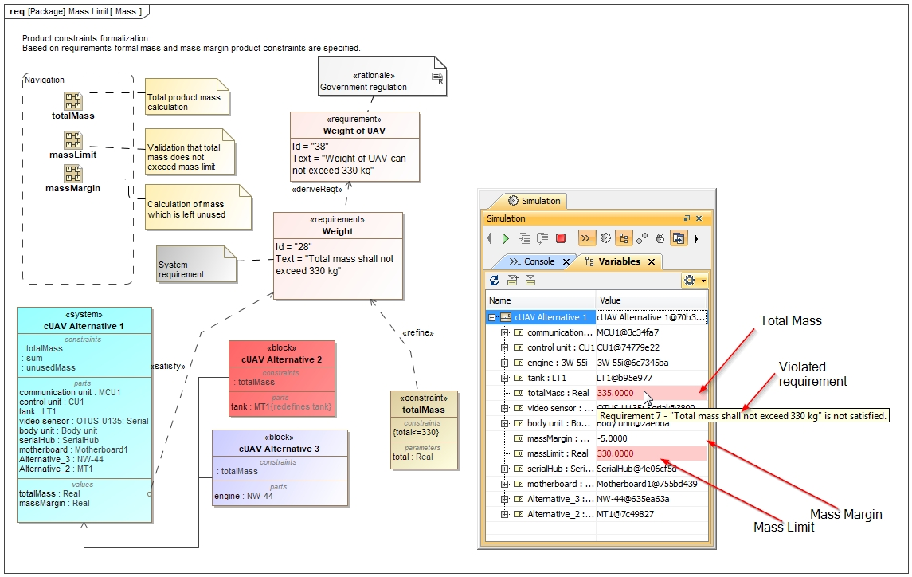
Process SE-15: Conduct Tradeoff Analysis

Slide 29
Process SE-16: Generate Operational and System Architecture Graphics, Briefings and Reports
Establish requirements/architecture baselines at each level of system structure
Generate deliverable documentation for each system element from the element’s digital architecture information in the project information repository.
  Standardize the look and feel of the project’s documentation by using pre-defined templates.
  All documents that can be generated from the project information repository should be auto generated from it, not hand crafted.

Slide 30
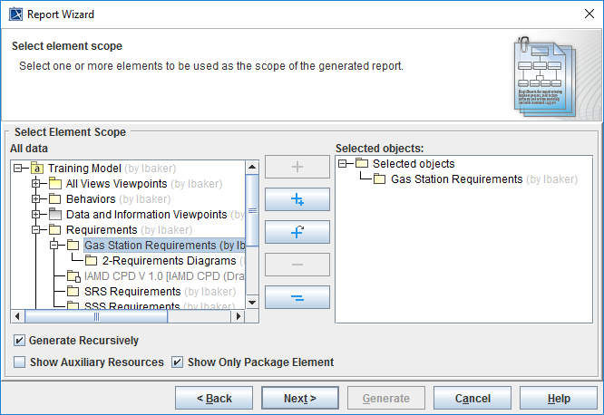
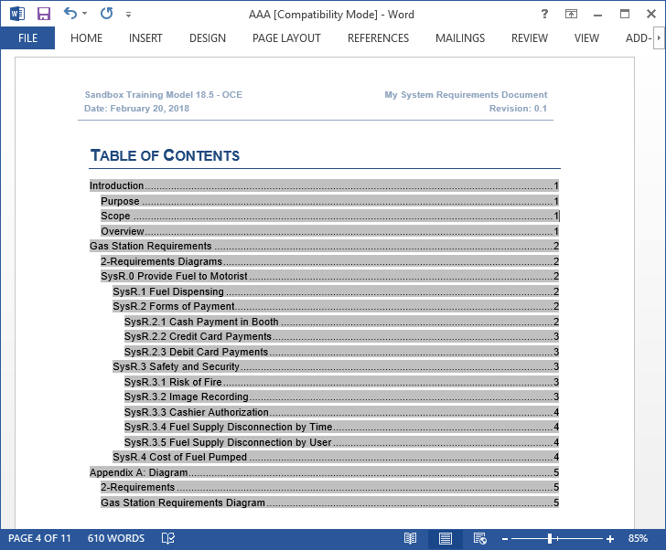
Process SE-16: Generate Operational and System Architecture Graphics, Briefings and Reports (cont)

Slide 31
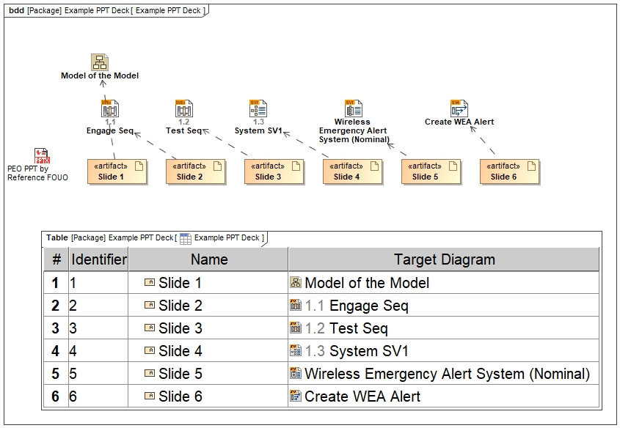
Process SE-16: Generate Operational and System Architecture Graphics, Briefings and Reports (cont)

Slide 32

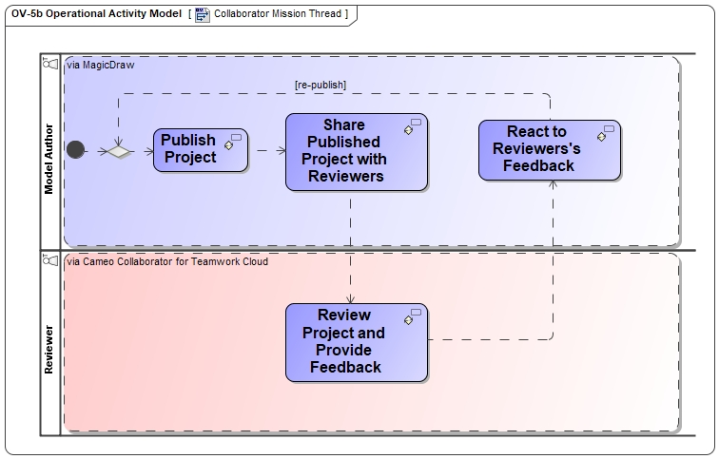
Process SE-16: Generate Operational and System Architecture Graphics, Briefings and Reports (cont)
Send URL
-Present models to stakeholders,
sponsors, or customers
-Present models to engineering teams
(modelers and non-modelers)
-Keep stakeholders/engineering
teams up-to-date with the precise, consistent information
-Review models and write comments to provide feedback to model authors
-Edit requirements on the web without having to use MagicDraw

Slide 33
MBSE Processes
Starting Point
Inspired by Steven Dam in his book DoD Architecture Framework - A Guide to Applying System Engineering to Develop Integrated, Executable Architectures

