Slide 1
MBSE Requirement Traceability Demo with SysML
Jared Biggs, Trideum Corporation

Slide 2
Purpose & Scope
Purpose
Contribute to WG goal to codify requirement model element relationships
Provide a Demo of tracing various elements to a notional requirement using SysML
Discuss connector types in SysML
Discuss arrow direction and why it matters
Brief will include some discussion of Sparx Enterprise Architect (EA), but is not the main purpose
Not to be confused with Cameo Enterprise Architecture (EA)
Scope
Brief will center on Requirements traceability: not defining architectures, interfaces, parametrics, etc.
This topic gets confusing very quickly due to overlapping terminology, varying toolsets, experience levels, industry terminology, practices, domains, etc.

Slide 3
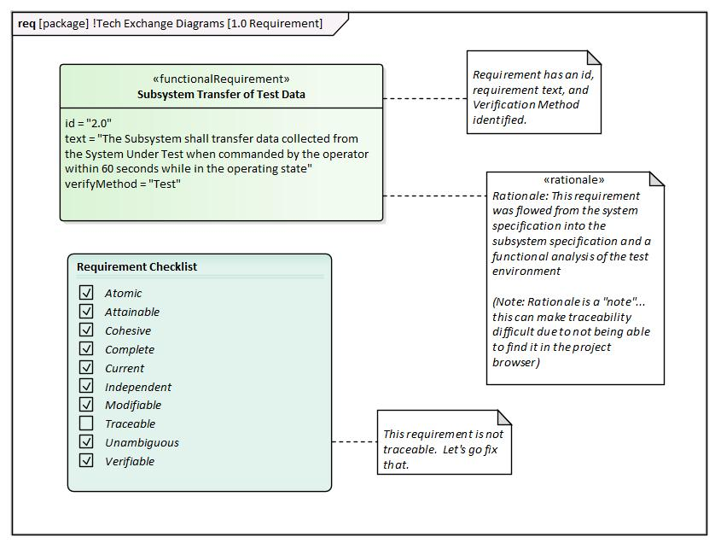
Requirement
Requirement listed has no traceability attributes
Artifacts of interest might be:
Parent
Function(s)
Test Cases
Analysis
Use Case
Logical Architecture
Verification
Etc.
A lack of traceability makes it difficult to assess requirement definition maturity as shown in the next slide
This requirement is not traced to anything. Let’s fix that

Slide 4
Requirement Traceability
How do I go from this:
ID | Requirement | Parent Name | Verification Method | Use Case | Function | Test Case | Logical Architecture Element | References | State | Rationale | Product Structure Element
 | Transfer of Test Data
to This?
ID | Req | Parent Name | Verification Method | Use Case | Function | Test Case | Logical Architecture Element | References | State | Rationale | Product Structure Element
2.0 | Transfer of Test Data | Parent Requirement | Test | Conducting a Data Transfer | Transer Test Data | Transfer from Test Element to Capture Element | Automated Test System | MIL-STD-123 | Operating | This requirement was flowed from the system specification… | Solution
SysML allows us to create this type of tracing via connectors

Slide 5
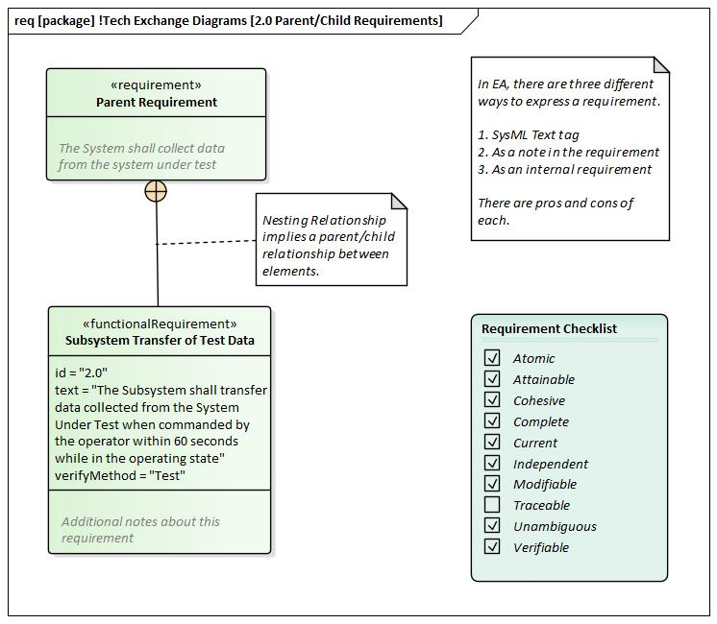
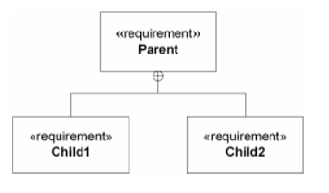
Parent/Child Relationship Connector
This requirement is now traced to the parent via a “Nesting/Containment” relationship.
The crosshair will need to be on the parent.
This is a one-to-one trace, but one parent can have many children
In rare cases, one child might have multiple parents. Consider using a derive trace for the tertiary “parent” requirement(s)
Metrics: Capture metrics to show how many requirements are either orphans or childless.
Recommend using Nesting/Containment when a parent to child association is needed

Slide 6
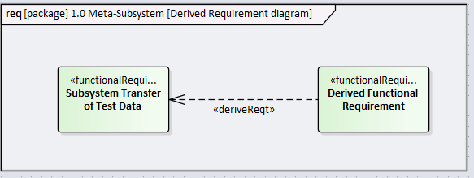
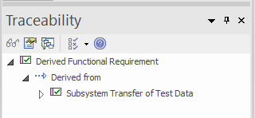
Derived Requirement Connector
Derived requirements are created when an analysis shows that additional requirements are needed to accomplish a given requirement.
“A DeriveReqt relationship (…) in which a client requirement can be derived from the supplier requirement. (…) As with other dependencies, the arrow direction points from the derived (client) requirement to the (supplier) requirement from which it is derived” – OMG SysML v1.6
The newly derived requirement will need to point back to the deriver(s) requirement(s)
Recommend using DeriveReqt when an analysis reveals that additional requirements are needed. This can be at sibling level and across tiers

Slide 7
Wait, which way does the arrow go?
SysML arrow direction can be a potential source of confusion for MBSE practitioners and audience members
Arrow direction defines which elements have which attributes
Ownership
Verification details
Allocations
Refinement
Usage
Traceability
Etc.
“Most requirement relationships in SysML are based on the UML dependency. The arrow points from the dependent model element (client) to the independent model element (supplier). Hence in SysML, the arrow’s direction is opposite to that typically used for requirements flows, where the higher-level requirement points to the lower-level requirement. Take care with this when you draw your relationships!” – Requirements Engineering Magazine
Pay close attention to arrow direction over the following slides. Watch for any inconsistencies

Slide 8
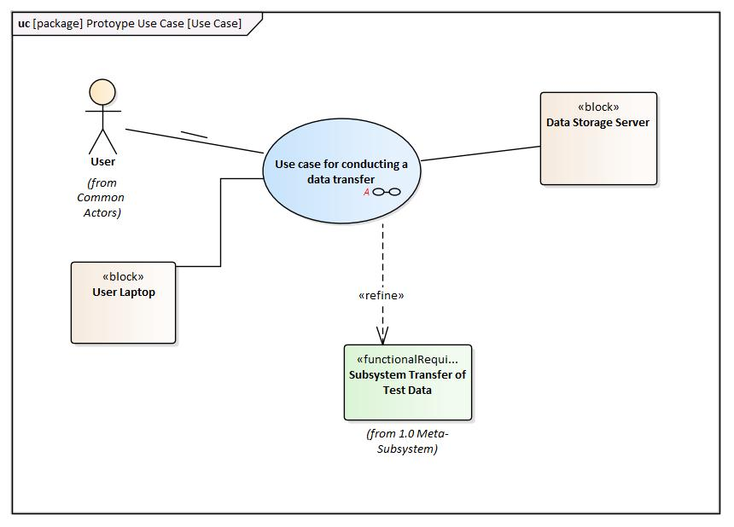
How to refine a Requirement using the Refine Connector
We created a Use Case to help better understand and refine the requirement
This Use Case is now associated with the requirement via a “refine” relationship
This use case is used to better understand the developers interpretation of the requirement, hence, <<refine>>
Read this connection as: This Use Case refines that Requirement
Refine can be used with other entities, (such as state/modes, activity diagrams, even other requirements)
Recommend using Refine when you are trying to reduce ambiguity about the requirement or model element.

Slide 9
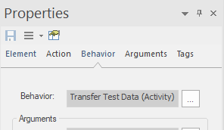
Relate Function to Functional Requirements (Syntax issue)
This diagram shows the functional analysis involved with completing a particular activity of interest
The action listed in the subsystem element swimlane is “calling” to the functional behavior (Transfer Test Data)
Discussion point: I’m using a Dependency to trace the function to the requirement, but could have used a different connector
EA enforces “strict UML syntax” which limits the relationship types you can use. This can option can be turned off in the Preferences.
Metrics: Capture metrics to show how many Functional Requirements do not have an associated function assigned.
Discuss which connector should be used to trace an Activity (Functional behavior) to a requirement.

Slide 10
Satisfying a Requirement with design elements
Structural design elements (blocks) satisfies the requirement of interest (whether logical or solution based)
Read this connection as: This block satisfies that Requirement
Metrics: Capture metrics to show how many requirements do not have a physical element associated to it.
Note: Example below shows a logical decomposition block to satisfy the requirement. Other organizations may use the solution element.
Recommend using Satisfy when allocating a structural block to a requirement (logical if applicable)

Slide 11
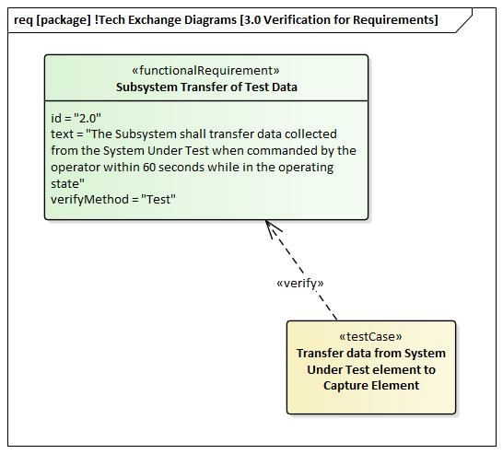
Verification for Requirements
Verification methods are described within the requirement block
Metrics: Capture how many requirements have no verification method defined
Metrics: Capture percentage breakdown of the different verification methods being used
The test case listed will allow the team to verify the requirement
Read this connection as: This test case verifies that requirement
Metrics: Capture how many requirements have no Test Cases described, and hence, have no verification details
TestCase can be used to describe standard verification methods: analysis, inspection, demo or test
Establish verbiage for each type
Ensure that both the Verification Method and the Test Case are in alignment with each other

Slide 12
Tracing a requirement back to a reference document
This diagram represents the trace of the requirement back to a reference document
This could be a MIL-STD, Industry Standard, Memo of Understanding, Engineering Change Request, etc.
Read this connection as: This requirement is traced back to that document.
“Trace” Relationship should be used sparingly throughout the model due to potential over-use.
“A generic trace requirement relationship provides a general-purpose relationship between a requirement and any other model element. The semantics of trace include no real constraints and therefore are quite weak.”
- OMG SysML V1.6
Ensure that Trace isn’t being used as a duplication of the other relationships described previously

Slide 13
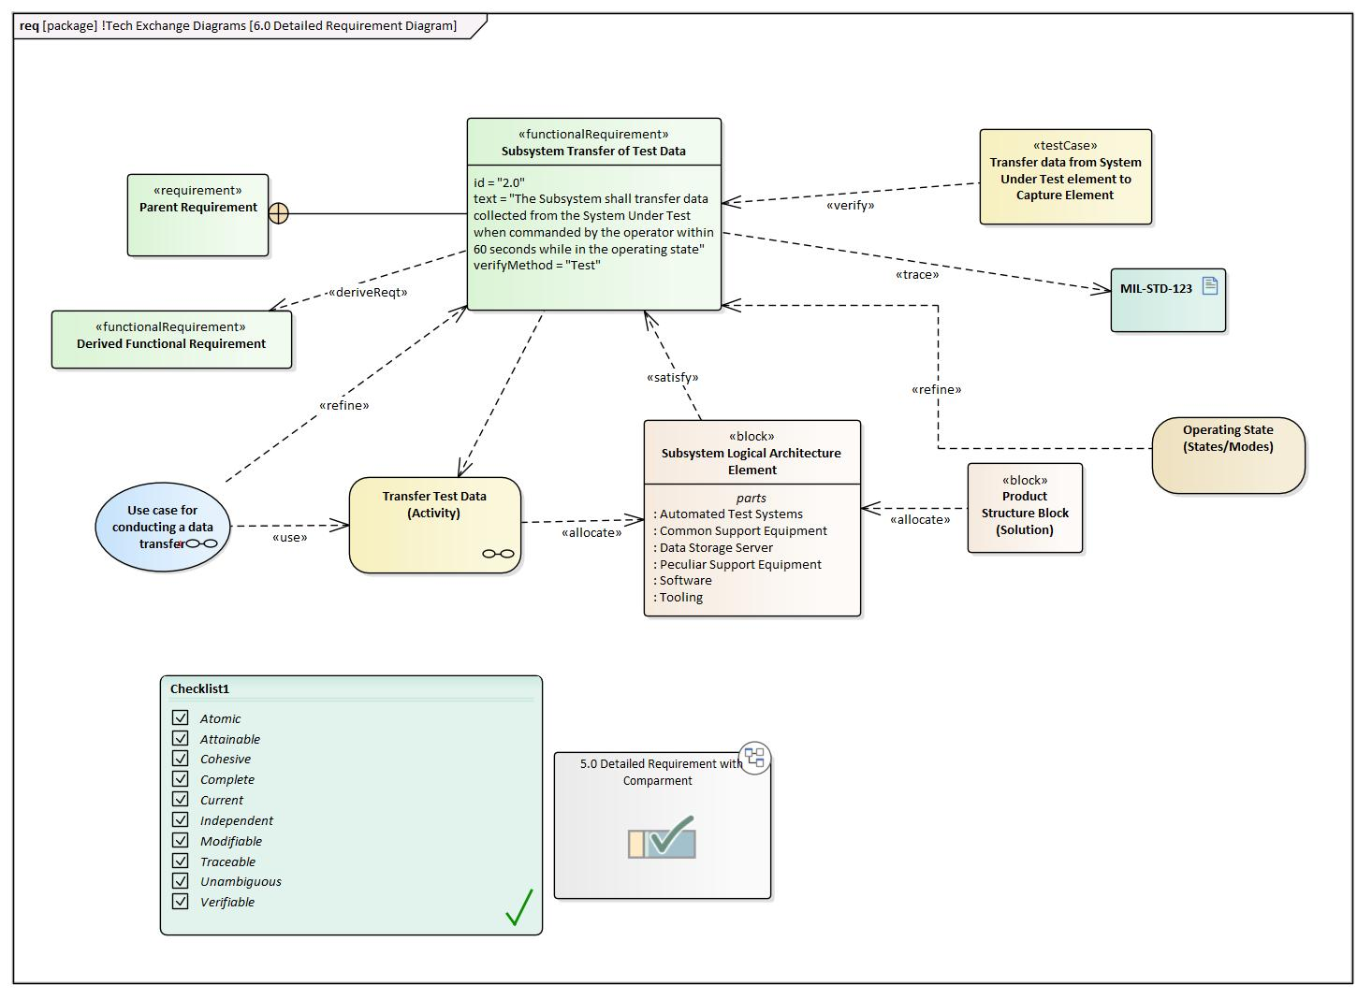
Established Requirement Traceability
The requirement is now fully traced, and is persistent across the model
Traceability can be queried and displayed in various forms and formats (Graphical is shown)
Tables
Matrices
Graphical
Compartments
We can assert that this requirement has been fully decomposed and defined due to all of the traceability that we have established (completeness)
Discussion point
Take note of all the various directions of each arrow
Capture metrics any missing traces
Notice any arrows going in the wrong direction?
Requirement traceability scope will need to be tailored for your organization

Slide 14
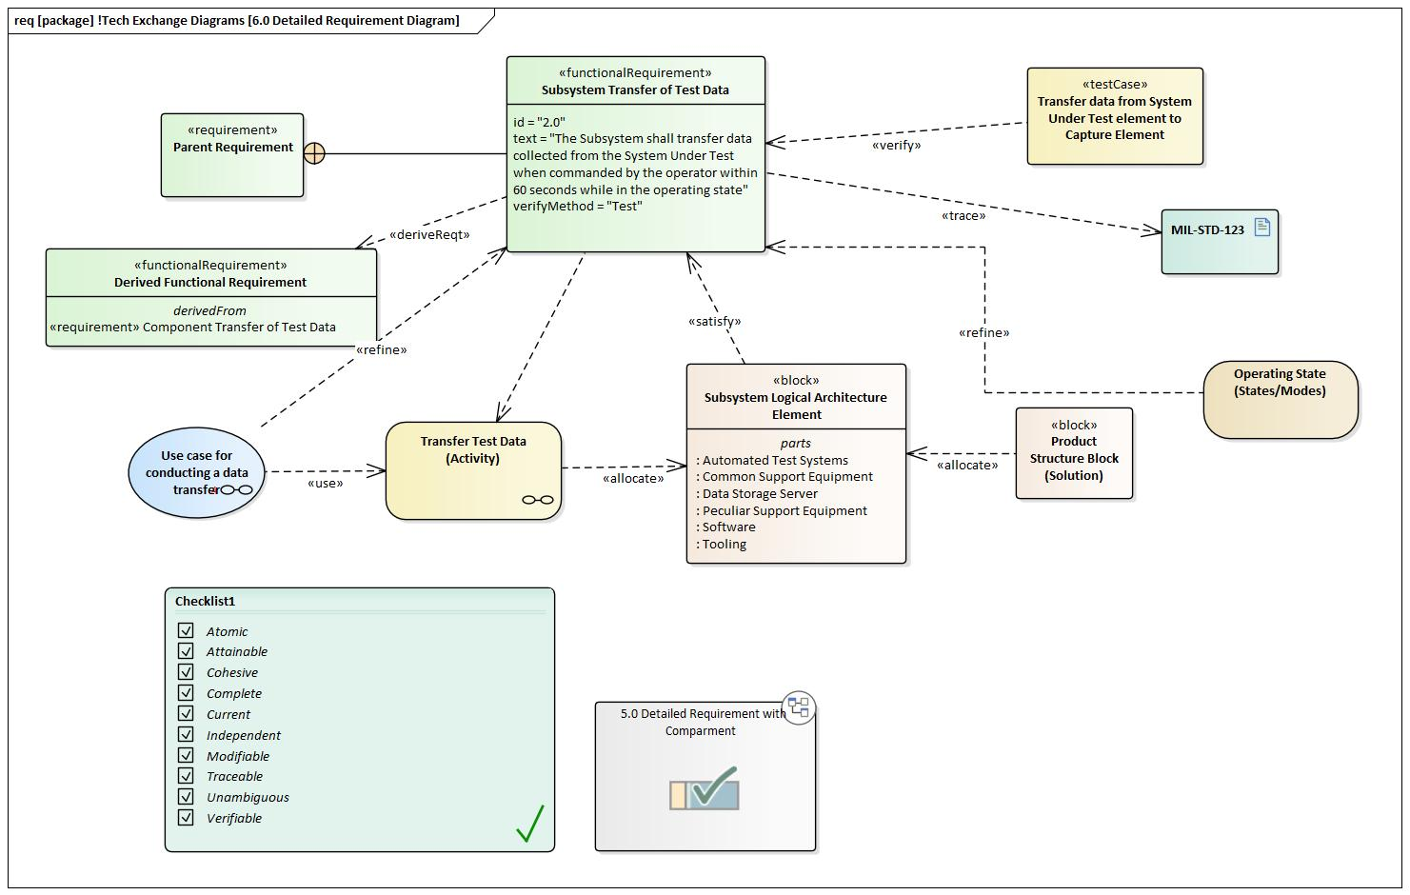
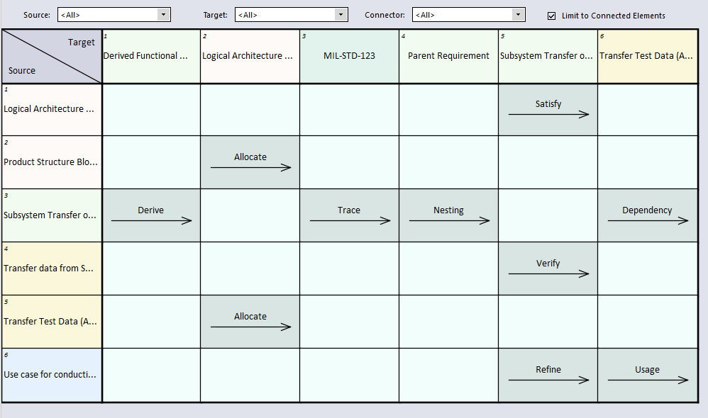
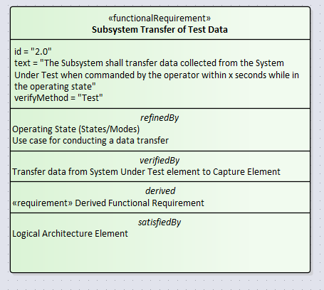
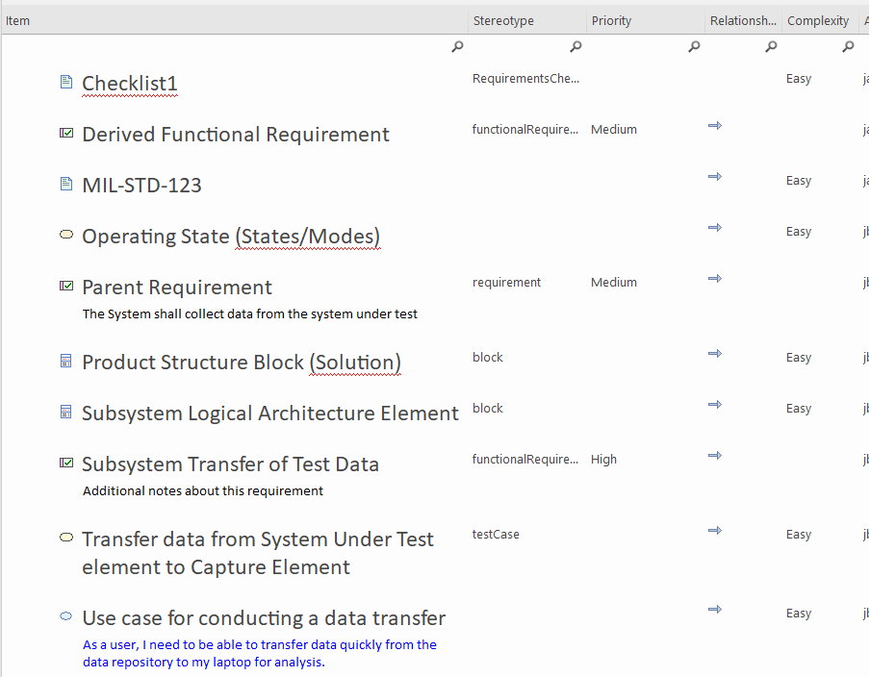
Alternate Views
MBSE allows us to view the same data either graphically, lists, or in matrices
All of these screenshots are of the same requirement from different views

Slide 15
Building Requirement Maturity via tracing
We can not effectively “navigate the meta-chain” to assess maturity if our arrows, relationship entities, and element types are inconsistent across the model.
The compartments of your requirements will be incorrect
Collecting metrics will be difficult
Traceability may appear to be broken
The table and the graphical representations are equivalent ways of showing your traceability
These won’t be in alignment if the arrows or incorrect connectors are used
ID | Req | Parent Name | Verification Method | Use Case | Function | Test Case | Logical Architecture Element | References | State | Rationale | Product Structure Element
2.0 | Transfer of Test Data | Parent Requirement | Test | Conducting a Data Transfer | Transer Test Data | Transfer from Test Element to Capture Element | Automated Test System | MIL-STD-123 | Operating | This requirement was flowed from the system specification… | Solution
Consistent use of various connectors will ensure that you can find the attributes of interest

Slide 16
Summary
SysML connectors and requirement attributes can be used to fully define and trace a requirement
Parent/Child
Satisfy
Verification Method and Details
Allocations
Rationale
Etc.
Consistent use of various model elements and connections are critical to a cohesive and mature model
Building consistent requirement tracing is a stepping stone towards mature model
Regardless of connector type or arrow direction, it is much better to be consistently “wrong” than it is to be inconsistently “right”
Inconsistencies are very difficult to find and correct
Consistently “wrong” uses are much easier to fix
Developing a style-guide and example model in your enterprise will enable better requirement traceability across your model

Slide 17
BACKUP

Slide 18
Resources
Object Modeling Group
OMG Systems Modeling Language (OMG SysML™) V1.6
Friedenthal, Sanford, Steiner
A Practical Guide to SysML: The Systems Modeling Language. Third Edition
INCOSE Presentation: OMG Systems Modeling Language Tutorial (2009)
Delligatti, Lenny.
SysML Distilled: A brief Guide to the Systems Modeling Language
Weilkiens
SYSMOD - The Systems Modeling Toolbox - Pragmatic MBSE with SysML
Friedenthal, Oster
http://sysml-models.com/spacecraft/
Requirements Engineering Magazine
https://re-magazine.ireb.org/

Slide 19
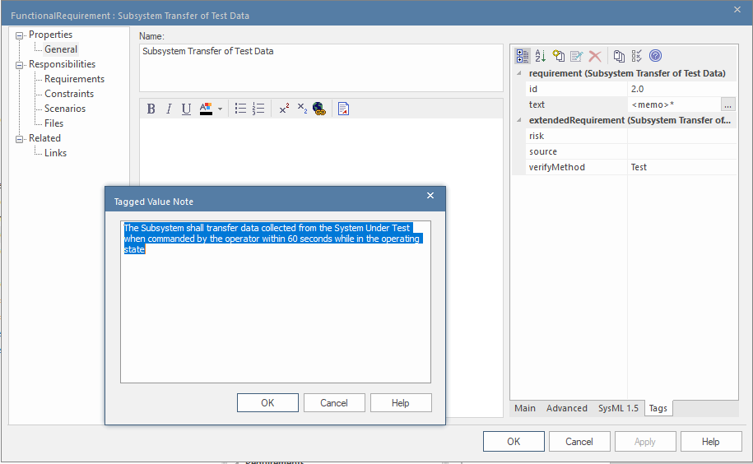
How To: SysML ID, Text, and Verification Method in EA
The following are the steps to specify SysML ID, Text, and Verification Method:
1. Double-Click on the Requirement (to show Properties)
2. Click on Tags
3. Modify the ID
4. Click on “…” next to text
5. Update the verifyMethod,
3.
4.
5.
2.

Slide 20
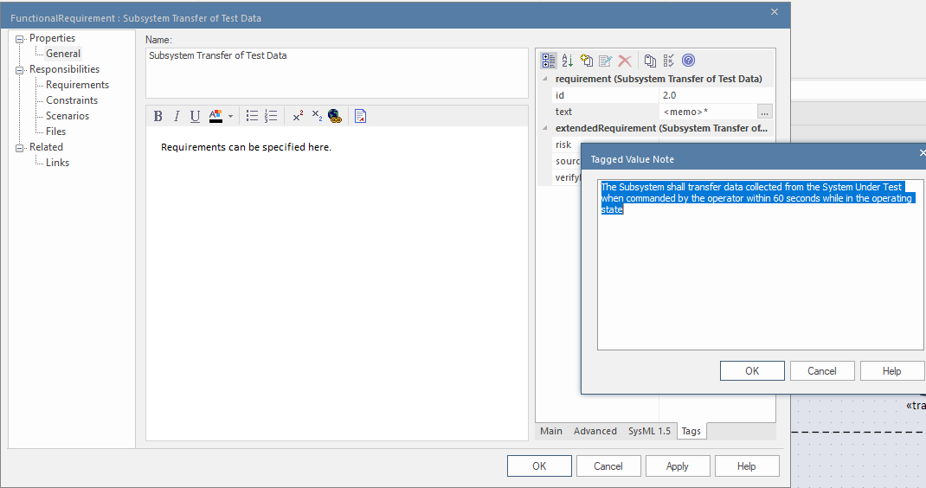
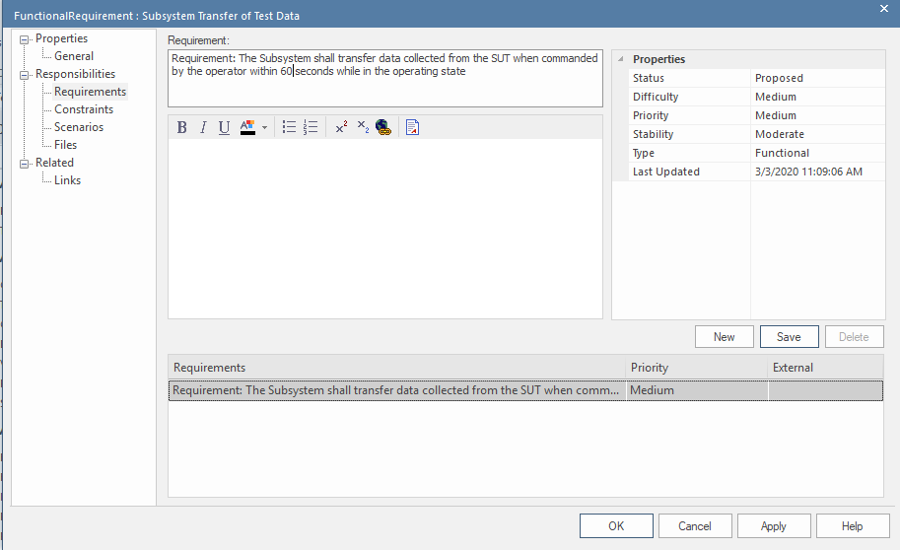
Three ways to specify a requirement in EA
In EA there are three different ways to specify a requirement
There are pros and cons to each
Your team needs to decide where and how you will specify requirements
#3 is the “correct” way to specify the requirement text in SysML, but #1 is much more convenient to find and use in EA
1.
3.
2.
Recommend that style-guide and example model directly address where requirements need to be defined

Slide 21
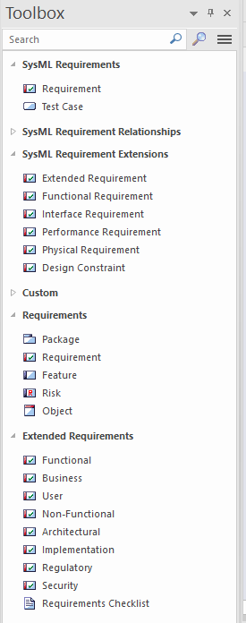
Discussion Point: Requirement Types
Take note of how many requirement types there are in the toolbox
Includes non-SysML types
The requirement type should be consistent across your enterprise, otherwise you may run into similar issues as experienced with traceability
Makes requirement metrics difficult to measure
Recommend that style-guide and example model directly address requirement type. Should align with enterprise definition of requirement types

Slide 22
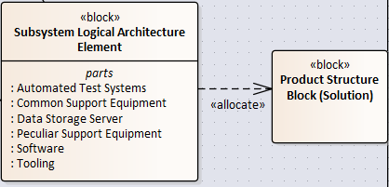
Functional and Structural Allocation
Functional Allocation (also known as behavioral allocation)
Allocate connector can be used to associate a function performed by the system of interest
Read this as: This function is allocated to that system
One system may have hundreds or thousands of functions allocated to it (directly or indirectly)
Allocate connector can be used to assign the Logical Element to a physical solution element.
Logical elements are typically defined early in the lifecycle before a solution has been defined
The logical architecture can be allocated to the solution once it has been defined
Some organizations do not assign logical architectures, and instead proceed directly to the solution
Similar schema can be used to allocate a software property to a hardware property

