Slide 1
Digital Engineering Transformation of Requirements Analysis within Model-Based Systems Engineering
Presented at 10TH ANNUAL WORLD CONFERENCE OF THE SOCIETY FOR INDUSTRIAL AND SYSTEMS ENGINEERING
Andrew R. Miller, Ph.D., PMP and Daniel R. Herber, Ph.D.
Department of Systems Engineering
Colorado State University
Fort Collins, CO 80523

Slide 2
Agenda
Background
Methodology
Brief Example
Conclusion
References
Questions and Answers

Slide 3
Background
Digital Engineering (DE): An integrated digital approach that uses authoritative sources of systems' data and models as a continuum across disciplines to support life cycle activities from concept through disposal.¹
Model-Based Systems Engineering: MBSE is the formalized application of modeling to support system requirements, design, analysis, verification and validation activities beginning in the conceptual design phase and continuing throughout development and later life cycle phases.²
Architecture: System fundamental concepts or properties of a system in its environment embodied in its elements, relationships, and in the principles of its design and evolution.³
Requirement Quality: Consistency, correctness, and completeness of the translation are the measure of goodness with respect to architecture and model maturity.⁴
The presented approach provides rigor and formality to translate document data for requirements analysis to instantiate a quality architecture
Notes:
Ref 1 DEFENSE ACQUISITION GUIDEBOOK, VOLUMES 1 & 2. (2013). Army AL & T, 163–.
Ref 2 INCOSE SE Vision 2020 (INCOSE-TP-2004-004-02, Sep 2007)
Ref 3 ISO/IEC/IEEE 42010:2011(E) (Revision of ISO/IEC 42010:2007 and IEEE Std 1471-2000). (2011). IEEE.
Ref 4 Faudou, R. (2016) Requirements and Architecture Within Modeling Context, AFIS (Association Française d’Ingénierie Système). INCOSE Affiliate
Notes:
Architecture Forms the Basis of Process Relationships in a Digital Engineering Flow
Developed Models Consist of Organized Structure and Relationships of Elements creating an architecture
MBSE Process Provides Orderly Definition of Model Elements, Relationships and Attributes in a Balanced System Design Architecture

Slide 4
Background Cont.
Traditional system designers use analog or ad hoc practices in translating the nonspecific text of customer requirements’ to detailed technical functional requirements
Sometimes this is not clear, concise, correct, and or even verifiable
Specifications must be revised repeatedly to arrive at a suitable quality level to reduce programmatic risk
DoD capabilities typically give rise to more relevant detailed requirement information from many stakeholders, driving increased data sharing needs and enabling greater data analytics (feedback loops) in the holistic lifecycle management, but at the same time introducing programmatic and quality risks
Human-centered translation is where ambiguity and programmatic risk are introduced in the traditional SE process
Ambiguity and programmatic risk are most often introduced by translation of SE documentation into the Digital Engineering Environment
Notes:
Ref 1 DEFENSE ACQUISITION GUIDEBOOK, VOLUMES 1 & 2. (2013). Army AL & T, 163–.
Ref 2 INCOSE SE Vision 2020 (INCOSE-TP-2004-004-02, Sep 2007)
Ref 3 ISO/IEC/IEEE 42010:2011(E) (Revision of ISO/IEC 42010:2007 and IEEE Std 1471-2000). (2011). IEEE.
Ref 4 Faudou, R. (2016) Requirements and Architecture Within Modeling Context, AFIS (Association Française d’Ingénierie Système). INCOSE Affiliate

Slide 5
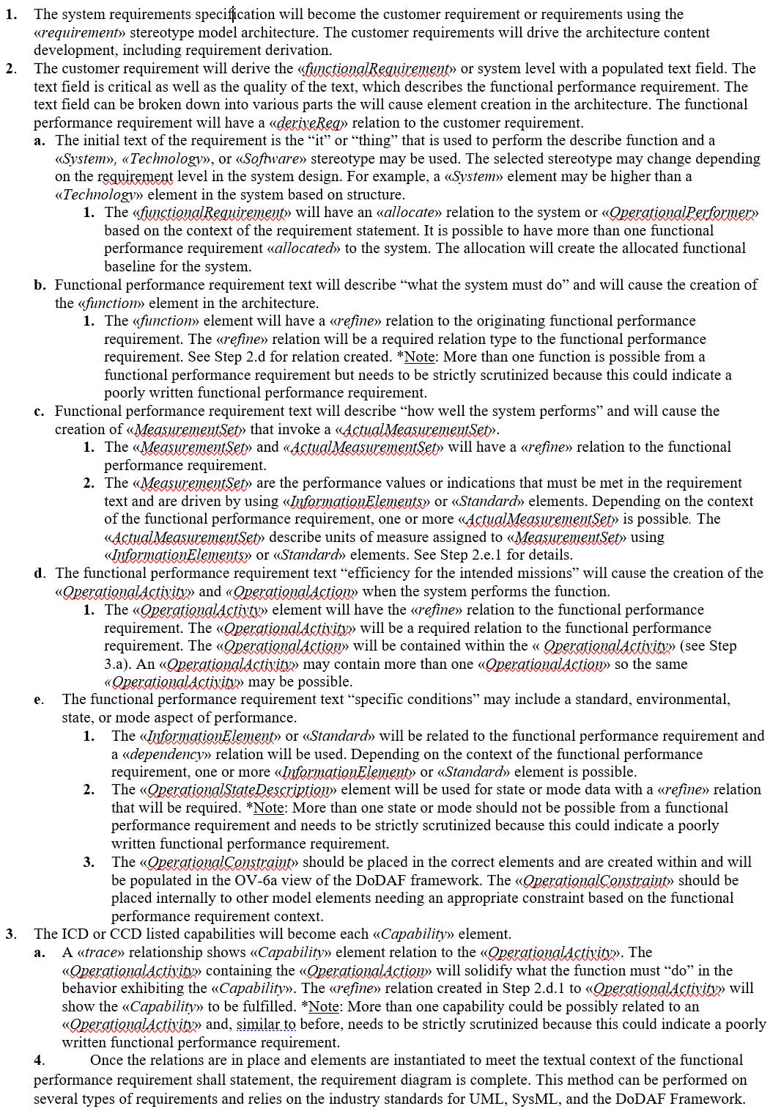
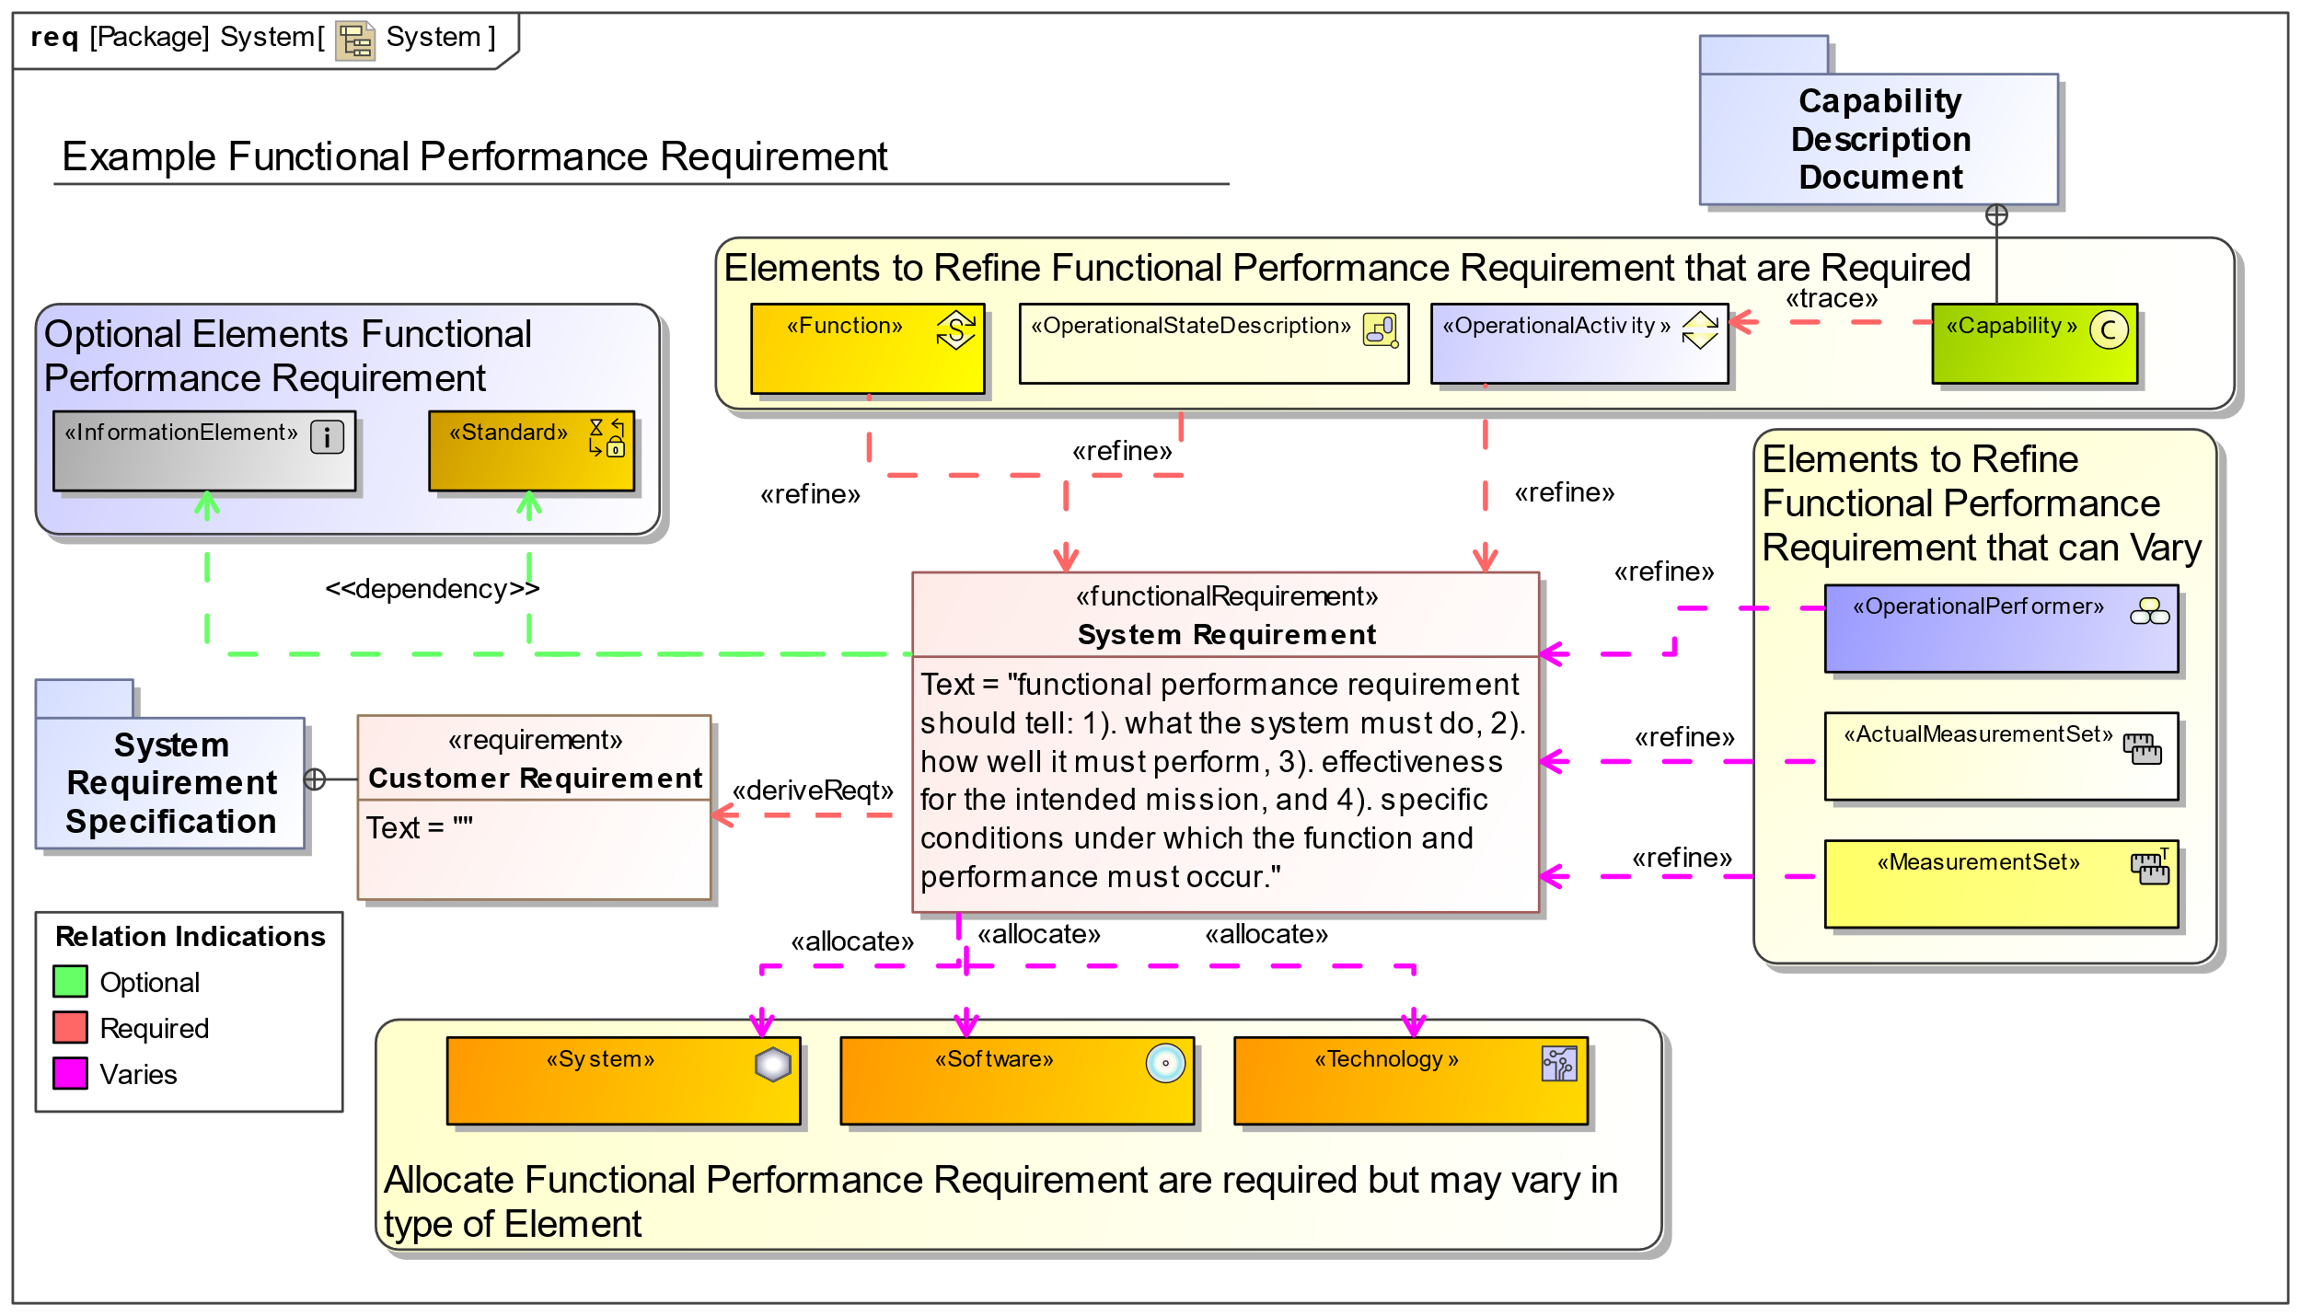
Methodology
Method Step | Element Stereotype Created | Relations Created
1 | «requirement»
2 | «functionalRequirement» | «deriveReq»
2.a | «System»
2.a.1 |  | «allocate»
2.b | «function»
2.b.1 |  | «refine»
2.c | «MeasurementSet» «ActualMeasurementSet»
2.c.1 |  | «refine»
2.c.2 | «Standard»
2.d | «OperationalAction» «OperationalActivity»
2.d.1 |  | «refine»
2.e.1 |  | «dependency»
2.e.2 | «OperationalStateDescription» | «refine»
2.e.3 | «OperationalConstraint»
3 | «Capability»
3.a |  | «trace»
4 | Complete | Complete
Created Elements in MBSE Tool
Steps to Create Elements
Notes:
An MBSE requirements diagram illustrates the relation to the DoD customer requirement, which comes from the customer specification and/or the customer needs: ICD / CDD / CPD / IRD / SRS. Specifically for a functional performance requirement, the modeling elements and associated relationships show specifics about the system under design and provide the states or modes of operation to meet the intended derived functional performance requirements. The elements and relationships can show energy, matter, and data (information) flows, highlighting the requirements and specifications for the system holistically as well as interdependencies. This MBSE architecture and model development approach can be modular and repeatable for each requirement type; relying on compliance standards, trade studies, simulations, and related allocated specifications to perform the needed analyses. The key is ensuring a complete and early agreement on the defined compliance criteria (disciplined, developed requirements and management of those requirements), architectural elements, and relationships for the graphical representation of the requirements to enable needed analysis.
Assumptions: Here are some assumptions for the architecture stereotype mapping methodology: 1. Awarded contract is defined with SRS and CDD documents; 2. DoDAF 2.02 is the selected architecture framework (Officer 2010); 3. Completion criterion is established for requirement analysis diagrams; 4. Functional performance requirement is the only requirement type shown, and 5. The textual pattern “«stereotype»” indicates a UML, SysML, or DoDAF stereotype.
*Note: The functional performance requirement context must be complete enough to illustrate creation of the model architecture. The functional performance requirement should tell: 1. What the system must do; 2. How well it must do it; 3. Efficiency for the intended missions; and 4. Specific conditions under which the function and performance are applicable.
Next the key steps in the proposed DE requirements analysis method in the context of MBSE are enumerated:
The system requirements specification will become the customer requirement or requirements using the «requirement» stereotype model architecture. The customer requirements will drive the architecture content development, including requirement derivation.
2. The customer requirement will derive the «functionalRequirement» or system level with a populated text field. The text field is critical as well as the quality of the text, which describes the functional performance requirement. The text field can be broken down into various parts the will cause element creation in the architecture. The functional performance requirement will have a «deriveReq» relation to the customer requirement.
a. The initial text of the requirement is the “it” or “thing” that is used to perform the describe function and a «System», «Technology», or «Software» stereotype may be used. The selected stereotype may change depending on the requirement level in the system design. For example, a «System» element may be higher than a «Technology» element in the system based on structure.
The «functionalRequirement» will have an «allocate» relation to the system or «OperationalPerformer» based on the context of the requirement statement. It is possible to have more than one functional performance requirement «allocated» to the system. The allocation will create the allocated functional baseline for the system.
b. Functional performance requirement text will describe “what the system must do” and will cause the creation of the «function» element in the architecture.
The «function» element will have a «refine» relation to the originating functional performance requirement. The «refine» relation will be a required relation type to the functional performance requirement. See Step 2.d for relation created. *Note: More than one function is possible from a functional performance requirement but needs to be strictly scrutinized because this could indicate a poorly written functional performance requirement.
c. Functional performance requirement text will describe “how well the system performs” and will cause the creation of «MeasurementSet» that invoke a «ActualMeasurementSet».
The «MeasurementSet» and «ActualMeasurementSet» will have a «refine» relation to the functional performance requirement.
The «MeasurementSet» are the performance values or indications that must be met in the requirement text and are driven by using «InformationElements» or «Standard» elements. Depending on the context of the functional performance requirement, one or more «ActualMeasurementSet» is possible. The «ActualMeasurementSet» describe units of measure assigned to «MeasurementSet» using «InformationElements» or «Standard» elements. See Step 2.e.1 for details.
d. The functional performance requirement text “efficiency for the intended missions” will cause the creation of the «OperationalActivity» and «OperationalAction» when the system performs the function.
The «OperationalActivty» element will have the «refine» relation to the functional performance requirement. The «OperationalActivity» will be a required relation to the functional performance requirement. The «OperationalAction» will be contained within the « OperationalActivity» (see Step 3.a). An «OperationalActivity» may contain more than one «OperationalAction» so the same «OperationalActivity» may be possible.
e. The functional performance requirement text “specific conditions” may include a standard, environmental, state, or mode aspect of performance.
The «InformationElement» or «Standard» will be related to the functional performance requirement and a «dependency» relation will be used. Depending on the context of the functional performance requirement, one or more «InformationElement» or «Standard» element is possible.
The «OperationalStateDescription» element will be used for state or mode data with a «refine» relation that will be required. *Note: More than one state or mode should not be possible from a functional performance requirement and needs to be strictly scrutinized because this could indicate a poorly written functional performance requirement.
The «OperationalConstraint» should be placed in the correct elements and are created within and will be populated in the OV-6a view of the DoDAF framework. The «OperationalConstraint» should be placed internally to other model elements needing an appropriate constraint based on the functional performance requirement context.
3. The ICD or CCD listed capabilities will become each «Capability» element.
A «trace» relationship shows «Capability» element relation to the «OperationalActivity». The «OperationalActivity» containing the «OperationalAction» will solidify what the function must “do” in the behavior exhibiting the «Capability». The «refine» relation created in Step 2.d.1 to «OperationalActivity» will show the «Capability» to be fulfilled. *Note: More than one capability could be possibly related to an «OperationalActivity» and, similar to before, needs to be strictly scrutinized because this could indicate a poorly written functional performance requirement.
4. Once the relations are in place and elements are instantiated to meet the textual context of the functional performance requirement shall statement, the requirement diagram is complete. This method can be performed on several types of requirements and relies on the industry standards for UML, SysML, and the DoDAF Framework.

Slide 6
Methodology Assumptions
The SRS and CDD documents (for the example)
DoDAF is the selected architecture framework (at minimum)
Functional performance requirement (for the example)
First tier of the system is only level presented (for the example)
Typically, not all data is present on Requirement Diagrams (the example shows the connections on the same diagram)
Specifically for a functional performance requirement, the modeling elements and associated relationships show specifics about the system under design and provide the states or modes of operation to meet the intended derived functional performance requirements.

Slide 7
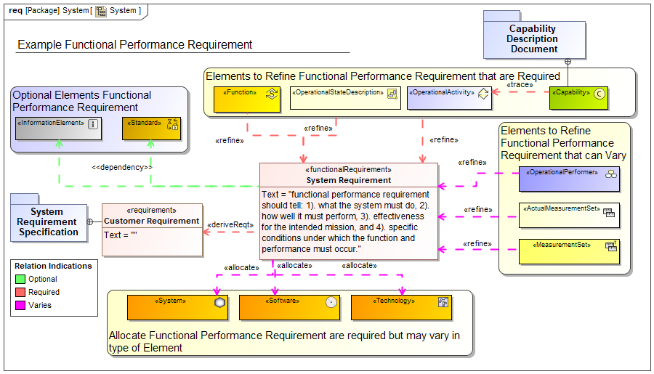
Example Method Execution
“The PEMS shall measure emission NOx high value between 1.25 and 2 times the normal 100 ppmv emission level during dry normal operational conditions in accordance with Code of Federal Regulations Title 40 (CFR 40) Part 86 Subpart B through model year 2021 & International Organizational Standard (ISO) 17025.”
The functional performance requirement shall statement is as follows:
What the system must do
How well it must do it
Efficiency for the intended missions
Specific conditions to be met
Translated into Approach

Slide 8
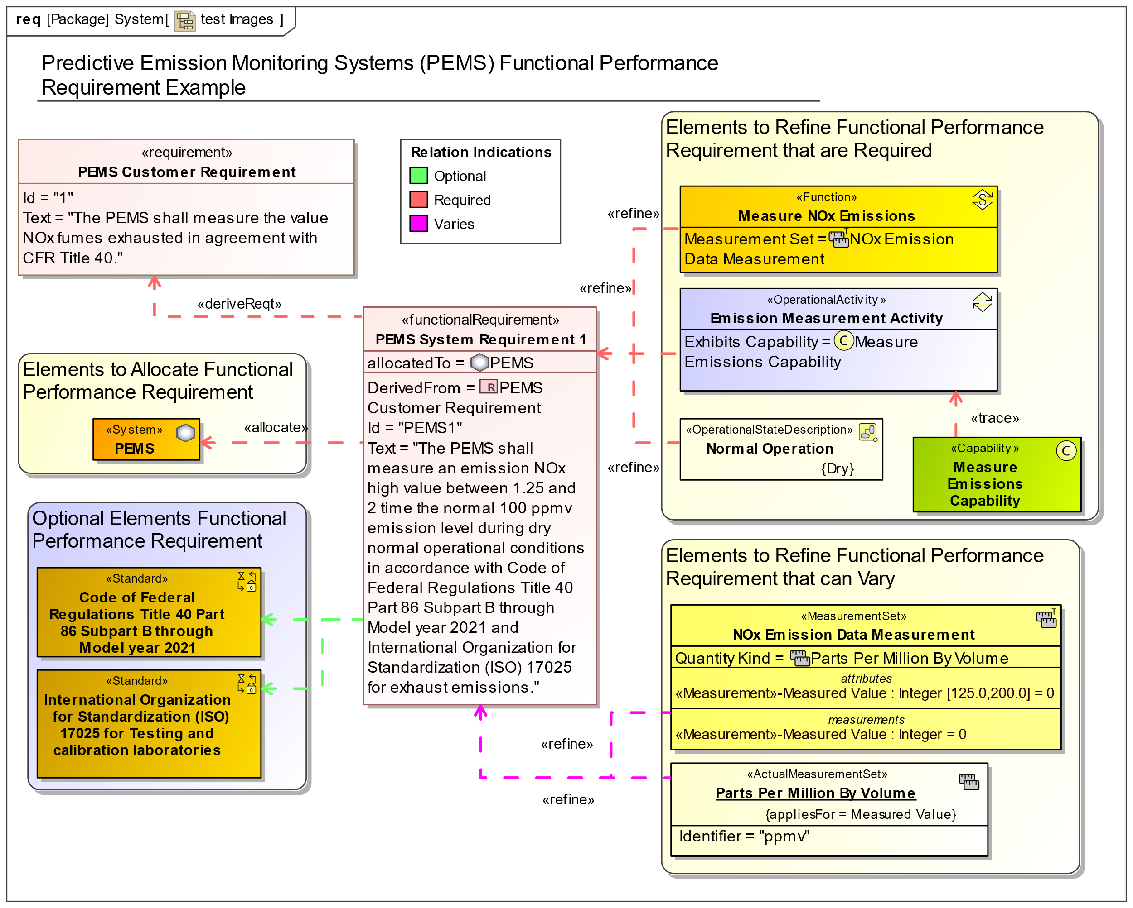
Example Method Execution
The functional performance requirement shall statement is as follows:
“The PEMS shall measure emission NOx high value between 1.25 and 2 times the normal 100 ppmv emission level during dry normal operational conditions in accordance with Code of Federal Regulations Title 40 (CFR 40) Part 86 Subpart B through model year 2021 & International Organizational Standard (ISO) 17025.”

Slide 9
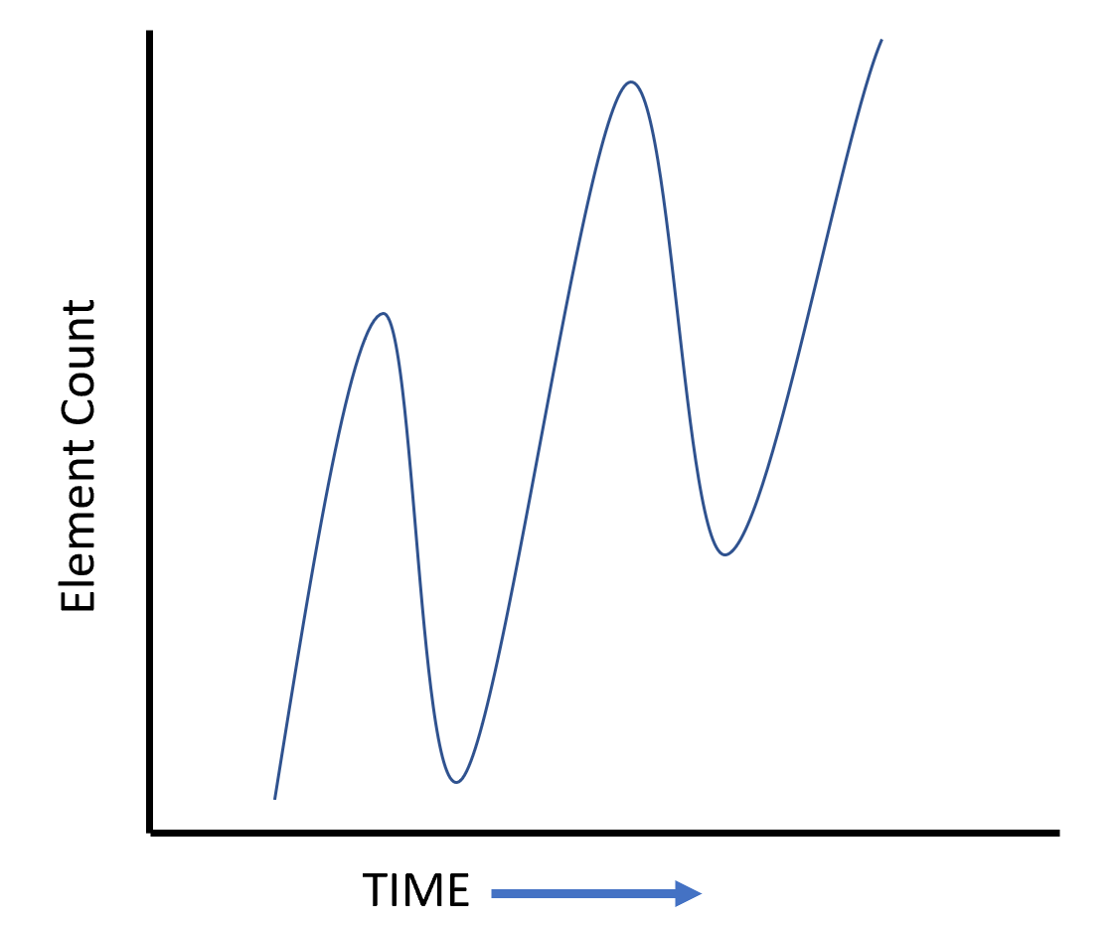
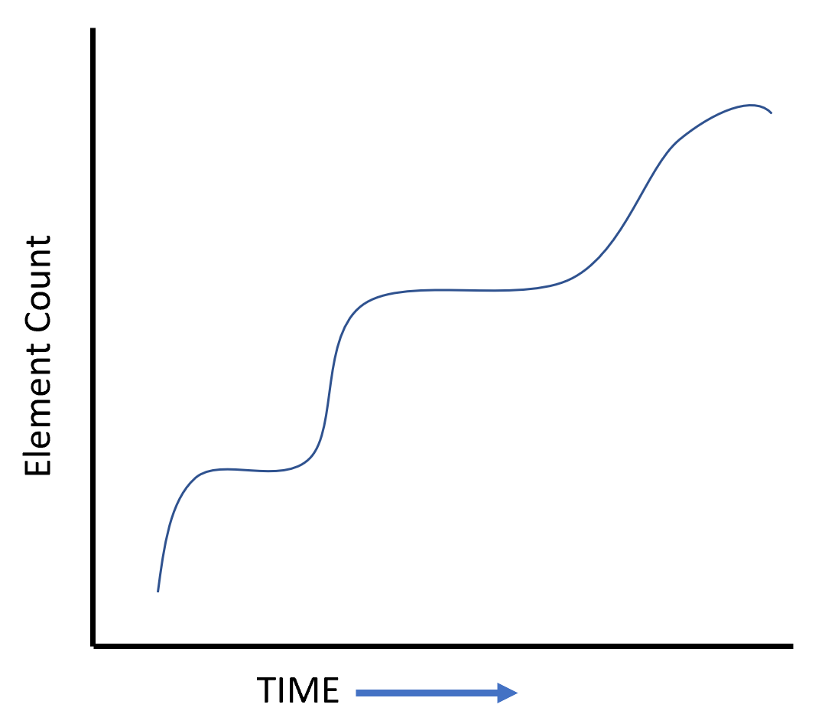
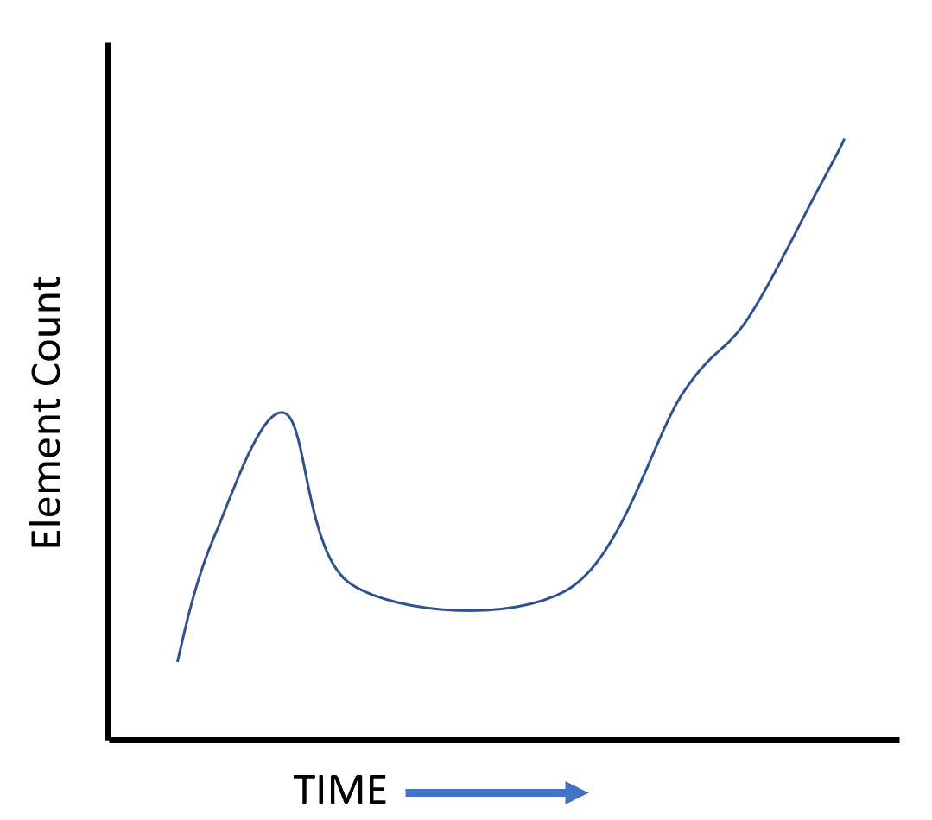
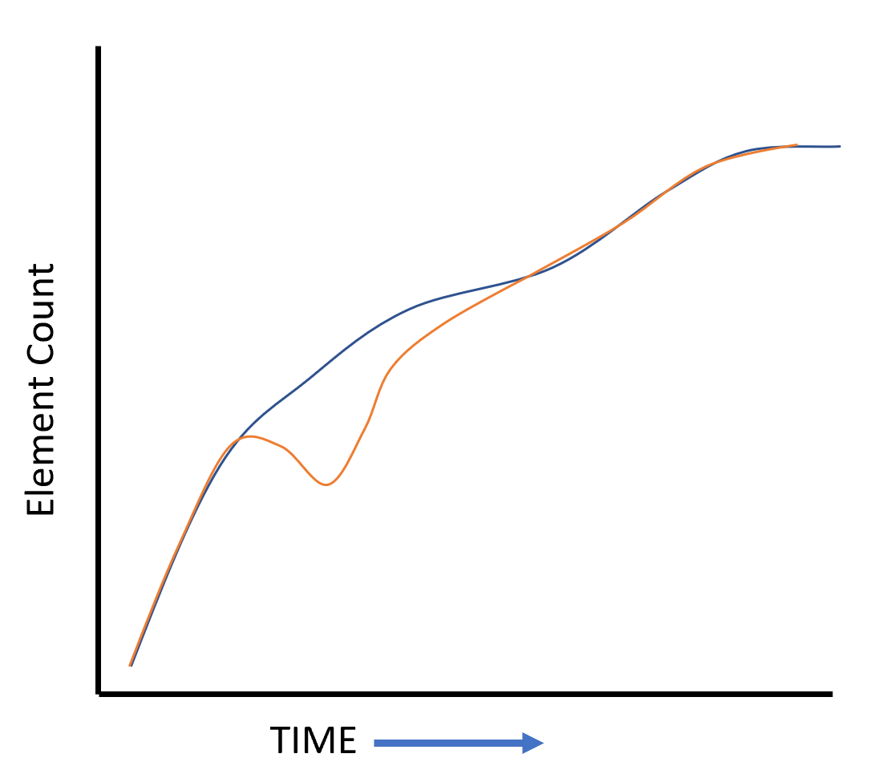
Programmatic Risk Indicators
Graph Trend Line Indicators | Meaning | Risk Level | Trend Line Graphic (x axis: time / y axis: count)
Spikes | Up or Down. Up: a large element count increase and could be indicative of “Model Bloat” or increase in useless information Down: loss of data or missing model elements. Happens over very short periods. | High Up: possible model performance issues Down: costly rework for lost data
Flat | Flat: data is not being created or deleted. Dependent on what is being worked in the model. | Low Lull in task execution or drop in modeling development occurring before milestone
Dips | Dips: longer loss or changes to model element trends. Monitoring is essential to ensure baselined model content is not changing or being modified | Medium Possibly caused with missing content or data
Diverging trends | Blue: indicates element count Orange: indicates related element count Assuming one-to-one relation the divergence needs investigation | Medium diverging areas need to be inspected to verify functional performance
Notes:
The requirement analysis methodology defined above provides a means to take SE requirements development process and break that data into the DE approach to instantiate the complete DoDAF architecture. The method shows a promising way to create related architecture element items linking the traditional SE process to new DE best processes using built-in standardized framework data elements. The most critical piece of MBSE metrics related to development is defining what the metrics highlight from an analysis perspective (i.e., improved design, quality, robustness of the architecture, etc.). Collecting the number of various elements from within the model can demonstrate quantifiable numbers of elements. Using the notes provided in the method, quantifiable trends of counts can be shown for a model. If applied correctly, there are huge efficiencies and effectiveness benefits realized over time that can be provided to a DE implementation. Table 2 shows line trend indicators for model element metric count and the risk implication for programmatics.

Slide 10
Conclusion
Critical to understand functional performance requirement analysis for DoD & SE process
Identified issues with current process
Method of tailoring MBSE model content in the DoDAF framework based on functional performance requirement analysis was presented
Notional example was created using the prescribed methodology
Means to gather quantifiable data was discussed through the collecting of counted elements created with the methodology
Evaluation of graph trends relating to possible programmatic risks
Presented methodology can be used and expounded upon in a similar manner to address and evaluate the quality of an MBSE model.
Notes:
Further work will provide a quality evaluation methodology and approach to programmatic expounding upon the one presented in this paper. This future quality evaluation framework will address DoDAF architectures using the MBSE and an alternative perspective approach. Included in the framework will be described conceptual DoDAF architecture quality analysis, including re-contextualization of Quality by Design (QbD) to the DoDAF framework, formalized taxonomy, metrics development, defined profile, integration plugin, data analysis, and programmatic implications. The approach to QbD improves the understanding of completeness for a DoDAF architecture by building better checks on the design process. The DoDAF Quality Framework can provide greater visibility into the quality system engineering process of the DoDAF application in MBSE hence improving trust in the system and data architecture models.

Slide 11
References
Ref 1 DEFENSE ACQUISITION GUIDEBOOK, VOLUMES 1 & 2. (2013). Army AL & T, 163–.
Ref 2 INCOSE SE Vision 2020 (INCOSE-TP-2004-004-02, Sep 2007)
Ref 3 ISO/IEC/IEEE 42010:2011(E) (Revision of ISO/IEC 42010:2007 and IEEE Std 1471-2000). (2011). IEEE.
Ref 4 Faudou, R. (2016) Requirements and Architecture Within Modeling Context, AFIS (Association Française d’Ingénierie Système). INCOSE Affiliate
Paper Can be Found here:
http://www.ieworldconference.org/content/SISE2021/author.html

Slide 12
Questions?
Dr. Andrew R. Miller is researching applied model-based systems engineering (MBSE) aspects that drive quality of MBSE models. He has worked in the defense industry for over a decade with a particular focus on MBSE quality process and application.
Orcid ID: https://orcid.org/0000-0001-6866-9024
LinkedIn: www.linkedin.com/in/andrew-miller-ph-d-pmp-8b75648b
Dr. Daniel R. Herber is an Assistant Professor at Colorado State University with research interests in the areas of model-based systems engineering, computational design, design optimization, system architecture synthesis, and combined physical and control system design (control co-design).
Orcid ID: https://orcid.org/0000-0003-4995-7375

