Slide 1




How to Host a Great Regional Conference
Paul White
March 10, 2020

Slide 2
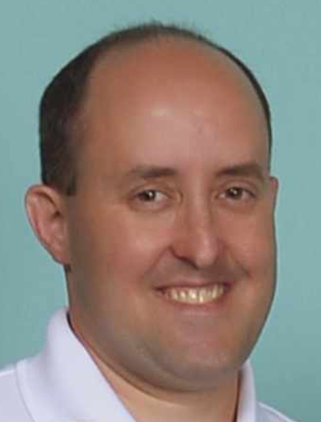
Brief Introduction About Myself
Work Experience
  2015 – Present: KIHOMAC / BAE – Layton, Utah
  2011 – 2015: Astronautics Corporation of America – Milwaukee, Wisconsin
  2001 – 2011: L-3 Communications – Greenville, Texas
  2000 – 2001: Hynix – Eugene, Oregon
  1999 – 2000: Raytheon – Greenville, Texas
Education
  2019: OMG OCSMP Model Builder—Fundamental Certification
  2011: Graduate Certification in Systems Engineering and Architecting – Stevens Institute of Technology
  1999 – 2004: M.S. Computer Science – Texas A&M University at Commerce
  1993 – 1998: B.S. Computer Science – Texas A&M University
INCOSE
  Chapters: Wasatch (2015 – Present), Chicagoland (2011 – 2015), North Texas (2007 – 2011)
  Conferences: WSRC (2018-2020), GLRCs (2012-2017)
  CSEP: (2017 – Present)
  2019 INCOSE Outstanding Service Award
  2019 INCOSE Wasatch -- Most Improved Chapter Award & Gold Circle Award
Utah Engineers Council (UEC)
  2019 & 2018 Engineer of the Year (INCOSE) for Utah Engineers Council (UEC)
  Vice Chair
Family
  Married 14 years
  Three daughters (1, 12, & 10)

Slide 3

Introduction
What is a Regional Conference?
Benefits of Hosting a Regional Conference
Committee Structure
Planning and Executing the Conference
  Logistics
  Technical Program
  Integrated Operations
  Outreach
  Budget
  Sponsors
  Timeline
Going forward in North Texas
Examples
  Western States Regional Conference (WSRC)
  Great Lakes Regional Conference (GLRC)

Slide 4
What is a Regional Conference?

Slide 5
What is a Regional Conference?
Conference covers at least three days.
Conference offers an average of eight hours of programming per day.
Technical program has at least two tracks running concurrently throughout program.
Technical program features at least three keynote speakers.
Multiple chapters participate in planning and promotion.
Organizations sponsor the conference with funding and participation.
Conference has an identity that is separate from the host chapter.

Slide 6
Benefits of Hosting a Regional Conference

Slide 7



Benefits of Hosting a Regional Conference
Promote INCOSE in your region.
Showcase your region’s systems engineering capabilities.
Strengthen your local companies.
Network among chapter members and friends.
Collaborate with chapters in your region.
Earn money for your chapter.

Slide 8
Committee Structure

Slide 9
WSRC Committee Structure
WSRC Steering Committee
WSRC Event Planning Committee
(Current Year)
Memorandum of Agreement
(MoA)
Participating Chapters
(Host & Supporting)
WSRC Event Planning Committee
(Current Year + 1)
Memorandum of Agreement
(MoA)
INCOSE Events Committee
WSRC Event Planning Committee
(Current Year + 2)
Memorandum of Agreement
(MoA)

Slide 10
WSRC Event Planning Committee
Conference Chair
Co-chair
Technical Program
Chair
Co-chair
Proposal Review Coordinator
Proposal Reviewers
Session Chairs
SEP Beta Exam Coordinator
Integrated Operations
Chair
Co-chair
Host Site Coordinator
Satellite Site Coordinator
Satellite Site Leads
Outreach
Chair
Co-chair
Webmaster
Publications Coordinator
Marketing Coordinator
Finance
Chair
Co-chair
MoA Coordinator
Sponsorship & Exhibits
Chair
Co-chair
Coordinates the Current Year’s WSRC

Slide 11
WSRC Event Planning Committee Meetings
Meet regularly – Biweekly at first then weekly.
Take attendance at every meeting.
Have a set agenda.
Take meeting minutes, and make them regularly available.
Host remote meetings.
Start and end on time.

Slide 12

Why Have a Steering Committee?
WSRC Event Planning Committee
(Current WSRC)
WSRC Steering Committee
(Future WSRCs)

Slide 13
Logistics

Slide 14
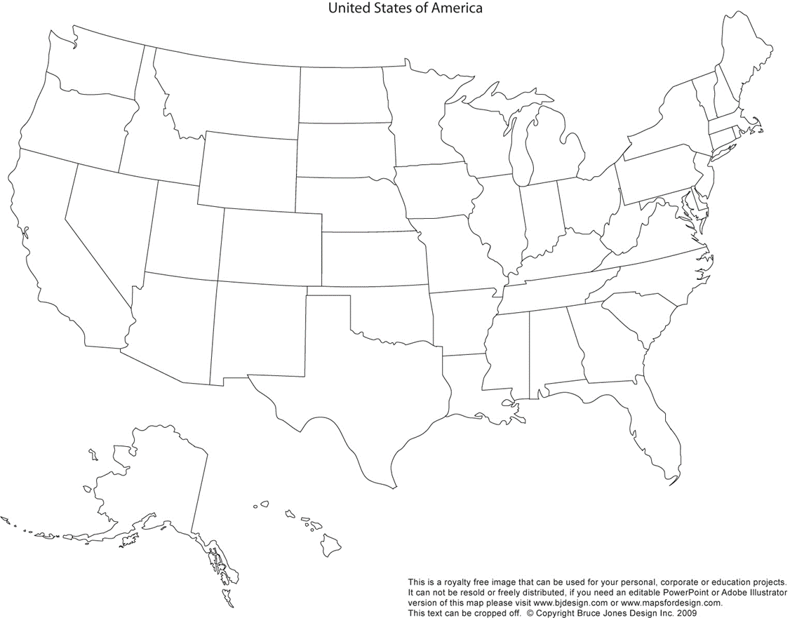
Seattle
Mackinac Island
Bloomington
Grand Rapids
Detroit
Schaumburg
Cleveland
West Lafayette
Ogden
Indianapolis
Los Angeles
Great Lakes Regional Conference (GLRC) Locations
Western States Regional Conference (WSRC) Locations

Slide 15
How to Select Locations?
Create your plan.
Collect lessons learned.
Determine stakeholders &
criteria (a.k.a. requirements).
Make sure locations are meeting the needs of stakeholders.
Send Request for Proposals (RFP).
Make sure everything is coming together.
Review proposals against criteria.
Make adjustments.
Select locations, and finalize plan.
Gauge how well your plan is going.
Implement your plan.

Slide 16
Consider These Location Criteria
Getting There – Airports, Roads, Public Transportation, etc.
Getting Around – Meeting spaces, restaurant, preferred hotel, shuttle service, etc.
Cost – Rental of locations, Hotel contracts, catering, etc.
Quality of Area – Restaurants, hotels, attractions, etc.
Technology – Conference phones, computers, monitors, microphones, acoustics, etc.
Weather – Temperature, humidity, precipitation, wind, etc.
INCOSE IW/IS – No regional conferences within six weeks (INCOSE policy).

Slide 17
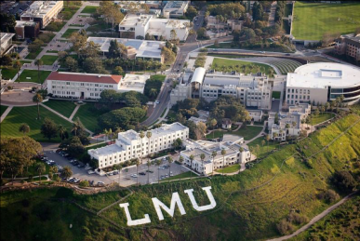
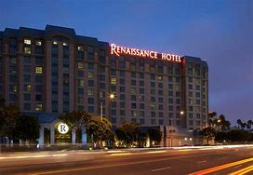
WSRC 2019 – Los Angeles (Sept. 13-15)
I-405
Loyola Marymount University
Shuttle Service
Renaissance Hotel
Los Angeles International Airport

Slide 18
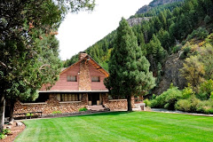
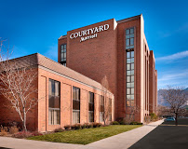
WSRC 2018 – Ogden, Utah (Sept. 20-22)
Salt Lake Express Shuttle
Public Transportation between
Salt Lake City and Ogden
Northrop Grumman Conference Center
I-15
Salt Lake City International Airport
Courtyard by Marriott – Ogden

Slide 19
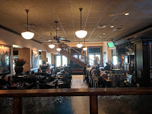
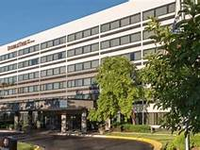
GLRC 6 and 8 – Schaumburg, Illinois (Oct. 2012 & 2014)
Maggiano’s Little Italy
Doubletree at Schaumburg
Chicago O’Hare International Airport
I-290
IBM

Slide 20


GLRC 10 – Mackinac Island, Michigan (Oct. 2016)
Walk, bike, ride in a horse-driven buggy
(but nothing motorized)
Ferries from Mackinaw City
& St. Ignace
Mission Point Resort
I-75
Pellston Regional Airport

Slide 21
Technical Program

Slide 22
Conference Theme
Conference theme is critical for setting tone of conference!
Strike a balance between broad domains & specific focuses.
Be creative! Promote your area!
Examples
  WSRC 2020 in Seattle, Washington – Celebrating the Sound of Systems Engineering
  WSRC 2019 in Los Angeles, California – Systems Engineering Relevance: Time for a Sea Change
  WSRC 2018 in Ogden, Utah – Systems Engineering Out W.E.S.T. (Workplace | Environment |Sustainment | Technology)

Slide 23
Have a Strong Program
Opening & closing plenaries
Keynote Speakers – Captivating speakers with broad appeal
Block out times for longer workshops & tutorials (start & end)
Run multiple tracks concurrently
Banquet
Ample networking opportunities
Systems Engineering Professional Development Day (SEPDD)

Slide 24
Example of Multiple Tracks

Slide 25
Systems Engineering Professional Development Day (SEPDD)
Set aside one track for one day.
Offer opportunity for people to participate remotely at a reduced rate.
Have SEPDD presenters record their presentations
  Shuffle program to fit local area
  Mitigate for technical difficulties
WSRC 2018
  2 locations in Seattle
  2 locations in Los Angeles

Slide 26
Integrated Operations

Slide 27
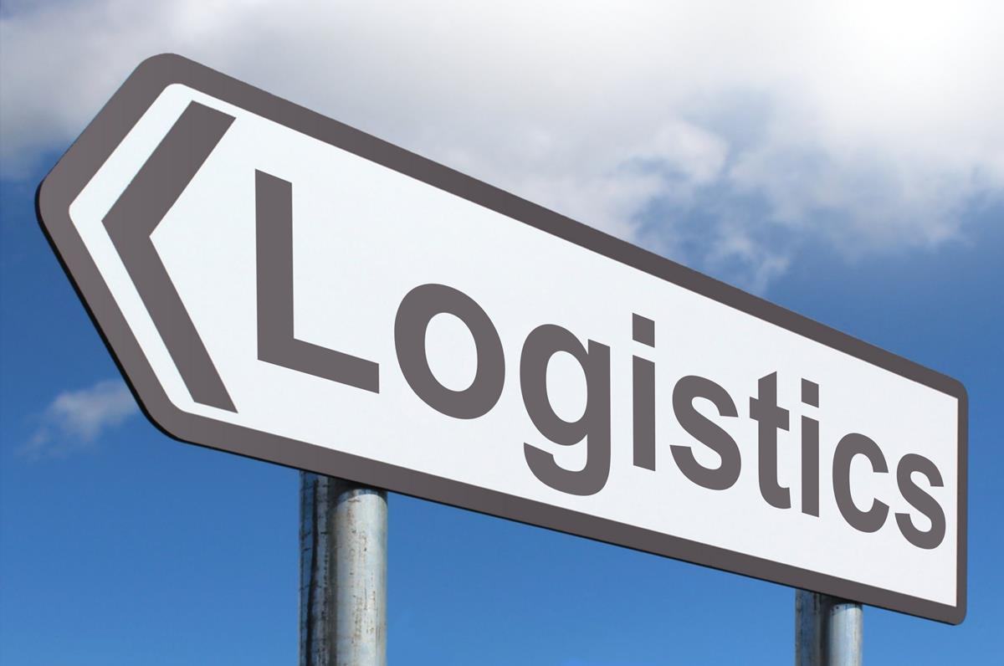
Manage Logistics
Meeting space
Catering
Shuttle service
Hotel contract
Signage – VistaPrint
Ticket Sales – Eventbrite or Constant Contact
Assemble materials before first day
NOTE: Subcontract these out to maximize volunteer time!

Slide 28
INCOSE App

Slide 29
Satellite Site Guidelines

Slide 30
Shuttle Schedule

Slide 31
Outreach

Slide 32
Call for Proposals
Type of proposals
Guidelines for abstract
Incentives
How to submit? (EasyChair)
Deadlines
Notification of decision
Conditions of acceptance
INCOSE IP Release Form

Slide 33
Conference Flyer

Slide 34
Tote Bags

Slide 35

Conference Booklet
Welcome
Conference Program
Floor Plan
Sponsor Logos
Keynote Biographies
Teaser for Next Year’s Conference

Slide 36

Promotion at Events
International Workshop (IW)
International Symposium (IS)
Participating Chapter Websites
Americas Sector Meetings

Slide 37
Certificates & Gifts
Certificates
  Certificate of Sponsorship
  Certificate of Presentation
  Certificate of Service
Gifts to Keynote Speakers
  Inexpensive (< $10)
  Some keynote speakers may have limitations on accepting gifts.

Slide 38
Budget

Slide 39

Income & Expenses
Revenue
  Ticket sales
  Sponsors
  Contributions from participating chapters
Expenses
  Location
  Catering
  Preparation of materials
Consider pessimistic, realistic, & optimistic scenarios

Slide 40
Memorandum of Agreement (MoA)
Opportunity for host & participating chapters to benefit from conference
Bank account that carries over from year to year
WSRC chapters provide financial support in 2020 and receive no financial return. In 2021 and future years they are not required to provide financial support. They still receive credit as sponsoring chapters.
Surplus less $2500 (TBR) stays in a WSRC financial account and is used by the next year’s host chapter with a goal of reaching $10,000 and more in the future.
$2500 (TBR) remains with the host chapter

Slide 41

Participating Chapters (WSRC)
Snake River
Seattle Metro
Cascade
Wasatch
San Francisco Bay Area
Colorado Front Range
Los Angeles
Enchantment
San Diego
Central Arizona
Southern Arizona
*All chapters are within the
Pacific or Mountain time zones.
(Participating chapters are in
orange.)

Slide 42
Sponsors

Slide 43

Where Do You Find Sponsors?
Meeting Locations
Chapter Participation
Present Supporters
Past Supporters of Events
Frequent Supporters of INCOSE Events
INCOSE
  Regional Chapters
  Americas Sector

Slide 44
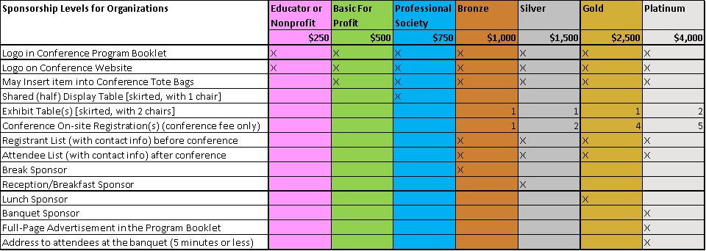
Sponsorship Invitation

Slide 45
Exhibits

Slide 46
Express Gratitude to Your Sponsors

Slide 47
Timeline

Slide 48
Sample Timeline (1 of 2)
Date (All 2018) | Milestone
1/15 | Distribute MoA, Distribute Call for Sponsorship, Publish WSRC Website
1/31 | Chapters commit to conference sponsorship, Confirm keynotes
2/14 | Chapters return signed MoAs
2/28 | Chapters provide chapter sponsorship funds
3/1 | Call for presentations – Open
3/31 | Call for presentations – Closed
4/1 | Presentation review – START
4/28 | Presentation review – STOP
4/30 | Presentation notifications – Accept or Reject
5/26 | Deadline to submit presentations
5/31 | Conference program is published

Slide 49
Sample Timeline (2 of 2)
Date (All 2018) | Milestone
6/4 | Registration Early-bird – START
6/9 | Presentation feedback
6/30 | Deadline to submit final presentations
8/19 | Registration Early-bird – STOP
8/20 | Registration Regular – START
8/25 | Order conference materials
9/20-9/22 | WSRC
10/20 | Close out MoA. Publish conference proceedings.
12/31 | WSRC close-out.

Slide 50
Going Forward in North Texas

Slide 51
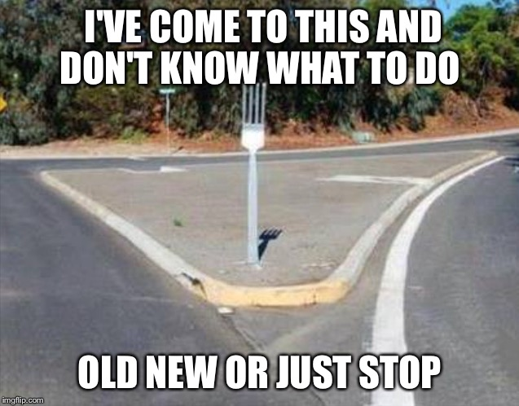
Going Forward
Are you ready to host a conference?
If not, consider participating in WSRC or GLRC.
If so, WSRC and GLRC have plenty of resources to support you.
Think about the committee structure (e.g., chair, co-chair, subcommittee chairs, and role players)

Slide 52
Concluding Thoughts

Slide 53
Concluding Thoughts
You have gained a greater understanding of regional conferences.
You have some ideas about where to proceed from here.
INCOSE WSRC and GLRC have resources to help you.
The INCOSE North Texas chapter and region will benefit from a regional conference.

Slide 54
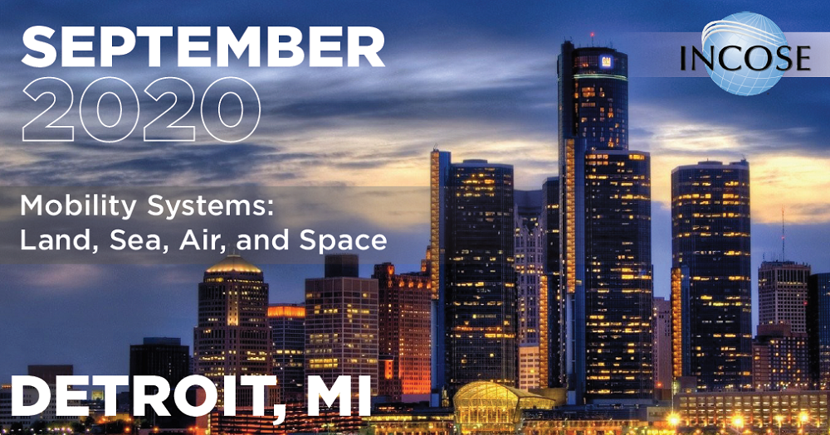
INCOSE 14th Annual GLRC
“Mobility Systems –
Land, Sea, Air and Space”
September 13-16, 2020
Detroit, Michigan
https://www.incose.org/glrc

Slide 55
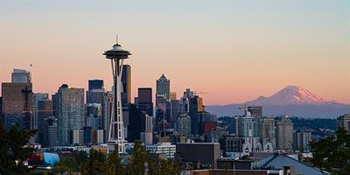
INCOSE WSRC 2020
“Celebrating the Sound of
Systems Engineering!”
September 17-19, 2020
Seattle, Washington
https://www.incose.org/wsrc/wsrc2020/home
Call for Proposals available through March 31!

Slide 56
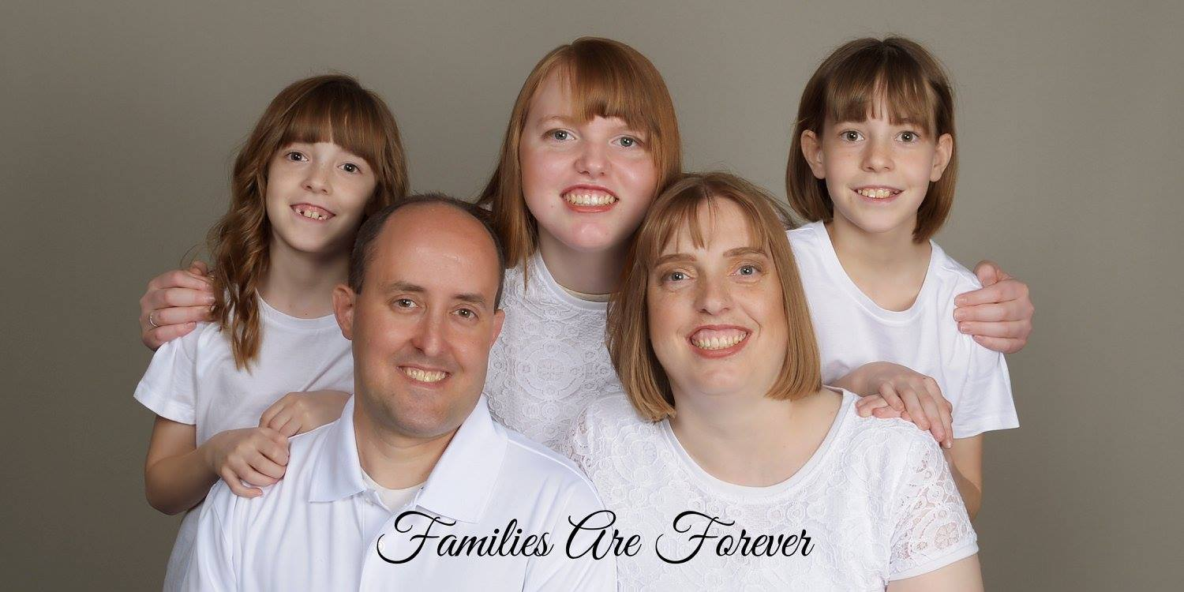
Contact Information
Paul White
  BAE/KIHOMAC
  E-mail: paul.white@kihomac.com
  Phone: 385-393-2137

