Slide 1

Enabling Repeatable SE Cost Estimation with COSYSMO and MBSE
Dr. Gan Wang, BAE Systems
Mr. Barry Papke, No Magic, Inc.
Dr. Saulius Pavalkis, No Magic, Inc.
PSM Users Group Conference
June 12-16, 2017
Arlington, VA

Slide 2
Introduction
Parametric cost estimating should be a natural extension of Model-Based Systems Engineering
COSYSMO can be seamlessly integrated into the SysML-based modeling environment
A use case: integrating COSYSMO with MagicDraw
Benefits and future work

Slide 3
What do we mean when we say MBSE?
Model Based
Systems Engineering
Language
Methodology
Tool
Model/data repository provides a single source of truth!
  Cost model is another model
  Estimate is another piece of data within repository

Slide 4
COSYSMO – Parametric Cost Model for Systems
4 Size Drivers and 14 Cost Drivers
# Requirements
# Interfaces
# Scenarios
# Algorithms
+
Volatility Factor
Size
Drivers
COSYSMO
Effort
Effort
Multipliers
Application factors
  8 factors
Team factors
  6 factors
Schedule driver
Calibration

Slide 5

Basic Cost Estimating Relationship (CER)
$${PH}_{NS}=A∙{SS}^{E}∙CEM$$
PH_{NS} = systems engineering effort in person-hours under nominal schedule
SS = system size, determined by the four size drivers
CEM = composite effort multiplier, determined by the fourteen cost drivers
A = productivity constant, typically derived from historical project data
E = nonlinearity for the productivity curve, representing a diseconomy of scale

Slide 6
Four Size Drivers
Number of System Requirements
Number of System Interfaces
Number of Critical Algorithms
Number of Operational Scenarios
Each weighted by: 1) Levels of complexity; 2) Degrees of reuse

Slide 7
Driver Counting/Classification Rules
Degrees of Reuse
“Generalized Reuse Framework”
Development for Reuse (DFR):
No DFR
Conceptualized For Reuse
Designed For Reuse
Constructed For Reuse
Validated For Reuse
Development with Reuse (DWR):
New
Design Modified
Design Implemented
Adapted for Integration
Adopted for Integration
Managed
Level of Complexity
“Easy”
“Nominal”
“Difficult”

Slide 8
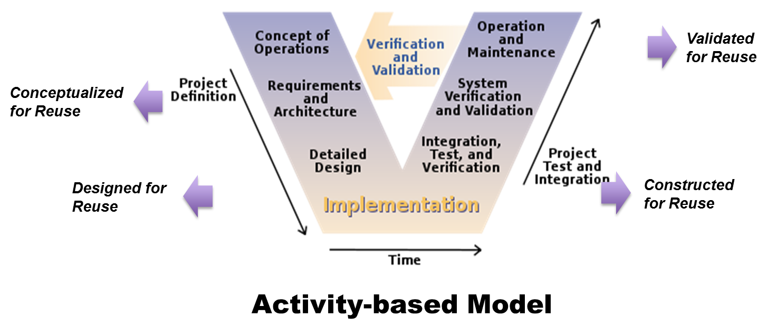
Development for Reuse (DFR) Process
Category | Required Activities | Delivering (for reuse)
No DFR | N/A | Little / accidental
Conceptualized For Reuse | Analysis Architecture development | Functional & Logical architecture
Designed For Reuse | Analysis Architecture System design | Physical design of system
Constructed For Reuse | Design Build Unit test | Implemented system or component
Validated For Reuse | Design Build System test | Validated and deployed system or component

Slide 9
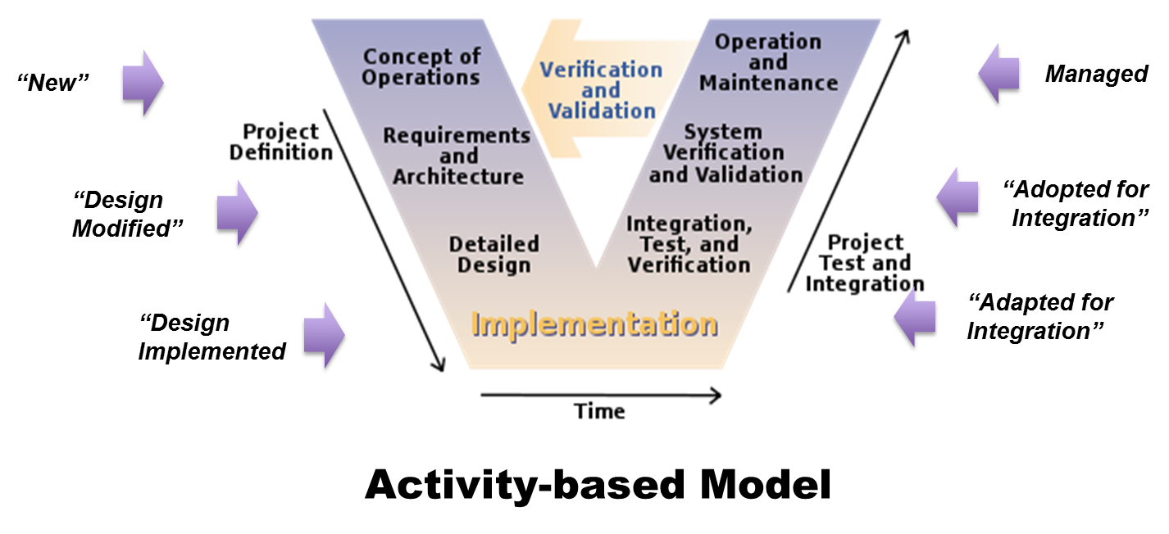
Development with Reuse (DWR) Process
Category | Required Activities | Leveraging (existing)
New | Develop anew Revamp of existing | New concept
Design Modified | Design & implement from logical architecture | Logical/functional architecture
Design Implemented | Implement from design Build-to-print | Physical design of system
Adapted for Integration | Adapt from existing implementation Tailor to integrate | Built system or component
Adopted for Integration | Integrate per instructions V&V testing | Build system or component
Managed | Manage Inspect | Integrated & verified system or component

Slide 10
COSYSMO 3.0 with the Generalized Reuse Framework
Total Project Effort = DWR Effort + DFR Effort
Where:
  PM_{DWR} = effort in Person Hours/Months (Nominal Schedule)
  A₁ = DWR constant derived from historical project data
  k = {REQ, IF, ALG, SCN}
  r = {New, D. Modified, D. Implemented, Adapted for Int., Adopted for Int., Managed}
  w_{r} = weight for defined levels of size driver reuse
  w_{x} = weight for “easy”, “nominal”, or “difficult” size driver
  Ф_{x} = quantity of “k” size driver
  E₁ = represents diseconomy of scale in DWR
  CEM₁= composite effort multiplier for DWR
Where:
  PM_{DFR} = effort in Person Hours/Months (Nominal Schedule)
  A₂ = DFR constant derived from historical project data
  k = {REQ, IF, ALG, SCN}
  q = {No DFR, Conceptualized, Designed, Constructed, Validated}
  w_{q} = weight for defined levels of size driver reuse
  w_{x} = weight for “easy”, “nominal”, or “difficult” size driver
  Ф_{x} = quantity of “k” size driver
  E₂ = represents diseconomy of scale in DFR
  CEM₂ = composite effort multiplier for DFR

Slide 11
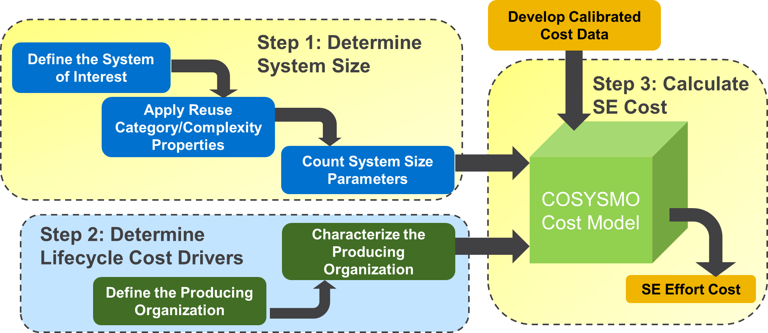
COSYSMO Cost Modeling Process
These steps can be naturally achieved in an MBSE modeling environment…

Slide 12

An Integrated COSYSMO-SysML Modeling Use Case
SysML
Develops design artifacts and cost estimate simultaneously
Define Architecture Artifacts
Classify Drivers: Levels of Complexity & Categories of Reuse
Identify 4 Size Drivers
Export Drivers & Classifications
Define
Analyze
Systems Engineer
Assess
COSYSMO
Assess Cost Drivers
Performs quick-turn, “what-if” DTC analysis
Create & Report Estimate

Slide 13
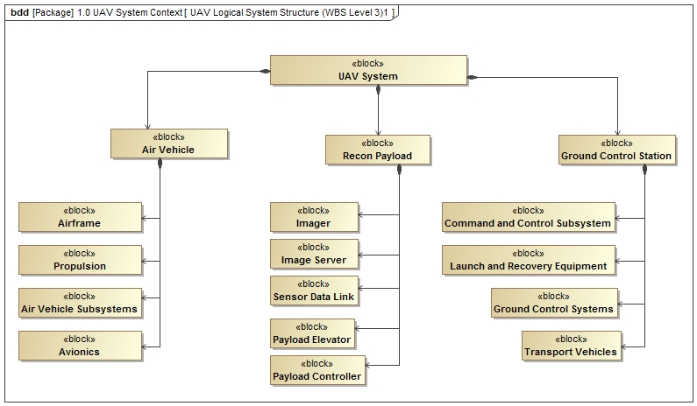
Define Scope of the “System of Interest”
WBS Level 1
WBS Level 2
WBS Level 3
Example SOI

Slide 14
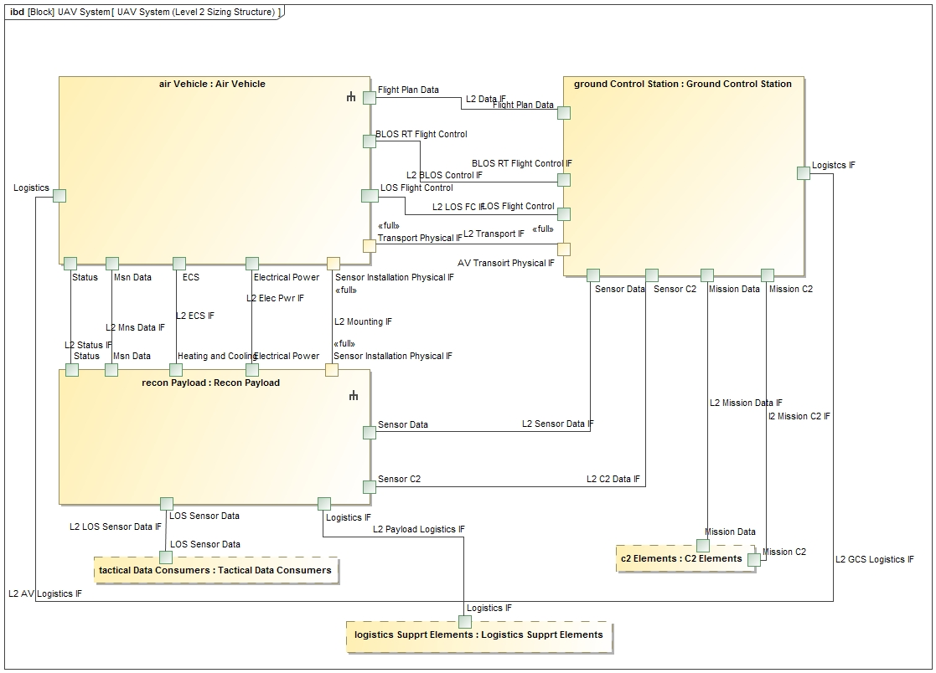
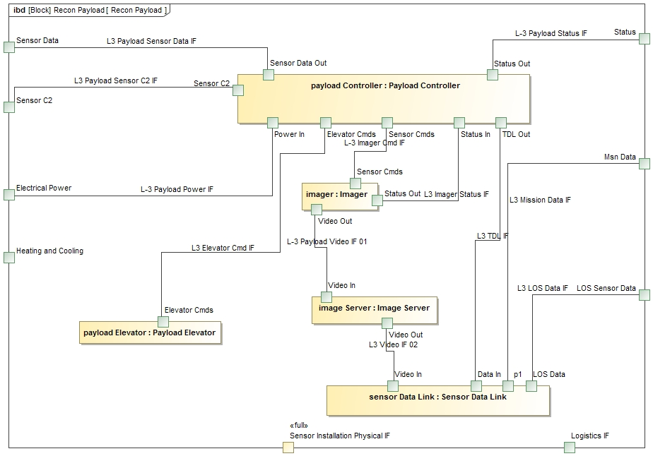
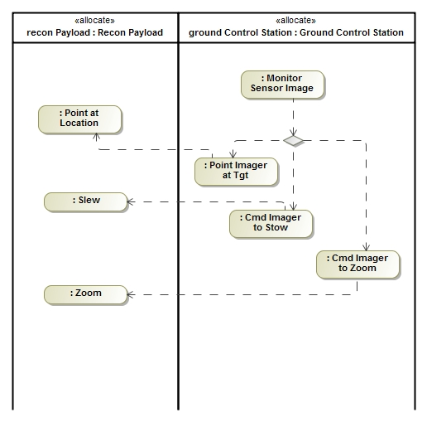
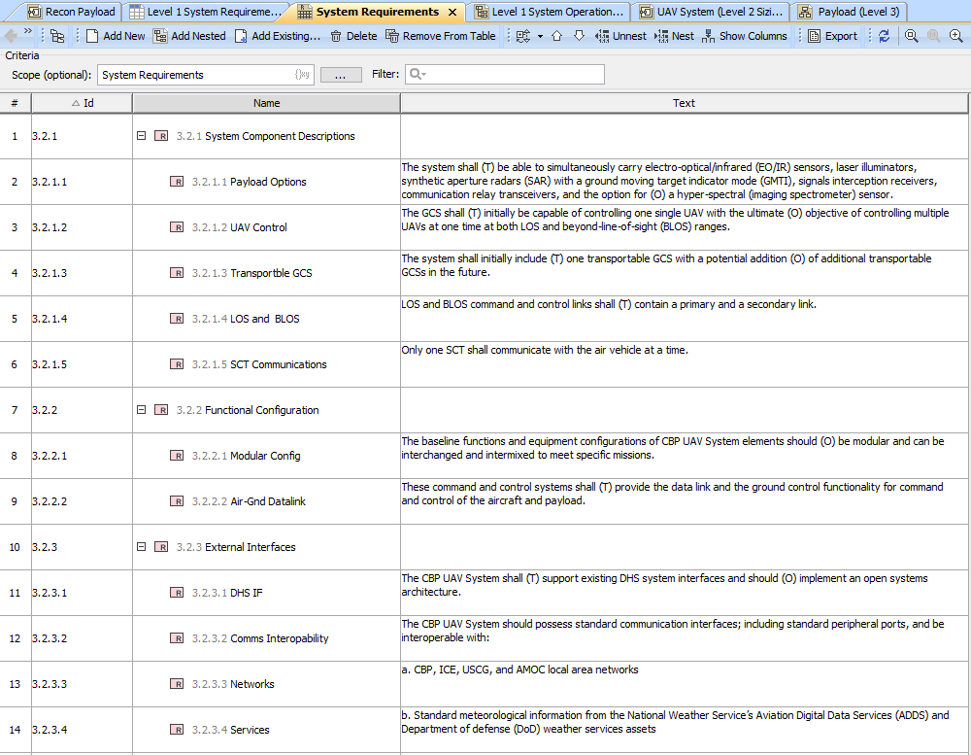
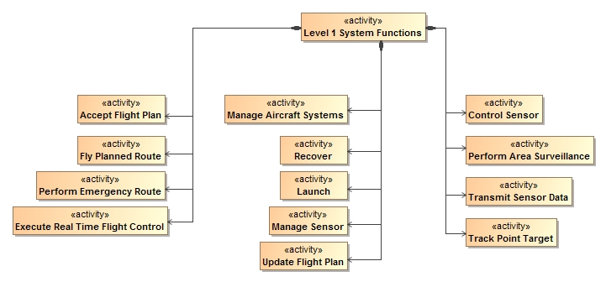
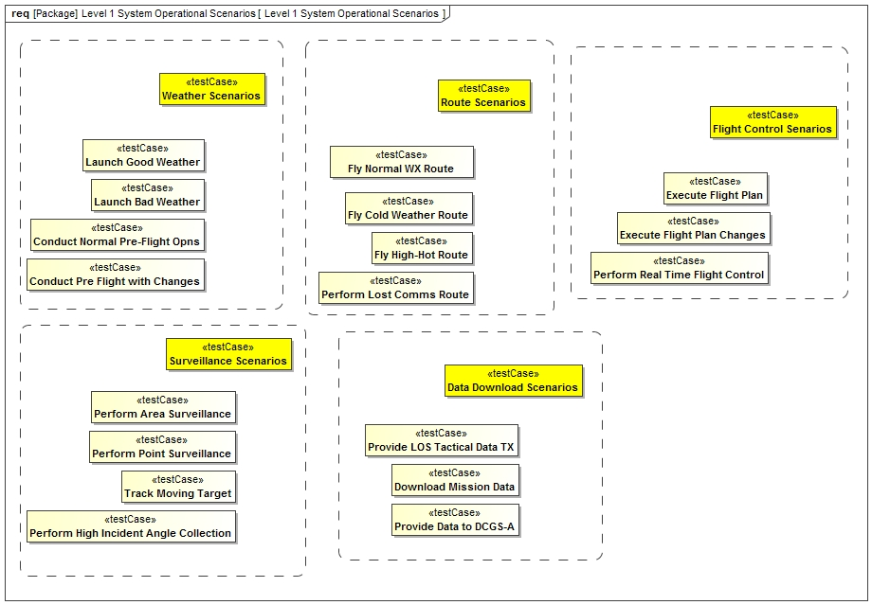
Identify Size Drivers While Defining System Architecture
Interfaces
Algorithms
Requirements
Scenarios
This is the natural systems engineering design process.

Slide 15
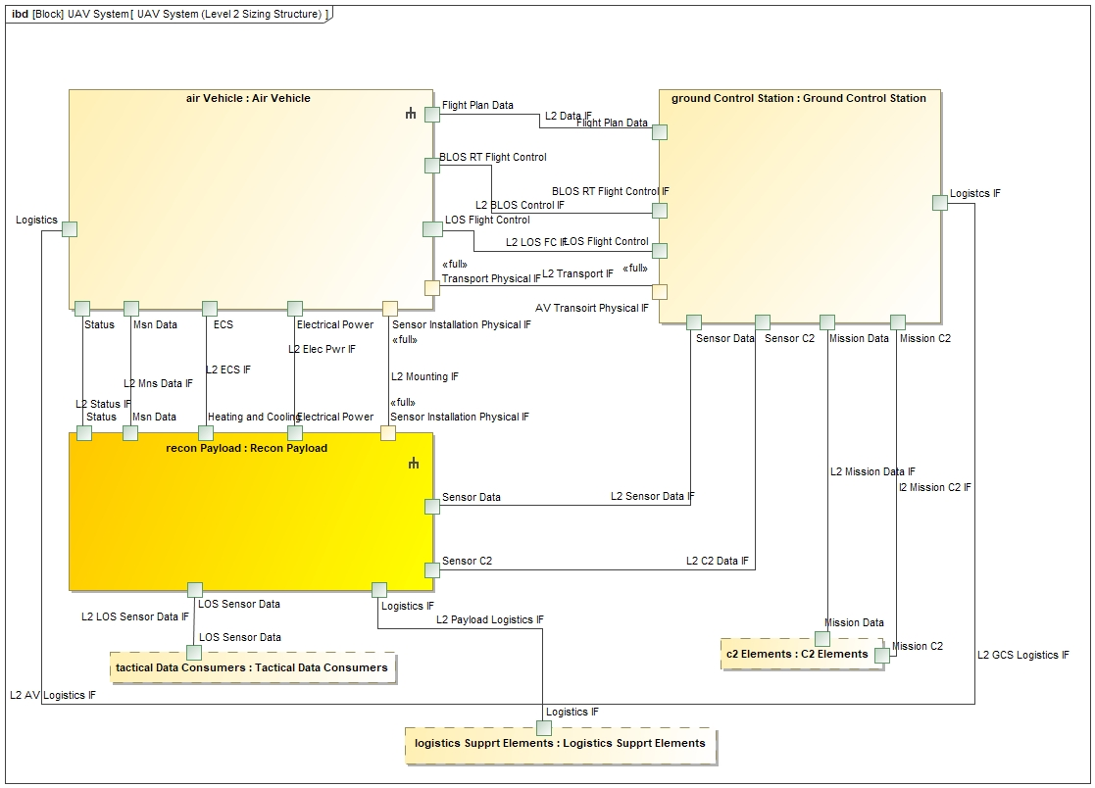
Maintain the Levels of Abstraction, Consistency and Traceability
Example SOI Context Level
  300 REQ
  9 IF
  11 ALG
  3 SCN

Slide 16

Maintain the Levels of Abstraction, Consistency and Traceability
Example SOI Level 1
  Payload Controller
    8 IF
    250 REQ
    8 ALG
    1 SCN
  Payload Elevator
    2 IF
    100 REQ
    2 ALG
    2 SCN
  Imager
    3 IF
    300 REQ
    6 ALG
    3 SCN
  Image Server
    …..
  Sensor Data Link
    …..
The level of abstraction chosen for the sizing estimate directly affects the quantity of sizing elements.
The key is to maintain consistency with the approach used across projects and with that used for calibration.

Slide 17
Applying Reuse Categories and Levels of Complexity
Reuse category and complexity are simply properties of the model elements being considered
There are multiple methods to assign properties to model elements in SysML
Different tools provide different capabilities for defining model element properties and calculating model metrics
The approach shown in this presentation was selected because it took advantage of advanced tool features in the tool (MagicDraw™) that resulted in the lowest total effort to assign and count sizing elements

Slide 18
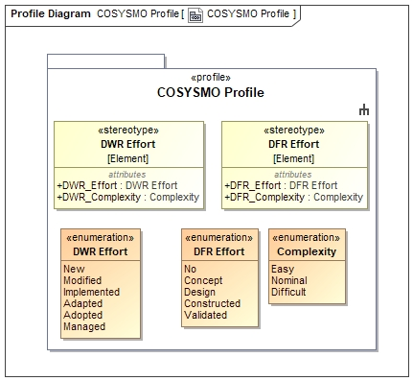
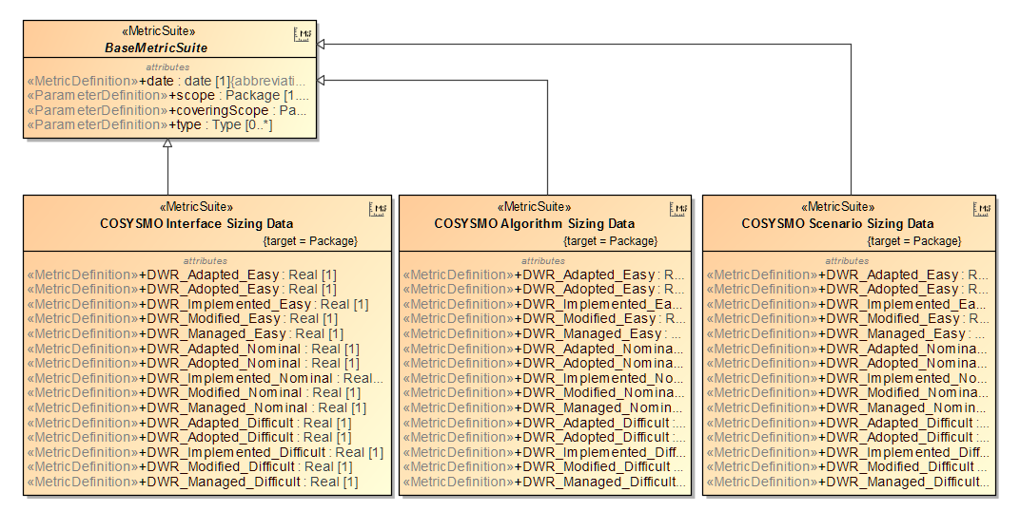
Create COSYSMO Profile and Metrics Rules (Non-Recurring)
COSYSMO sizing elements are created as new stereotype elements:
  Stereotypes are a core SysML feature
  Defined in a Profile Package
Metrics rules and measurements are a tool specific feature:
  Multiple methods exist to determine the numbers of each sizing element
The COSYSMO profile and metrics set are created once as a separate project and reused:
  The are applied (reused) on each new system project when generating sizing estimates
5 DFR Reuse Categories
6 DWR Reuse Categories
3 Levels of Complexity for each (Easy, Nominal, Difficult)
4 Sizing Elements Types (REQ, ALG, SCN and IF)
A potential of 132 individual pieces of sizing data:
  (5+6) x 3 x 4 = 132

Slide 19
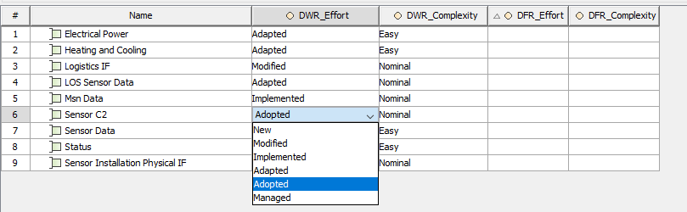
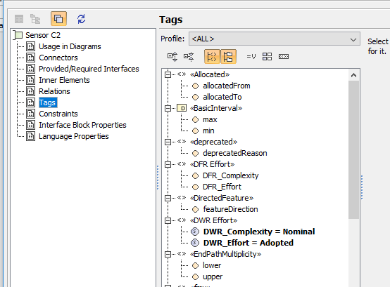
Apply Reuse Categories
Application of re-use category and complexity is a trivial effort:
  Create generic table and select element type and package scope.
  Select the new stereotypes from the “show columns” pull-down.
  Select the cell in the table and apply the reuse category and complexity.
  Once selected, the tool applies the properties as tag values to the model element.
Interface Count Example
  Properties selected in the table are actual properties of the model element.

Slide 20
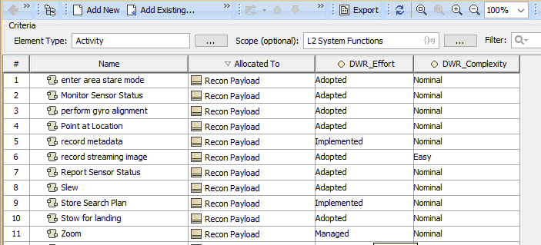
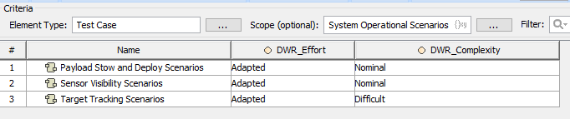
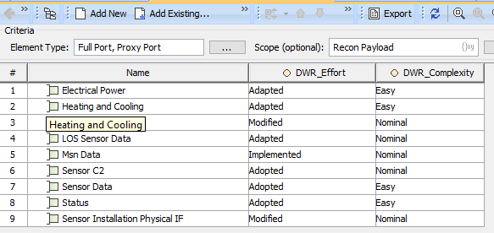
Apply Reuse Categories
The process of applying re-use categories and complexity level is repeated for each of the four sizing categories (REQ, IF, ALG and SCN)
If requirements are managed in an external requirements management tool, sizing metrics for requirements can be easily calculated by applying properties in that tool, and using spreadsheets or other applications to sum each category.

Slide 21
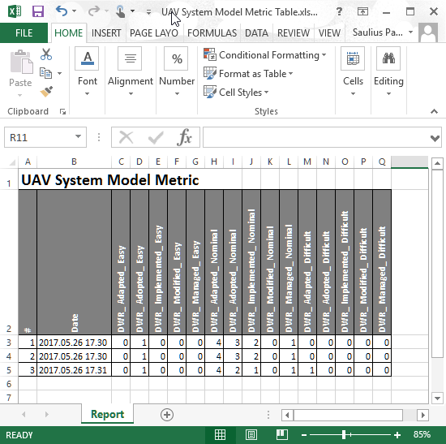
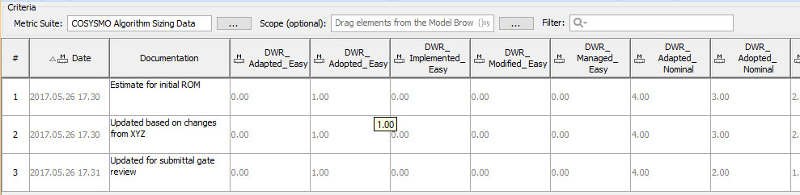
Run the Metrics Tool and Calculate Sizing Element Counts
Run the metrics tool to generate a metrics table with counts for each reuse category/complexity combination.
  Separate tables are create for each sizing element type (REQ, IF, ALG and SCN)
  Metrics tables can be exported to Excel for input to the cost model.
Depending on the tool, other methods may be available to determine sizing counts:
  Export of element tables and count externally.
The metrics tables shows the history of metrics calculations.
A documentation column can be added to record rational and other data for each metric calculation.

Slide 22
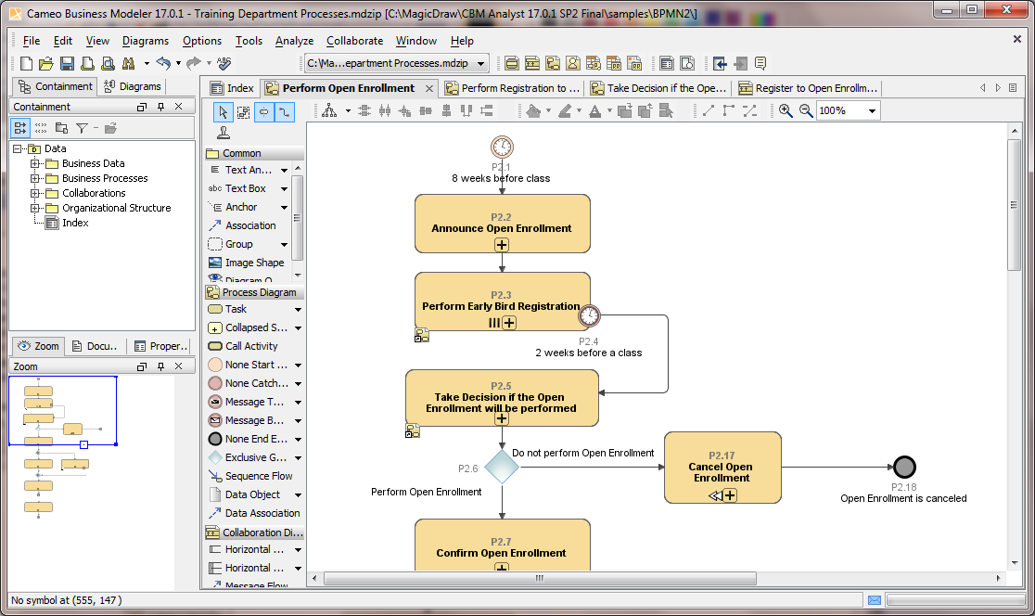
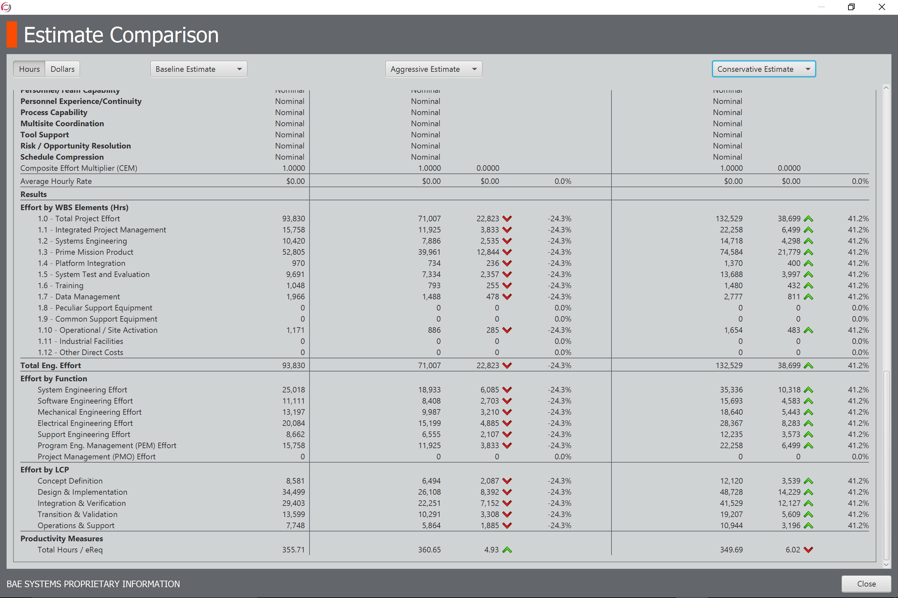
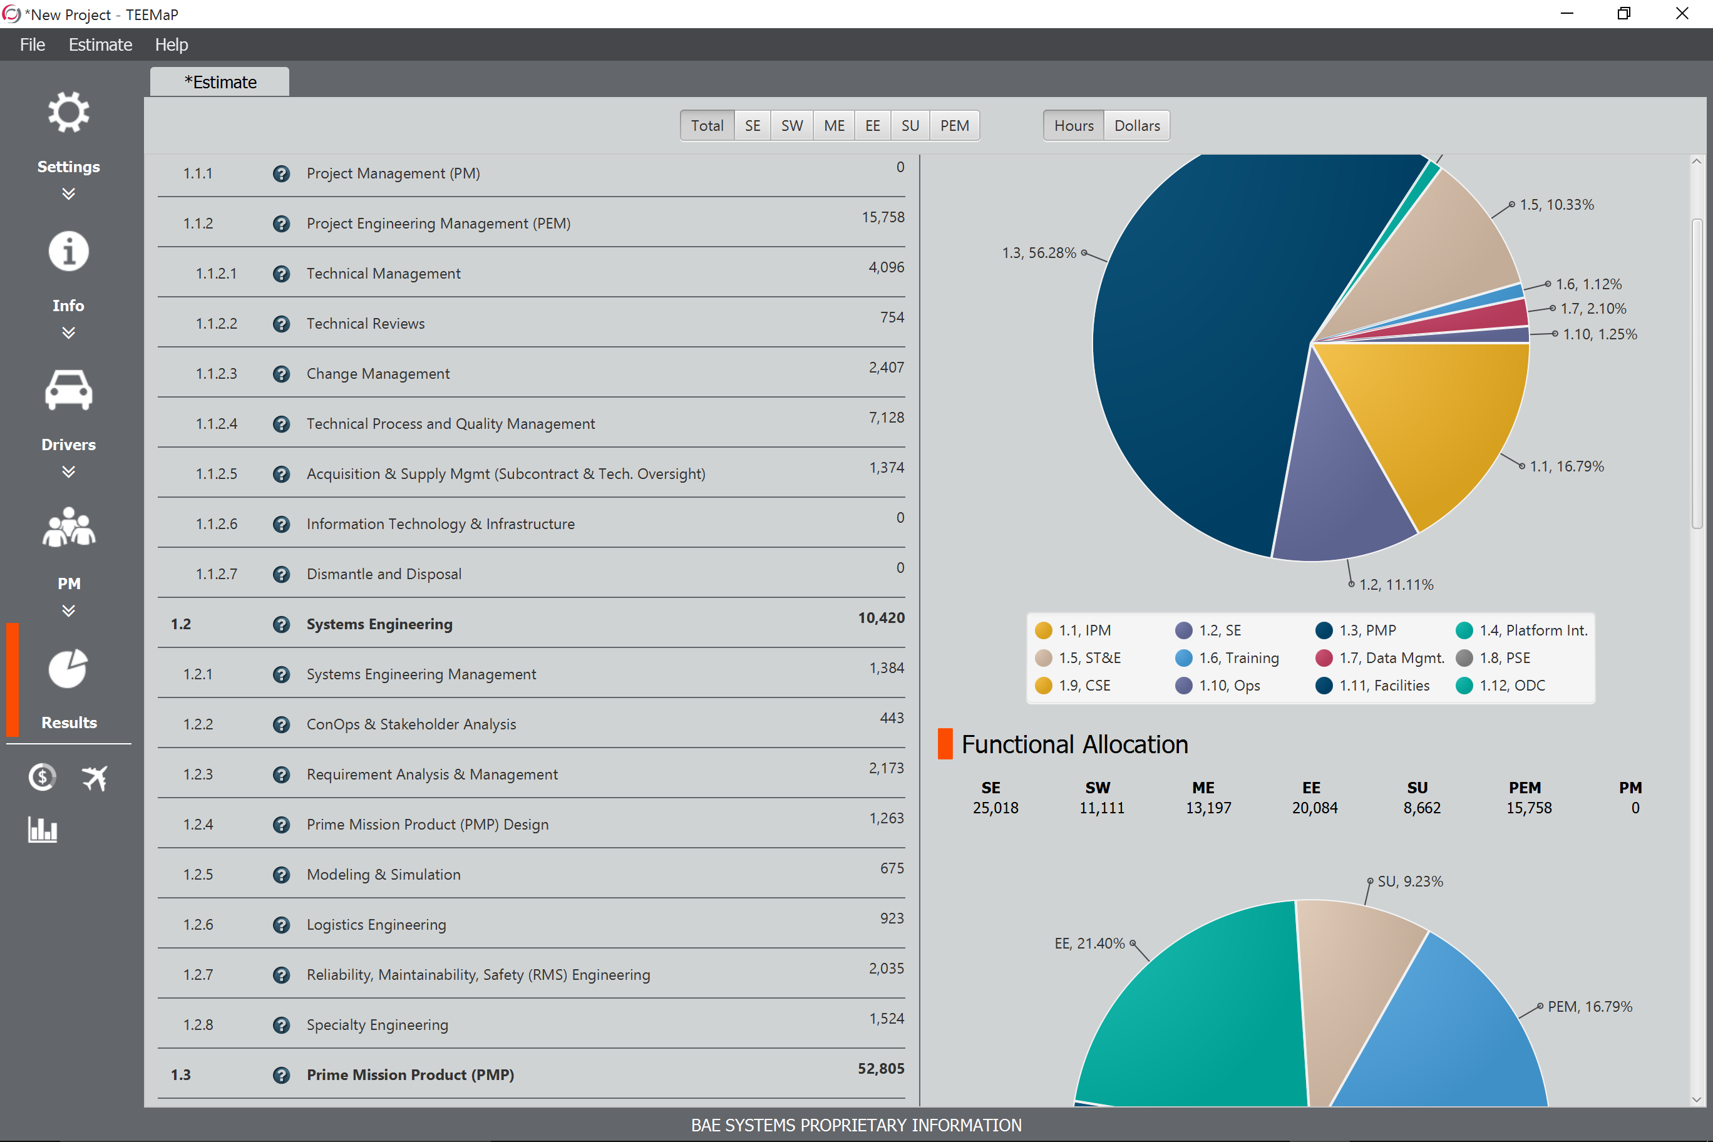
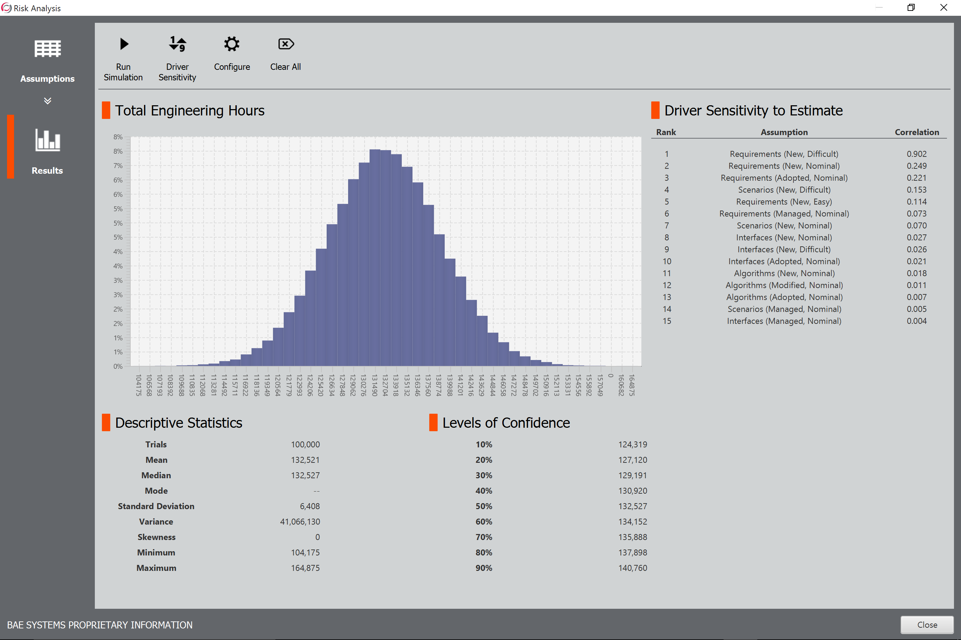
Analyze Estimate Result
Rapid “what-if” analysis roundtrips

Slide 23
Conclusion
Parametric cost estimating can be seamlessly integrated into Model-Based Systems Engineering:
  Sizing data becomes a property of each model element
  The model repository provides a single source of truth
  Libraries can be created to maintain and revise reuse category and complexity consistent with changes in project lifecycles
  Rigor of MBSE with SysML and the automated features of the tools provide a practical and efficient mechanism to develop sizing models of legacy systems in order to establish a calibration baseline
Feasibility of COSYSMO integrated into a SysML-based modeling environment demonstrated with MagicDraw:
  All methods shown are existing features of the SysML language or the toolset
Feasibility of tool-tool interfaces enabled by reusable profiles and templates:
  Create once, reused again and again
  Can be applied to new SysML models

Slide 24
Key Benefits
Seamless integration of cost estimation with the system design and modeling process:
  Providing consistency and traceability.
    Sizing data becomes a property of the model element.
  Enabling rapid-turnaround “what-if” architecture trade analysis
  Promoting Design-To-Cost.
  Enabling design reuse.
  Economic impact early in system lifecycle and an integral part of architecture
  Culture change for systems engineers:
    Shift of mindset and right behavior in design
    Systems engineering for economic goals
  Application of Model Based Systems Engineering – LET THE TOOLS DO THE WORK

Slide 25
Next Steps
Design Patters and Guidelines for Sizing Estimation
  Develop guidelines and standards for levels of abstraction, design patters and identification of model elements that should be included or excluded from the sizing counts.
Design Patters and Guidelines for Developing Calibration Data
  Develop guidelines and standards for modeling existing/delivered systems with known cost data for calibration of cost model equations.
Tool-Tool Data Exchange
  Develop an export/report format that can be used as direct input to the calibrated cost estimation tools.
Commercial Plugin
  Develop a tool plug-in or template that can be obtained as an off-the-shelf module with all required COSYSMO model stereotypes, pre-defined counting metrics and export formats to further automate the sizing collection and estimation process.

Slide 26

Thank You
Dr. Gan Wang, BAE Systems
Mr. Barry Papke, No Magic, Inc.
Dr. Saulius Pavalkis, No Magic, Inc.

