Slide 1
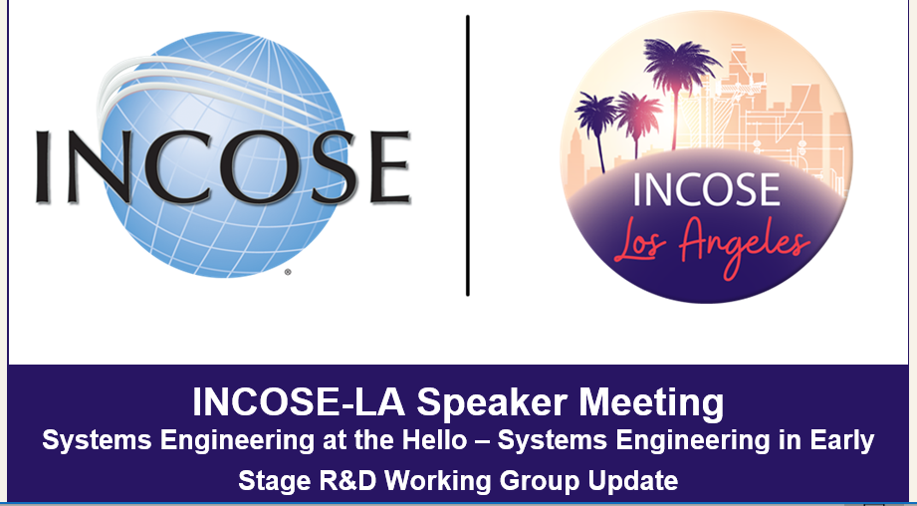
Dr. Michael DiMario, Ann Hodges, Dr. Gary Mastin

Slide 2
SE in Early Stage R&D Working Group
Notes:
Identify self-as one of the co-leads of the WG

Slide 3
Charter Overview
Purpose: To provide an open forum for the development, application, and dissemination of systems engineering principles, best practices, and solutions to scaling systems engineering applications to Early Stage R&D (ESR&D) projects so that the level of systems engineering effort is commensurate with risk and the anticipated ESR&D outcomes are achieved
Primary Goal: To provide knowledge, guidelines, and frameworks for the application of systems engineering in ESR&D

Slide 4
Charter Overview Cont’d
Scope: Focus on activities at Technology Readiness Levels (TRLs) 1 – 5
Outcomes:
  An ESR&D SE framework that contains guidelines and processes for the “right” and “right-sized” tailored SE practices and products based on a TRL of 1-5 and other characteristics e.g., organizational culture and philosophies
  Papers, articles, briefings, and tutorials
  Support the development of additions to the INCOSE SE Handbook and standards related to ESR&D
Notes:
Levels 1-2 generally define basic technology research and readiness levels 3-4 define research to prove application feasibility.
An ESR&D SE framework that contains guidelines and processes for the “right” and “right-sized” tailored SE practices and products based not only on TRL but also on other characteristics e.g., organizational culture and philosophies

Slide 5
Charter Overview Cont’d – Background
Early Stage Research and Development (ESR&D) is one of the most crucial phases in the product development process
  ESR&D is defined in terms of Technology Readiness Levels (TRLs) 1 – 5
  Is a critical phase in the product development process
Many organizations/positions/key stakeholders are unwilling to apply SE in ESR&D due to due to perceptions of SE being process/cost heavy
  Results in technical issues with solutions, difficulty in transitioning to higher TRLs, higher R&D costs, and extended development timelines
ESR&D differs from traditional SE in a number of important ways:
  ESR&D addresses higher risk technologies with multiple opportunities for failure
  ESR&D accounts for the fact that there is much about the underlying technology and its associated concept of operations that is poorly understood
  ESR&D is a way to practice SE for organizations without a strong SE culture
  ESR&D of focused on areas of high “system development risk”
Lack of a commonly understood and accepted framework inhibits multi-disciplinary collaboration
  A common framework that can be tailored and sustained for ESR&D, while enabling transition to TRL 5 and higher, is needed
Notes:
Early-Stage Research and Development, which is defined in terms of Technology Readiness Levels 1 through 4, is one of the most crucial phases in the product development process. It blends and blurs the lines between science and engineering, and it is argued that it requires a risk-based, disciplined, and graded approach to effectively manage scope, cost, and complexity.
However, many key stakeholders, including leaders, program managers, and scientists, are seemingly unwilling to use practices of systems management and engineering in the early stages of R&D because of the perception that systems engineering is heavily process oriented, adds unnecessary costs, and should be applied only to mature technologies. One can argue that misapplication of systems engineering principles has led to negative perceptions of systems engineering in ESR&D.
But, failing to apply any SE results in R&D efforts that may have solved the wrong problem, require technical rework, have difficulty transitioning to later maturity levels, and result in higher R&D costs, low return on investment, and extended development timelines.
A fundamental difference between R&D and more traditional systems engineering activities is that traditional SE is reductionist in that it depends on the ability to decompose complex systems into fundamental components having manageable complexity, bounded development costs, and highly predictable completion schedules. ESR&D, however, is radically different. Innovation and research do not happen by reduction processes. Innovation and research depend upon the creativity and discovery that leads to “expansionism.” The expansionist process is indeterministic in contrast to the determinism inherent in “reductionism.”
An additional key difference between traditional systems engineering and ESR&D involves “capabilities” versus “requirements.” ESR&D seeks to address a capability need; traditional SE seeks to satisfy requirements.
This WG’s core team thinks that the lack of a commonly understood and accepted framework inhibits the kind of multi-disciplinary collaboration that is required for innovation and have identified the need for common framework that can be tailored and sustained for ESR&D, while enabling transition to TRL 5 and higher.
That is the focus of our current efforts and what will be discussed during the working group sessions at IW. We are looking for volunteers to help flesh out the existing frameworks and to develop new ones.

Slide 6
Review WG Products, Initial Concepts
CORE Team officially formed February 2020
Charter affirmed March 2020
INCOSE recognized WG April 2020
INCOSE Connect Site IT Logistics
Publications
  “Implementing Systems Engineering in Early Stage Research and Development (ESR&D) Engineering Projects” IS20 30Th Annual INCOSE International Symposium July 18-23, 2020
  “Perceived Conflicts of Systems Engineering in Early Stage Research and Development” Draft INCOSE InSight August 2021
IS21 July 17-22, 2021 Panel Submission and Preparation
Established suggested SE in ESR&D Frameworks
Notes:
Early-Stage Research and Development, which is defined in terms of Technology Readiness Levels 1 through 4, is one of the most crucial phases in the product development process. It blends and blurs the lines between science and engineering, and it is argued that it requires a risk-based, disciplined, and graded approach to effectively manage scope, cost, and complexity.
However, many key stakeholders, including leaders, program managers, and scientists, are seemingly unwilling to use practices of systems management and engineering in the early stages of R&D because of the perception that systems engineering is heavily process oriented, adds unnecessary costs, and should be applied only to mature technologies. One can argue that misapplication of systems engineering principles has led to negative perceptions of systems engineering in ESR&D.
But, failing to apply any SE results in R&D efforts that may have solved the wrong problem, require technical rework, have difficulty transitioning to later maturity levels, and result in higher R&D costs, low return on investment, and extended development timelines.
A fundamental difference between R&D and more traditional systems engineering activities is that traditional SE is reductionist in that it depends on the ability to decompose complex systems into fundamental components having manageable complexity, bounded development costs, and highly predictable completion schedules. ESR&D, however, is radically different. Innovation and research do not happen by reduction processes. Innovation and research depend upon the creativity and discovery that leads to “expansionism.” The expansionist process is indeterministic in contrast to the determinism inherent in “reductionism.”
An additional key difference between traditional systems engineering and ESR&D involves “capabilities” versus “requirements.” ESR&D seeks to address a capability need; traditional SE seeks to satisfy requirements.
This WG’s core team thinks that the lack of a commonly understood and accepted framework inhibits the kind of multi-disciplinary collaboration that is required for innovation and have identified the need for common framework that can be tailored and sustained for ESR&D, while enabling transition to TRL 5 and higher.
That is the focus of our current efforts and what will be discussed during the working group sessions at IW. We are looking for volunteers to help flesh out the existing frameworks and to develop new ones.

Slide 7
Initial Framework Concepts

Slide 8
ESR&D Framework for Research and Engineering Transition –
Dr. Michael DiMario
Innovation and research is noted with high failure
  High risk and low return of investment
  Projects fail at TRL 5-6 Valley of Death
  Engineering transition is difficult and high risk
    Research not appropriate for engineering transition
    Basic research vs applied research
    Solving the right problems for engineering transition
Research and ESR&D is based in principles of expansionism vs reductionism
  Continuous flow of ideas and experiment
  Transition requires reductionism
Framework must accommodate expansionism and reductionism
  Example: Tailored process, tools and organization structure; Gated research artifacts transition to early engineered artifacts in a continual spiral of expansionism-reductionism-expansionism-reductionism using prescribed and tailored tools and processes; Research oriented engineer responsible for research whereby basic or applied research only performed to solve engineering problems
Notes:
These are the practices and artifacts that provide the most value: a charter (why and what), milestone list, WBS, budget, change tracking, requirements management approach, risk management approach, configuration management approach, and quality control.

Slide 9

Framework Based on Risk, Industry Standards and Project Type – Sandia National Laboratories
Risk-informed graded approach to the application of systems engineering (SE), project/program management (PM), and quality management (QM)
Identified core set of practices that every project is required to follow – from the small best-effort research efforts to large pathfinder operational systems
Implement differing level of rigor (timing, scope, formality) based on intrinsic project risk
  Provide research-oriented projects an efficient and solid foundation for growth – either for future research efforts or further development of the research results – without stifling creativity and exploration
  Start early in the project creation phase using a rigor-level determination template, followed by the tailoring of a project and product plan template for the determined level of rigor
Developing project type category and subcategory templates for the risk-informed graded approach to increase efficiency and effectiveness.
SAND2020-12414C
Sandia National Laboratories is a multimission laboratory managed and operated by National Technology & Engineering Solutions of Sandia, LLC, a wholly owned subsidiary of Honeywell International Inc., for the U.S. Department of Energy’s National Nuclear Security Administration under contract DE-NA0003525.
Notes:
These are the practices and artifacts that provide the most value: a charter (why and what), milestone list, WBS, budget, change tracking, requirements management approach, risk management approach, configuration management approach, and quality control.

Slide 10
Another Framework Based on Risk, Standards and Project Type – Los Alamos National Laboratory
Risk-informed graded approach to the integrated application of systems engineering (SE), project management (PM), and quality management (QM)
  Called this Mission Assurance
  Quality standard for basic research is the ANSI standard, transitions to industry standard as TRL increases
Identified core set of practices that every project is required to follow – from basic scientific research to advanced technology development
  Provided the Mission Assurance Support Tool (MAST) as an implementation aid
Implemented differing level of rigor (reviews, approvals, required documentation) based on project risk
  Start early in the project initiation phase using a rigor-level determination template
  Review risk-level determination throughout the project and adjust as needed
LA-UR-19-25567
Notes:
These are the practices and artifacts that provide the most value: a charter (why and what), milestone list, WBS, budget, change tracking, requirements management approach, risk management approach, configuration management approach, and quality control.

Slide 11
Framework Based on Risk, Industry Standards and Project Type - Pacific Northwest National Laboratory
Extend risk-informed graded approaches for project/program management (PM) and quality management (QM) to SE
Define SE “triggers” which drive implementation of SE (informal, semi-formal, formal)
Define SE risks
  Across project life cycle (e.g., concept, development, utilization phase)
  Across project types (e.g., assessments, product development, test and evaluation)
  By TRL (TRL 3: defines KPPs; TRL 4+: define specification)
Notes:
These are the practices and artifacts that provide the most value: a charter (why and what), milestone list, WBS, budget, change tracking, requirements management approach, risk management approach, configuration management approach, and quality control.

Slide 12
Why is ESR&D needed? - Pacific Northwest National Laboratory
When system development risk is ignored or minimized
For organizations without a strong SE capability/culture
For organizations with a wide spectrum or project types, sponsors, and/or TRL levels
When there is a high risk of technical failure
When system requirements/ConOps are poorly defined
Where there is a desire to institutionalize SE processes and procedures (e.g., CMMI level 3)
ESR&D is a mechanism to transition engineering early out of engineering to iterate between research and engineering

Slide 13
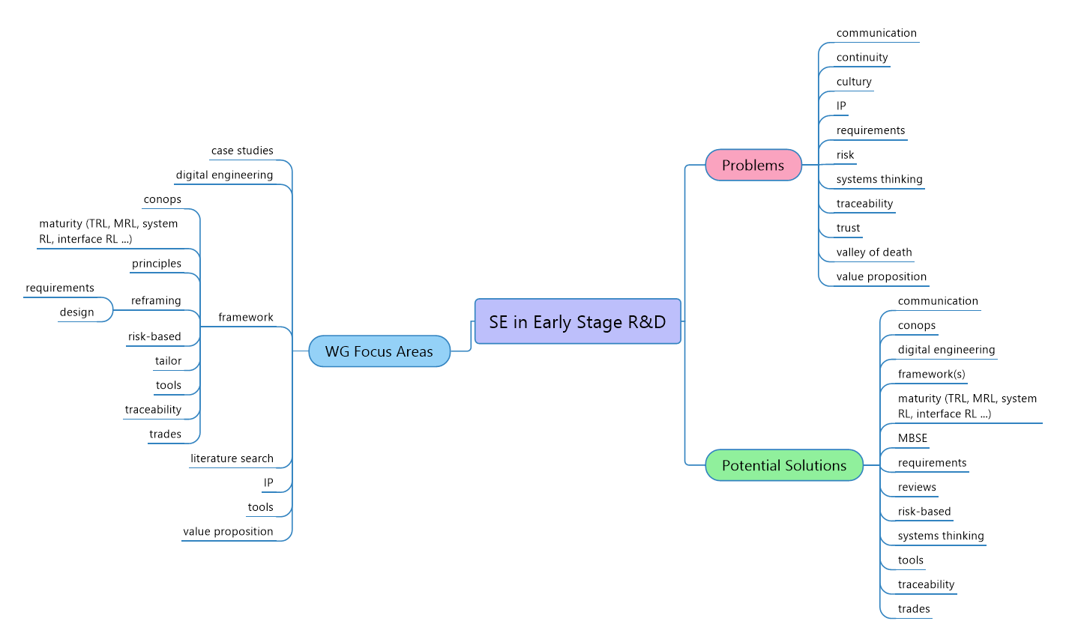
IW21 ESR&D Working Group – 65 participants

Slide 14
Your thoughts?
Problems
Thought 1

Slide 15
Your thoughts?
Solutions
Thought 1

Slide 16
How to Get Involved
Contact any of the core WG team to volunteer, for questions
  Ann Hodges, alhodge@sandia.gov
  Michael DiMario, mjdimario@outlook.com
  Heidi Hahn, drsquirt@outlook.com
  Nick Lombardo, nick.lombardo@pnnl.gov
  Gary Mastin, gary.a.mastin@gmail.com
Notes:
Early-Stage Research and Development, which is defined in terms of Technology Readiness Levels 1 through 4, is one of the most crucial phases in the product development process. It blends and blurs the lines between science and engineering, and it is argued that it requires a risk-based, disciplined, and graded approach to effectively manage scope, cost, and complexity.
However, many key stakeholders, including leaders, program managers, and scientists, are seemingly unwilling to use practices of systems management and engineering in the early stages of R&D because of the perception that systems engineering is heavily process oriented, adds unnecessary costs, and should be applied only to mature technologies. One can argue that misapplication of systems engineering principles has led to negative perceptions of systems engineering in ESR&D.
But, failing to apply any SE results in R&D efforts that may have solved the wrong problem, require technical rework, have difficulty transitioning to later maturity levels, and result in higher R&D costs, low return on investment, and extended development timelines.
A fundamental difference between R&D and more traditional systems engineering activities is that traditional SE is reductionist in that it depends on the ability to decompose complex systems into fundamental components having manageable complexity, bounded development costs, and highly predictable completion schedules. ESR&D, however, is radically different. Innovation and research do not happen by reduction processes. Innovation and research depend upon the creativity and discovery that leads to “expansionism.” The expansionist process is indeterministic in contrast to the determinism inherent in “reductionism.”
An additional key difference between traditional systems engineering and ESR&D involves “capabilities” versus “requirements.” ESR&D seeks to address a capability need; traditional SE seeks to satisfy requirements.
This WG’s core team thinks that the lack of a commonly understood and accepted framework inhibits the kind of multi-disciplinary collaboration that is required for innovation and have identified the need for common framework that can be tailored and sustained for ESR&D, while enabling transition to TRL 5 and higher.
That is the focus of our current efforts and what will be discussed during the working group sessions at IW. We are looking for volunteers to help flesh out the existing frameworks and to develop new ones.

Slide 17
BACKUPS

