Slide 1
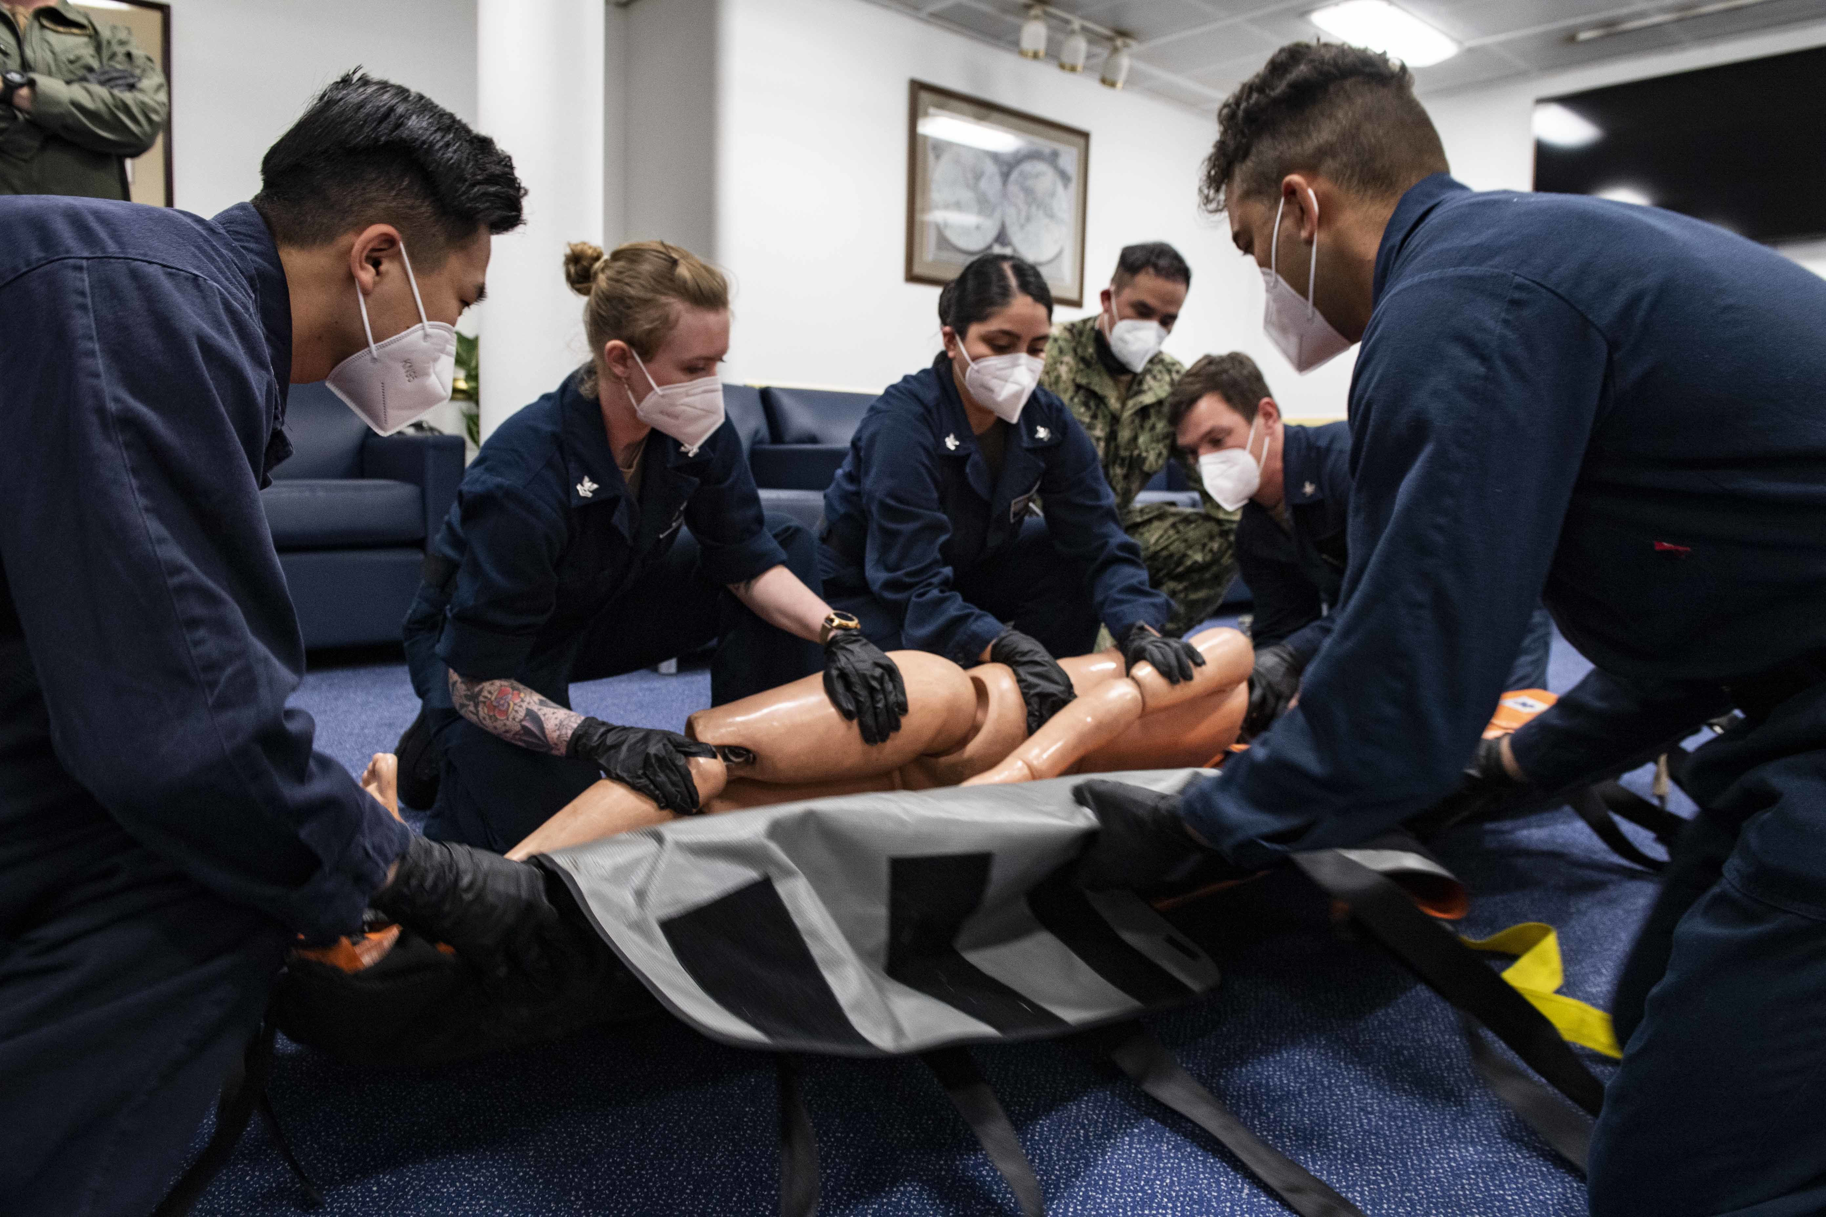
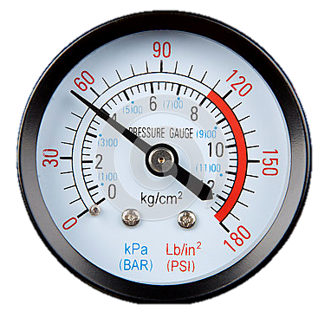
The Economic Benefits of Human Performance Models in Systems Engineering
https:/ /media.defense.gov/2020/May/05/2002294813/-1/-1/0/ 200504-N-BM428-0032.JPG
Workload
Dick Steinberg
User Experience and HFE Team Lead
16 Nov 2021

Slide 2

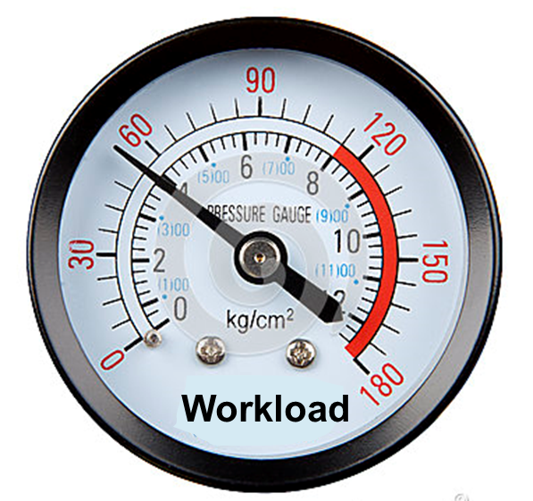
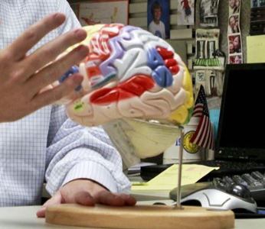
What is a Human Performance Model?
Human Performance Modeling (HPM) is a method of quantifying human behavior, cognition and processes for the analysis of human function and system development.
https://media.defense.gov/2016/Aug/29/2001619846/-1/-1/0/160825-F-HX271-237.JPG
https://www.defense.gov/Photos/Photo-Gallery/igphoto/2001100841/
Notes:
Simply put, human performance models are simulations of crew interactions and task performance and workload during operations.
Human Performance Modeling (HPM) can be used to help design systems and allow trades to be performed between different crew sizes, task allocation and distribution, and levels of automation.
Computer models can evaluate a wide range of scenarios and combinations of events far more cost effectively and exhaustively than with direct observation of events. Using Monte Carlo simulations affords the opportunity to perform a myriad of combinations of events enabling a comprehensive analysis of workload.

Slide 4
Benefits of Modeling
Source: US Army Redstone Arsenal Software Engineering Directorate
Potential to Save Millions in Program Cost by Enabling Discovery of Design Issues Early in Product Development
Models enable designers to evaluate designs early in the life cycle with the highest return on investment

Slide 5
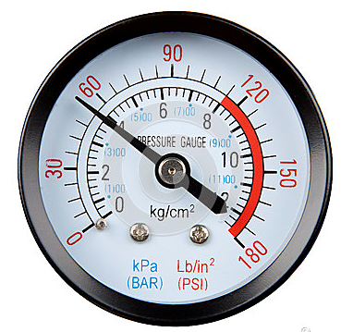
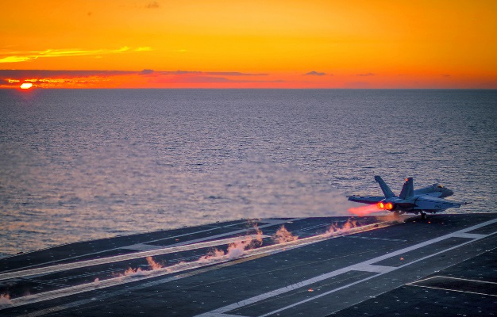
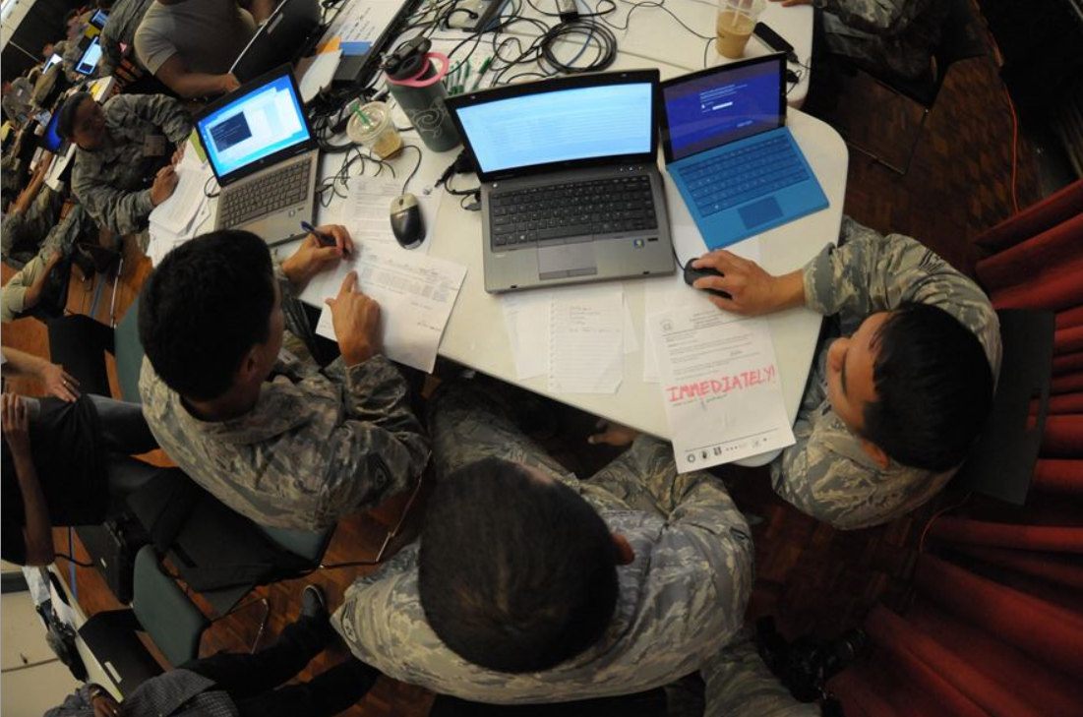

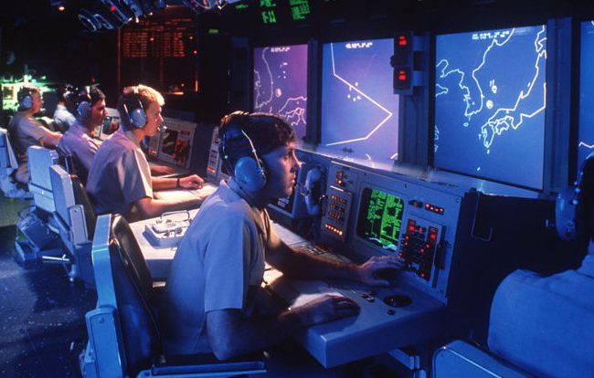
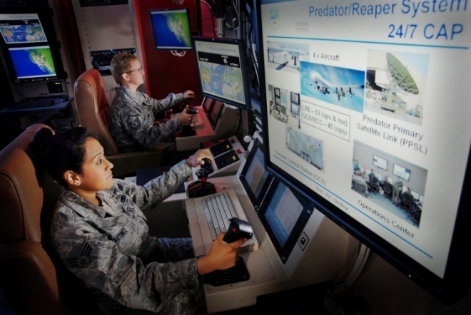
Applications for HPMs
Operations
Planning
Workload
Defense.gov/media/photo-gallery/oop510-Z-CJP10-818
Emergency Ops
DoD 150604-Z-UW413-016.JPG
C2 Centers
Unmanned Ops
www.defenseimagery.mil
www.defenseimagery.mil
https://www.defense.gov/Photos/Photo-Gallery/igphoto/2001221581/
Notes:
Human performance models have been used in a wide variety of industries including those shown here as well as non-military applications.
For example, they were used to determine:
the number of staff needed to operate rides at Walt Disney Parks,
bank tellers
and persons working in a fast food restaurant

Slide 6
Benefits of Human Performance Models
Set realistic system requirements
Determine Crew Size
Evaluate Need for Automation
Test alternate system-crew function allocations
Assess required maintenance man-hours – sustainment
Analyze alternative algorithms
Notes:
Human performance models are a form of model based engineering that can establish and inform engineering designs reducing overall development cost by resolving requirements for the system prior to investment of development resources.
Must of the benefits can be understood by the fact that the earlier in the life cycle development of a program that an engineering problem is fixed, the less it costs.

Slide 7
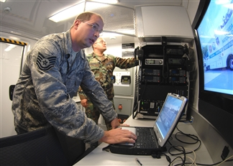
Need for an Model vs Observation
https://media.defense.gov/2008/Aug/29/2002026322/-1/-1/0/904783-O-YQZ86-996.jpg
https://www.defense.gov/Photos/Photo-Gallery/igphoto/2001754184/
Models enable more complete and robust analysis of options
Notes:
One might ask, why don’t you get respective operators to use your system or a prototype
The benefits of a Computer Model for crew workload analysis are as follows:
System maturity available too late for analysis
Resources for a mature prototype are costly
Monte Carlo nature affords the opportunity to perform a myriad of combinations of events enabling a comprehensive analysis of workload.
Real world demonstrations are costly
it could take years to perform all the myriads of combinations of anomalous activity and test cases addressed by a computer model.
It also needs a high enough fidelity prototype to enable operators to interact with it. These are often not available at the time design decisions are being made

Slide 8
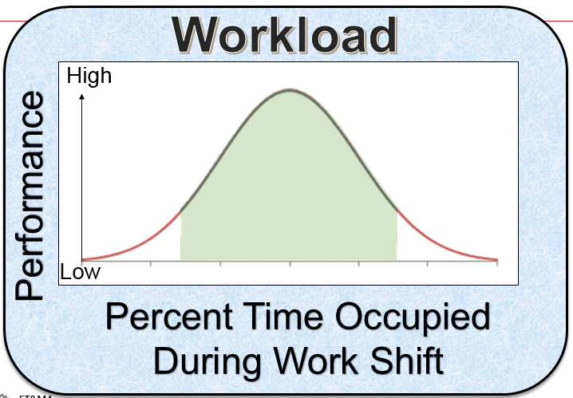
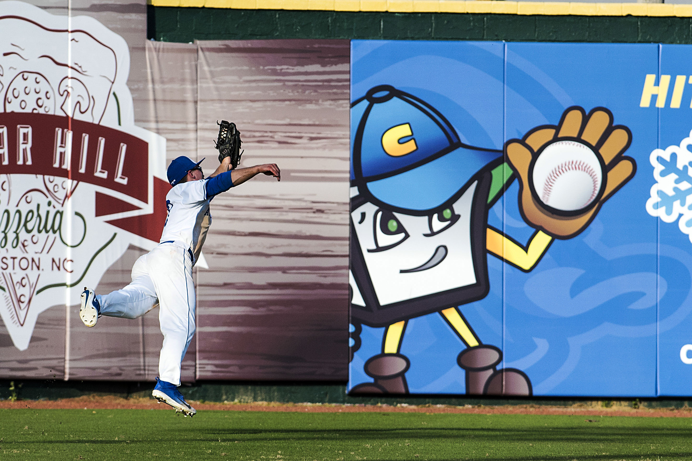
Modeling Challenges
https://www.defense.gov/observe/photo-gallery/igphoto/2002039391/
Notes:
Modeling workload has huge challenges.
1. Human workload models are complex since the goal of the crew design is not merely a matter of minimizing workload, but striving to balance each operator’s workload so that it is neither too high nor too low. Yerkes and Dodson (Reference in paper) found that insufficient or low workload also has a negative effect on operator performance.
2. Maintaining situation awareness plays an important role in operations. Consider the challenge of measuring workload for an outfielder in baseball. They are not typically busy during an inning until the ball is hit in their direction. This might suggest an extremely low workload. However, they must retain attentiveness on every pitch. It is not enough to wait for an alarm, but the monitoring of the action of pitcher and batter becomes a very important and high workload task for the outfielder.
This is not unlike an emergency management operator monitoring activity on a computer screen looking for triggers for task actions. Modeling the effort of maintaining situation awareness was addressed by a prior paper at AHFES in 2017 by Steinberg and Diggs.
3. This is the biggest challenge. Does the model have high enough accuracy to provide supportive evidence for design decisions? Without confidence in the results of the model, decision makers will likely dismiss the outputs and the model will fail to impact the design of the system. However, effective means for validating and verifying HPMs exists.

Slide 9
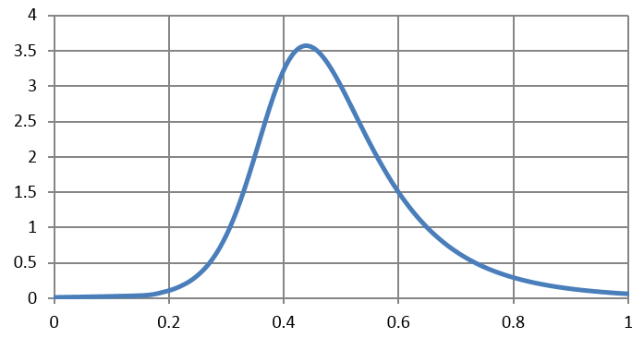
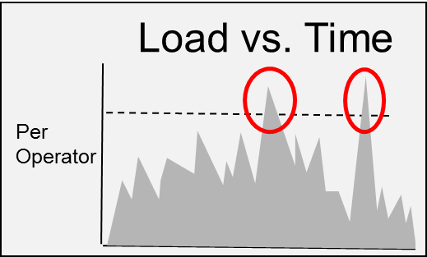
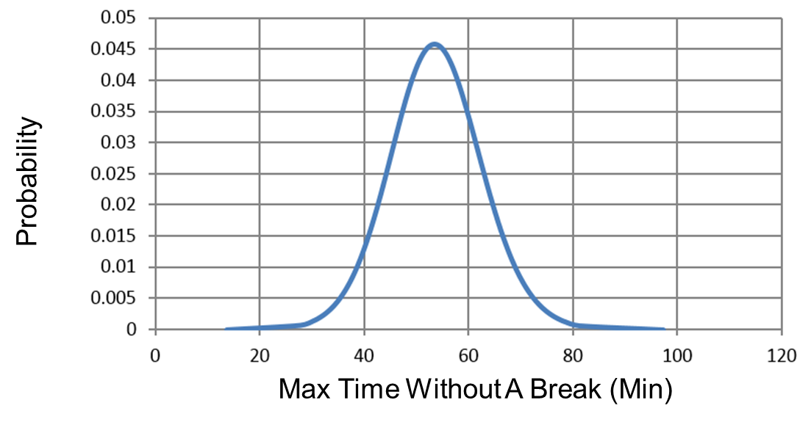
Our Case Study
Our Task
Measures of Workload
Workload Sufficient to Optimize Crew Performance
Occupancy during shift not too high or too low
Determine the efficacy of an advanced machine learning algorithm for our product
Ability to Perform Mission
Visual, Auditory, Cognitive, and Psychomotor demands to determine dropped or deferred tasks
Adequate Crew Rest to reduce human errors
Maximum Time without a break – Time a full cognitive loading
Notes:
If design decisions are going to be made, an accurate system model must be established.
The challenges for V&V for a HPM are unique and require different procedures than performing V&V on physics based computer models.
For example, for physics based models, a V&V practitioner obtains output data from real world measurements and then performs a statistical T-test to ensure the mean observed data is not statistically different from that resulting from the model output for a given confidence interval.
Gathering Human performance data operating on a system requires a system for the operator to act on. When the system is under development, no such system exists.
Performing V&V on a human performance model to ensure accuracy is a challenge.

Slide 10
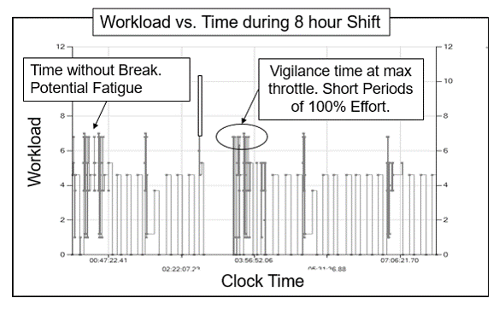
Output from a Human Performance Model

Slide 11
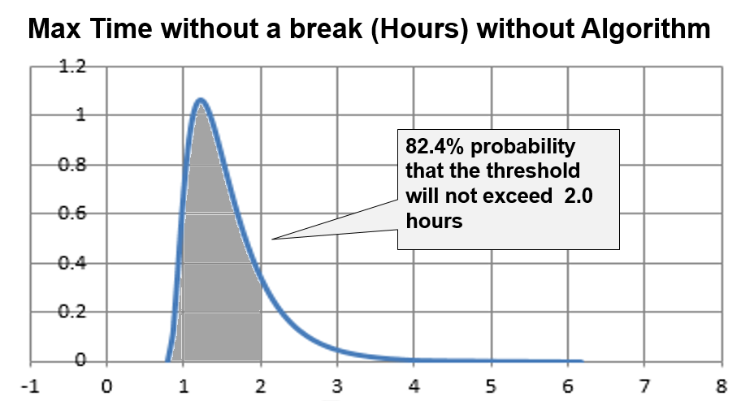
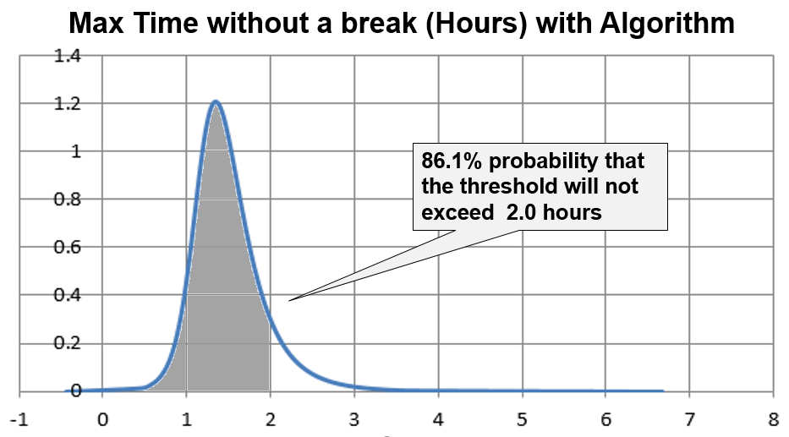
Max Time Without A Break
Notes:
The results of the analysis yielded little benefit for the decision-aid to operator performance. The analyst assessed the Monte Carlo runs against maximum time without a break, and the total cognitive effort. The operator’s mean maximum time without a break using the algorithm was 7083 seconds, compared to 7121 seconds without the algorithm. The probability that the maximum time without a break and no decision support would remain within the workload threshold of 2 hours was 82.4%. The probability of remaining within the workload threshold of max time without a break with the decision support algorithm was 86.5%. Figure 3 and 4 depict the probability density functions that revealed no statistical difference between the maximum times without a break using a decision support algorithm compared to not using one. (p = 0.9879).

Slide 12
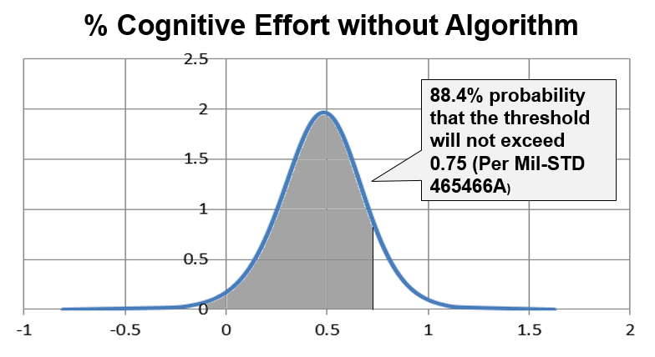
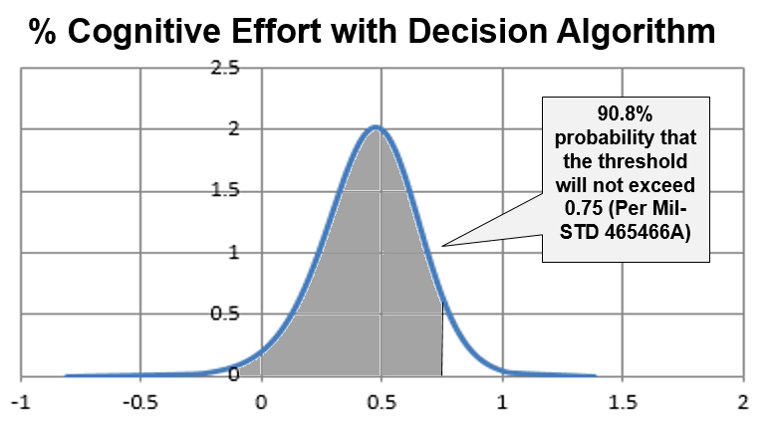
Cognitive Effort
Notes:
The mean cognitive effort with the decision support algorithm was 58.82% compared to a small increase of 59.04% without the algorithm. This resulted in a slight improvement in the probability of remaining under the workload threshold of 88.4% (without algorithm) to 90.8% (with algorithm) as depicted in Figures 5 and 6. There was no statistical difference between cognitive efforts using a decision support algorithm compared to not using one. (p = 0.965).

Slide 13
Conclusion
Trade study during the requirements phase saved the program:
$2.064M initial costs
$112K annual software license fees.
Total costs or $4.3M.
And…
Assessed required manpower / workload and crew size
Analyzed performance benefit of intelligent algorithms
Notes:
This decision resulted in a savings of $2.064M initial costs with a sustainment savings of $112K annual software license fees. Assuming a 2-year life cycle for the product estimates a savings of $2.064M plus $2.24M in sustainment costs or $4.3M.

